Slide 1

Gamow-Teller transitions from ⁵⁶Ni
Masaki Sasano
RIKEN Nishina Center

Slide 2
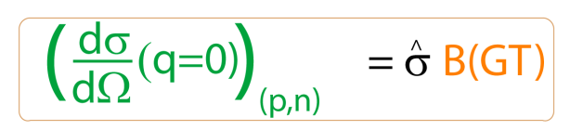
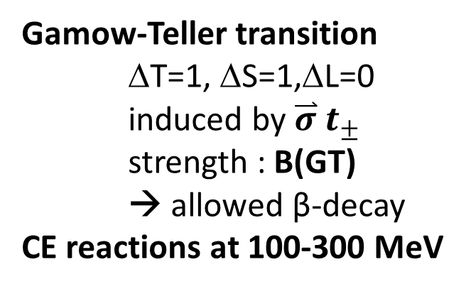
Charge-Exchange (CE) reactions: a tool for studying Gamow-Teller strengths
Gamow-Teller transition
ΔT=1, ΔS=1,ΔL=0
induced by $\overset{⃑}{σ}$ $t_{±}$
strength : B(GT)
→ allowed β-decay
CE reactions at 100-300 MeV
Cannot access by β-decay
CE
β-decay
energy
A,Z
A,Z±1
β⁻ type β⁺ type
(p,n), (³He,t) … (n,p), (t,³He), (d,²He), (⁷Li,⁷Be+γ)
Very powerful probe
Many successful studies on stable nuclei
Notes:
Gamow-teller transition is one of the most basic excitation modes in nuclei,
Which is characterized by isospin flip, spin flip, and no angular momentum transfer.
It’s strength is B(GT), which is directly connected with a half-life of the beta-decay.
However, the energy region beta can access is limited by the decay Q-value.
Thus, the charge exchange reaction such as the (p,n) reaction has been used as a powerful probe to obtain the B(GT) distribtuion up to a high
Excitati on energy region beta decay cannot access.
Here, to determine the B(GT) values from the measured cross sections, one can employ the proportionaliy relation between
B(GT) and the 0-degrees cross section which is calibrated with transitions for which B(GT) is known from beta-decay.

Slide 3
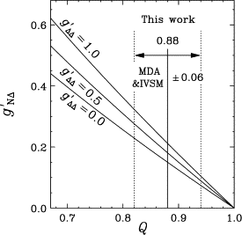
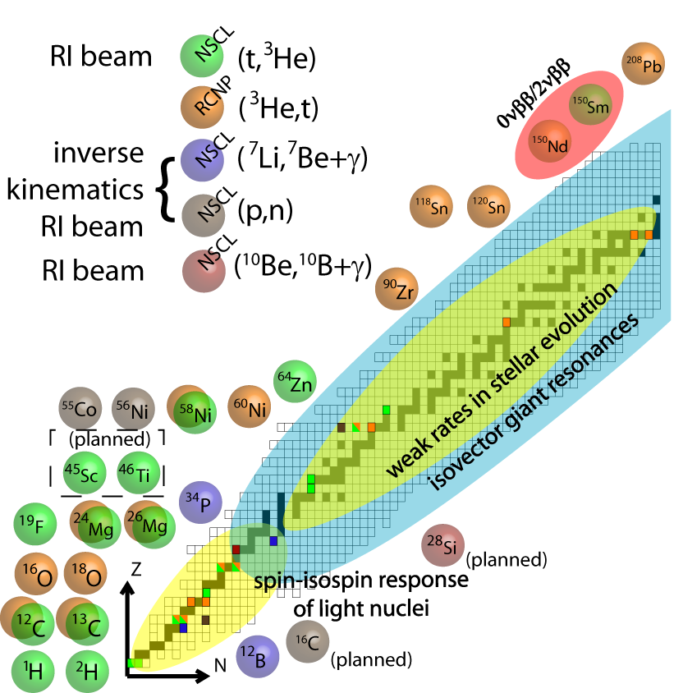
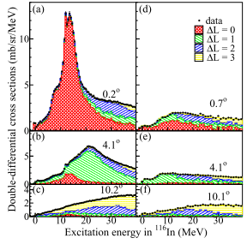
GT studies on stable nuclei via CE reactions
Exp. on ⁹⁰Zr
Fundamental
GT quenching ←→ non-nucleonic (Δ）
Nuclear astrophysics
→ Weak processes in Type Ia 、II supernovae
Deeper understanding of nuclear structures and its applications
→ e.g., nuclear matrix elements in double beta decay
Strength of coupling to Δ
Yako, Wakasa, Sakai et al.,
Phys. Lett. B 615(2005) 193.
NSCL/RCNP
¹¹⁶Cd
¹¹⁶Sn
GT
Sasano et al.,
Phys. Rev. C 85, 061301
By R. G. T. Zegers

Slide 4
Why unstable nuclei?
spin isospin collectivity
in terms of
  Ratio of neutron and proton numbers
  p-h vs. p-p
  density (neutron skin, neutron halo)
  double magicity far from the stability line
Nuclei of astrophysical interests (electron captures, neutrino responses, …)

Slide 5
How?

Slide 6
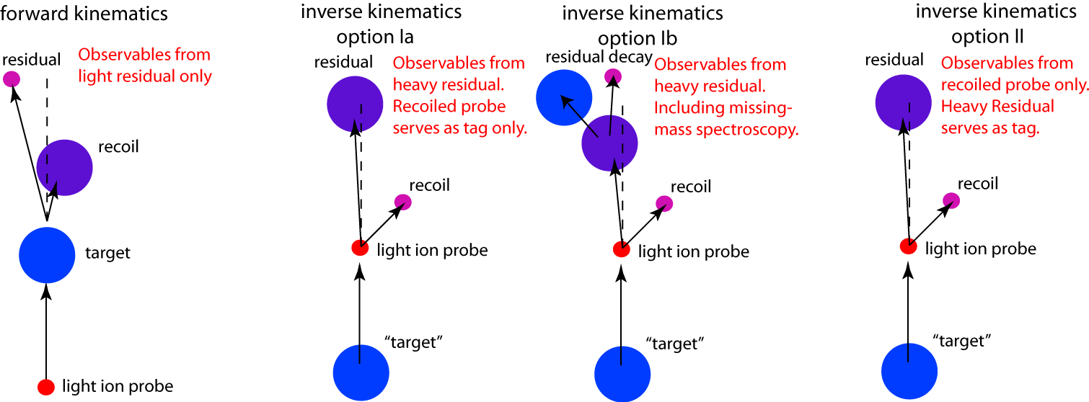
The (p,n) reaction in inverse kinematics
Missing mass with recoil neutron detection
Advantages
Efficient!
RI beam (10^6 pps) + Liq. H (100mg/cm^2)
~ stable p beam (160 nA) + 100 mg/cm^2 (A~100)
(after taking account detection eff. and acc.)
Simple!
All kinematic information
from measurement of the neutron
(two-body kinematics)
Extensive!
Can be applied to any mass region and to any
excitation energy
~100 – 300 MeV/u
Notes:
In our method, this limiations is overcome by employing the missing mass spectroscopy, where the kinematics is reconstructed only from the recoil neutron whose neutron energy is measured.
This method has advantages as following;
First of all, the target can be thick, because recoil neutron does not lose its energy inside the target.
Thus, it makes it possible to achive a relatively high luminosity event with unstable beams with low intensitiies.
Since all kinetic information is obtained from measurement of the neutron, measurment and analysis are simple compared to invariant mass method.
In addition, in this method, heavy beam fragments are particle identified by using S800 and servers as tag for CE reaction with different particle decay channel, giving brancghing ratio.
Owing to these advangates, this method can be applied to any mass region and to any excitation energy region.

Slide 7
Applications
Possible to probe
any Ex on any A/Z
(beam intensity 10⁴⁻⁵ pps)
Ex
SDR
r-process?
(ν,ν,)
GTGR
EC, beta-decays
Proton rich
Neutron rich
⁶He, ¹¹Li, ¹⁴Be,
^{70,72}Ni, ¹³²Sn
at RIKEN RIBF

Slide 8
⁵⁶Ni
isospin symmetry
0⁺→1⁺
Gamow-
Teller
⁵⁶Co
⁵⁶Ni
⁵⁶Cu
T=1 T=0 T=1
electron
capture
(p,n) charge
exchange
One of the important cases
in core collapse super novae of massive stars
(Phys. Rev. Lett. 86, 1678 (2001))
Notes:
Because the ec in 56ni is one of the most important cases in core collapse supernovae of massive stars.
In addition, in this case, there holds isospin symmetry relation between the electron capture in 56ni and the gamow-teller transitions reduced by the (p,n) reaction from 56ni to 56cu, as shown in this fugreu.
Thus, B(GT) measured by the (p,n) reaction is directly connected with the EC rate.

Slide 9
⁵⁶Ni is a key nucleus in Fe region
p_{1/2} p_{1/2}
p_{1/2} p_{1/2}
p_{3/2} p_{3/2}
p_{3/2} p_{3/2}
GT
f_{5/2} f_{5/2}
⁵⁶Ni (Z=N=28)
independent particle model
→ ⁵⁶Ni is doubly magic
Large p-n residual interaction
→ ⁵⁶Ni is not magic
f_{5/2} f_{5/2}
GT
28
20
f_{7/2} f_{7/2}
f_{7/2} f_{7/2}
20
sd sd
sd sd
p p
p p
s s
s s
N P
N P
f7/2 70% in ⁵⁶Ni (GXPF1A, KB3G)
(e.g., Honma et al., Phys. Rev. C 69, 034335 (2004))
Notes:
Furthermore, 56ni is a key nucleus in fe region, because it consists of 28 neutrons and 28 protons, which is doubly magic in the independent particle model.
But, actually, because large p-n residual interaction, 56ni is no magic. Only 70% of 56ni ground state comes from f72.
Thus, the GT strength from 56ni is key to bench mark nuclear model used weak rates in the fe region.
However, such a study has been experimentally chanllenging.

Slide 10
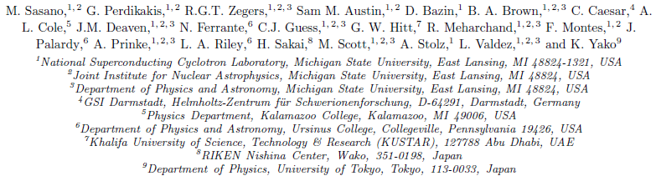




Collaborators for the ⁵⁶Ni(p,n) measurement

Slide 11
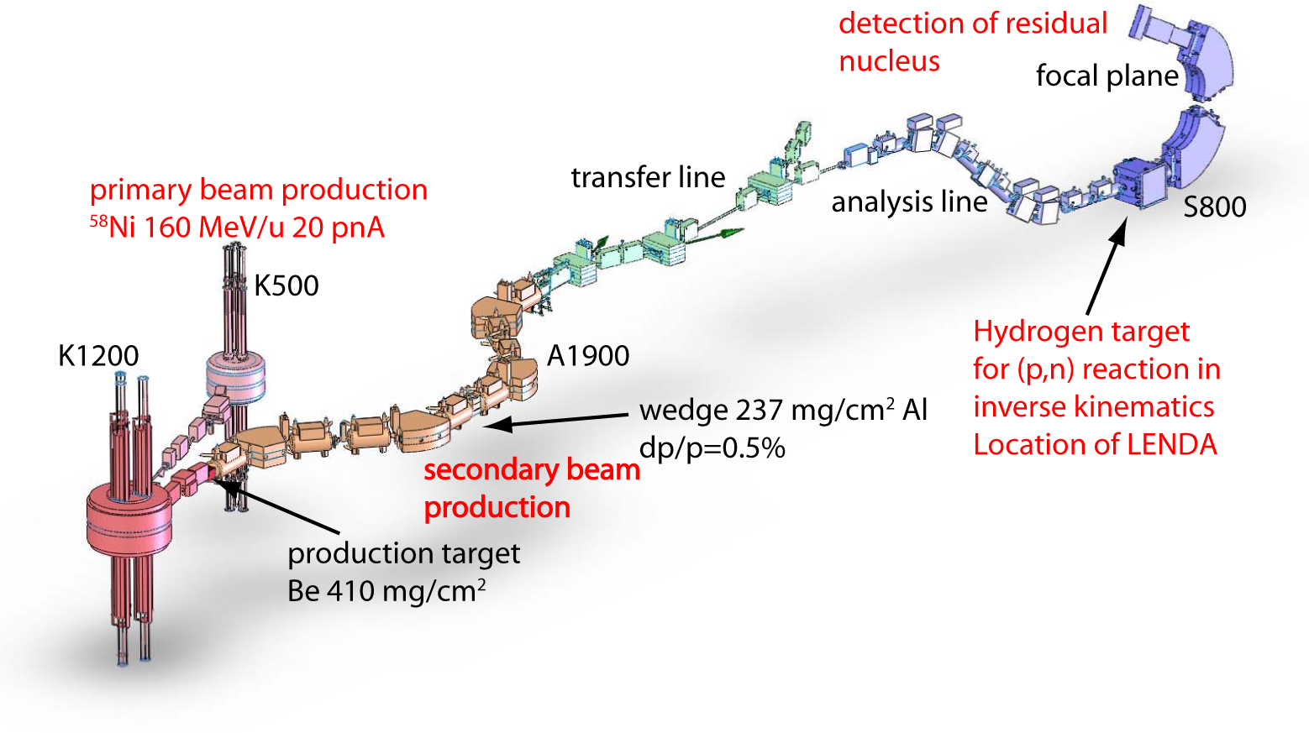
⁵⁶Ni beam production and experiment overview
diamond timing detector
8x10⁵ pps
⁵⁶Ni (66%),
⁵⁵Co(32%),
⁵⁴Fe (2%).
→ Calibration purpose
Notes:
In the expeirment, a primary beam of 58Ni was provided by using NSCL coupled cycltron facility. The target for the secondary beam production is be, and the produced beam was purified by the A1900 separator with al edge and slits.
The obtained beam has an intensity of 8x10 to 5 pps, containing 56ni and 55co, mainly. These components are particle identified on event-by-event basis using the timing information measured by the diamond detector.
The beam was transported onto the hydrogen target placed in front of the S800 spectrometer. The beam residue produced by the (p,n) reaction in the target was particle indentified in the focal plane of the S800 spectromenter.

Slide 12
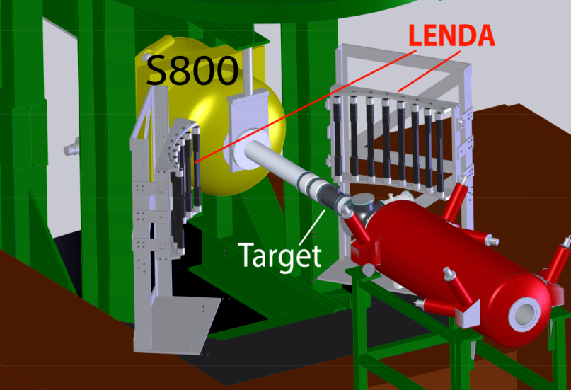
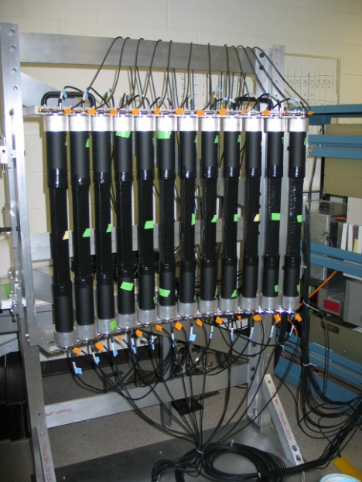
Set up of LENDA
⁵⁶Ni(p,n)⁵⁶Cu
⁵⁶Ni(p,n)⁵⁶Cu→⁵⁵Ni+p
n
RI beam
Only b.g.
Low Energy Neutron
Detector Array (LENDA)
neutron detection
Plastic scintillator
24 bars 2.5x4.5x30cm
150 keV < E_{n} < 10 MeV
ΔE_{n} ~ 5% Δθ_{n} < 2º
efficiency 15-40%
Left array Right array
Flight path : 1 m
Perdikakis et al, NIM.
Notes:
The hydrogen target was surrounded by the neutron detectors LENDA, where a low energy neutron with energyies from 150 keV up to 10 MeV are detected with the detection efficiecy typically from 15-40% depending on the neutron energy. The flight path length is 1 m, the neugron energy resolution is 5%.
The right figure shows the kinetics curve of the (p,n) reactin, which shows the relation between the neutron energy and the laboratory angle of the recoil neutron.
The solid line corresponds to the states from the ground states to 30 MeV with 5 MeV steps.
The red dotted lines correpond to the scatteringles in the center of mass system from 2 to 10 degrees with 2 degrees steps.
Blue shaded areas correspond to the acceptance of the LENDA. The bars on the left and right sides with respect to the beam line are shown with negative and positive laboratory angle values.

Slide 13
Double differential cross sections
⁵⁴Co
Sp=560 keV
S_{2p}
⁵⁵Ni
GT
⁵⁶Ni(p,n)
S_{p}=560 keV
⁵⁶Cu
⁵⁶Cu
⁵⁶Ni
Two bumps at 3 and 5 MeV
with forward angle peaks (GT:∆L=0)
A bump around 12 MeV
Peak around 10-12 degrees
Spin dipole (∆L=1)
States without proton emission
Peak at most backward angle
Higher multipoles (∆L>1)
SD
To extract GT component quantitatively
→ Multipole decomposition

Slide 14
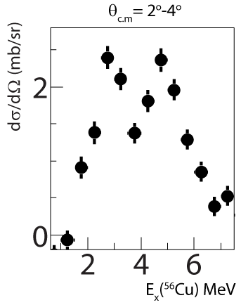
Results of MDA
⁵⁶Ni(p,n)
⁵⁵Ni
⁵⁶Cu
⁵⁶Cu
⁵⁶Ni
GT component dominates the region below 8 MeV.
→ Scale the spectrum before smearing

Slide 15
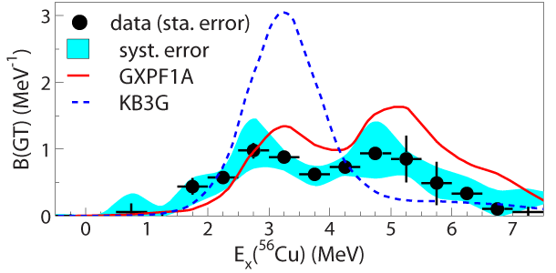
GT strengths from ⁵⁶Ni(p,n) at 110 MeV/u
Use the extracted ΔL=0 component in combination with unit cross section to extract Gamow-Teller strength [B(GT)].
Compare with large-scale shell-model calculations
PRL107, 202501 (2011).
GXPF1A: Honma et al. : constrained by data in full pf-shell
KB3G: Poves et al. : less constraints – used in database for weak rates for astrophysical purposes.
Difference between KB3G and GXPF1A:
KB3G weaker spin-orbit and pn-residual interactions
KB3G lower level density

Slide 16
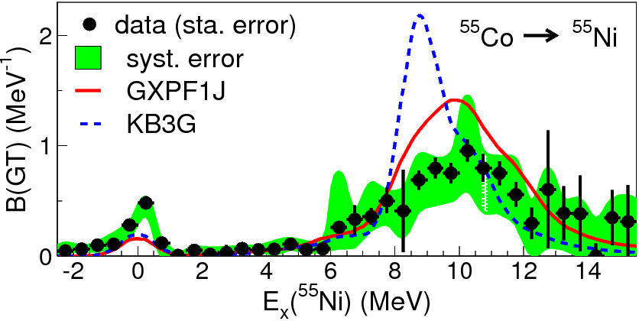
A question
(from nuclear structure)
Two prominent peaks exist
Large difference between KB3G and GXPF1
Remove one neutron
from parent & daughter
Two peaks disappear
Small difference between KB3G and GXPF1
Point:
Along N=Z, B(GT) is sensitive to some part of interaction and showing two peaks.
Question:
What picture can intuitively explain the origin of the two peaks?

Slide 17
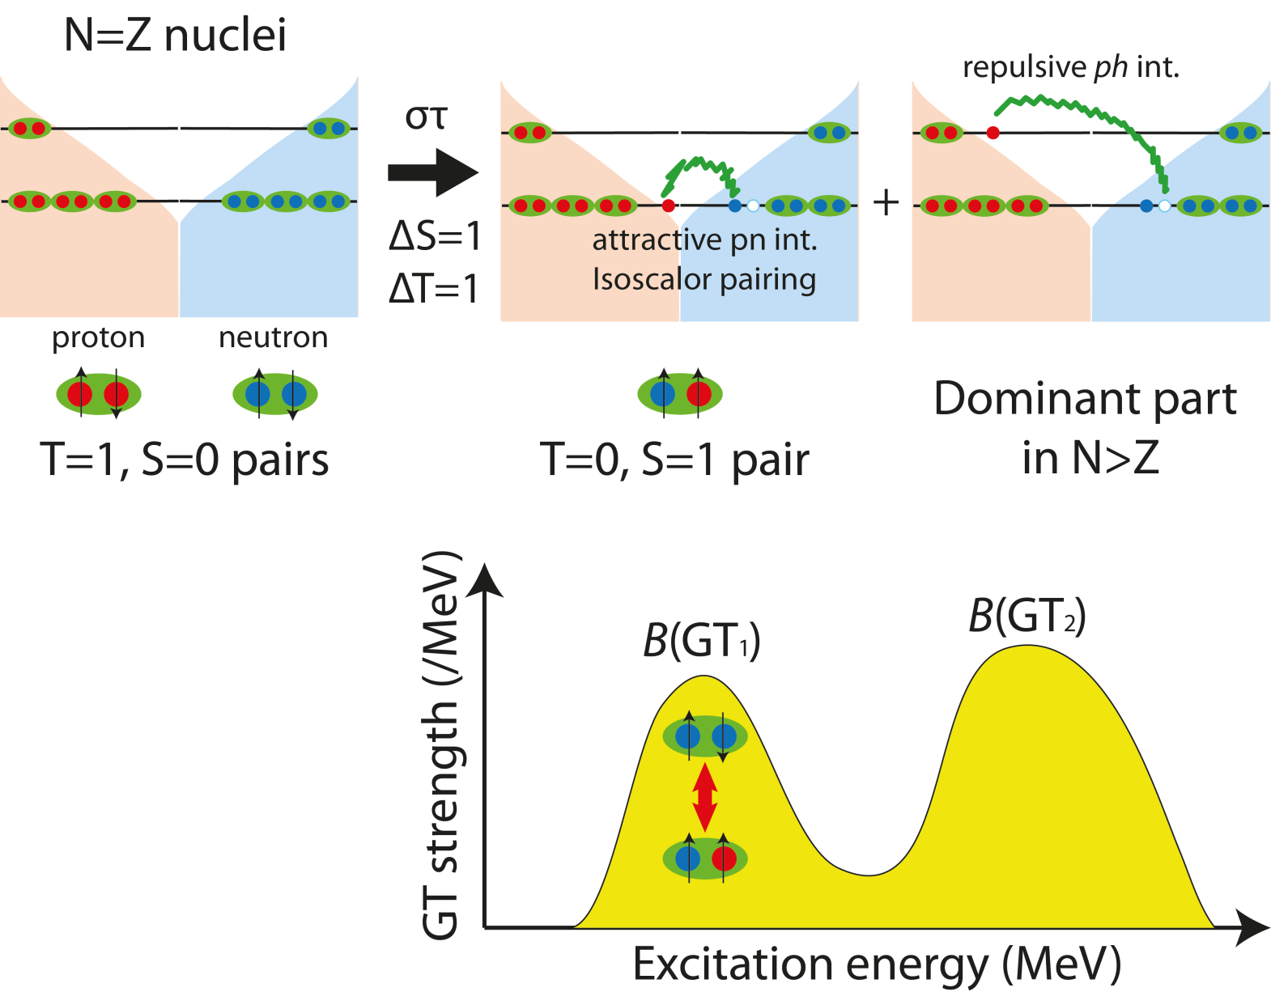
A new picture of GT resonance
Initial ground state
Filled with pp/nn (isovector) pair
GT transition
breaking a pair
Final state
particle-hole: repulsive
→ pushed up to higher energy
(well studied in stable nuclei)
particle-particle (pn): attractive
→ pushed down to lower energy
The states in the lower peak is expected to form a T=0, S=1 pair (identical proton and neutron orbits)

Slide 18

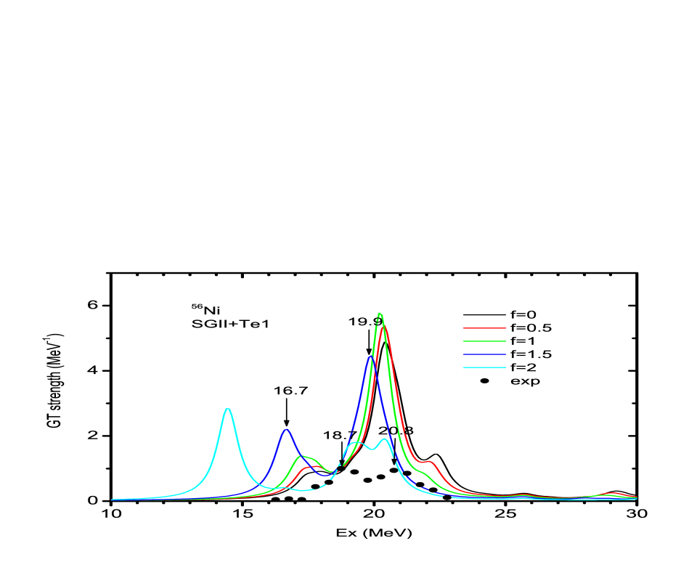
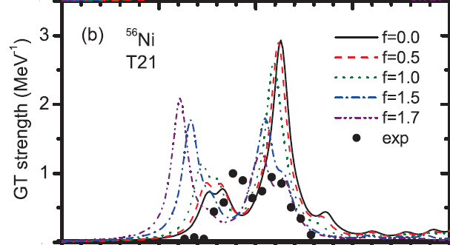
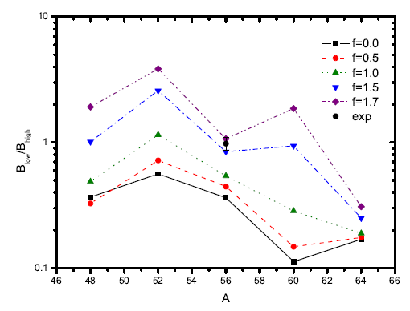
pn (T=0) effect along N=Z
Bai, Sagawa, et al.,
C. L. Bai, H. Sagawa, et al., Phys. Lett. B 719 (2013).
QRPA
SU(4)
Particle-particle
(pn pair) dominant
Particle-hole
dominant
Ex(MeV, from ⁵⁶Ni)
⁴⁸Cr and ⁶⁴Ge at RIKEN RIBF
(4 neutrons and protons away from⁵⁶Ni)
for a wide (0-20 MeV) Ex region
→
Confirm the picture;
(nn → pn vibration )
Determine the strength of the pn pairing
B(GT1)/B(GT2)
Different pn strength
⁴⁸Cr
⁵⁶Ni
⁶⁴Ge
Mass number (A=2N=2Z)

Slide 19
Take-home messages
From a key nucleus (⁵⁶Ni), we learned a lot that was not so easy to extract from a wide range of experiments
Pinning down key parameters of nuclear models
Spin isospin collectivity hidden in stable nuclei

Slide 20
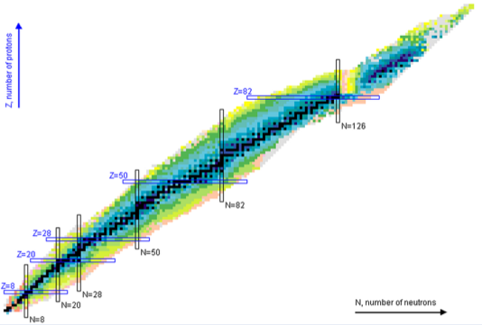


Overview of (p,n) studies for unstable nuclei using RI beam
N=Z line
Isoscalar pairing
(partially approved)
@NSCL, MSU
S800
¹³²Sn (spokespersons:
M. Sasano, R. Zegers)
double magic nuclei
⁵⁶Ni
M.Sasano et al.,
performed @RIBF SAMURAI, April 2014
Extend (p,n) study to A~100 region
¹²Be
K.Yako et al.,
⁸He
H. Sakai et al.,
¹¹Li, ¹⁴Be, …, Stuhl et al. (exp. approved)
Notes:
Here I show a overview of (p,n) studies for unstable nuclei.
Previous experiments are mainly light nuclei and up to A~50 region.
By using WINDS + SAMURAI setup we can extend (p,n) study to A~100 region as shown by red circles.
In this work, the most heaviest case of 132Sn was studied.

Slide 21

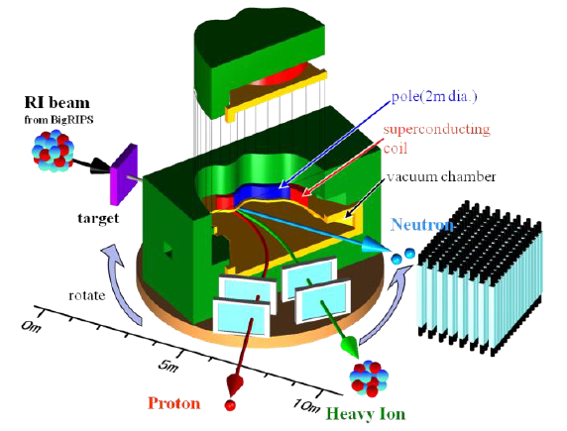





132Sn(p,n) exp. collaboration
R. G. T. Zegers, S. Noji, M. Scott, C. Sullivan, S. Lipschutz, D. Bazin, S. Austin, A. Brown, E. Litvinova, D-L. Fang (NSCL, MSU), T. Uesaka, J. Zenihiro, M. Dozono, T. Motobayashi, K. Yoneda, H. Sato, Y. Shimizu, H. Otsu, H. Baba, M. Nishimura, H. Sagawa, H. Sakai, N. Inabe, H. Hiroshi, N. Fukuda, T. Kubo, Zhenyu Xu (RIKEN Nishina Center) ,
T. Kobayashi, Tako (Tohoku University), Koyama, N. Kobayashi (University of Tokyo)
T. Nakamura, Y. Kondo, Shikata, J. Tsubota (Tokyo Institute of Technology),
K. Yako, S. Shimoura, S. Ota, S. Kawase, Y. Kubota, M. Takaki, S. Michimasa, K. Kisamori, C. Lee, H. Tokieda (CNS, University of Tokyo), R. G. T. Zegers, S. Noji (NSCL, Michigan State University),
J. Yasuda, T. Wakasa (Kyushu University)
A. Krasznahorkay, Laszlo Stuhl (ATOMKI)

Slide 22
Summary & perspective
Gamow-Teller study at any Ex & (A,Z)
The first case is done on 56Ni at NSCL (A1900xLENDAxS800)
GXPF1A ○、 KB3G X
Key (sometimes, unstable) nuclei
pin down key parameters in nuclear model
collectivity hidden in stable nuclei
Perspective
Expanding rapidly…
  N=Z nuclei, ⁴⁸Cr and ⁶⁴Ge
  ¹³²Sn(p,n) study at RIBF
  (p,n) reactions on halo nuclei

