Slide 1

Strong tensor correlation in light nuclei
with tensor-optimized antisymmetrized molecular dynamics (TOAMD)
Takayuki MYO
International symposium on “High-resolution Spectroscopy and Tensor interactions” (HST15), Osaka, 2015.11

Slide 2
Outline
Tensor Optimized Shell Model (TOSM)
Importance of 2p2h excitation involving high-momentum component for tensor correlation
Applications to He, Li, Be isotopes
Tensor Optimized AMD (TOAMD)
Toward clustering with tensor correlation
Formulation given in PTEP 2015, 073D02

Slide 3
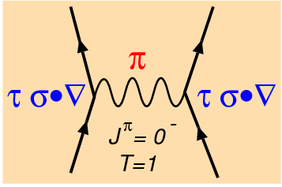
Pion exchange interaction & V_{tensor}
involve large
momentum
δ interaction
Yukawa interaction
Tensor operator
V_{tensor} produces the high momentum component.
3
Notes:
3

Slide 4
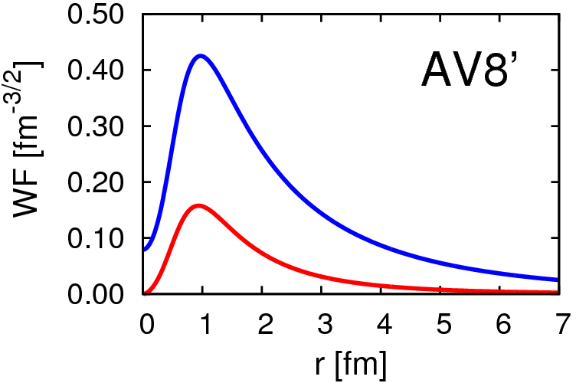
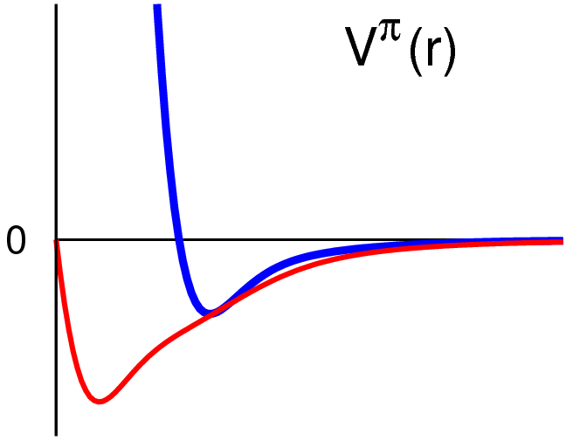
Deuteron properties & tensor force
Energy | -2.24 MeV
Kinetic | 19.88
Central | -4.46
Tensor | -16.64
LS | -1.02
P(L=2) | 5.77%
Radius | 1.96 fm
S
D
AV8’
V_{central}
R_{m}(s)=2.00 fm
R_{m}(d)=1.22 fm
r
d-wave is
“spatially compact”
(high momentum)
V_{tensor}

Slide 5
Tensor-optimized shell model (TOSM)
TM, Sugimoto, Kato, Toki, Ikeda
PTP117(2007)257
Shell model type configuration
with mass number A
(0p0h+1p1h+2p2h)
particle state Gaussian expansion for each orbit
Gaussian basis function
Hiyama, Kino, Kamimura PPNP51(2003)223
c.m. excitation is excluded by Lawson’s method

Slide 6
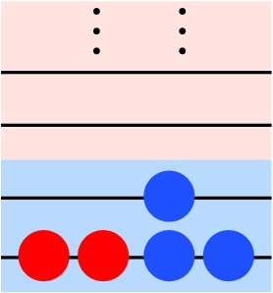
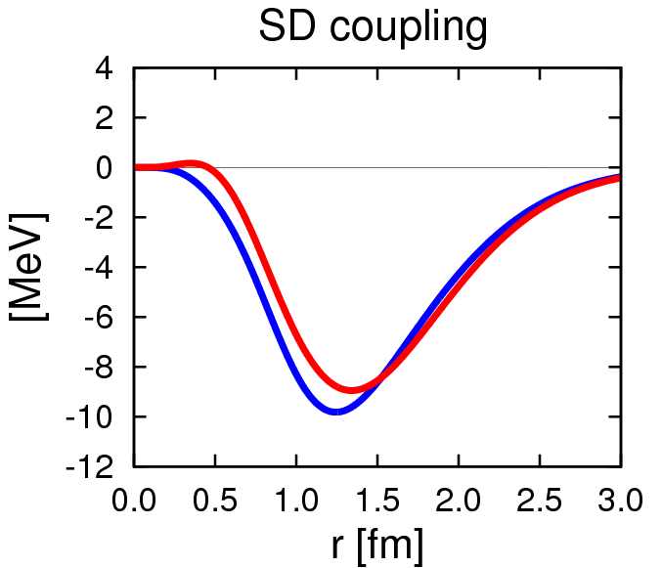
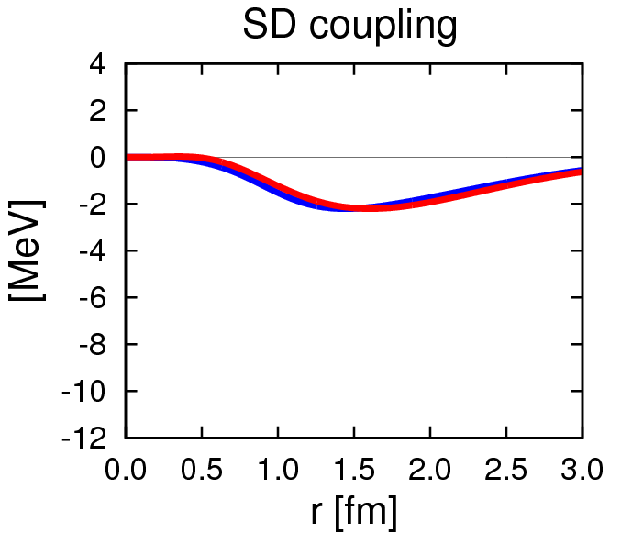
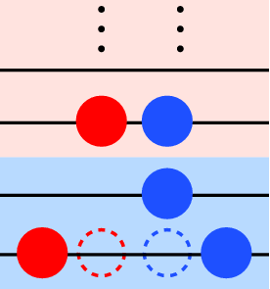
Tensor force matrix elements
particle
M_{SD}(r) = r²·φ_{S}(r,b_{S})·V_{T}·φ_{D}(r,b_{D})
Integrand of Tensor ME
b_{D} ~ b_{S}
V_{T} = V_{residual}
1st order
π+ρ (Bonn)
AV8’
hole
b_{D} ~ b_{S}×0.5
3.8 MeV
V_{T} ≠ V_{residual}
15.0 MeV
0p0h-2p2h
high momentum
6
6
Centrifugal potential (1GeV@0.5fm) pushes away D-wave.

Slide 7
He, Li, Be isotopes in TOSM
TM, A. Umeya, H. Toki, K. Ikeda PRC84 (2011) 034315
TM, A. Umeya, H. Toki, K. Ikeda PRC86 (2012) 024318
TM, A. Umeya, K. Horii, H. Toki, K. Ikeda PTEP (2014) 033D01
TM, A. Umeya, H. Toki, K. Ikeda PTEP (2015) 073D02

Slide 8
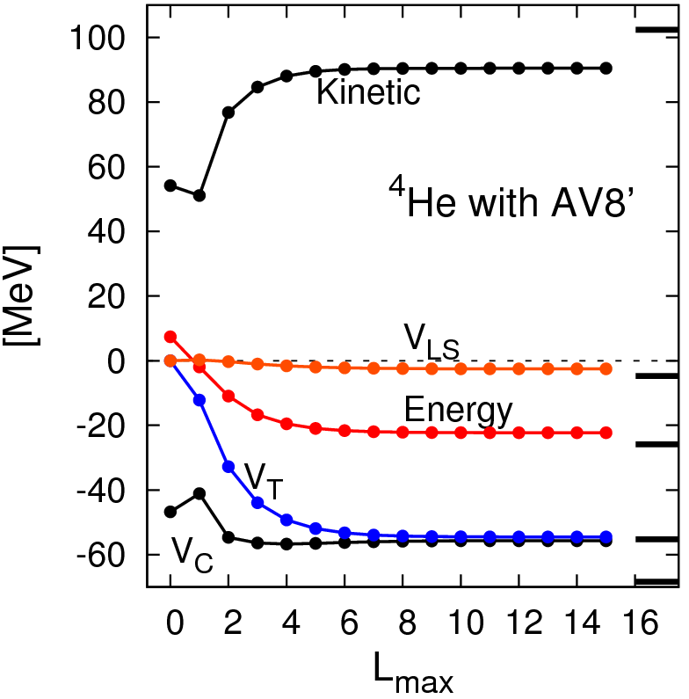
⁴He in TOSM + central UCOM
T
(exact)
Kamada et al.
PRC64 (Jacobi)
TM, H. Toki, K. Ikeda
PTP121(2009)511
variational calculation
V_{LS}
Gaussian expansion
at most with 9 bases
E
High-k components bring large kinetic energy
V_{C}
V_{T}
good convergence

Slide 9


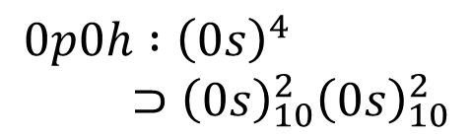
Selectivity of the tensor coupling in ⁴He
$$0p0h :{\left(0s\right)}^{4} \\ ⊃{\left(0s\right)}_{10}^{2}{\left(0s\right)}_{10}^{2}$$
$$2p2h:{(0s)}_{10}^{2}{(p_{1/2})}_{10}^{2}$$
l₁=l₂=0
l₃=1
l₄=1
l₁=l₂=l₃=l₄=0
V_{T}
s₁
s₂
s₃
s₄
L=2
s₁
s₂
s₃
s₄
1⁺(pn)
1⁺(pn)
V_{T}
$$2p2h:{(0s)}_{10}^{2}{\left[\left(1s\right)\left(d_{3/2}\right)\right]}_{10}$$
l₁=l₂=0
l₃=0
l₄=2
Selectivity of S₁₂
ΔL = 2 ΔS = −2
s₁
s₂
s₃
s₄
L=2
9

Slide 10
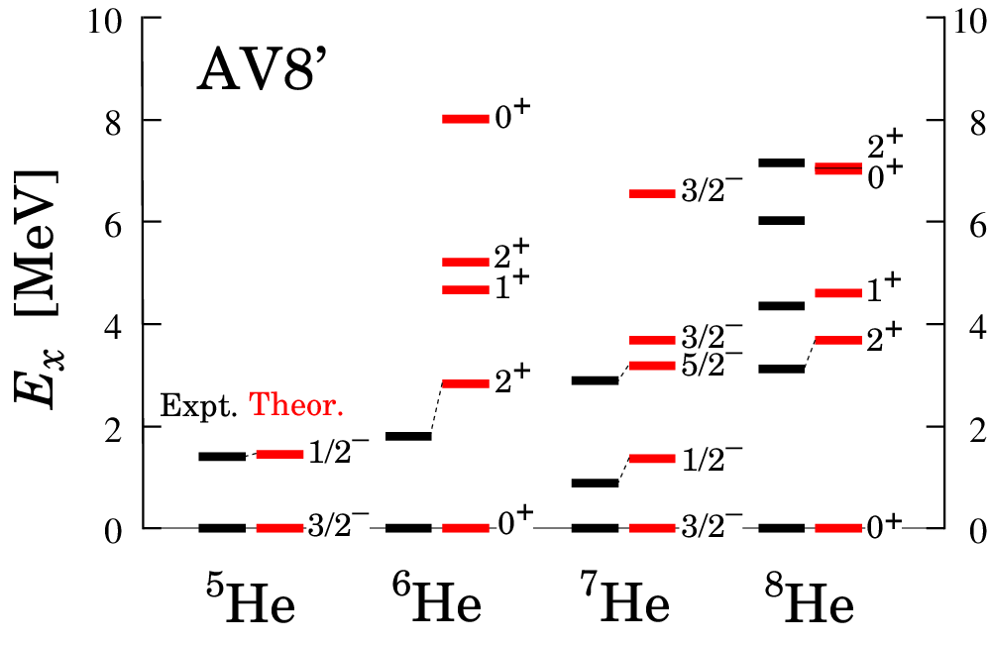
⁵⁻⁸He with TOSM+UCOM
Excitation energies in MeV
TM, A. Umeya, H. Toki, K. Ikeda PRC84 (2011) 034315
Excitation energy spectra are reproduced well

Slide 11
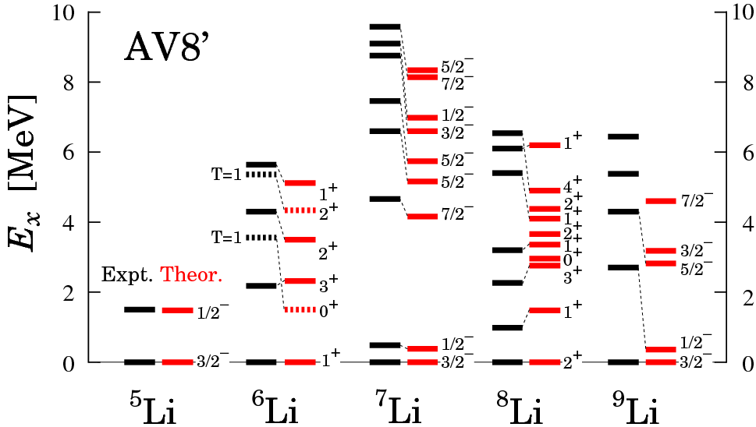
⁵⁻⁹Li with TOSM+UCOM
Excitation energies in MeV
TM, A. Umeya, H. Toki, K. Ikeda PRC86(2012) 024318
Excitation energy spectra are reproduced well

Slide 12
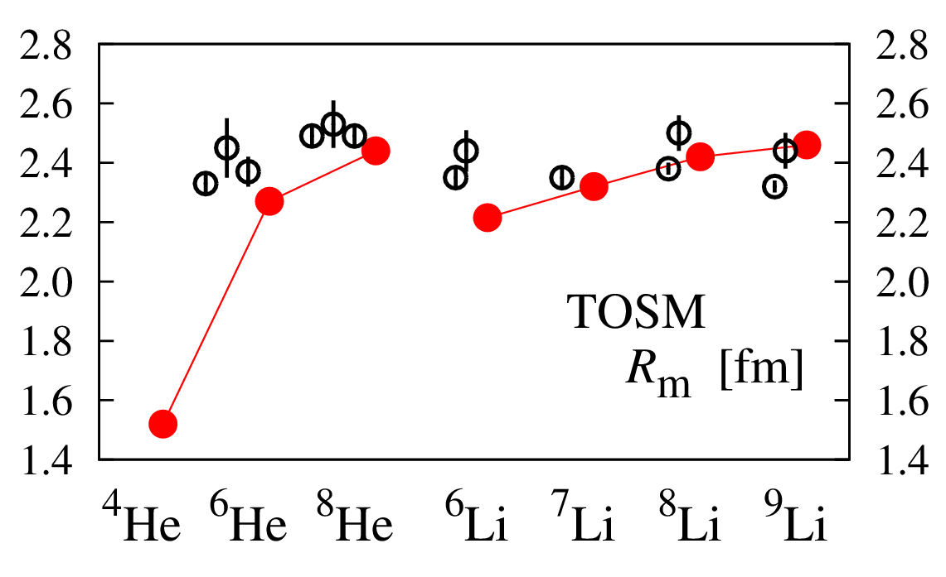
Radius of He & Li isotopes
Expt
TOSM with AV8’
Halo
Skin
A. Dobrovolsky, NPA 766(2006)1
I. Tanihata et al., PLB289(‘92)261 G. D. Alkhazov et al., PRL78(‘97)2313
O. A. Kiselev et al., EPJA 25, Suppl. 1(‘05)215. P. Mueller et al., PRL99(2007)252501
12
12

Slide 13
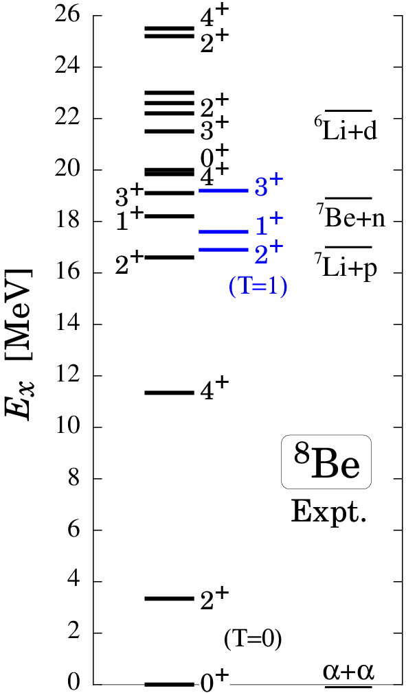
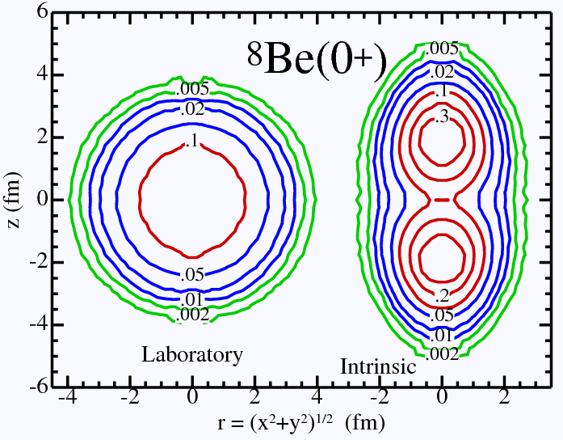
⁸Be spectrum
Γ< 1MeV
Argonne Group
Green’s function Monte Carlo C. Pieper, R. B. Wiringa, Annu.Rev.Nucl.Part.Sci.51 (2001)
Γ~ few MeV
TUNL
α-α structure

Slide 14
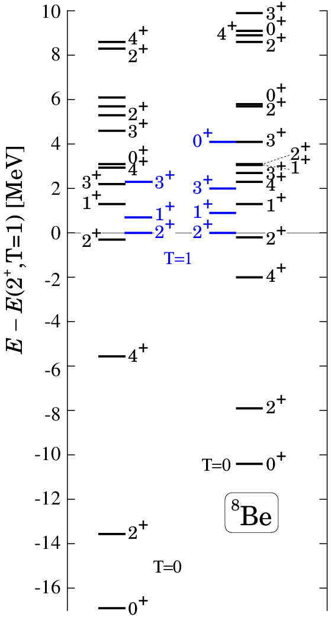
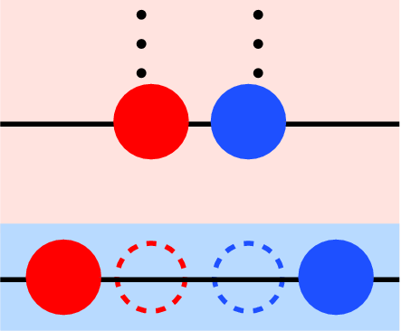
⁸Be in TOSM − AV8’ −
V_{T} × 1.1, V_{LS} × 1.4
simulate ⁴He benchmark (Kamada et al., PRC64)
correct level order (T=0,1)
tensor contribution : T=0 > T=1
α : 0p0h+2p2h with high-k
2α needs 4p4h.
spatial asymptotic form of 2α
Expt. (TUNL)
α
α
TOSM
clustering
⇒ TOAMD

Slide 15
Tensor-Optimized Antisymmetrized Molecular Dynamics (TOAMD)
TM, H. Toki, K. Ikeda, H. Horiuchi, T. Suhara, PTEP 2015, 073D02
Toward the clustering with tensor correlation explicitly

Slide 16

(TOAMD)
0p0h
2p2h
Gaussian expansion
tensor correlation
short-range correlation

Slide 17
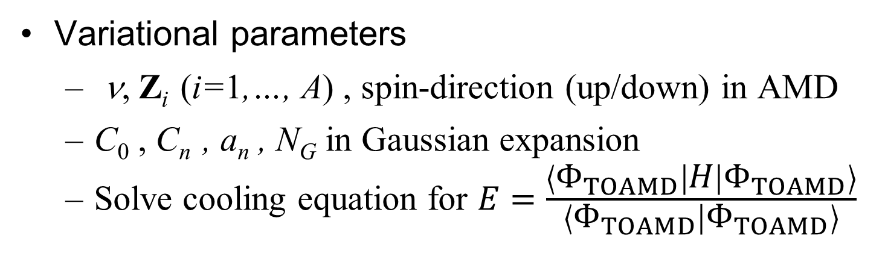
Formulation of TOAMD
0p0h
2p2h
4p4h
Variational parameters
ν, Z_{i} (i=1,…, A) , spin-direction (up/down) in AMD
C₀ , C_{n} , a_{n} , N_{G} in Gaussian expansion
Solve cooling equation for $E=\frac{\left\langle Φ_{TOAMD} | H | Φ_{TOAMD}\right\rangle }{\left\langle Φ_{TOAMD} | Φ_{TOAMD}\right\rangle }$

Slide 18
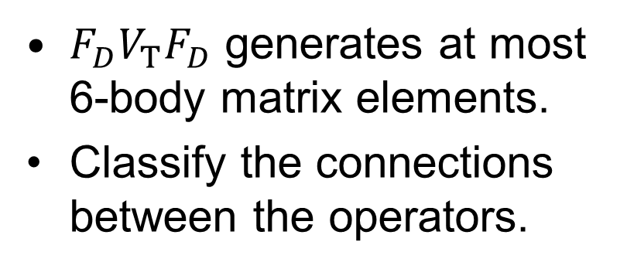
Matrix elements of multi-body operator
Matrix elements
range
particle
coordinate
centroid
$F_{D}V_{T}F_{D}$ generates at most 6-body matrix elements.
Classify the connections between the operators.
2-body
4-body
F_{D}
F_{D}
V_{T}
V_{T}
F_{D}
F_{D}

Slide 19
Matrix elements with Fourier trans.
Fourier transformation of the interaction V & F_{D}, F_{S.}
Y. Goto and H. Horiuchi, Prog. Theor. Phys., 62 (1979) 662
Gaussian expansion of V, F_{D}, F_{S} for relative motion
Multi-body operators are represented in the separable form for particle coordinates.
Three-body interaction can be treated in the same manner.
single particle
relative
tensor-type
overlap
Quadratic + Linear terms of k

Slide 20


Matrix elements with Fourier trans.
Example : F_{D}×V_{T}
F_{D}
$${\vec{k}}_{1}$$
a₁
(2-body)×(2-body)
= (2-body)+(3-body)+(4-body)
$${\vec{k}}_{2}$$
a₂
2-body
V_{T}
k-integral
spatial part
(tensor)²
B_{ij}=⟨ϕ_{i}|ϕ_{j}⟩
spin-isospin part
antisymmetrization
overlap

Slide 21


Matrix elements with Fourier trans.
Example : F_{D}×V_{T}
F_{D}
$${\vec{k}}_{1}$$
a₁
V_{T}
(2-body)×(2-body)
= (2-body)+(3-body)+(4-body)
$${\vec{k}}_{2}$$
3-body
a₂
k-integral
spatial part
(tensor)²
B_{ij}=⟨ϕ_{i}|ϕ_{j}⟩
spin-isospin part
antisymmetrization
overlap

Slide 22
TOSM vs. TOAMD
 | TOSM | TOAMD
Correlation | 1p1h, 2p2h (single particle) | Relative motion in F_{D,} F_{S}
CM excitation | Lawson method | Nothing with single ν
Hole states | harmonic oscillator basis | Can optimize in each basis
Short-range repulsion | central-UCOM | Correlation function, F_{S}

Slide 23
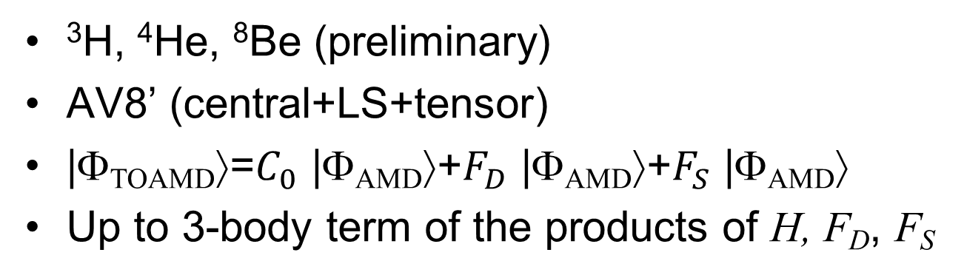
Results
³H, ⁴He, ⁸Be (preliminary)
AV8’ (central+LS+tensor)
|Φ_{TOAMD}⟩=$C_{0}$ |Φ_{AMD}⟩+$F_{D}$ |Φ_{AMD}⟩+$F_{S}$ |Φ_{AMD}⟩
Up to 3-body term of the products of H, F_{D}, F_{S}
2-body
3-body
others...
F_{S}
F_{D}
F_{S}
F_{D}
F_{D}
V_{T}
V_{T}
T
V_{T}
T
F_{S}
F_{D}
F_{S}
F_{D}
F_{D}

Slide 24
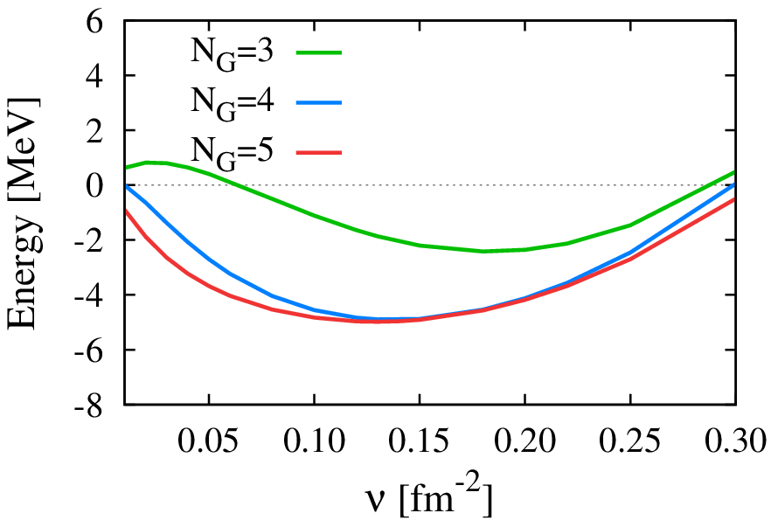
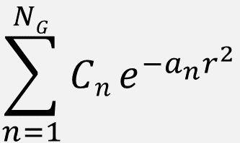
³H energy surface
Gaussian expansion
$$\sum_{n=1}^{NG}{Cn}e^{−a_{n}r^{2}}$$
Radius=1.76 fm
wide
compact
Good convergence for Gaussian numbers N_{G}.
Obtain the saturation property with good radius.

Slide 25
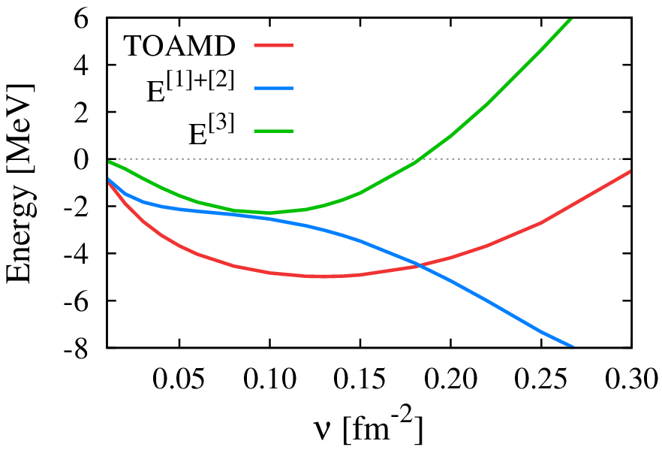
Three-body term in energy of ³H
3-body term
Full
1& 2-body terms
Radius=1.76 fm
wide
compact
No saturation point with one- & two-body terms.
Three-body term has a saturation behavior.

Slide 26
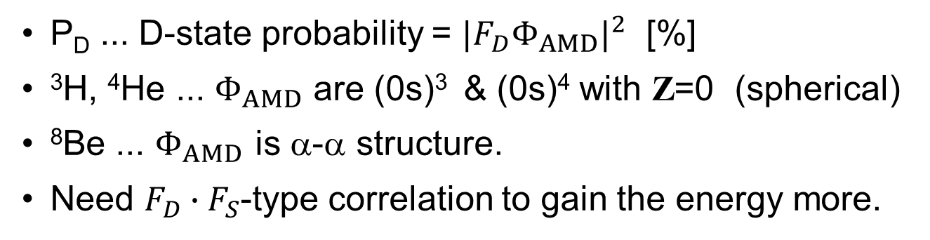
Energy components
preliminary
in MeV
 | E_{AMD} | E_{TOAMD} | T | V_{C} | V_{T} | V_{LS} | P_{D}
³H | 16.9 | -5.0 | 37.9 | -17.4 | -24.1 | -1.3 | 6.4
⁴He | 41.4 | -13.3 | 61.5 | -34.9 | -38.3 | -1.6 | 7.3
⁸Be | 110.3 | -27.6 | 134.7 | -91.0 | -69.1 | -2.2 | 9.4
P_{D} ... D-state probability = ${|F_{D}Φ_{AMD}|}^{2}$ [%]
³H, ⁴He ... $Φ_{AMD}$ are (0s)³ & (0s)⁴ with Z=0 (spherical)
⁸Be ... $Φ_{AMD}$ is α-α structure.
Need ${F_{D}∙F}_{S}$-type correlation to gain the energy more.
in progress

Slide 27
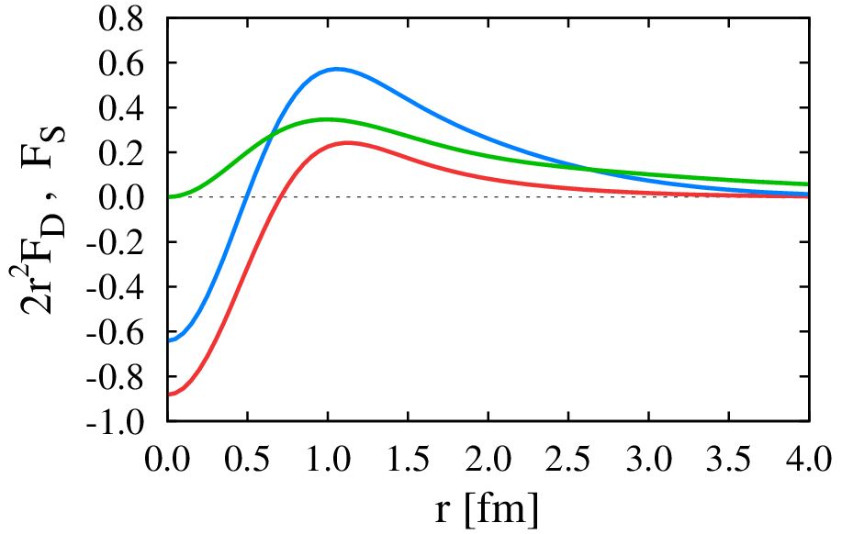
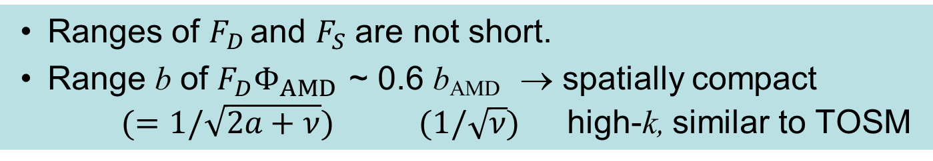
Correlation functions F_{D}, F_{S} in ³H
F_{S} ³E
2×r²F_{D} ³E
preliminary
F_{S} ¹E
same trend
in ³H, ⁴He, ⁸Be
Ranges of $F_{D}$ and $F_{S}$ are not short.
Range b of $F_{D}Φ_{AMD}$ ~ 0.6 b_{AMD} → spatially compact $(=1/\sqrt{2a+ν})$ $(1/\sqrt{ν})$ high-k, similar to TOSM

Slide 28
Summary
Tensor-Optimized Shell Model (TOSM) using V_{bare}.
Strong tensor correlation from 0p0h-2p2h involving high-k components.
He, Li, Be isotopes : Energy spectra, Radius of n-rich nuclei.
For ⁸Be, two aspects : grand state region & highly excited states, which indicates of more configurations, such as α−α states.
Tensor-Optimized AMD (TOAMD).
Two-kinds of correlation functions F_{D} (tensor) & F_{S} (short-range)
Three-body term contributes to the energy saturation.
Ranges of F_{D} , F_{S} are not short.
Spatially compact behavior of F_{D} produces high-k component.
28
Notes:
28

