Slide 1
Large-scale shell-model study of E1 strength function and level density
Yutaka Utsuno
Advanced Science Research Center, Japan Atomic Energy Agency
Center for Nuclear Study, University of Tokyo
Collaborators
N. Shimizu (CNS), T. Otsuka (Tokyo), M. Honma (Aizu), S. Ebata (Hokkaido),
T. Mizusaki (Senshu), Y. Futamura (Tsukuba), T. Sakurai (Tsukuba)
“High-resolution Spectroscopy and Tensor interactions” (HST15), Osaka, November 16-19, 2015

Slide 2
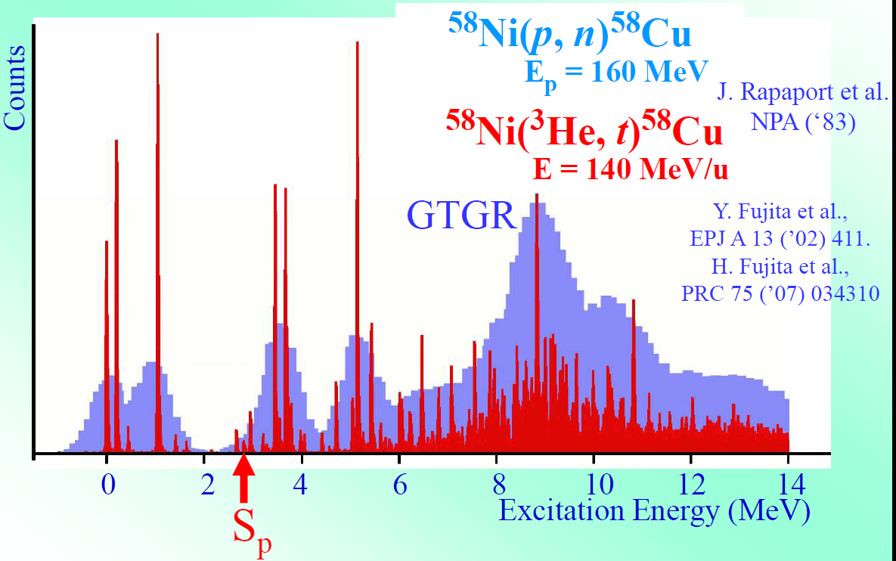
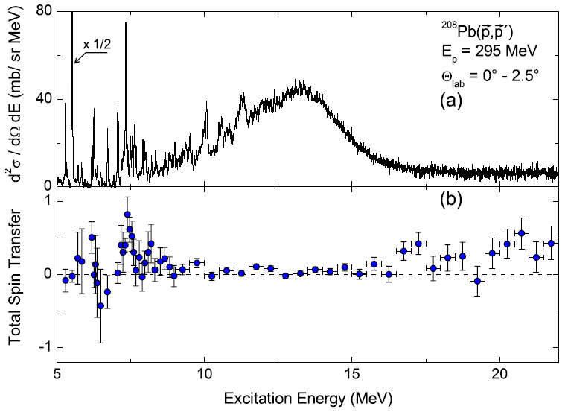
Fine structure by high-resolution spectroscopy
Taken from a slide by Y. Fujita
Gamow-Teller giant resonance
giant dipole resonance
A. Tamii et al., Phys. Rev. Lett. 107, 062502 (2011).

Slide 3
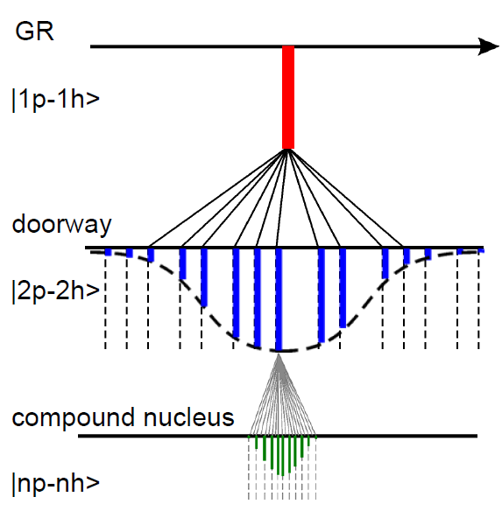
Formation of fine structure
Interplay among
  Fine structure
  Damping of GDR
  Level density
Shell model (CI)
  All the levels in a given model space
  Transitions between excited states
Taken from a figure by A. Richter

Slide 4
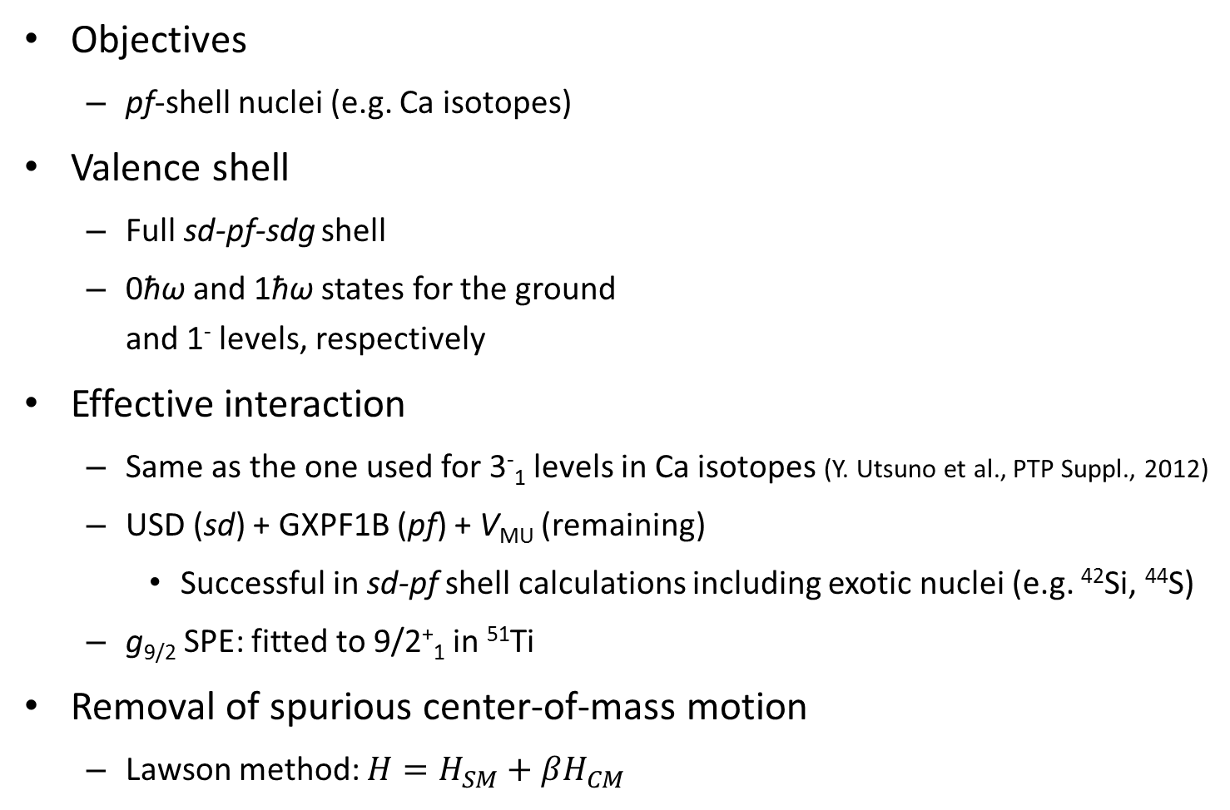
Framework
Objectives
  pf-shell nuclei (e.g. Ca isotopes)
Valence shell
  Full sd-pf-sdg shell
  0ħω and 1ħω states for the ground
  and 1⁻ levels, respectively
Effective interaction
  Same as the one used for 3⁻₁ levels in Ca isotopes (Y. Utsuno et al., PTP Suppl., 2012)
  USD (sd) + GXPF1B (pf) + V_{MU} (remaining)
    Successful in sd-pf shell calculations including exotic nuclei (e.g. ⁴²Si, ⁴⁴S)
  g_{9/2} SPE: fitted to 9/2⁺₁ in ⁵¹Ti
Removal of spurious center-of-mass motion
  Lawson method: $H=H_{SM}+βH_{CM}$
0g1d2s
0f1p
or
0d1s

Slide 5
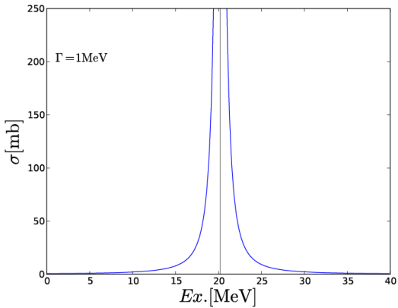
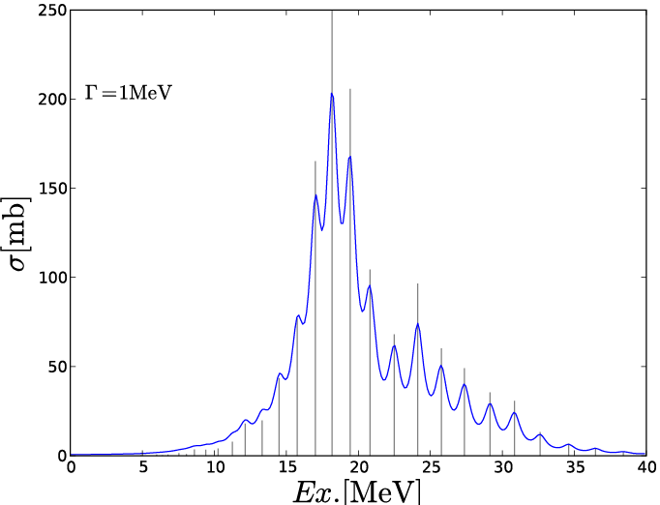
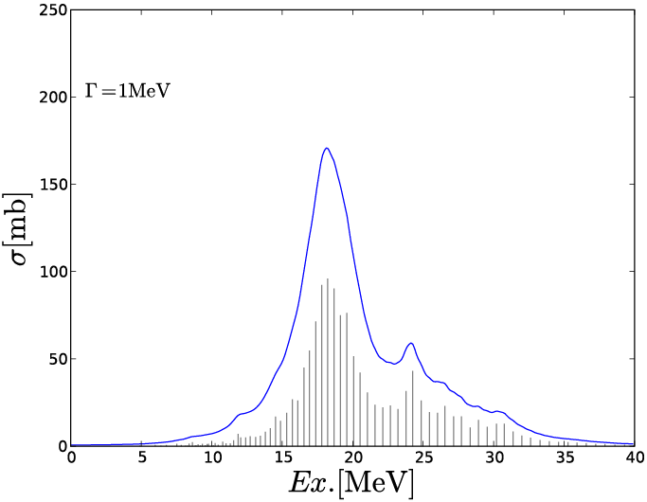
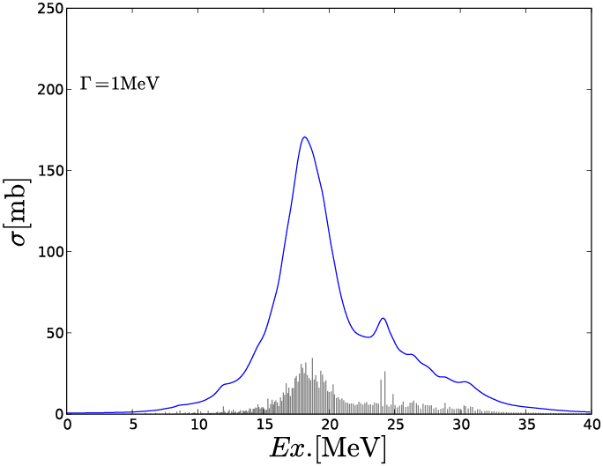
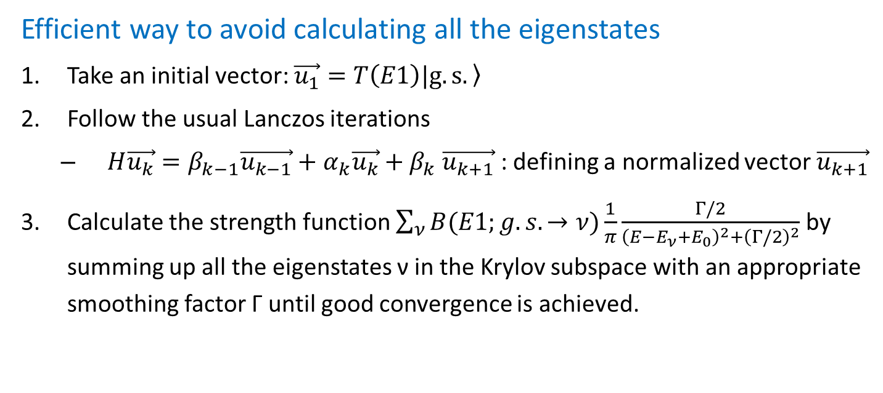
Lanczos strength function method
Efficient way to avoid calculating all the eigenstates
Take an initial vector: $\vec{u_{1}}=T\left(E1\right)|\left.g.s.\right\rangle$
Follow the usual Lanczos iterations
  $H\vec{u_{k}}=β_{k−1}\vec{u_{k−1}}+α_{k}\vec{u_{k}}+β_{k}$ $\vec{u_{k+1}}$ : defining a normalized vector $\vec{u_{k+1}}$
Calculate the strength function $\sum_{ν}{B(E1;g.s.→ν)\frac{1}{π}\frac{Γ/2}{{\left(E−E_{ν}+E_{0}\right)}^{2}+{\left(Γ/2\right)}^{2}}}$ by summing up all the eigenstates ν in the Krylov subspace with an appropriate smoothing factor Γ until good convergence is achieved.
Example of convergence with Γ = 1 MeV
1 iter.
100 iter.
300 iter.
1,000 iter.

Slide 6
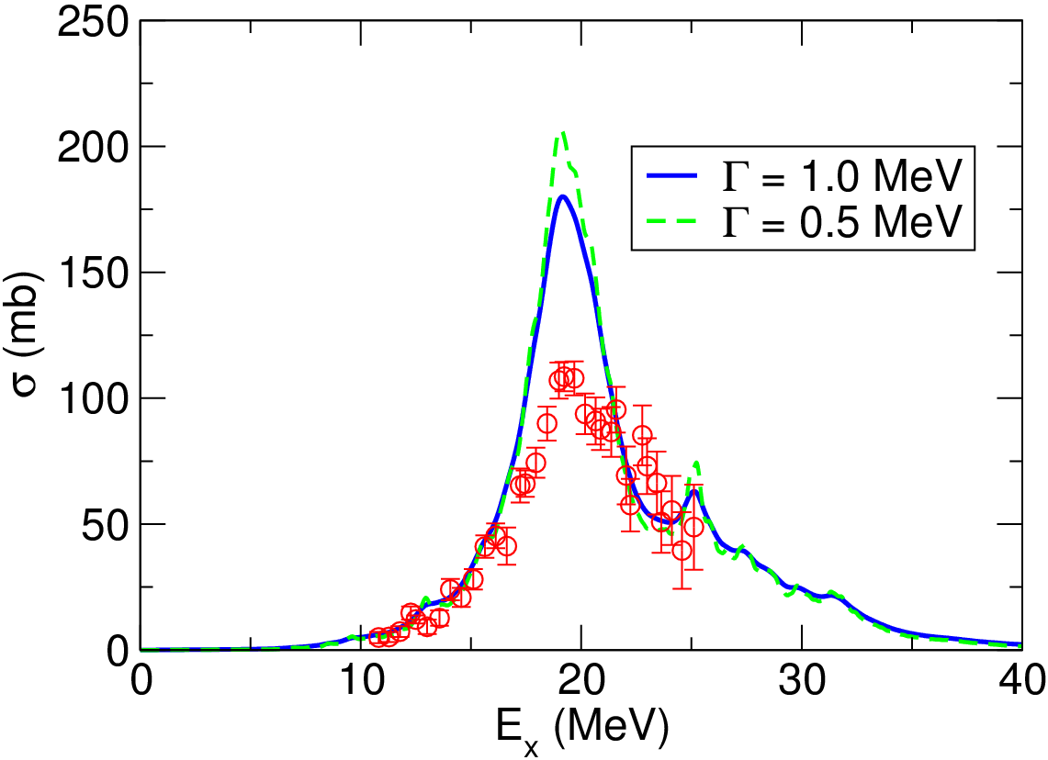
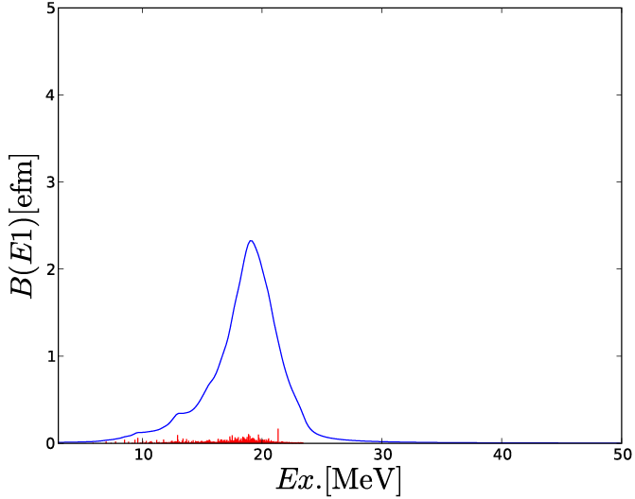
Photo-absorption cross sections for ⁴⁸Ca
23.4 MeV
3,000
1⁻ states
GDR peak position: good
GDR peak height: overestimated
GDR tail: weak dependence on the choice of Γ fine structure

Slide 7
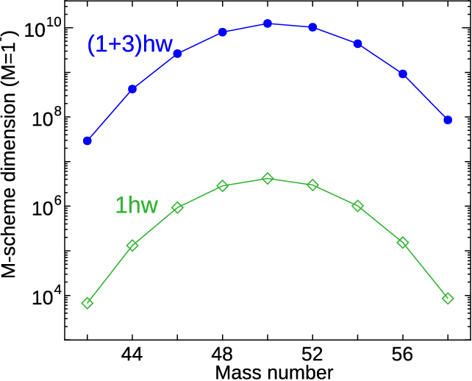
Beyond 1ħω calculation
(1+3)ħω
M-Scheme dimension for Ca isotopes
0g1d2s
0f1p
0d1s
1ħω
0g1d2s
0f1p
or
0d1s
(1+3)ħω 1⁻ levels in the sd-pf-sdg: Dimension becomes terrible!
  KSHELL code (N. Shimizu)
  Ground state: (0+2)ħω state in the (1+3)ħω calculation

Slide 8
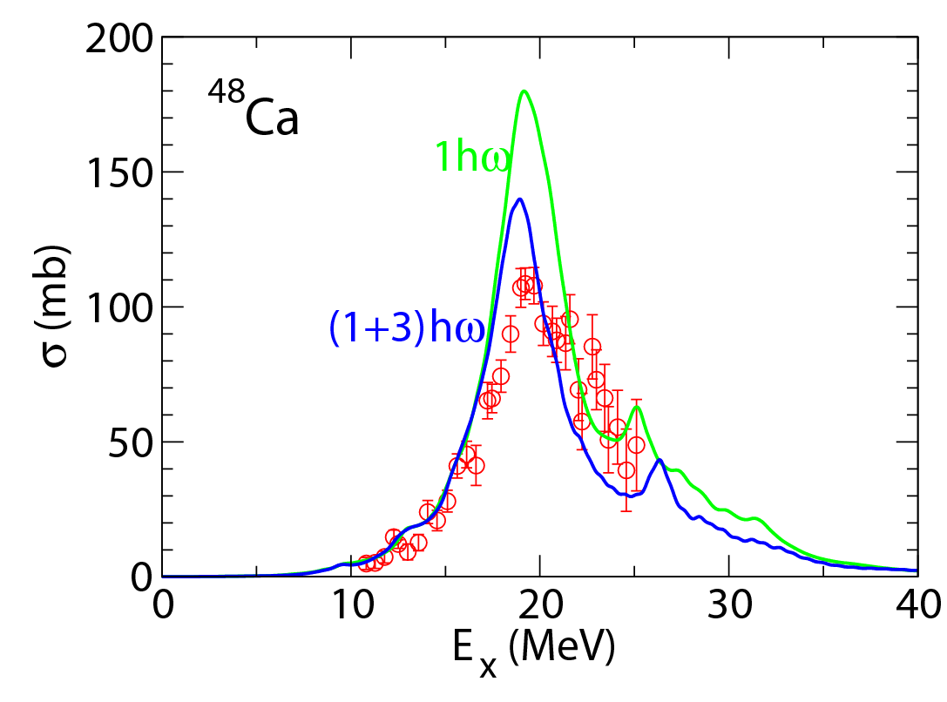
Effect of higher-order correlation
 | B(E1) sum
1ħω | 16.5
(1+3)ħω | 13.6
MCSM 50 dim. | 10.1
GDR peak height is suppressed and improved with increasing ground-state correlation.
Low-energy tail is almost unchanged.
1ħω calculation works quite well for low-energy phenomena.

Slide 9
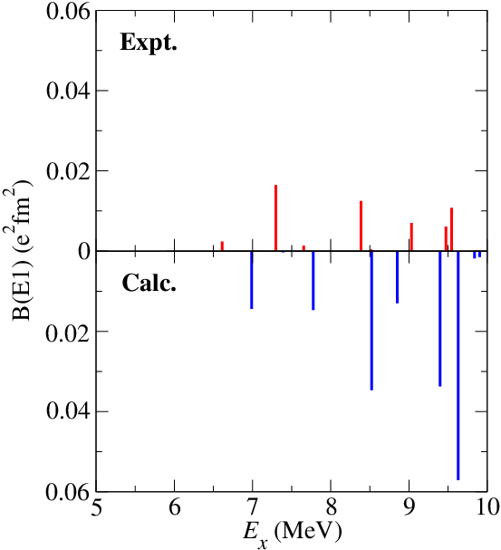
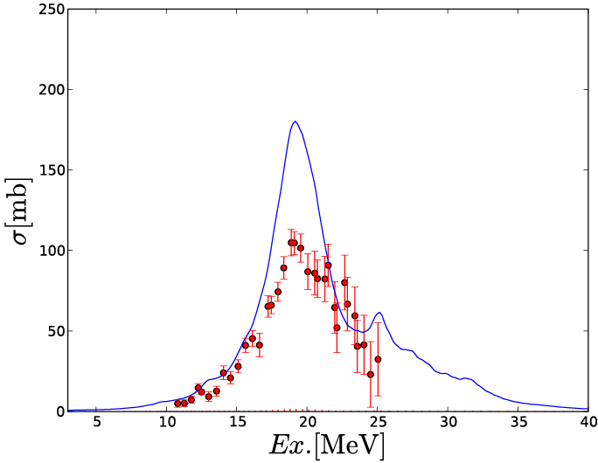
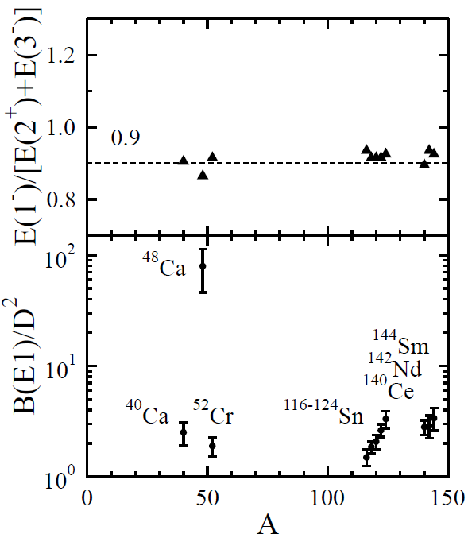
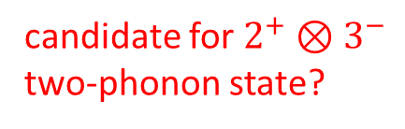
Low-lying 1⁻ levels: two-phonon state?
T. Hartmann et al.,
Phys. Rev. Lett. 85, 274 (2000).
candidate for $2^{+}⊗3^{−}$
two-phonon state?
GDR tail and low-lying levels: a few hundred keV shift gives excellent agreement

Slide 10
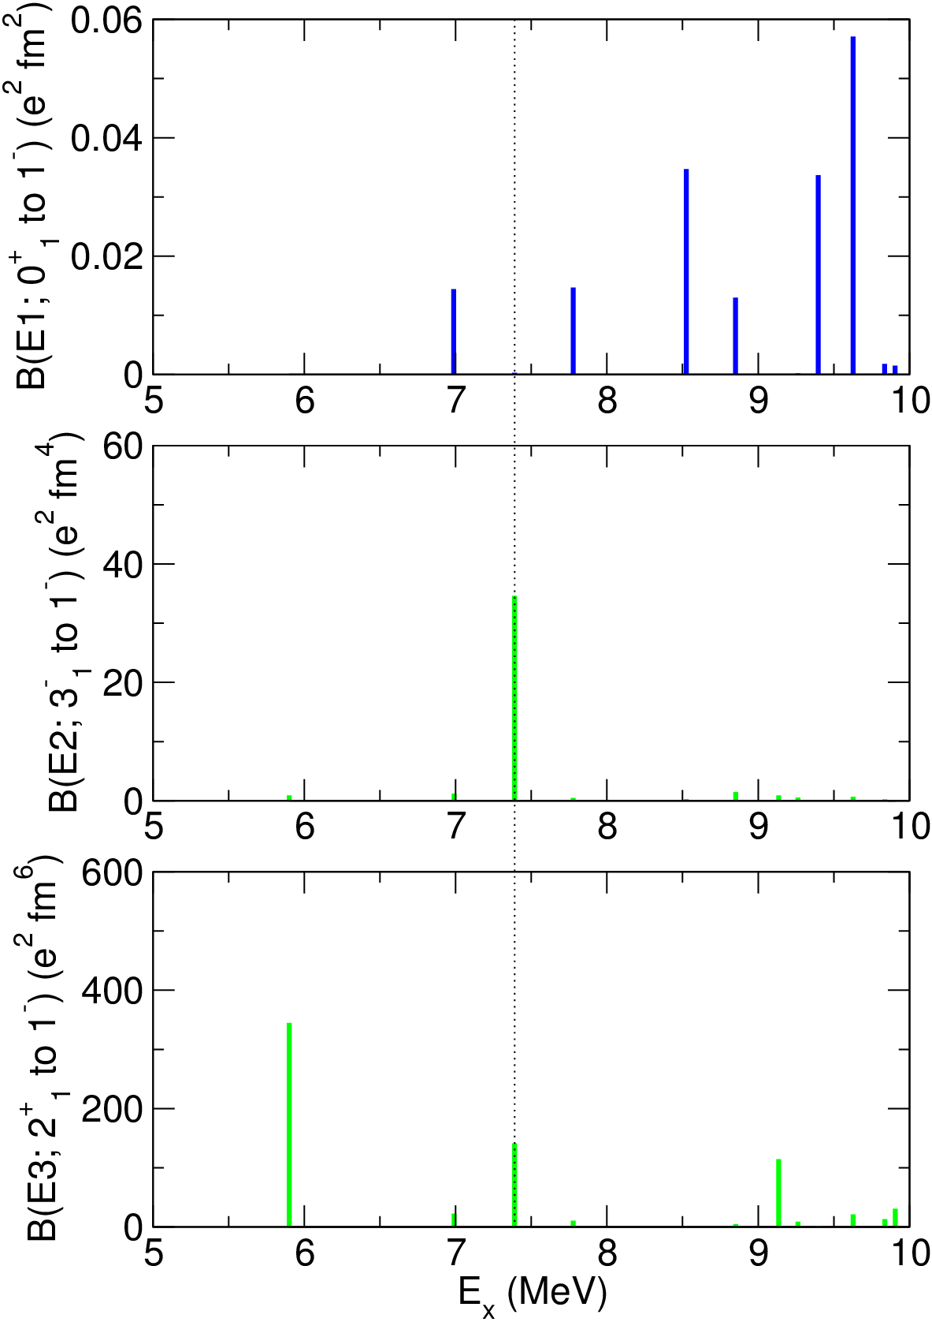
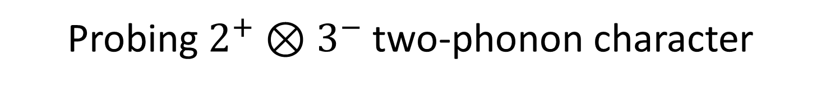
Probing $2^{+}⊗3^{−}$two-phonon character
E1 distribution
0⁺
E2 distribution
3⁻
2⁺
0⁺
E3 distribution
3⁻
2⁺
0⁺
two-phonon-like state: very small E1 strength from the g.s.

Slide 11
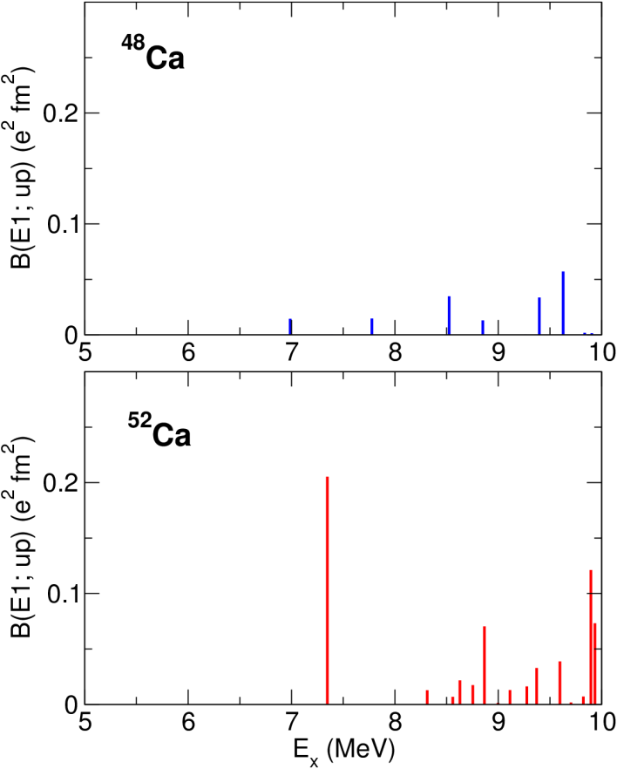
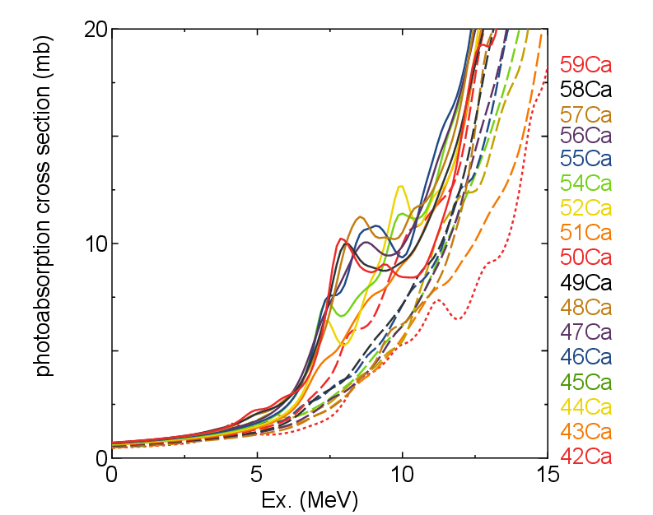
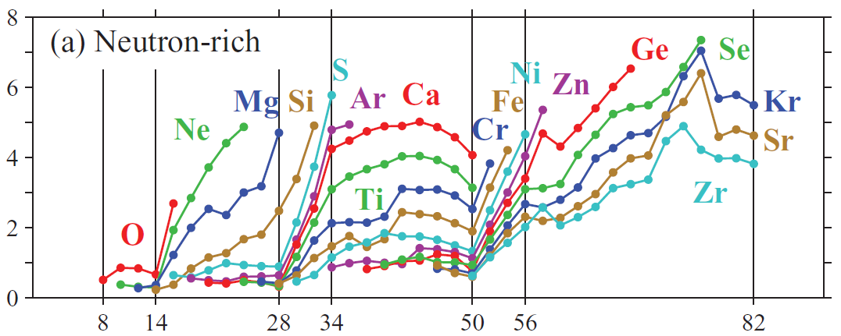
Development of pygmy dipole resonance
solid
lines
dashed
lines
T. Inakura et al., Phys. Rev. C 84,
021302(R) (2011)
PDR fraction (%)
pointed out strong correlation with the occupation of the p orbitals

Slide 12
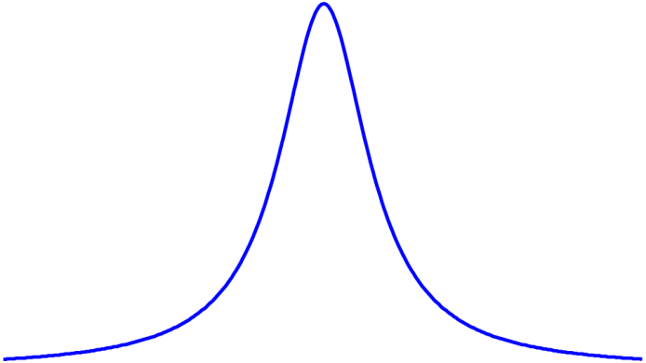
Validating the Brink-Axel hypothesis
GDR built on excited states
  Presumed to be identical with that of the ground state (except energy shift)
    Reflecting geometric nature of GDR
  Practically very important to theoretically evaluate (n, γ) cross sections
  Not easy to verify from experiment (few data available)
initial
ΔE
ΔE
initial

Slide 13
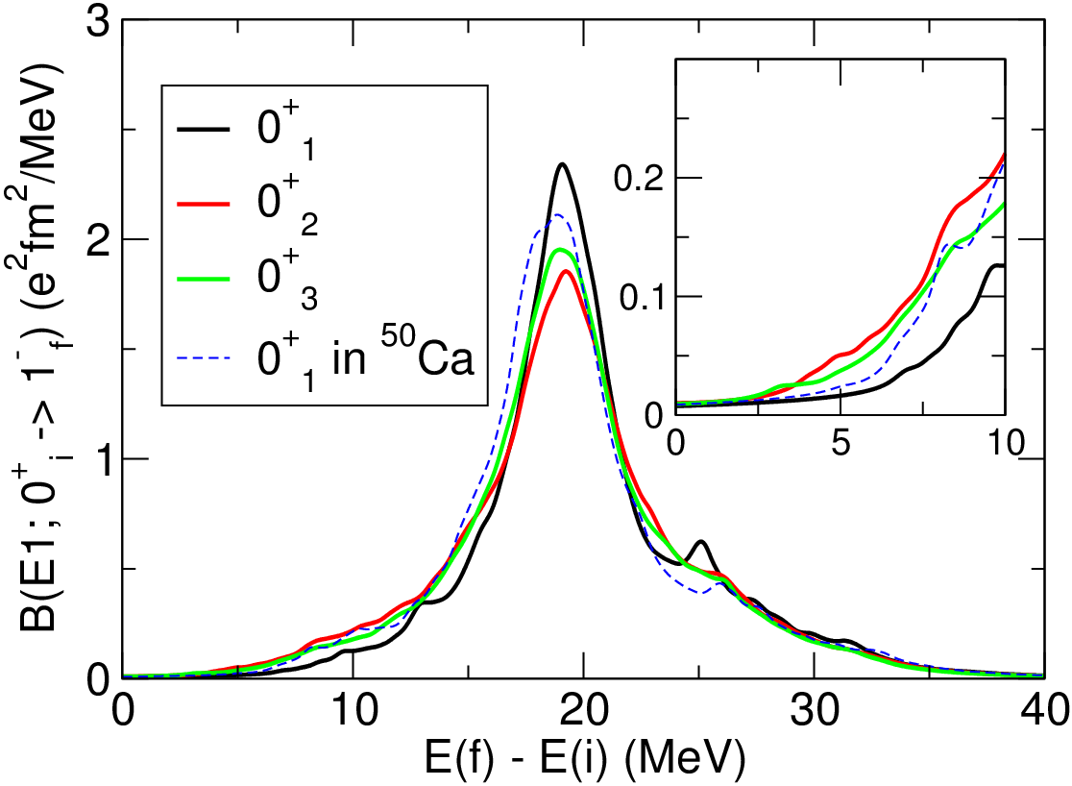
⁴⁸Ca
“pygmy-favored”
configuration
0f_{5/2}
1p_{1/2}
1p_{3/2}
J=0
J=2
0f_{7/2}
0⁺₁
0⁺₂
0⁺₃

Slide 14
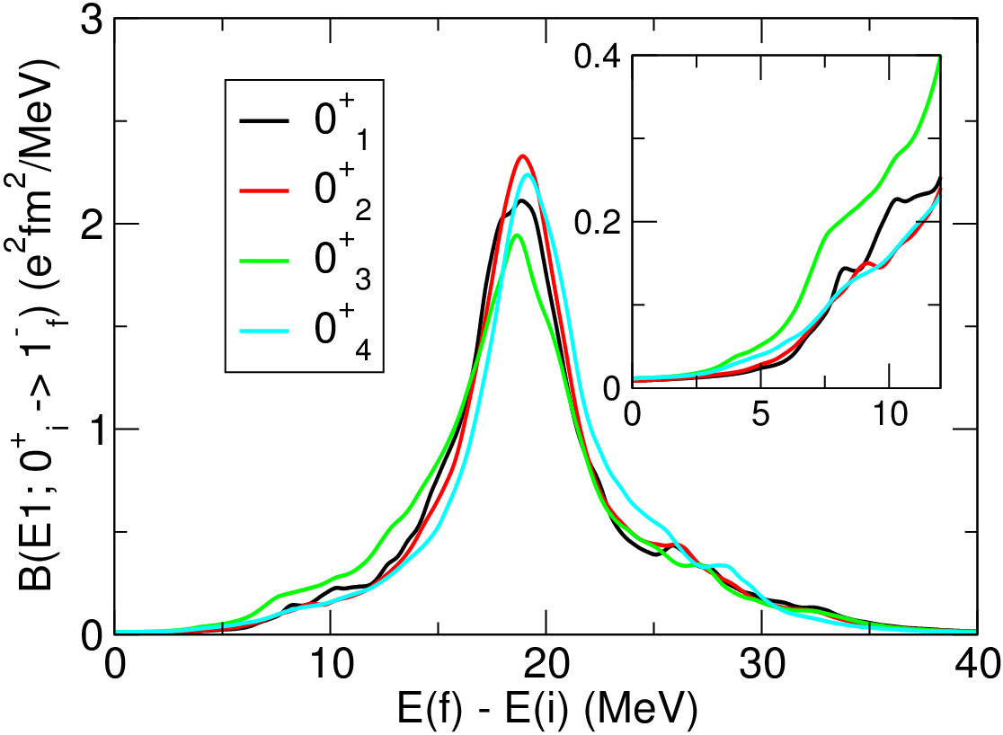
⁵⁰Ca
“pygmy-favored”
configuration
0f_{5/2}
1p_{1/2}
1p_{3/2}
0f_{7/2}
0⁺₁
0⁺₂
0⁺₃
0⁺₄

Slide 15
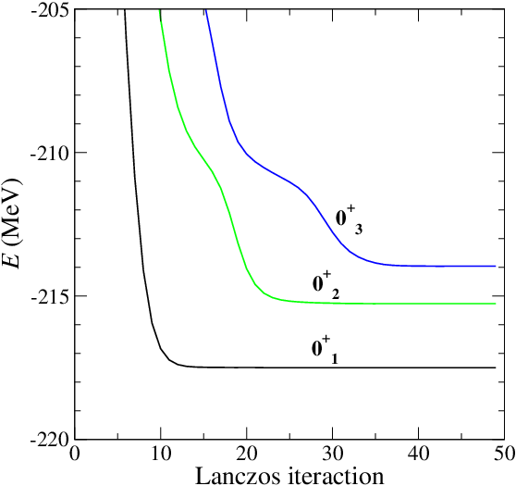
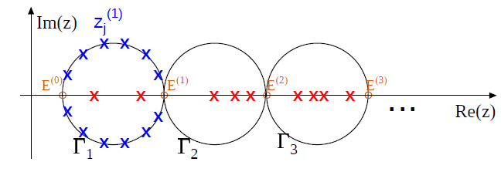
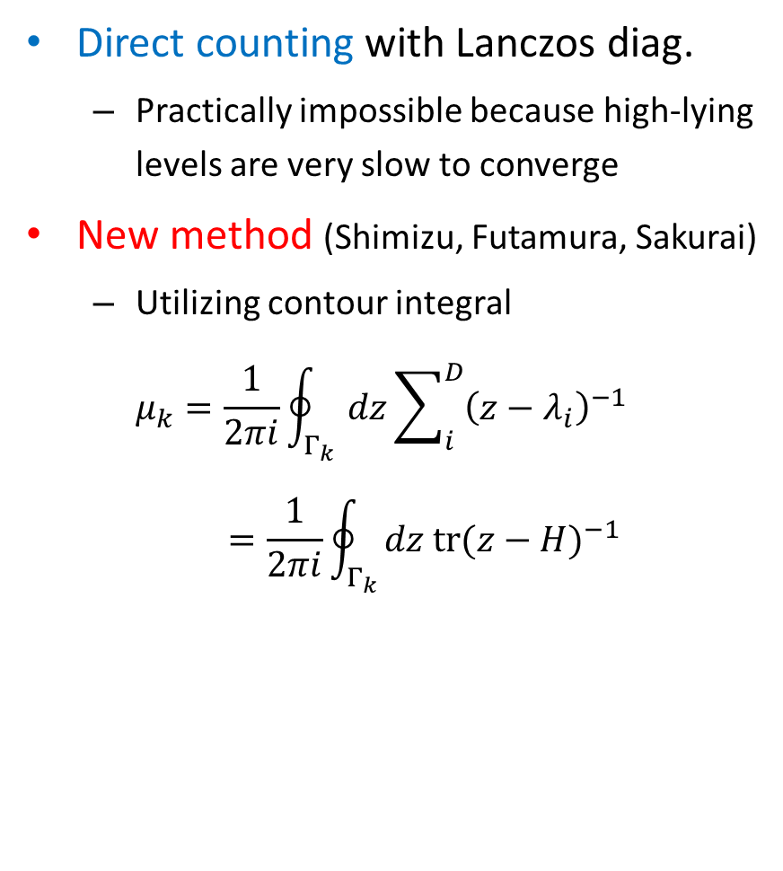
Shell-model calculation for level density
Direct counting with Lanczos diag.
  Practically impossible because high-lying levels are very slow to converge
New method (Shimizu, Futamura, Sakurai)
  Utilizing contour integral
  $μ_{k}=\frac{1}{2πi}\oint_{Γ_{k}}{dz\sum_{i}^{D}{{\left(z−λ_{i}\right)}^{−1}}}=\frac{1}{2πi}\oint_{Γ_{k}}{dz {tr(z−H)}^{−1}}$
Typical convergence pattern

Slide 16
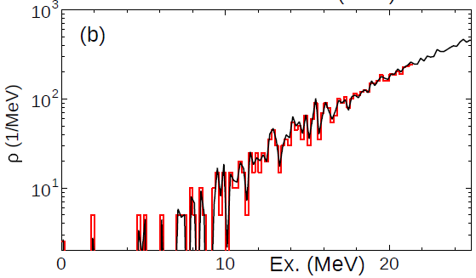

Stochastic estimate of the trace
Remaining task: estimating ${tr(z−H)}^{−1}$
$=\sum_{i}^{D}{e_{i}^{T}{\left(z−H\right)}^{−1}e_{i}}$
Stochastic sampling
  $$≃\frac{1}{N_{s}}\sum_{s}^{N_{s}}{v_{i}^{T}{\left(z−H\right)}^{−1}v_{i}}$$
Exact vs. stochastic estimate (N_{s}=32) for the level density in ²⁸Si
dimension
# sampling
Solve $v_{i}=\left(z−H\right)x_{i}$ using the conjugate gradient method
When $v_{i}$’s are chosen to have good quantum numbers (J, π), spin-parity dependent
level densities are obtained.
The trace can be excellently estimated with a small number of sampling
(known in computational mathematics).

Slide 17
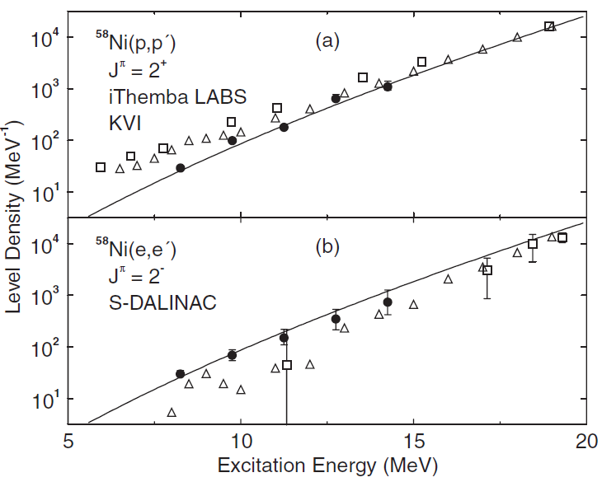
Spin-parity dependence in level density
Important, especially from application point of view
Parity equilibration is often assumed (e.g. BSFG model).
  This assumption clearly breaks down for low-lying states.
Recent measurement of 2⁺ and 2⁻ level densities in ⁵⁸Ni based on high-resolution spectroscopy
  Early onset of parity equilibration in contrast to existing calculations
2⁺ and 2⁻ level densities in ⁵⁸Ni
Expt.
HFB
SMMC
Y. Kalmykov, C. Özen, K. Langanke,
G. Marítnez-Pinedo, P. von Neumann-Cosel,
and A. Richter,
Phys. Rev. Lett. 99, 202502 (2007).

Slide 18
What is the issue in ⁵⁸Ni level densities?
⁵⁸Ni: middle of the pf shell
  Large energy is needed to cross the 1ħω shell gap, and therefore parity equilibration at low energy appears unlikely.
Consistent description of 1ħω shell gaps and parity equilibration in level density?
  Probing 1ħω shell gaps: spectroscopic strengths
    -1p → proton hole
    +1p → proton particle
    -1n → neutron hole
    +1n → neutron particle
sdg
pf-sdg shell gap
pf
Fermi surface
sd-pf shell gap
sd
proton
neutron
Fine-tune the single-particle energies
of the sdg orbits in the sd-pf-sdg shell
calculation (two-body force is left unchanged
from the E1 calculations).

Slide 19
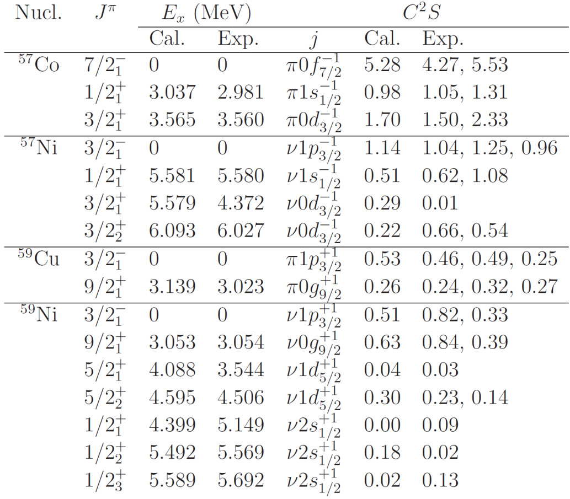
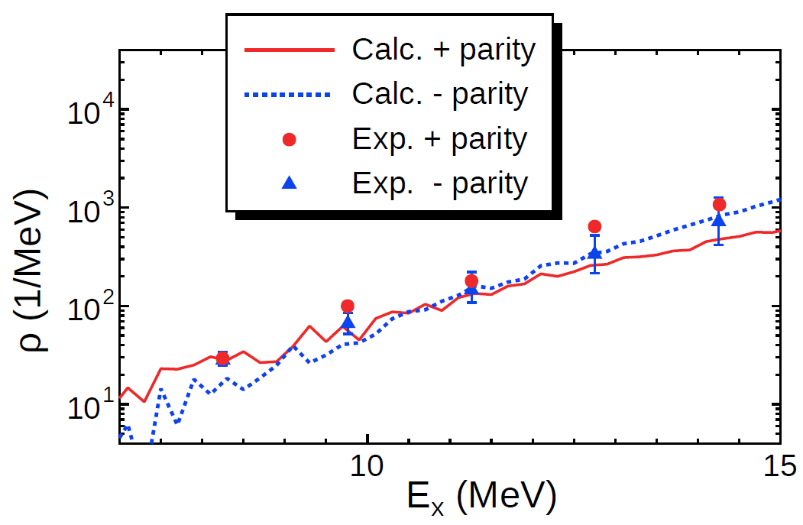
Results of the shell-model calculation
Very large-scale shell-model calculation
  M-scheme dimension = 1.5×10¹⁰
Spectroscopic strengths
2⁺ and 2⁻ level densities in ⁵⁸Ni
-1p
-1n
+1p
+1n
Early onset of parity equilibration
is well reproduced.

Slide 20
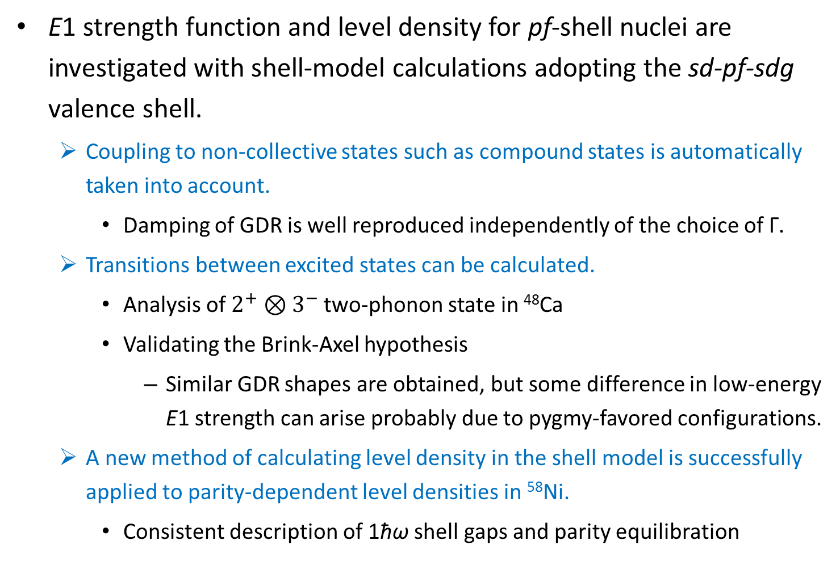
Summary
E1 strength function and level density for pf-shell nuclei are investigated with shell-model calculations adopting the sd-pf-sdg valence shell.
  Coupling to non-collective states such as compound states is automatically taken into account.
    Damping of GDR is well reproduced independently of the choice of Γ.
  Transitions between excited states can be calculated.
    Analysis of $2^{+}⊗3^{−}$two-phonon state in ⁴⁸Ca
    Validating the Brink-Axel hypothesis
      Similar GDR shapes are obtained, but some difference in low-energy E1 strength can arise probably due to pygmy-favored configurations.
  A new method of calculating level density in the shell model is successfully applied to parity-dependent level densities in ⁵⁸Ni.
    Consistent description of 1ħω shell gaps and parity equilibration

