Slide 1
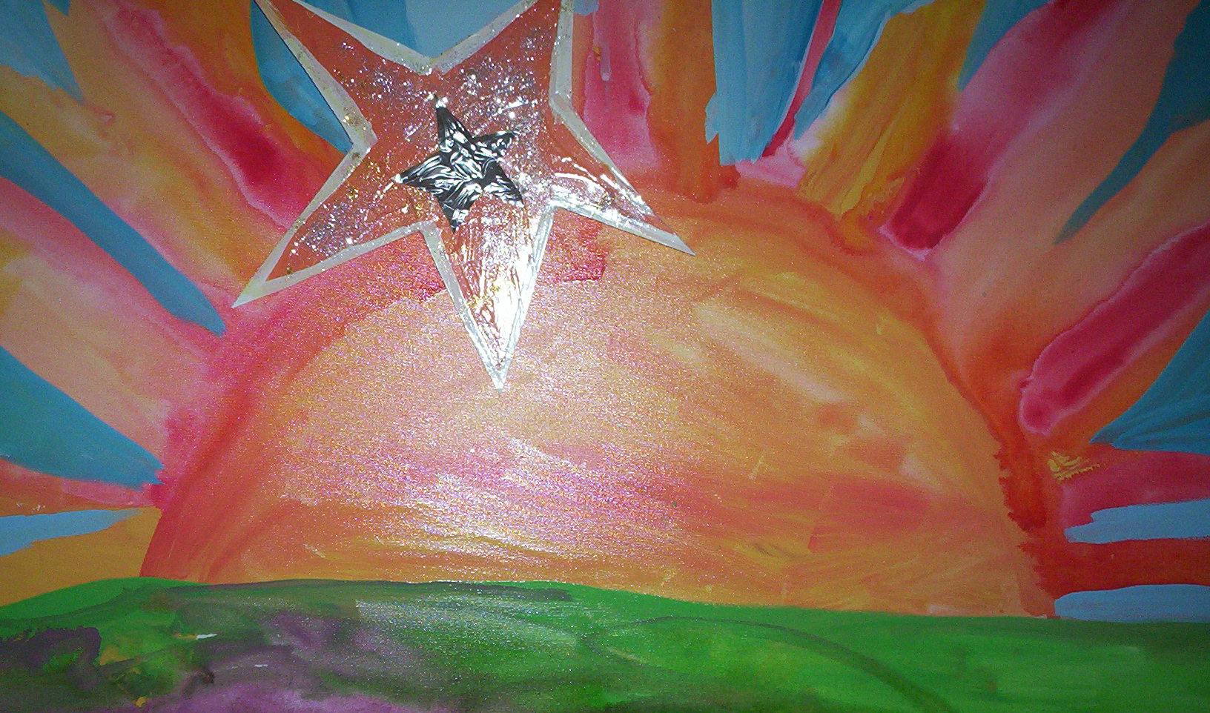


High Resolution Spectroscopy in Nuclear Astrophysics
Joachim Görres
University of Notre Dame & JINA

Slide 2
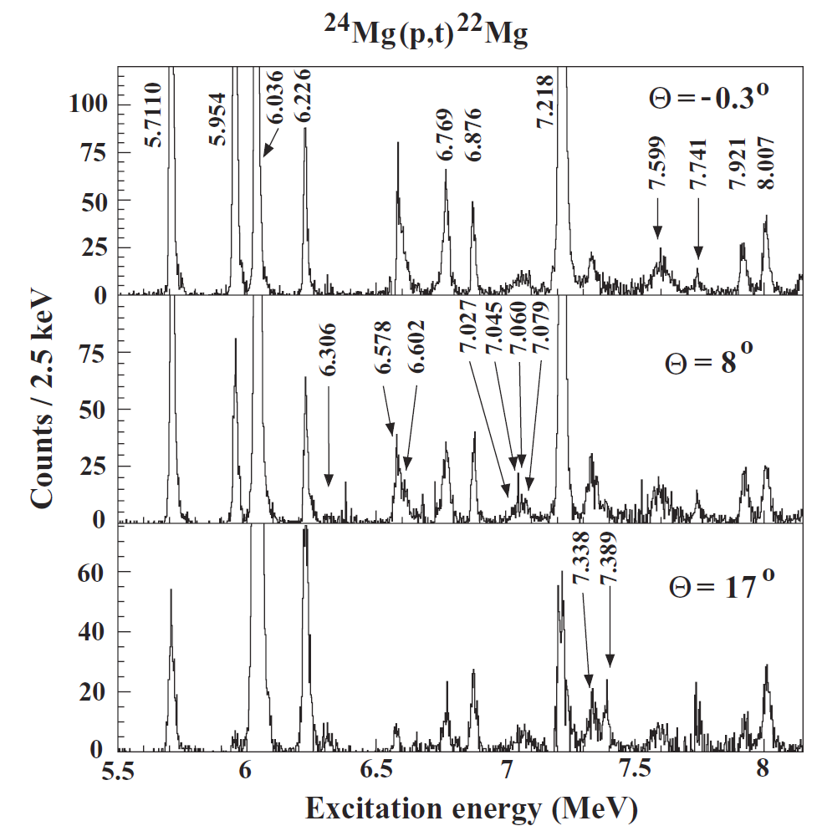
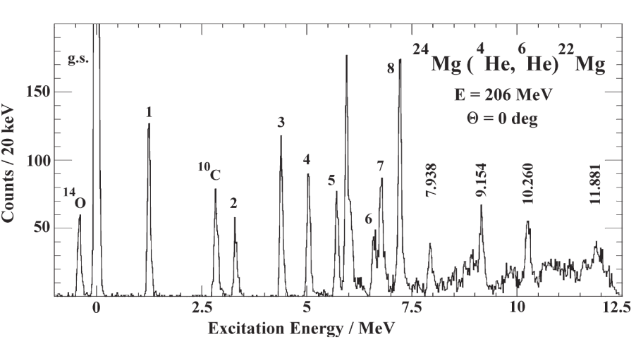
Nuclear Astrophysics Studies at RCNP
Osaka – Notre Dame – Groningen
Started in 2002 (Georg @ RCNP) with a series of (p,t) reactions
explosive H burning in X-ray bursts in the αp-process
indirect study of (α,p) reactions on the “waiting points” ¹⁸Ne, ²²Mg, and ²⁶Si
75 keV energy resolution 13 keV

Slide 3
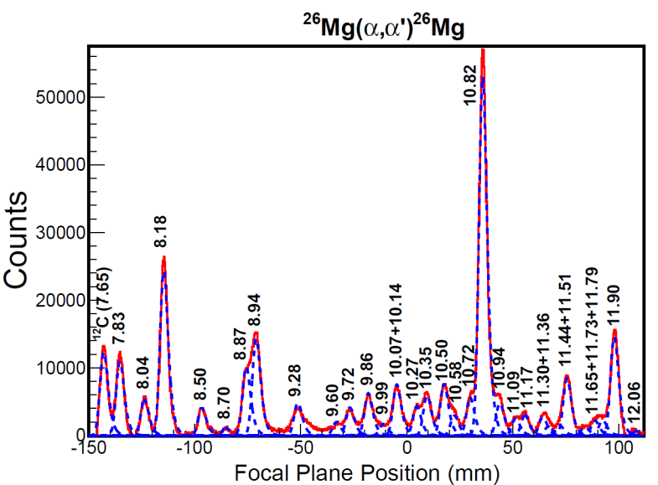
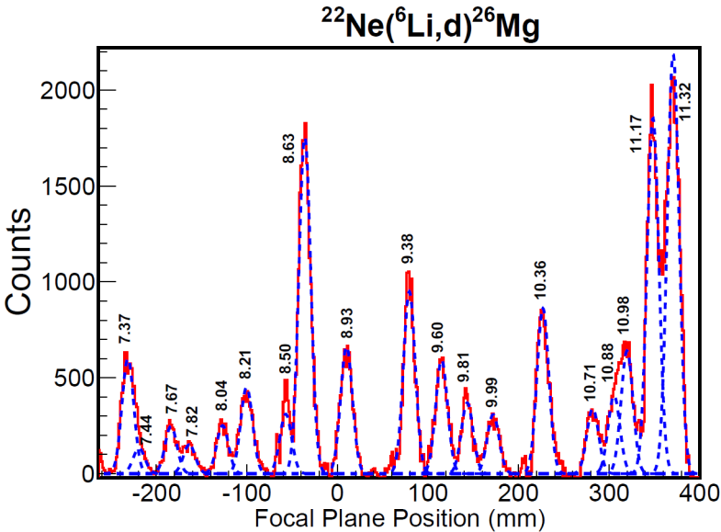
Since 2009:
focus on the ²²Ne neutron source for the s-process
indirect study of ²²Ne(α,n) (s-process): (α,α’), (⁶Li,d) and ²⁵Mg(d,p)
Program very successful
2 Master Theses (RCNP)
so far 3 PhD Theses!
2 more coming up
Collaborators
Osaka
Y. Fujita
K. Hatanaka
A. Tamii
H. Fujita
T. Adachi
Y. Shimbara
K. Miki
Groningen
A. Matic
A. van der Berg
M.N. Harakeh
A. Matic (IBA Particle Therapy) S. O’Brien (US Federal Gov.) R. Talwi (ANL)

Slide 4
Neutron sources for the s-process
Main Component A>100
Weak Component A< 100
low mass AGB stars
T= 0.1 GK
N_{n} ~ 10⁷ /cm⁻³
s-process at kT=8 keV
Time scale:
a few 10,000 years
¹³C(α,n) & ²²Ne(α,n)
core He burning in massive stars
T=0.3 GK
N_{n} ~ 10⁶ /cm⁻³
s-process at kT=25 KeV
Time scale:
Last few 10,000 years
²²Ne(α,n)
Shell C burning in massive stars
T=1 GK
N_{n} ~ up to 10¹² /cm⁻³
s-process at kT=90 KeV
Time scale: 1 year
(not the “typical” s-process)
²²Ne(α,n)

Slide 5
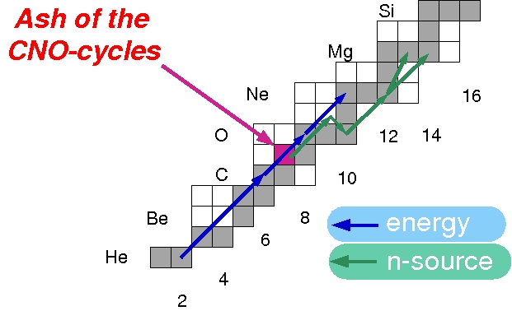
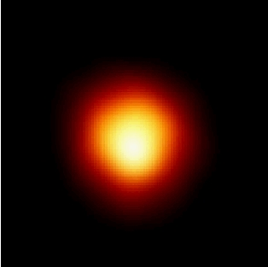
Core Helium Burning
weak component
of s-Process
A<100
Hubble Space Telescope
Betelgeuse

Slide 6
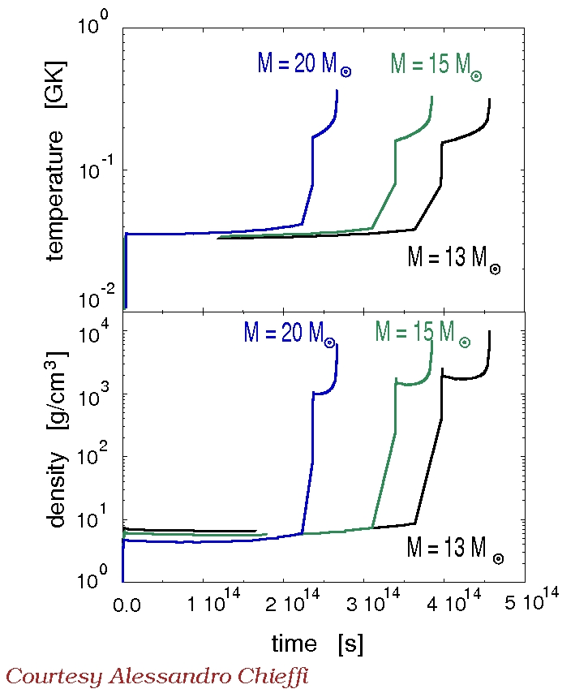
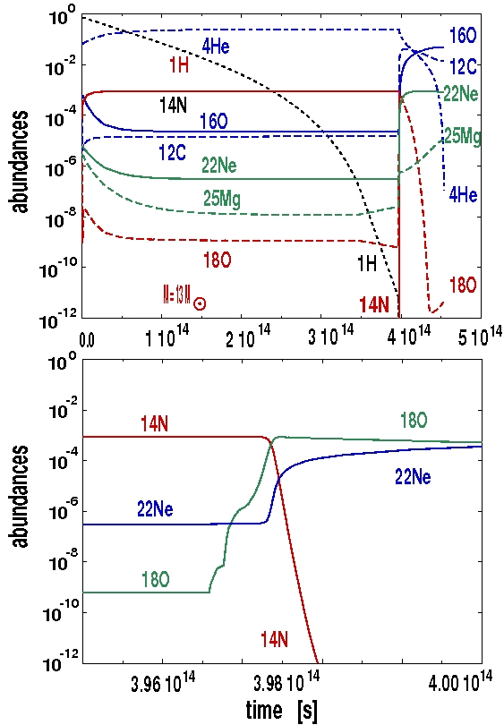
Simple “1-Zone” Model
12.6 million years

Slide 7
Shell Carbon Burning
burns on the ashes of He-Burning
¹²C,¹⁶O,^{20,22}Ne and ^{25,26}Mg
²⁰Ne+α
!
¹²C+¹²C
main energy source: ¹²C+¹²C
²³Na+p
p/α-ratio
main neutron source: ²²Ne(α,n)
well known at 1GK
residual from He burning
→how much is left at end of He burning?
Small production branch:
²⁰Ne(p,γ)²¹Na(β⁺)²¹Ne(p,γ)²²Na(β⁺)
²²Ne poison: ²²Ne(p,γ)
possible neutron source at end
of burning: ^{25,26}Mg(α,n)
Most abundant isotopes at end of burning:
¹⁶O, ²⁰Ne, ²³Na and ²⁴Mg

Slide 8
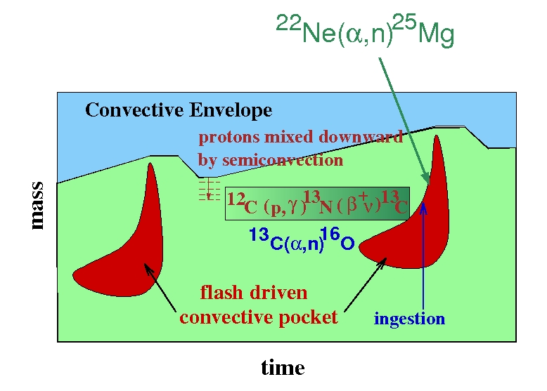
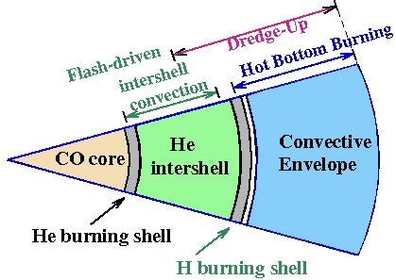
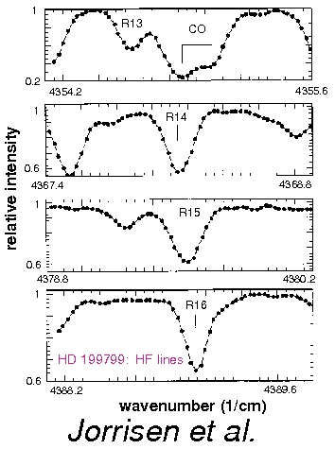
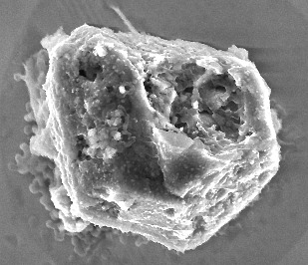
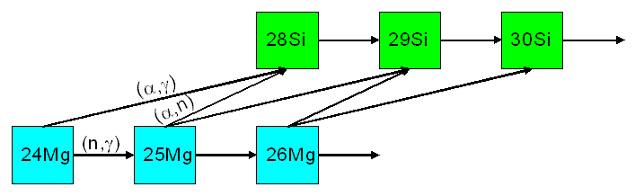
s-Process (Main Component A>100)
TP-AGB Stars
Large Mass Loss
Chemical Evolution
meteorite
inclusions
Fluorine Lines Observed
On Surface of AGB Star
^{29,30}Si isotope
ratios

Slide 9
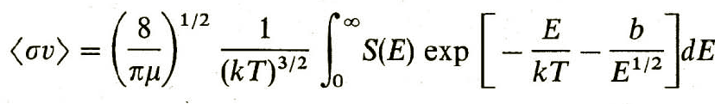
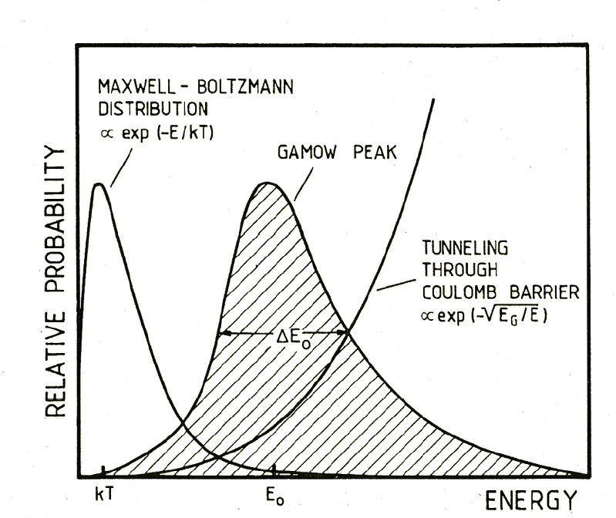
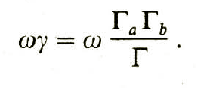
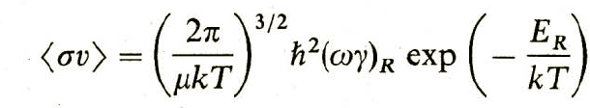
Reaction Rates
non-resonant reaction
resonant reaction
S(E) ≈ constant
S(E) ≈ Breit-Wigner
Resonance Strength:
!
Γ_{p}(E<<E_{C}) ~ exp(-k∙E_{R}^{-1/2})
!
Gamow Peak

Slide 10
Indirect approach
Γ_{α}∙ Γ_{n}
ω ——————
Γ_{α}+Γ_{γ}+Γ_{n}
ωγ =
≈ ω Γ_{α} = ω S_{α} Γ_{α}^{sp}
assuming Γ_{α},Γ_{γ/n} << Γ_{n/γ}
need to know:
Spin and parity (natural J^{π}? ω)
excitation energy (see above)
Γ_{α} or S_{α} from transfer reaction
Γ_{n}/Γ_{γ} if both channels are open
S_{α} and Γ_{α}^{sp} are model dependent
if Γ_{α} is known, only relative value
are needed! (see example later on)

Slide 11
²²Ne(α,n) neutron source
competition between (α,n) & (α,γ)
reaction channels
NO (α,γ) below 832 keV resonance !!
Q(α,n) = -0.48 MeV
630 keV J^{π}=1⁻
resonance ??
Jaeger et al.,
PRL 87, 202501 (2001)
present upper limit: < 60 neV

Slide 12
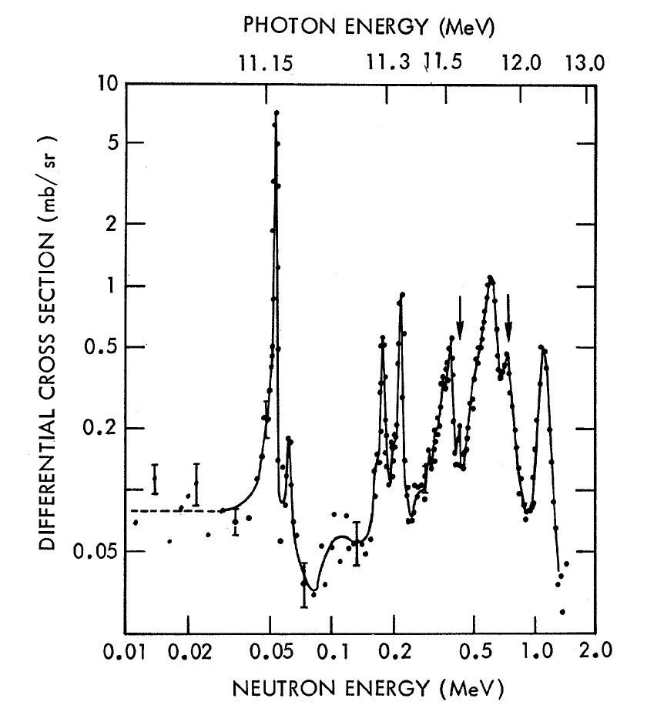
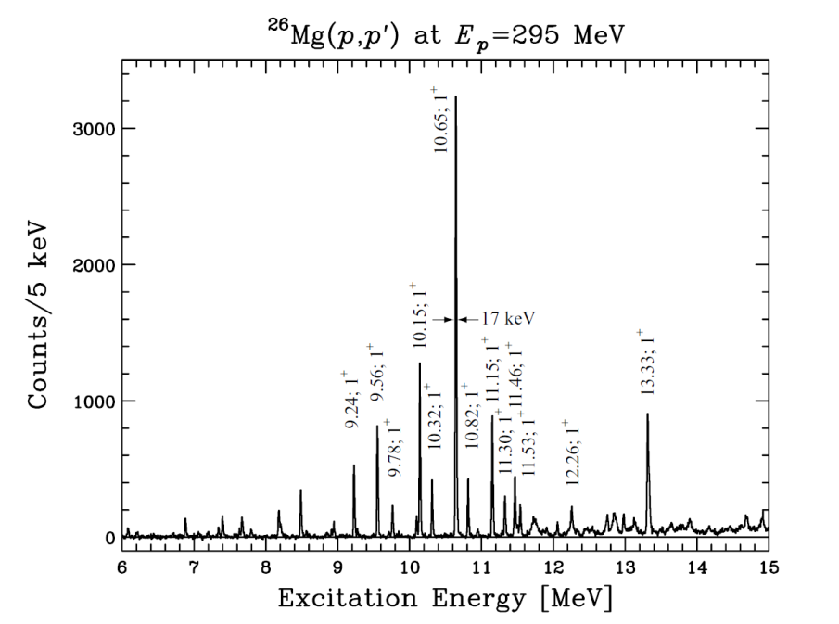
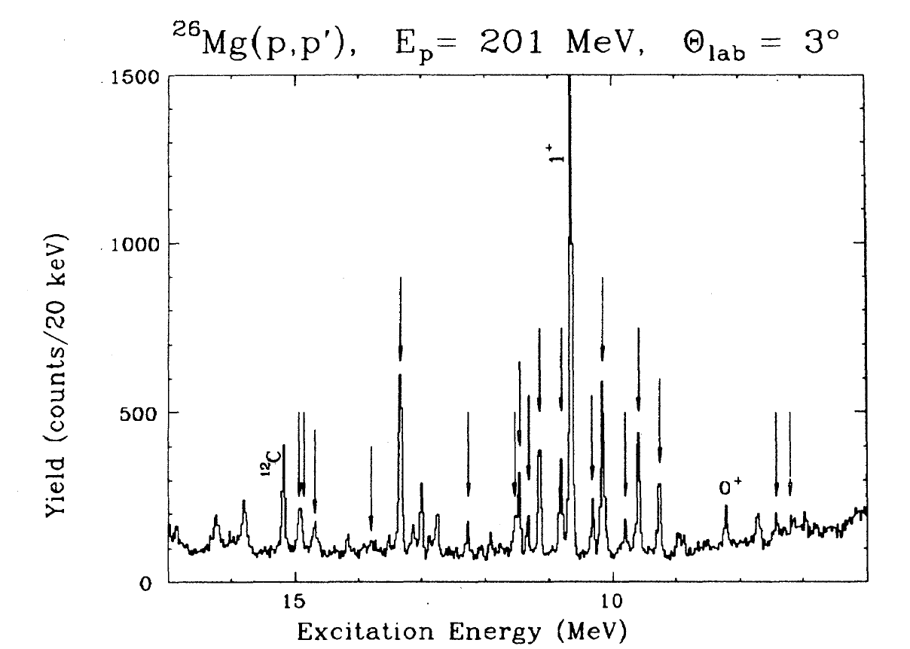
1⁻?
2009
1989
1⁺
1⁺
60 keV
²⁶Mg(γ,n) 1969
Shown by Yoshi at a seminar
on the occasion of his visit to
Notre Dame !!
(γ,γ’) 2009
Surprisingly enough:
Latest compilation (NNDC 1998) still
shows state without spin assignment
1⁺

Slide 13
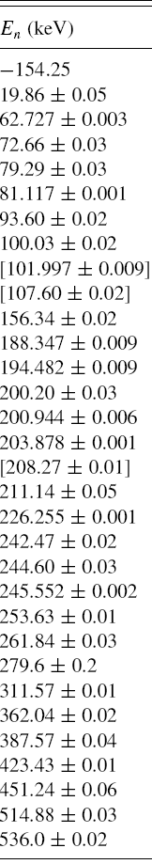
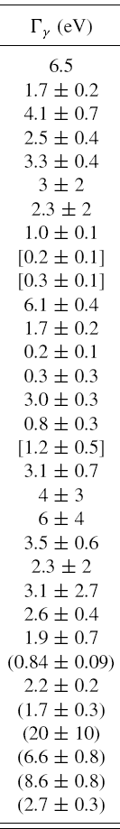
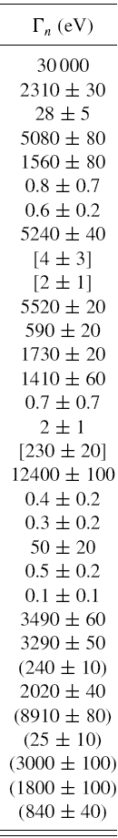
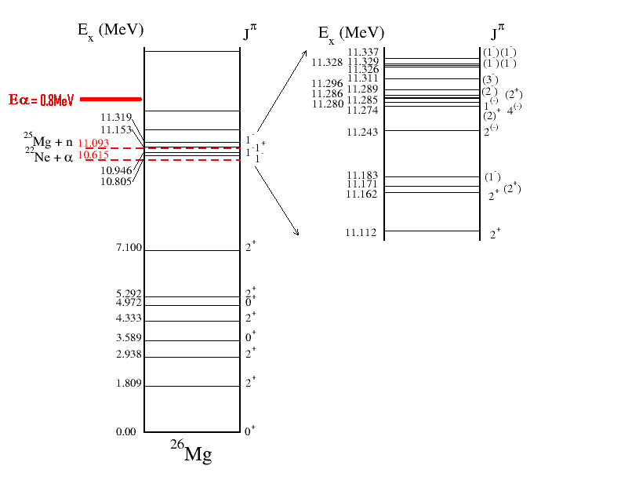
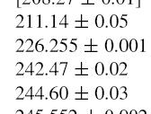
²⁵Mg+n: new n-tof data
20 keV average spacing of states
Γ_{n}/Γ_{γ} :
from 1000
to
1/10
10.998
10.978
10.927
10.945
10.915
10.893
10.881
10.824
1⁺- 4⁺
10.806
10.746
10.767
10.719
10.726
10.693
10.707
10.650
10.682
4⁻ - 7⁻
10.646
1⁺
Below n-threshold:
no widths and nearly
no spins are known
234±2 keV = last known resonance at 831 keV
Massimi et al 2012

Slide 14
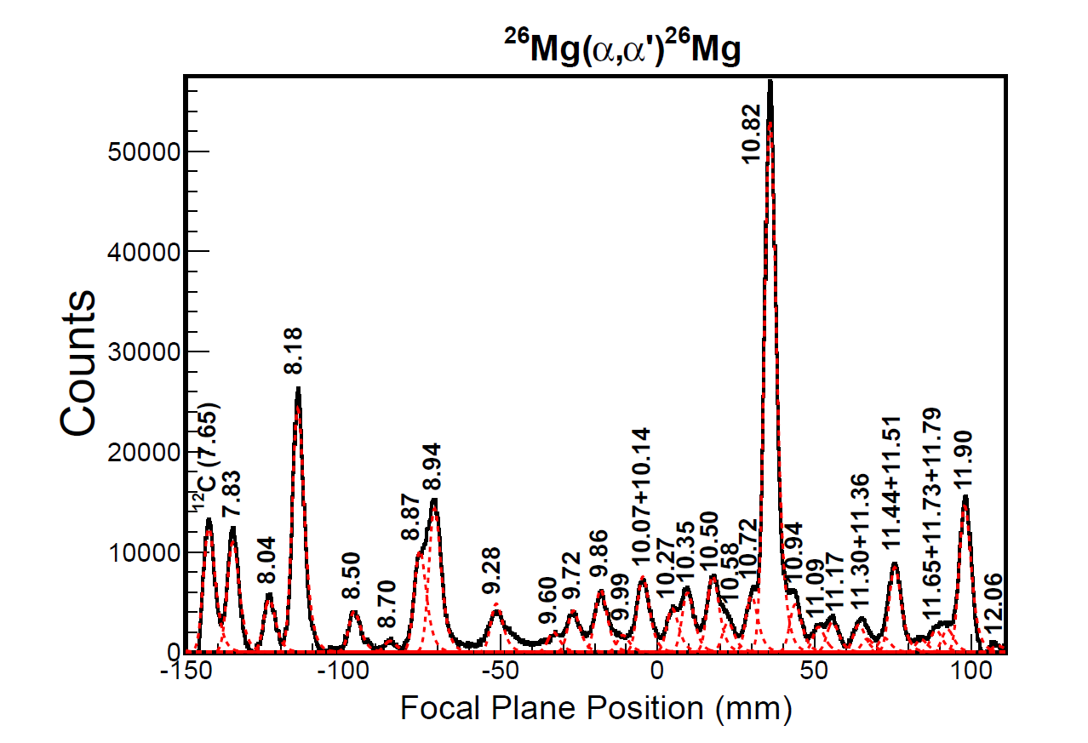
First step: ²⁶Mg(α,α’) @ 206 MeV
Going to 206 MeV to learn
about 206 keV
(α,α’) populates
preferentially
natural parity states
18 out of known 92 states
α- unbound
n-unbound
no unnatural parity
state observed
below α-threshold

Slide 15
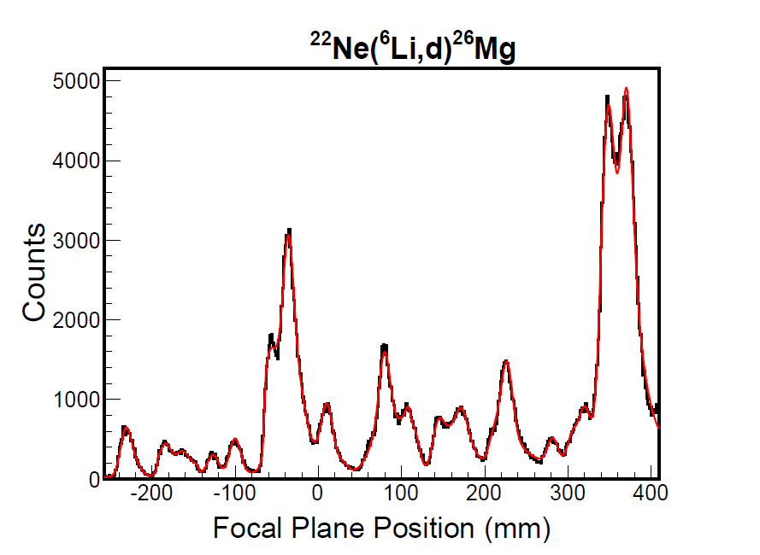
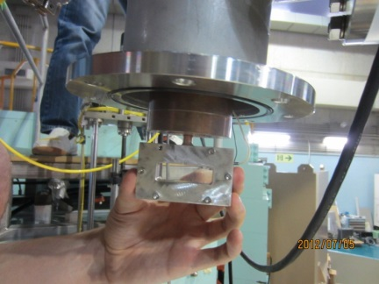
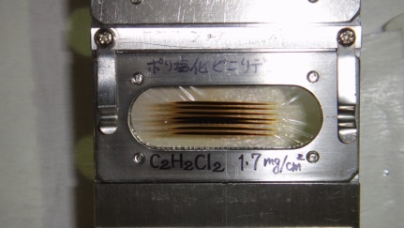
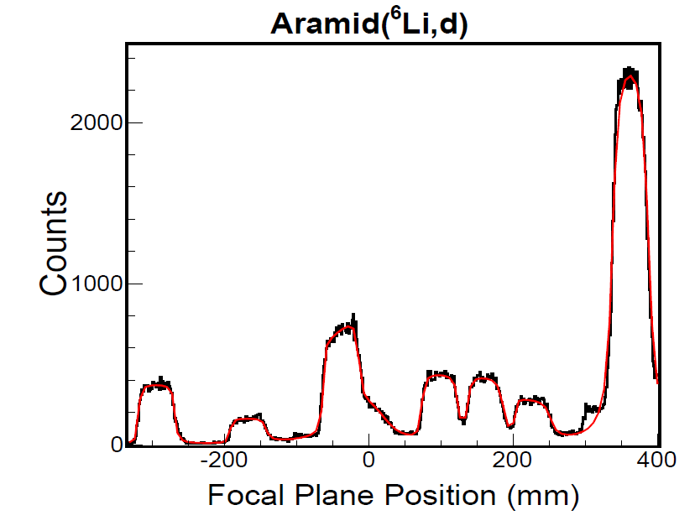
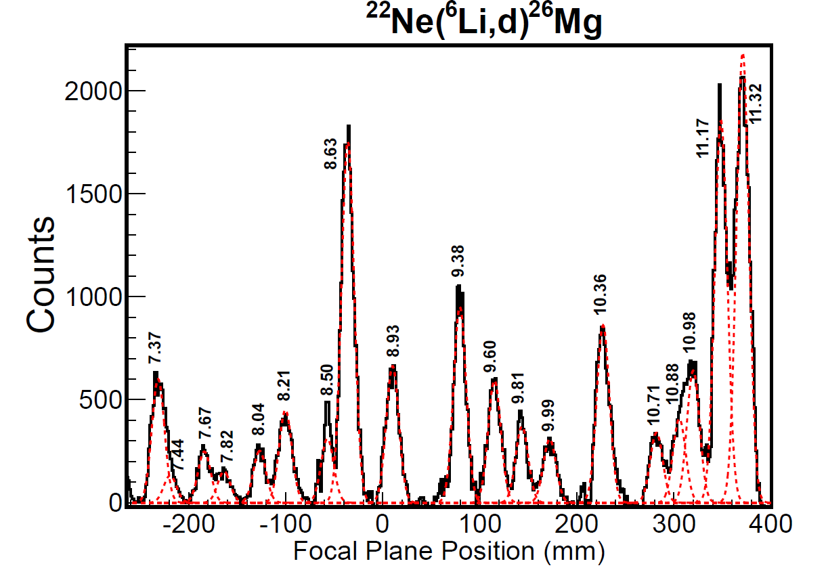
Second step: ²²Ne(⁶Li,d) @ 80 MeV
n-unbound
α- unbound

Slide 16
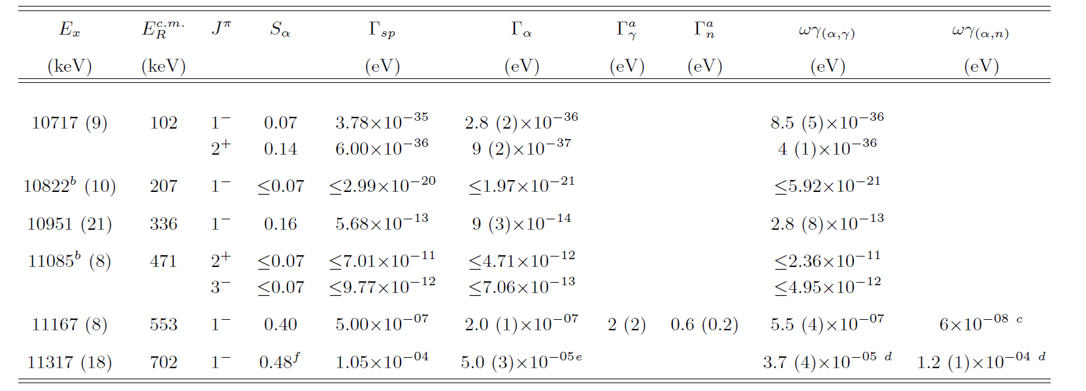
Result:
n-threshold
lowest known
resonance
calculated
from Γ_{α}
calculated
from ωγ
experimental
resonance strengths

Slide 17
Result:
from n-tof
experiment
n-threshold
upper limit
from Jaeger
ωγ_{αγ}= 0.5 μeV !
within experimental reach

Slide 18
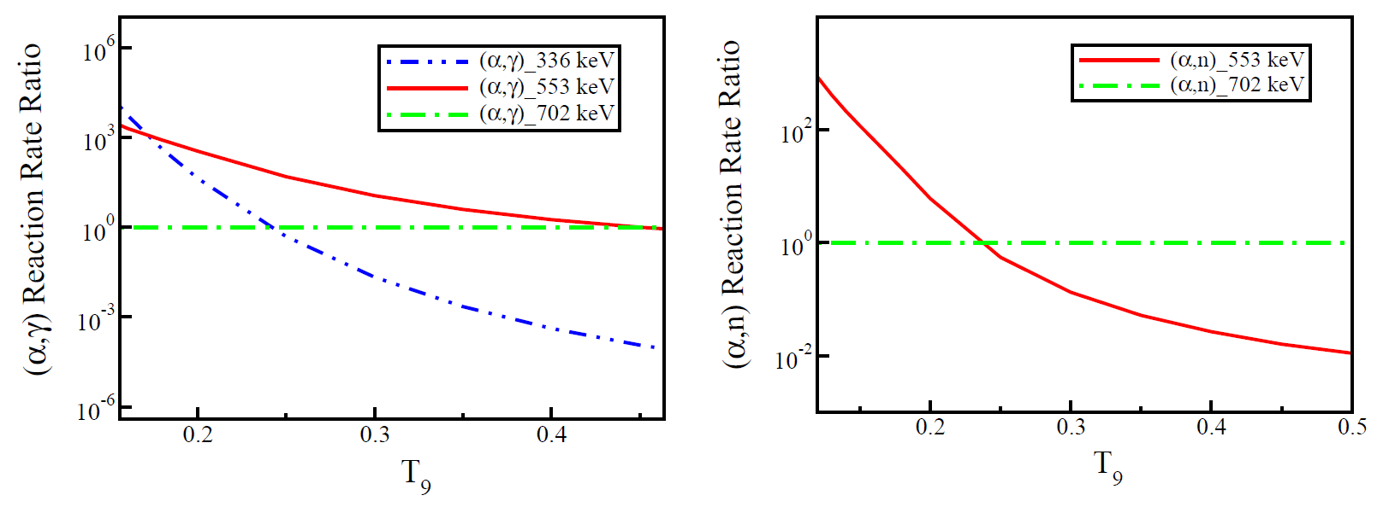
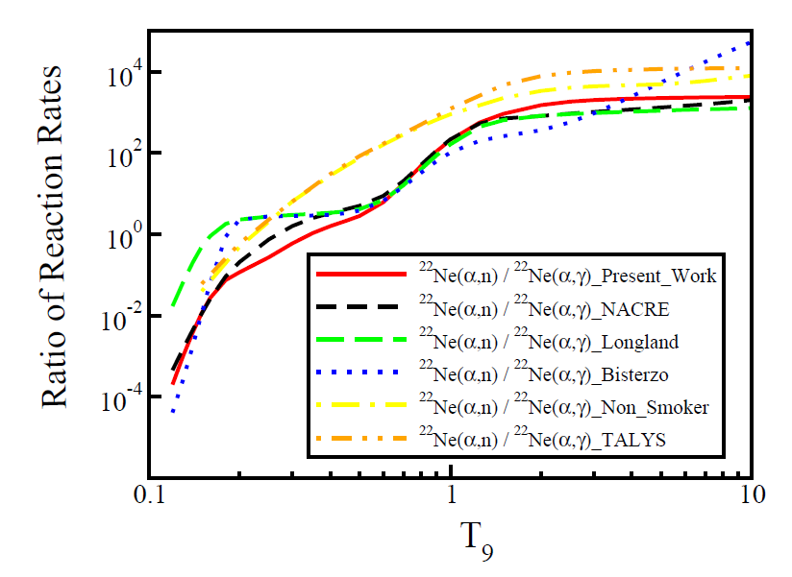
Reaction Rates:
ABG
temperature
²²Ne(α,γ)
²²Ne(α,n)
(α,n)/(α,γ)
General Impact:
reduction of s-process synthesis
but
significant uncertainties remain

Slide 19
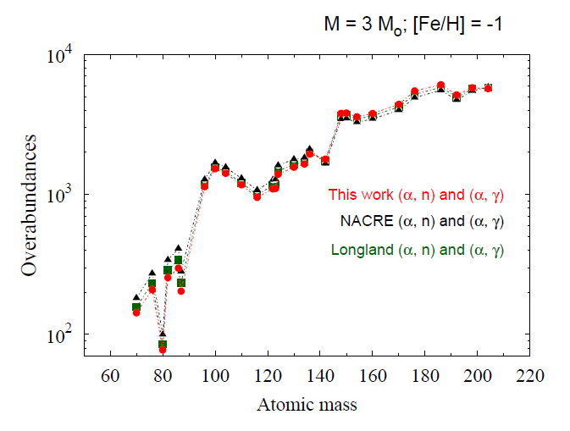
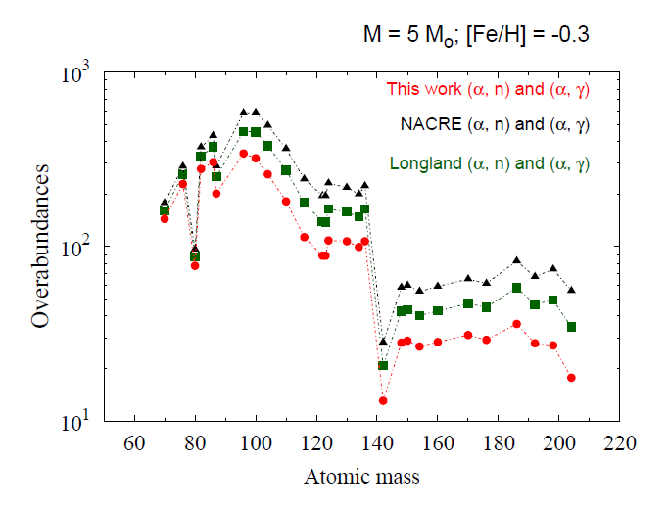
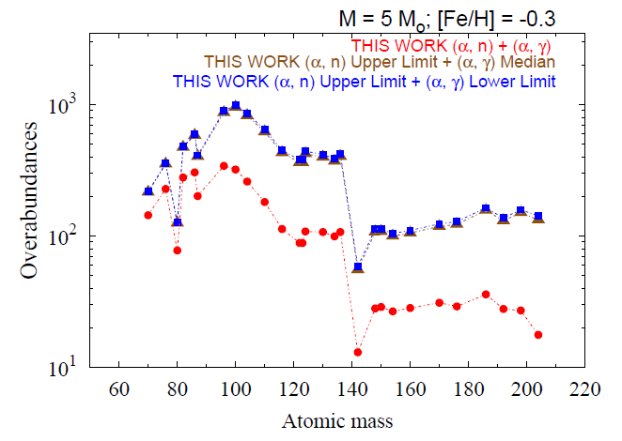
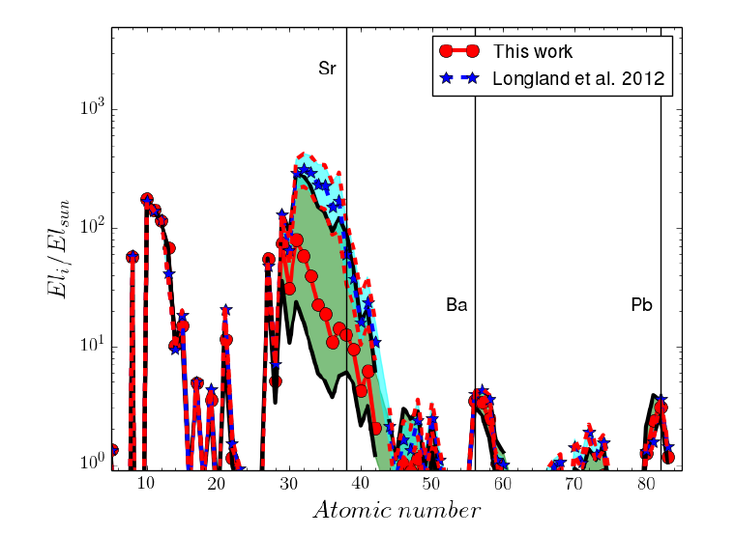
ABG Nucleosynthesis:
Massive Stars
(25 solar mass)
Thanks to:
S. Bisterzo
M. Pignatari

Slide 20
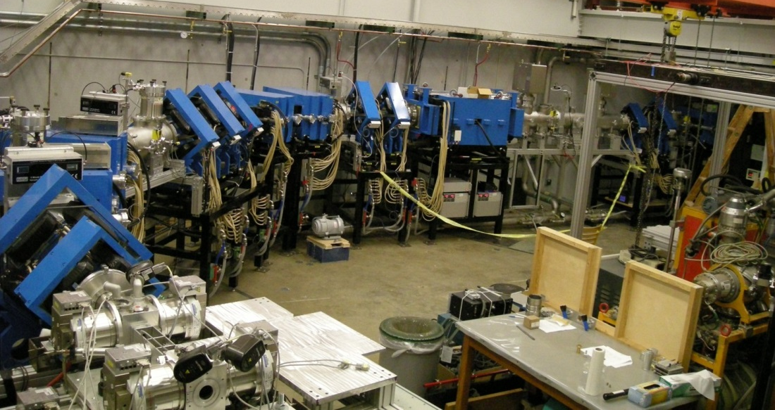
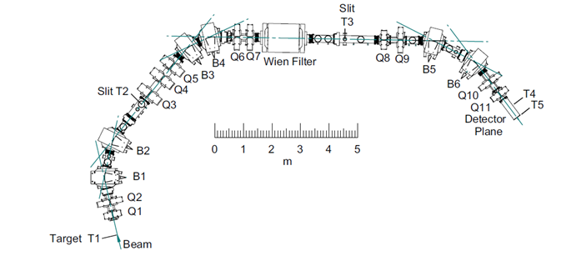
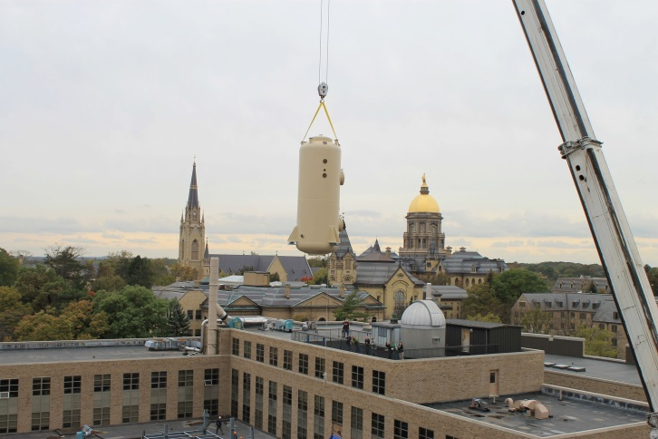
Low Energy Alpha Capture Experiments @ Notre Dame
St. George Recoil Separator
ECR in
terminal
experiments are time consuming
single ended
5 MV vertical
accelerator
knowledge from indirect
search are very helpful

Slide 21
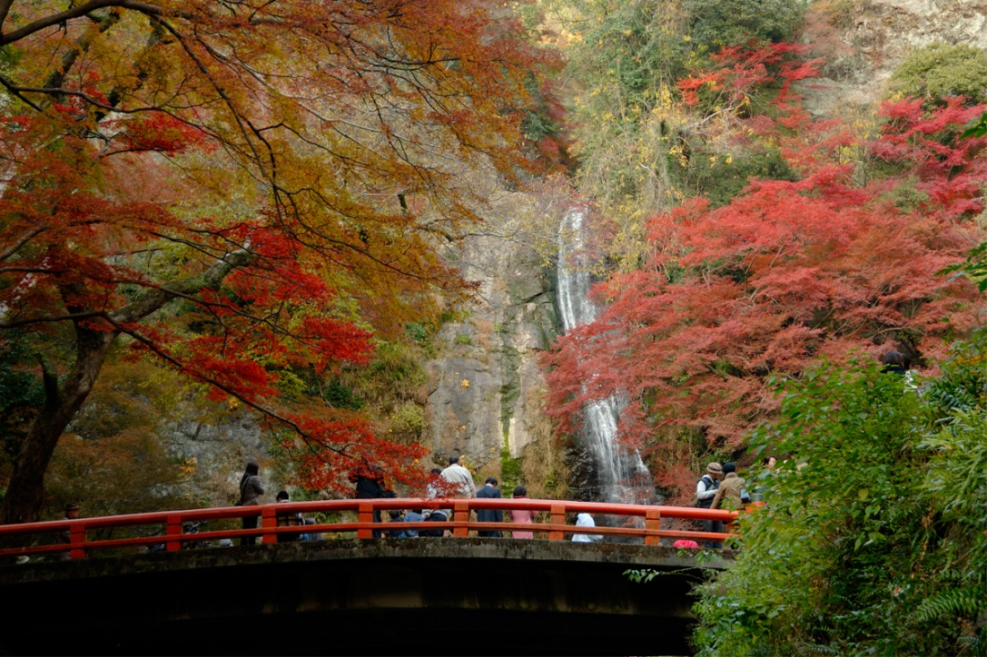
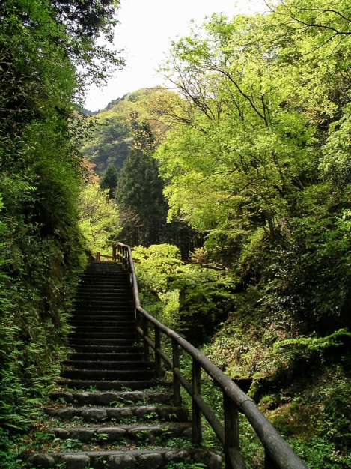
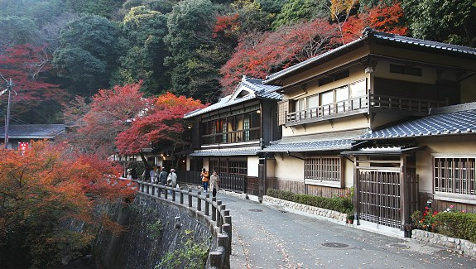
A Trip with Yoshi To Minoh Waterfall
Yoshi’s
“small” walk
The “easy” way
from Minoh station

Slide 22
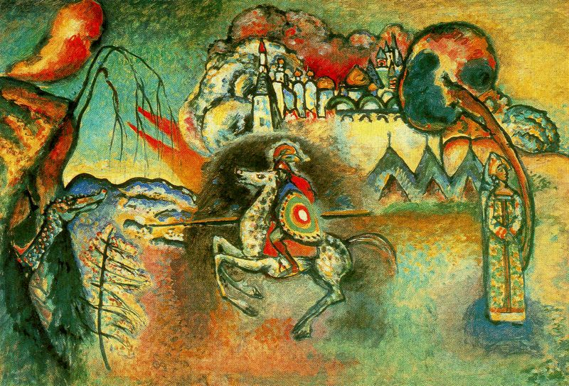

Slide 23
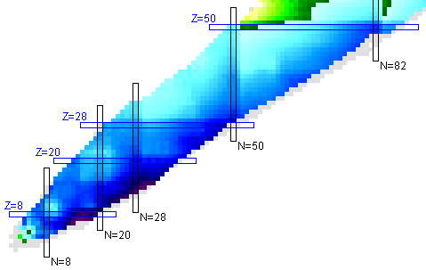
13C(a,n) 6.36 6
17O(a,n) 7.35 27
22Ne(a,n) 10.61 55 *
25Mg(a,n) 11.31 ?
26Mg(a,n) 10.64 30
 | 1.41E+4 |  | -4.61E+3
 | 1.22E+4 |  | -6.49E+3
 | 1.03E+4 |  | -8.37E+3
 | 8.52E+3 |  | -1.02E+4
 | 6.64E+3 |  | -1.21E+4
 | 4.76E+3 |  | -1.40E+4
 | 2.89E+3 |  | -1.58E+4
 | 1.01E+3 |  | -1.77E+4
 | -8.64E+2 |  | -1.96E+4
 | -2.74E+3 |  | -2.15E+4
 | -4.61E+3 |  | -2.33E+4

