Slide 1
Fine structure of giant resonances in Calcium isotopes
Iyabo Usman
University of the Witwatersrand
On behalf of
iThemba/Wits/UCT/RCNP/IKP-TU-Darmstadt K600 Group
*Project Funded By
South African National Research Foundation (Grant No: 85730)
German DFG under contracts SFB 634, NE 679/2-2
HST15 RCNP Osaka University 16 – 19 November 2015

Slide 2
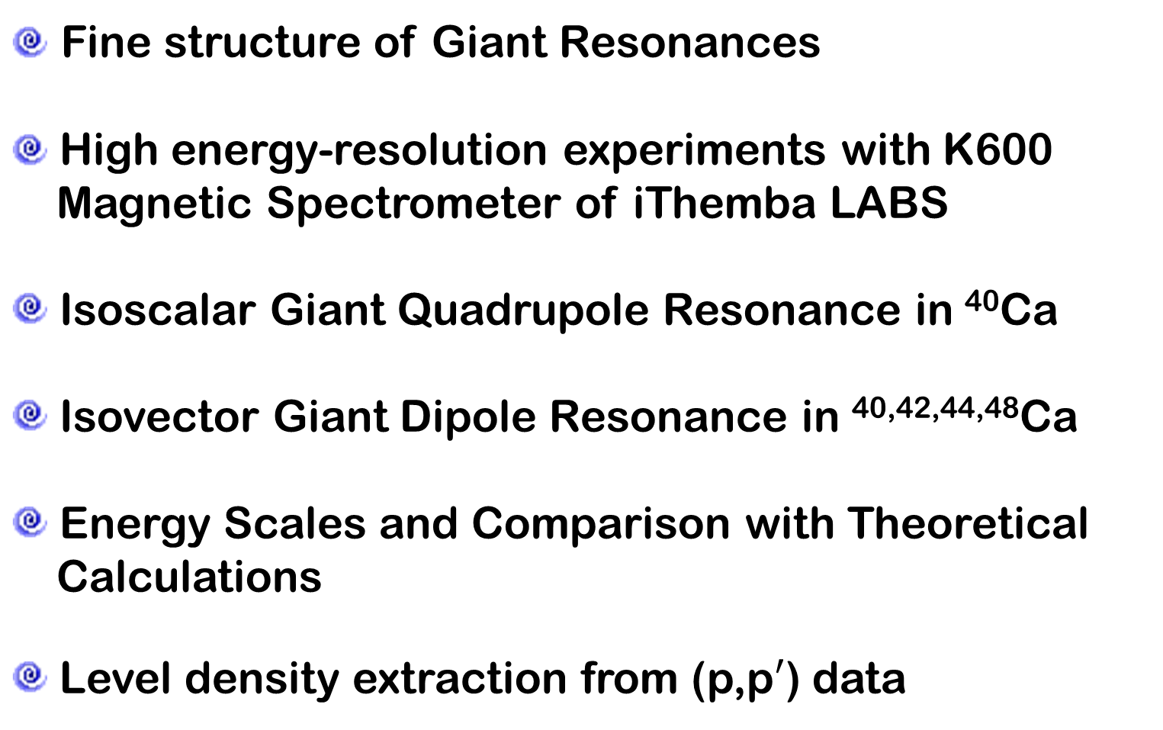
Outline
Fine structure of Giant Resonances
High energy-resolution experiments with K600
Magnetic Spectrometer of iThemba LABS
Isoscalar Giant Quadrupole Resonance in ⁴⁰Ca
Isovector Giant Dipole Resonance in ^{40,42,44,48}Ca
Energy Scales and Comparison with Theoretical
Calculations
Level density extraction from (p,p$′$) data

Slide 3
Fine Structure of Giant Resonances
Have been established as a Global phenomenon in
- nuclei across the periodic table
- other resonances
Dominant processes of the decay?
Spin- and parity-resolved level densities at energies above thresholds?
Notes:
Global phenomenon have been established in nuclei across the periodic table as well as other resonances. However, dominant damping mechanisms as well as spin and parity resolved level densities are yet to be elucidated

Slide 4
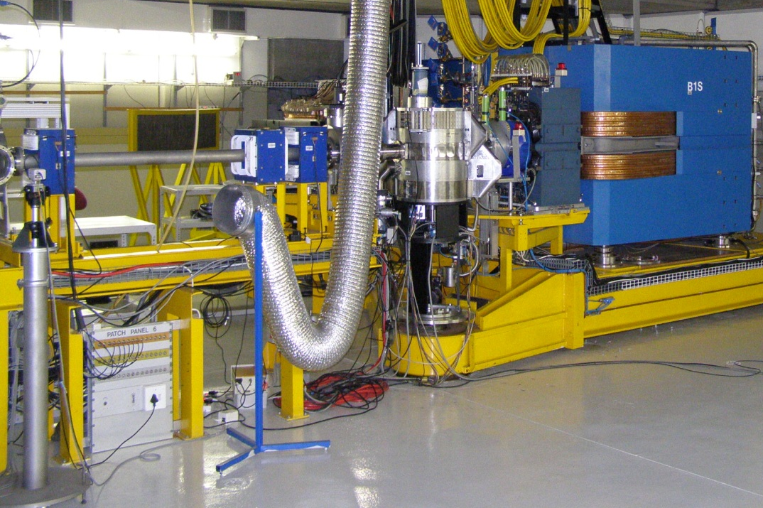
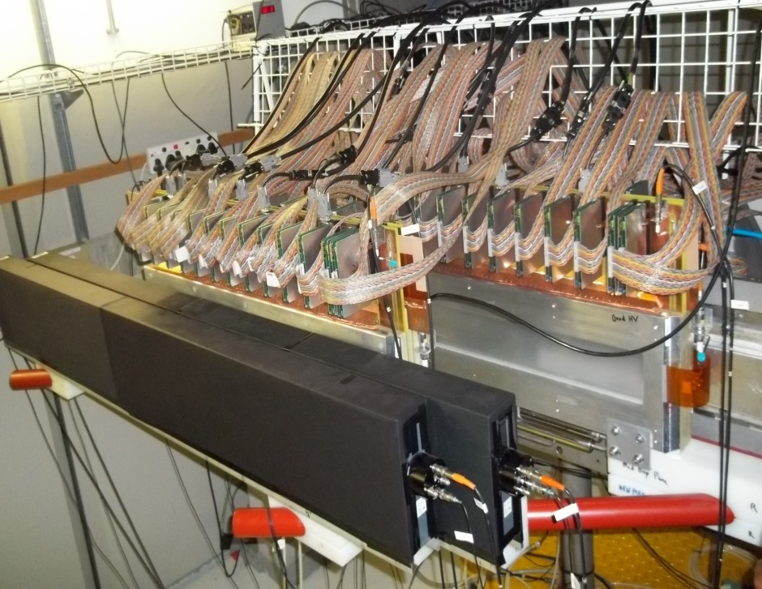
K600 Magnetic Spectrometer
Dipole magnet 1
drift-chambers
Scattering chamber
Scintillator paddles1 and 2
Best resolution = 25 keV @
200 MeV on Au target
Best resolution = 9 keV @
66 MeV on Pb target
Largest angle so far = 87º
Smallest angle = 21º with external beamstop
Smallest angle = 7º with internal beamstop
2 VDC: high accuracy horizontal
position determination in focal plane
1 HDC: high accuracy vertical position determination
2 plastic scintillators (BC-408) acting
as trigger detectors for particle
identification

Slide 5
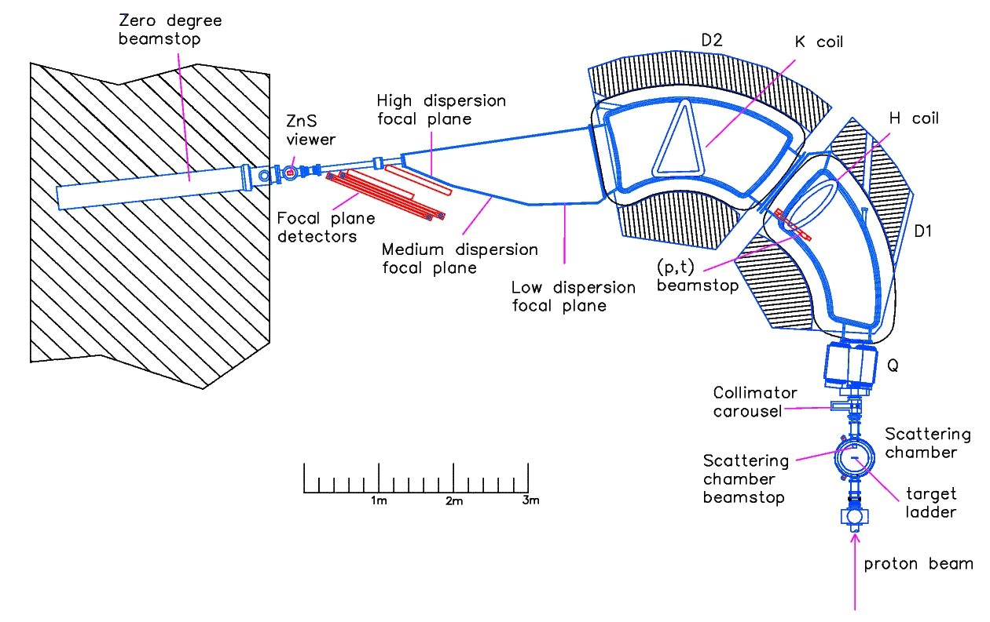
K600 magnetic spectrometer at 0º
Contact person: neveling@tlabs.ac.za
Notes:
Ion-optics values is included mainly for completeness

Slide 6
Fine structure of ISGQR in ⁴⁰Ca
∆E = 35 - 40 keV
(FWHM)
Fine structures in the region of the ISGQR are clearly visible.
Excitation energy spectra in ⁴⁰Ca at angles below, at and above the maximum of the ISGQR.

Slide 7
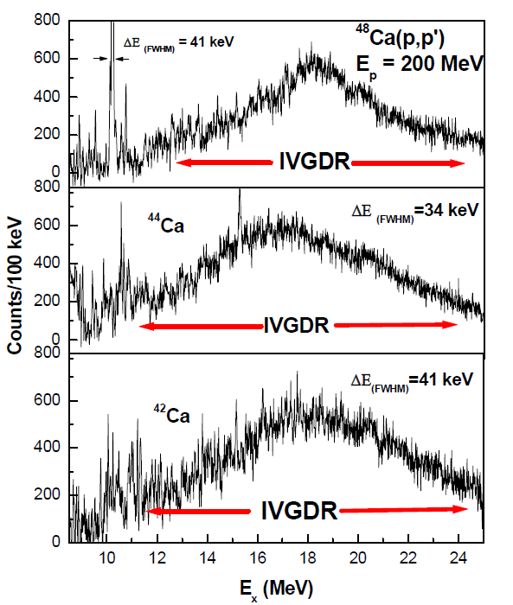
Fine structure of the IVGDR in ^{42,44,48}Ca
M. Latif, PhD Thesis
(in preparation)
University of the Witwatersrand
∆E = 34 - 41 keV (FWHM)
Excitation energy spectra in ^{42,44,48}Ca at zero-degree

Slide 8
Wavelet Analysis
Wavelet coefficients
position
scale
spectrum
wavelet
Morlet:
Complex Morlet:
Complex Lorentzian:

Slide 9
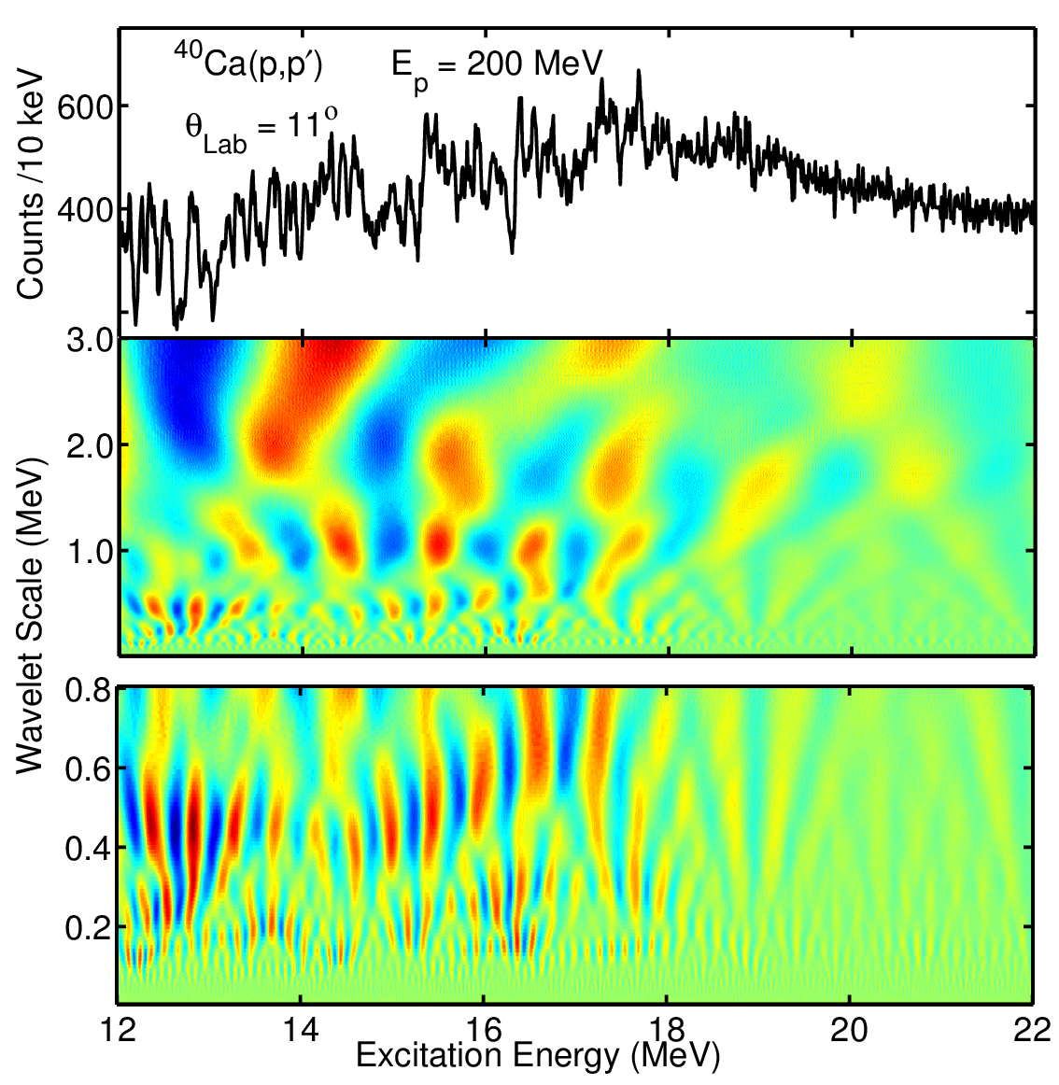
Characteristic Energy Scales
⁴⁰Ca ISGQR
ISGQR is not mainly concentrated in a well-defined peak in light nuclei but completely fragmented e.g. ⁴⁰Ca, ²⁸Si & ¹²C
Wavelet Coefficients
Pronounced fine structure is observed up to

Slide 10
Comparison with Theoretical Calculations
To understand the origin and physical nature of different scales, comparison of experimental results with model calculations is important.
Theoretical models for ISGQR and IVGDR in ^{40,42,44,48}Ca
- Random Phase Approximation (RPA)
- Second-RPA (SRPA)
- (R-QRPA)
- Relativistic Quasiparticle Time Blocking Approximation (RQTBA)

Slide 11
Comparison with Theoretical Calculations
RPA and SRPA in ⁴⁰Ca ISGQR
Experimental Scales
(150, 240, 460) keV;
(1.05, 2.0, 3.9) MeV;
Observed fragmentation is
attributed to mixing of the
1p–1h states with more complex configurations, including collective phonons
RPA only accounts for
Landau damping
I. Usman, Z. Buthelezi, J. Carter, G. R. J. Cooper, R. W. Fearick, S. V. Fortsch, H. Fujita, Y. Fujita, Y. Kalmykov, P. von Neuman-Cosel, R. Neveling, P. Papakonstantinou, A. Richter, R. Roth, A. Shevchenko, E. Sideras-Haddad, F.D. Smit, Physics Letters B 698 (2011) 191-195.

Slide 12
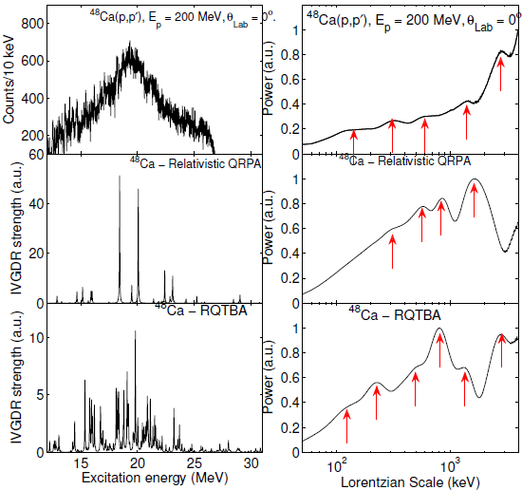
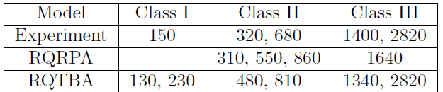
Comparison with Theoretical Calculations
QRPA and RQTBA ⁴⁸Ca IVGDR
M. Latif, PhD Thesis
(in preparation)
University of the Witwatersrand
E. Litvinova, P. Ring and V. Tselyaev, Phys. Rev. C 78 (2008) 014312.
E. Litvinova, Phys. Rev. C 91 (2015) 034332.

Slide 13
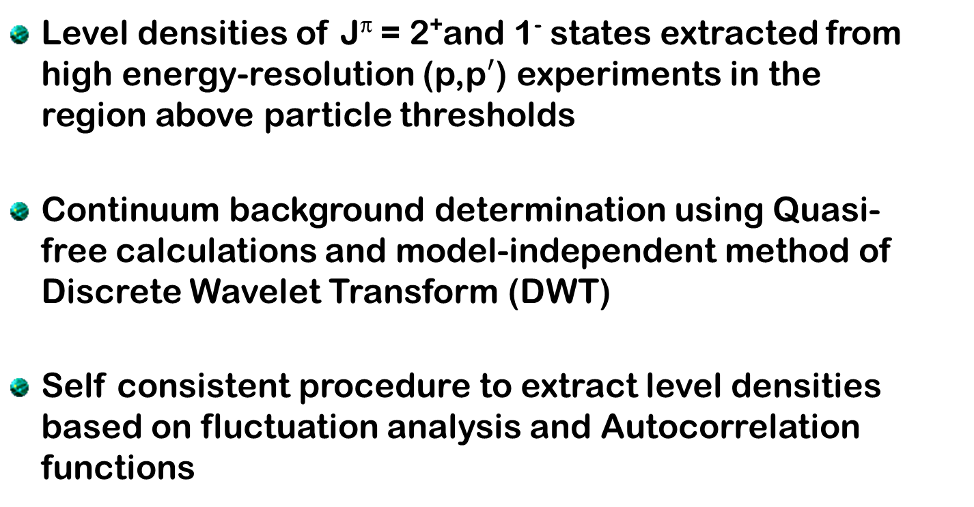
Extraction of spin- and parity-dependent
Level densities
Level densities of J^{π} = 2⁺and 1⁻ states extracted from high energy-resolution (p,p$′$) experiments in the region above particle thresholds
Continuum background determination using Quasi-free calculations and model-independent method of Discrete Wavelet Transform (DWT)
Self consistent procedure to extract level densities based on fluctuation analysis and Autocorrelation functions

Slide 14
Fluctuation Analysis
Measure of cross section fluctuations with respect to a
stationary mean value.
Assumptions:
Procedure:
Background subtraction from the experimental spectrum
Smoothing by convolution with a Gaussian function of width larger than ∆E
Folding with a Gaussian function with a width smaller than ∆E
Create a stationary spectrum
Mean level width
Mean level spacing
Energy resolution
Sum of normalised variances

Slide 15
Autocorrelation Function
Mean level spacing
proportional to the variance of
Intensity fluctuations in can be autocorrelated at energies E and E + ε
can be extracted from
ε = energy increment
C(ε) = Autocorrelation function

Slide 16
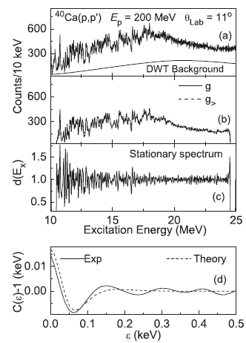
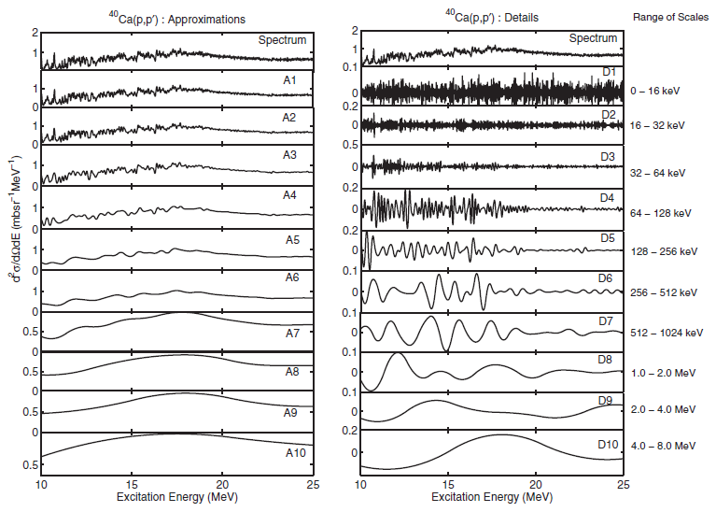
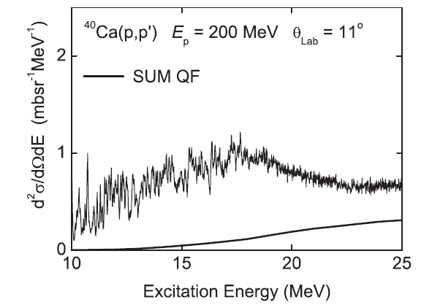
Level density: Background Subtraction and Autocorrelation Function
DWT Background subtraction
Fluctuation Analysis
Autocorrelation
Quasi-free Background subtraction
Limited contribution from quasi-free in
the ISGQR region

Slide 17
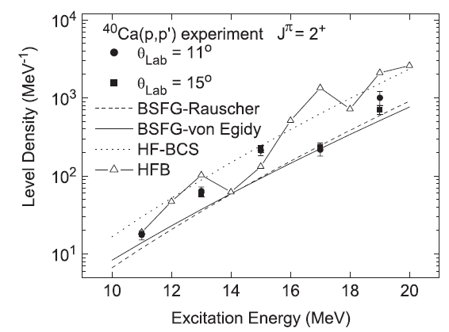
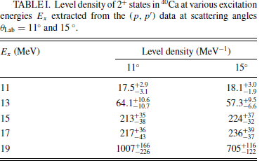
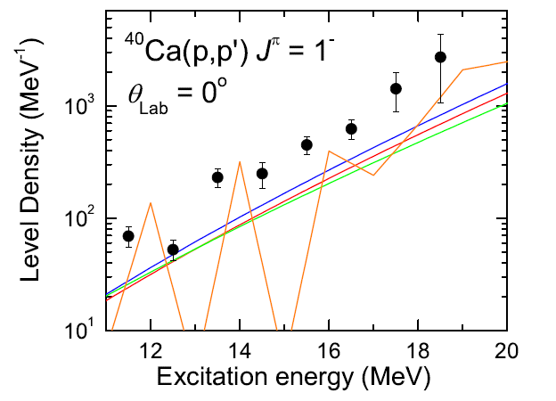
Spin-parity-resolved Level Densities
I. Usman et.al., PRC 84 (2011) 054322
M. Jingo, PhD Thesis (2014)
University of the Witwatersrand
Experimental (filled symbol)
BSFG-Rauscher (red);
BSFG-von Egidy (Green);
HF-BCS (Blue);
HFB (Orange);

Slide 18
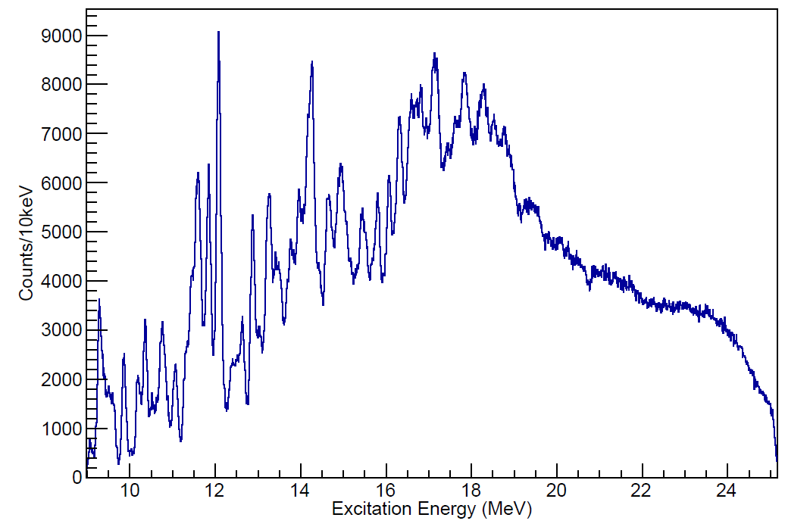

Ongoing work:
Fine structure of the ISGMR in ⁴⁰Ca
$${}_{}^{40}{Ca\left(α,α^{′}\right)@ 0^{o}}$$
Preliminary data
analysis !!!
Level density of J$π$ = 0⁺ states to be extracted !!!

Slide 19
Summary
The Fine structure conforms to the global character of phenomenon in ISGQR and IVGDR
Theoretical calculations: RPA, SRPA, R-QRPA and R-QTBA reveal good agreements with the experimental energy scales
Spin-parity dependent level densities extraction as important ingredients used as input for calculations in nuclear astrophysics

Slide 20


Thank you

