Slide 1
Analysis of Baryon Resonances
Production & Decay
Ahmad Jafar Arifi
24B17874
International Physics Course (IPC) Trip
Spring 2018
Notes:
Good evening everyone,
I hope you can still focus the student session.
Firstly, let me introduce my self,
My name is jafar, D1 student from RCNP theory group,
Supervised by Hosaka sensei.
Today, I would like to present the topic which is related to my research work.
I hope you get familiar with my work.
The title is analysis of baryon resonances: production & decay.

Slide 2
Contents
Introduction of Baryon Resonances
Kaon Photo-production
Strong Decay of Heavy Baryon
Notes:
This is the contents of my talks.
Basically, I will talk about three things.
First, I will start with a very general introduction: that is baryon
Then, I eventually look closer to some analysis dealing with baryon:
Kaon photo production and the strong decay of heavy baryon.
I hope I can explain in easy way.

Slide 3
Mesons
Baryons
Made by quark and anti-quark
Made by three quarks
Quarks
n
p
$$∆^{−}$$
$$∆^{0}$$
$$∆^{+}$$
$$∆^{++}$$
udd
uud
ddd
udd
uud
uuu
Nucleon
Delta
Baryon in SU(2) Symmetry
Notes:
Let go to the first question:
1. What is baryon??
Let us see first the strucutre of atom,
From atom we can recognize the internal structure: electron and nucleus.
Electron is elementary particle but nucleus is a composite particle made by proton and neutron ( or usually called nucleon).
Nucleon itself made by quark.
Proton /neutron is called baryon which is made by three quark.
That is also another kind of composite particle of quark, namely meson made by quark and anti quark.
Let’s focus on baryon.
Quark has six kind of flavor, u, d, s, c, b, t.
2. Next question, How many baryon can we construct with 6 kind of quark?
The answer is many.
Even, people can call it particle zoo. Because too many particle.
Let start with two quark, u & d.
And we can make, two kind of group of particle. and we have six particles.
This is called isospin group, it is regards as the same particle if we neglect electromagnetic interaction.
3. Next question, what about u & d & s quark, how many baryon?

Slide 4
Baryons in SU(3) Symmetry
I₃= $−$1
I₃= $0$
I₃= $+$1
Now consider u, d, & s quark
S=0
S=0
S=-1
S=-1
S=-2
S=-2
S=-3
I₃= $−$1/2
I₃= $+$1/2
Organization: Group Theory
SU(3) Symmetry
3 objects: u, d, & s quark
Notes:
This is the answer,
Please calculate the the total number of baryon by yourself.
From the diagram you can recognize the nucleon and delta,
Going down by replacing with one strange quark, and so forth.
The one of the powerful finding is the prediction of Omega-,
At first, this particle is missing. Then the experimentalist found it and complete the diagram.
4. How can we organize particle that way?
That is by using the group theory and we then impose the SU(3) symmetry to the system.
Then we will get this can kind of diagram.
How about, u, d, s, c SU(4), the diagram will be complecated.
But, I will pospond the discussion later.
Let us focus on this baryon first.
Let me remind you that the particle can be excited.
And similar to the atom, the excitation is unique for every particle.
Let see the excitation of the baryon.

Slide 5
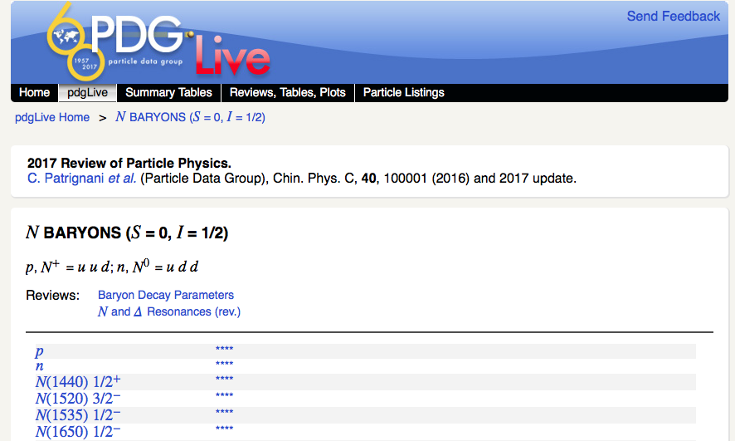
Baryon Resonances
Particle Data Group (PDG) 2017
 | $$N$$ | $$∆$$ | $$Λ$$ | $$Σ$$ | $$Ξ$$ | $$Ω$$
All | 27 | 22 | 19 | 28 | 10 | 4
**** | 11 | 7 | 8 | 5 | 1 | 1
*** | 4 | 3 | 5 | 4 | 4 | 1
** | 10 | 7 | 1 | 6 | 2 | 2
* | 2 | 5 | 5 | 13 | 3 | 0
http://pdglive.lbl.gov
Missing Resonances
**** | Existence is certain, properties are at least fairly well explored.
*** | Existence is very likely, further confirmation of decay modes is required.
** | Evidence of existence is only fair
* | Evidence of existence is poor
Quark Model predicted more states than the observed ones
Notes:
If we neglect the Isospin, we can classify the baryon as six particle,
How many excitation states observed so far for every baryon?
N =27, Delta =22, Lambda =19, and so on.
If you are courius you can visit pdg live (particle data group website)
And you can find the current states for baryon.
For example, if you click nucleon baryon,
Then you will find a list of excitation state with the star which represent the existante of the state,
If **** that it is well established, but if * the existance is poor and need more analysis.
One of the important note that.
The number of observed states are less then the prediction of quark model.
The missing state is called missing resonances, and people now trying to solve the puzzle of missing resonance.
Let see the nucleon excitation state.

Slide 6
Nucleon Resonances
Mass spectrum and their spin-parity
23 Resonances
2800
PDG 1990
2600
****
***
2400
**
*
2200
2000
1800
1600
1400
$$−$$
$$+$$
$$−$$
$$+$$
$$−$$
$$+$$
$$−$$
$$+$$
$$−$$
$$+$$
$$−$$
$$+$$
$$−$$
$$+$$
$$1/2$$
$$3/2$$
$$5/2$$
$$7/2$$
$$9/2$$
$$11/2$$
$$13/2$$
Notes:
This is the nucleon resonances and their spin parity from PDG 1990, (23 resonances).
Each excitation state has spesific spin-parity.
The vertical axis is mass, the higher excited state has larger mass.
And then, let see if we compare to PDG 2017,

Slide 7
Nucleon Resonances
Mass spectrum and their spin-parity
27 Resonances
2800
PDG 2017
2600
****
***
2400
**
*
2200
2000
1800
1600
1400
$$−$$
$$+$$
$$−$$
$$+$$
$$−$$
$$+$$
$$−$$
$$+$$
$$−$$
$$+$$
$$−$$
$$+$$
$$−$$
$$+$$
$$1/2$$
$$3/2$$
$$5/2$$
$$7/2$$
$$9/2$$
$$11/2$$
$$13/2$$
Notes:
Not many changes, but you can notice some states are discovered.
Let pay attention at nucleon around 1900. I will explain it later.
Question arise;
How can we find this states?
Because I am theorist, I will give you an example of theoretical calculation.

Slide 8
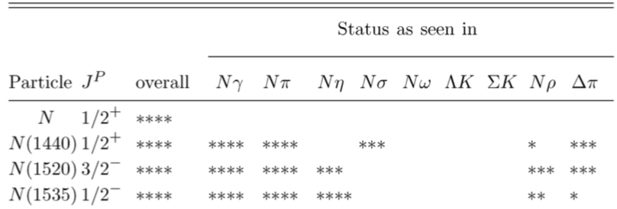
Sources for Baryon Resonance Analysis
Nucleon Resonances
$$πN ⟶πN$$
Pion Elastic Scattering
$$πN ⟶X$$
Pion Inelastic Scattering
Kaon Photo-production
$$γN⟶KΛ$$
$$γN ⟶πN, KΛ, ηN, …$$
Photo- and Electro-Production
Notes:
For nucleon resonances,
These proceses are the source of baryon analysis:
The scattering process.
In scattering process, for example,
Pion nucleon scattering, they can produce everything with a given energy.
But, for sure, the most probable one is the elastic scattering which is the mostly from this process, baryon resonances are analyzed.
In our case, I analyzed the photo production, gamma and nucleon as target. And we choose the K Lambda in final state.
As you can see, that the nucleon resonances are seen in several process as depicted here.
But, How we can see the nucleon resonance in this process. Let go into detail

Slide 9
Kaon Photo-production
Nucleon resonance

Slide 10
Kaon Photo-Production
$KΛ$ Channel (Isobar Model)
Nucleon
Hyperon
Kaon
From the Feynman diagrams, we can calculate the scattering amplitude for each process by introducing effective Lagrangian
$$M_{total}=M_{p}+M_{N^{∗}}+M_{Λ}+M_{Λ^{∗}}+M_{Σ}+M_{Σ^{∗}}+M_{K}+M_{K^{∗}}+ …$$
And we can calculate the observables by fitting the free parameter to the experimental data
Total Cross-section
CLAS Collaboration
LEPS Collaboration (Spring-8)
Differential Cross-section
MAMI Collaboration
Polarization Observables
GRAAL Collaboration
Notes:
In quantum field theory, this proces is described by several feynman diagram.
If you dont understand, don’t worry, this is my job, not your.
You can see, there are several channel.
Let me empasize that there is an intermediate state for each diagram.
And each diagram correspond to a scattering amplitude.
you may wonder how many diagram for this channel with nucleon resonance in intermediate state.
But for starting point, we include several resonance into model.
After getting total amplitude, we can make a theoreticall prediction by fiiting to the experimental data.
This is the typical observables for kaon photoproduction,
Cross section and polarization observables. One of them is measured in Spring-8 (LEPS collaboration).
They can measured this process by using photon beam.

Slide 11
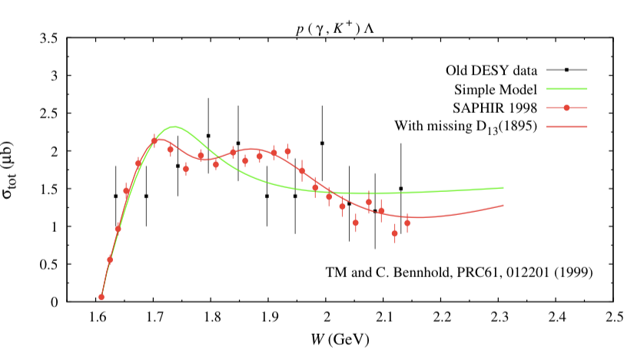
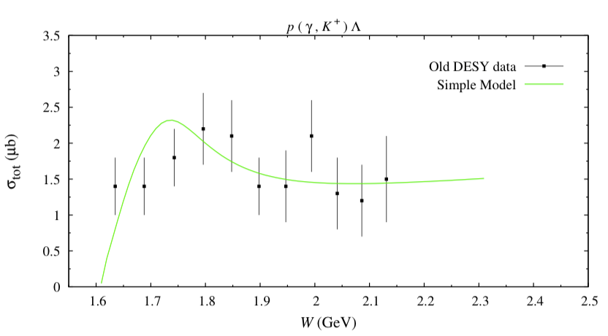
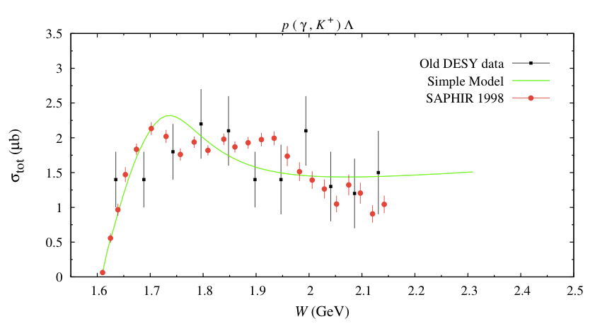
Evidence of Missing Resonance N(1895)
In total cross section
Recent model contains many resonances with higher spin. But, its formulations are still problematic.
Notes:
Let go to the result,
Here is one of a historical discovery in kaon photoproduction.
First, It is a common sense that the resonance appear as a peak in cross section.
see the Data from DESY, and by simple model, the data can be reproduced.
Then, new data is coming from saphire,
Then, the model was fitted again but with new resonances to reproduce the bump, and
The result is perfect at that time,
Then it become a new evident for a missing resonance.
If you open up the particle data book, you will find a name printed. (this is actually my supervisor in Indonesia).
Recent model contain many resonances with higher spin, it is very complecated.

Slide 12
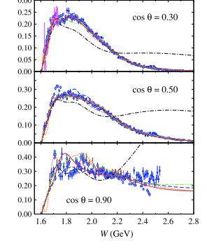
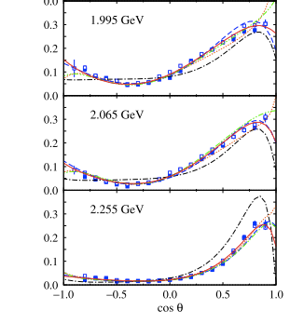
Cross Section
Kaon Photo-production
Total cross section
Differential cross section
Motivation
Comparing models for nucleon resonances spin 3/2 and spin 5/2 with different formulations.
T.Mart, S. Clympton, A.J. Arifi, PRD 92, 094019 (2015)
Notes:
This is the result of recent model, it is a huge project. And my contribution at that time is to calculate the amplitude of nucleon resonance spin 3/2.
What I describe here is the cross section and the model with different formulation.
As you can see, not so much different among the models.
Then we need more observables to compare.

Slide 13
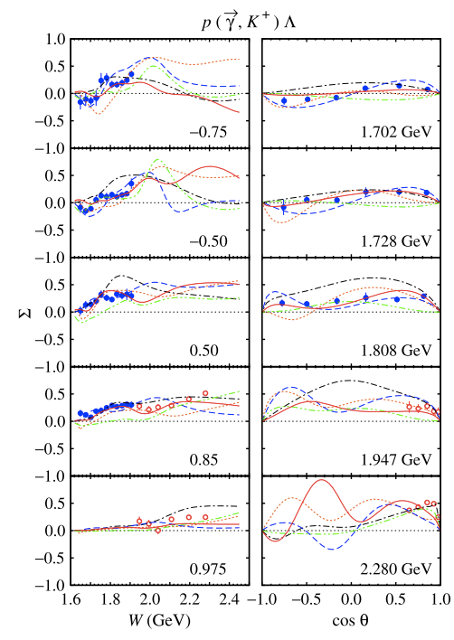
Photon-Beam Asymmetry
Polarization observables
Linearly polarized photon: Vertically & Horizontally polarized
Photon-beam asymmetry is defined by
$$Σ∝\frac{N_{v}−N_{h}}{N_{v}+N_{h}}$$
Photon asymmetry is sensitive to the model of nucleon resonances.
But, we need more experimental data to disentangle the models.
GRAAL Collaboration
LEPS Collaboration
Notes:
This is one of the polarization observable: photon beam asymmetry.
the idea is as follow:
The photon is either vertically and horizontally polarized,
Then we calculate the different of the cross section when the initial state is v or h,
here is the experimental data,
You can see that the backward angle, the model is sensitif.
But the data from leps is only in forward angle region.
Starting from here, we can make a recommendation for experimentalist what to measure.
I am not an expert here, but if there is a question, you are welcome.

Slide 14
Charmed Baryons
Strong decay

Slide 15
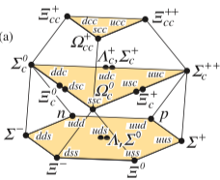
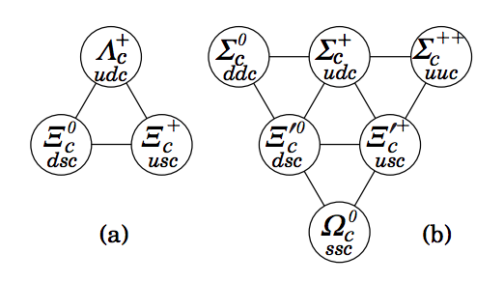
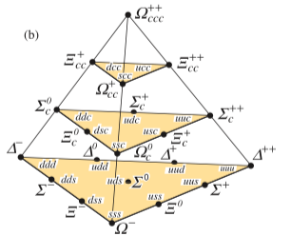
C=2
Charmed Baryons
With charm quark
C=1
Singly charmed baryons
C=0
C=3
C=2
C=1
Firstly observed doubly charmed baryon $Ξ_{cc}$
C=0
R. Aaij, et al. [LHCb], Phys. Rev. Lett. 119, 112001 (2017)
Baryon in SU(4) Symmetry
Notes:
For SU(4) symmetry including charm quark the diagram is like this,
But because of the charm quark is quite heavy then it is somewhat decoupled.
And we need a lot discussion for that and it is beyond my talk.
Ok, now see the first layer it is SU(3) diagram,
The second layer is with single charm quark. we called charmed baryon.
The diagram is like this, in the following slide I will focus on the lambda c baryon which is the lightest charmed baryon.
Not many states are observed in this diagram,
Even there is a firstly found the doubly charmed baryon last year.
There was a discovery from other group previously but it was controversy.

Slide 16
Singly Charmed Baryons
Production and Decay
Charmed baryons need to be explored further (6 states $Λ_{c}^{∗}$ & 3 states $Σ_{c}^{∗}$)
Some quantum numbers of several states are not yet established.
$?$?
$$Λ_{c}^{∗}(2940)$$
$5/2$⁺
$$Λ_{c}^{∗}(2880)$$
$?$?
$$Σ_{c}^{∗}(2800)$$
$?$?
One pion emission
$$Λ_{c}(2765)$$
Two-body decay (quark model)
$3/2$⁻
$$π$$
$$Λ_{c}^{∗}(2625)$$
$1/2$⁻
$$Λ_{c}^{∗}(2595)$$
$3/2$⁺
$$Λ_{c}^{∗}$$
$$Σ_{c}, Σ_{c}^{∗}$$
$$Σ_{c}^{∗}(2520)$$
$1/2$⁺
$$Σ_{c}(2455)$$
Charmed baryon production is also interesting subject to study in this field. [Shim Sangin]
$1/2$⁺
$$Λ_{c}(2286)$$
Notes:
This is the spectrum of Lambda c and Sigma C, only 6 state of lambda c, very small compared to nucleon resoances.
But here, I dindnt analyze the scattering process. You may look at shim presentation for the production/scattering process.
Here I analyze the decay with pion emission. in nuclear physics, excited states usually emit photon to go to ground states,
But in hadron physics, usually, pion emission is emiited to go to ground states.
From the decay, we can understand the internal structure of Lambda c, for example spin and parity.
As you can see, some states has no information about the spin parity.

Slide 17
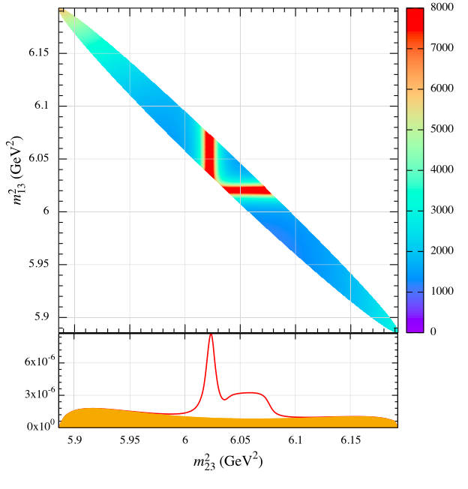
Dalitz Plot of $Λ_{c}(2625)$
Two pion emission
Three-body decay
Theoretical calculation
$3/2$⁻
$$Λ_{c}^{∗}(2625)$$
$1/2$⁻
$$Λ_{c}^{∗}(2595)$$
$3/2$⁺
$$Σ_{c}^{∗}(2520)$$
$1/2$⁺
$1/2$⁺
$$Σ_{c}(2455)$$
$$Λ_{c}(2286)$$
Sequential Decay (quark model)
$$π$$
$$π$$
$$Λ_{c}^{∗}$$
$$Λ_{c}$$
$$Σ_{c}, Σ_{c}^{∗}$$
A resonance appears as a peak (band structure)
A.J. Arifi, H. Nagahiro, A. Hosaka, PRD 95(2017) 114018
Notes:
One of the similar process with scattering is the three body decay by two pion emission.
Then the process is described by this diagram with Sigma_c in intermediate states,
Again, the the resonance appear as a peak here, but there is an additional information in decay process.
We can see the Dalitz plot, and the resonance appear as a band structure.
And it gives a lot of information about the resonance.
This dalitz plot is from theoretical calculation.

Slide 18
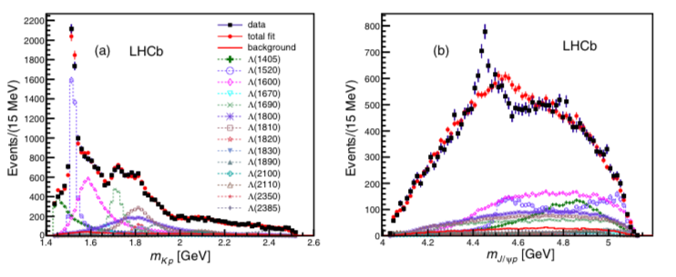
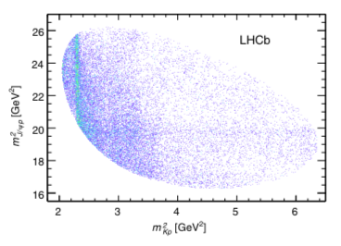
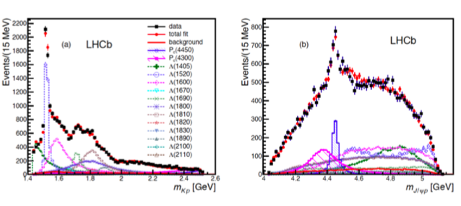
First: they assume a kinematical reflection
(doesn’t fit)
Pentaquark $P_{c}$ (exotics)
Experiment
Second: insert $P_{c}(4300)$ and $P_{c}(4450)$
(fit)
R. Aiij, et al [LHCb], PRL 115, 072001 (2015)
Notes:
This is the dalitz plot produced by LHCb experiment, you can see band structure,
It s a long story to understand this peak.
First, actually, they try to

Slide 19
Summary
Baryon
Baryon and symmetry
Baryon Resonances
Kaon Photo-production
Missing Resonance
Photon-Beam Asymmetry
Strong Decay of Heavy Baryon
Charmed Baryon Decay
Discovery of Pentaquark P_{c}

