Slide 1
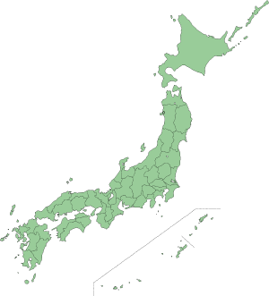
微視的核構造反応模型を用いた ⁹Li 原子核の励起状態の研究
RCNP研究会「核子・ハイペロン多体系におけるクラスター現象」
(7月26,27日, 2013 at関東学院大学KGU関内メディアセンター)
古本 猛憲
(一関工業高等専門学校)
共同研究者
須原唯広 (松江工業高等専門学校)
板垣直之 (京都大学基礎物理学研究所)

Slide 2
Contents
Motivation
- The ⁹Li nucleus has a role of the core in ¹¹Li
- Structures of the ⁹Li nucleus
Formalism
- Stochastic Multi-configuration mixing Method
- Microscopic Coupled Channel (MCC) Method
with complex G-matrix interaction (CEG07)
Results
- Elastic & Inelastic cross sections
- Discussion for the second 3/2⁻ state
Summary

Slide 3
Motivation
Halo structure
⁷Be + p
Z=5
⁸B
⁹B
¹⁰B
¹¹B
¹²B
¹³B
¹⁰Be + n
Z=4
⁷Be
⁹Be
¹⁰Be
¹¹Be
¹²Be
Z=3
⁶Li
⁷Li
⁸Li
⁹Li
¹¹Li
Z=2
⁴He
⁶He
⁸He
⁹Li + n + n
N=2
N=3
N=4
⁴He + n + n
N=5
N=6
N=7
N=8
Experiment
I. Tanihata et. al., (Phys. Rev. Lett. 55 (1985) 2676)
T. Minamisono et. al., (Phys. Rev. Lett. 69 (1992) 2058)
I. Tanihata, (J. Phys. G: Nucl. Part. Phys. 22 (1996) 157)

Slide 4
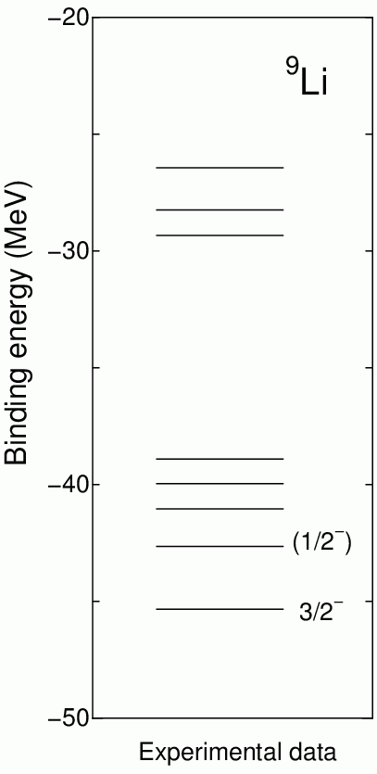
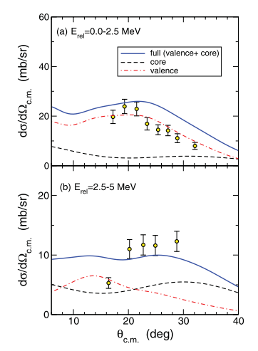
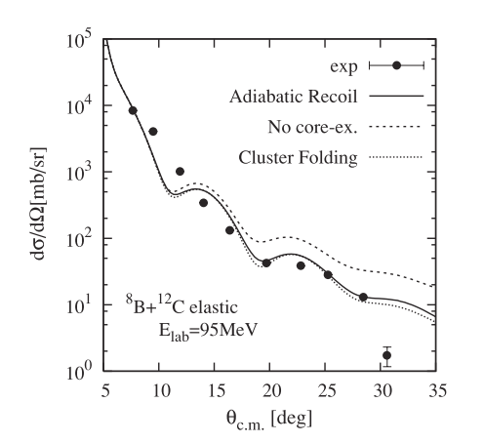
Motivation
Break up of ¹¹Be → ¹⁰Be + n
Importance role of the core excitation
for the nuclear reaction
⁸B elastic scattering
¹¹Li has a halo structure
⁹Li itself in this study
K. Horii et. al., (Phys. Rev. C.81 (2010) 061602(R))
A. M. Moro et. al., (Phys. Rev. C.85 (2012) 054613)

Slide 5
⁹Li
Formalism (Structure)
n₁
Z
t
α
Brink model + Stochastic multi-configuration mixing
n₂
Randomly fixed
Hamiltonian
Effective NN interaction
Central : Volkov No.2 (W=1-M, M=0.6, B=H=0.08)
LS : G3RS (V_{LS}=2000MeV)

Slide 6
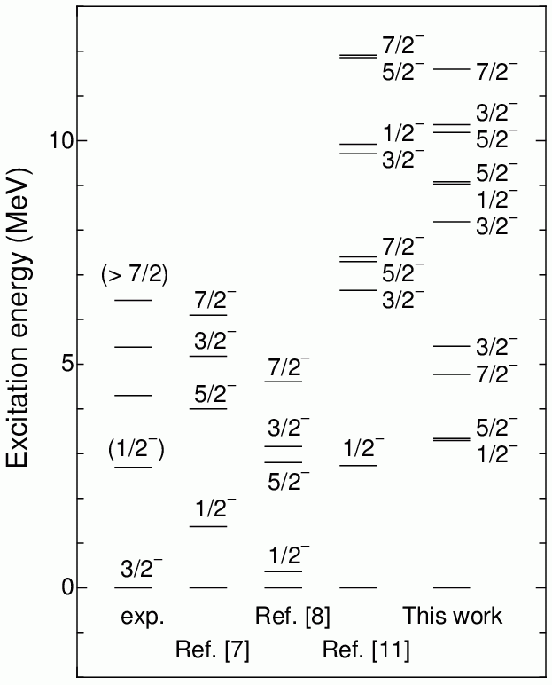
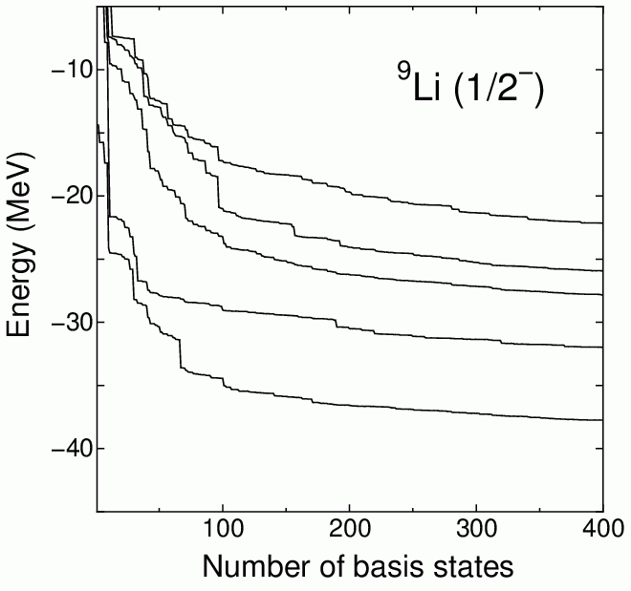
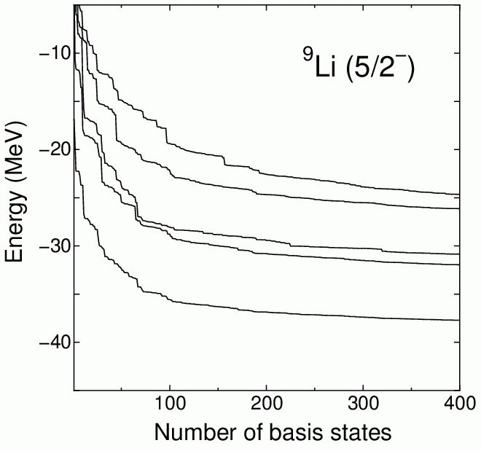
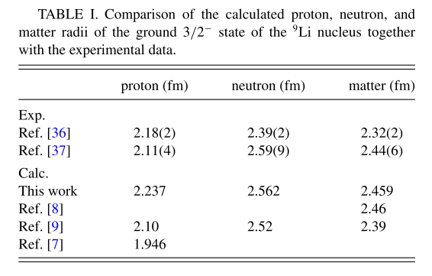
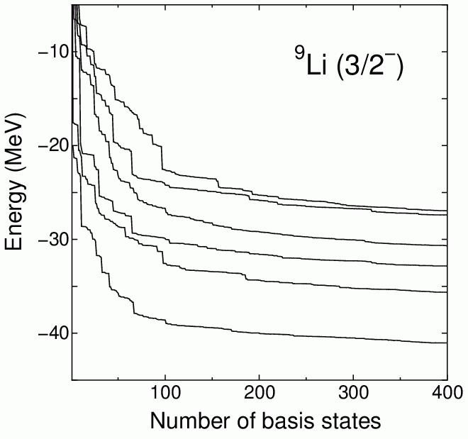
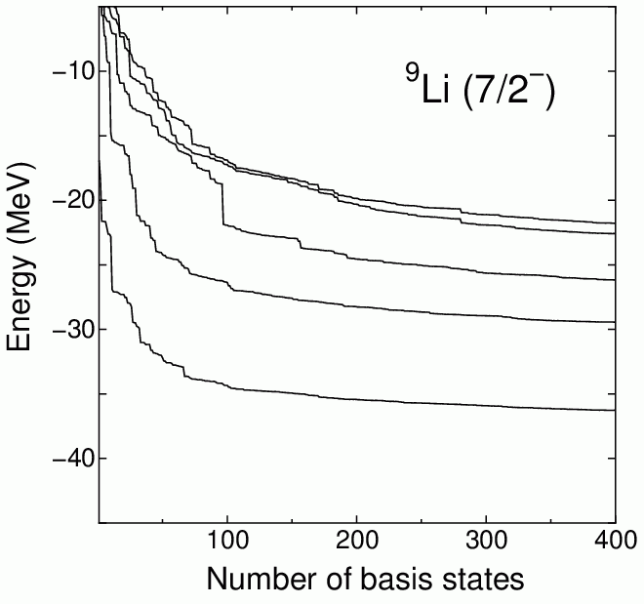
Energies & rms radii & B(E2)
[7] No-core shell model
[8] TOSM + UCOM
[9] α + t + n + n
[11] ⁶He + t
B(E2; 1/2⁻ → 3/2⁻)
Exp. 6.8(3) e²fm⁴
Cal. 8.778 e²fm⁴
T. Furumoto, T. Suhara, and N. Itagaki (Phys. Rev. C.87 (2013) 064320)

Slide 7
Formalism (Reaction)
Microscopic Coupled Channel (MCC)
The diagonal and coupling potentials are derived from microscopic view point.
transition density
CEG07
v_{NN}(s)
Transition density
r₂
r₁
R
Projectile
Target

Slide 8
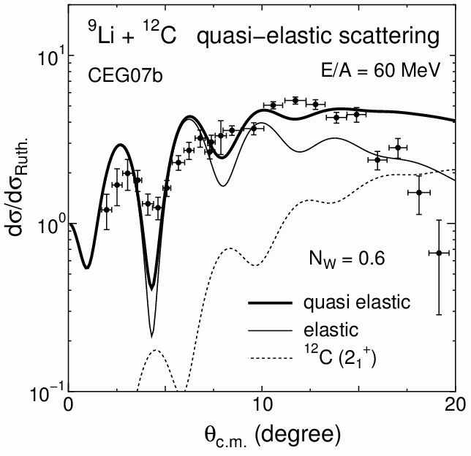
Quasi-elastic ⁹Li + ¹²C cross section
In MCC with CEG07
to reproduce the data
T. Furumoto, T. Suhara, and N. Itagaki (Phys. Rev. C.87 (2013) 064320)

Slide 9
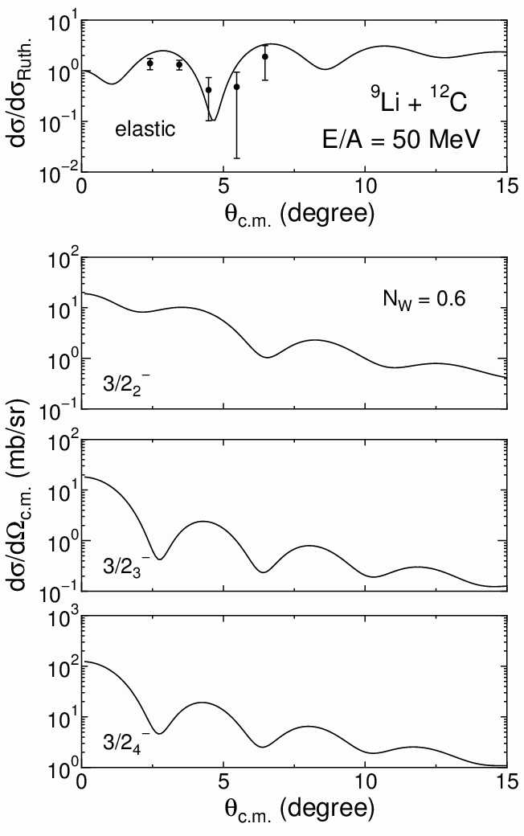
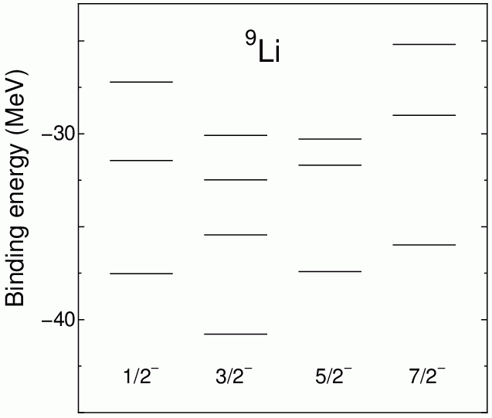
Elastic & Inelastic
cross sections
T. Furumoto, T. Suhara, and N. Itagaki
(Phys. Rev. C.87 (2013) 064320)

Slide 10
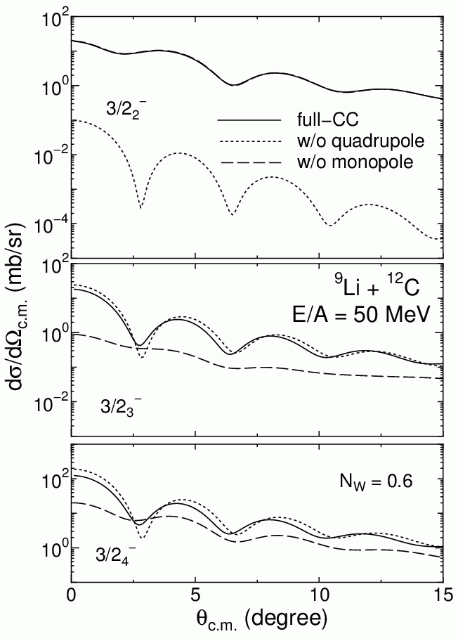
Decomposition into monopole & quadrupole
transitions
Monopole
Quadrupole
T. Furumoto, T. Suhara, and N. Itagaki
(Phys. Rev. C.87 (2013) 064320)

Slide 11
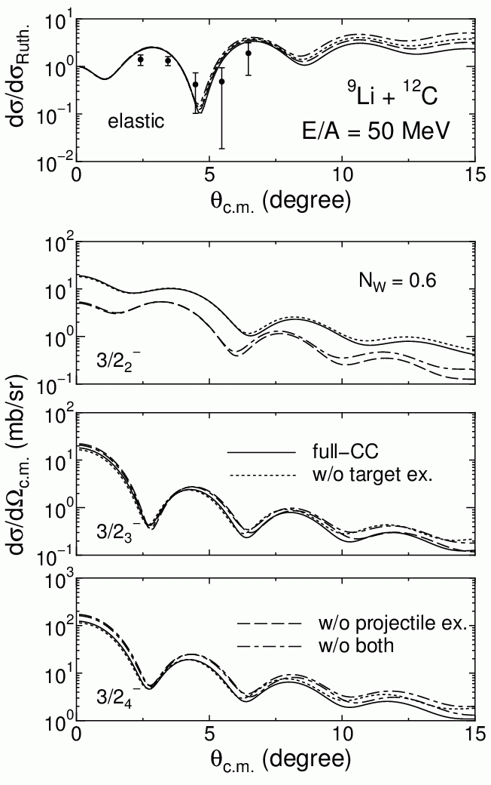
Mutual-excitation and multistep effects
✔Mutual-excitation (¹²C*) effect
Minor role for all 3/2⁻ states
✔Multistep (⁹Li*) effect
Drastic change of the 3/2₂⁻ state
Minor role for other 3/2⁻ states
T. Furumoto, T. Suhara, and N. Itagaki
(Phys. Rev. C.87 (2013) 064320)

Slide 12
Second 3/2⁻ state shows exotic behavior
in the inelastic angular distribution
Need for the investigation of the state in detail

Slide 13
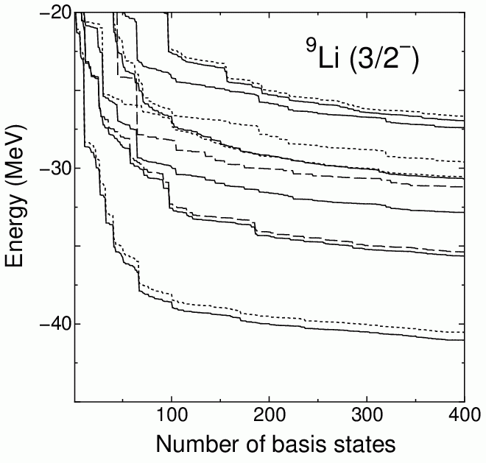
Decomposition into K-quantum number
⁹Li
n₁
Z
t
α
n₂
K = 1/2 only
K = 3/2 only
T. Furumoto, T. Suhara, and N. Itagaki
(Phys. Rev. C.87 (2013) 064320)

Slide 14
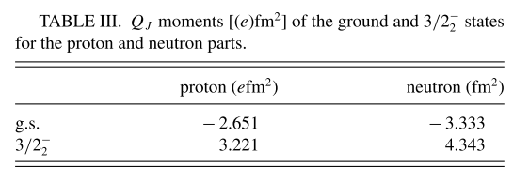
Deformation of ⁹Li
Exp. -2.53(9) efm²
In the collective model
K = 1/2 only
K = 3/2 only
In the assumption,
all Q₀ gives positive values
Prolate like deformation
T. Furumoto, T. Suhara, and N. Itagaki
(Phys. Rev. C.87 (2013) 064320)

Slide 15
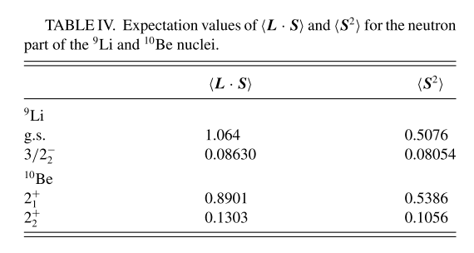
Behavior of two valence neutrons in ⁹Li
α + t + di-neutron
α + α + di-neutron
T. Furumoto, T. Suhara, and N. Itagaki
(Phys. Rev. C.87 (2013) 064320)
¹⁰Be
⁹Li
n
α
n
Analogy
t
α
α
n
n

Slide 16
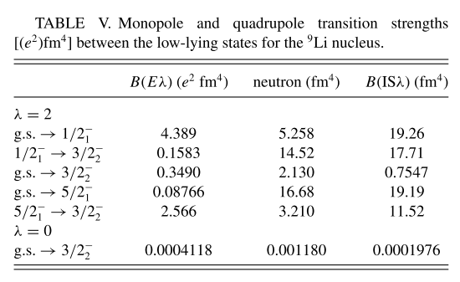
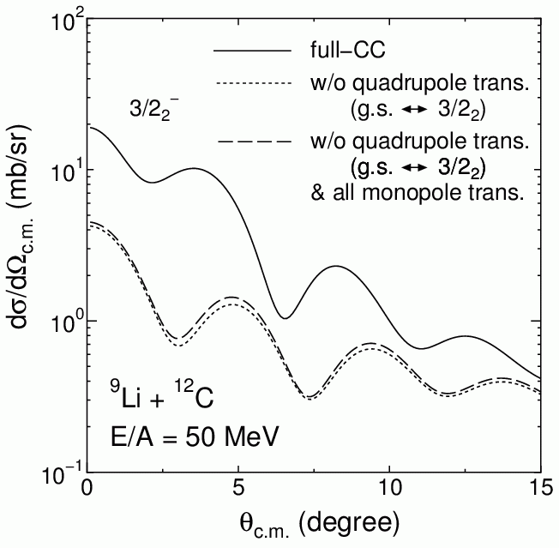
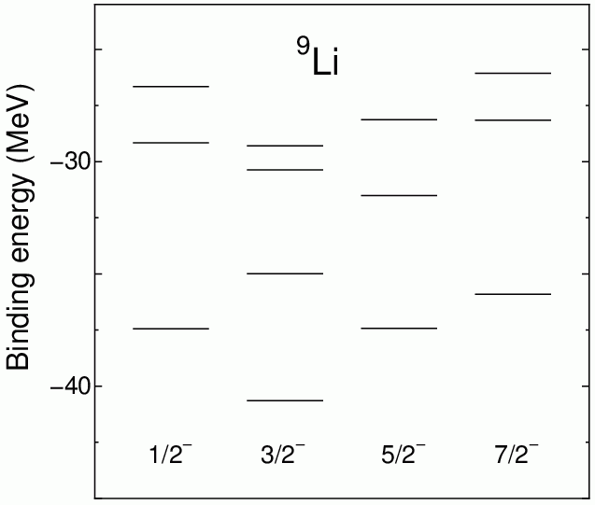
Multi-step effect
T. Furumoto, T. Suhara, and N. Itagaki
(Phys. Rev. C.87 (2013) 064320)

Slide 17
Summary
Application of microscopic cluster and microscopic folding modes to ⁹Li nuclear scatterings
Inelastic cross section to the 3/2⁻ state
- Quadrupole transition for the 2nd 3/2⁻ state
- Monopole transition for the 3rd and 4th 3/2⁻ states
Possibility in the 2nd 3/2⁻ state
- triaxial deformation & mixing of di-neutron components
The multi-step coupling effect
- important for the 2nd 3/2⁻ state
- through the 1st 1/2⁻ and 5/2⁻ states

