Slide 1
J-PARCにおけるd(π⁺, K⁺)反応を用いたK中間子原子核の探索
Yudai Ichikawa (Kyoto University/JAEA)
2013/07/26 RCNP研究究会「核子・ハイペロン多体系におけるクラスター現象」
1

Slide 2
Contents
Introduction
Nuclear K bound states
K⁻pp
J-PARC E27 experiments
d（π⁺,K⁺）X reaction
Experimental set up
K1.8 beam line + SKS + Range counter Array(RCA)
Coincidence with RCA
Preliminary result of first stage data
Summary
2

Slide 3
Introduction
Nuclear K bound state
The deeply bound state by strong interaction.
Strong attraction of the I =0 KN interaction（KN^{I=0}） plays an important role in nuclear K bound state.
K⁻pp nuclear bound state
The simplest nuclear K bound state.
Theoretical prediction of B.E. and Γ depends on the KN interaction models and the calculation method .
Theoretical prediction | B.E（MeV） | Γ（MeV）
T. Yamazaki and Y. Akaishi | 48 | 61
A. N. Ivanov, P. Kienle, J. Marton, E. Widman | 118 | 58
N. V. Shevchenko, A. Gal, J. Mares, J. Revai | 50~70 | ~100
Y. Ikeda and T. Sato | 60~95 | 45~80
A. Dote, T. Hyodo, W. Weise | 20±3 | 40~70
S. Wycech and A. M. Green | 56.5~78 | 39~60
Barnea et al. | 15.7 | 41.2
PRC76, 045201 (2002)
arXiv:0512037v2[nucl-th]
PRC76, 044004 (2007)
PRC76, 035203 (2007)
NPA804, 197 (2008)
‘
PRC80, 045207 (2009)
PRL B712, 132-137 (2012)
3

Slide 4
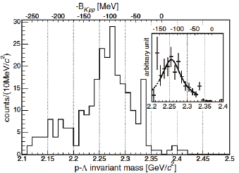
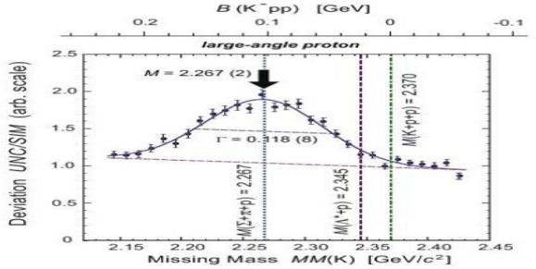
Experimental approach of K⁻pp
 | FINUDA | DISTO
reaction | Stopped K⁻ absorption on ^{6,7}Li+¹²C | p + p @ Tp=2.85GeV
method | Invariant mass of back to back Λp pairs | p+p→X+K⁺ （missing mass） X→Λ+p （invariant mass）
B.E |  | 105 ± 5 MeV
Width |  | 118 ± 8 MeV
-
M.Agnello et al., PRL 94, 212303 (2005)
T.Yamazaki et al., PRL 104, 132502 (2010)
K⁻+p+p~2.37GeV/c²
K⁻+p+p~2.37GeV/c²
M.Agnello et al., PRL 94, 212303 (2005)
T.Yamazaki et al.,
PRL 104, 132502 (2010)
4
Notes:
Quotient value of counts and simulation value

Slide 5
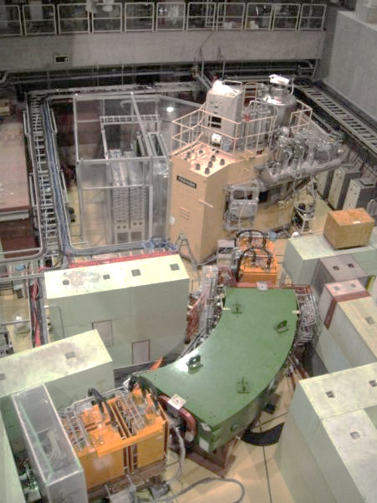
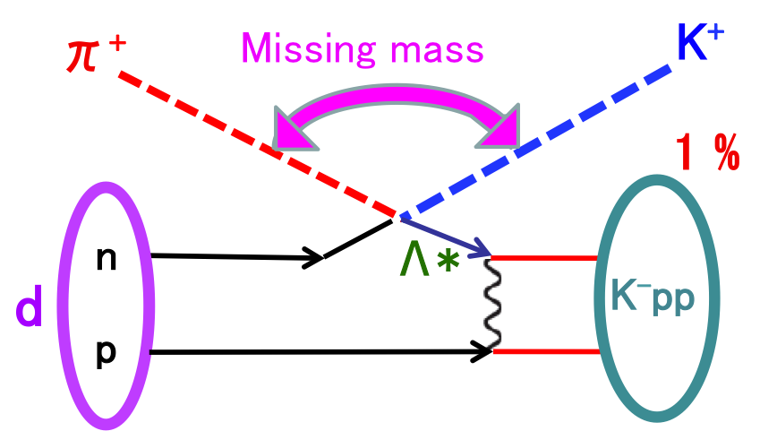
d(π⁺, K⁺) reaction for J-PARC E27 @ K1.8 beam line
P_{π} = 1.7GeV/c
K⁻pp is produced via a Λ(1405) doorway
π⁺ + n → Λ(1405) + K⁺
Λ(1405) + p → bound K⁻pp 1 %
(→ quasi free Λ* 99%）
K⁺
Target
π⁺
Y.Akaishi, T.Yamazaki, Phys. Rev. C 76 045201 (2007)
5

Slide 6
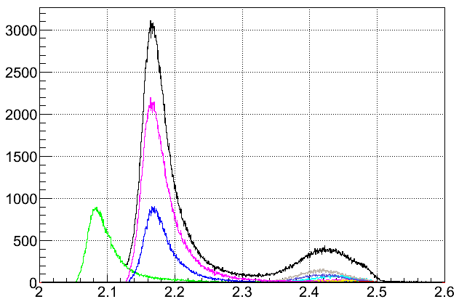
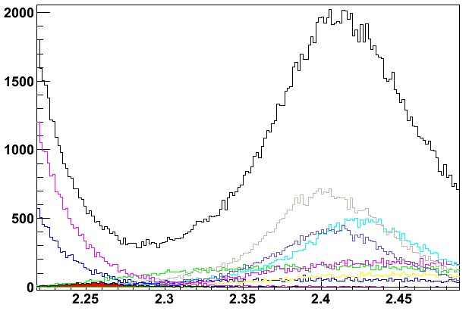
Expected Inclusive spectrum
Background of d（π⁺,K⁺）X @1.7GeV/c
- π⁺ “n” -> Σ⁰ K⁺
- π⁺ “n” -> Λ K⁺
- π⁺ “n” -> Λ(1405) K⁺
- π⁺ “n” -> ΣπK⁺
- π⁺ “n” -> Σ⁰(1385)K⁺
- π⁺ “n” -> ΛπK⁺
- π⁺ “n” -> pK⁻K⁺
- π⁺ “p” -> Σ⁺ K⁺
- π⁺ “p” -> Σ⁺(1385)K⁺
- π⁺ “p” -> ΛπK⁺
-π⁺ “p” -> ΣπK⁺
106μb
K⁻+ p+p~2.37GeV/c²
246μb
20.6μb
Cannot observe K⁻pp signal from the Inclusive spectrum.
->Coincidence measurement.
40μb
76.7μb
Counts / 500keV
13.7μb
38μb
K⁻pp
470μb
124μb
40μb
28.9μb
K⁻pp ~1000events
(Λ(1405)1% sticking)
Γ_{FINUDA} =67MeV/c²
Missing Mass [GeV/c²]
6

Slide 7
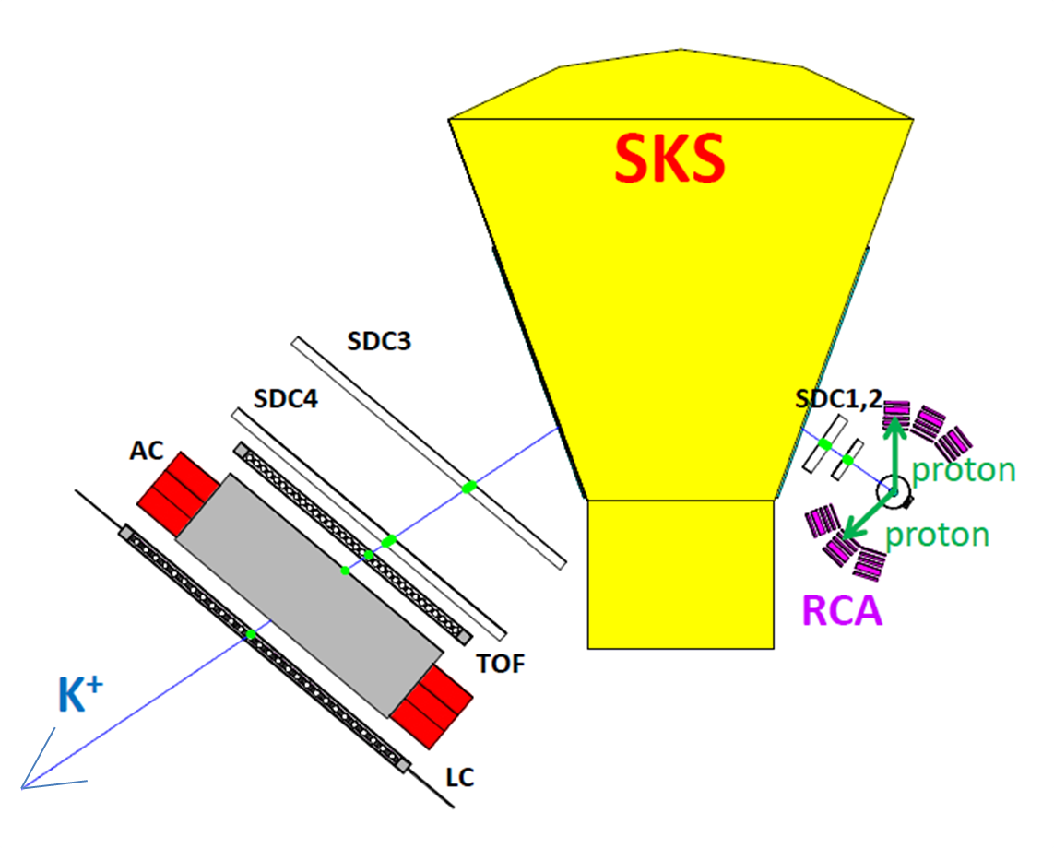
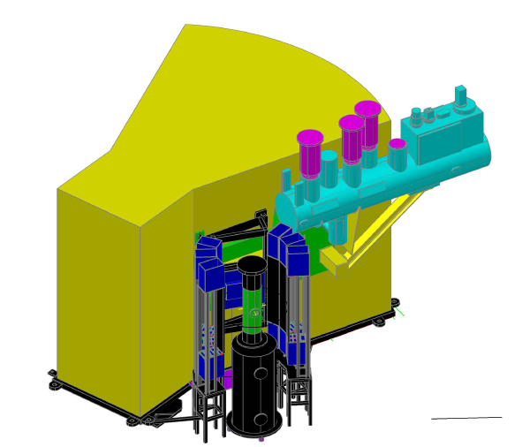
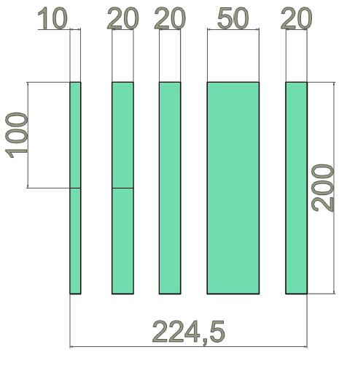
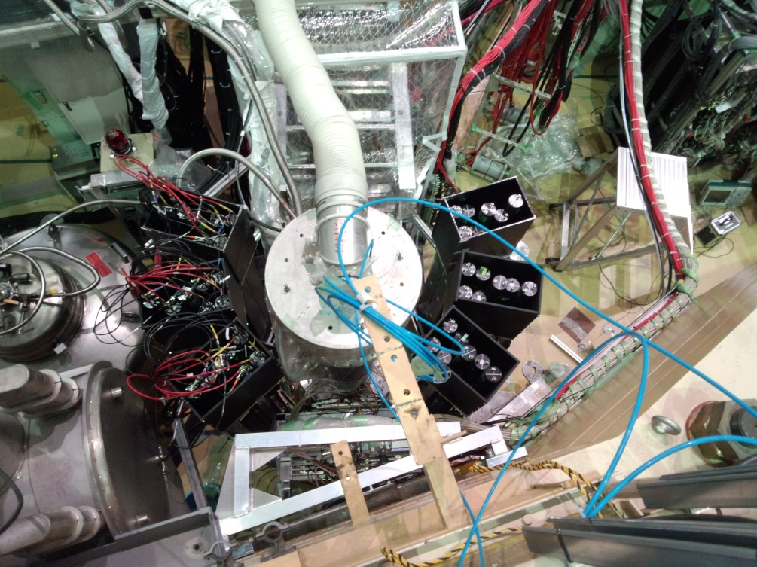
Range Counter Array (RCA) for BG suppression
d（π⁺,K⁺）K⁻pp
Range counter Array(RCA)
6units
5 layers (1+2+2+5+2cm)
of plastic scintillator.
39° – 122° (L+R)
50 cm TOF
K⁻pp → Λ + p
SKS
p+π⁻
RCA
θ
7

Slide 8
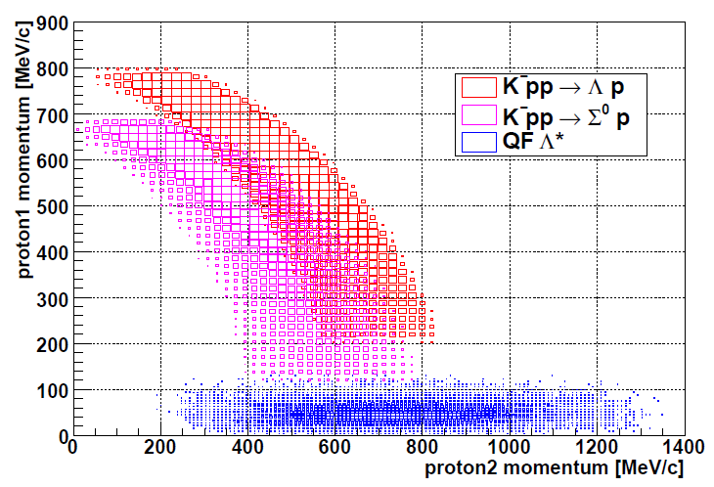
Background suppression by protons tag
K⁻pp decay
Background process
π⁺ + d → Λ* + K⁺ + p_{1s},
Λ* → Σ + π,
Σ⁺ → p₂ + π⁰
K⁻pp → Λ + p₁, K⁻pp → Σ⁰ + p₁,
p₂ + π⁻ Λ + γ,
p₂ + π⁻
P_{1s}< 250MeV/c
In the quasi free background process,
momentum of spectator proton(p_{1s}) is
smaller than 250MeV/c.
8

Slide 9
Summary of first step data
Goal
Inclusive d(π⁺,K⁺)X spectrum @2.2 < Mx <2.5GeV/c².
The first measurement of this reaction and this missing mass region.
p(π⁺,K⁺)X data
Check the contribution of “p” in “d”
Check the feasibility of coincidence measurements.
One proton tag/ two proton tag (with RCA)
Beam time summary
p(π⁺,K⁺)X @1.7GeV/c
0.6 days; pion number ~ 7.6*10⁹
d(π⁺,K⁺)X @1.7GeV/c
7.6 days; pion number ~ 3.3*10¹¹
9

Slide 10
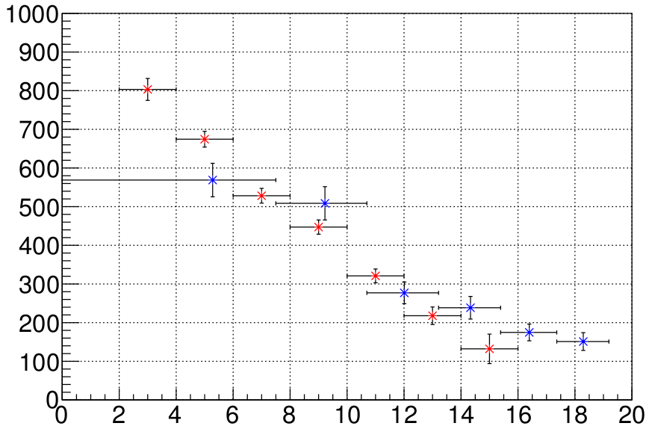
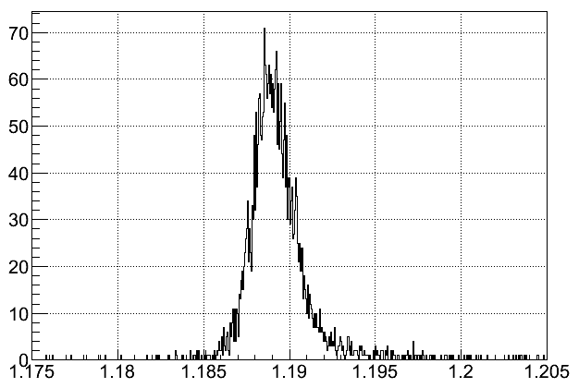
Spectrometer performance
p(π⁺,K⁺)Σ⁺ @1.58 GeV/c [LH₂Target]
~ Energy Calibration & Cross section normalization ~
○Resolution ; ΔM ~ 2.41MeV(FWHM)
○Mean ; 1188.98 ± 0.03 MeV (PDG = 1189.37MeV)
Red: Present data
Blue: D.J. Candlin
Σ⁺ Cross section [μb/sr]
Counts / 0.05MeV
preliminary
preliminary
Scattering angle(Lab)[degree]
MissingMass[GeV/c²]
10

Slide 11
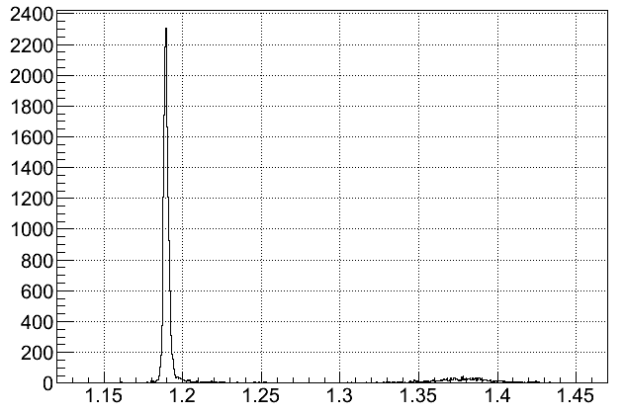
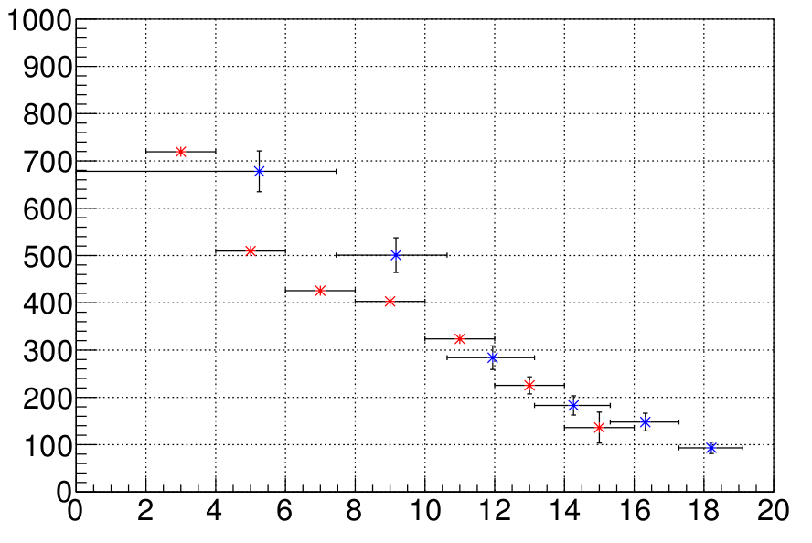
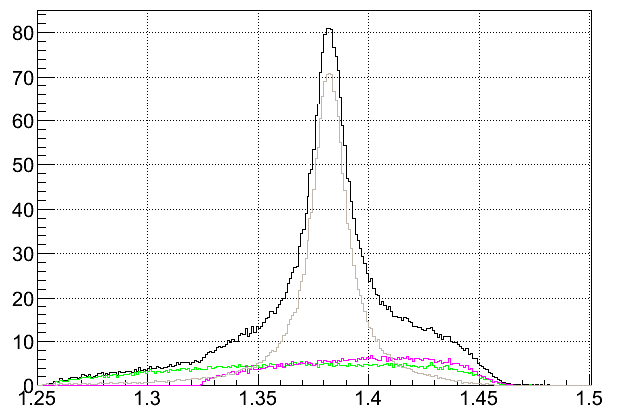
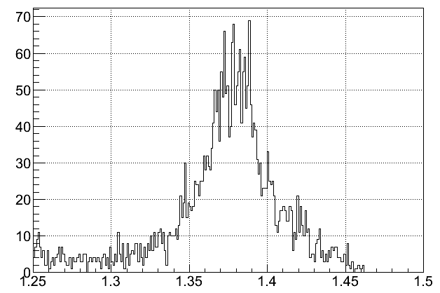
p(π⁺,K⁺)1.7GeV/c
Σ⁺ production
ΔM = 3.2MeV(FWHM)
Mass = 1188.92MeV
Σ⁺(1385) production
Yπ production
Σ⁺
Counts / 1MeV
preliminary
Red: Present data
Blue: D.J. Candlin
Σ*⁺
Σ⁺ Cross section [μb/sr]
Simulation
Data
Missing Mass[GeV/c²]
- π⁺ “p” -> Σ⁺(1385)K⁺
- π⁺ “p” -> ΛπK⁺
- π⁺ “p” -> ΣπK⁺
Zoom
preliminary
Counts / 1MeV
Counts / 1MeV
preliminary
Scattering angle(Lab)[degree]
Missing Mass[GeV/c²]
Missing Mass[GeV/c²]
11

Slide 12
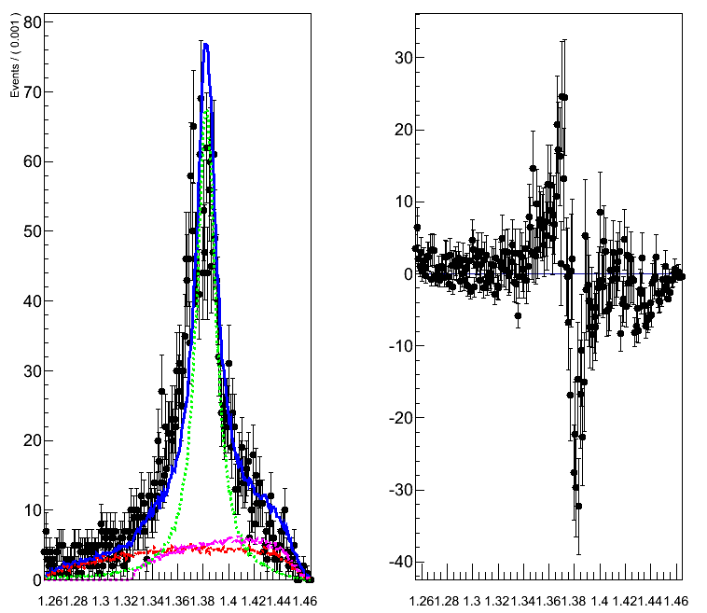
p(π⁺,K⁺)1.7GeV/c
Fitting result for Σ(1385) region
<Residual distribution>
Black:Data
Green: Σ(1385)⁺
Red: Λπ
Pink: Σπ
Counts/ 1MeV
Σ(1385)⁺
Mass & Width
=PDG value
preliminary
χ²=2.270
Missing Mass[GeV]
Missing Mass[GeV]
12

Slide 13
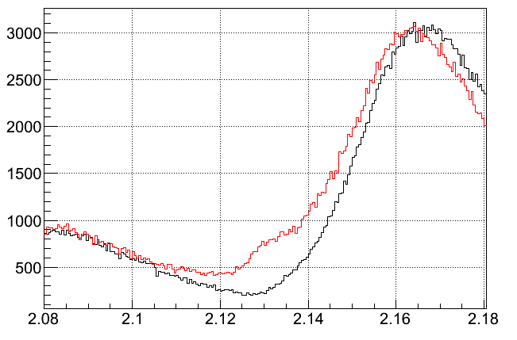
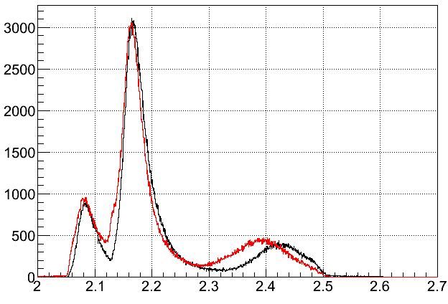
d(π⁺,K⁺)1.7GeV/c
Inclusive spectrum
Proton + Σ⁰ = 2.1309GeV
Neutron + Σ⁺ = 2.1289GeV
Black: Simulation
Red: Data
Σ
Counts / 500keV
preliminary
Zoom
Λ
preliminary
Y*
Missing Mass [GeV/c²]
13

Slide 14
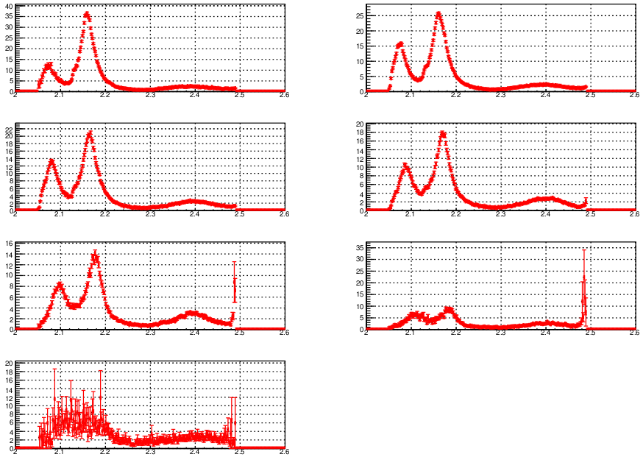
Differential cross section for d(π⁺,K⁺) reaction
θ_{Lab}= 2 - 4°
θ_{Lab}= 4 - 6°
dσ/dΩ/dm[ub/sr/2MeV]
dσ/dΩ/dm[ub/sr/2MeV]
Missing Mass[GeV]
Missing Mass[GeV]
θ_{Lab}= 6 - 8°
θ_{Lab}= 8 - 10°
dσ/dΩ/dm[ub/sr/2MeV]
dσ/dΩ/dm[ub/sr/2MeV]
Missing Mass[GeV]
Missing Mass[GeV]
θ_{Lab}= 10 - 12°
θ_{Lab}= 12 - 14°
dσ/dΩ/dm[ub/sr/2MeV]
dσ/dΩ/dm[ub/sr/2MeV]
Missing Mass[GeV]
Missing Mass[GeV]
θ_{Lab}= 14 - 16°
dσ/dΩ/dm[ub/sr/2MeV]
preliminary
Missing Mass[GeV]
14

Slide 15
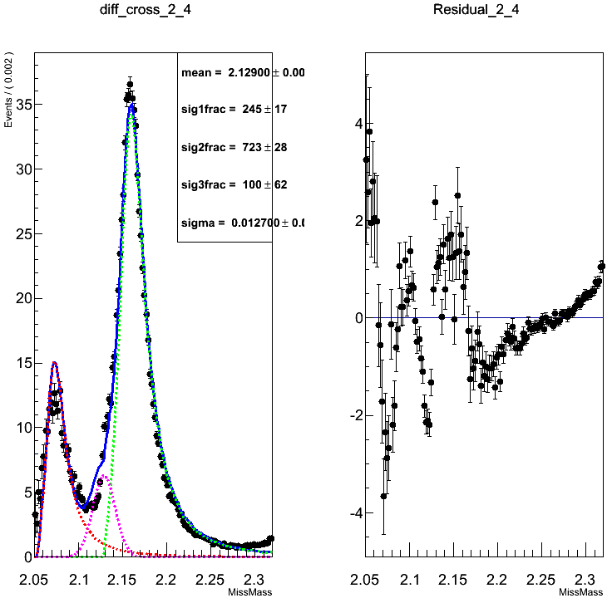
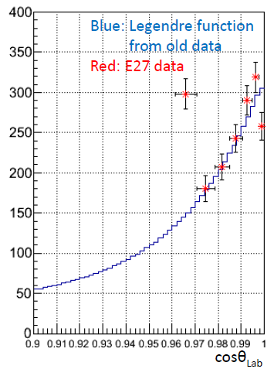
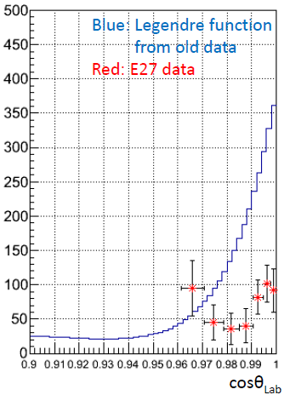
Cross section for Λand Σ⁰ production
dσ/dΩ/dm for θ=2~4°
Residual
Cross section for
Λ production
Cross section for
Σ⁰ production
dσ/dΩ/dm[ub/sr/2MeV]
preliminary
dσ/dΩ[ub/sr]
preliminary
Missing Mass[GeV]
Missing Mass[GeV]
preliminary
Black: data
Pink: ΣN cusp
Red: Λ
Green: Σ⁺+Σ⁰
Blue: Simulation all
15

Slide 16
Summary
E27 experiment
Search for K⁻pp bound state via the d(π⁺,K⁺) reaction.
Coincidence measurement with RCA.
Inclusive analysis
We have obtained d(π⁺, K⁺) at 1.7 GeV/c for the first time.
Together with the p(π⁺, K⁺) data, the inclusive spectra are understandable.
Cusp structure in ΣN threshold is observed.
There are some differences between data and simulation in Y* region.
Coincidence analysis with RCA
Analysis is on going.
–> Need detail study.
16

Slide 17
Back up
17

Slide 18
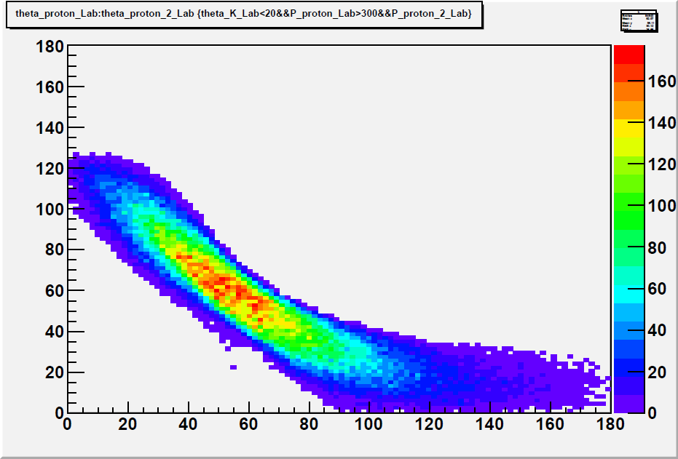
Background suppression by protons tag
angular distribution of 2protons （>300MeV/c) from K⁻pp
K⁻pp → Λ + p₁
Background process
p₂+π⁻
π⁺ + d → Λ* + K⁺ + p_{1s},
Λ* → Σ + π,
Σ⁺ → p₂ + π⁰
K⁻pp → Λ + p₁,
→ p₂ + π⁻
proton1 theta_Lab
P₂ > 250MeV/c
RCA
θ_{P2} < 30°
We can suppress the quasi-free BG by requiring high momentum proton with RCA.
proton2 theta_Lab
18
Notes:
Concentrate
outer region of RCA Acceptance

Slide 19
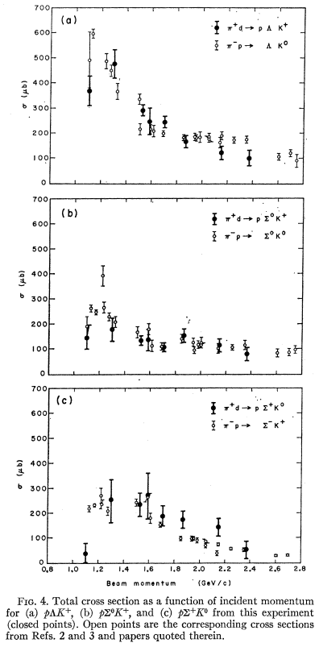

Slide 20
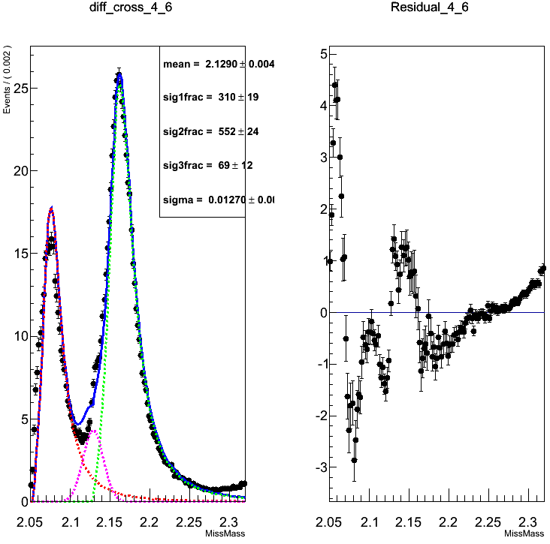
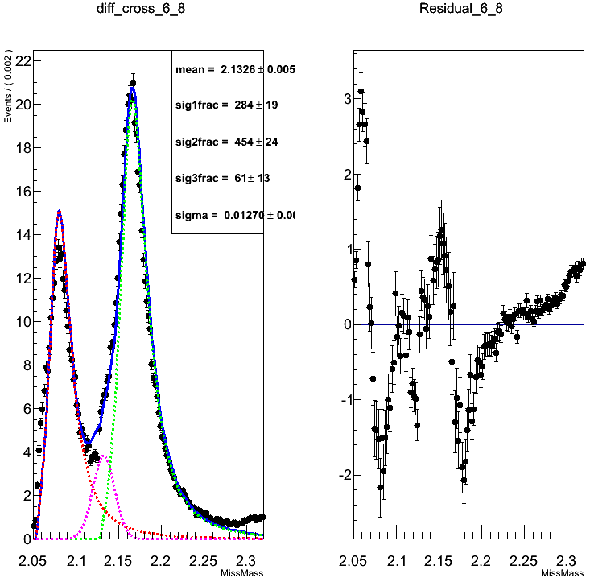
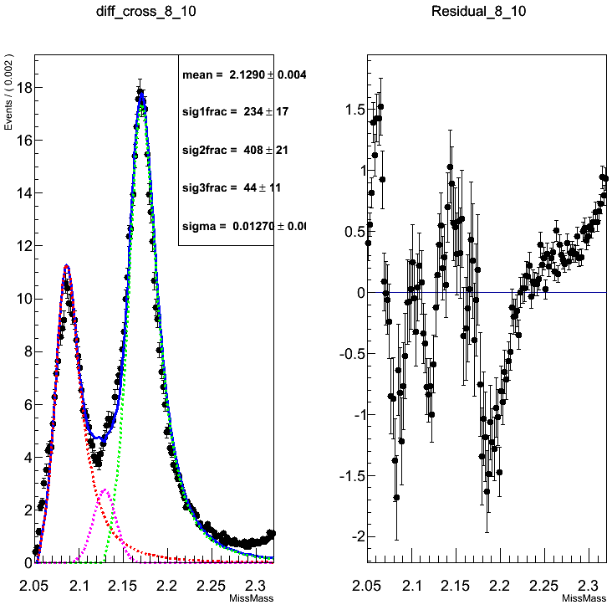
20

Slide 21
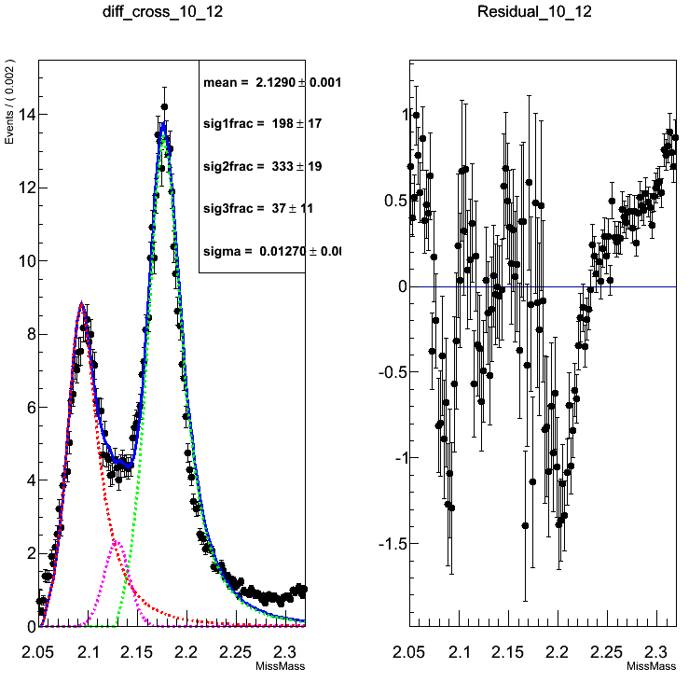
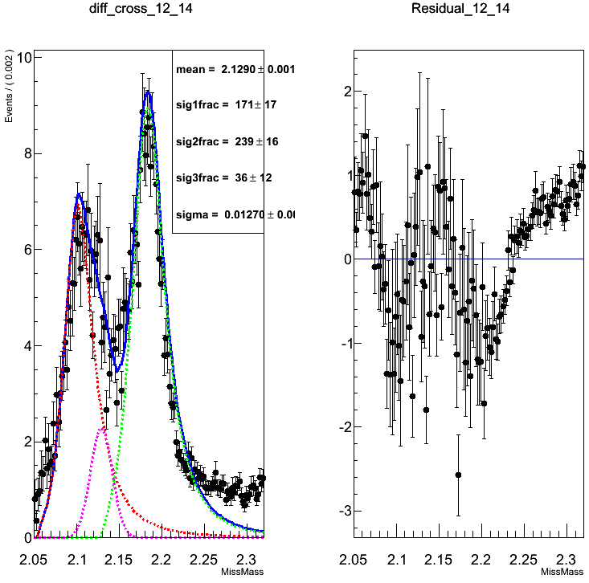
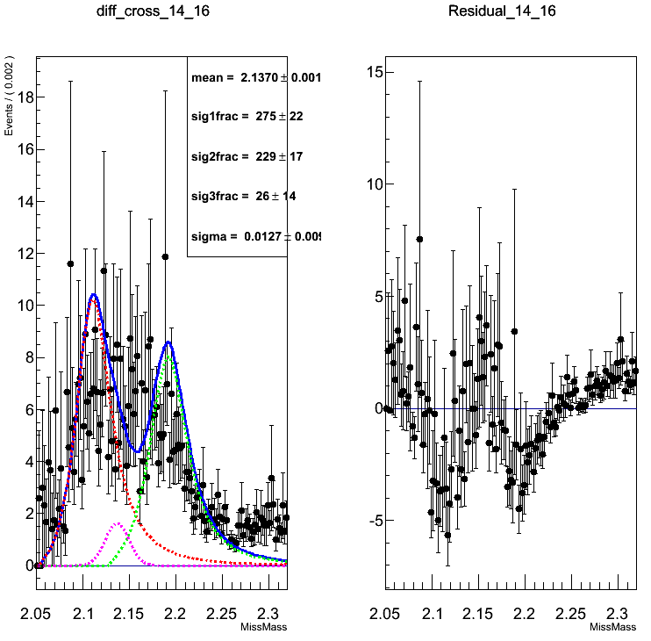
chisqr
2_4deg=12.7784
4_6deg=20.2207
6_8deg=20.5354
8_10deg=16.0251
10_12deg=13.0986
12_14deg=6.94085
14_16deg=2.59671
21

Slide 22
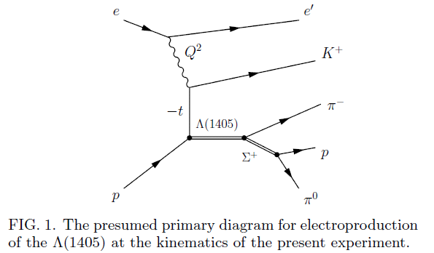
Result from CLASS for Λ(1405)
http://arxiv.org/pdf/1307.4411v1.pdf
<abstract>

Slide 23
