Slide 1
Be同位体における
Λ粒子による核構造の変化
井坂政裕(理研)
共同研究者：本間裕明，木村真明(北大)

Slide 2
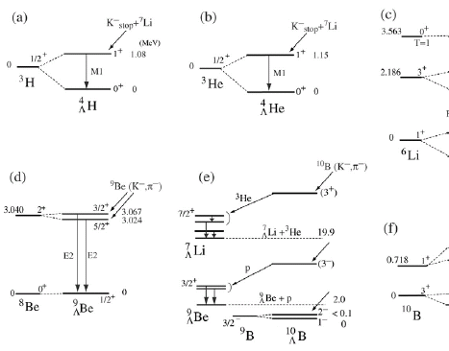
Structure study of Λ hypernuclei
Study of light(s, p-shell) Λ hypernuclei
  Knowledge of ΛN effective interaction
    Accurate solution of few-body problems ^{[1]}
    ΛN G-matrix effective interactions ^{[2]}
    Increases of experimental information ^{[3]}
Development of theoretical models
  Through the study of unstable nuclei
  Ex.: Antisymmetrized Molecular Dynamics (AMD)^{[4]}
      AMD describes dynamical changes of various structure
      No assumption on clustering and deformation
Systematic (theoretical) study of Λ hypernuclear structure
“Structure changes by hyperon”
[1] E. Hiyama, NPA 805 (2008), 190c, [2] Y. Yamamoto, et al., PTP Suppl. 117 (1994), 361.,
[3] O. Hashimoto and H. Tamura, PPNP 57 (2006), 564., [4] Y. Kanada-En’yo et al., PTP 93 (1995), 115.

Slide 3






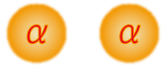
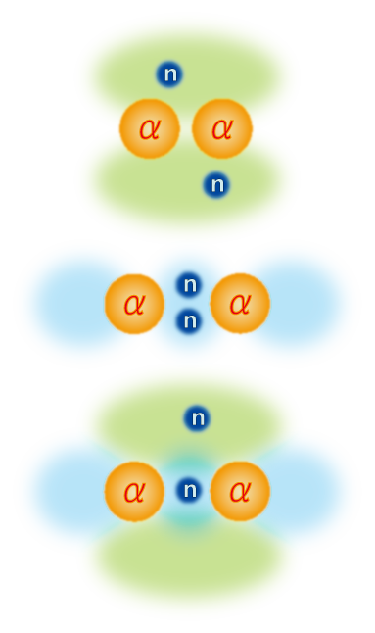
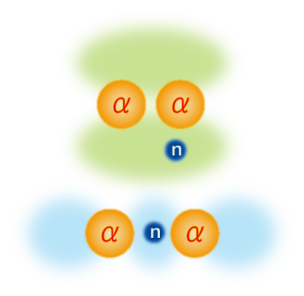
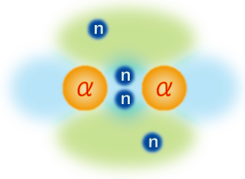
Structure of Be isotopes
  Be isotopes have 2α cluster structure
    2α cluster structure is changed depending on the neutron number
“molecular-orbit”
Y. Kanada-En’yo, et al., PRC60, 064304(1999)
N. Itagaki, et al., PRC62 034301, (2000).
π² config.
σ² config.
σ-orbit
πσ config.
π-orbit
πσ config.

Slide 4
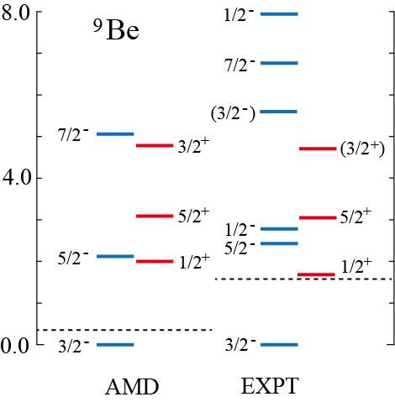
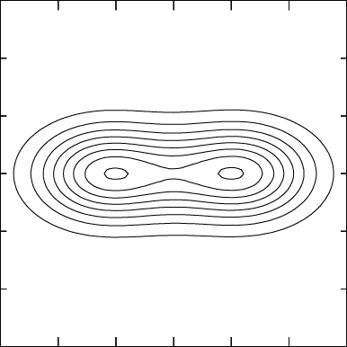
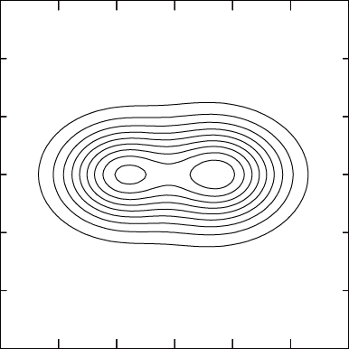
Structure of ⁹Be
⁹Be has 2α + n structure
  The difference of the orbit of the last neutron leads to the difference of deformation
1/2⁺
3/2⁻
β = 1.02
β = 0.73
⁸Be(0⁺) + n(s-orbit)
⁸Be(0⁺) + n(p-orbit)
No barrier
Centrifugal barrier
due to L=1
Large deformation
Small deformation

Slide 5
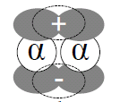
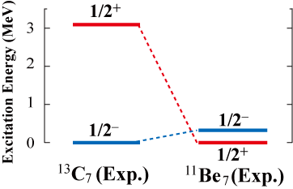

Exotic structure of ¹¹Be
₄
Parity inversion of the ¹¹Be₇ ground state
  The ground state of ¹¹Be is the 1/2⁺
  One of the reasons of the parity inversion is the molecular orbit structure of the 1/2+ and 1/2- states.
¹¹Be 1/2⁻
Vanishing of the magic number N=8
inversion
Extra neutrons in π orbit^{[1]}
(small deformation)
¹¹Be 1/2⁺
Extra neutrons in σ orbit^{[1]}
(large deformation)
Difference of deformation
[1] Y. Kanada-En’yo and H. Horiuchi, PRC 66 (2002), 024305.

Slide 6
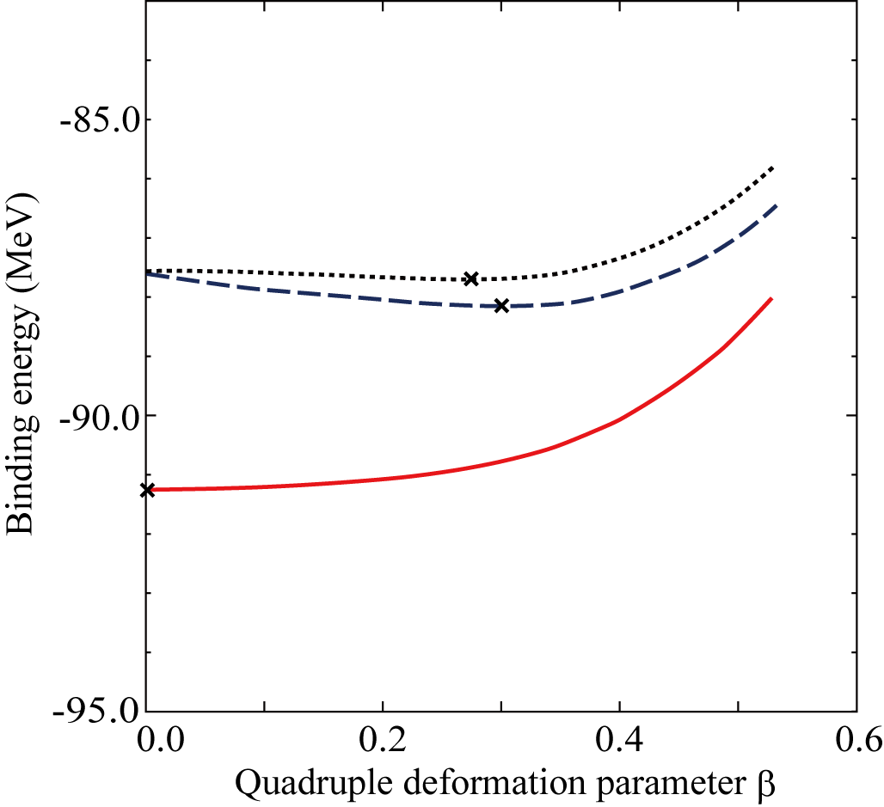
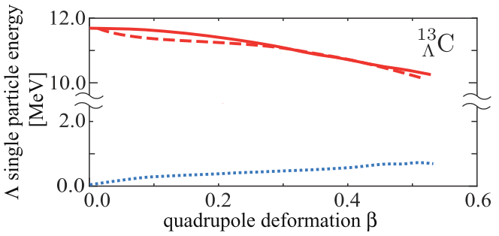
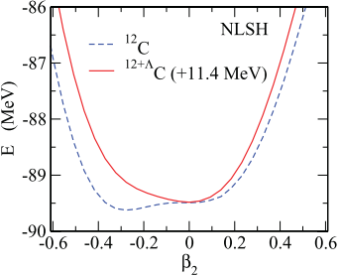
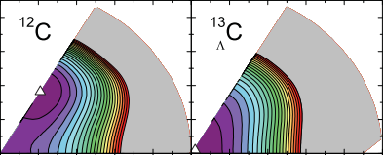
Λ binding energy as a function of β
  Λ in s-orbit is deeply bound with smaller deformation
Example: ¹³_{Λ}C Binding energy of Λ
Energy curves of ¹³_{Λ}C
¹²C(Pos.)⊗Λ(s)
¹²C Pos.
¹²C(Neg)⊗Λ(s)
Λ binding energy [MeV]
E energy (MeV)
¹²C(Pos)⊗Λ(p)
¹²C(Pos)⊗Λ(p)
¹²C(Pos)⊗Λ(s) + 8.0MeV
M. Isaka, et. al., PRC 83 (2011), 044323.
M. T. Win and K. Hagino, PRC78, 054311(2008)
Bing-Nan Lu, et al., PRC 84, 014328 (2011)

Slide 7
Purpose of this study
Purpose of this study
  To reveal how Λ hyperon affects and modifies the low-lying states of Be isotopes with different deformation
  Examples:
  ¹⁰_{Λ}Be: ground and 1/2+ resonance states of ⁹Be
  ¹²_{Λ}Be: abnormal parity ground state of ¹¹Be
Method
  HyperAMD (Antisymmetrized Molecular Dynamics for hypernuclei)
    No assumption on 2α cluster structure
    AMD has succeeded in the structure studies of Be isotopes
  YNG-interaction (NSC97f, NF)

Slide 8
Theoretical framework: HyperAMD
  We extended the AMD to hypernuclei
  HyperAMD (Antisymmetrized Molecular Dynamics for hypernuclei)
Hamiltonian
    NN：Gogny D1S
    ΛN：YNG interaction (NSC97f, NF^{[１]})
Wave function
Nucleon part：Slater determinant
Spatial part of single particle w.f. is
described as Gaussian packet
Single particle w.f. of Λ hyperon:
Superposition of Gaussian packets
Total w.f.：
[1] Y. Yamamoto, T. Motoba, H. Himeno, K. Ikeda and S. Nagata, Prog. Theor. Phys. Suppl. 117 (1994), 361.
[2] E. Hiyama, M. Kamimura, T. Motoba, T. Yamada and Y. Yamamoto, Prog. Theor. Phys. 97 (1997), 881.

Slide 9
Theoretical Framework (AMD^{[1],[2]})
Procedure of the calculation
Variational Calculation
Imaginary time development method
Variational parameters:
Angular Momentum Projection
Generator Coordinate Method(GCM)
Superposition of the w.f. with different configuration
Diagonalization of and
[1] Y. Kanada-En’yo, H. Horiuchi and A. Ono, Phys. Rev. C 52 (1995), 628.
[2] H. Matsumiya, K. Tsubakihara, M. Kimura, A. Doté and A. Ohnishi, To be submitted

Slide 10
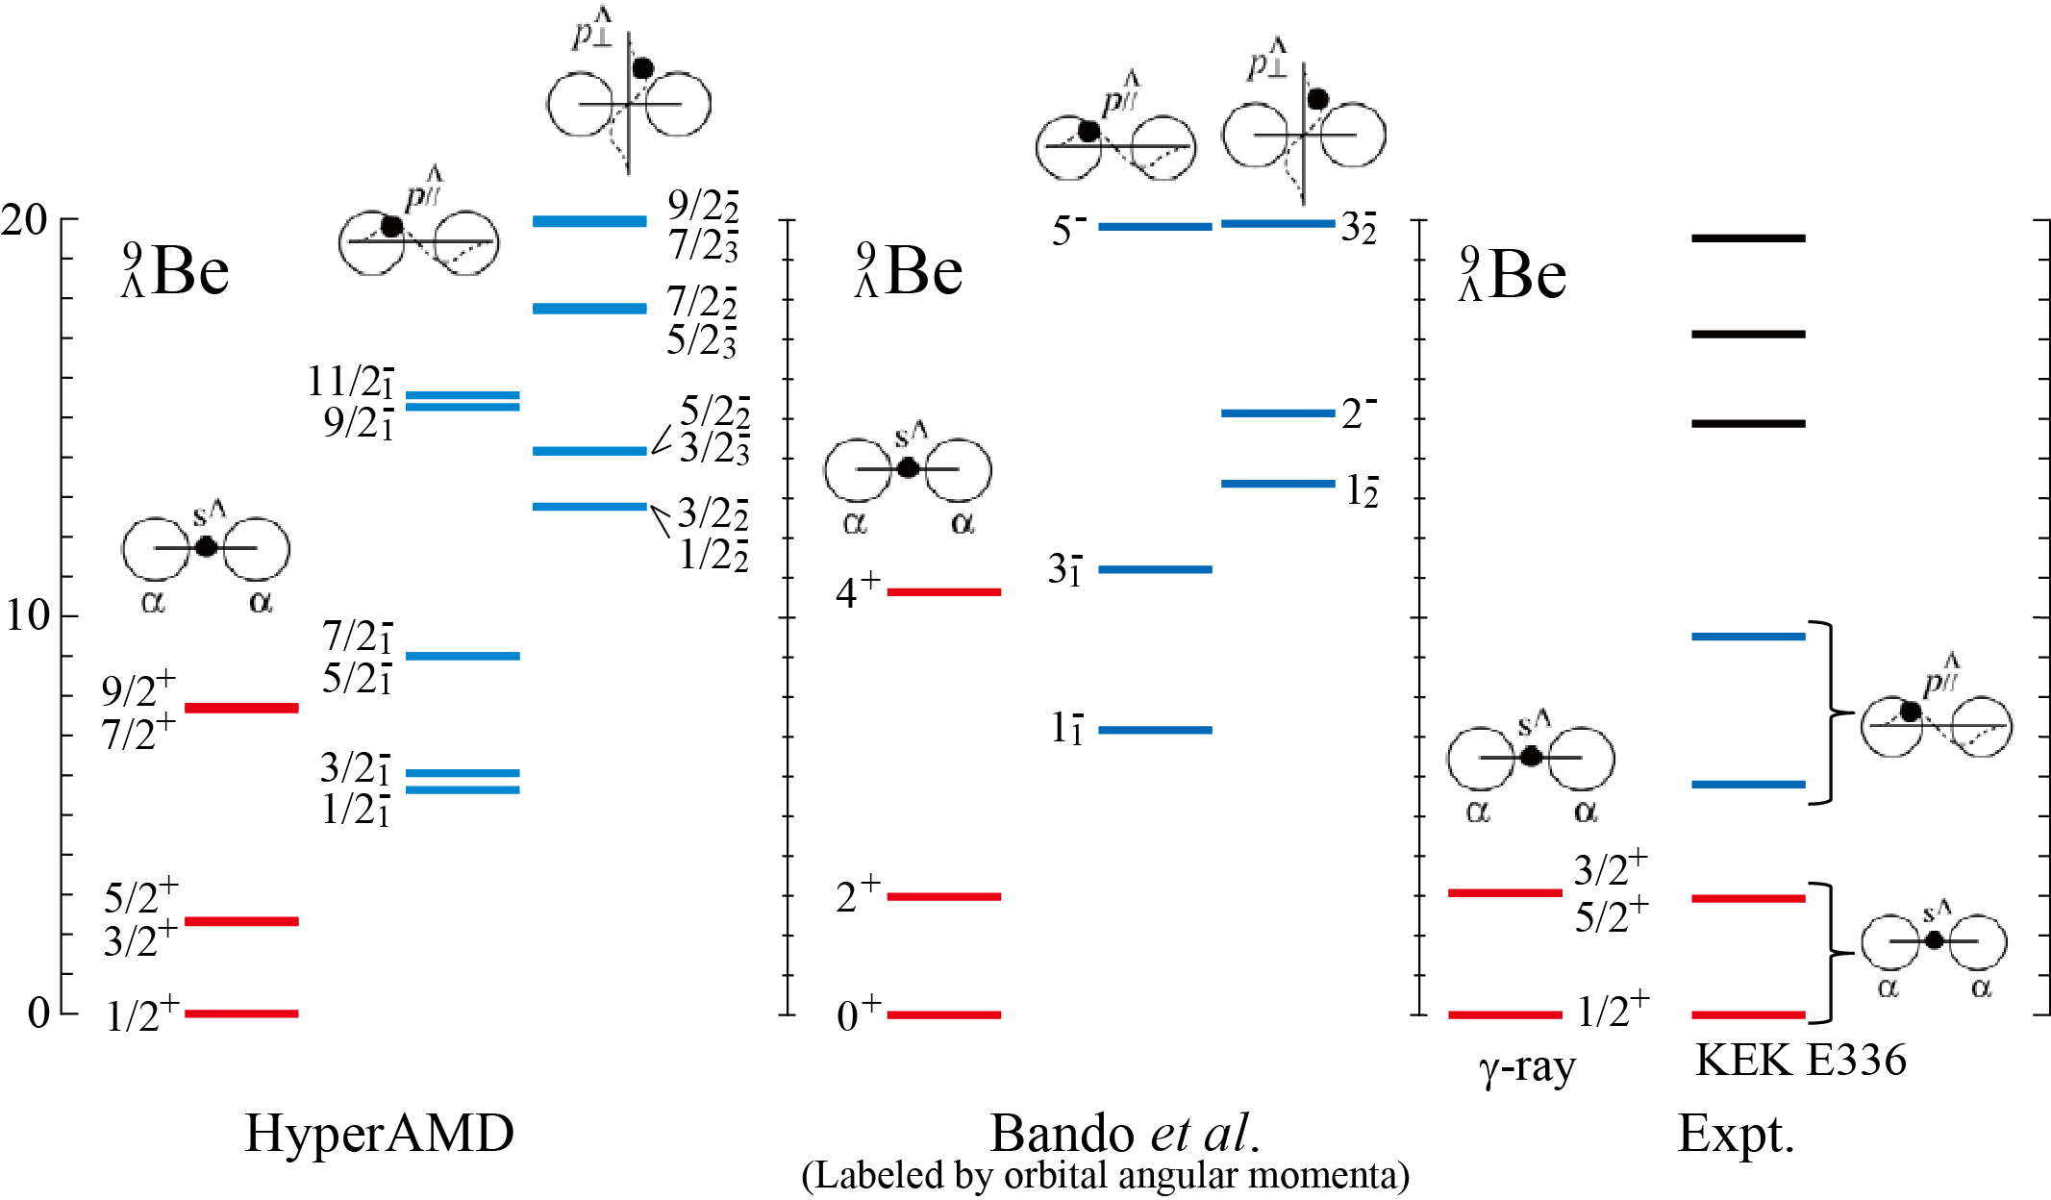
Application to ⁹_{Λ}Be hypernucleus
[2]
[3]
[1]
[1] Bando et al., PTP 66 (1981) 2118.
[2] M. May et al., PRL 51 (1983) 2085; H. Akikawa et al., PRL 88 (2002) 082501.
[3] O. Hashimoto et al., NPA 639 (1998) 93c

Slide 11
Level structure of ¹⁰_{Λ}Be

Slide 12
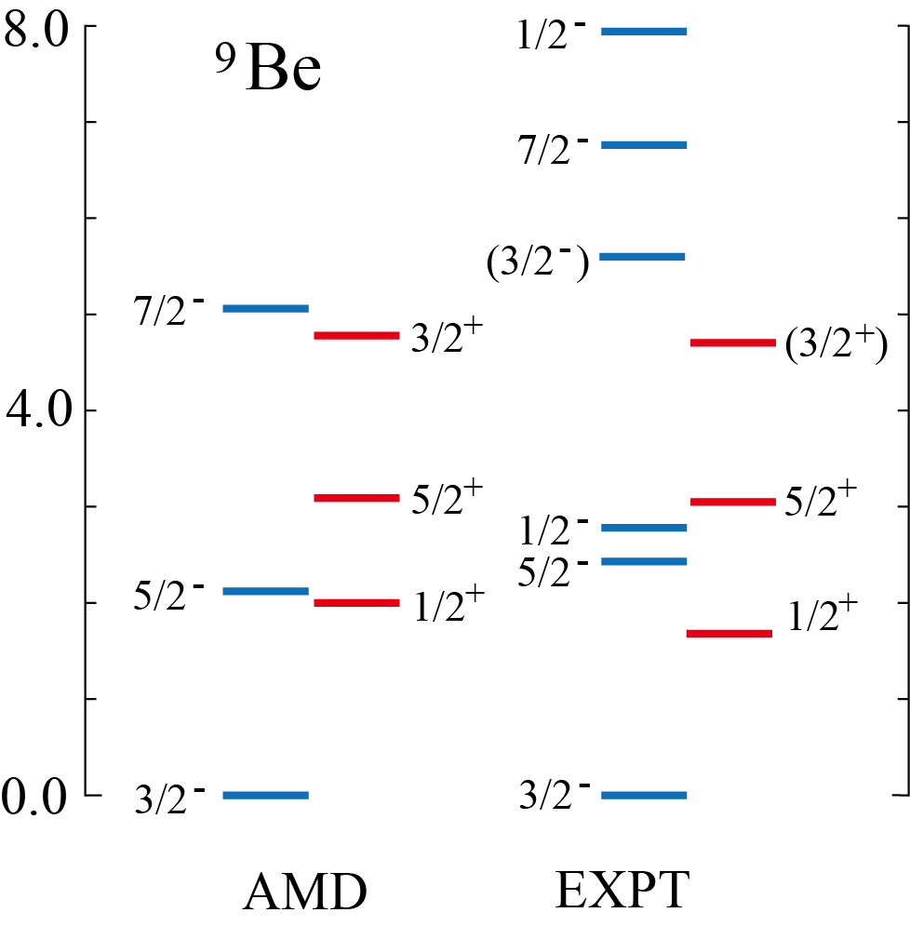
Structure of ⁹Be
⁹Be has 2α + n structure
  The difference of the orbit of the last neutron leads to the difference of deformation
1/2⁺
3/2⁻
β = 1.02
β = 0.73
⁸Be(0⁺) + n(s-orbit)
⁸Be(0⁺) + n(p-orbit)
No barrier
Centrifugal barrier
due to L=1
Large deformation
Small deformation
How does Λ hyperon modify the level structure with different deformation?

Slide 13
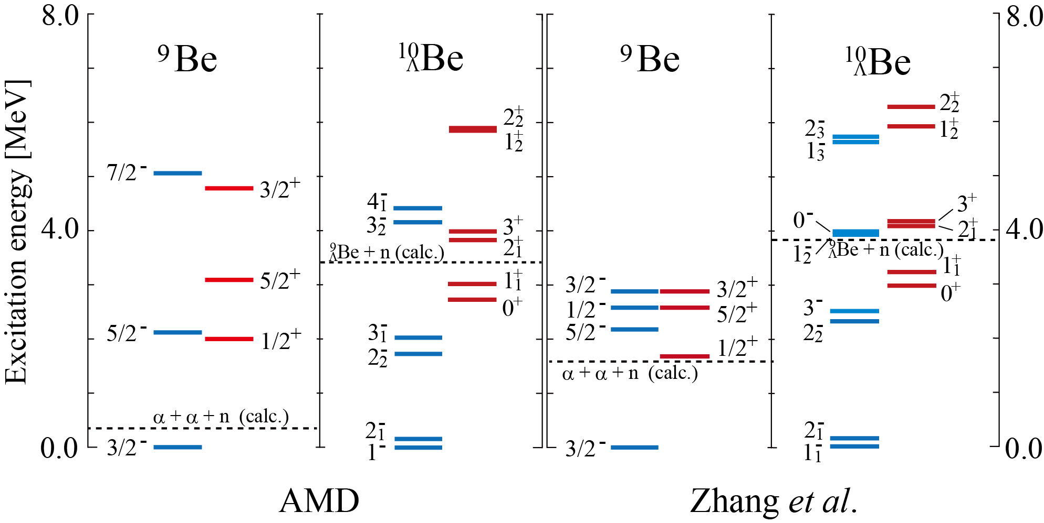
Excitation spectra of ¹⁰_{Λ}Be
Four-body cluster model

Slide 14
Excitation spectra of ¹⁰_{Λ}Be
Four-body cluster model
Y. Zhang, E. Hiyama, Y. Yamamoto, NPA 881, 288 (2012).
Positive parity states in ¹⁰_{Λ}Be are shifted up by Λ hyperon

Slide 15
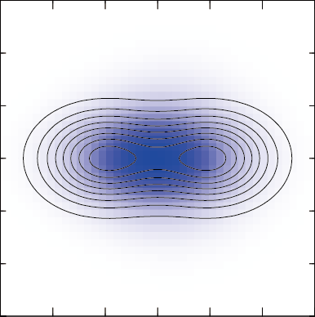
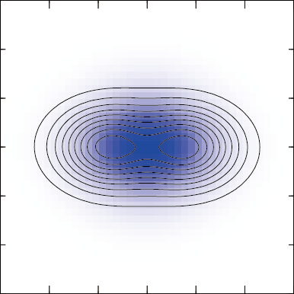
Binding energy of Λ hyperon
Shift up of the positive parity states
  Λ hyperon coupled to the 3/2⁻ state is more deeply bound due to the smaller deformation.
  Λ hyperon in s-orbit is deeply bound with small nuclear deformation
0⁺ (1/2⁺⊗Λs)
1/2⁺
⁹Be
¹⁰Be
_{Λ}
r = 2.94fm
B_{Λ}= 8.2 MeV
2.0 MeV
β = 0.92
β = 1.02
r = 2.82fm
r = 2.55fm
1⁻ (3/2⁻⊗Λs)
3/2⁻
B_{Λ}= 8.9 MeV
2.7 MeV
r = 2.46fm
β = 0.70
β = 0.73

Slide 16
Ground state parity of ¹²_{Λ}Be

Slide 17
Exotic structure of ¹¹Be
₄
Parity inversion of the ¹¹Be₇ ground state
  The ground state of ¹¹Be is the 1/2⁺
  One of the reasons of the parity inversion is the molecular orbit structure of the 1/2+ and 1/2- states.
¹¹Be 1/2⁻
Vanishing of the magic number N=8
inversion
Extra neutrons in π orbit^{[1]}
(small deformation)
¹¹Be 1/2⁺
Extra neutrons in σ orbit^{[1]}
(large deformation)
Difference of deformation
How does the Λ hyperon affect the parity-inverted ground state?
[1] Y. Kanada-En’yo and H. Horiuchi, PRC 66 (2002), 024305.

Slide 18
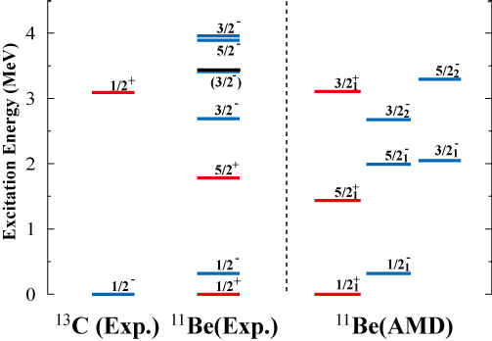
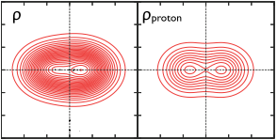
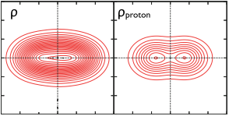
Excitation spectra of ¹¹Be
¹³C(Exp)
¹¹Be(Exp)
¹¹Be(AMD)
¹¹Be 1/2⁻
β=0.52
¹¹Be 1/2⁺
β=0.72
Deformation of the 1/2⁻ state is smaller than that of the 1/2⁺ state
Λ hyperon in s orbit is deeply bound at smaller deformation
  Parity reversion of the ¹²_{Λ}Be ground state may occur by Λ in s orbit

Slide 19
Excitation spectra of ¹¹Be
¹³C(Exp)
¹¹Be(Exp)
¹¹Be(AMD)
¹¹Be 1/2⁻
β=0.52
¹¹Be 1/2⁺
B_{Λ}
B_{Λ}
β=0.72
Reversion?
¹²_{Λ}Be
Deformation of the 1/2⁻ state is smaller than that of the 1/2⁺ state
Λ hyperon in s orbit is deeply bound with smaller deformation
  Parity reversion of the ¹²_{Λ}Be ground state may occur by Λ in s orbit

Slide 20
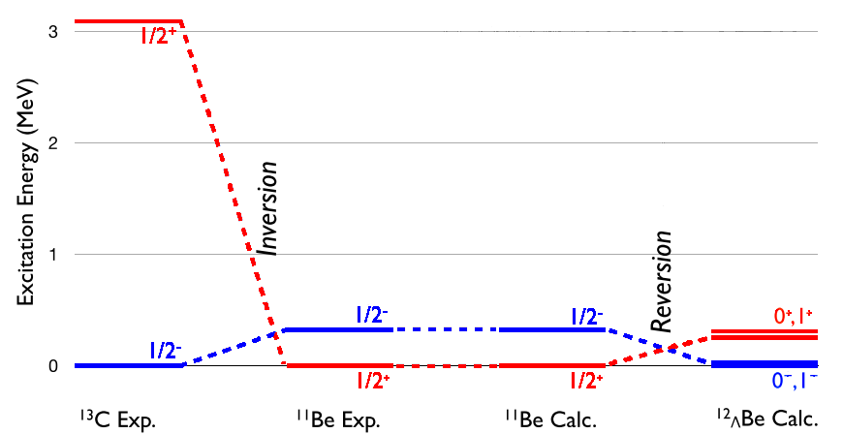
Results: Parity reversion of ¹²_{Λ}Be
Ground state of ¹²_{Λ}Be
  The parity reversion of the ¹²_{Λ}Be g.s. occurs by the Λ hyperon
3.0
2.0
¹³C₇
¹¹Be₇
¹¹Be₇
¹²_{Λ}Be
(Exp.)
(Exp.)
(AMD)
Excitation Energy (MeV)
(HyperAMD)
1.0
0.0

Slide 21
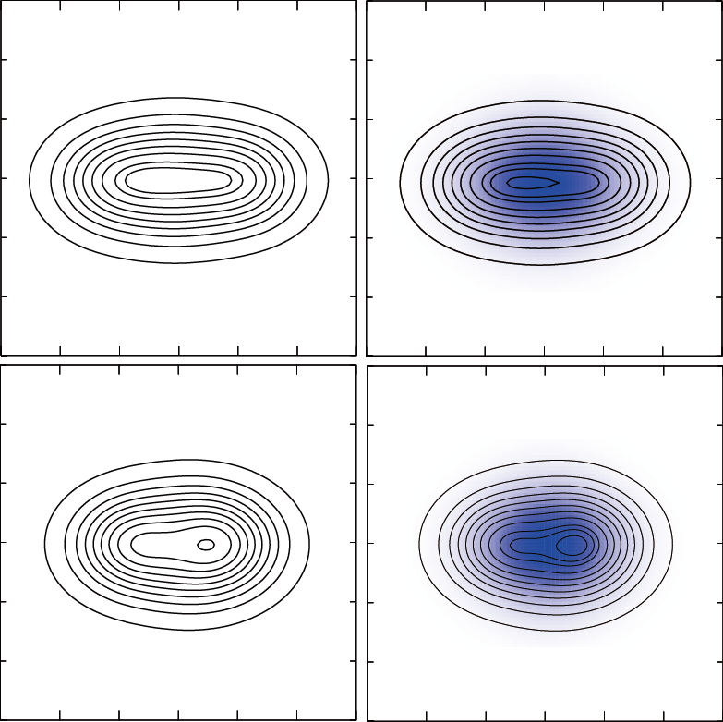
Deformation and Λ binding energy
  Λ hyperon coupled to the 1/2⁻ state is more deeply bound than that coupled to the 1/2⁺ state
    Due to the difference of the deformation between the1/2⁻ and 1/2⁺ states
1/2⁻
¹¹Be
¹²Be
_{Λ}
0⁺ (1/2⁺⊗Λs)
(Calc.)
(Calc.)
r = 2.53 fm
β=0.52
0.32 MeV
B_{Λ} = 10.24 MeV
β=0.70
1/2⁺
r = 2.69 fm
0⁻ (1/2⁻⊗Λs)
B_{Λ} = 9.67 MeV
r = 2.67 fm
0.25 MeV
β=0.72
r = 2.51 fm
β=0.47

Slide 22
Glue-like role in ¹⁰_{Λ}Be

Slide 23
Glue-like role of Λ hyperon in ¹⁰_{Λ}Be
Y. Zhang, E. Hiyama, Y. Yamamoto, NPA 881, 288 (2012).
The resonance (virtual) state 1/2+ will bound by adding Λ hyperon

Slide 24
Glue-like role of Λ hyperon in ¹⁰_{Λ}Be
Y. Zhang, E. Hiyama, Y. Yamamoto, NPA 881, 288 (2012).
The resonance (virtual) state 1/2+ will bound by adding Λ hyperon

Slide 25
Summary
Summary
  To reveal how Λ hyperon affects and modifies the low-lying states of Be isotopes with different deformation, we applied the HyperAMD to ¹⁰_{Λ}Be and ¹²_{Λ}Be.
  We focus on the positive and negative parity states in ¹⁰_{Λ}Be and ¹²_{Λ}Be
    Λ hyperon coupled to compact state is more deeply bound
    ¹⁰_{Λ}Be: pos. parity states are shifted up by Λ hyperon
    ¹²_{Λ}Be: the parity reversion of the ground state will occur.
  In ¹⁰_{Λ}Be, the resonance (virtual) state 1/2⁺ in ⁹Be will be bound by Λ hyperon
Future plans
  To reveal how Λ hyperon affects the 2α clustering and orbit of extra neutrons
  To predict production cross section of ¹⁰_{Λ}Be, ¹²_{Λ}Be etc.
Consistent with the prediction of ¹³_{Λ}C by Hiyama et al.
Systematic structure study of Be hyper isotopes

