Slide 1
反対称化分子動力学による
Drip-line核の研究に向けて
M. Kimura (Hokkaido Univ.)

Slide 2
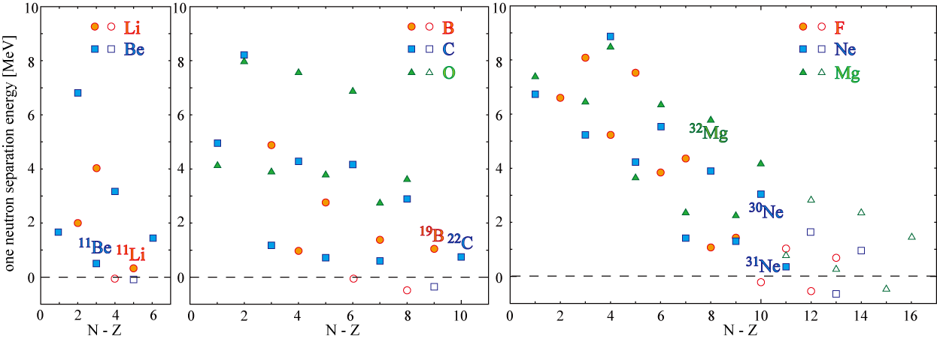
Introduction: Drip-lineへの実験の進展
A～40程度までのdrip-lineに実験が到達しつつある
  Beam intensityの大幅な向上
  豊富な実験ツール – クーロン励起, クーロン分解 ⇒ (p,p’), (p,2p) –
  豊富な分光学的情報 – Ex, B(EM), Γ, S-factor, momentum-distribution, etc…
Drip-line近傍での興味
  安定核とは異なる極端な環境下での核子相関 (di-neutron, 2n-BEC, …)
  Shell orderの変化に伴う変形共存
  弱束縛による特異な核構造の出現
  Unbound nucleus

Slide 3
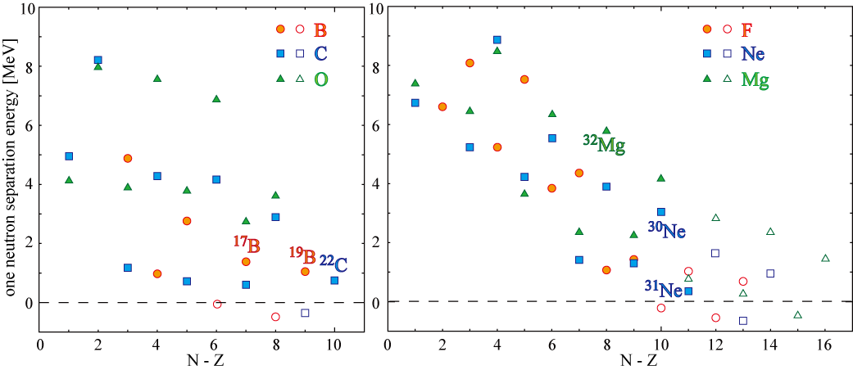
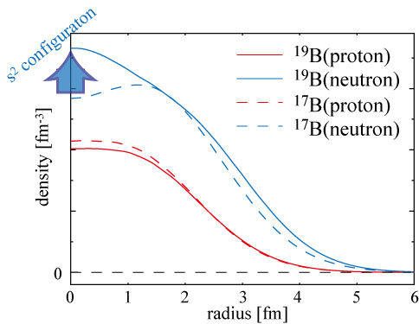
Introduction: Drip-lineでの興味
Drip-line近傍での興味
  変形共存 + 1n, 2n-halo (³¹Ne, ¹⁹B, …)
Y. Kanada-En’yo, PRC71, 014303 (2005)
With Gogny D1S
¹⁷B: prolate 3/2⁻
¹⁹B: oblate 3/2⁻
(a few MeV unbound)
prolate 3/2⁻
(E_{x} ～ 4 MeV)

Slide 4
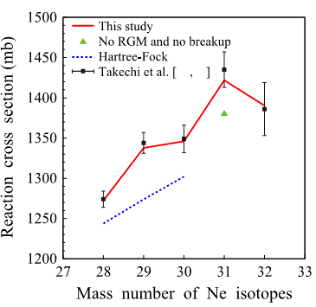

Introduction: Drip-lineでの興味
Drip-line近傍での興味
  変形共存 + 1n, 2n-halo (³¹Ne, ¹⁹B, …)
M. K and H.Horiuchi PTP111,841 (2004).
異なった変形状態(ph 配位)
と余剰中性子の結合
K. Minomo et al PRL108, 052503 (2012)

Slide 5
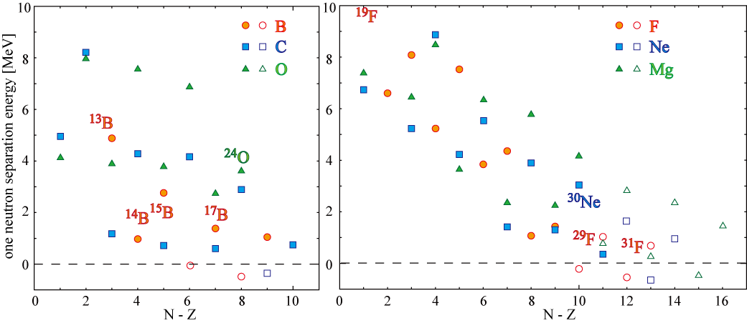
Introduction: Drip-lineでの興味
Drip-line近傍での興味
  Drip-lineを超えた領域での殻構造 (unbound Oxygen isotopes)
  過剰中性子による、クラスター構造の発達
Y. Kanada-En’yo and H.Horiuchi, PRC52, 647 (1995)
中性子数の増加に伴うクラスターの発達
¹¹B
¹³B
¹⁵B
¹⁷B
¹⁹B

Slide 6
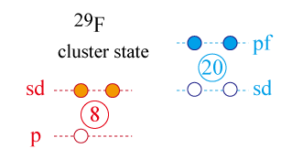
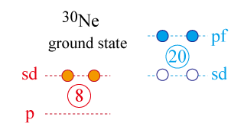
Introduction: Drip-lineでの興味
Drip-line近傍での興味
  Drip-lineでの殻構造 (unbound Oxygen isotopes)
  過剰中性子による、クラスター構造の発達
M. K and N.Furutachi PRC83,044304 (2011).

Slide 7
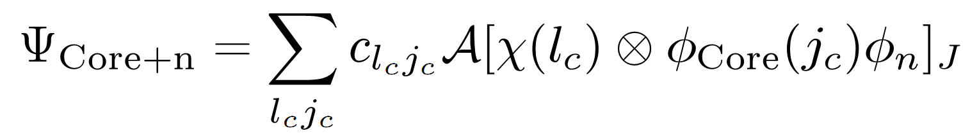
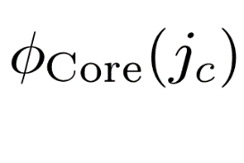
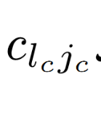
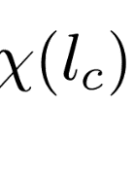
Drip-line核の記述
単純な構造を仮定できないコアに、余剰核子が付随した系を記述
  変形共存 + 1n, 2n-halo (³¹Ne, ¹⁹B, …)
  コアの変形共存と弱束縛中性子を同時に記述
  Drip-lineを超えた領域の殻構造 (unbound Oxygen isotopes)
  連続状態、共鳴状態の記述
  過剰中性子による、クラスター構造の発達
  Z±1 の中性子過剰核への1p-transfer, 1p-pickup
  S-factor for transfer, pickup reactions
そうした方法の一つとして、反対称化分子動力学(AMD)を使う
コア核: AMDで記述
各チャンネルの重みと, 中性子の波動関数: RGM(GCM)を解く

Slide 8
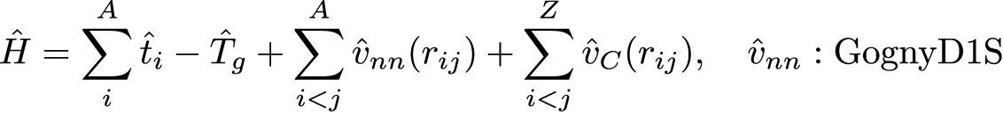
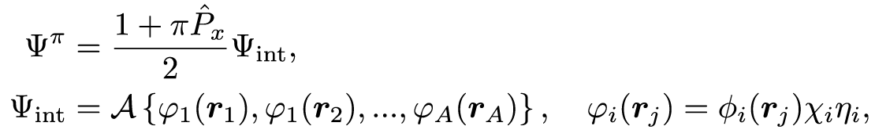
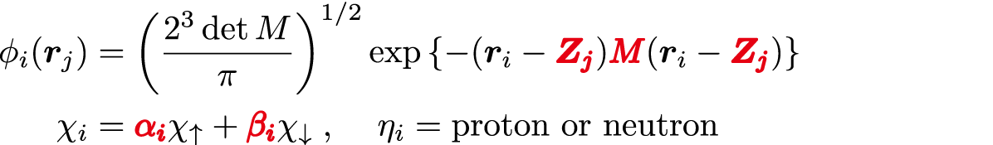
AMD Framework (コアの記述)
A-body Hamiltonian
Gogny D1S effective interaction, Exact removal of spurious c.o.m. motion
Variational wave function
Variational calculation after parity projection
Single particle wave function is represented by a deformed Gaussian wave packet

Slide 9
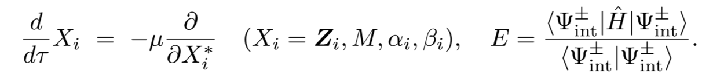
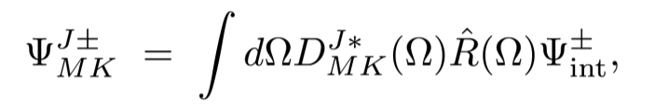
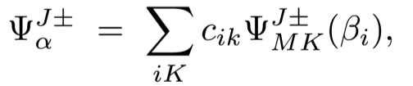
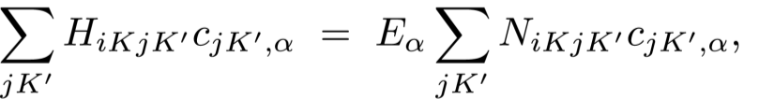
AMD Framework (コアの記述)
1. Energy variation with the constraint on the Quadrupole deformation β
2. Angular momentum projection
3. GCM
Configuration mixing between the states with different deformation and configurations
Solve Hill-Wheeler eq. to obtain eigenvalue and eigenfunction

Slide 10
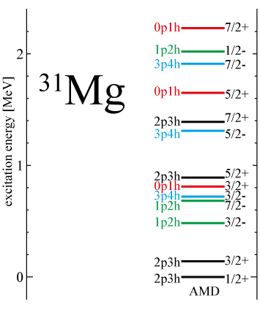
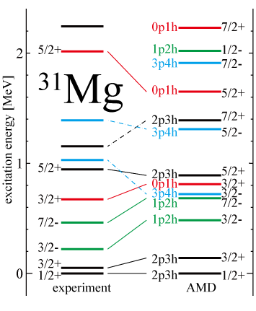
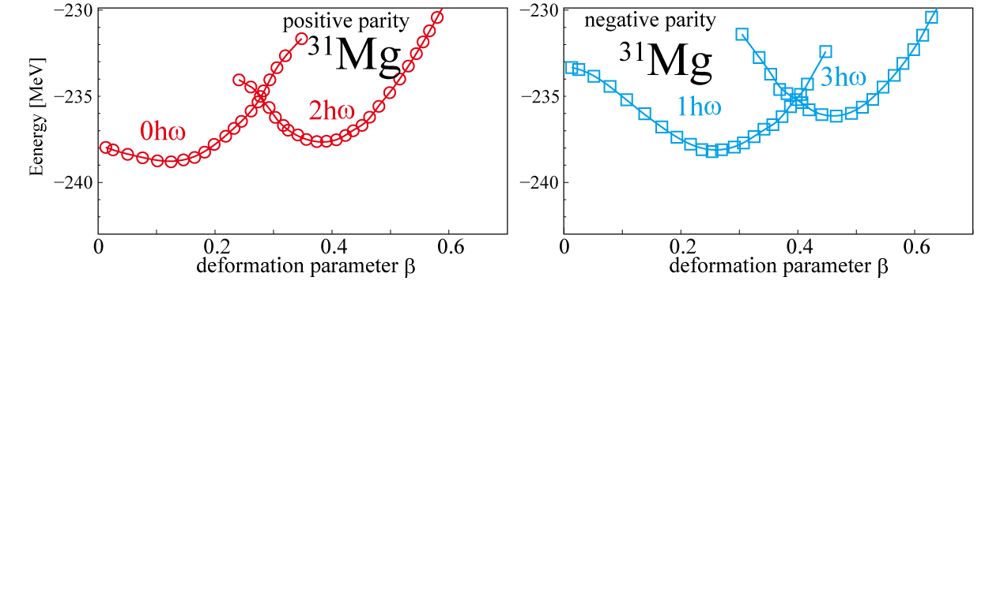
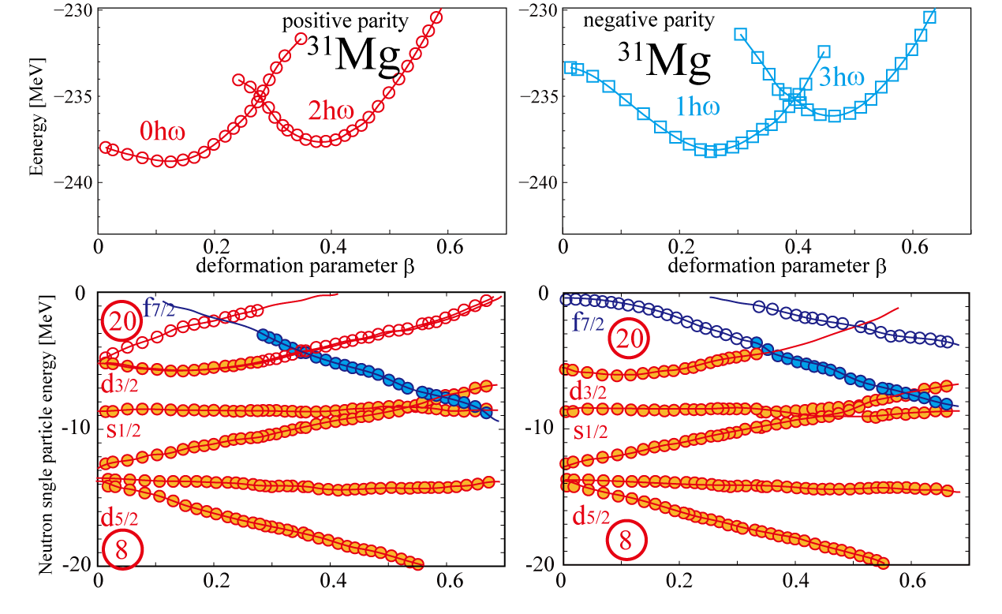
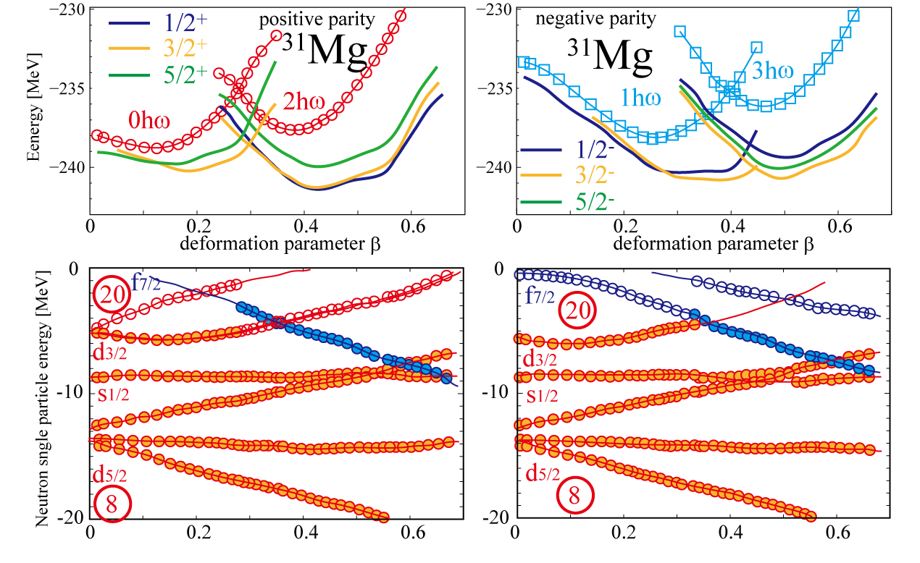
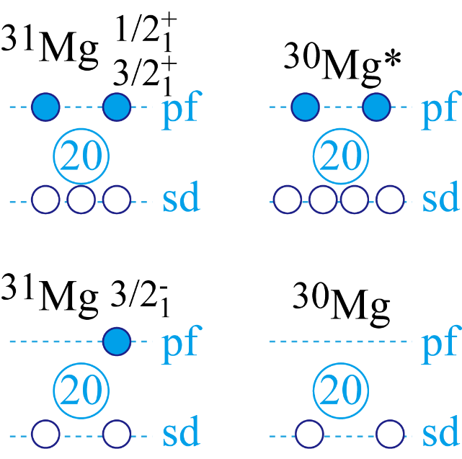





コアの変形共存
Coexistence of many particle-hole
states at very small excitation
energy has been predicted by AMD
Coexistence of many particle-hole
states with different deformations
(shape coexisting phenomena) is
now establishing
$1/2_{1}^{+}$, $3/2_{1}^{+}$ (2p3h): ³⁰Mg*(2p4h)$⊗ν$
$3/2_{1}^{−}$ (1p2h): ³⁰Mg(0p2h)$⊗ν$
M. Kimura, Phys.Rev. C 75, 041302 (2007)
3. GCM
1. Energy variation with the constraint on the Quadrupole deformation β
2. Angular momentum projection
G. Neyens, PRC84, 064301 (2011)
Single particle energy and wave function
Construct single particle Hamiltonian from variational results
and diagonalize it.

Slide 11


AMD + RGM (core + 1n, 2n system)
Solve core + 1n, 2n system (Coupled Channnel Core + n RGM)
: Wave function of the core described AMD+GCM method
(In the case of the ³⁰Ne+n system, the core is ³⁰Ne.
is a linear combination of J^{π} projected Slater determinants)
: Valence neutron
(In the case of the Core+2n system, there are two )
: Coefficient of each channels, and relative wave function
between the core and valence neutrons
(They are the unknown variables (functions) to be calculated
by this method)

Slide 12
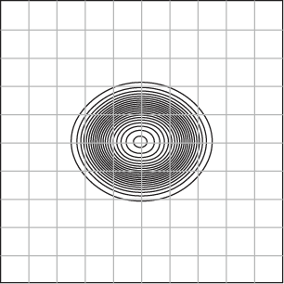
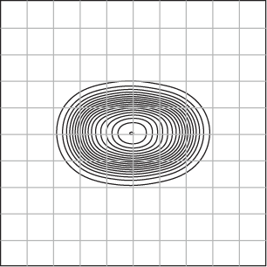
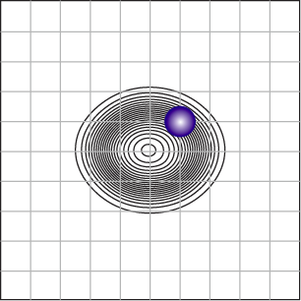
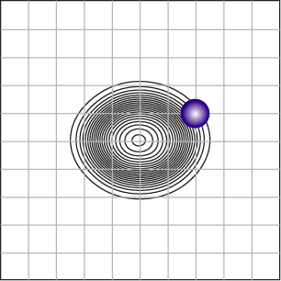
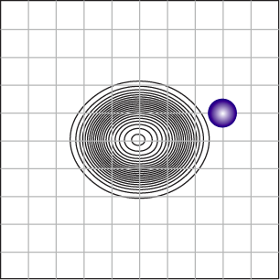
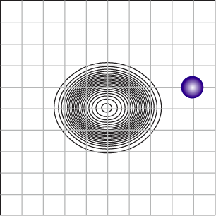
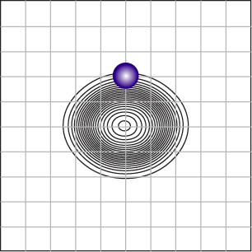
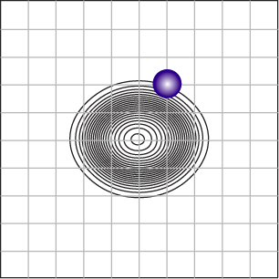
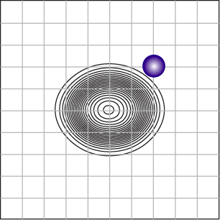
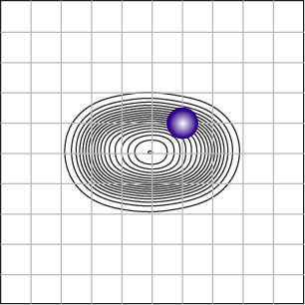
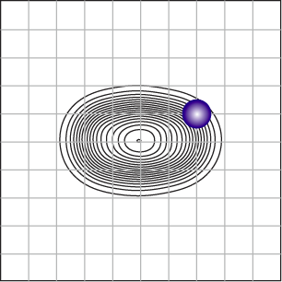
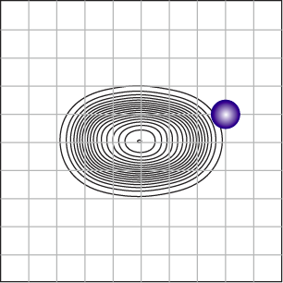
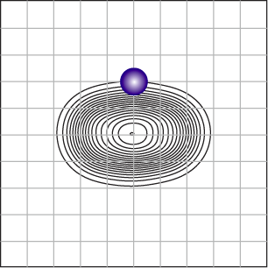
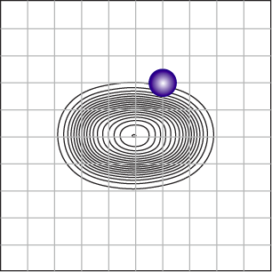
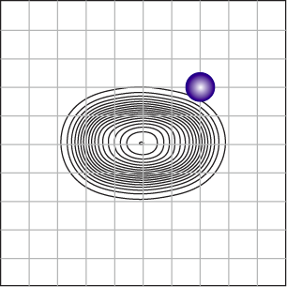
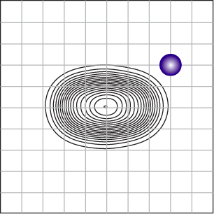
AMD + RGM (core + 1n, 2n system)
In the practical calculation, the RGC wave function is transformed to the GCM wave functions. (straightforward but CPU demanding )
The core is a linear combination of different shapes (AMD+GCM w.f)
=
+
+ …
The basis wave functions of AMD+RCM
And, we diagonalize total Hamiltonian for Core + n (2n) system

Slide 13
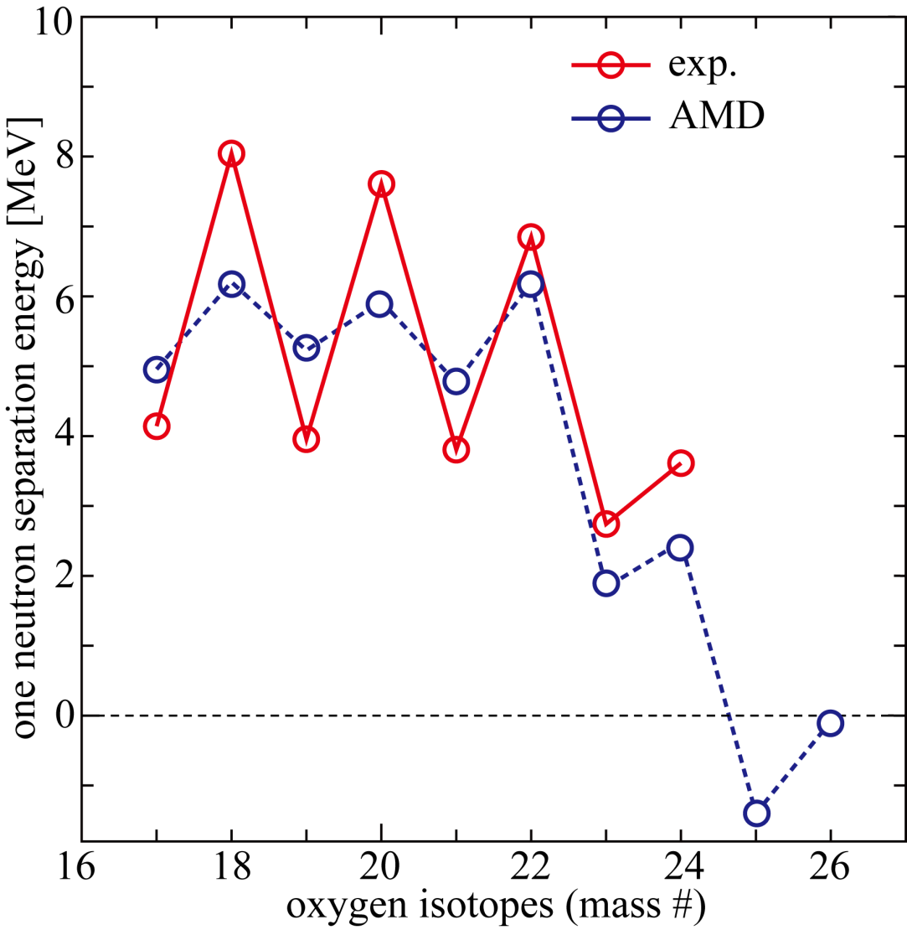
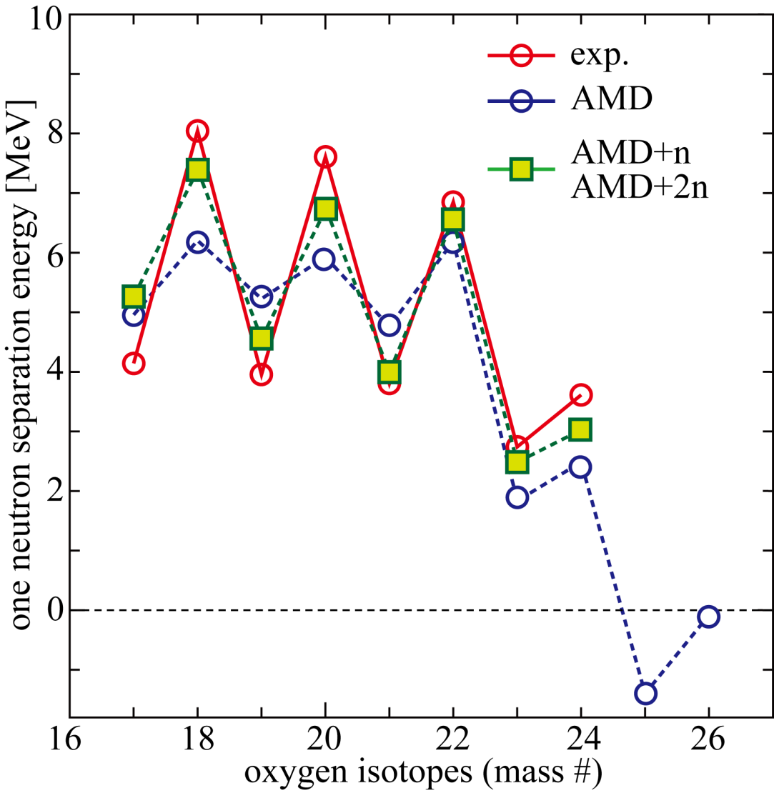
AMD + RGM (core + 1n, 2n system): O isotopes
AMD Results (Blue Symbols)
Correct description of neutron
drip-line (Gogny D1S)
Underestimation of even-odd
staggering
(Pairing correlation is not enough?)
Underestimation of Sn for ²³O
and ²⁴O (1s orbit)
AMD+RGM Results (Green Symbols)
Better staggering
( (1s_{1/2})² and (0d_{3/2})² pairs )
Improvement of the last neutron(s)
orbital in ²³O and ²⁴O (1s orbit).

Slide 14
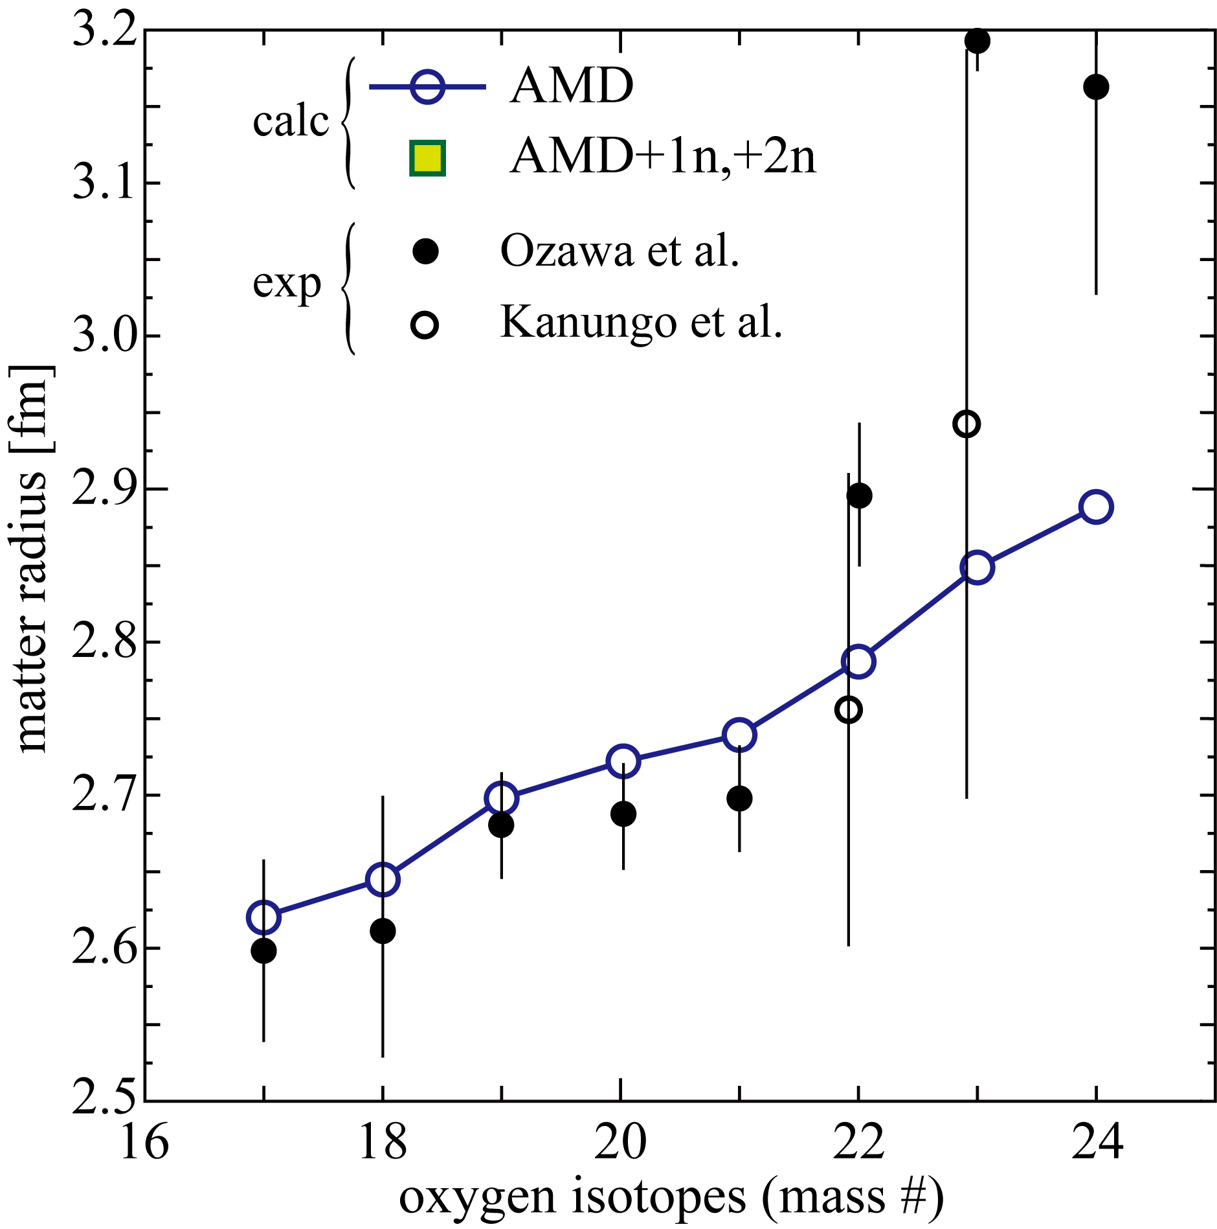
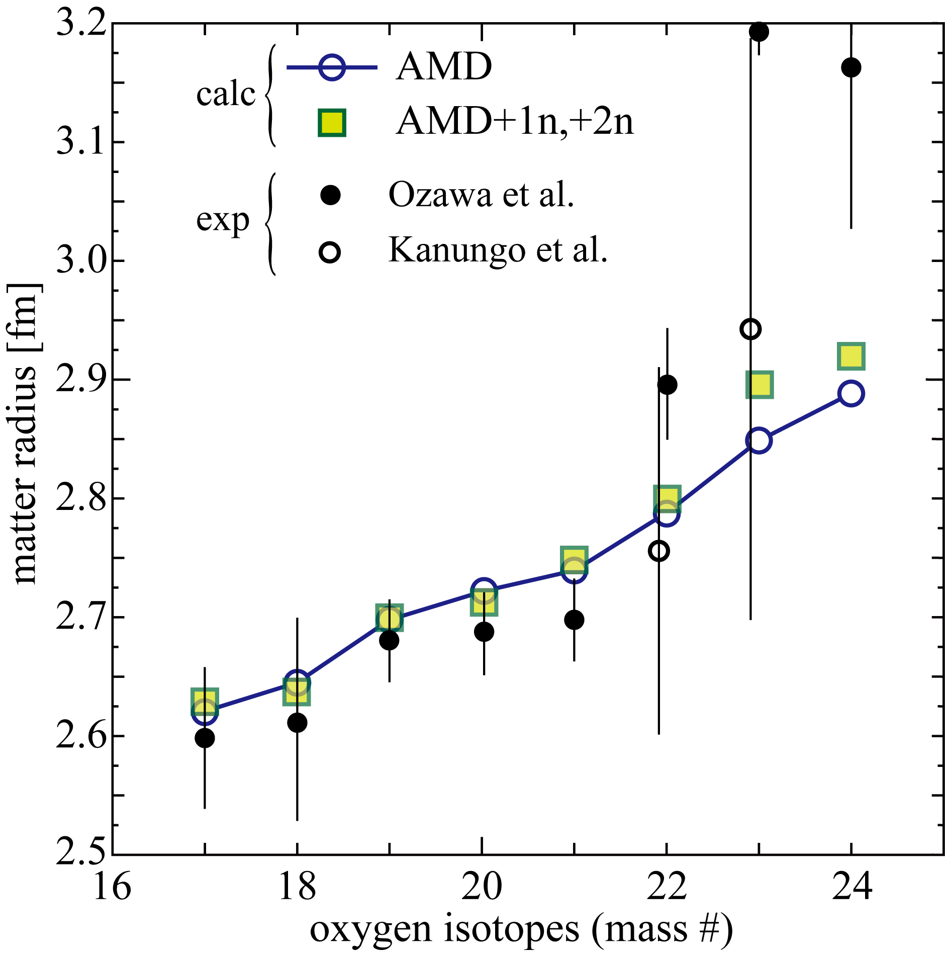
AMD + RGM (core + 1n, 2n system): O isotopes
AMD Results (Blue Symbols)
Overestimation for light isotopes
Monotonic increase of radii in the
calculation, while ²³O and ²⁴O
show drastic increase in the
observation
AMD+RGM Results (Green Symbols)
Almost no effect for light isotopes
(d_{5/2}) dominance
Slight increase in ²³O and ²⁴O
(1s_{1/2}). But not enough to explain
the observation.

Slide 15
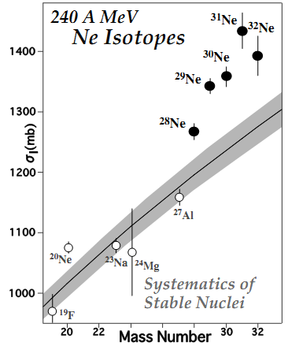
1n Halo of ³¹Ne(N=21)
Coulomb breakup, and enhanced B(E1)
Observed large cross section can be explained with l= 1, 2
Large Interaction cross section
M. Takechi, et. al., Nucl. Phys. A 834, (2010), 412
T. Nakamura, et. al., PRL103, 262501 (2009)

Slide 16
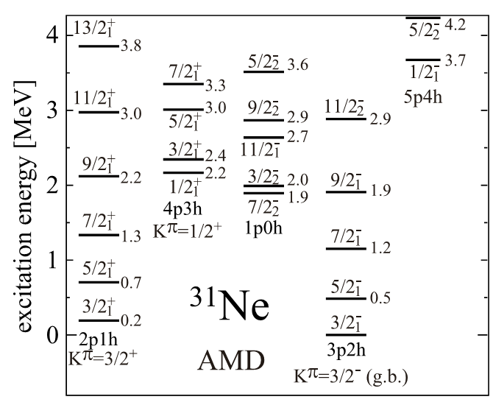
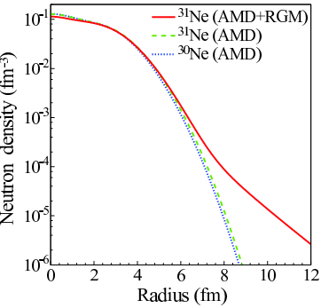
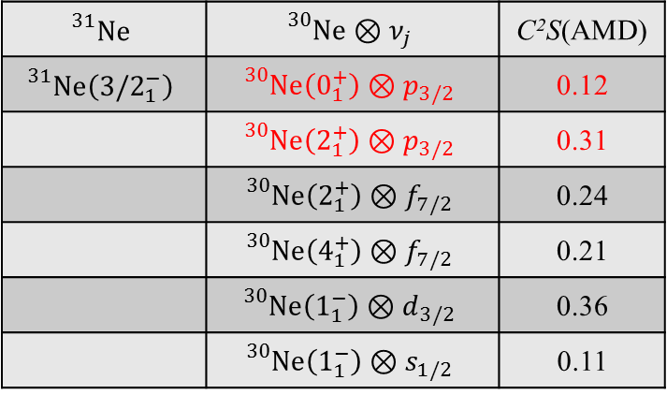
1n Halo of ³¹Ne(N=21)
$${}_{}^{31}{Ne}$$ | $${}_{}^{30}{Ne⊗ν_{j}}$$ | C²S(AMD)
$${}_{}^{31}{Ne\left({3/2}_{1}^{−}\right)}$$ | $${}_{}^{30}{Ne\left(0_{1}^{+}\right)⊗p_{3/2}}$$ | 0.12
 | $${}_{}^{30}{Ne\left(2_{1}^{+}\right)⊗p_{3/2}}$$ | 0.31
 | $${}_{}^{30}{Ne\left(2_{1}^{+}\right)⊗f_{7/2}}$$ | 0.24
 | $${}_{}^{30}{Ne\left(4_{1}^{+}\right)⊗f_{7/2}}$$ | 0.21
 | $${}_{}^{30}{Ne\left(1_{1}^{−}\right)⊗d_{3/2}}$$ | 0.36
 | $${}_{}^{30}{Ne\left(1_{1}^{−}\right)⊗s_{1/2}}$$ | 0.11

Slide 17
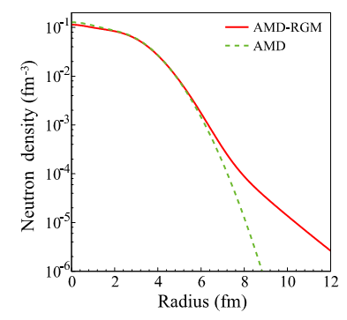

AMD + RGM for ³¹Ne
Wave function of ³⁰Ne is AMD w.f., relative motion between 30Ne and n is solved
All states below 10MeV of ³⁰Ne are included as the core wave function of ³¹Ne
AMD result shows particle (ν p3/2) + rotor (³⁰Ne(g.s.)) nature
AMD + RGM tends to weak coupling
between ³⁰Ne and neutron
Sn=250 keV → 450keV
$${}_{}^{30}{Ne⊗ν_{j}}$$ | C²S(AMD) | C²S(RGM)
$${}_{}^{30}{Ne\left(0_{1}^{+}\right)⊗p_{3/2}}$$ | 0.12 | 0.32
$${}_{}^{30}{Ne\left(2_{1}^{+}\right)⊗p_{3/2}}$$ | 0.31 | 0.29
$${}_{}^{30}{Ne\left(2_{1}^{+}\right)⊗f_{7/2}}$$ | 0.24 | 0.19
$${}_{}^{30}{Ne\left(4_{1}^{+}\right)⊗f_{7/2}}$$ | 0.21 | 0.08
$${}_{}^{30}{Ne\left(1_{1}^{−}\right)⊗d_{3/2}}$$ | 0.36 | 0.26
$${}_{}^{30}{Ne\left(1_{1}^{−}\right)⊗s_{1/2}}$$ | 0.11 | 0.12
Talk by Minomo
K. Mimono, et al., PRC84, 034602 (2011)
K. Mimono, et al., in preparation.

Slide 18
Summary & Plans
反対称化分子動力学(AMD)によるdrip-line近傍核の研究
  変形共存 + 1n, 2n-halo (³¹Ne, ¹⁹B, …)
  Drip-lineを超えた領域の殻構造 (unbound Oxygen isotopes)
  過剰中性子による、クラスター構造の発達
コア核の変形共存研究
  Mpmh配位の共存 (Island of Inversion)
  Island of Inversion境界領域でのS-factor (³¹Mg)
RGM(GCM)による余剰核子の記述
  Oxygen drip-line, Reaction cross sectionを説明するまでには至らず
  ³¹Neの1n-halo構造 “particle+rotor” ⇒ “変形したcore”+p波
Plans
  ¹⁹Bの s² 配位, Be, C 同位体との S-factor
  S-factorによる、Island of Inversionの境界探索
  AMD-RGMによるhaloの記述: 1n (³⁷Mg), 2n(²²C, ³¹F)

