Slide 1
⁸Heにおける
ダイニュートロン形成と崩れ
arXiv:1305.4323 [nucl-th]
Department of Physics, Kyoto University
Fumiharu Kobayashi
Yoshiko Kanada-En’yo

Slide 2
Outline
Introduction
    Dineutron correlation
Framework
    Extended ⁶He+2n cluster wave function
    ⁸He dineutron condensate wave function
Result : Dineutron correlation in ⁸He(0⁺)
    Shell-model and dineutron components in 0⁺₁
    Two-dineutron condensation in 0⁺₂
Summary

Slide 3
Introduction

Slide 4
Dineutron correlation
dineutron
A dineutron : A compact spin-singlet pair of two neutrons.
Dineutron correlation is enhanced in some situations. (e.g. in the low-density region of the nuclear matter,
in the neutron-halo and -skin region of neutron-rich nuclei; ⁶He, ¹¹Li…)
core
M. Matsuo, PRC 67 (2006)…
G. F. Bertch and H. Esbensen, Ann. Phys. (NY) 209 (1991)
M. V. Zhukov et al., Phys. Rep. 231 (1993)
Our aim
To make clear the mechanism of the dineutron formation, and
the universal properties of the dineutron correlation.

Slide 5
Our aim
What is the mechanism of the dineutron formation?
What is the universal properties of the dineutron correlation?
To answer these questions,
it is necessary to investigate various nuclei systematically
and to make clear the effect of
occupied orbits
neutron-halo or -skin
core deformation …
We constructed a model,
the dineutron condensate (DC) wave function.

Slide 6
⁸He
α + four valence neutrons
α
α
⁶He
(0p_{3/2})⁴-shell
developed two-dineutron
developed one-dineutron
the 0⁺₁ state
the 0⁺₂ state
(Y. Kanada-En’yo, PRC 76 (2007),
N. Itagaki et al. PRC 78 (2008))

Slide 7
Framework

Slide 8
Description of ⁸He
In ⁸He,
the (0p)⁴-shell and the dineutron components would be important.
α
⁶He
α
We superpose two kinds of wave functions,
extended ⁶He + 2n cluster wave functions
and
⁸He dineutron condensate (DC) wave functions.
N. Itagaki et al, PRC 71 (2005)
F.K. and Y. Kanada-En’yo. PTP 126 (2011)

Slide 9
Extended ⁶He+2n cluster w.f.
The ⁸He system is composed of ⁶He(H.O.(0p)²) core and two neutrons around it.
2n*
The dissociation effect of 2n cluster
due to the spin-orbit interaction
can be taken into account.
⁶He
N. Itagaki et al, PRC 71 (2005)
We mainly describe H.O.(0p_{3/2})⁴ and one dineutron at the surface.

Slide 10
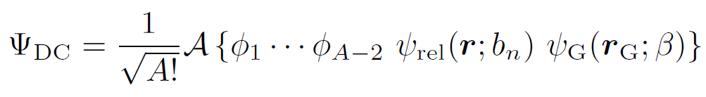



DC wave function (one-dineutron case)
Assuming that the A-nucleon system is composed of (A-2)-nucleon core and one dineutron.
relative part
c.o.m. part
2b_{n}
r
(s-wave)
r_{G}
2n*
β
size of the dineutron
α
(S-wave)
spatial expansion of the dineutron

Slide 11
Result
Shell-model and dineutron components in 0⁺₁
Two-dineutron condensation in 0⁺₂

Slide 12

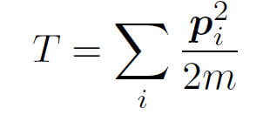
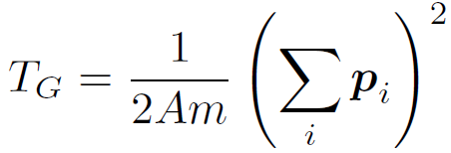


Hamiltonian
: Volkov No.2 m=0.55, b=h=0.125
: LS part of G3RS v_{LS} = 2000 MeV

Slide 13
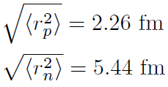
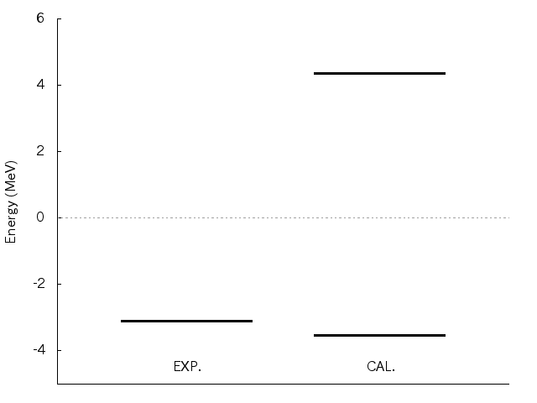

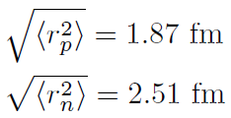

⁸He(0⁺_{1,2})
0⁺₂
gas-like
α+4n threshold
0⁺₁
0⁺₁
EXP.
CAL.
(0p_{3/2})⁴
+
⁶He
Next, we consider the dineutron component in 0⁺_{1,2}.

Slide 14
Dineutron component
In order to see the one- and two-dineutron components,
we calculate the overlap with the DC wave function.
2b_{n}
β
b_{n} : the dineutron size
β : its expansion from ⁶He
⁶He
2b_{n}
Two dineutrons in the S-wave
have
the same size, b_{n},
the same expantion, β.
α
β

Slide 15
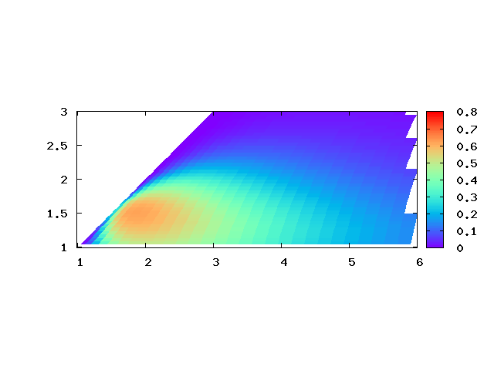
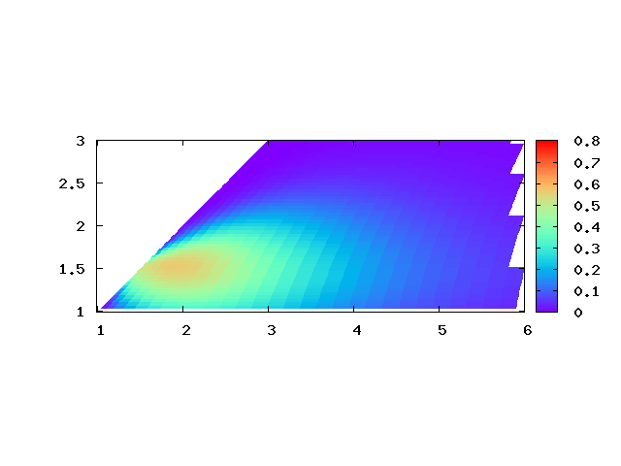
Dineutron component in 0⁺₁
one-dineutron component
In the ground state,
(0p_{3/2})⁴ -component
and
developed one-dineutron component
are significant.
Not only one
but also two compact dineutrons are formed
at the surface.
(β, b_{n})~ (2.0, 1.5)
2b_{n}
β
⁶He
(fm)
two-dineutron component
However,
the tail component
(β ≥ 4 fm) diminishes
in two-dineutron one.
A dineutron is fragile.
(0p_{3/2})⁴
+
b_{n} : dineutron size
2b_{n}
⁶He
α
β
β : dineutron expansion
(fm)

Slide 16
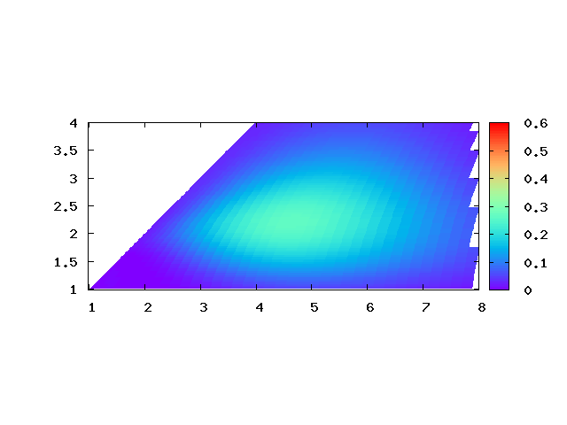
Dineutron component in 0⁺₂
(fm)
two-dineutron component
b_{n} : dineutron size
2b_{n}
β
β : dineutron expansion
(fm)
This state has a gas-like structure of
one α and two compact dineutrons expanded very largely.
Two-dineutron condensate state

Slide 17
Summary

Slide 18
Summary
We investigated the dineutron correlation in ⁸He(0⁺).
In ⁸He(0⁺₁),
(0p_{3/2})⁴- and developed one-dineutron components are mixed,
but developed two-dineutron one is minor
because of the fragility of the dineutrons.
In ⁸He(0⁺₂)
the two-dineutron condensation would exist,
characterized by a gas-like structure of an α and two dineutrons .

Slide 19
Outlook
We are investigating the effect of the core structure
for the dinucleon correlation in the ground state of ⁹Li,
compared with that in ¹⁰Be and ^{9,10}C.
We will make clear how the core deformation affects
the behavior of the dineutron
through the investigation of neutron-rich Be, C isotopes
by using the AMD+DC method.

Slide 21
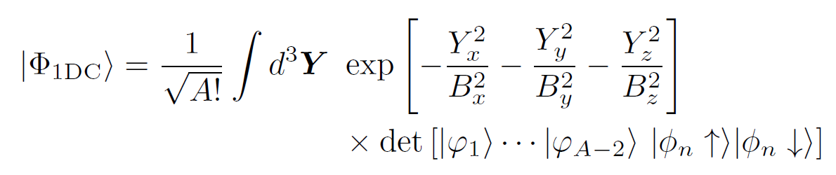

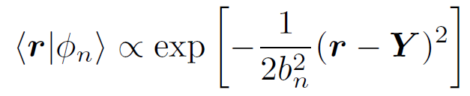
1-DC wave function
( Not a dineutron condensate state )
Assuming that the A-nucleon system is composed of (A-2)-nucleon core and one dineutron.
B
core (Brink)
dineutron
dineutron
n
Y
core
n
~ b_{n}
Here assuming that B = B_{x} = B_{y} = B_{z} .

Slide 22

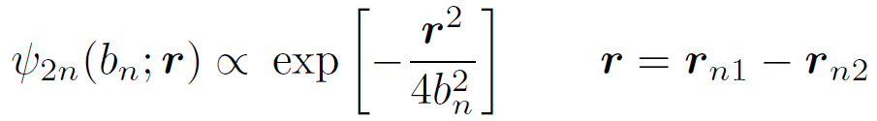
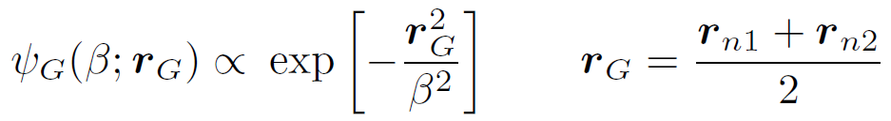
Transformation to relative and c.o.m. w.f.
coordinate transformation Y-integral
relative part
c.o.m. part
2b_{n}
n
r
(s-wave)
r_{G}
β
size of the dineutron
n
core
(S-wave)
spatial expantion of the dineutron

Slide 23
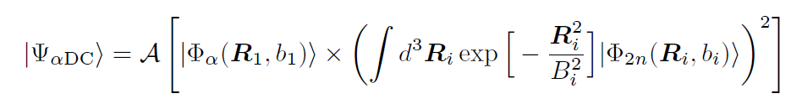
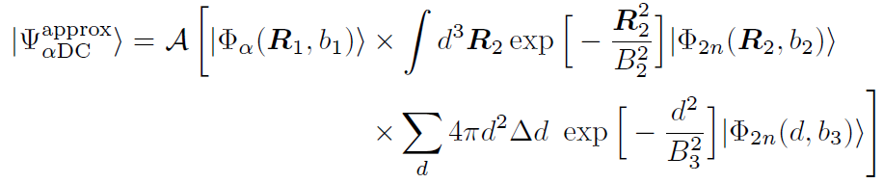
Dineutron condensate component
We calculate the overlap with αDC w.f. to see the dineutron condensate components in ⁸He.
Here we approximate αDC w.f. as follows.
replace one of the R-integal by the d-summation

Slide 24
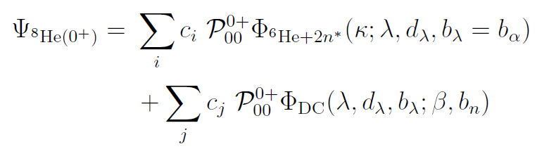
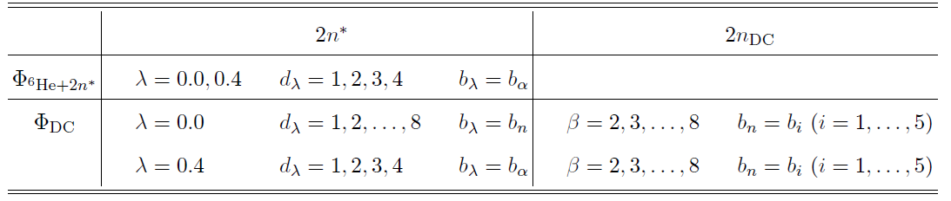
Description of ⁸He
⁶He+2n* → (0p_{3/2})⁴ sub-shell closure
⁶He in (0p)² + one dineutron around ⁶He
DC → ⁶He in (0p)² + one developed dineutron
α + two developed dineutron

Slide 25
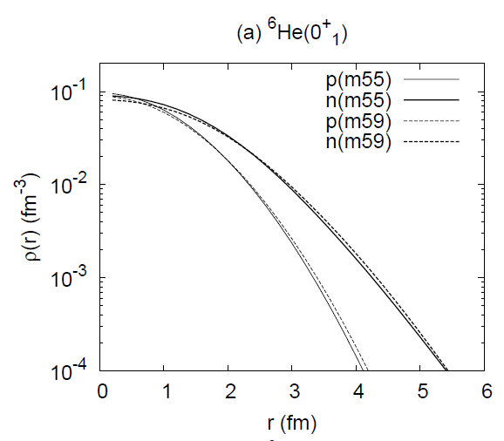
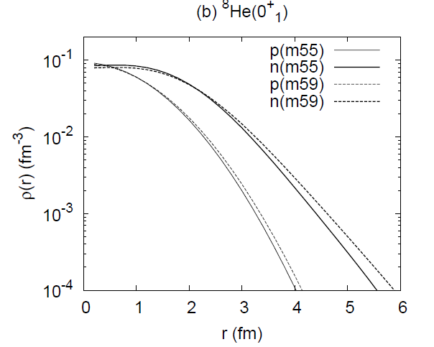
One-body density

Slide 26
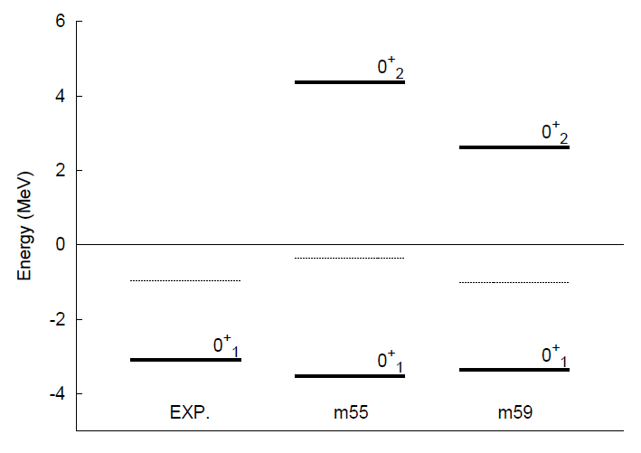
0⁺ energy spectra
0⁺₂
Two-dineutron
in the S-wave
α+n+n+n+n
⁶He+n+n
0⁺₁
competition of (0p_{3/2})⁴ and
one-dineutron
(2n unbound)
(2n bound)

Slide 27
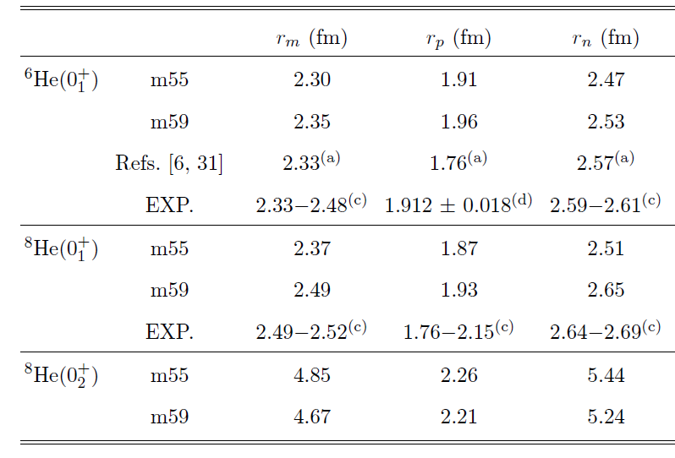
R.m.s. radii
(a) K. Arai et al, PRC 59 (1996)
Three body
model
The neutron expansion (halo, skin) in ^{6,8}He(0⁺₁) is reproduced.
⁸He(0⁺₂) has much larger neutron radius than that of ⁸He(0⁺₁).

Slide 28

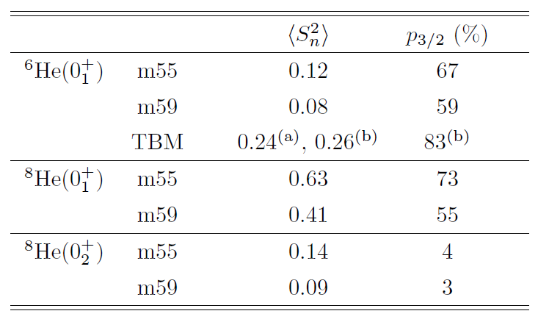
Degree of shell-model component
We calculate the squared spin and the 0p_{3/2}-shell component.
in (0p_{3/2})²
in (0p_{3/2})⁴
K. Arai et al, PRC 59 (1996)
K. Hagino et al, PRC 72 (2005)
Dineutron is major.
Shell-model and dineutron compete.
Dineutron is dominant.

Slide 29

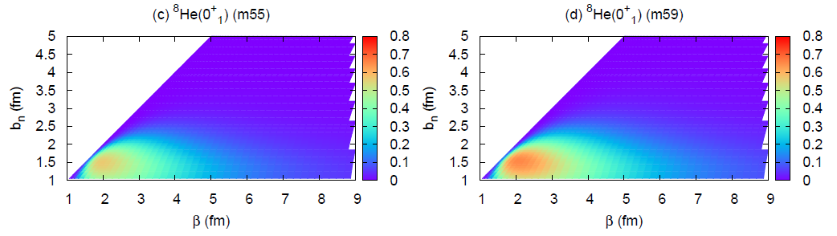
One-dineutron component in ⁸He(0⁺₁)
(fm)
m55
m59
b_{n} : dineutron size
(fm)
β : dineutron expansion
In m55 (strong α-n interaction),
the dineutron is more dissociated.
In m59 (strong n-n interaction),
the dineutron correlation is enhanced.
b_{n}
β
core

Slide 30
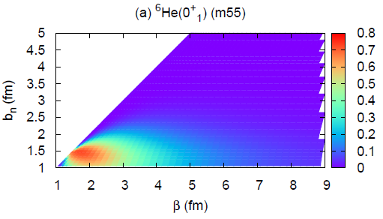
Comparison of ⁸He(0⁺₁) with ⁶He(0⁺₁)
(fm)
⁸He
⁶He
b_{n} : dineutron size
(fm)
β : dineutron expansion
In ⁶He, a dineutron is formed
at the surface.
In ⁸He, a dineutron is dissociated
at the surface due to the spin-orbit interaction.
b_{n}
β
core

Slide 31
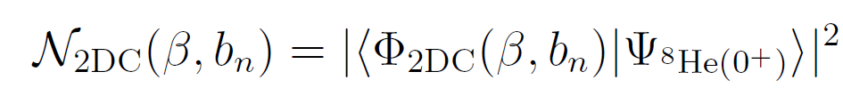
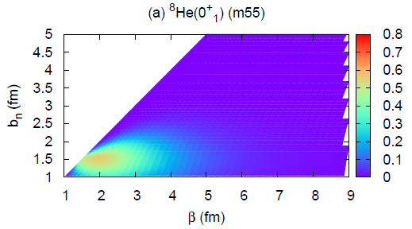
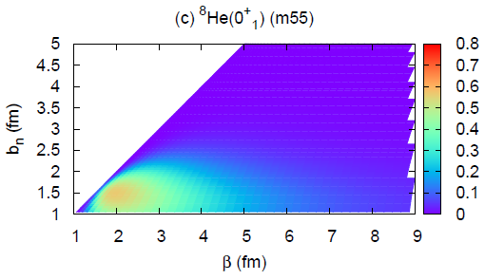
Two-dineutron component in ⁸He(0⁺₁)
(fm)
2DC
1DC
b_{n} : dineutron size
β : dineutron expansion
(fm)
β
The peak component is similar,
but the tail component is reduced in 2DC.
b_{n}
The component of two developed dineutrons is suppressed.

Slide 32
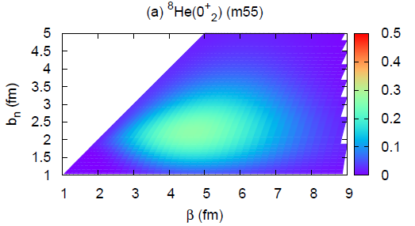
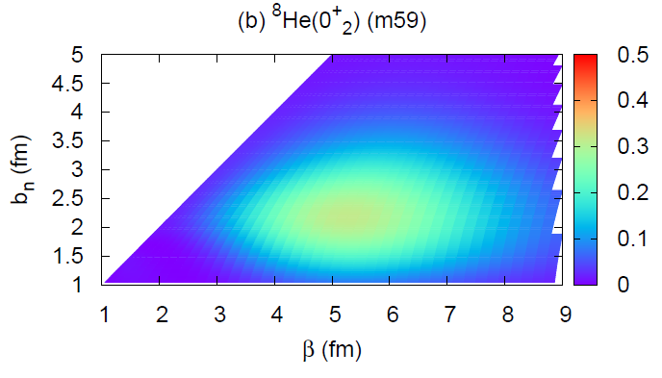
Two-dineutron condensation in ⁸He(0⁺₂)
(fm)
m55
m59
b_{n} : dineutron size
β : dineutron expansion
(fm)
⁸He(0⁺₂) contains swelled dineutrons
expanded largely from the origin.
b_{n}
β
Two-dineutron condensation

