Slide 1
Cluster-orbital shell model approach for unstable nuclei
RCNP研究会「核子・ハイペロン多体系におけるクラスター現象」, KGU関内, 26-27 Sep. 2013, 横浜
Hiroshi MASUI
Kitami Institute of Technology
Collaborators:
K. Kato Hokkaido Univ.
K. Ikeda RIKEN

Slide 2
What we have done
Core-size and total system
Continuum shell model
M-scheme
Coupled-channel model
H. M, K. Kato and K. Ikeda, PRC73, (2006) 034318.
H. M, K. Kato and K. Ikeda, PRC75, (2007) 034316.
H. M, K. Kato and K. Ikeda, EPJA42, (2009) 535.
H. M, K. Kato and K. Ikeda, NPA895, (2012) 1.

Slide 3
What we have done
Core-size and total system
Continuum shell model
M-scheme
Coupled-channel model
H. M, K. Kato and K. Ikeda, PRC73, (2006) 034318.
H. M, K. Kato and K. Ikeda, PRC75, (2007) 034316.
H. M, K. Kato and K. Ikeda, EPJA42, (2009) 535.
H. M, K. Kato and K. Ikeda, NPA895, (2012) 1.

Slide 4
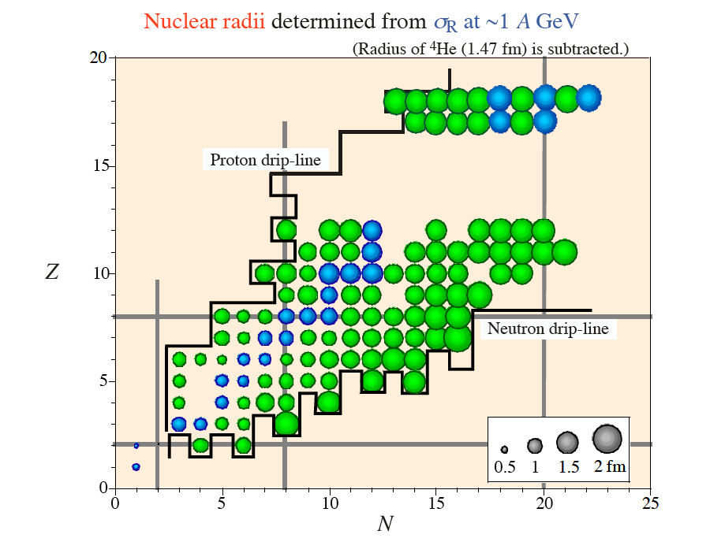
Matter radius of nuclei near the drip-lines
A. Ozawa 2001
An “abrupt” change of the radius due to the weakly bound neutron or proton

Slide 5
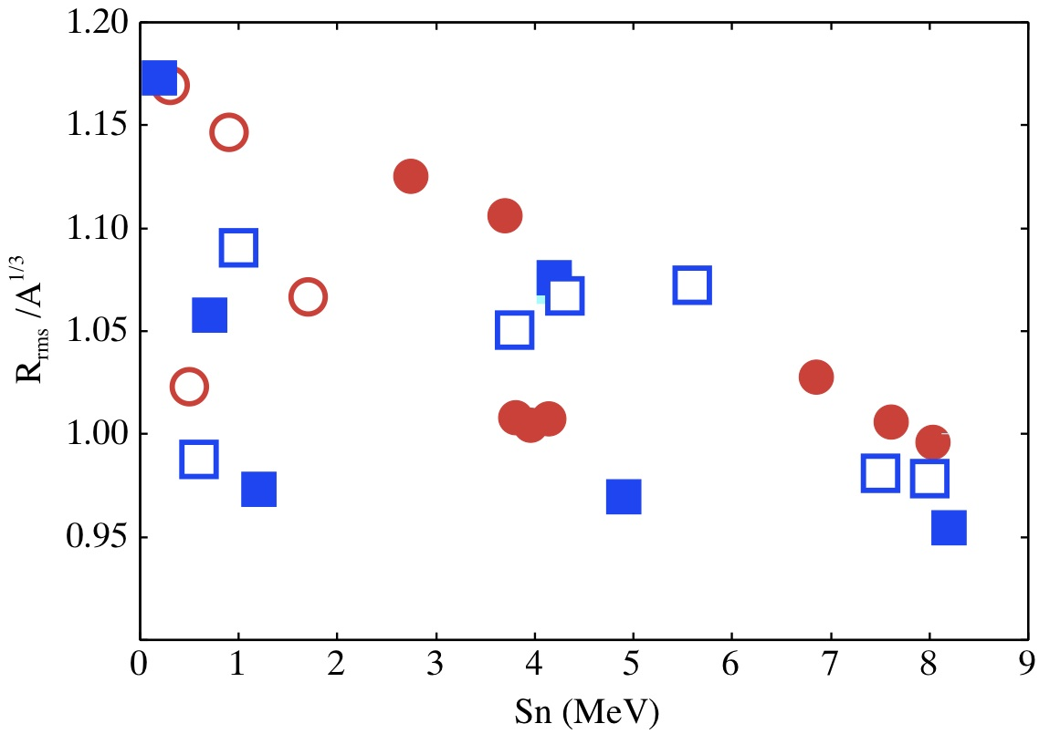
Relation for the S_{n} and (R_{rms}/A^{1/3})
¹⁹C
¹¹Li
Large S_{n}
Large R_{rms}
¹¹Be
²³O
²⁴O
²⁶F
⁸He
F-iso.
⁶He
O-iso.
C-iso.

Slide 6
Difference from typical halo nuclei: ⁶He, ¹¹Be, ¹¹Li
Large S_{n} values of ²³O and ²⁴O ( 2.7MeV and 3.7MeV )
Weakly-bound neutrons
Strongly-bound neutrons
S_{n}
⁶He : 0.98MeV ¹¹Li : 0.38MeV
¹¹Be: 0.50MeV
S_{n}
²³O : 2.7MeV ²⁴O : 3.7MeV
²²O
Core+n (+2n)
Core + Xn

Slide 7
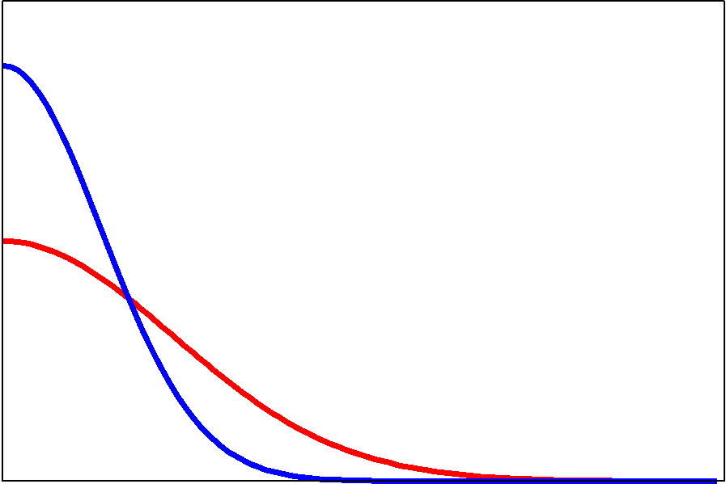
2. Basis function
Radial part:
Gaussian
Angular momentum part:
Z-component
“M-Scheme”
Basis function
Each coordinate is spanned from the c.m. of the core,
and is expressed by Gaussian with a different width parameter
Shell-model
H.O.basis:
Non-Orthogonal
Gamow S.M.:

Slide 8
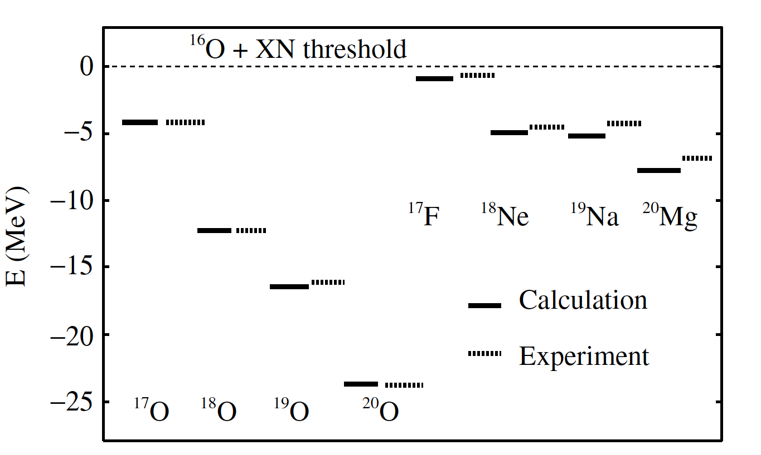
Energies of ¹⁶O+XN systems
Energies are almost reproduced

Slide 9
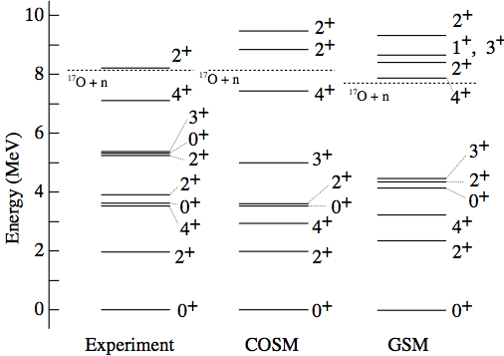
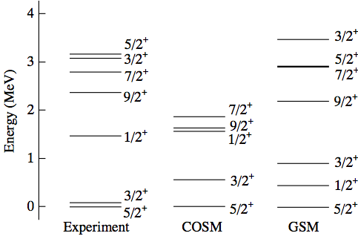
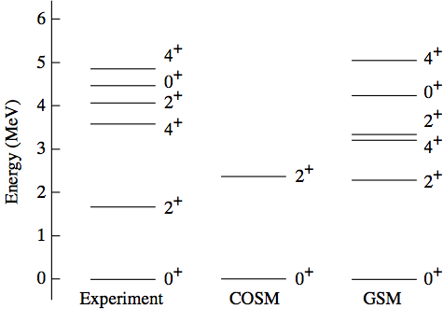
Calculated levels of O-isotopes
¹⁸O
¹⁹O
²⁰O
Order of levels: good
GSM : N. Michel, et al., PRC67 (2003)

Slide 10
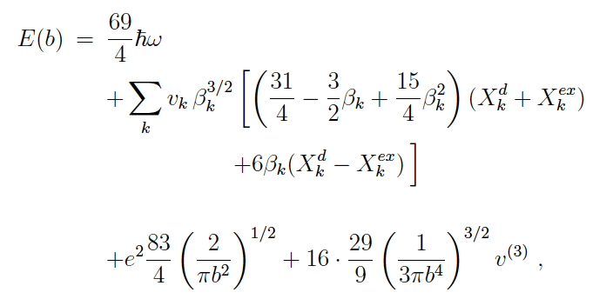
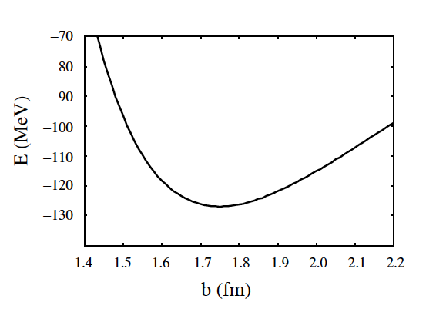
Dynamics of the core
Energy of ¹⁶O-core for the h.o. w.f. with effective NN-int..
T. Ando, K. Ikeda, and A. Tohsaki-Suzuki, PTP64 (1980).
Volkov No.2
Additional 3-body force
Energy and R_{rms} of ¹⁶O

Slide 11
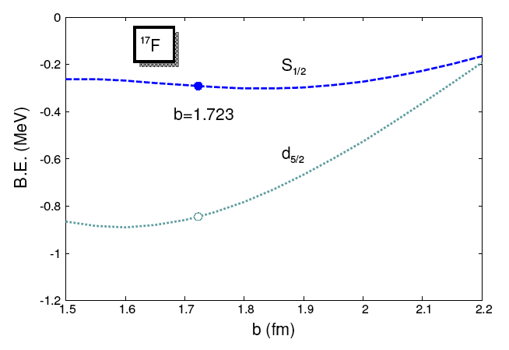
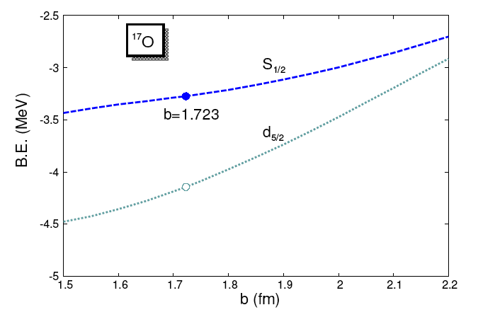
Core-N Hamiltonian:
Microscopic core-N potential:
Change the core size

Slide 12
Dynamics of the core
Energy of ¹⁶O-core
Core-N part
Optimum value of b is different in isotopes and isotones

Slide 13
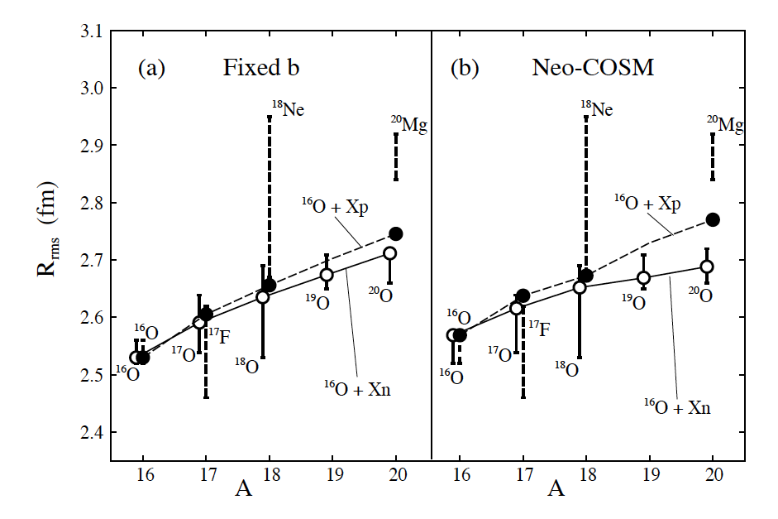
Inclusion of the dynamics of the core:
R_{rms} are improved

Slide 14
What we have done
Core-size and total system
Continuum shell model
M-scheme
Coupled-channel model
H. M, K. Kato and K. Ikeda, PRC73, (2006) 034318.
H. M, K. Kato and K. Ikeda, PRC75, (2007) 034316.
H. M, K. Kato and K. Ikeda, EPJA42, (2009) 535.
H. M, K. Kato and K. Ikeda, NPA895, (2012) 1.

Slide 15
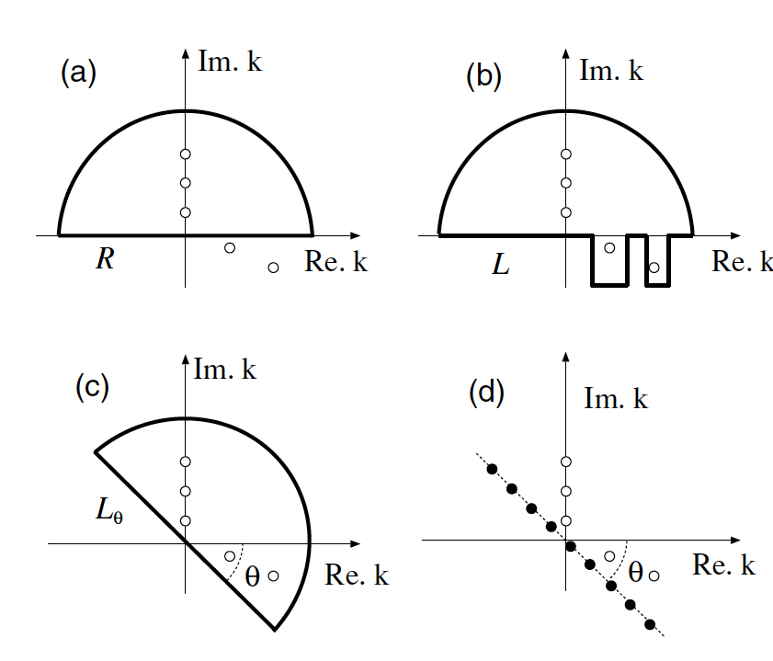
Wave function to describe the weakly bound systems
Shell-model-like approach
Our COSM approach
Basis function:
Basis function:
Completeness relation:
Linear combination of Gaussian:
Continuum shell model
Gamow shell model
Cluster-orbital shell model
Long tail of halo w.f.

Slide 16
Check the component of the continua
H. M, K. Kato and K. Ikeda, PRC75, (2007) 034316.
Comparison between the COSM w.f. and GSM w.f..
Shell model
COSM
(Products of s.p.w.f.)
(Gaussian w.f.)
Preparation of s.p. completeness relation:
Diagonalize the s.p. Hamiltonian
by using complex scaling method (CSM)
Re. E
2θ
CSM:
Imag. E
Resonant poles
No explicit path for continua

Slide 17
Im.k
Gamow Shell Model
Bound states
Re. k
Anti-bound states
(Virtual states)
Complex momentum plane
Resonant states

Slide 18
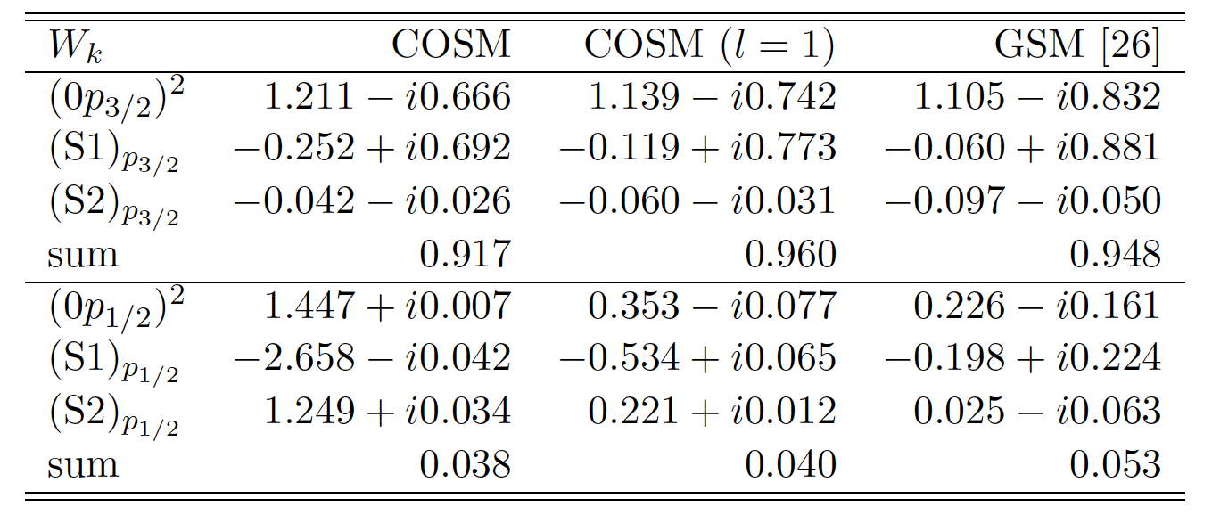
Comparison between COSM and GSM
H. M, K. Kato and K. Ikeda, PRC75, (2007) 034316.
⁶He (0⁺)
L ≤ 5
L=1 (p_{3/2}, p_{1/2})
L=1 (p_{3/2}, p_{1/2})
[26] G. Hagen et al., PRC71 (2005)

Slide 19
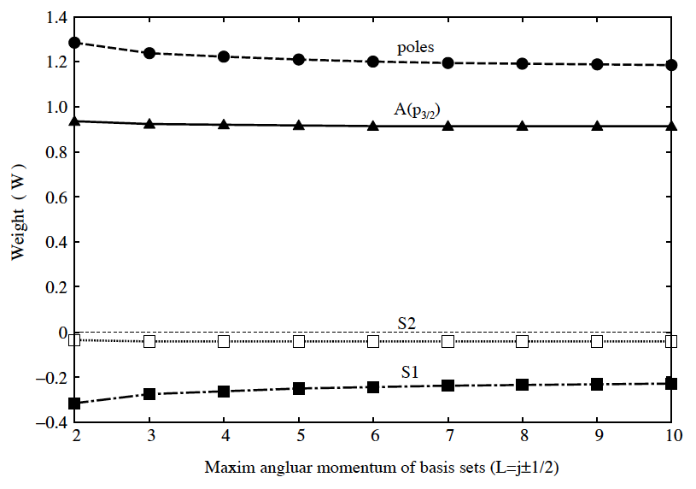
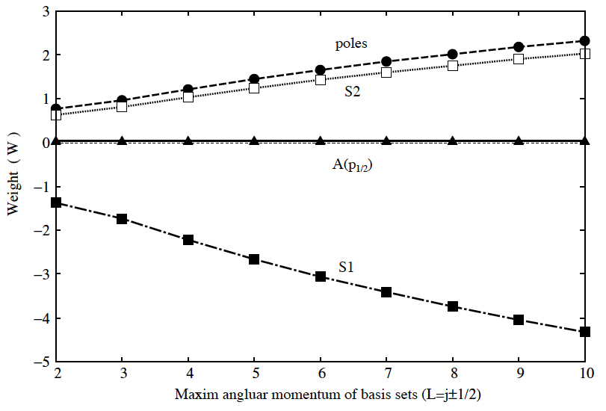
Large cancellation occurs in the p_{1/2} case
For L ≤ 5 case
Total: C[(p_{3/2})²] ≅ 0.9
Total: C[(p_{1/2})²] ≅ 0.04
Poles: (0p_{3/2})² ≅ 1.2
Poles: (0p_{1/2})² ≅ 1.45
Pole-Cont. ≅ −0.2
Pole-Cont. ≅ −2.66
Cont.-Cont. < −0.1
Cont.-Cont. ≅ 1.25
Total
Total
(p_{3/2})²
(p_{1/2})²

Slide 20
What we have done
Core-size and total system
Continuum shell model
M-scheme
Coupled-channel model
H. M, K. Kato and K. Ikeda, PRC73, (2006) 034318.
H. M, K. Kato and K. Ikeda, PRC75, (2007) 034316.
H. M, K. Kato and K. Ikeda, EPJA42, (2009) 535.
H. M, K. Kato and K. Ikeda, NPA895, (2012) 1.

Slide 21
To reproduce the drip-line at ²⁴O
ab initio calc. + Realistic force
Effect of the thee-body interaction
G. Hagen et al., Phys. Rev. C 80, 021306(R) (2009)
T. Otsuka et al, Phys. Rev. Lett. 105, 032501 (2010)

Slide 22
Ab initio calc. + Realistic force
G. Hagen et al., Phys. Rev. C 80, 021306(R) (2009)
Coupled-cluster (2-body) + N3LO int.
Λ-dependence:
lack of many-body int.

Slide 23
How about the radius?
G. Hagen et al., Phys. Rev. C 80, 021306(R) (2009)
Coupled-cluster (2-body) + N3LO int.
hω ~ 27 MeV
b ~ 1.24 (fm)
Very small radius

Slide 24
Our approaches
Role of many valence neutrons
¹⁶O+Xn model
m-scheme COSM + Gaussian basis
Role of last one- or two-neutrons
“Core” + n or “Core”+2n model
A simplified model approach

Slide 25
Wave function:
Radial part
Coordinate system
is defined from the
center of mass of
the core nucleus
Product of Gaussian with polynomial
Spin-isospin part
Total M and M_{T} are fixed
We check the expectation value of the total J as <J²>

Slide 26
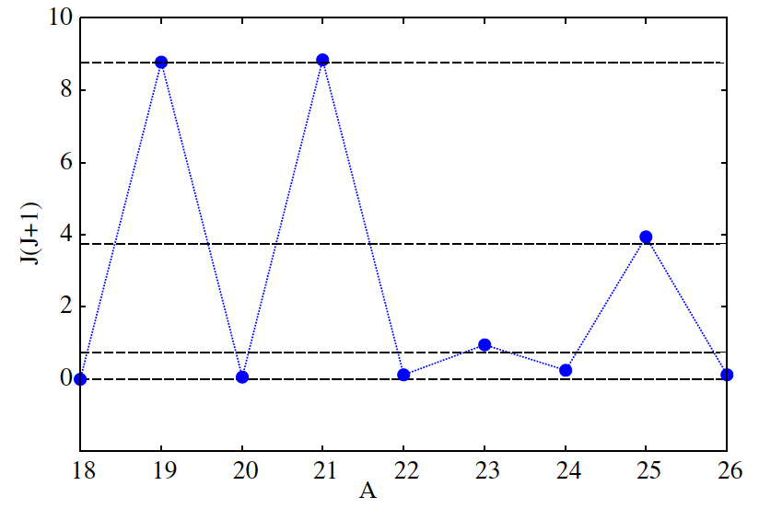
Expectation value of J²
J=5/2
J=3/2
J=1/2
J=0

Slide 27
To treat the Pauli-forbidden states (PFS)
Basis function
(r^{2k} x Gaussian)
Conditions
Solve them
(Normalized)
(Orthogonalized)
Gauss. with poly. (orthogonal to PFS)
Pauli Forbidden states (PFS)

Slide 28
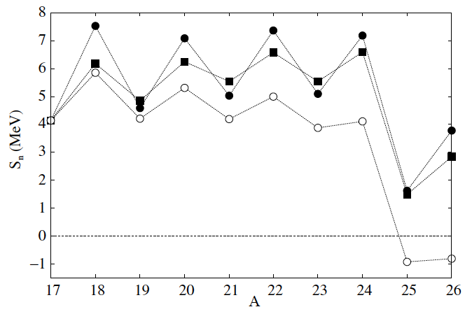
S_{n} for O-isotopes
B=H=0.07
B=H=0.25
<
B=H=0.07
Attraction

Slide 29
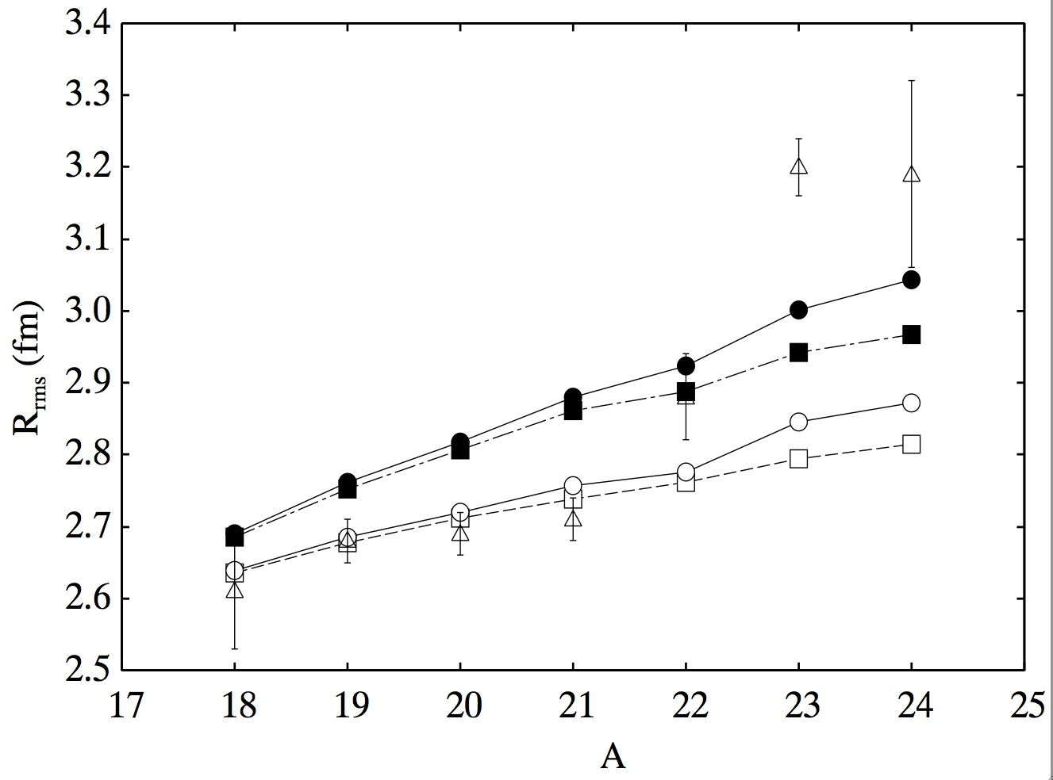
Change the core size with A^{1/6}
Fixed-core
Expanded-core
B=H=0.07
b~A^{1/6}
B=H=0.25
b: 1.723 (fm)

Slide 30
Comparison with other approaches
●: m-COSM with b〜A^{1/6}
b〜A^{1/6}
○: fixed-b
Exp. [4]
■: [1]
0.31fm
Fixed-b
□: [2]
▲: [3]
0.25fm
C.C.M. (Hagen et al [3])
[1] H. Nakada, NPA764 (2006)
[4] A. Ozawa et al, NPA693 (2001)
[2] B. Ab-Ibrahim et al., JPSJ 78 (2009)
[3] G. Hagen et al., PRC 80 (2009)

Slide 31
What we have done
Core-size and total system
Continuum shell model
M-scheme
Coupled-channel model
H. M, K. Kato and K. Ikeda, PRC73, (2006) 034318.
H. M, K. Kato and K. Ikeda, PRC75, (2007) 034316.
H. M, K. Kato and K. Ikeda, EPJA42, (2009) 535.
H. M, K. Kato and K. Ikeda, NPA895, (2012) 1.

Slide 32
Inclusion of the core excitation
a coupled-channel picture for ¹⁶O
(Submitted to NPA)
0p-0h
2p-2h ex.
Radius : large
Radius : small
“Mean-field-like“ core

Slide 33
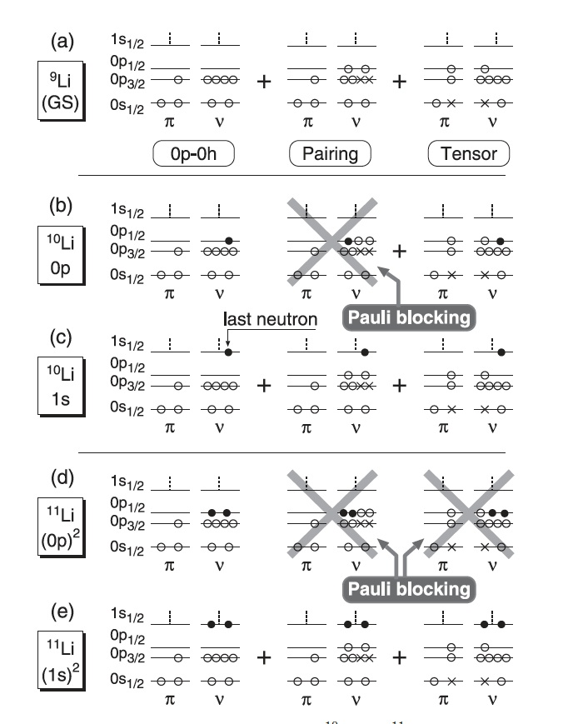
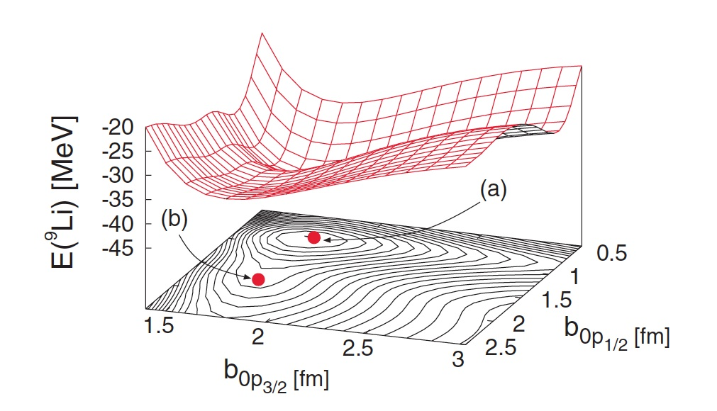
Inclusion of the core excitation
TOSM in ⁹Li
T. Myo, K. Kato, H. Toki and K. Ikeda, PRC76(2007)
1. Different size for each orbit
2. Some config. are suppressed
due to the Pauli-blocking

Slide 34
[2p2h excitations]
0d_{3/2}
1s_{1/2}
0d_{5/2}
0d_{3/2}
1s_{1/2}
0d_{5/2}
Renormalized to 1ch and 2ch
[XpXh excitations]
0d_{3/2}
…
1s_{1/2}
0d_{5/2}

Slide 35
A coupled-channel approach
Hamiltonian:
1ch
2ch
(0p0h)
(2p2h)
b = 1.1A^{1/6} (fm)
b = 1.5(fm) : fixed
1s_{1/2} is allowed
1s_{1/2} is forbidden
Coupling term
Δ₁₂ = Δ₂₁ = −2MeV
Energy difference of the core
ΔE = 2.5, 5, 7.5, 10 (MeV)
Fit: E, R_{rms}
¹⁶O
¹⁸O
²⁰O
²²O
¹⁷O (¹⁶O+n)
¹⁹O (¹⁸O+n)
²¹O (²⁰O+n)
²³O (²²O+n)

Slide 36
¹⁷O (5/2⁺)
0d_{3/2}
0d_{3/2}
1s_{1/2}
1s_{1/2}
0d_{5/2}
0d_{5/2}
¹⁶O-core (0p0h)
¹⁶O-core (2p2h)
¹⁹O (5/2⁺)
0d_{3/2}
0d_{3/2}
1s_{1/2}
1s_{1/2}
0d_{5/2}
0d_{5/2}
¹⁸O-core (0p0h)
¹⁸O-core (2p2h)

Slide 37
²¹O (5/2⁺)
0d_{3/2}
0d_{3/2}
1s_{1/2}
1s_{1/2}
0d_{5/2}
0d_{5/2}
²⁰O-core (0p0h)
²⁰O-core (2p2h)
²³O (1/2⁺)
Pauli-forbidden
0d_{3/2}
0d_{3/2}
1s_{1/2}
1s_{1/2}
0d_{5/2}
0d_{5/2}
²²O-core (0p0h)
²²O-core (2p2h)

Slide 38
Results for a coupled-channel core+n model approach
Sn (MeV)
Fitted
²⁰O+n
¹⁶O+n
¹⁸O+n
S_{n} are almost reproduced
²²O+n

Slide 39
Results for a coupled-channel core+n model approach
R_{rms}(fm)
A. Ozawa et al. NPA693 (2001)
R. Kanungo et al. PRC84 (2011)
Mean-field-like core
²²O+n
¹⁶O+n
²⁰O+n
¹⁸O+n
Fixed core

Slide 40
Summary
Oxygen isotopes
M-scheme COSM approach
Many valence nucleons
Semi-microscopic int., OCM, resonance (CSM)
Rrms ²³O and ²⁴O
¹⁶O(fixed size) +Xn : failed to reproduce the experiment
Modification of the core is important
[An attempt to reproduce the Rrms]
Coupled-channel picture
(Shrunk core) + (Broad core)
is a possible way

Slide 41
What we want to do
Systematics
More precise core-configuration
Coupled-channel and deformed core
GSM-like treatment
Core + XN
0p0h, 2p2h, 4p4h,….
Valence-core competition
S.P. basis function

