Slide 1
テンソル最適化殻模型による
軽い核での核力の役割
明 孝之 大阪工業大学
共同研究者 梅谷 篤史 日本工業大学
土岐 博、堀井 香織 阪大RCNP
池田 清美 理研
1
RCNP研究会「核子・ハイペロン多体系におけるクラスター現象」@ KGU 関内メディアセンター 2013.7.26

Slide 2
Outline
Role of V_{tensor} in light nuclei
He & Li isotopes, ⁸Be with V_{bare}
Tensor Optimized Shell Model (TOSM) to describe tensor correlation.
Unitary Correlation Operator Method (UCOM) to describe short-range correlation.
He and Li isotopes
TM, A. Umeya, H. Toki, K. Ikeda PRC84 (2011) 034315
TM, A. Umeya, H. Toki, K. Ikeda PRC86 (2012) 024318

Slide 3
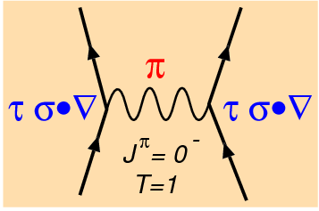
Pion exchange interaction vs. V_{tensor}
Involve large
momentum
δ interaction
Yukawa interaction
Tensor operator
- V_{tensor} produces the high momentum component.
3
Notes:
3

Slide 4
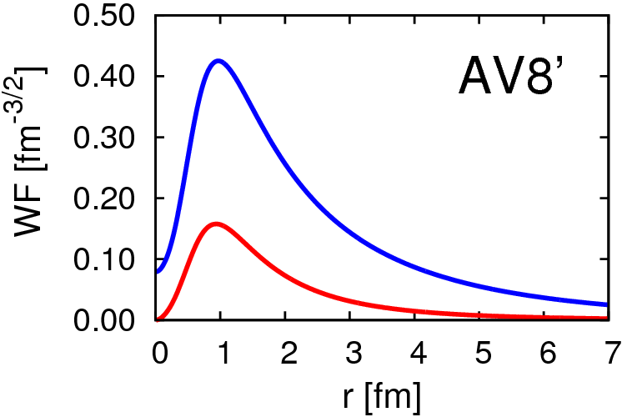
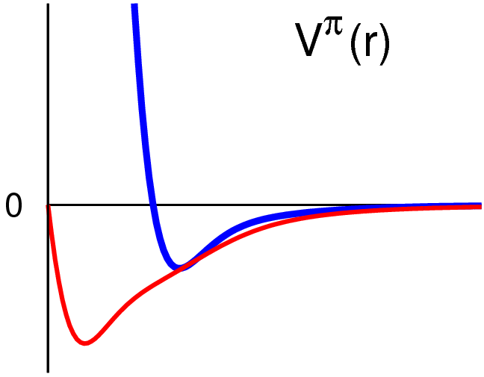
Deuteron properties & tensor force
Energy | -2.24 MeV
Kinetic | 19.88
Central | -4.46
Tensor | -16.64
LS | -1.02
P(L=2) | 5.77%
Radius | 1.96 fm
S
D
AV8’
V_{central}
R_{m}(s)=2.00 fm
R_{m}(d)=1.22 fm
r
d-wave is
“spatially compact”
(high momentum)
V_{tensor}

Slide 5
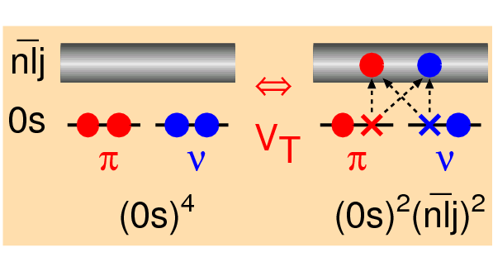
Tensor-optimized shell model (TOSM)
TM, Sugimoto, Kato, Toki, Ikeda PTP117(2007)257
⁴He
2p2h excitations with high-L orbits.
V_{tensor} is NOT treated as residual interactions cf. ~ 80% in GFMC
Length parameters such as b_{0s}, b_{0p} , … are optimized independently, or superposed by many Gaussian bases.
Spatial shrinkage of D-wave as seen in deuteron. HF (Sugimoto, NPA740) , RMF (Ogawa, PRC73), AMD (Dote et al., PTP115)
Satisfy few-body results with Minnesota central force (^{4,6}He)
5
5

Slide 6
Configurations in TOSM
particle states
Gaussian expansion
C₀
C₁
C₂
C₃
nlj
proton
neutron
hole states (harmonic oscillator basis)
+ configuration mixing (0s→0p)
Application to Hypernuclei to investigate ΛN-ΣN coupling
by Umeya (NIT), Hiyama (RIKEN)

Slide 7
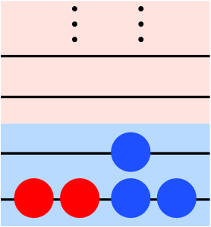
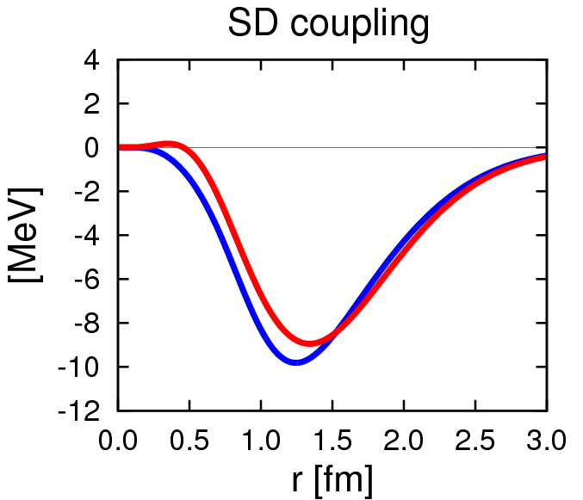
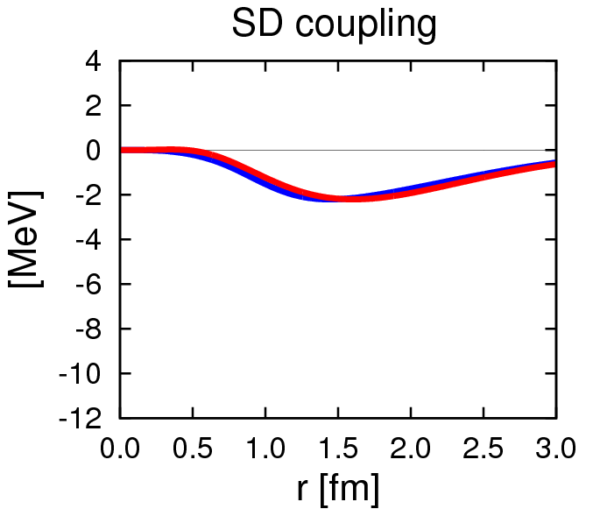
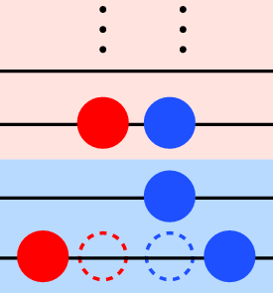
Tensor force matrix elements
M_{SD}(r) = r²φ_{S}(r,b_{S})·V_{T}·φ_{D}(r,b_{D})
: Integrand of Tensor ME
b_{D} ~ b_{S}
V_{T} = V_{residual}
1st order
π+ρ (Bonn)
AV8’
b_{D} ~ b_{S}×0.5
3.8 MeV
V_{T} ≠ V_{residual}
15.0 MeV
0p0h-2p2h
7
7
Centrifugal potential (1GeV@0.5fm) pushes away D-wave.

Slide 8
Effect of Tensor force in TOSM
1st order treatment of V_{T}
Spin-saturated nuclei : ⟨0| V_{T} |0⟩=0
For N ≠Z nuclei : ⟨0| V_{T} |0⟩ ~ few MeV
Effect on the energy spectra in unstable nuclei
HF state
cf. T. Otsuka et al. PRL95(2005)232502.
Coupling between 0p0h-2p2h
In ⁴He, ⟨V_{T}⟩ ~ −15MeV/A, comparable to GFMC.
SD coupling of 0p0h-2p2h is essential.
Describe high momentum (compact D-wave)
Break N=8 magicity in ¹¹Li.
Experiments using (p,d) reaction by Ong-Tanihata @ RCNP, to observe high momentum nucleon.
TM et al.PRC76(2007)024305
PLB
8
8

Slide 9
Hamiltonian and variational equations in TOSM
(0p0h+1p1h+2p2h)
Shell model type configuration
with mass number A
Particle state : Gaussian expansion for each orbit
Gaussian basis function
Hiyama, Kino, Kamimura PPNP51(2003)223
c.m. excitation is excluded by Lawson’s method

Slide 10
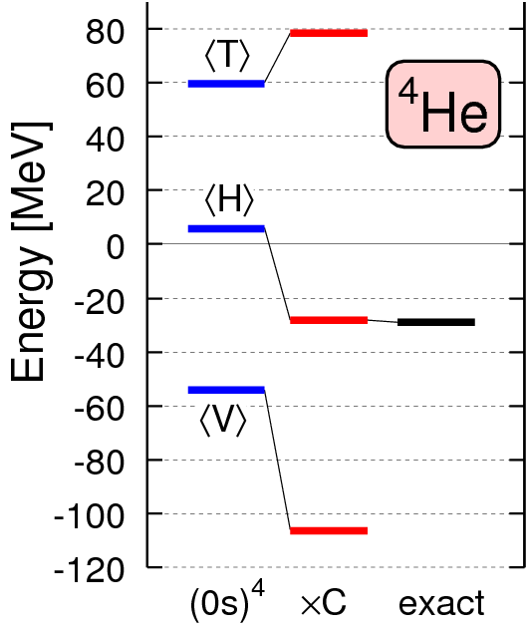
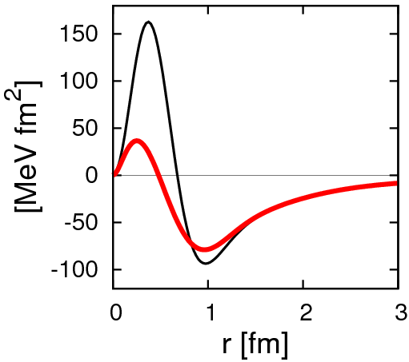
⁴He in UCOM (Afnan-Tang, Central only)
Unitary Correlation Operator Method
(short-range part)
C : UCOM operator
V_{NN} ×r²
3GeV repulsion
C⁻¹V_{NN} C
10
H. Feldmeier, T. Neff, R. Roth, J. Schnack, NPA632(1998)61
10

Slide 11
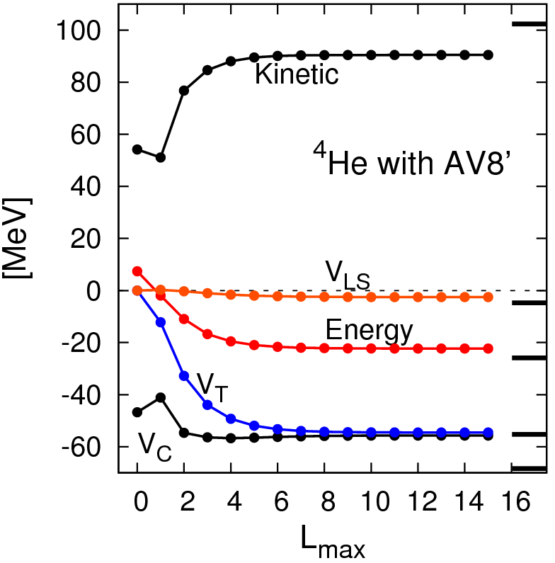
⁴He in TOSM + short-range UCOM
T
(exact)
Kamada et al.
PRC64 (Jacobi)
TM, H. Toki, K. Ikeda
PTP121(2009)511
variational calculation
V_{LS}
E
Gaussian expansion
with 9 bases
V_{C}
V_{T}
good convergence
11

Slide 12
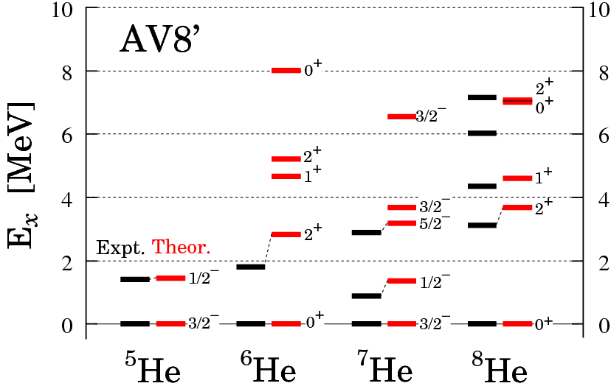
⁵⁻⁸He with TOSM+UCOM
Excitation energies in MeV
TM, A. Umeya, H. Toki, K. Ikeda PRC84 (2011) 034315
Bound state app.
No continuum
No V_{NNN}
Excitation energy spectra are reproduced well

Slide 13
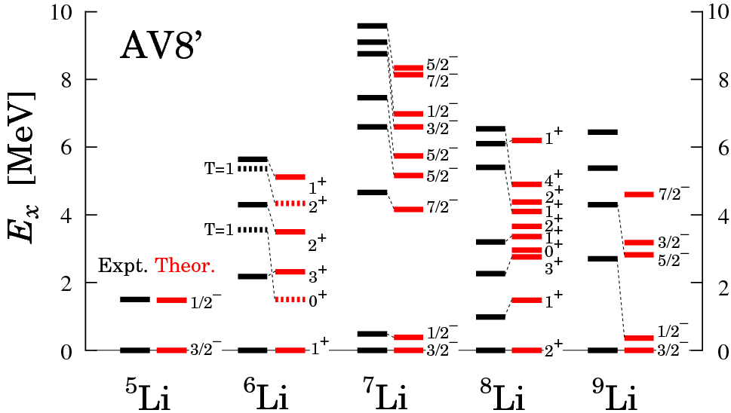
⁵⁻⁹Li with TOSM+UCOM
Excitation energies in MeV
TM, A. Umeya, H. Toki, K. Ikeda PRC86(2012) 024318
Excitation energy spectra are reproduced well

Slide 14
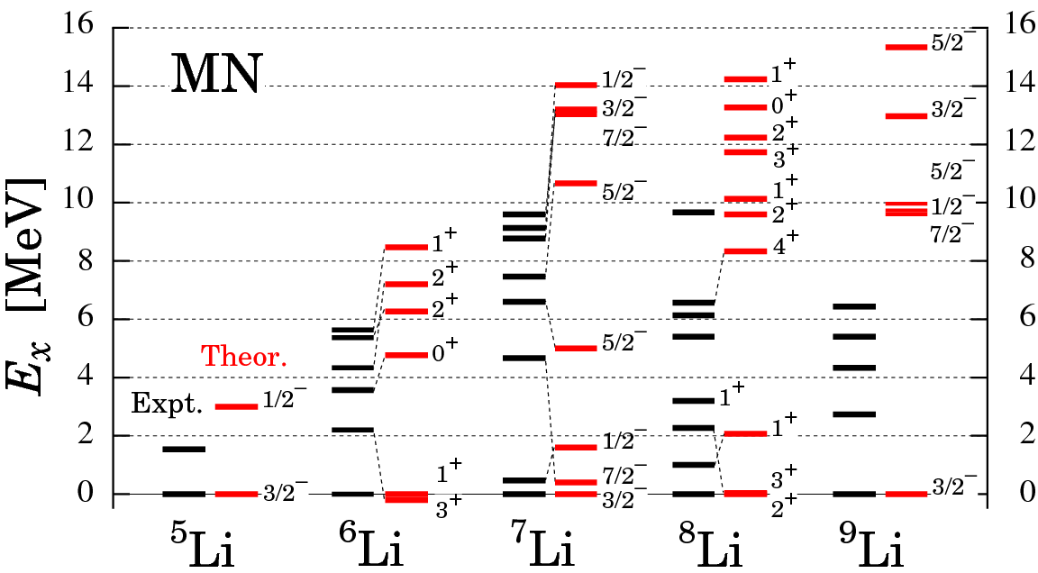
⁵⁻⁹Li with TOSM
Minnesota force
NO tensor
Excitation energies in MeV
Too large excitation energy

Slide 15
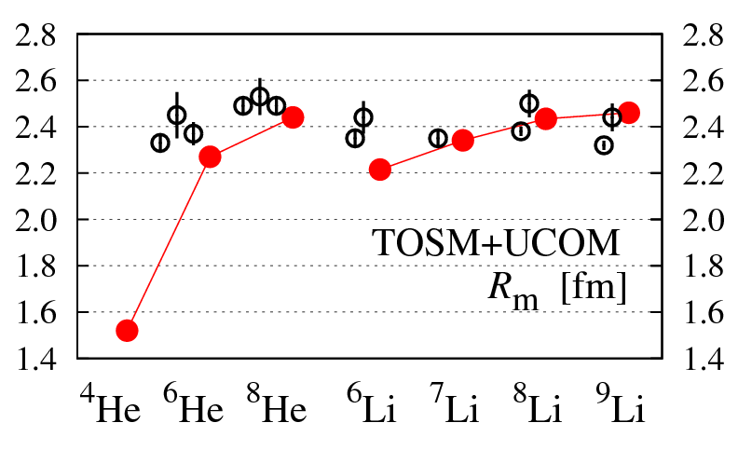
Matter radius of He & Li isotopes
Expt
TOSM with AV8’
Halo
Skin
A. Dobrovolsky, NPA 766(2006)1
I. Tanihata et al., PLB289(‘92)261 G. D. Alkhazov et al., PRL78(‘97)2313
O. A. Kiselev et al., EPJA 25, Suppl. 1(‘05)215. P. Mueller et al., PRL99(2007)252501
15
15

Slide 16
Configurations of ⁴He with AV8’
TM, H. Toki, K. Ikeda
PTP121(2009)511
(0s_{1/2})⁴ | 83.0 %
(0s_{1/2})⁻²_{JT}(p_{1/2})²_{JT} JT=10 | 2.6
JT=01 | 0.1
(0s_{1/2})⁻²₁₀(1s_{1/2})(d_{3/2})₁₀ | 2.3
(0s_{1/2})⁻²₁₀(p_{3/2})(f_{5/2})₁₀ | 1.9
Radius [fm] | 1.54
deuteron correlation with (J,T)=(1,0)
Cf. R.Schiavilla et al. (VMC)
PRL98(2007)132501
R. Subedi et al. (JLab)
Science320(2008)1476
¹²C(e,e’pN)
S.C.Simpson, J.A.Tostevin
PRC83(2011)014605
⁴He contains p_{1/2} of “pn-pair”
¹²C→ ¹⁰B+pn
– Same feature in ⁵He-⁸He ground state
16

Slide 17
Selectivity of the tensor coupling in ⁴He
V_{T}
s₁
s₂
s₃
s₄
L=2
s₁
s₂
s₃
s₄
1⁺(pn)
1⁺(pn)
V_{T}
Selectivity of S₁₂
ΔL=2, ΔS=-2
s₁
s₂
s₃
s₄
L=2
17

Slide 18
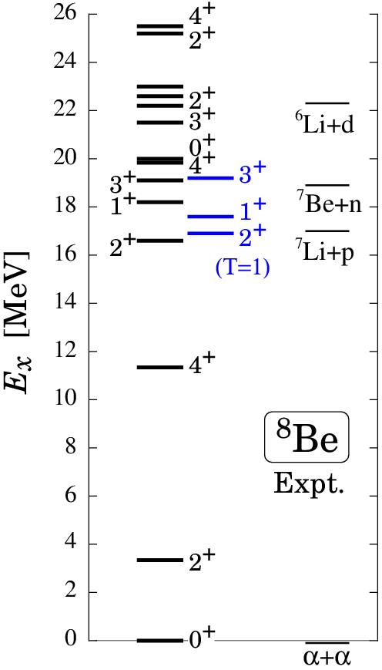
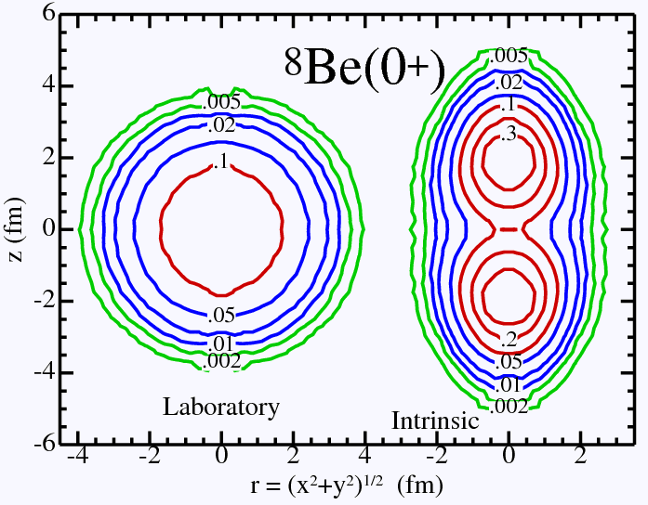
⁸Be spectrum
Γ< 1MeV
Argonne Group
Green’s function Monte Carlo C.Pieper, R.B.Wiringa, Annu.Rev.Nucl.Part.Sci.51 (2001)
Γ~ few MeV
(TUNL)
(T=0)
α-α structure

Slide 19
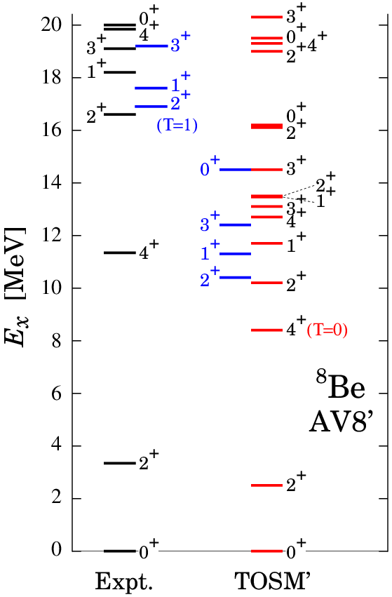
⁸Be in TOSM’ − AV8’ −
V_{T} × 1.1, V_{LS} × 1.4
simulate ⁴He benchmark (Kamada et al., PRC64)
Ground band
Highly excited states
small E_{x}
correct level order (T=0,1)
R_{m}(⁸Be)=2.26 fm
Brink 2α model: 2.48 fm

Slide 20
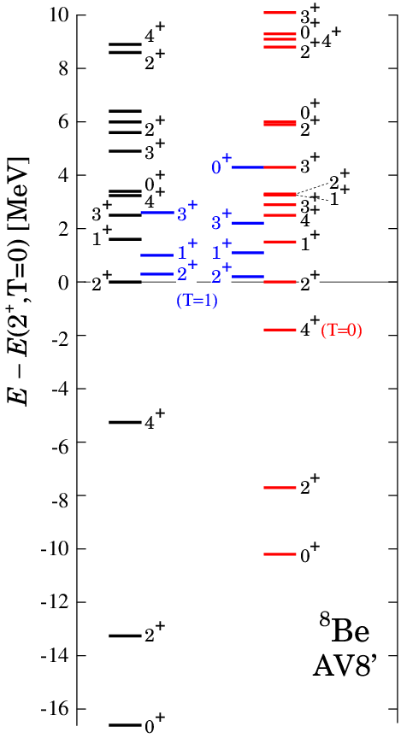
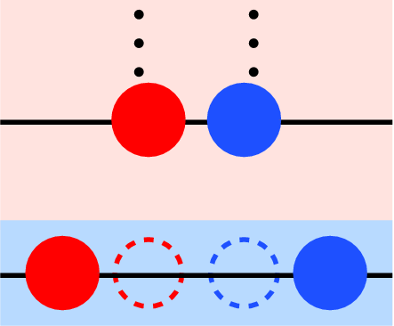
⁸Be in TOSM’ − AV8’ −
V_{T} × 1.1, V_{LS} × 1.4
simulate ⁴He benchmark (Kamada et al., PRC64)
α : 0p0h+2p2h with high-k → naively 2α needs 4p4h.
Expt.
α
α
p-h
TOSM’

Slide 21
Hamiltonian components in ⁸Be
State |  | Kinetic | Central | Tensor
⁴He |  | 95 | ‒56 | ‒62
⁸Be | 0⁺₁ | 192 | ‒115 | ‒97
 | 2⁺₁ | 191 | ‒112 | ‒95
 | 2⁺₂ | 185 | ‒98 | ‒92
 | 2⁺_{T=1} | 168 | ‒94 | ‒82
Grand state
Kinetic & Central ~ twice of ⁴He
Tensor ~ 1.6 of ⁴He
larger ⟨H⟩ components than highly excited states.
Kinetic & Tensor
T=0 states > T=1 states

Slide 22
Summary
TOSM+UCOM using V_{bare}.
Strong tensor correlation from 0p0h-2p2h.
He & Li isotopes
Energy spectra, Radius
⁴He contains “pn-pair of p_{1/2}” due to V_{T}.
⁸Be, T=0 & T=1.
Two aspects : Grand band states & highly excited states.
Indication of more configurations such as 4p4h to describe 2α structure in the grand band states.
22
Notes:
22

