Slide 1
複素レンジガウス基底関数を用いた
Complex Scaling Method
--- ¹²C の 3 クラスター共鳴状態への応用 ---
大坪慎一 (福大理)
福嶋義博 (福大理)
上村正康 (理研仁科セ)
肥山詠美子(理研仁科セ)
RCNP研究会「核子・ハイペロン多体系におけるクラスター現象」,
KGU関内メディアセンター, 2013年 7月26 ～ 27日.

Slide 2
Complex Scaling Method (CSM) において,
複素レンジガウス基底関数が, 実数レンジガウス基底関数
よりも有効に機能するかを調べた.
例として, ¹²C の ３α-cluster resonant states を
OCM で行った.
C. Kurokawa and K. Katō
Phys. Rev. C71 (2005) 021301.
Nucl. Phys. A792 (2007) 82.
主に, New $0_{3}^{+}$

Slide 3
3α-cluster Hamiltonian by OCM
OCM : Orthogonality Condition Model ,
直交条件模型
$$H = \sum_{i=1}^{3}{t_{i}} − T_{G} + \sum_{i=1}^{3}{V_{αα}\left(r_{i}\right)} + V_{3α}\left(r_{1}, r_{2},r_{3}\right) + V_{Pauli}$$
$t_{i}$ : kinetic energy of i–th cluster
$T_{G}$ : kinetic energy of the center of mass
$V_{αα}$ : $α$-$α$ potential, Schmit-Wildermuth
$V_{3α}$ : $3α$ potential
$V_{Pauli}$ : pseudo potential representing the Pauli principle
between $α$-clusters

Slide 4
Complex Scaling Method (CSM)
変換 :
$$r_{j} → r_{j}e^{iθ}$$
$$R_{j} → R_{j}e^{iθ}$$
scaling angle : $θ$
$H → H\left(θ\right)=U\left(θ\right)H{U(θ)}^{−1}$
$$U(θ)r_{j} = r_{j}e^{iθ}$$
$\left[ H\left(θ\right) −E\left(θ\right) \right] Ψ\left(θ\right)=0$
Jacobi 座標

Slide 5
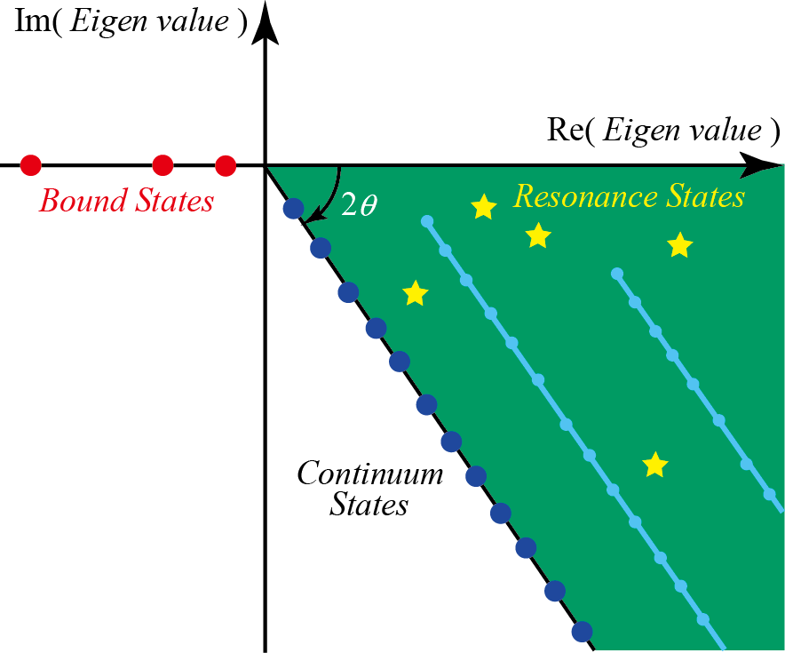
共鳴状態
$$E_{res}= E_{r} −i \frac{Γ}{2}$$
$E_{r}$ : resonance energy
$Γ$ : decay width
scaling angle : $0 ≤θ < \frac{π}{4}$

Slide 6
C. Kurokawa and K. Katō, Phys. Rev. C71, 021301(2005)
scaling angle : $θ= {16}^{°}$
by ACCC + CSM
New $0_{3}^{+}$
$$E_{0_{3}^{+}}=1.66−i \frac{1.48}{2}$$
Fig.1
in Phys. Rev. C71, 021301(2005).
M. Itoh, et. al,
Phys .Rev. C84,
054308(2011).
New $0_{3}^{+}$
$$E_{0_{3}^{+}}= E_{r} −i \frac{Γ}{2}$$
$$=1.77 −i\frac{1.45}{2}$$

Slide 7
$\left[ H\left(θ\right) −E\left(θ\right) \right] Ψ\left(θ\right)=0$,
$$Ψ\left(θ\right)=\sum_{γ=1}^{γ_{max}}{C_{γ}}\left(θ\right) Ψ_{γ}$$
$$γ ≔ \left\{nl, NL, JM\right\}$$
$$Ψ_{γ} = Φ_{γ} \left(r_{1}, R_{1}\right) +Φ_{γ} \left(r_{2}, R_{2}\right) +Φ_{γ} \left(r_{3}, R_{3}\right)$$
$$Φ_{γ} \left(r_{j}, R_{j}\right) = φ_{nl}\left(r_{j}\right)ψ_{NL}\left(R_{j}\right){\left[Y_{l}\left({\hat{r}}_{j}\right)⊗Y_{L}\left({\hat{R}}_{j}\right)\right]}_{JM}$$

Slide 8
Real-range Gaussian Basis Function
$φ_{nl}\left(r\right) \sim r^{l}\exp\left[−{\left(\frac{r}{r_{n}}\right)}^{2}\right]$
geometric progression :
$$r_{n} = r_{1} a^{n−1}$$
ガウス型基底関数の利点
短距離相関や長距離 tail の記述に適している
３体系以上の座標変換や行列要素の積分に適している
ガウス型基底関数の不得意
高励起状態
入射エネルギーの高い散乱状態

Slide 9
Complex-range Gaussian Basis Function
$φ_{nl}^{\left(+ω\right)} \sim r^{l}\exp\left[ − \left( 1+i ω \right){\left(\frac{r}{r_{n}}\right)}^{2}\right]$
金城 隆志, 九州大学 修士論文 (2000)
E. Hiyama, Y. Kino, and M. Kamimura,
Prog. Part. Nucl. Phys. 51 (2003) 223.
$φ_{nl}^{\left(−ω\right)} \sim r^{l}\exp\left[ − \left( 1−i ω \right){\left(\frac{r}{r_{n}}\right)}^{2}\right]$
$$r_{n} = r_{1} a^{n−1}$$
geometric progression :
$φ_{nl}^{\left(cos\right)} \sim r^{l}\exp\left[ − {\left(\frac{r}{r_{n}}\right)}^{2}\right] cos\left[ω{\left(\frac{r}{r_{n}}\right)}^{2}\right]$
$φ_{nl}^{\left(sin\right)} \sim r^{l}\exp\left[ − {\left(\frac{r}{r_{n}}\right)}^{2}\right] sin\left[ω{\left(\frac{r}{r_{n}}\right)}^{2}\right]$

Slide 10
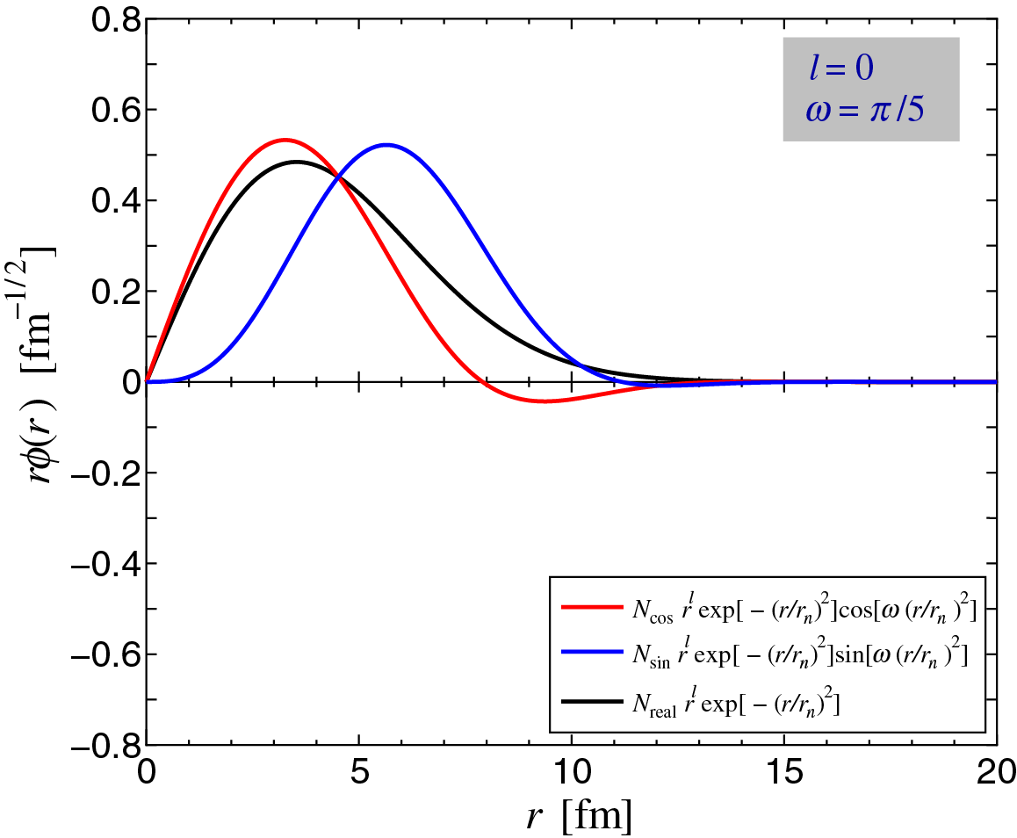
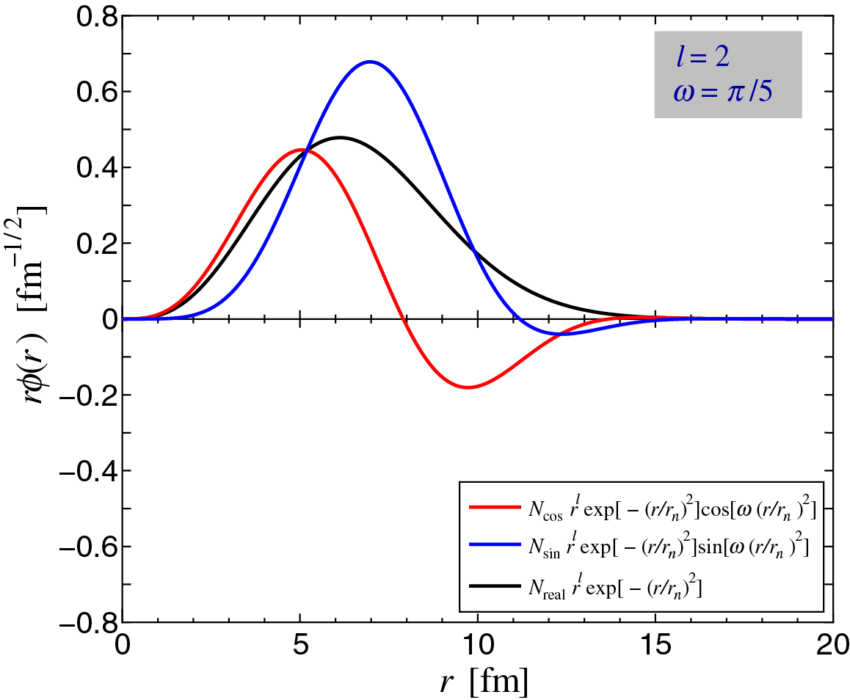
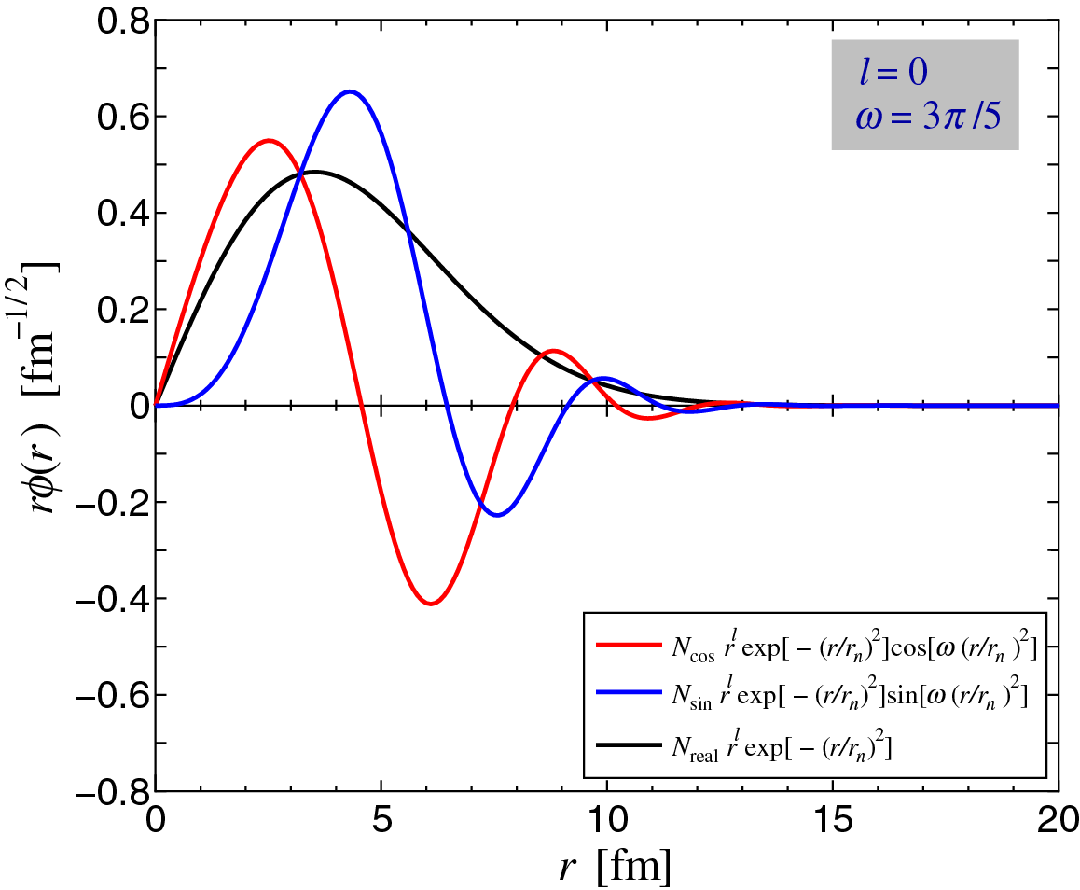
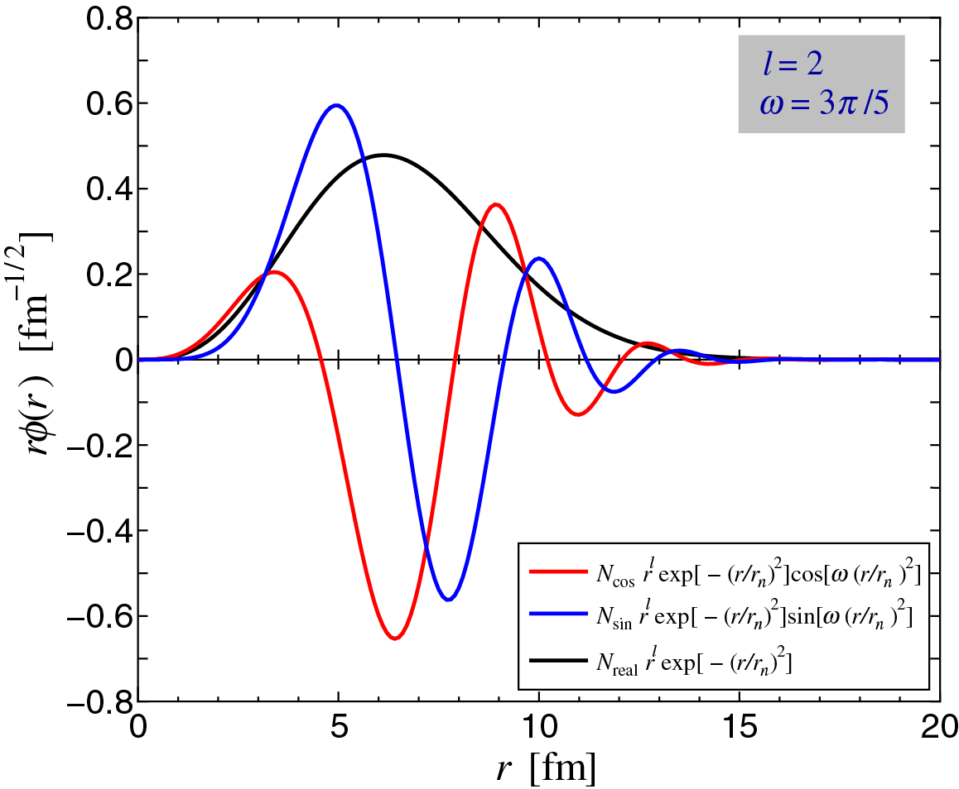
Examples of Gaussian Basis Function
l = 0, 2
$$ω= \frac{π}{5}, \frac{3}{5}π$$

Slide 11
Eigenvalues of 3D Harmonic oscillator potential
$$2n$$ | Eigenvalue $−1.5$
12 | 12.00000007
16 | 16.00000068
20 | 20.00000510
24 | 24.00003082
28 | 28.00016387
32 | 32.00056547
36 | 36.00439902
40 | 40.00477577
44 | 44.18678726
48 | 48.41380294
$$\left(2n+l+ \frac{3}{2}\right)ℏω$$
$$l=0$$
$$ℏω =1$$

Slide 12
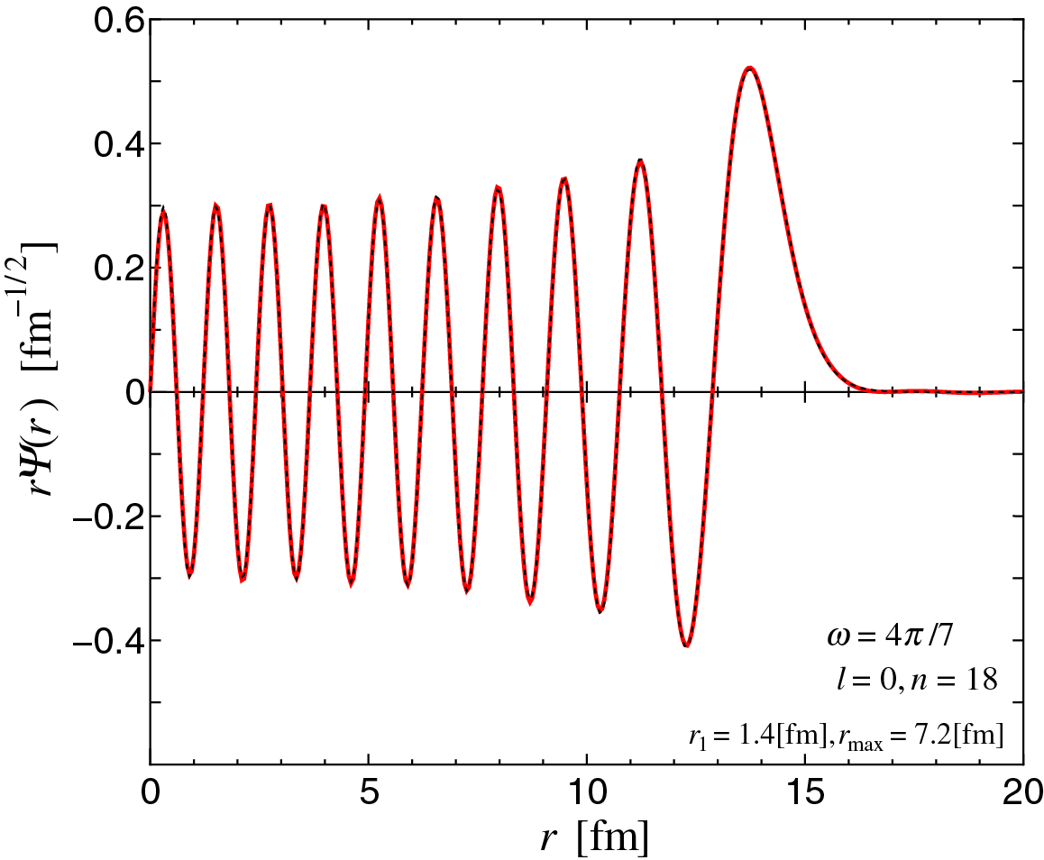
Wave function of 3D Harmonic oscillator potential
n = 18

Slide 13
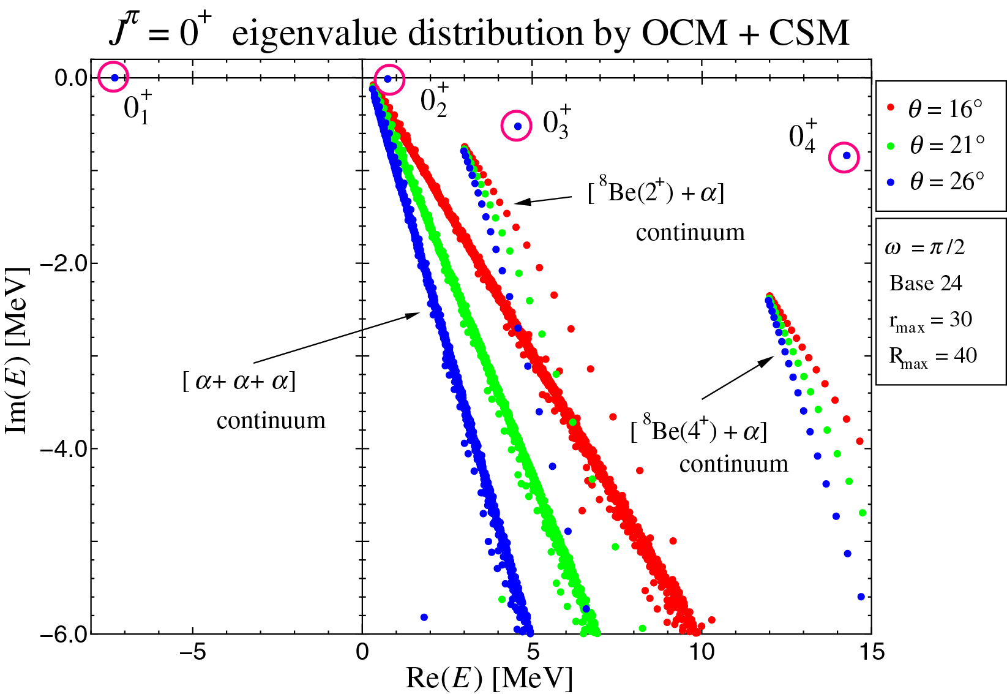

Slide 14
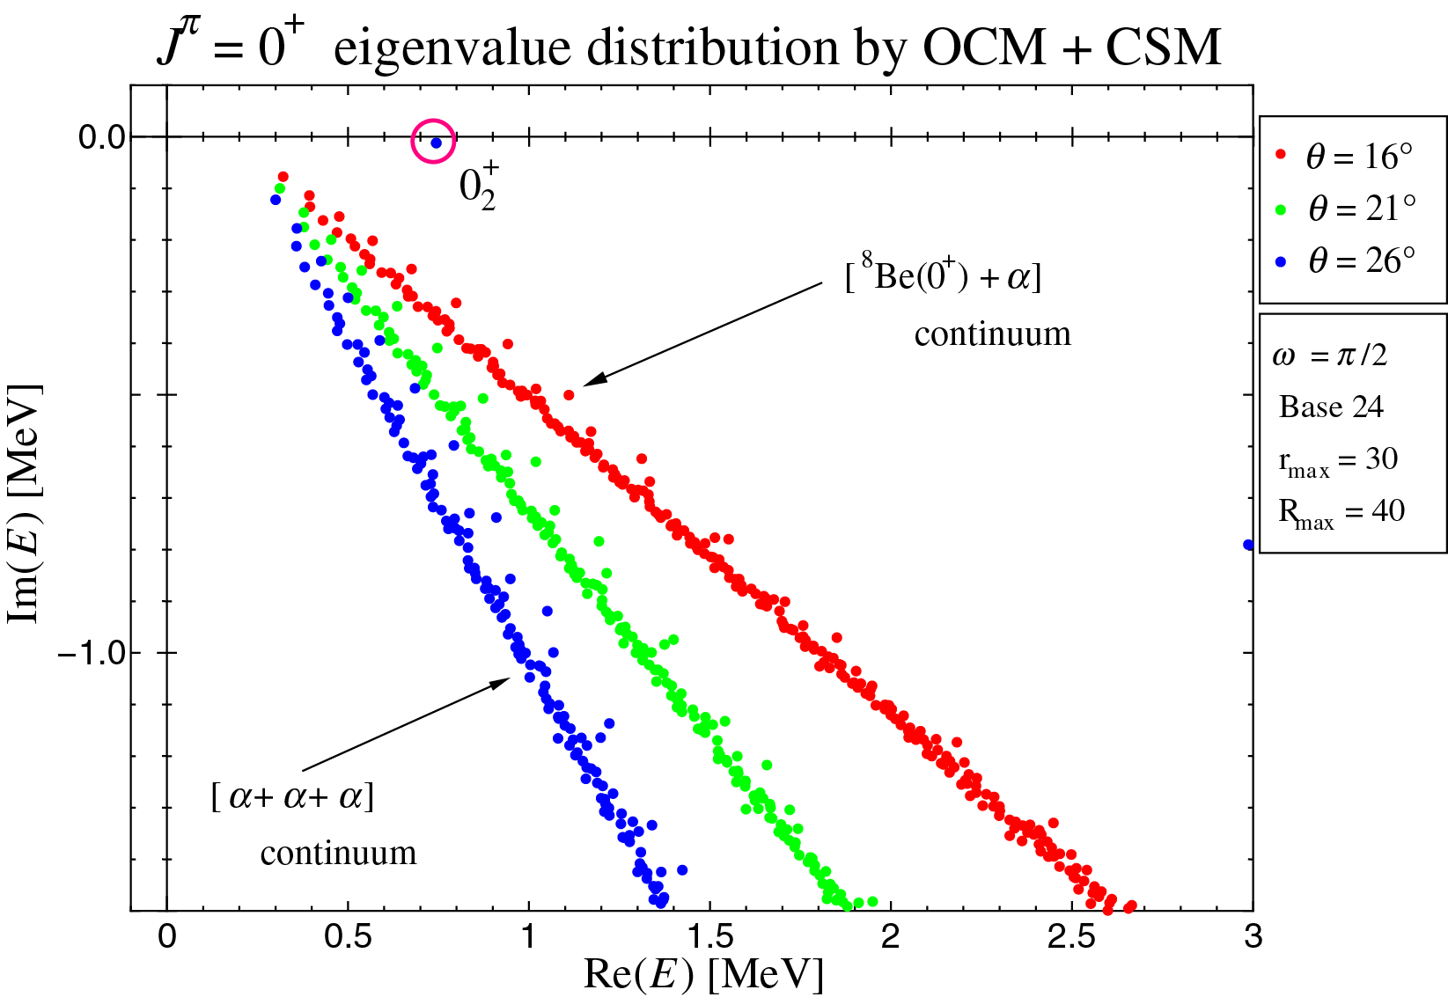

Slide 15
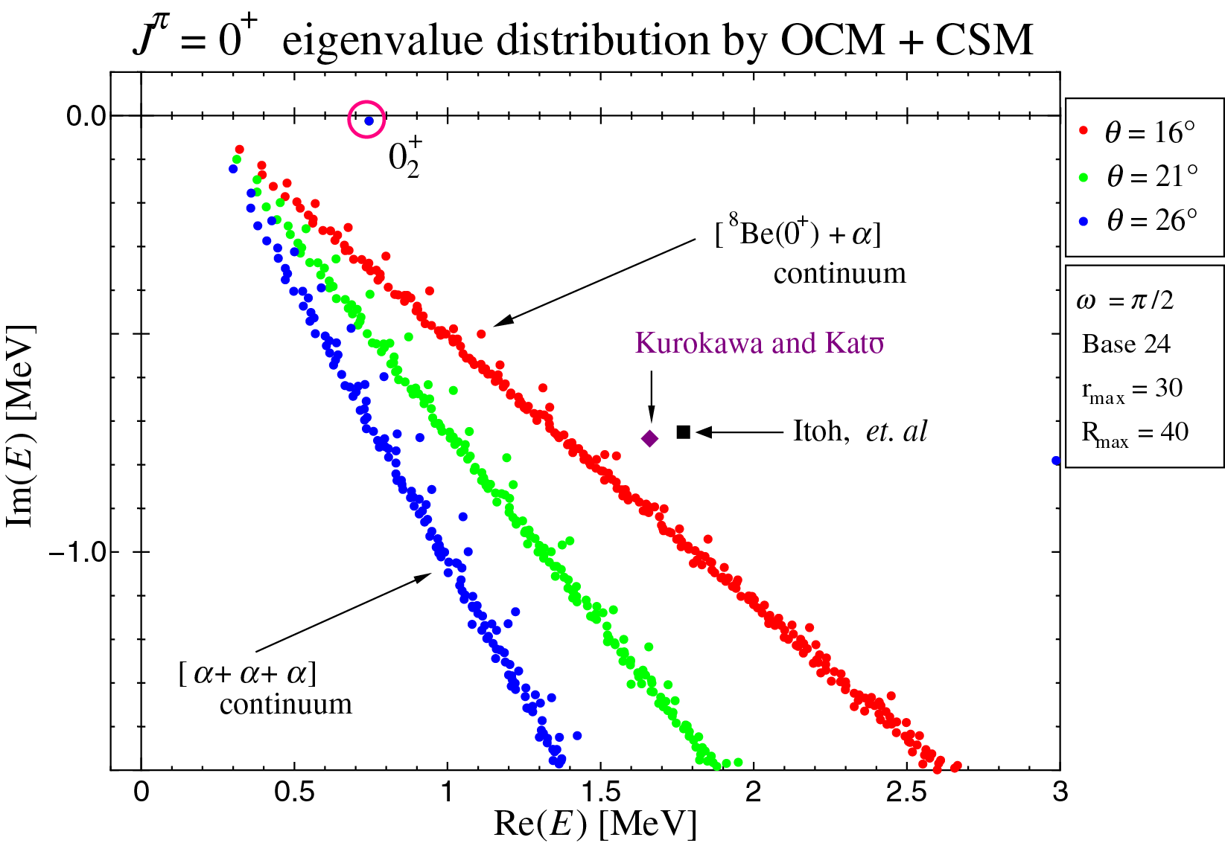

Slide 16
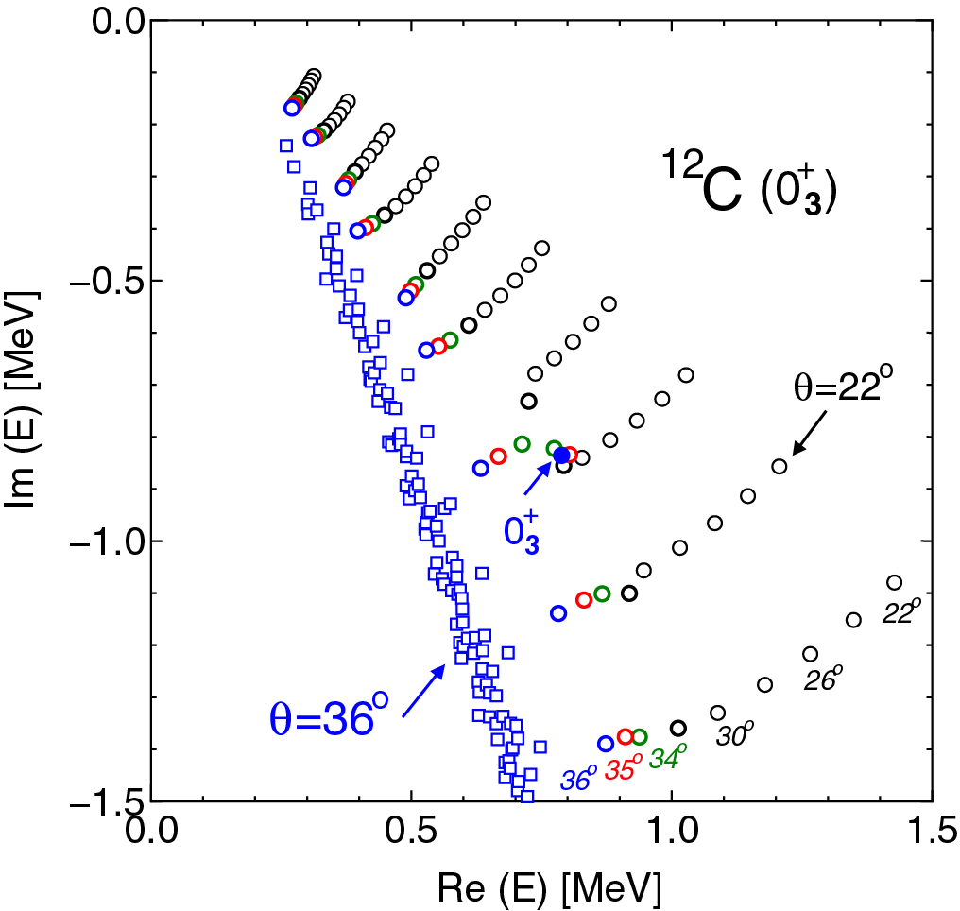
New $0_{3}^{+}$ by C. Kurokawa and K. Katō
$$E_{0_{3}^{+}}=1.66−i \frac{1.48}{2}$$
Our result
$$E_{0_{3}^{+}}=0.79−i \frac{1.68}{2}$$

Slide 17
C. Kurokawa and K. Katō, Phys. Rev. C71, 021301(2005)
Analytical Continuation in the Coupling Constant (ACCC) + CSM
$$H → H+V_{aux}\left(r_{1}, r_{2},r_{3}\right)$$
$$V_{aux}\left(r_{1}, r_{2},r_{3}\right) = δ\exp\left[ − μ \left(r_{1}^{2}+ r_{2}^{2}+ r_{3}^{2}\right)\right]$$
Fig.2 upper
in Phys. Rev. C71, 021301(2005).

Slide 18
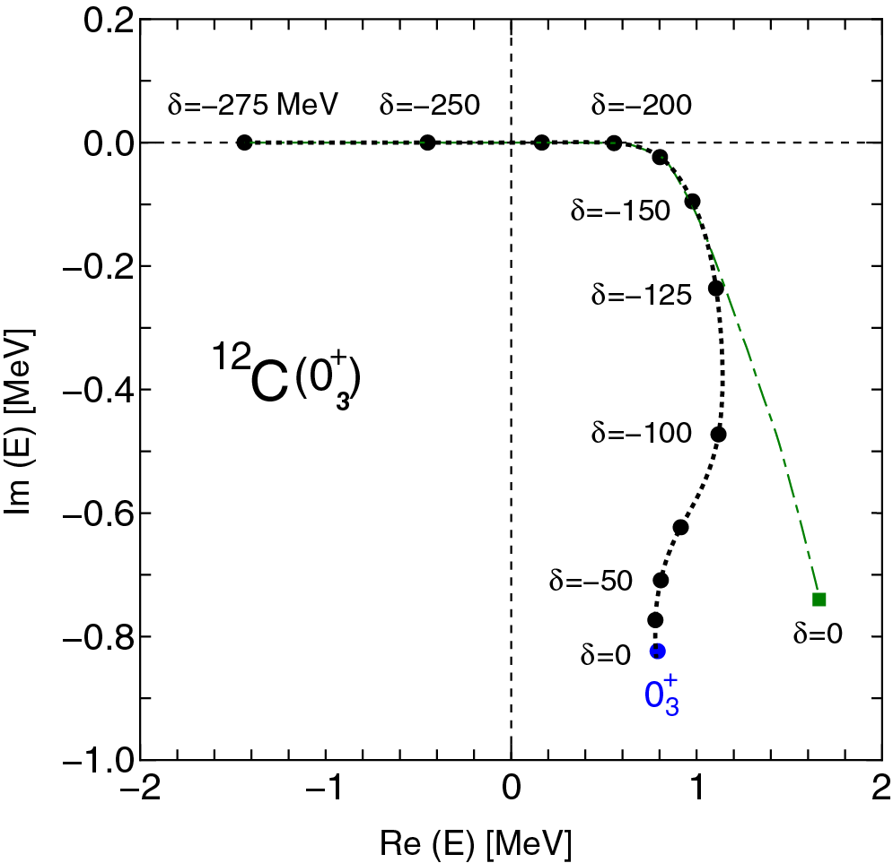
New $0_{3}^{+}$ by C. Kurokawa and K. Katō
$$E_{0_{3}^{+}}=1.66−i \frac{1.48}{2}$$
Our result
$$E_{0_{3}^{+}}=0.79−i \frac{1.68}{2}$$

Slide 19
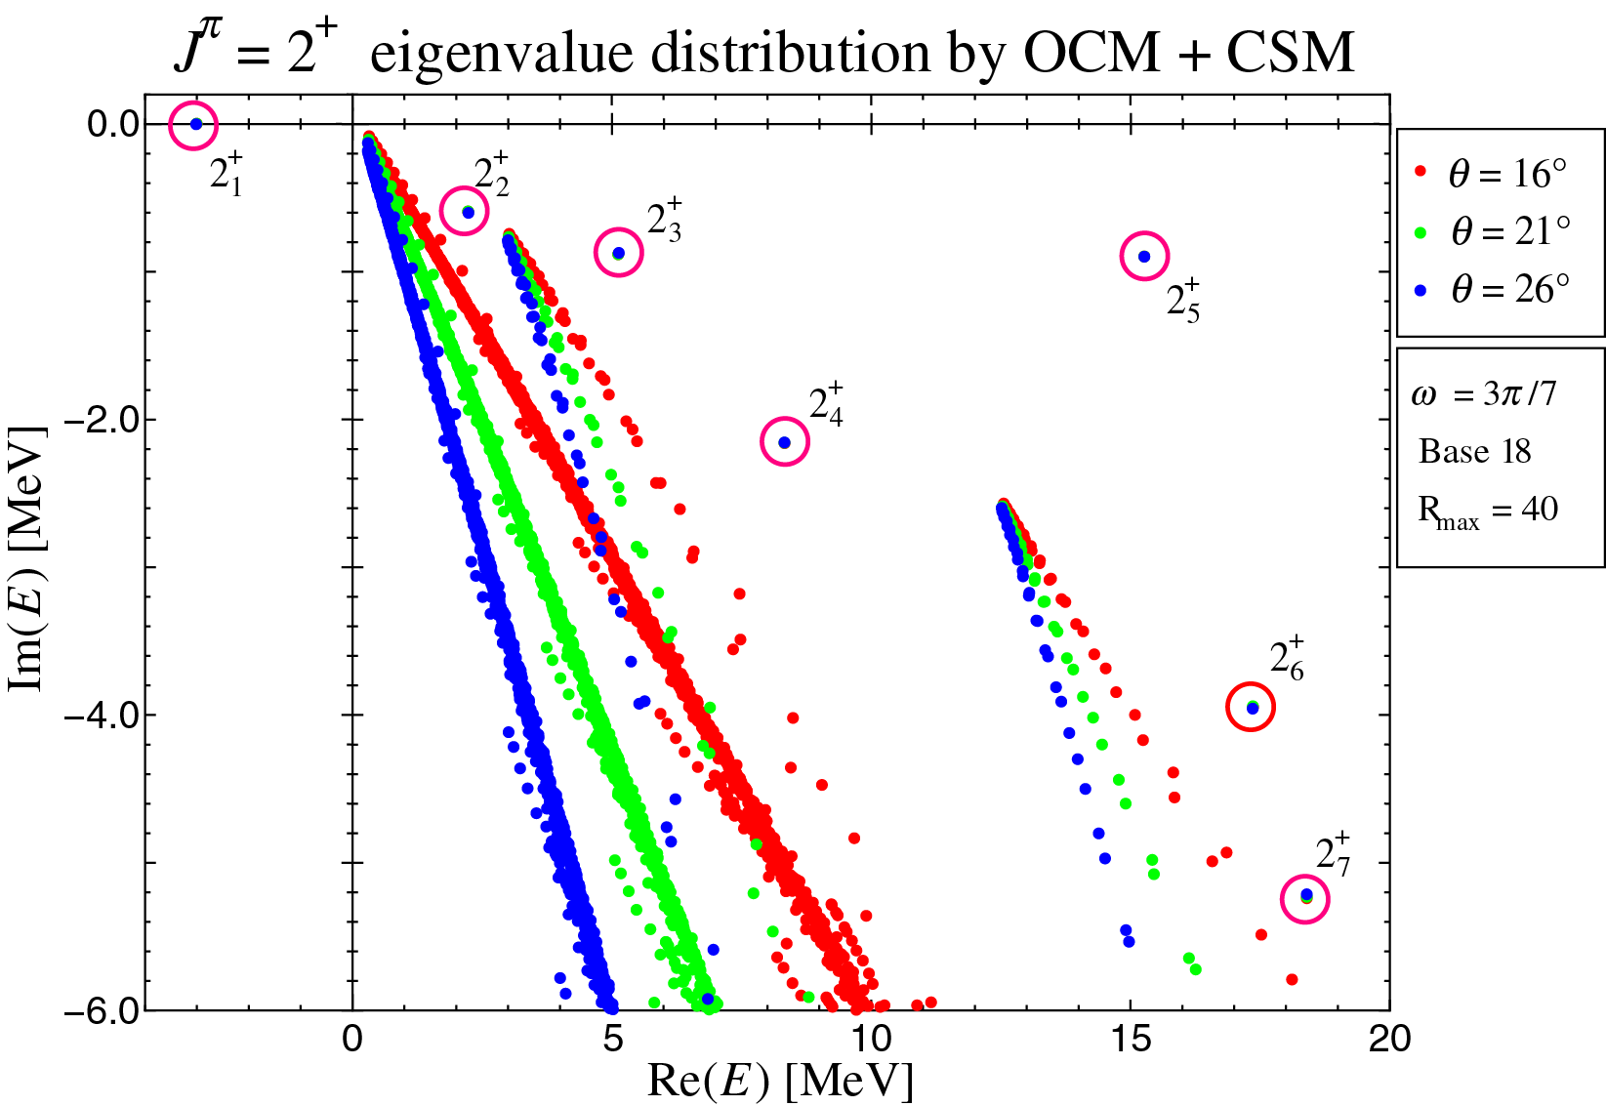

Slide 20
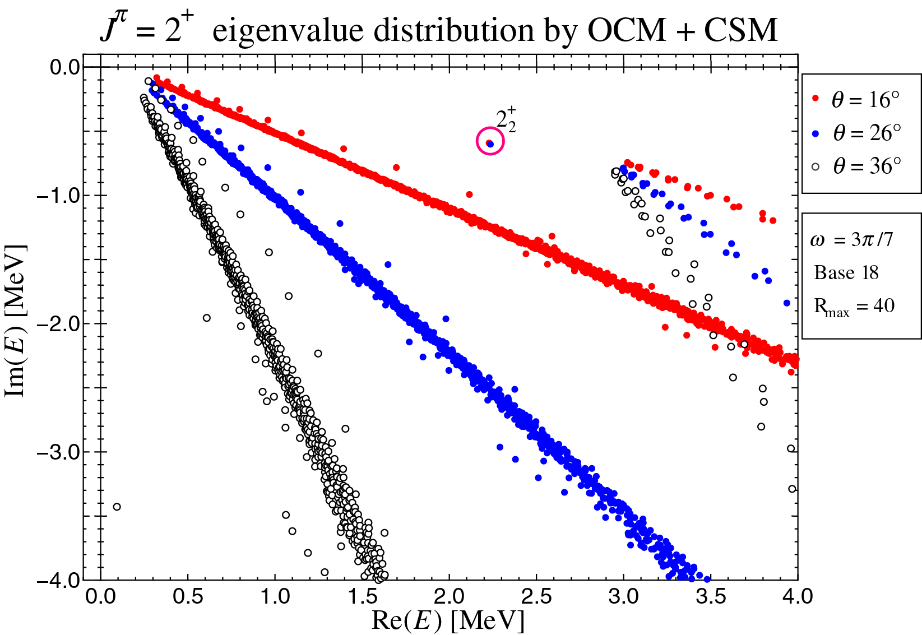

Slide 21
 | Present work |  |  |  | Kurokawa and Katō |  |  |  | Experimental Data
$$J^{π}$$ | $$E_{x}$$ | $$E_{r}$$ | $$Γ$$ |  | $$E_{x}$$ | $$E_{r}$$ | $$Γ$$ |  | $$E_{x}$$ | $$E_{r}$$ | $$Γ$$
$$0_{1}^{+}$$ | 0.00 | - 7.30 | --- |  | 0.00 | - 7.29 | --- |  | 0.00000 | -7.2747 | ---
$$2_{1}^{+}$$ | 4.32 | - 2.98 | --- |  | 4.31 | - 2.98 | --- |  | 4.443891 | -2.8358 | ---
$$0_{2}^{+}$$ | 8.05 | 0.75 | 0.0088 |  | 8.05 | 0.76 | 0.0024 |  | 7.65420 | 0.3795 | $$8.5×{10}^{−6}$$
$$0_{3}^{+}$$ | 8.09 | 0.79 | 1.68 |  | 8.95 | 1.66 | 1.48 |  | 9.04(9) | 1.77 | 1.45(18)
$$2_{2}^{+}$$ | 9.54 | 2.24 | 1.2 |  | 9.57 | 2.28 | 1.1 |  | 9.84(6) | 2.57 | 1.01(15)
$$0_{4}^{+}$$ | 11.89 | 4.59 | 1.0 |  | 11.87 | 4.58 | 1.1 |  | 10.56(6) | 3.29 | 1.42(8)
$$2_{3}^{+}$$ | 12.47 | 5.15 | 1.8 |  | 12.43 | 5.14 | 1.9 |  | 11.16(5) | 3.89 | 0.43(8)
$$2_{4}^{+}$$ | 15.67 | 8.36 | 4.3 |  | 15.93 | 8.64 | 3.9 |  | 15.44(4) | 8.17 | 1.5(2)
$$0_{5}^{+}$$ | 21.60 | 14.3 | 1.7 |  | 21.59 | 14.3 | 1.5 |  | --- | --- | ---
$$2_{5}^{+}$$ | 22.70 | 15.3 | 1.8 |  | 22.39 | 15.1 | 1.2 |  | --- | --- | ---
$$2_{6}^{+}$$ | 24.70 | 17.4 | 8.0 |  | 24.89 | 17.6 | 6.0 |  | --- | --- | ---

Slide 22
 | Present work |  |  |  | Kurokawa and Katō |  |  |  | Experimental Data
$$J^{π}$$ | $$E_{x}$$ | $$E_{r}$$ | $$Γ$$ |  | $$E_{x}$$ | $$E_{r}$$ | $$Γ$$ |  | $$E_{x}$$ | $$E_{r}$$ | $$Γ$$
$$4^{+}$$ | 12.25 | 4.96 | 2.2 |  | --- | --- | --- |  | --- | --- | ---
$$4^{+}$$ | 13.91 | 6.61 | 0.20 |  | 14.11 | 6.82 | 0.24 |  | 14.083 | 6.808 | 0.258
$$4^{+}$$ | 18.92 | 11.62 | 8.0 |  | --- | --- | --- |  | --- | --- | ---
$$4^{+}$$ | 19.53 | 12.23 | 2.2 |  | 20.39 | 13.1 | 3.4 |  | --- | --- | ---
$$4^{+}$$ | 24.41 | 17.11 | 6.3 |  | --- | --- | --- |  | --- | --- | ---
C. Kurokawa and K. Katō, Nucl. Phys. A792, 82(2007).
M. Itoh, et. al, Phys .Rev. C84, 054308(2011).
F. Ajzenberg-Selobe, Nucl. Phys. A506, 1(1990),

Slide 23
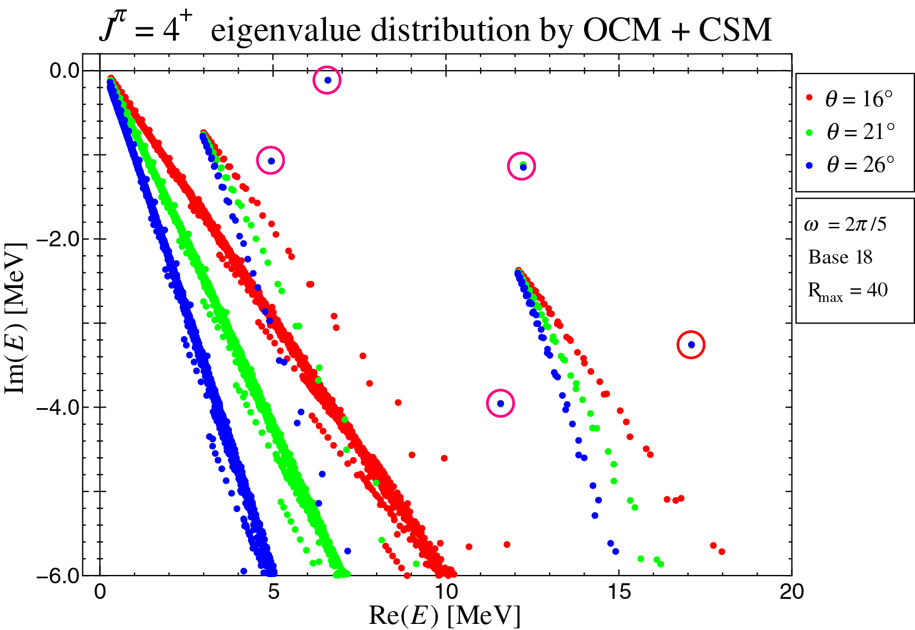

Slide 24
Repulsive 3$α$ Potential
$$V_{3α}\left(r_{1}, r_{2},r_{3}\right) = V_{3α}^{J^{π}}\exp\left[ − μ \left(r_{1}^{2}+ r_{2}^{2}+ r_{3}^{2}\right)\right]$$
$μ=$ 0.15 [${fm}^{−2}$]
$V_{3α}^{0^{+}}=$ 31.7 [MeV]
$V_{3α}^{2^{+}}=$ 63.0 [MeV]
$V_{3α}^{4^{+}}=$ 150.0 [MeV]
other $V_{3α}^{J^{π}}=$ 31.7 [MeV]
$$J^{π}$$ | $$0^{+}$$ | $$2^{+}$$ | $$4^{+}$$ | Others
$V_{3α}^{J^{π}}$ [MeV] | 31.7 | 63.0 | 150.0 | 31.7

Slide 25
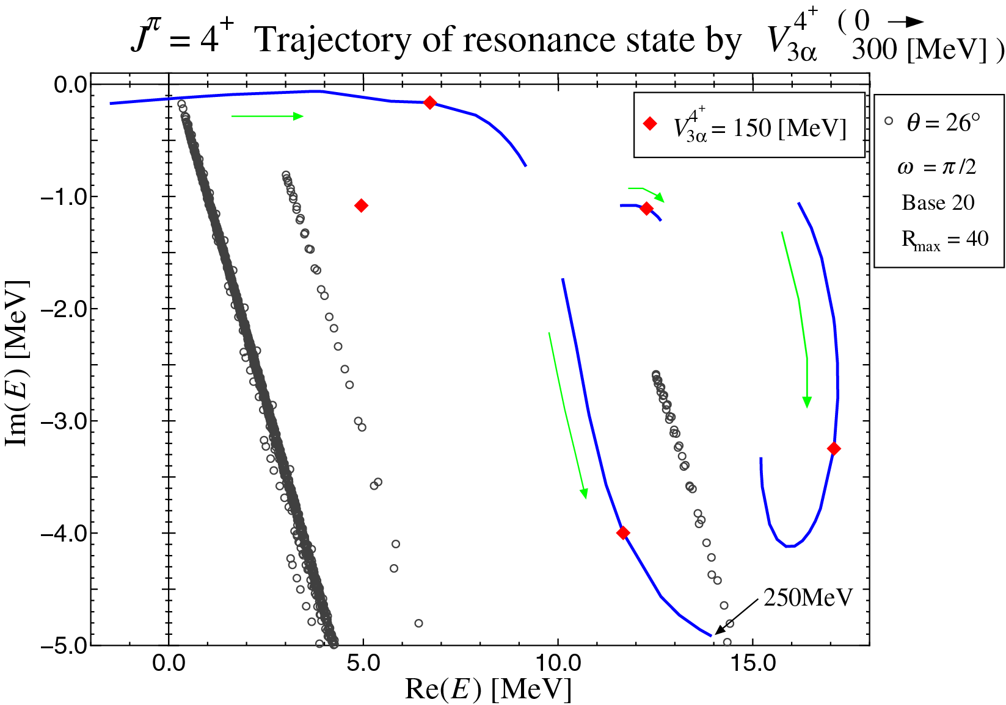

Slide 26
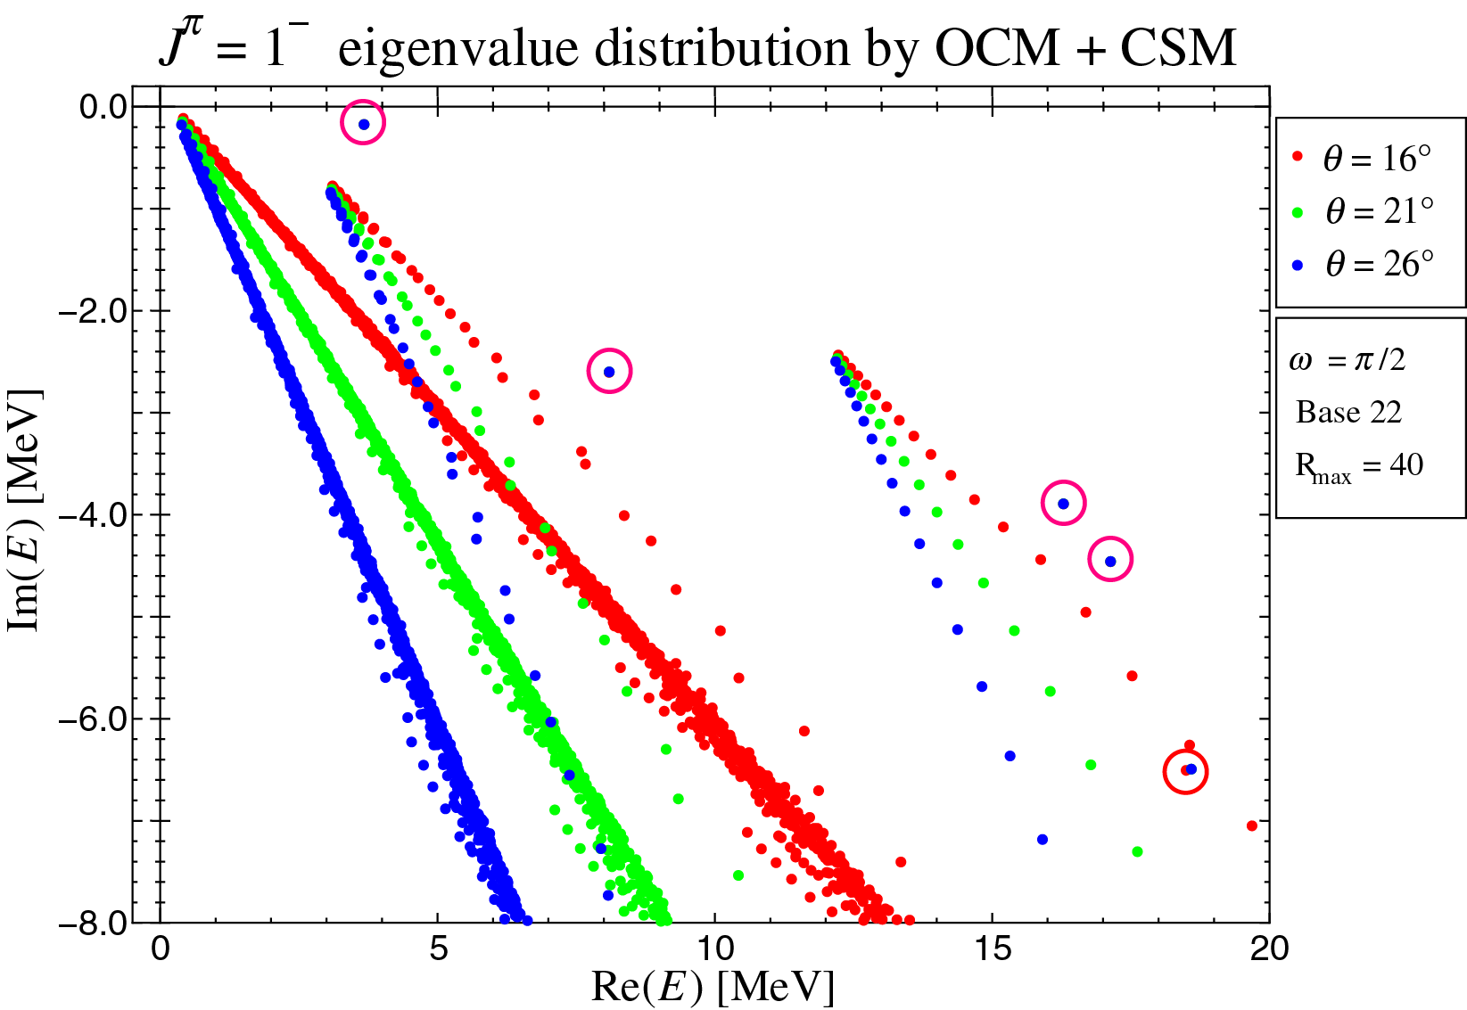

Slide 27
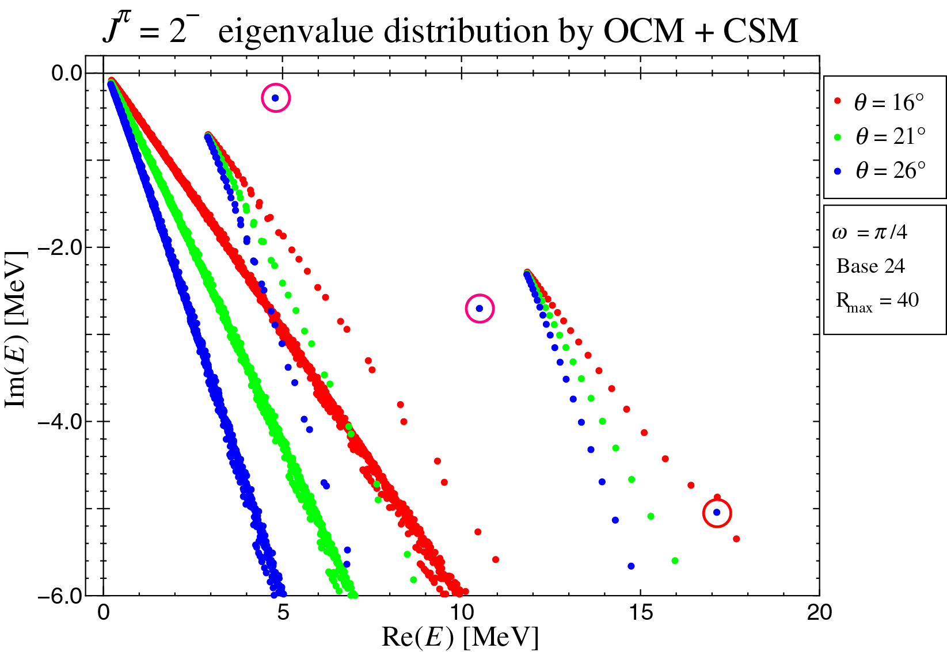

Slide 28
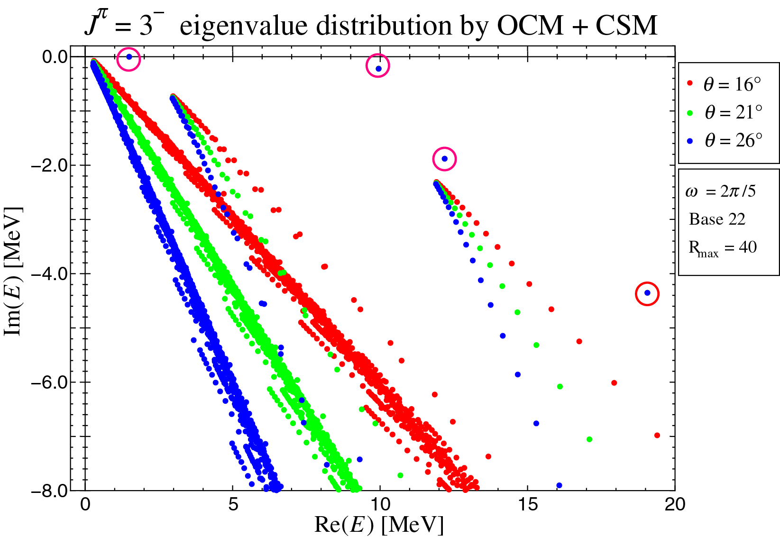

Slide 29
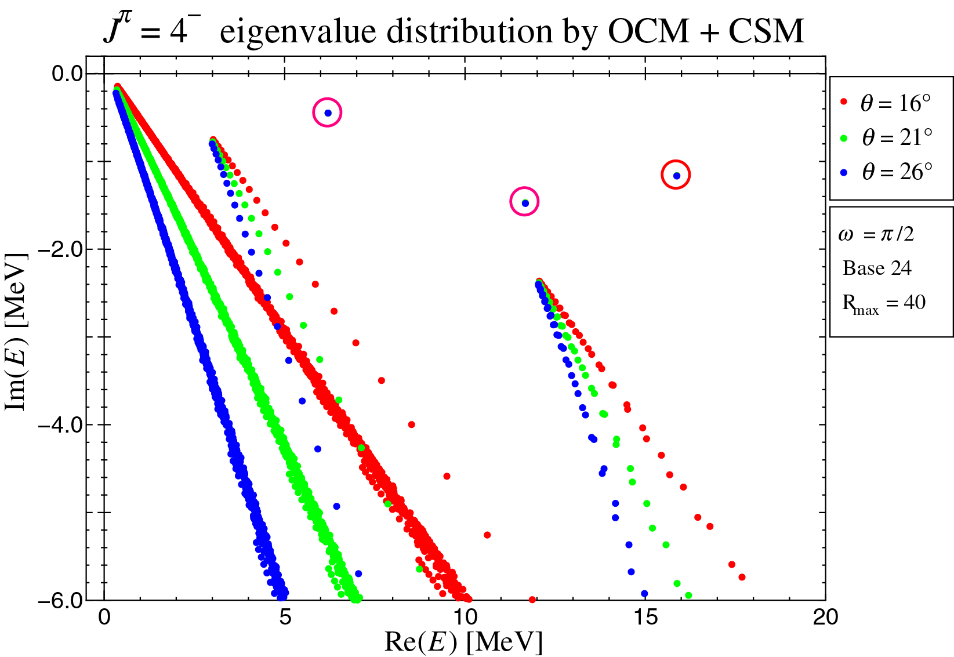

Slide 30
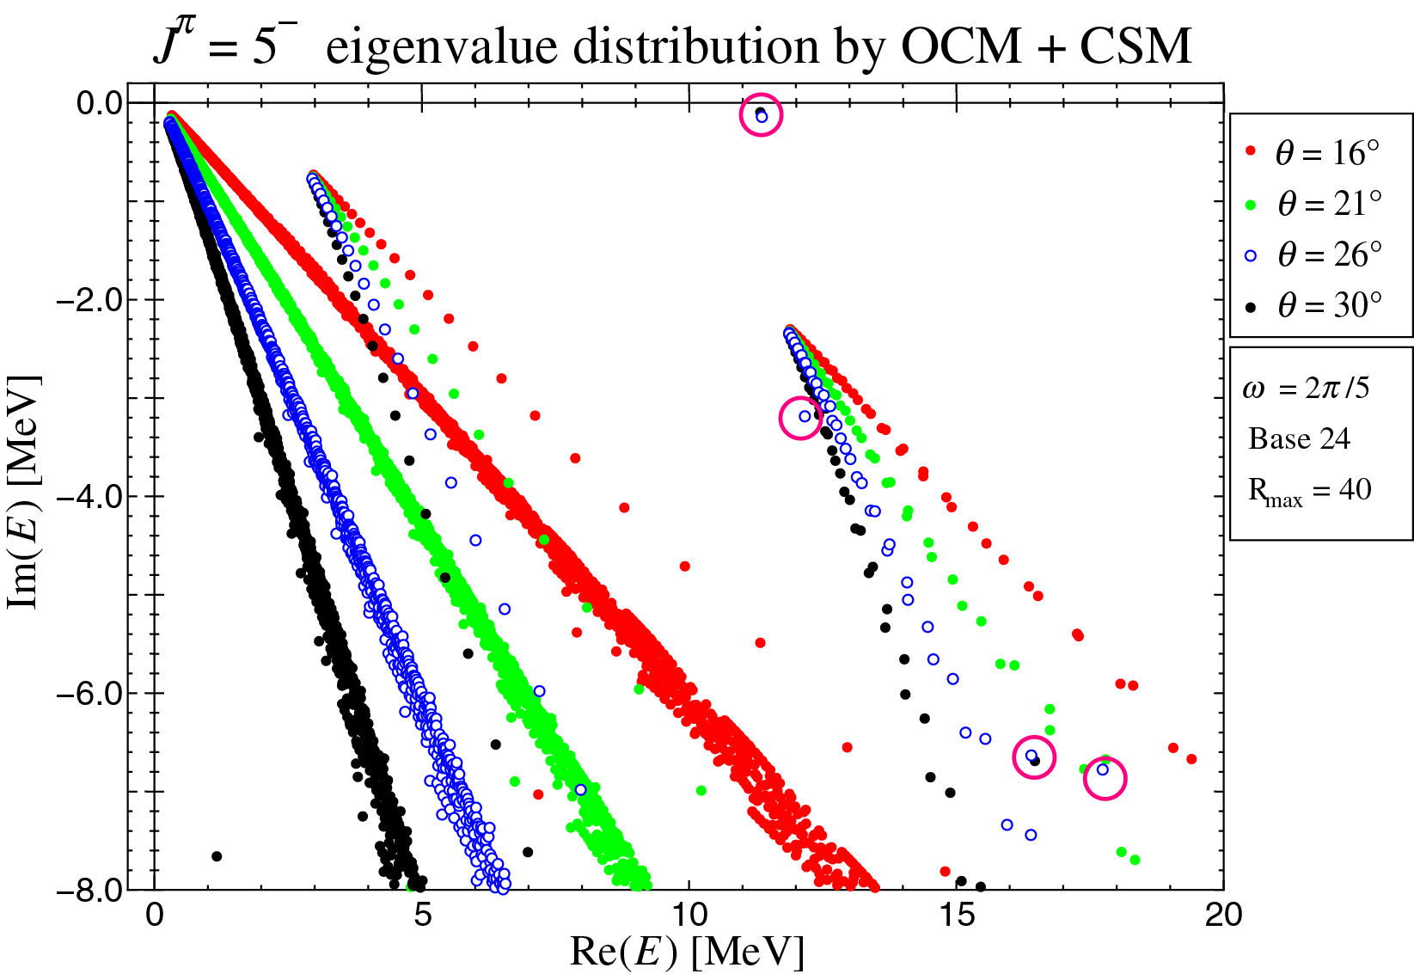

Slide 31
 | Present work |  |  |  | Kurokawa and Katō |  |  |  | Experimental Data
$$J^{π}$$ | $$E_{x}$$ | $$E_{r}$$ | $$Γ$$ |  | $$E_{x}$$ | $$E_{r}$$ | $$Γ$$ |  | $$E_{x}$$ | $$E_{r}$$ | $$Γ$$
$$3_{1}^{−}$$ | 8.79 | 1.49 | $2.1×{10}^{−3}$ |  | 8.80 | 1.51 | $$2.0×{10}^{−3}$$ |  | 9.641(5) | 2.366 | $$3.4×{10}^{−2}$$
$$1_{1}^{−}$$ | 10.98 | 3.68 | 0.35 |  | 10.94 | 3.65 | 0.30 |  | 10.844(16) | 3.569 | 0.315(25)
$$2_{1}^{−}$$ | 12.10 | 4.80 | 0.57 |  | 11.97 | 4.68 | 0.42 |  | 11.828(16) | 4.553 | 0.260(25)
$$4_{1}^{−}$$ | 13.51 | 6.21 | 0.45 |  | 12.45 | 5.16 | 0.12 |  | 13.352(17) | 6.077 | 0.375(40)
$$1_{2}^{−}$$ | 15.40 | 8.10 | 5.20 |  | --- | --- | --- |  | --- | --- | ---
$$3_{2}^{−}$$ | 17.25 | 9.95 | 0.45 |  | 18.29 | 11.0 | 0.5 |  | --- | --- | ---
$$2_{2}^{−}$$ | 17.80 | 10.50 | 5.40 |  | 16.60 | 9.31 | 4.65 |  | --- | --- | ---
$$5_{1}^{−}$$ | 18.66 | 11.36 | 0.29 |  | 18.69 | 11.4 | 0.3 |  | --- | --- | ---
$$4_{2}^{−}$$ | 18.97 | 11.67 | 2.93 |  | --- | --- | --- |  | --- | --- | ---
$$5_{2}^{−}$$ | 19.47 | 12.17 | 6.37 |  | --- | --- | --- |  | --- | --- | ---
$$3_{3}^{−}$$ | 19.49 | 12.19 | 3.67 |  | --- | --- | --- |  | --- | --- | ---
$$4_{3}^{−}$$ | 23.15 | 15.85 | 2.34 |  | --- | --- | --- |  | --- | --- | ---
$$1_{3}^{−}$$ | 23.58 | 16.28 | 7.79 |  | --- | --- | --- |  | --- | --- | ---
$$5_{3}^{−}$$ | 23.70 | 16.40 | 13.27 |  | --- | --- | --- |  | --- | --- | ---

Slide 32
Complex Scaling Method (CSM) において,
複素レンジガウス基底関数も有効に機能する.
arXiv:1302.4256
Prog. Theor. Exp. Phys. (2013) 073D02.

