Slide 1
K中間子原子核探索実験 （J-PARC E15実験） の解析状況
佐田優太(京都大学、理研)
Y.SADA for the E15 collaboration
RCNP研究会「核子・ハイペロン多体系におけるクラスター現象」

Slide 2
Contents
Introduction
Kaonic nuclei
Status of Kaonic nuclei study
J-PARC E15 experiment
Set up
Beamline
CDS
Neutron Counter
Analysis status
Summary

Slide 3
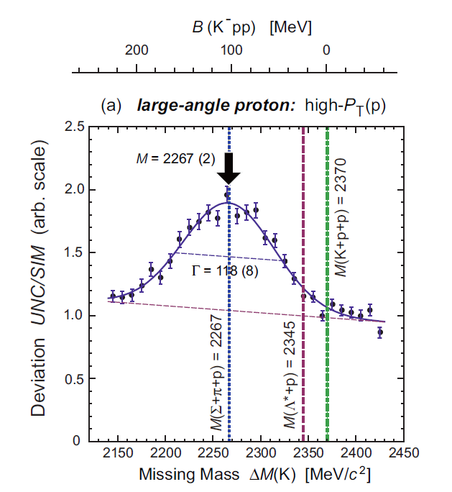
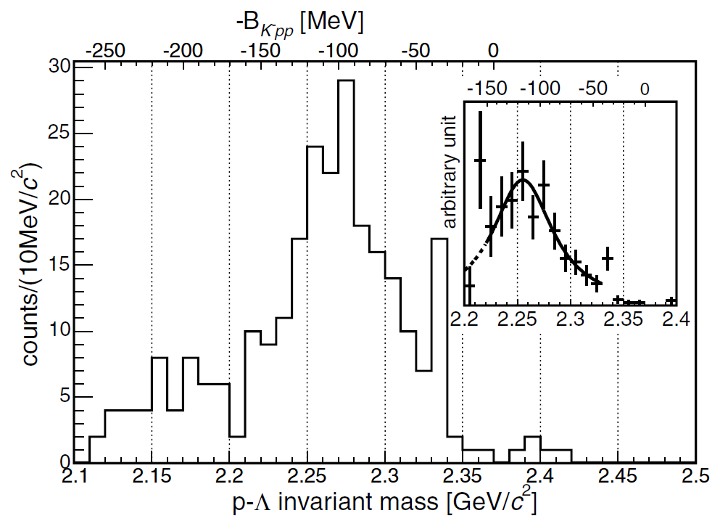
Kaonic nuclei
3
Bound state of anti-kaon and nuclei with strong interaction
High density matter??
FINUDA
DISTO
B = 115±6±4 MeV
Γ = 67±14±3 MeV
B = 105±2±5 MeV
Γ = 118±8±10MeV
FINUDA exp.(DAΦNE)
⁶Li, ⁷Li, ¹²C target, stop K− reaction
Λp invariant mass
DISTO exp.
p+p →X +K⁺, X →Λ + p reaction
missing-mass & invariant mass
And LEPS/Spring-8（ d(γ,Kπ) <=previous talk by Tokiyasu-san
J -PARC E27 exp（ d(π+,K+) <=previous talk by Ichikawa-san
Kaonic nuclei exist or not? binding energy and width?
⇒result with other reaction is important !

Slide 4
Theoretical calc. Of KNN(K⁻pp)
 | Binding energy[MeV] | Width[MeV]
N. Barnea, A. Gal, E.Z. Liverts(2012) | 16 | 41
A. Dote, T. Hyodo, W. Weise(2008,2009) | 17-23 | 40-70
Y. Ikeda, H. Kamano, T. Sato(2010) | 9-16 | 34-46
 | Binding energy[MeV] | width[MeV]
T. Yamazaki, Y. Akaishi(2002) | 48 | 61
N.V. Shevchenko, A. Gal, J. Mares(2007) | 50-70 | 90-110
Y. Ikeda, T. Sato (2007,2009) | 60-95 | 45-80
S. Wycech, A.M. Green (2009) | 40-80 | 40-85
Potential is deep or shallow??

Slide 5
J-PARC E15 Experiment
5
in-flight (K⁻, n) reaction on ³He target
K⁻
^{1.0GeV/c}
³He
Neutron
Formation
KNN
cluster
Missing mass
Spectroscopy via neutron
Decay
Mode to decay charged particles
Λ
p
We are able to observe both
“Formation” & “Decay”
of KNN bound state
π⁻
Invariant mass reconstruction
p

Slide 6
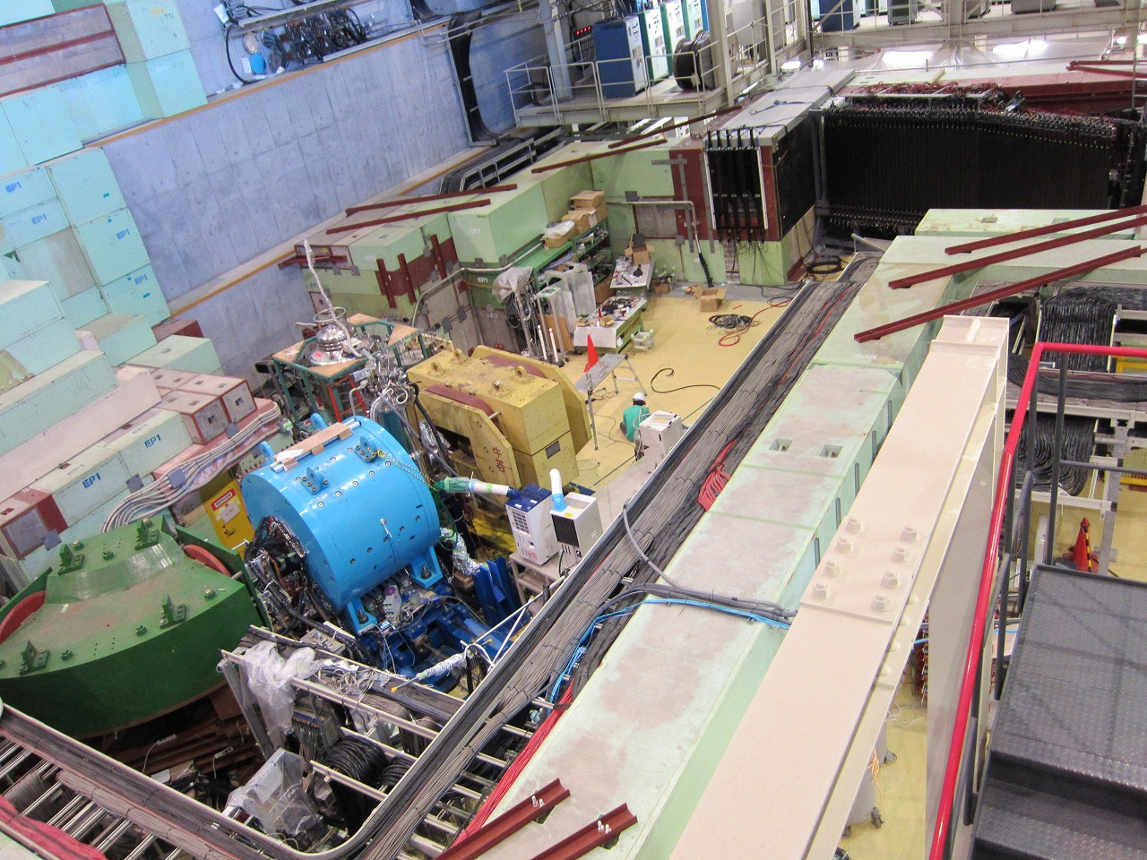
J-PARC K1.8BR beam line[Jun. 2012]
beam dump
beam sweeping
magnet
neutron counter &
TOFstop/proton counter
CDS
³He-target
³He(K⁻,N) reaction
beam line
spectrometer

Slide 7
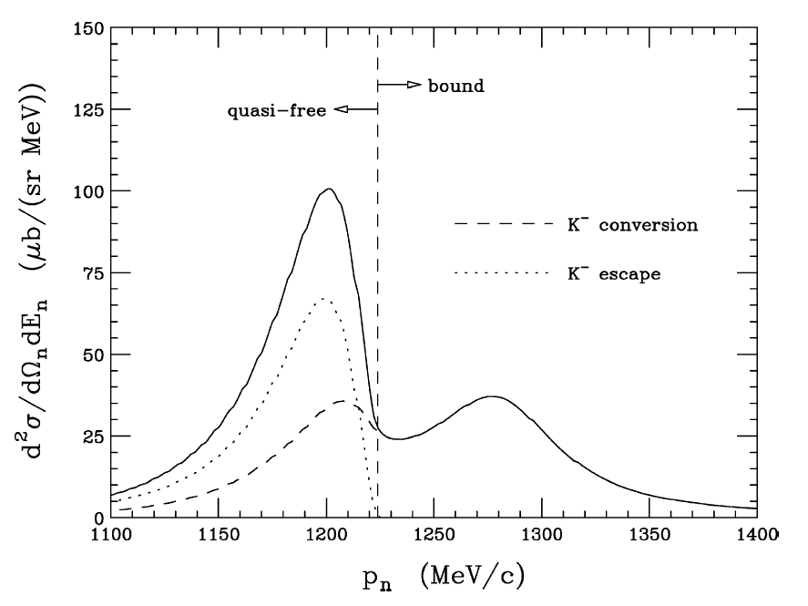
Formation spectra : in-flight ³He(K⁻,n)
K⁻ + ³He → “K⁻pp” + n @ P_{K}=1GeV/c, θ=0º
V0 = -292 W0 = -107 MeV
(YA potential)
quasi-free
Quasi-free peak ~1.2 GeV/c
Kpp peak >1.22GeV/c
YA potential
bound
K⁻ conversion
K⁻ escape
Easy to observe
If dσ/dΩ >1.0 mb/sr
(This example dσ/dΩ ~3.0 mb/sr.)
One of the examples
T.Koike and T.Harada. , PLB652 (2007) 262

Slide 8
Physics Data amount
 | Beam intensity | Duration [hour] | K on target
Mar 2013 | 14.5kW | 30 | 0.9x 10⁹
May 2013 | 24kW | 88 | 4.0x 10⁹
We accumulated physics data =>total ~5x10⁹ Kaon on target
Reaction in accumulated data
³He(K⁻,n)
³He(K⁻,p)
³He(K⁻,d)
=> KNN search, multi-nucleon absorption, hyperon production etc.

Slide 9
Detector performance & preliminary result

Slide 10
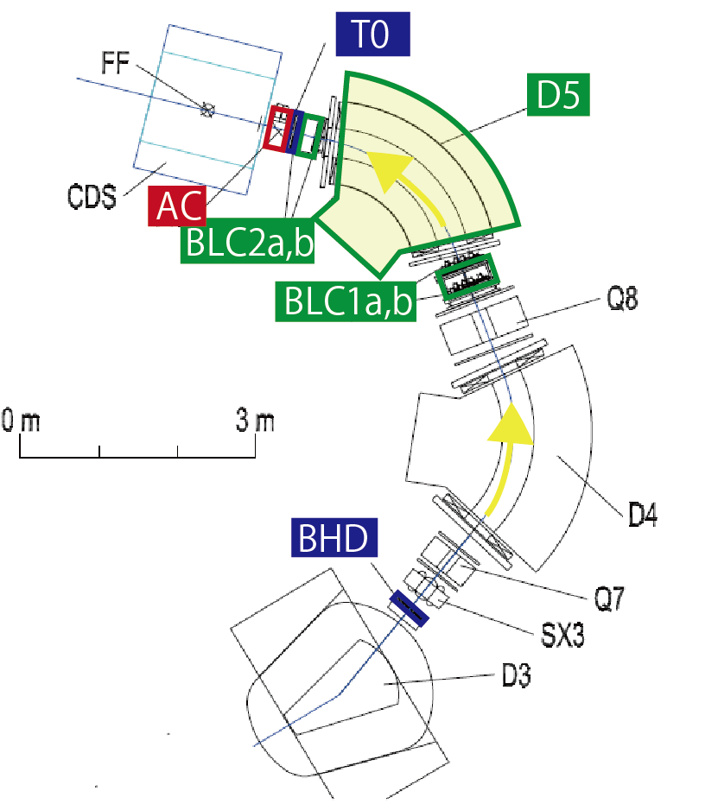
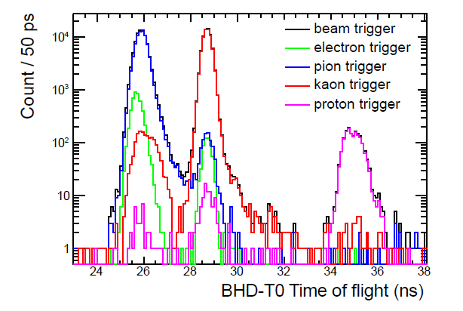
Beamline spectrometers
BHD & T0(Beam trigger)
Plastic scintillator
PID for beam
Time resolution TOF(BHD-T0)~160ps
AC(Kaon ID at trigger level)
Aerogel Cherenkov (index=1.05)
P ID eff. =97%(Vth=5.p.e.)
D5 magnet & BLC (Beam spectrometer)
Dipole Mag. & wire chamber
Momentum resl=0.2%
π
K
TOF (BHD-T0)
1.0GeV/c beam
P

Slide 11
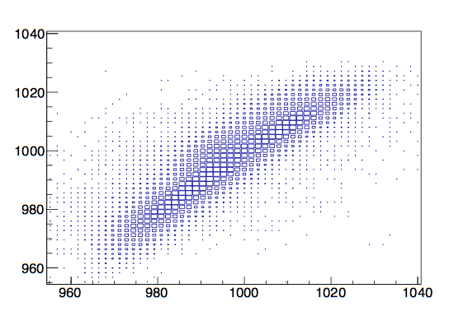
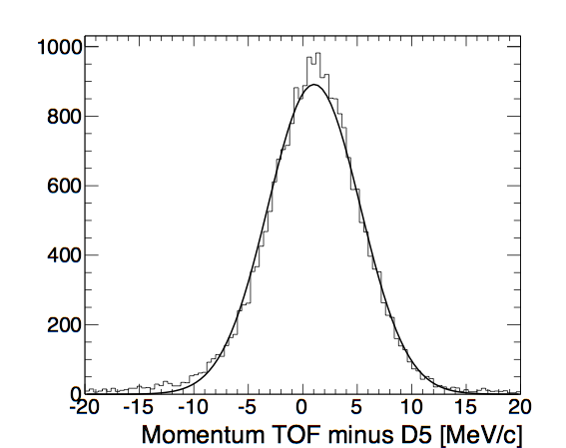
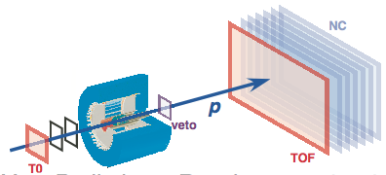
Beam Spectrometer
P^{spectrometer} [MeV/c]
σ^{spectrometer}~ 0.2%
@1 GeV/c
P^{spectrometer} - P^{TOF}[MeV/c]
We achieved Enough performance

Slide 12
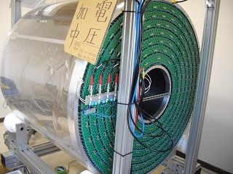
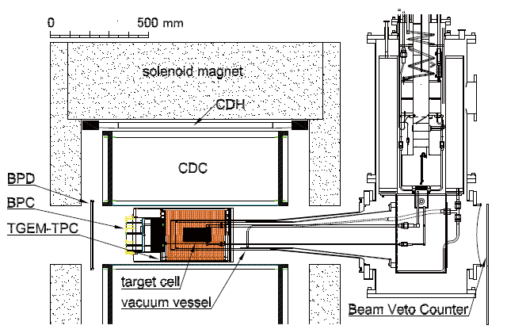
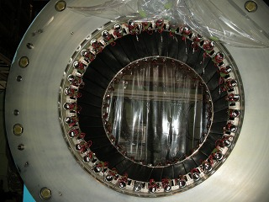
Cylindrical Detector System
12
CDC
Cell Drift length~9mm
Layer 15 layers
Read out : 1816 ch
Gas : Ar-C₂H₆ (50:50)
Counters & chamber around ³He target
Hodoscope
And Solenoid
Size : 99 x 30 x 700 mm³ (W x T x L)
Configuration : 36 modules
PMT : fine-mesh type (H8409)
Solenoid Mag. Max 0.7T
Expected mass resolution :
- σ ~ 3.5 MeV/c² for Λ
- σ ~ 10 MeV/c² for K⁻pp
( σ_{cdc} = 200 μm / Field : 0.7 T)

Slide 13
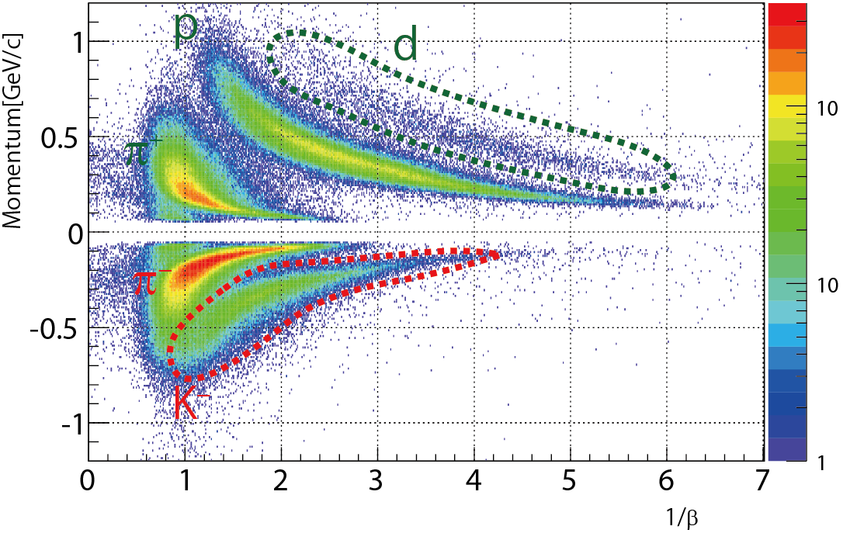
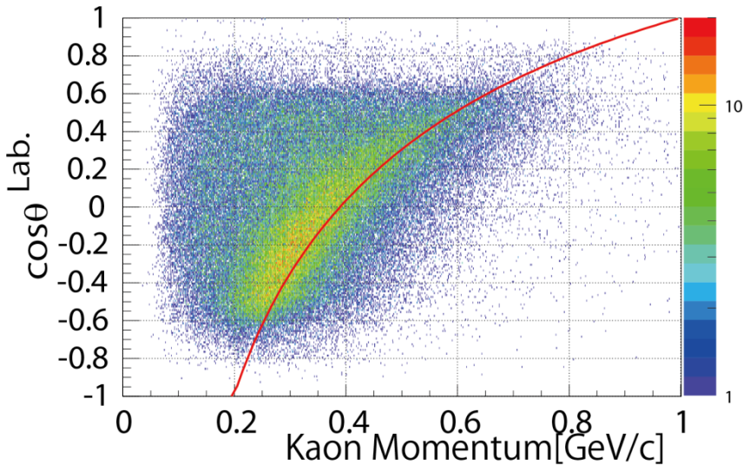
PID for CDS
Kaon P vs cosθ
”N”(K⁻, K⁻)N
PID for CDS (vertex in target volume)
Cos θ is angle between K- beam and scattered particle
Good consistency of cosθ − momentum plot (K- p) and elastic scattering curve
Notes:
文字 axial

Slide 14
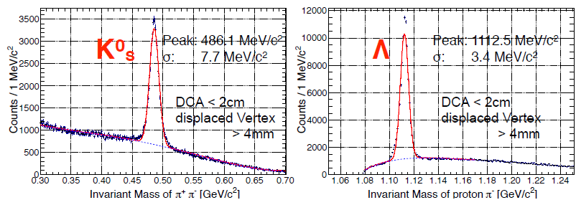
Invariant mass of π⁺π⁻ & proton π⁻
We achieved design performance
K0s , Λ’s center of peak & width is consistent with simulation result
Kpp resl ~10MeV (from simulation)
dPt/Pt @1GeV ~8%
Vertex resl. xy ~2mm z ~5mm

Slide 15
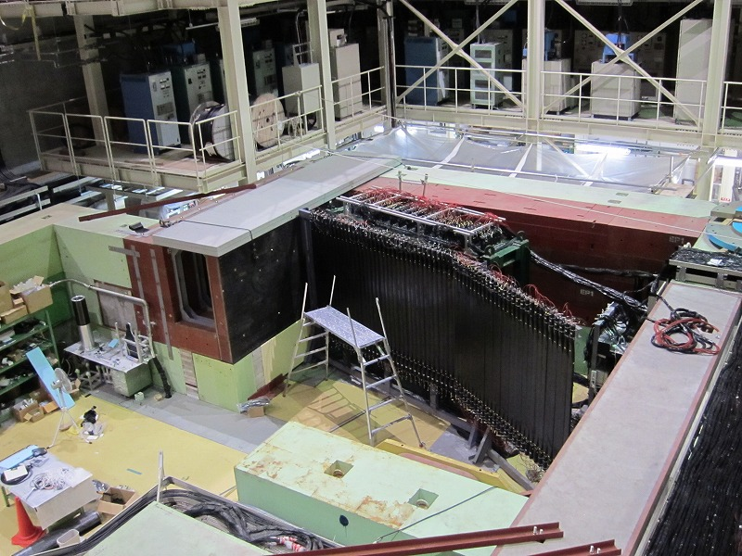
Forward TOF counters
15
Neutron counter(NC)
20 x 5 x 150 cm³
Plastic Scintillator
Configuration :
16 (wide) x 7 (depth)
Surface area : 3.2m x 1.5m
missing mass resolution for K⁻pp σ = 9.2 MeV/c²
(P_{n}=1.3 GeV/c, σ_{TOF}=150 ps)
Neutron counter
Proton counter
Proton counter
10 x 3 x 150 cm³
Plastic Scintillator
Configuration :
27+34 layer
missing mass
resolution for KNN σ = 6.8 MeV/c²
(P_{p}=1.3 GeV/c, σ_{TOF}=100 ps)
Caved Beam dump
To suppress background of NC from beam

Slide 16
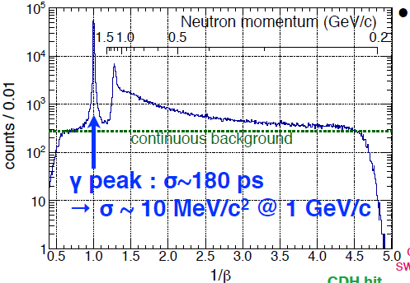
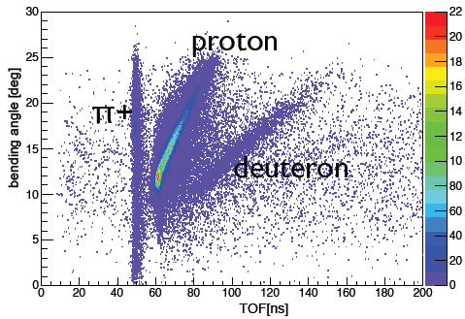
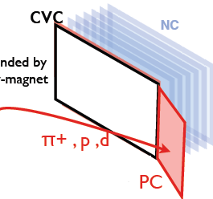
Neutron & Proton Counter
Neutron Counter 1/β
Proton Counter TOF
Neutron counter
=>separated γ & neutron
Proton counter
=> separated π & p & d

Slide 17
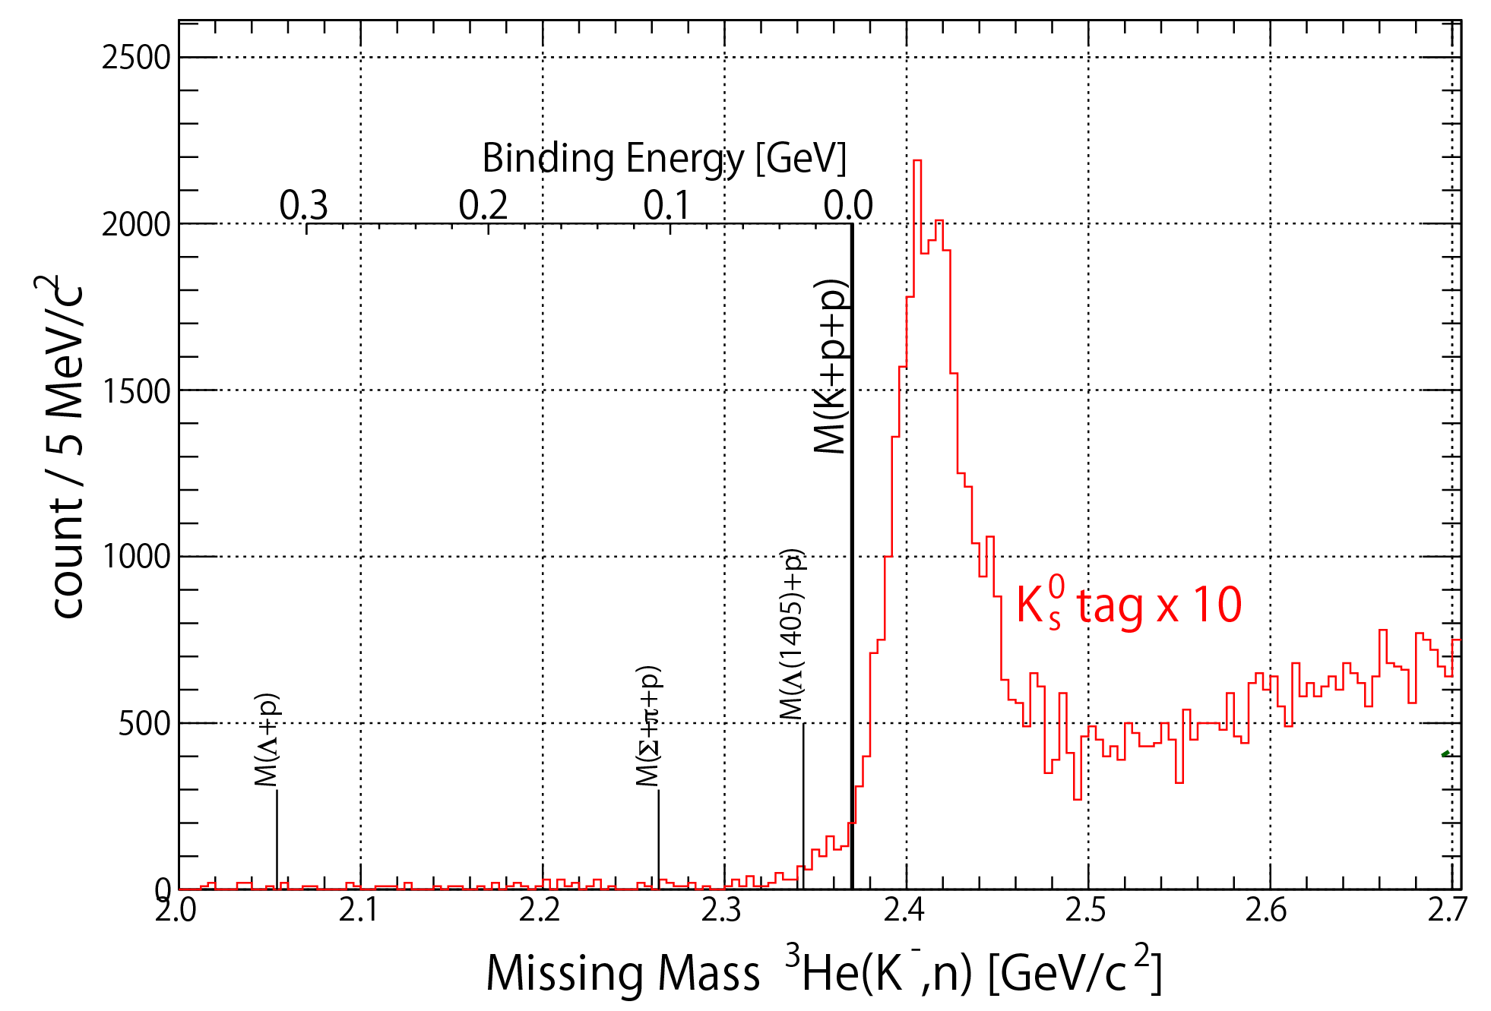
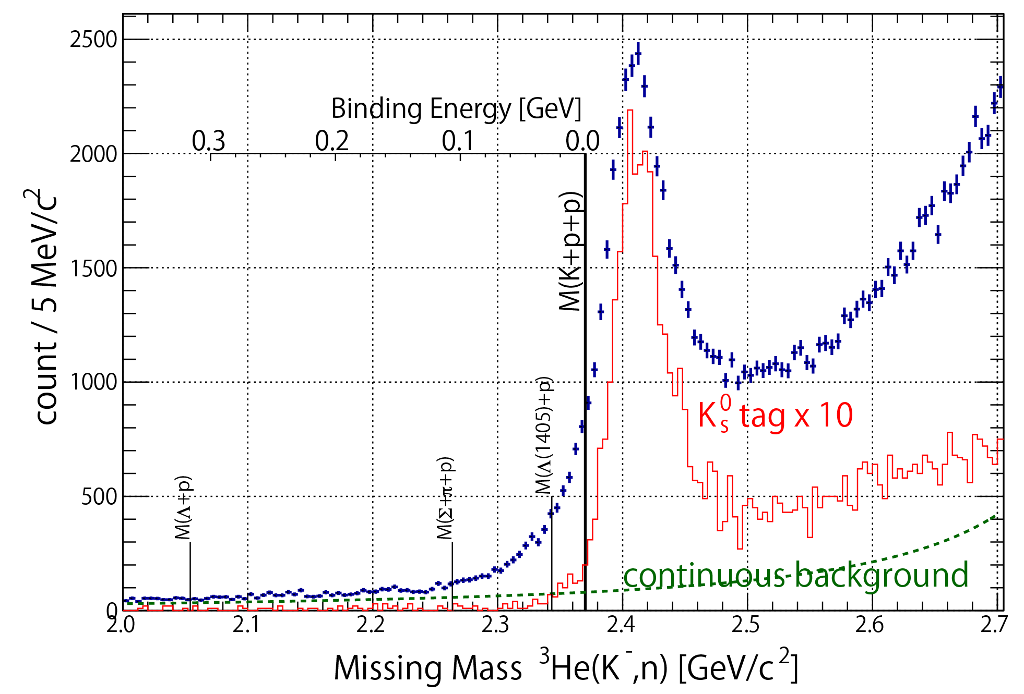
Forward neutron spectrum
Very Preliminary
Enhanced
”p”(K-,n)K⁰s reaction

Slide 18
Summary
Kaonic nuclei
Bound state of anti-kaon and nuclei with strong interaction
J-ARC E15 Experiment
Search for KNN with in-flight ³He(K⁻, N) reaction
We achieved design performance in every system
Beam line =>momentum resl. 0.2%
from mass resolution of K0s ,Λ
=> Kpp invariant mass resl.=10MeV/c²(with sim)
=>Missing mass resolution (Kpp) =10MeV/c²
We accumulated physics data (Mar & May 2013)
total ~5x10⁹ Kaon on target
Detail Analysis is under way

Slide 19
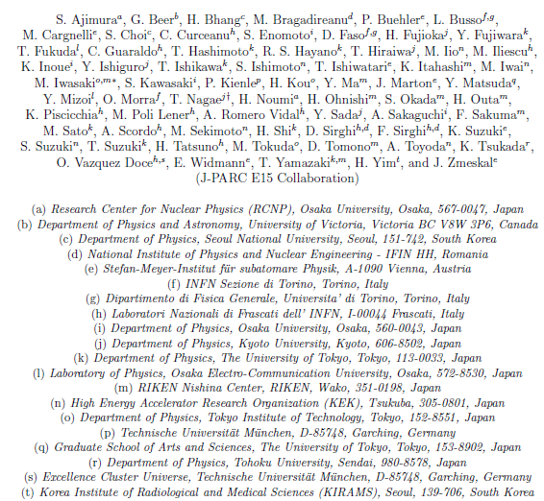
J-PARC E15 Collaboration
19

