Slide 1

Search for 3-body kaonic nuclei using γ-induced reaction at LEPS/Spring-8
LEPS/SPring-8におけるγ線を用いた３体系K中間子原子核の探索
A. O. Tokiyasu for LEPS collaboration
RCNP

Slide 2
Index
What are Kaonic nuclei?
LEPS experiment
Results
Future work: search in LEPS2 experiment
Conclusion
☆ This presentation is based on arXiv.1306.5320

Slide 3
What are Kaonic nuclei?

Slide 4
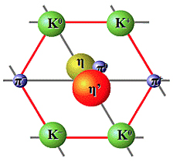
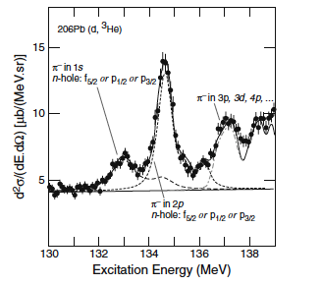
meson in nuclei
π⁻ (139.6 MeV, I=1)
K (493.7 MeV, I=1/2)
pseudo-scalar meson
J^{P}=0⁻
s-wave πN int
repulsive
pionic atomic state
-chiral symmetry restoration
s-wave KN int
strong attractive
K bound state in nuclei
(Kaonic Nuclei)
(B.E. = several dozen MeV)
-K exist as a real particle?
Strange dibaron?
Λ*hyper-nuclei?
-high density state.
-sub-threshold KN int
Pb(d, ³He) @GSI
PRL.88.122301

Slide 5
Kaonic nuclei (Exist or not?)
2-body: KN
- Λ(1405) very strange hadron
too light. qqq? or qqq+qq?
KN bound state + Σπ resonance
3-body: KNN [K[NN]_{I} ]_{I, Iz}
  K⁻nn : v(I=1)
  K⁻pn : 3/4v(I=1) + 1/4v(I=0)
  K⁻pp : 3/4v(I=0) + 1/4v(I=1) ←strongest
>4-body: KNNN…
-K⁻ppn, K⁻pnn (KEK-E471,E549) → no narrow peak
-K⁻+¹¹B,¹¹C, ¹⁵N,¹⁶O (BNL-E930,KEK-E522) →shape analysis
-effective nuclear force, absorption effect...
v(I=1) weak attractive
v(I=0) strong attractive
In order to understand more complicated systems,
the investigation of the simplest system is important!

Slide 6
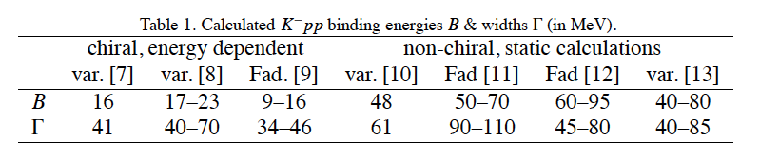
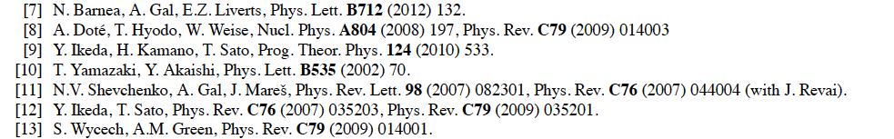
theoretical prediction
from HYP 2012.Proc by A.Gal
K⁻pp will exist.
However predicted values are dependent on
the interactions and the methods.
→still controversial situation!
B.E. = 10 - 80 MeV
Γ = 30 – 110 MeV

Slide 7
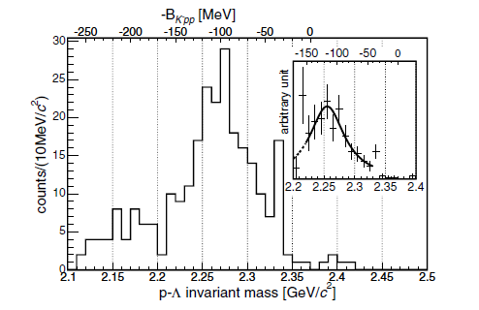
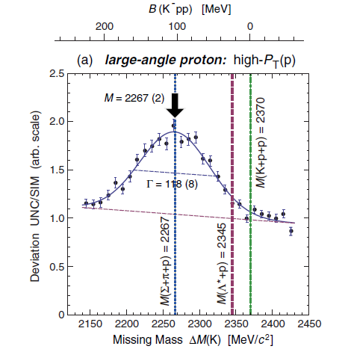
experiments
M.Agnello, Nagae and Fujoka et al., PRL 94, 212303 (2005)
T.Yamazaki et al., PRL 104, 132502 (2010)
FINUDA @ DAΦNE (2005)
DISTO@ SATURNE(2010)
stropped K⁻ on (⁶Li, ⁷Li, ¹²C, ²⁷Al and ⁵¹V)
  p p → Λ p K⁺
invariant mass (Λ + p)
Missing mass (Κ⁺)
B.E. =
MeV
B.E. =
MeV
Γ =
MeV
Γ =
Notes:
bound state K-pp threshold以下にbump structure

Slide 8
Recent status
K⁻pp will exist but
theory: shallow? deep? wide? narrow?
experiment: deeper than any of the prediction. K⁻pp?
Search experiments via different reactions are awaited.
  E15 (J-PARC) 3He(K⁻,n)X →
  E27 (J-PARC) d(π⁺,K⁺)X→
  FOPI (GSI), HADES same as DISTO
  AMADEUS (DAΦNE) stopped K-
  ALICE, Super-B (LOI)
  γ-induced reaction (LEPS/SPring-8) → This talk
Y. Sada 13:30-13:50 @Rm.803
  Y. Ichikawa 13:50–14:10 @Rm.803

Slide 9
γ-induced reaction
K⁺
γ
d (γ, K⁺ π) X
π⁰ : X = K⁻pn
π⁺ : X = K⁻nn
π⁻ : X= K⁻pp
π
K⁻
N
n
K
p
search in inclusive missing mass spectrum at LEPS/SPring-8.
N
detect K+ at very forward angle (< 15degree)
→ t-channel reaction (on-shell meson exchange)
→ virtual K⁻ beam

Slide 10
LEPS experiment

Slide 11
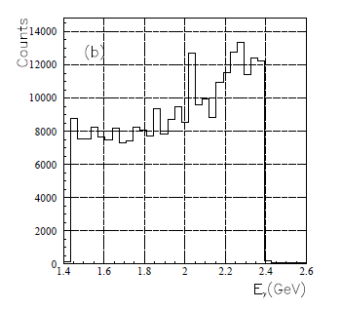
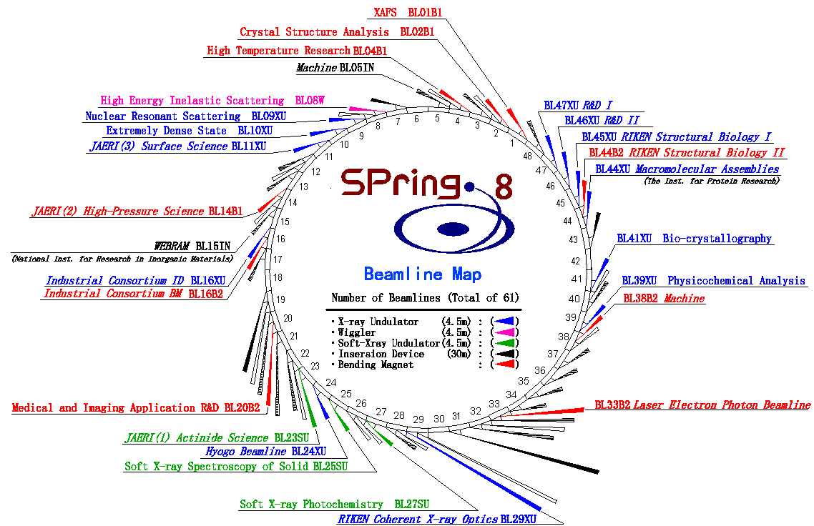
LEPS/SPring-8
SPring-8: 8 GeV electron storage-ring
LEPS : hadron physics using γ beam
Back-word Compton Scattering
ΔE_{γ}=12 MeV
Detect with
Tagging counter
e
8 GeV
355nm laser
e
Eγ=1.5 - 2.4 GeV
experimental
hatch →
Data take:
2002/2003, 2006/2007
→7.6 x 10¹² photons on LD₂ target
LEPS

Slide 12
LEPS spectrometer
TOF
position
SVTX
DC1
SSD
(SVTX)
Drift Chamber
(DC 1~3)
π⁻
AC(n=1.03)
time
Start Counter
(SC)
Time of flight wall
(TOF)
K⁺
γ
(1.5−2.4 GeV)
trigger
Aerogel Cherencov counter
(AC)
Start Counter (SC)
Target
Dipole Magnet
0.7 [Tesla]
Start Counter
DC2
DC3

Slide 13
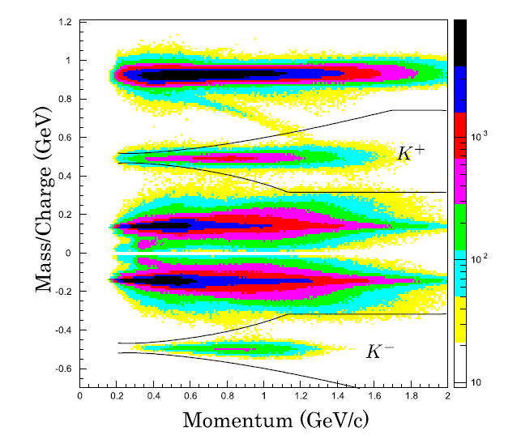
particle identification
TOF (Time of flight)
p
m² = p²(1/β² - 1)
K⁺
Track reconstruction
+ Runge-Kutta method.
π⁺
0
π⁻
Δp/p ~ 6 MeV/c
@ 1 GeV/c
K⁻
c.f.
mass p = 938.3 MeV
mass K⁺ = 493.7 MeV
mass π⁻ = 139.6 MeV

Slide 14
Analysis and Results

Slide 15
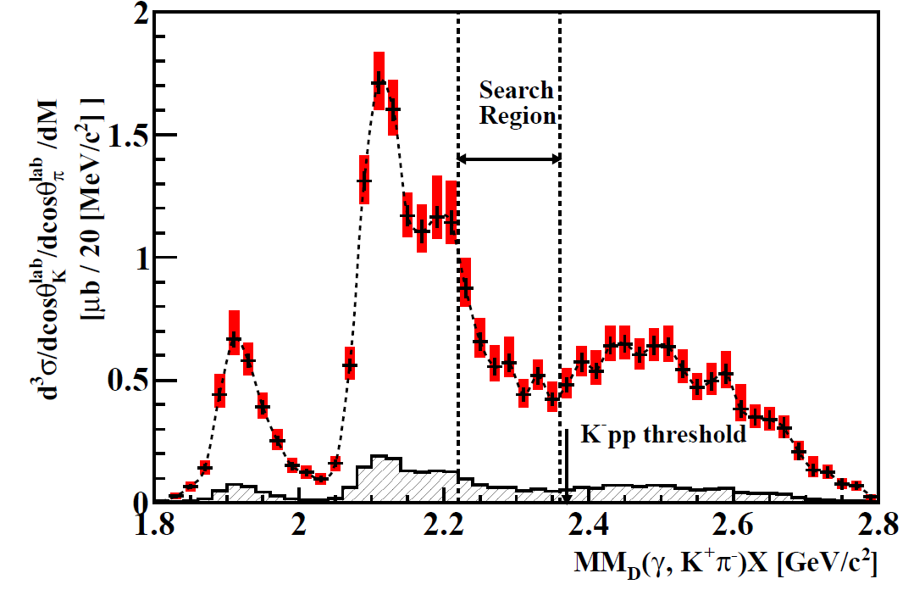
missing mass spectrum
search region:
Mass = 2.22 - 2.36 GeV/c²
B.E. = 10 - 150 MeV
d(γ, K⁺π⁻)X
B
Mx = MMd(K⁺π⁻)
=√(p_{E}+p_{d})² – (p_{K+}-p_{π-})²
C
A
expected signal
A: (~3 μb)
γ n → Σ⁻(1197) K⁺
Σ⁻ → n π⁻
B: (~7 μb)
γ p → Λ(1116) K⁺ π⁻
C: (~4 μb)
γ n → Σ⁻(1197) K⁺ π⁻
γ p → Σ⁰(1193)K⁺ π⁻
Bump structure was searched for with log-Likelihood ratio method.
→No bump structure was observed!
Notes:
----- 会議メモ (2013/07/27 01:11) -----
それではRCNPの時安敦史が話をさせていただきます。

Slide 16
upper limit of cross section
ΔL = 3.84 → 95% C.L. Upper Limit
B.E. →15 points (10-150 MeV)
Γ →3 points
-Γ= 20 MeV
0.05 - 0.25 μb
-Γ = 60 MeV
0.15 - 0.6 μb
-Γ =100 MeV
0.15 - 0.7 μb
a few % of typical hadron production cross section.

Slide 17
Background processes
BG process: QF-process
MM_{p}(K⁺π⁻) and M_{p}(K) spectra were fitted simultaneously.
MM_{p}(K⁺π⁻)
− γN→Y K⁺π⁻
− γN→Y* K⁺π⁻
− γN→Yπ K⁺π⁻
MM_{p}(K⁺)
Main component:
γd→Λ(1520) K⁺ (~20%)
γd→Yπ K⁺π⁻(~20%)

Slide 18
Search in LEPS2 experiment

Slide 19
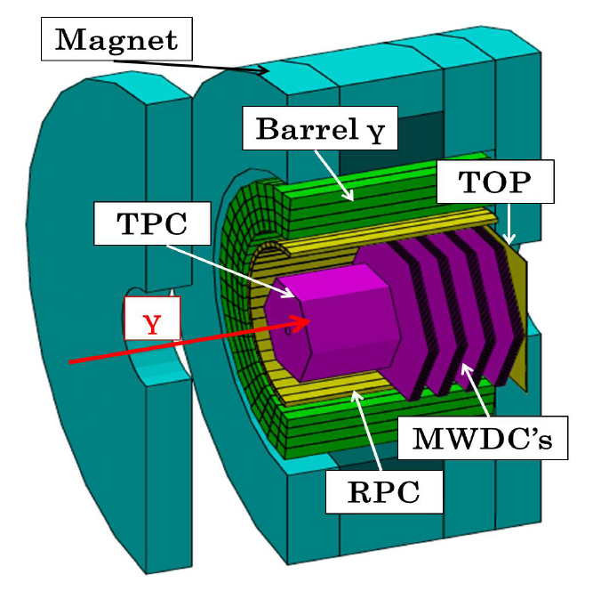
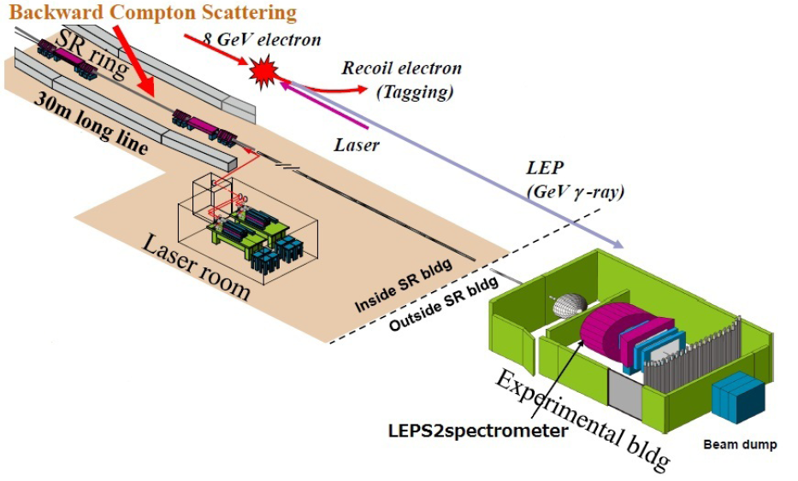
LEP2 facility
beam intensity x10 of LEPS ( 10⁷ cps)
4 π detector
under construction for the 1st experiment
acceptance: 5 – 120 degree
p/Δp ~ 1%

Slide 20
LEPS2 spectrometer
Detection of decay products from K⁻pp bound state.
improvement of S/N
Non-mesonic decay mode
accepted
γ d → K⁺ π⁻ K⁻pp
K⁻pp → Λ proton(p1)
Λ → proton (p2) π⁻
tagging two high-momentum protons is effective to reject background events from quasi-free process.
accepted

Slide 21
Conclusion

Slide 22
Conclusion
K⁻pp bound state give us rich information on anti-K and nucleon interaction
K⁻pp bound state was searched in γ d → K⁺ π⁻ X reaction at LEPS/SPring-8
Significant bump structures were not found and the upper limits of production cross section were determined
Main component of background processes were found to be quasi-free processes
LEPS2 experiment has potential for exclusive search.

Slide 23
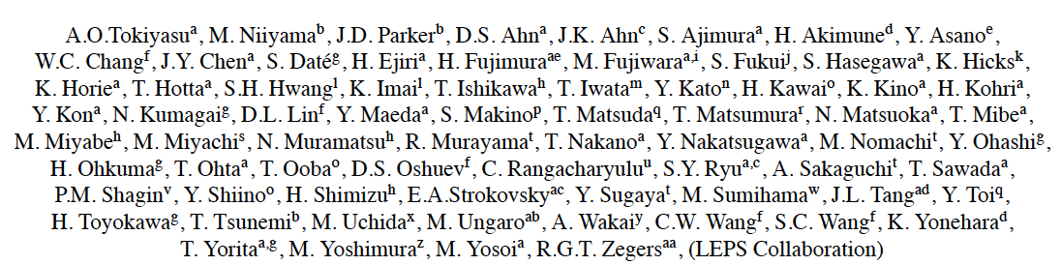
Collaborators
Thank you for your attention!

Slide 24
Appendix

Slide 25
Search in other mode for LEP2 experiment
K-pp
d → K_{s} K⁻pp
K⁻pp → Λp, Σ⁰p, (ΣπN)
*similar reaction as E27 experiment. (Λ* door-way reaction)
d → K* K⁻pp
K⁻pp → Λp, Σ⁰p, (ΣπN)
*virtual K can be selected clearly if decay plane of K* is perpendicular
K-pn
K-nn
d → K⁺ K⁻pn
K⁻pp → Λn, Σ⁻p
d → K⁺ π⁰ K⁻pn
K⁻pn → Λn, Σ⁻p
d → K⁺ K⁻pn
K⁻pp → Λn, Σ⁻p
d → K⁺ π⁰ K⁻pn
K⁻pn → Λn, Σ⁻p
d → K⁺ K⁻pn
d → K⁺ K⁻pn

Slide 26
K-d, K-nn (preliminary)
red: LH2
blue: LD2
d → K⁺ K⁻pn
d → K⁺ π⁺ K⁻nn

Slide 27
systematic errors
Error Bar :
statistical uncertainty
(~5%)
Red Box :
systematic uncertainty
(~20%)
Hatched :
discrepancy
between datasets (~12%)

