Slide 1


モンテカルロ殻模型による
ベリリウム同位体の密度分布
T. Yoshida^{(a)}, N. Shimizu^{(a)}, T. Abe^{(b)} and T. Otsuka^{(a, b)}
Center for Nuclear Study^{(a)} and Department of Physics^{(b)} , University of Tokyo

Slide 2
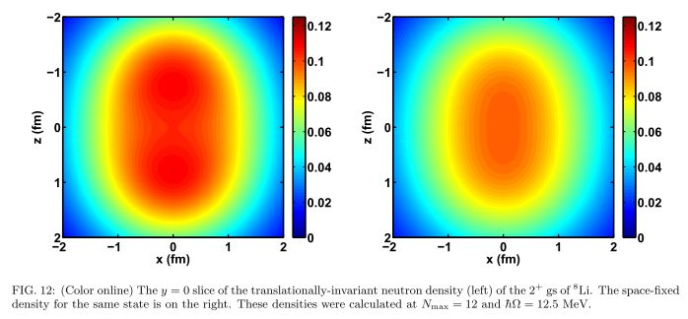
Background
- progress of ab-initio calculations -
GFMC (A=8, …, etc), lattice effective field theory (A=12, …, etc)
➡ The appearance of alpha cluster structure is indicated.
No core shell model (A≦14)
➡ Cluster structure appears in densities (Li isotopes with no-core FC)
How about cluster states in Monte Carlo shell model (MCSM)?
[Ref] C. Cockrel, J. P. Vary and P Maris, PRC86, 034325 (2012)
⁸Li(2⁺)
⁸Be
Introduction
neutron density
( with c.m. motion)
[Ref] R.B. Wiringa, PRC62 (2000), 014001
C. Cockrell et al, arxiv: 1201.0724v2 [nucl-th]

Slide 3
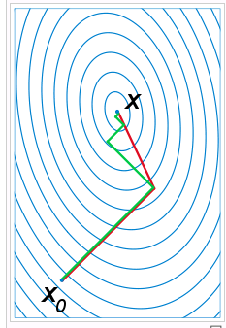
Next generation of Monte Carlo Shell Model (MCSM)
N_{B} : number of basis vectors (dimension)
N_{p} : number of (active) particles
N_{sp} : number of single-particle states
amplitude
Projection op.
N-th basis vector
(Slater determinant)
Minimize E(D) as a function of D utilizing
qMC and conjugate gradient methods
Deformed single-particle state
Step 1 : quantum Monte Carlo type method
→ candidates of n-th basis vector (σ : set of random numbers)
“ σ ” can be represented by matrix D
Select the one with the lowest E(D)
steepest
descent
method
conjugate
gradient
method
Step 2 : polish D by means of the conjugate gradient method
“variationally”.
Taken from “Perspectives of Monte Carlo Shell Mode”,
T. Otsuka, Nuclear Structure and Dynamics II, opatija Croatia, July 2012

Slide 4
Purpose
☆ Can we obtain cluster states in the “intrinsic state” of MCSM?
｜
〉
C₁ +c₂ +c₃ ＋ ・・・
・・・ + C₉₈ +c₉₉ +c₁₀₀
Slater determinant
several definitions might appear.
intrinsic state
Interpretation of the structure of the MCSM wave functions

Slide 5

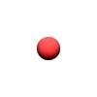
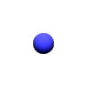
Model space for MCSM
N_{shell} : number major shell orbits
In MCSM, many light nuclei have been studied. Here, we focus on the following nuclei with parameters,
⁸Be (0⁺) : N_{shell}=4 hw = 20, 25 MeV
⁸Be (2⁺,4⁺) : N_{shell}=4 hw = 25 MeV
¹⁰Be (0⁺) : N_{shell}=4 hw = 25 MeV.
⁹Be, ¹²Be and other light nuclei
➡ under investigation
Extraction of c.m.
contamination is approximate.
➡Lawson’s “beta” parameter

Slide 6
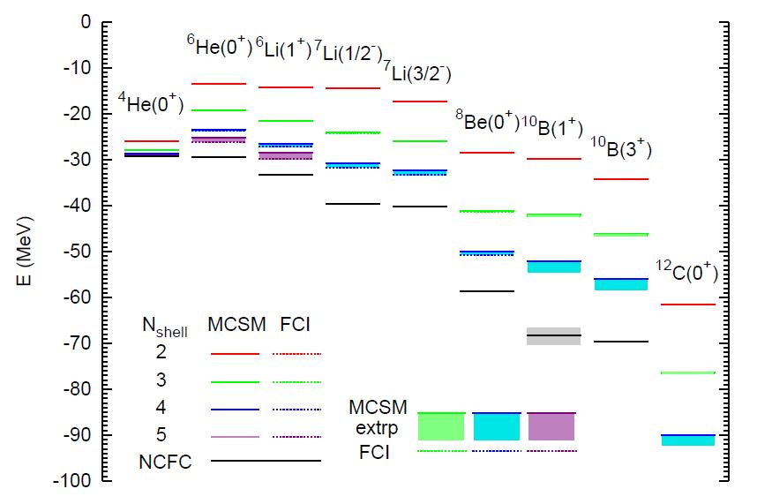
Energy spectra by no-core MCSM
[Ref] T. Abe, P. Maris, T. Otsuka, N. Shimizu, Y. Utsuno, J. P. Vary, Phys Rev C86, 054301 (2012)
JISP16 NN int.
w/ optimum hw
w/o Coulomb force
w/o spurious CoM treatment

Slide 7
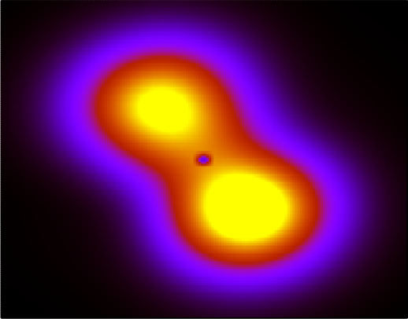
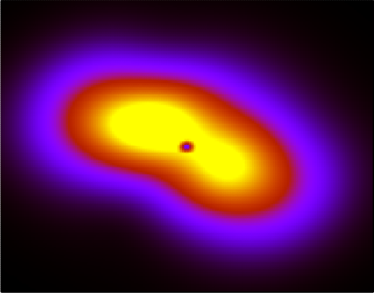
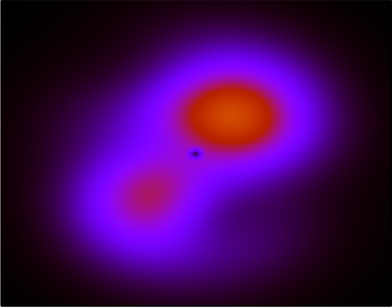
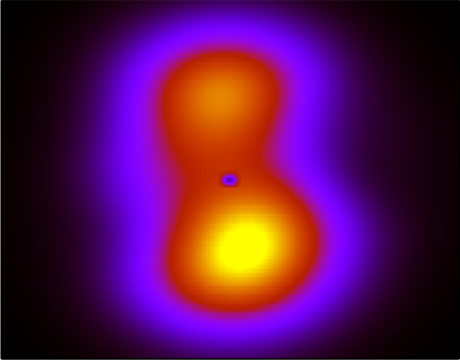
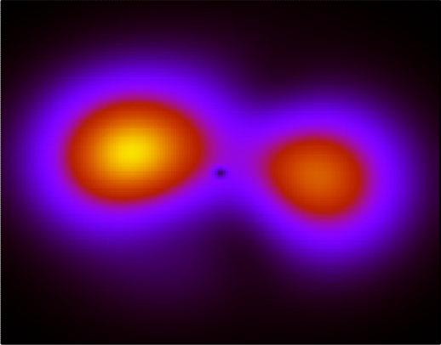
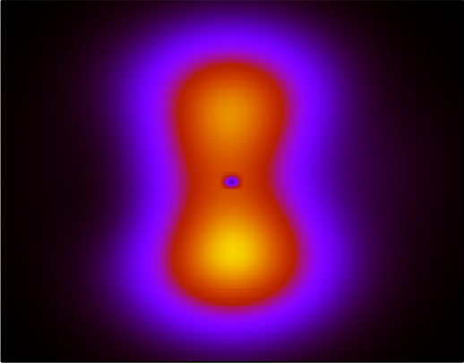
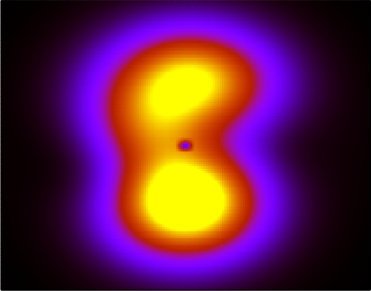
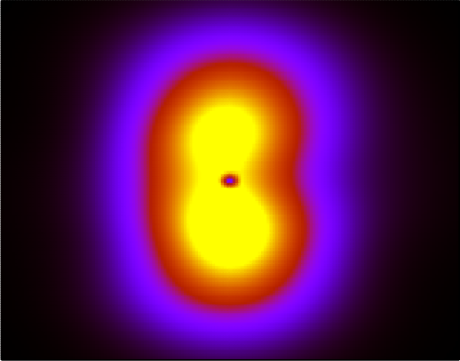
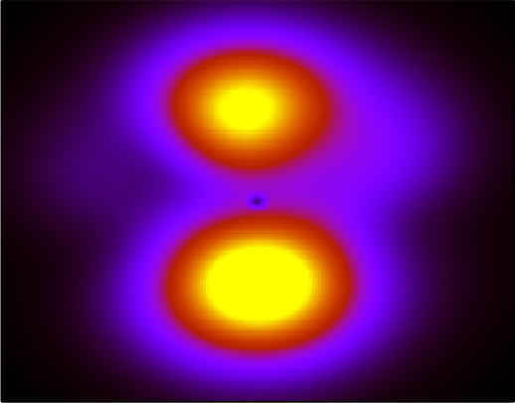
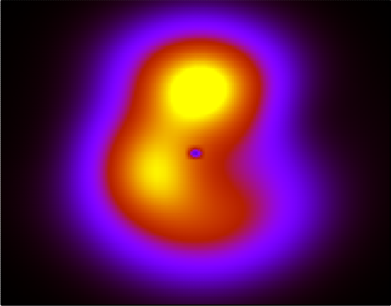
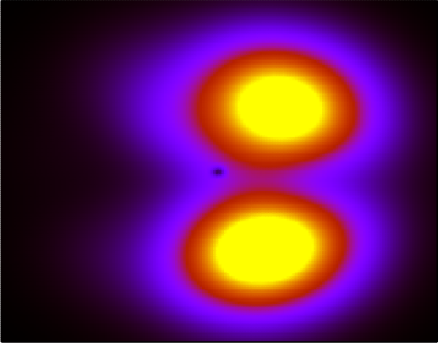
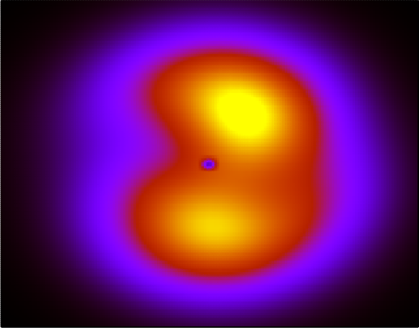
How to align each basis state
Before the alignment
｜
〉
C₁ +c₂ +c₃ ＋ ・・・
・・・ + C₉₈ +c₉₉ +c₁₀₀
Diagonalization of
each q-moment
After the alignment
｜
[Ref] R.B. Wiringa, PRC62 (2000), 014001
〉
C₁ +c₂ +c₃ ＋ ・・・
・・・ + C₉₈ +c₉₉ +c₁₀₀

Slide 8
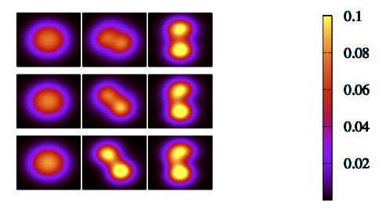
Density of ⁸Be before and after alignment
Lab. frame
Intrinsic frame
(q: 四重極
モーメント)
Nb = 100
Nb = 10
Nb = 1
8fm
(hw=20MeV,nshell=4)
J^{π}=0＋(E=-50 MeV, hw=20MeV,nshell=4)
2alpha cluster structure appears in the intrinsic frame

Slide 9
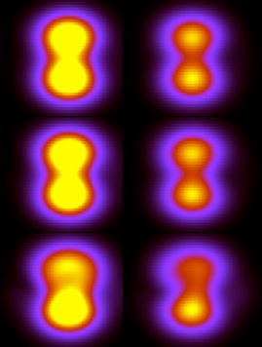
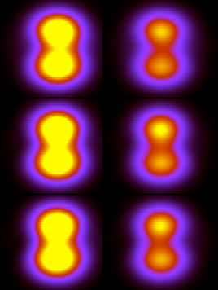
”intrinsic” states of ⁸Be (0+/2+)
Number of
Slater det. (Nb)
J^{π}=０＋
(E=-50.2 MeV)
J^{π}=２＋
(E=-45.7 MeV )
Nb=100
Nb=10
Nb=1
(hw=25MeV,nshell=4)
(hw=25MeV,nshell=4)
2alpha cluster structure both with J=0⁺ and 2⁺

Slide 10
Q-moment ⁸Be (0⁺, 2⁺) MCSM
(J^{π}=0⁺) (J^{π}=2⁺)
VMC(NN+NNN), intrinsic 26.2 27.9
[Wiringa et al. 2000]
MCSM, intrinsic (Nb=1 ) 28.2 29.3
(Nb=10 ) 30.6 28.7
(Nb=100 ) 29.9 28.8
w/o alignment ~10 ~10
Comparable with VMC.
(GFM shows larger value ~30 fm²[V.M. Datar, et al, 2013 arxiv])
The alignment in MCSM is essential.

Slide 11
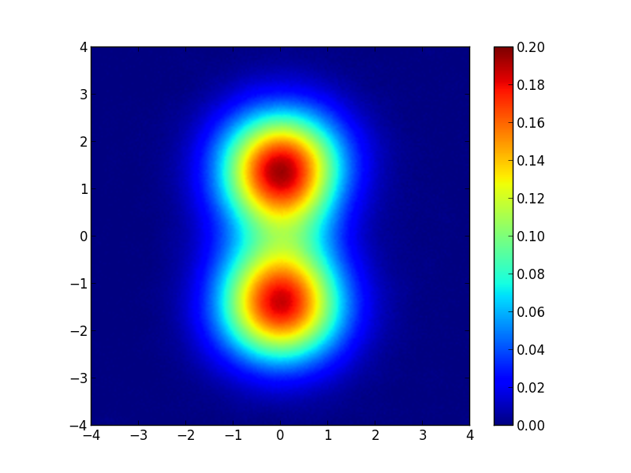
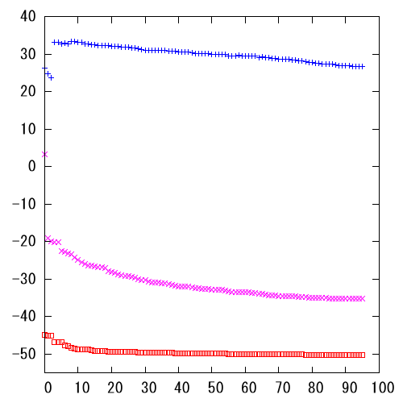
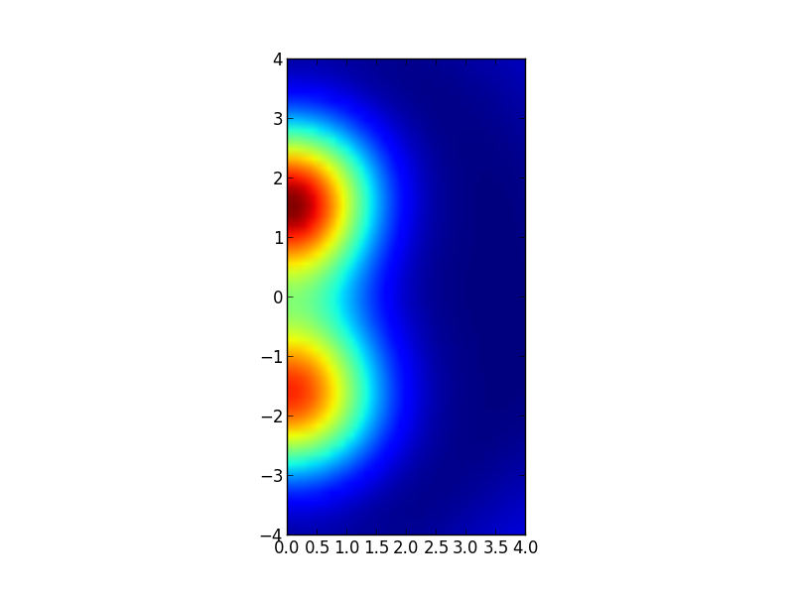
Interpretation of the “intrinsic state”
Energy convergence of ⁸Be
intrinsic
Jz =0projection
Symmetric with
z-axis by the definition.
Jz=0
J=0
Nb: number of Slater determinants

Slide 12
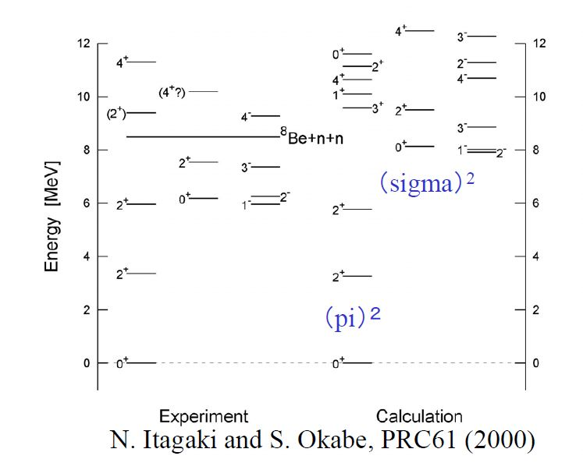
¹⁰Be; Molecular orbit in cluster model
Calculation : Molecular orbit of 2 excess neutrons
two neutrons
α
sigma-orbit
pi-orbit
Consistency with MCSM?

Slide 13
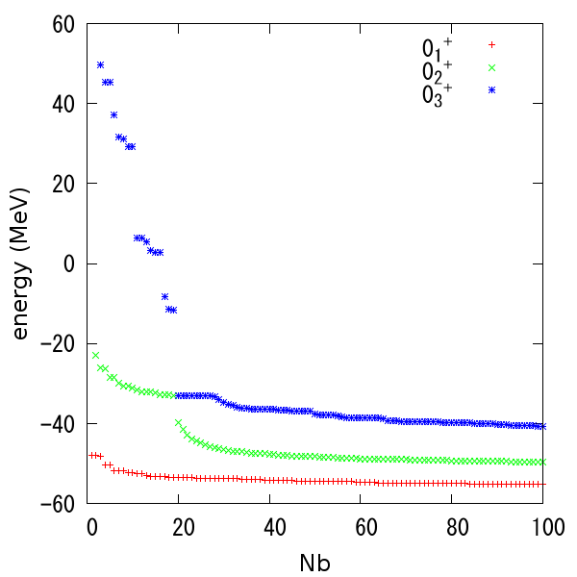
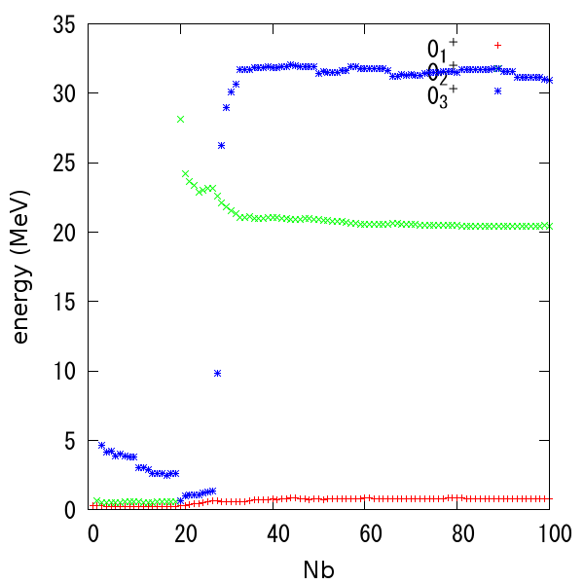
with valence neutrons ~ ¹⁰Be (0_{1,2,3}⁺)
Energy convergence
Energy of c.m. motion
0_{2,3}⁺ states
Large contamination of c.m. motion in 0_{2,3}⁺ states for beta=0 MeV parameter => we focus on 0₁⁺ .

Slide 14
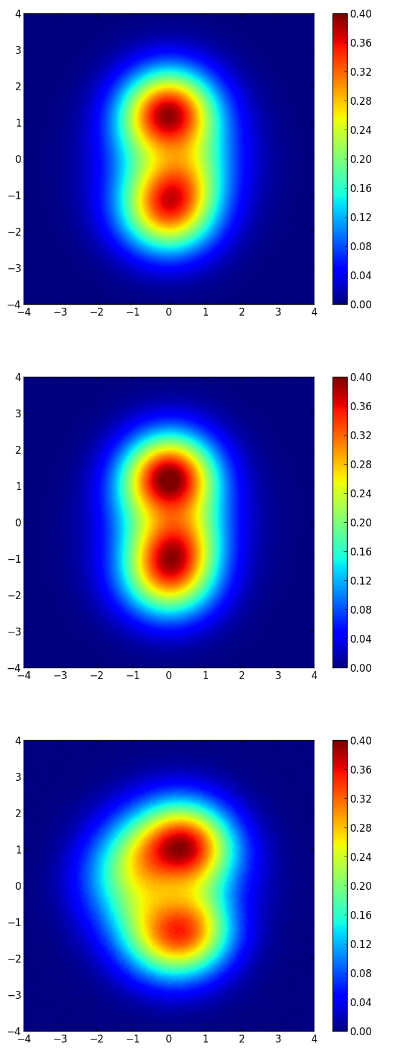
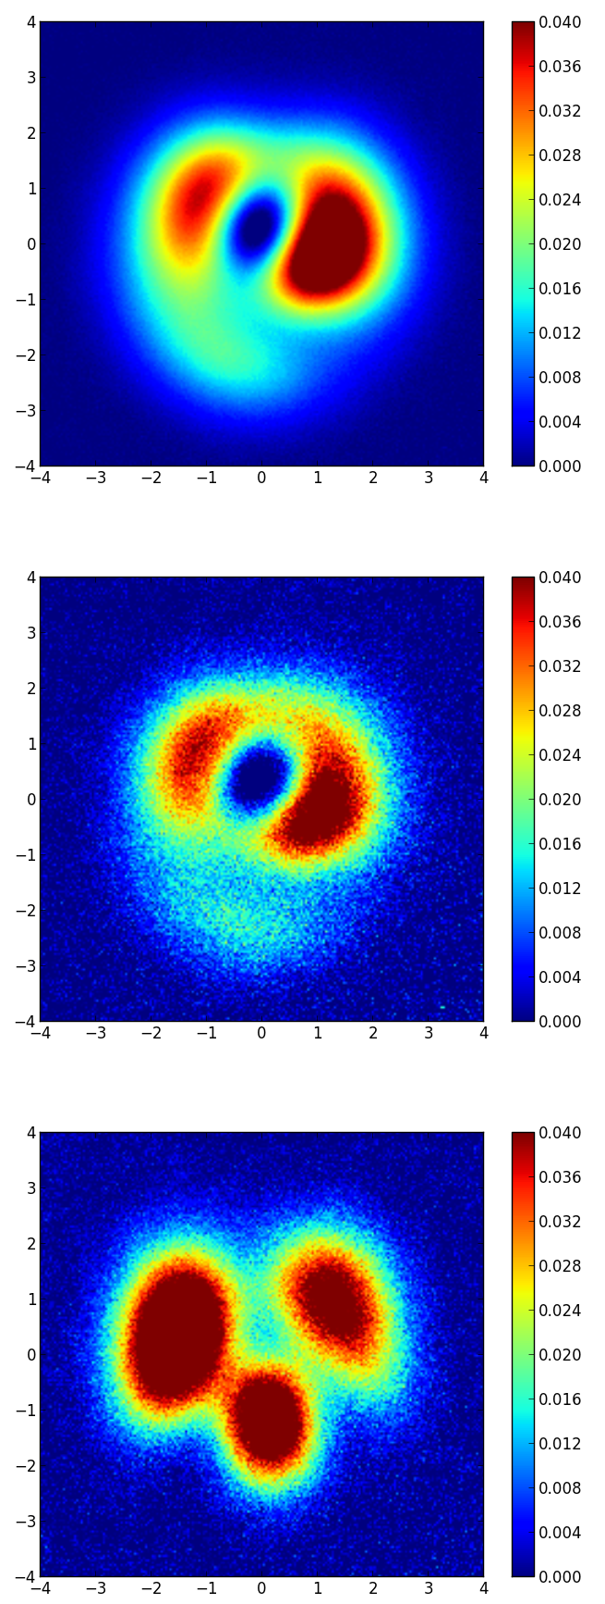
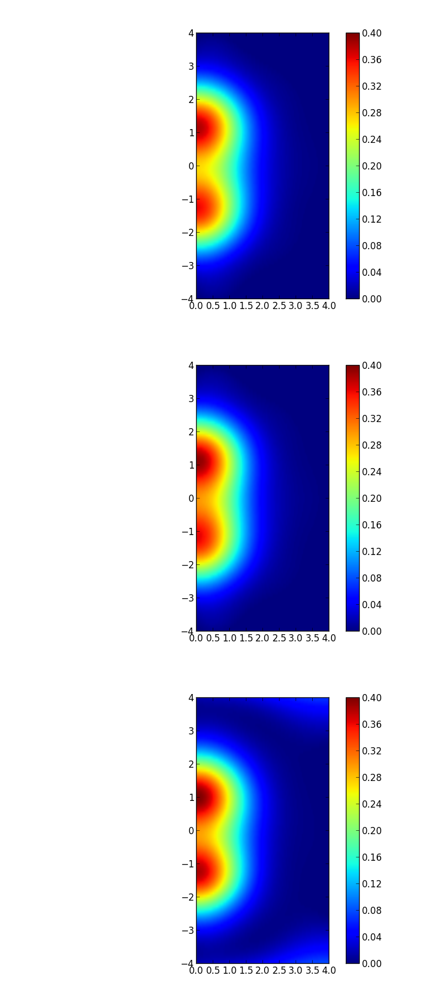
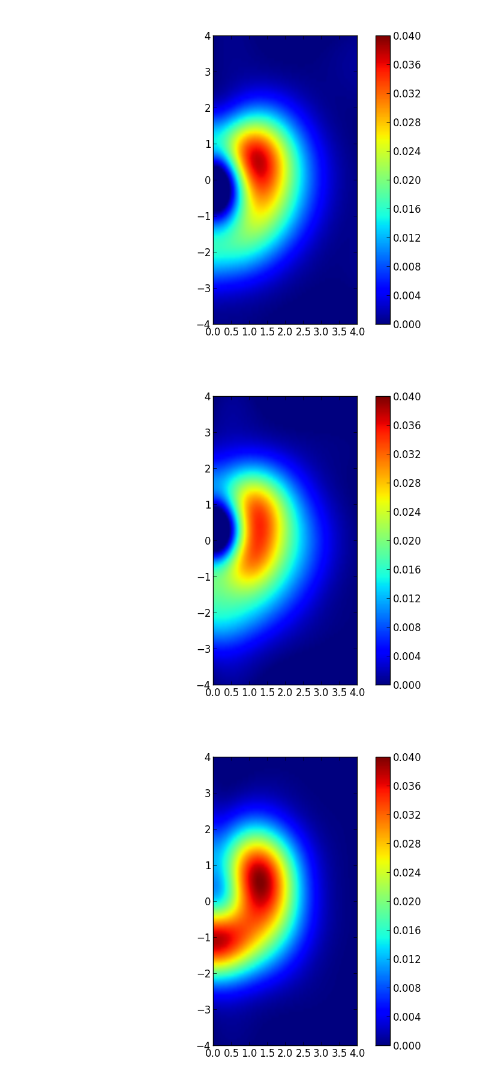
¹⁰Be (0₁⁺) aligned
Jz=0 projected
Nb=100
Nb=10
Nb=1
matter
valence(x10)
matter
valence(x10)
Appearnce of π orbit in the molecular-orbit picture.
Two-alpha distance shrinks compared with ⁸Be.

Slide 15
Summary
Definition of the intrinsic state
=> Alignment (Jz projection)
Two alpha in ⁸Be => consistent with VMC
Two alpha and pi (and sigma) orbit in ¹⁰Be
Shrinkage of alpha-alpha distance
Future plan
Nshell>4 ➡ (K-computer) enhancement of cluster structure in Be isotopes.
Proper beta value for Lawson’s parameter
Remove c.m. motion from density

Slide 16
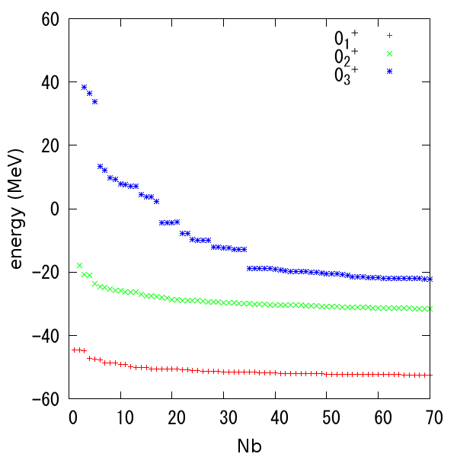
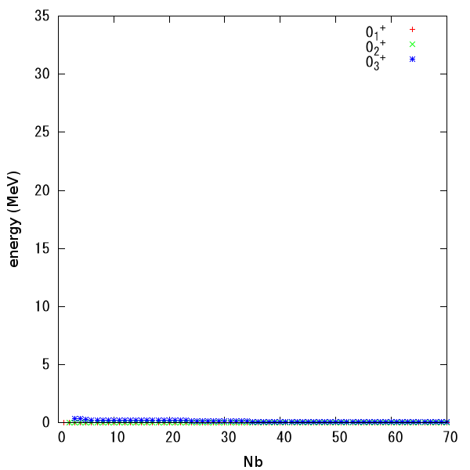
¹⁰Be(0_{1,2,3}⁺) beta=100 MeV
Energy convergence
Energy of c.m. motion
Contamination of c.m. motion is negligible
when beta=100 MeV

Slide 17
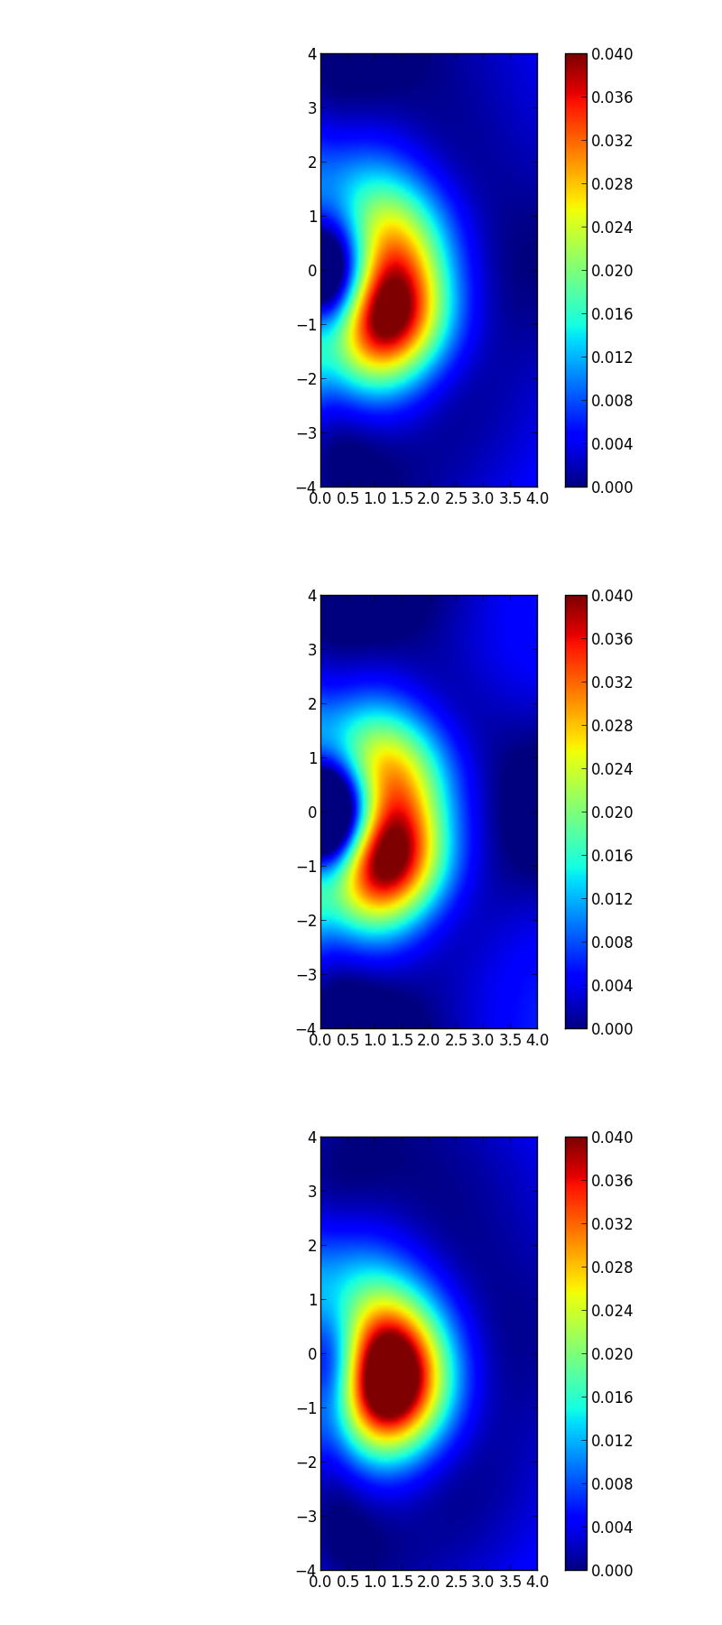
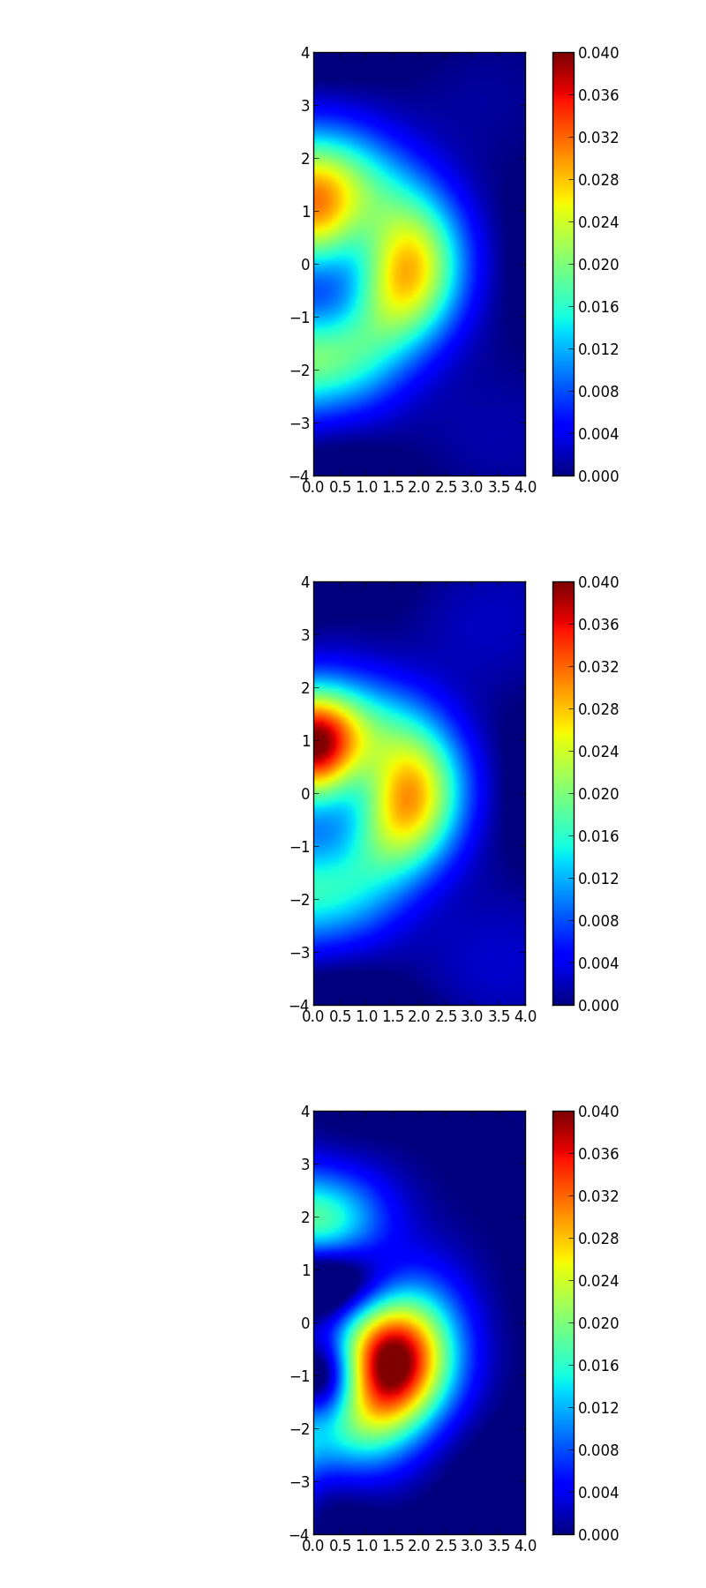
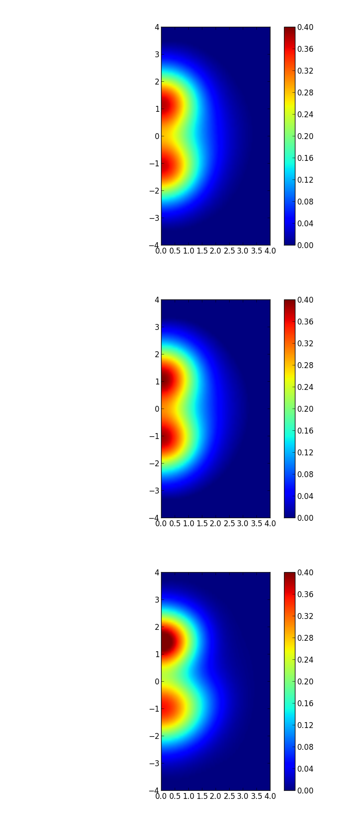
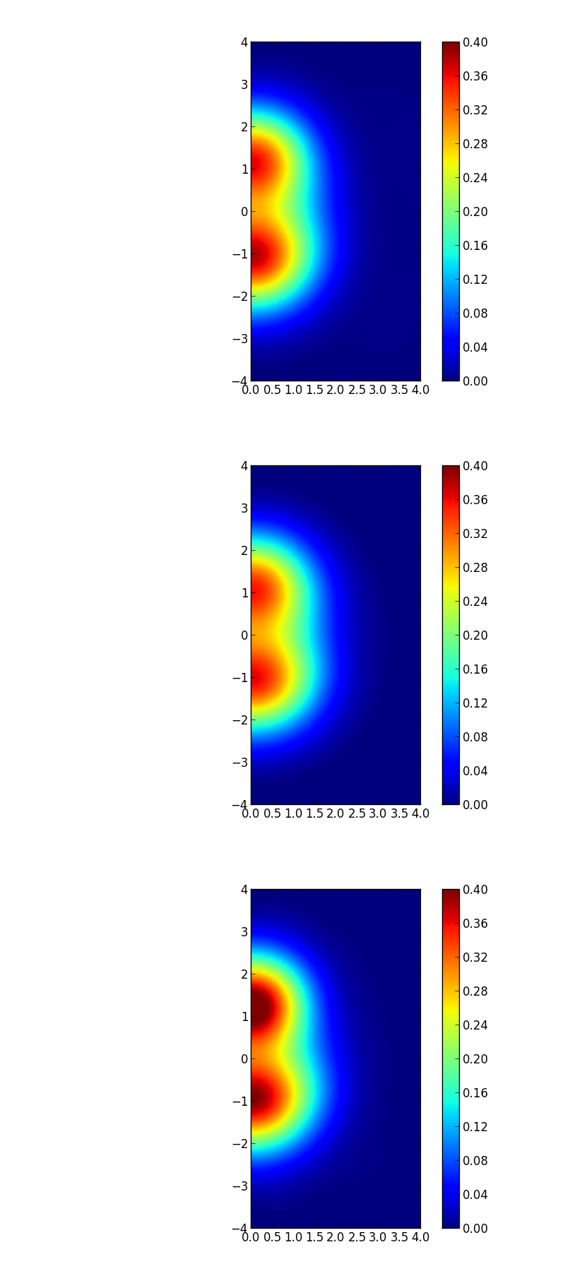
¹⁰Be (0₁⁺)
¹⁰Be (0₂⁺)
Nb=85
Nb=10
Nb=2
matter
valence(x10)
matter
valence(x10)
0₁⁺:consistent with π molecular-orbit picture.
0₂⁺:σ-orbit➡futher analysis is needed.
Notes:
Parity projectionをした方が文句が付かない。

