Slide 1
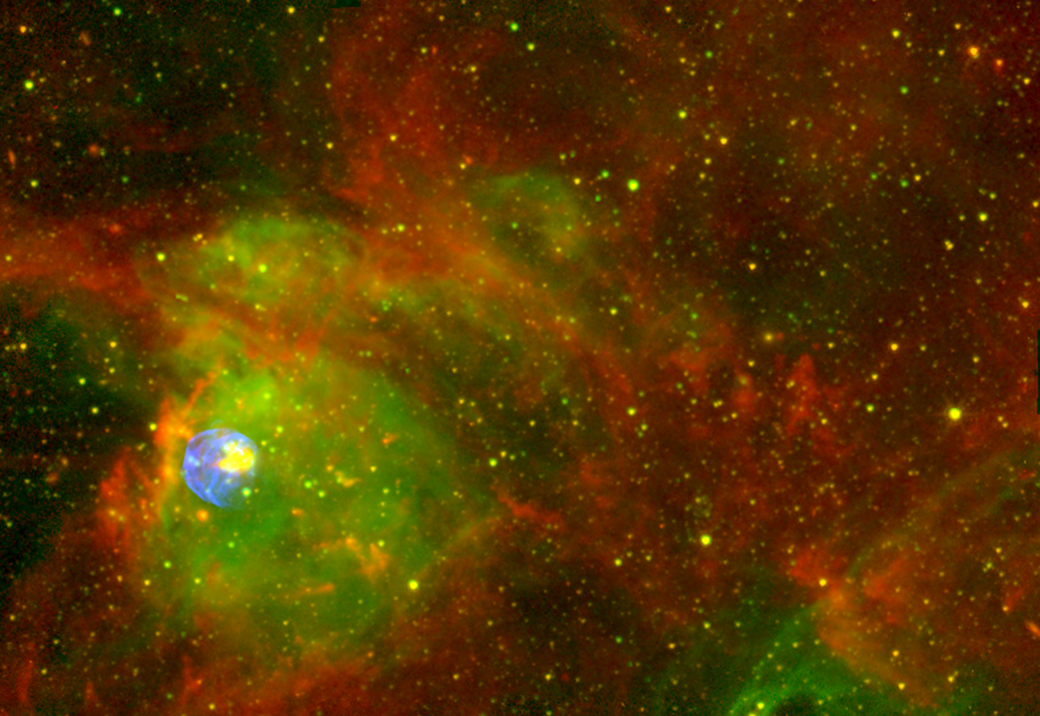
Studying alpha-cluster structure using low-energy RI beam
Nuclear astrophysics group (CRIB supporting
members) in Center for Nuclear Study, Univ. of Tokyo:
Hidetoshi Yamaguchi (Lecturer),
Daid Kahl (Postdoc.)
Taro Nakao (Postdoc.)
with an Aid of Technical Staff:
N. Yamazaki (CRIB/Wien Filter), K. Yoshimura, T. Senoo,
Y. Ohshiro (Hyper ECR ion source), S. Yamaka
in Collaboration with:
RIKEN, KEK, Kyushu, Tsukuba, Tohoku, Osaka, … (Japan)
McMaster (Canada), CIAE, IMP (China), Chung-Ang, Ehwa, SNU (Korea), INFN Padova/Catania (Italy), IOP(Vietnam) and others.

Slide 2
Today’s topic: α-cluster projects at CRIB
RI Beam+α resonant scattering at CRIB facility
⁷Li+α/⁷Be+α
Motivation: astrophysical (α,γ) reactions and α−cluster structure in ¹¹B/¹¹C.
Experiments: performed in 2009 and 2010,
using alpha-resonant scattering in inverse kinematics.
Results: Alpha resonances were observed. H. Yamaguchi et al., Phys. Rev. C (2011) and Phys. Rev. C (2013).
Future plans:
¹⁰Be+α: motivated by Suhara-En’yo calculation of linear cluster chain in ¹⁴C. Proposal accepted.
¹⁵O+α: α−cluster in ¹⁹Ne, which can be compared with ²⁰Ne. Proposal is being prepared with Korean collaborators.
⁴⁴Ti+α: being planned by KEK (Ishiyama).

Slide 3
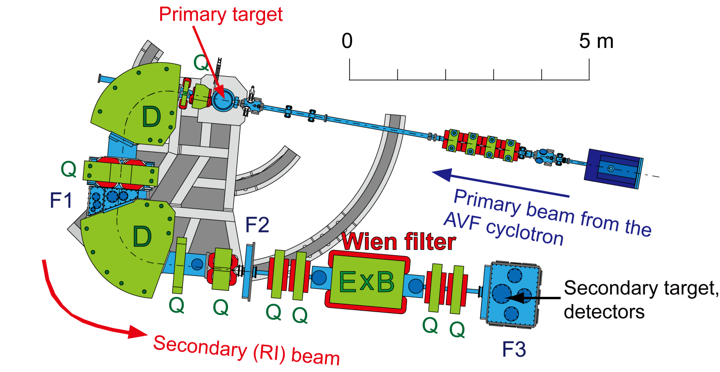
CRIB
CNS Radio-Isotope Beam separator , operated by CNS (Univ. of Tokyo), located at RIBF (RIKEN Nishina Center).
Low-energy(<10MeV/u) RI beams by in-flight method.
Primary beam from K=70 AVF cyclotron.
Momentum (Magnetic rigidity) separation by “double achromatic” system, and velocity separation by a Wien filter.
Orbit radius: 90 cm, solid angle: 5.6 msr, momentum resolution: 1/850.

Slide 4
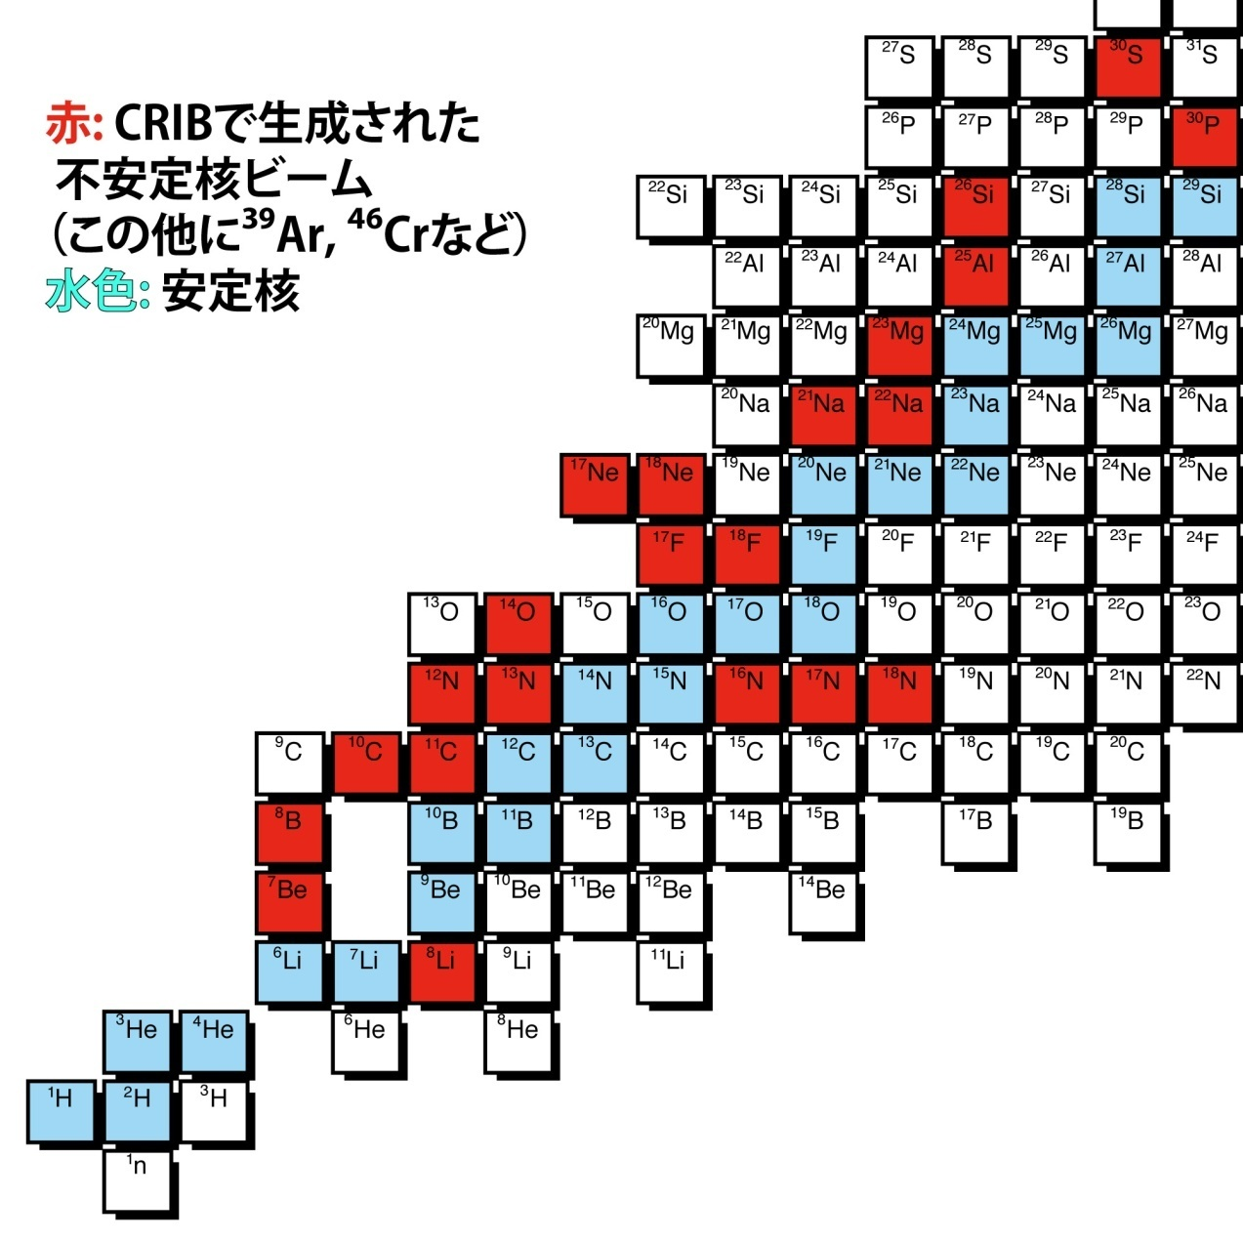
Low-Energy RI beam Productions at CRIB
Direct reactions such as (p,n), (d,p) and (³He,n) in inverse kinematics are mainly used for the production….large cross section
Many RI beams have been produced at CRIB:
typically 10⁴-10⁶ pps
RI beam at CRIB /
Stable nuclei

Slide 5
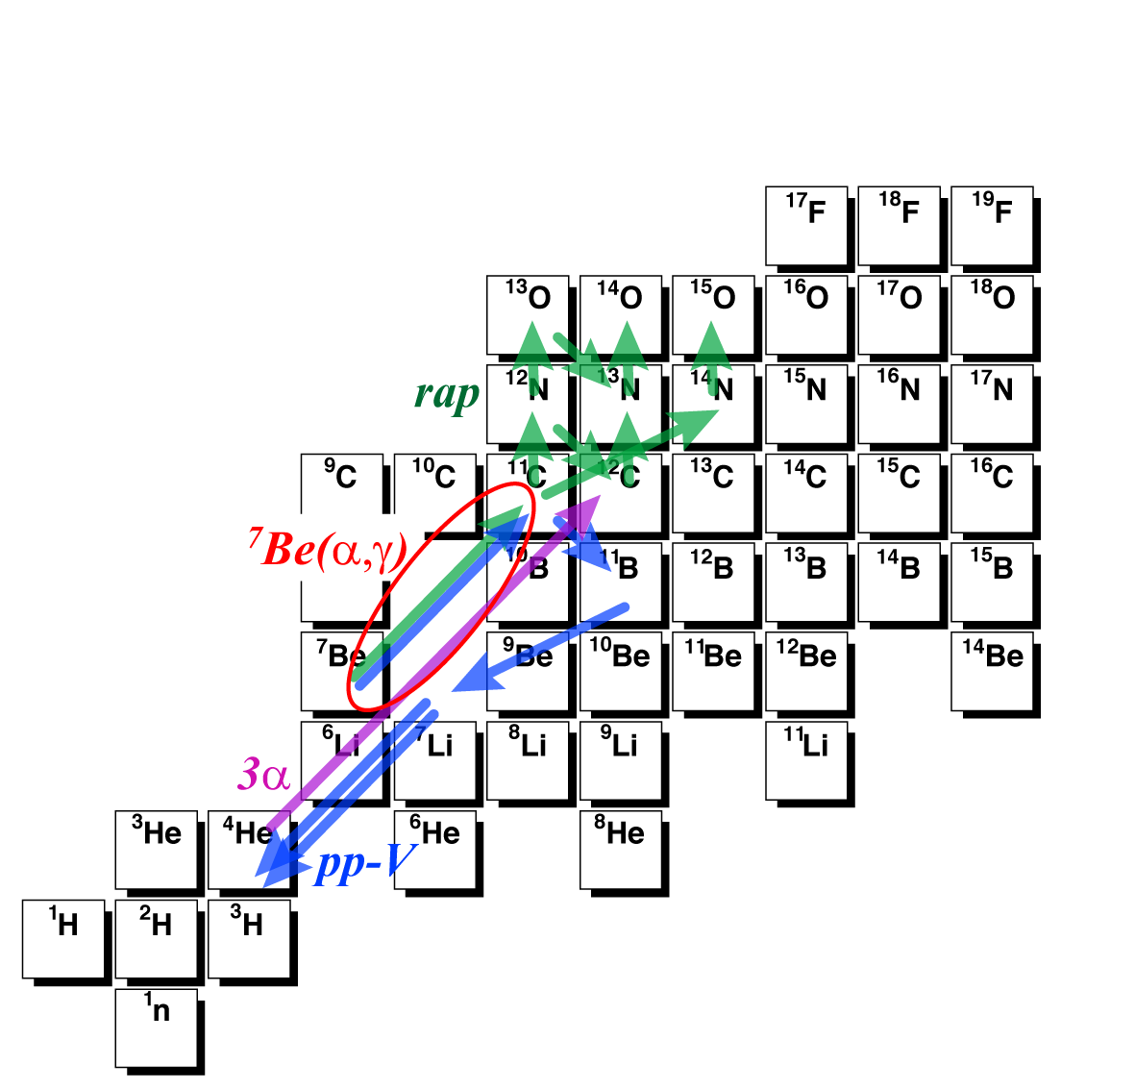
⁷Li+α/ ⁷Be+α study
⁷Li(α,γ)¹¹B …important at high-T, as a production reaction of ¹¹B (the ν-process in core-collapse supernovae).
⁷Be(α,γ)¹¹B … one of the reaction in hot p-p chain, relevant at high-T.
⇒ Needs information of higher lying resonances.
α-cluster structure in ¹¹B/¹¹C :
2α+t / 2α+³He cluster states are known to exist (En’yo, Kawabata et al.).
Several “bands” which have a feature of α-cluster structure could be formed. We can study the band and cluster structure more in detail.

Slide 6
⁷Be(α,γ) and other low-mass (α,p)
νp-process calculation (T₉>1) shows considerable contribution by ¹⁰B(α,p)¹³C and ⁷Be(α,γ)¹¹C as much as the triple-alpha process.
S. Wanajo et al., Astrophys. J (2010)

Slide 7
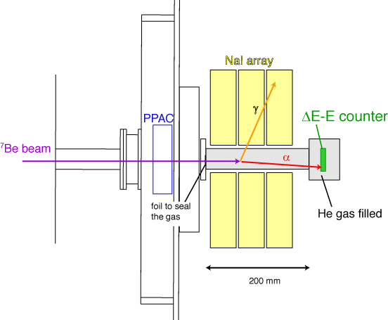
⁷Li/⁷Be+α; method
“Thick target with inverse kinematics” Resonant elastic scatterings can be measured at θcm=180 deg.
¹¹C+p; T. Teranishi et al., Phys. Lett. B (2003).
¹³N+p; T. Teranishi et al., Phys. Lett. B (2007).
²¹Na+p, ²²Mg+p; J.J. He et al, Eur Phys. J (2008) and Phys. Rev. C (2007).
⁷Be+p; H. Yamaguchi et al., Phys. Lett. B (2009).
We applied the method for proton +RI beams, but how good it can work for alphas? (Especially for light nuclei, where Z is not much different from 2.)
MCP

Slide 8
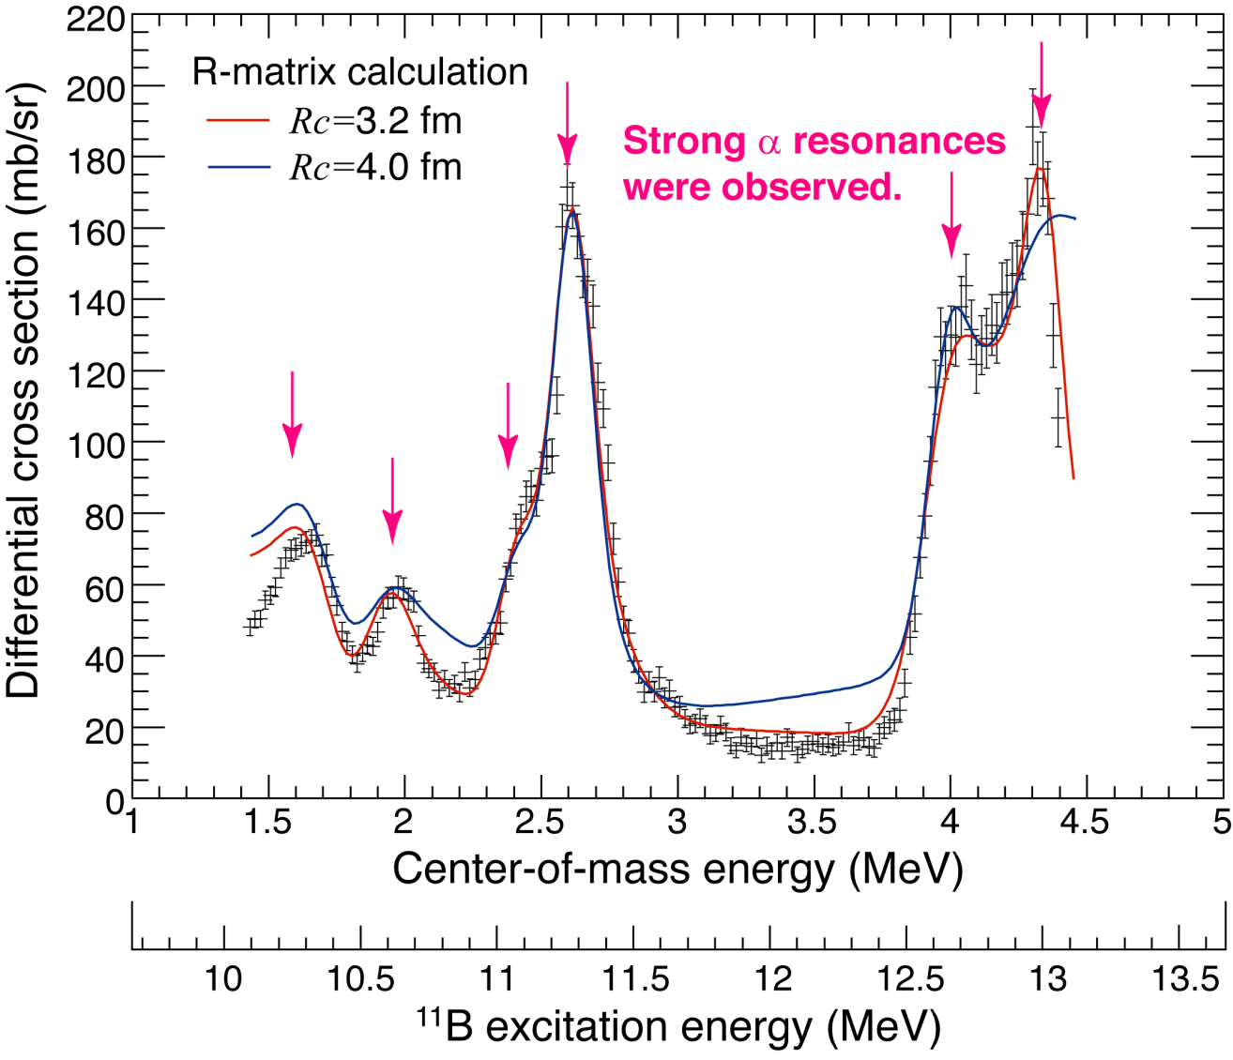
⁷Li+α result
Strong alpha resonances were successfully observed, and we determined the α widths (Γ_{α}). H. Yamaguchi et al., Phys Rev. C (2011).
T=3/2? 1/2?
Is J^{π} really 9/2-?
New!

Slide 9
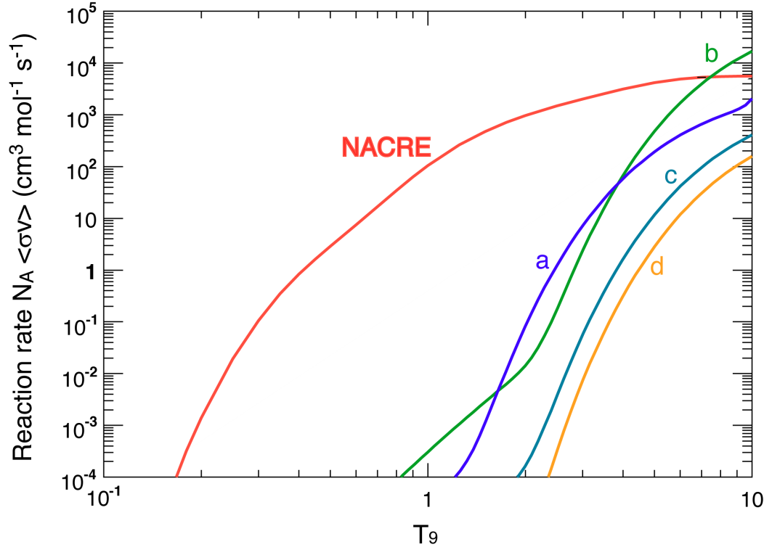
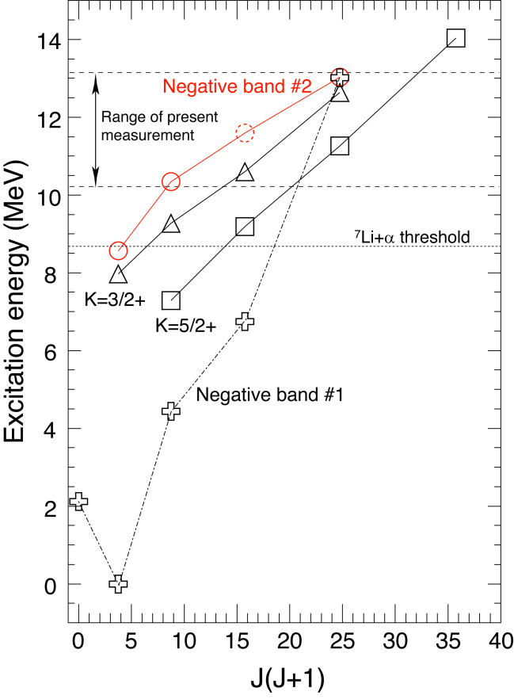
⁷Li+α; results
Resonant reaction rates for the observed resonances are compared with NACRE evaluation (including resonances below 11 MeV).
Conclusion: No need to modify NACRE evaluation (for T₉<5).
Newly proposed a negative parity band.
It may not be a simple rotational band, but corresponds to a 2α-t structure [AMD Calc. by Suhara & En’yo]

Slide 10
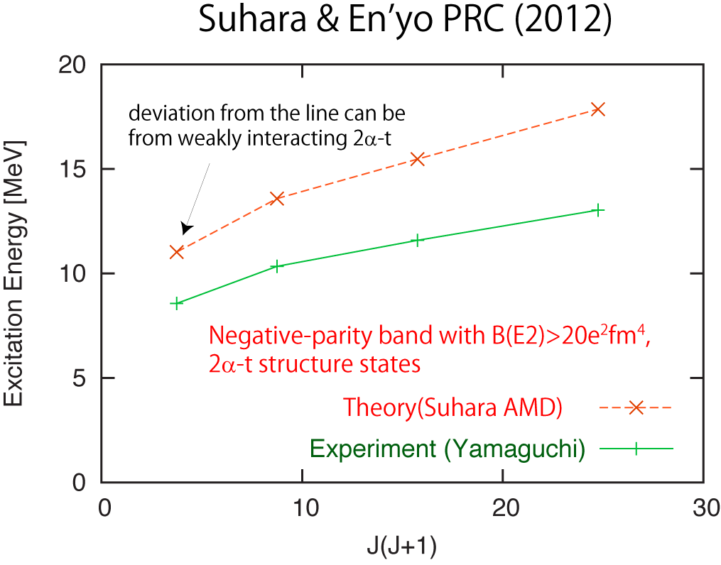
Interpretation of the new negative-parity band

Slide 11
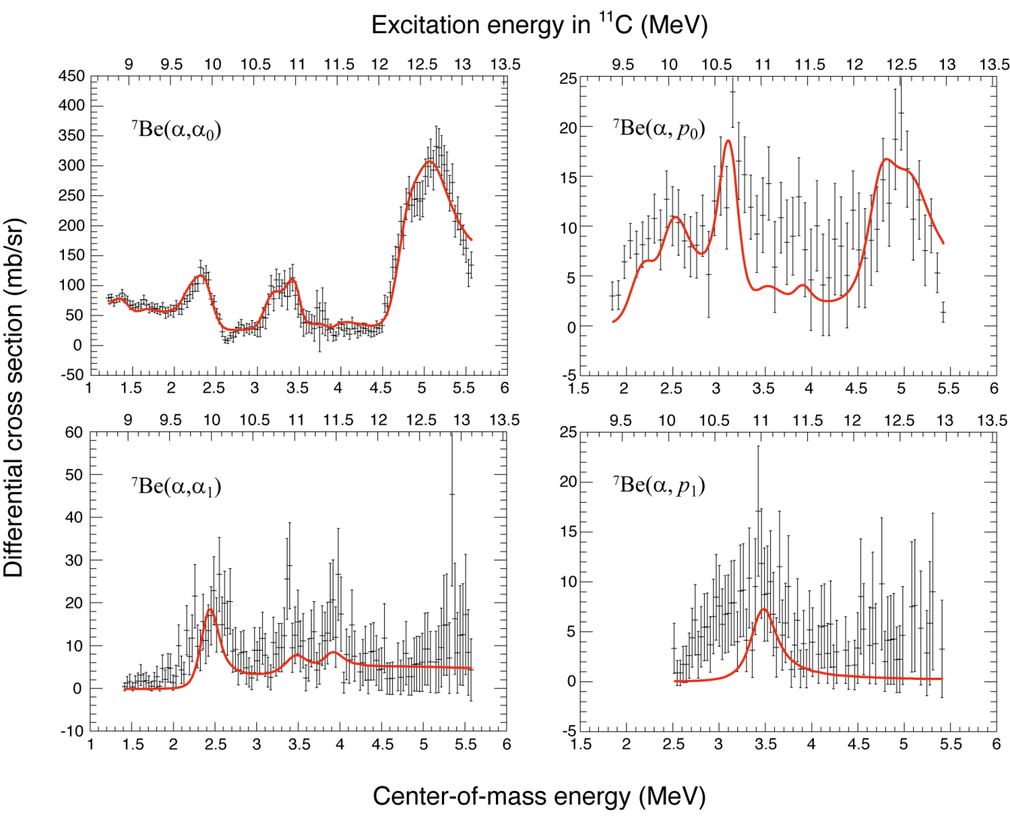
⁷Be+α Excitation functions
4 excitation functions… new information on resonant widths, spin, and parity. H. Yamaguchi et al., PRC (2013).

Slide 12
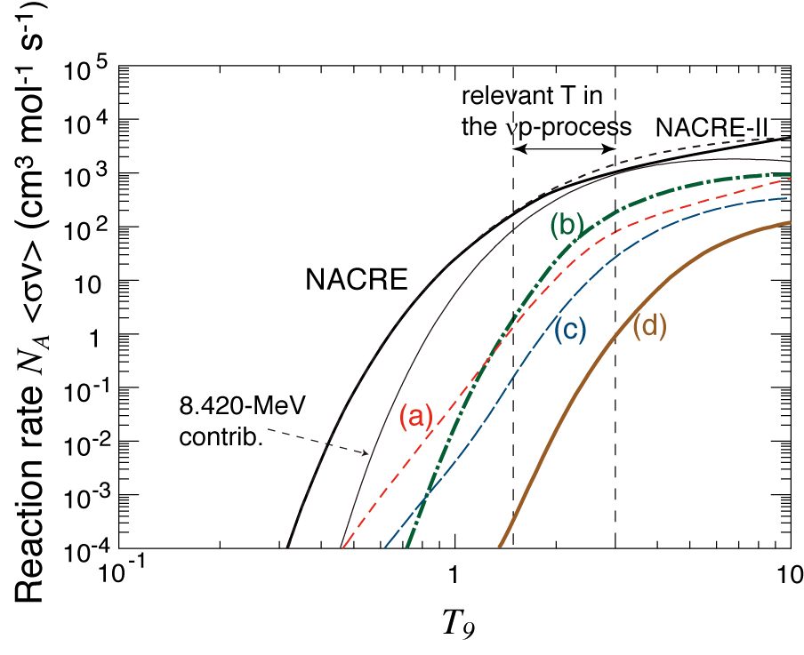
Resonant contribution to ⁷Be(α,γ)
Small but not negligible contribution compared to lower-lying states (~10%).

Slide 13
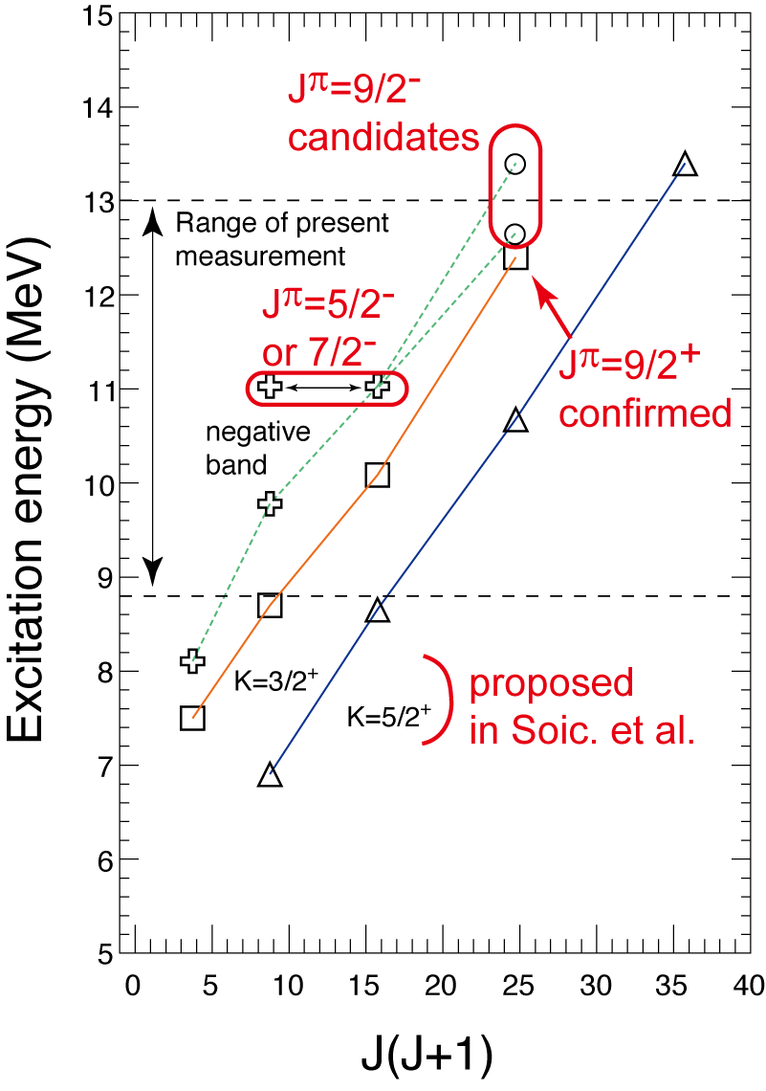
(Rotational) bands in ¹¹C
2 rotational bands (K=3/2⁺,5/2⁺) were suggested in Soic. et al. (2004).
J^{π}=9/2⁺ was assigned for the resonance at 12.4 MeV, and it can be the member of K=3/2⁺ band.
A negative-parity band is proposed.

Slide 14
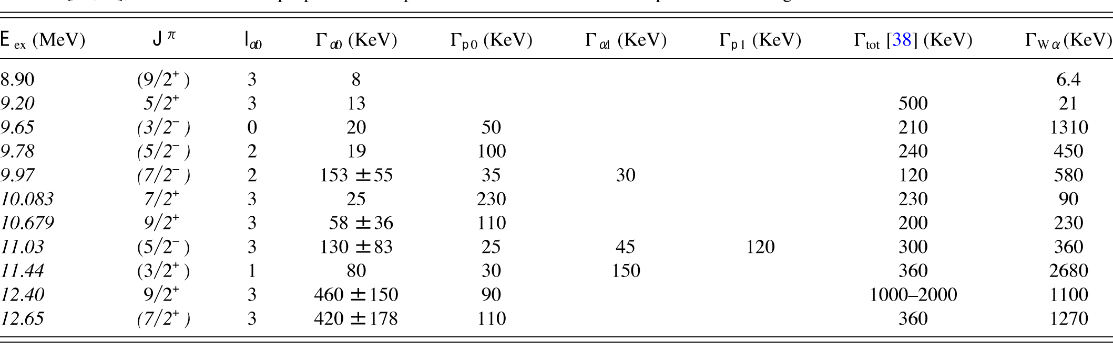
⁷Li/⁷Be+α; level parameters

Slide 15
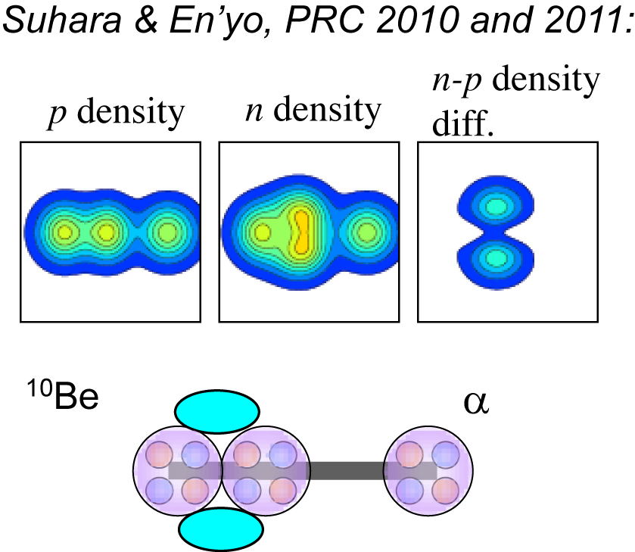
¹⁰Be+α
Linear-chain cluster levels in ¹⁴C were predicted in Suhara & En’yo papers.
Asymmetric, ¹⁰Be+α configuration …likely to be observed with ¹⁰Be+α alpha-resonant scattering.
May form a band with J^{π}=0⁺,2⁺,4⁺ a few MeV above α-threshold.
Scattering of two 0⁺ particles…only l-dependent resonant profile.
¹⁰Be beam has never been produced at CRIB, but an intensity of 3x10⁵ pps is expected.

Slide 16
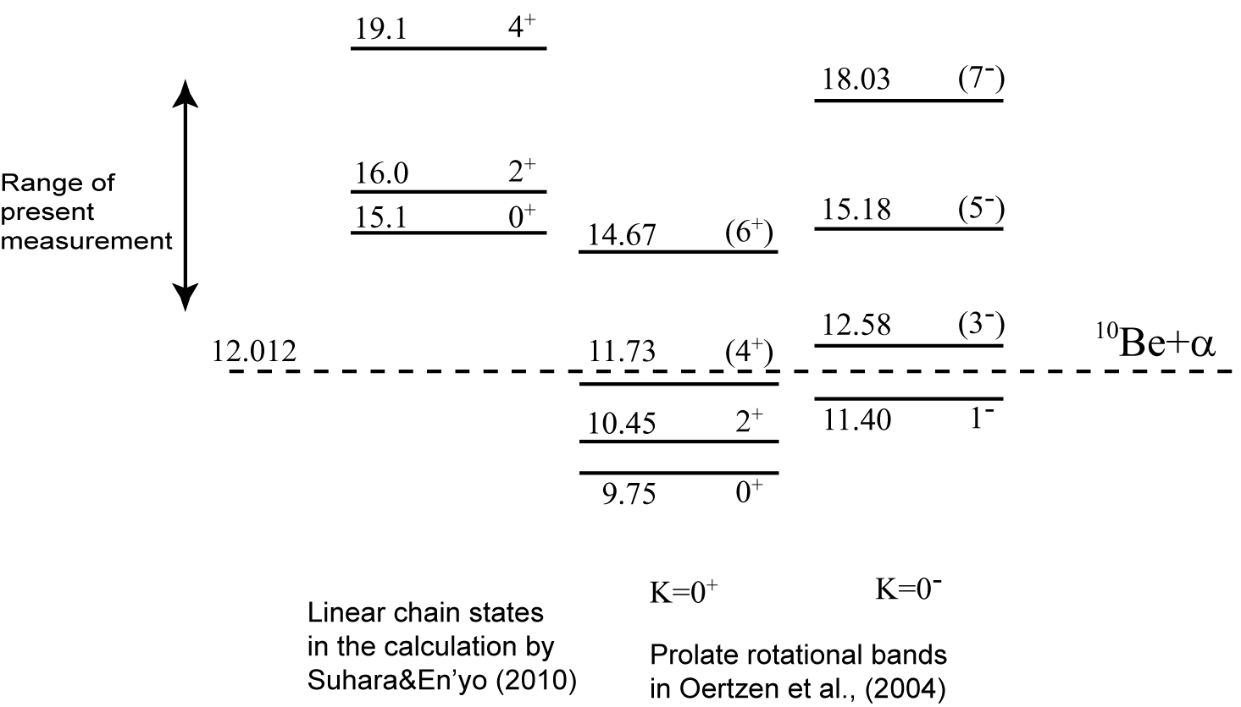
Cluster bands
Predicted energy…few MeV above the ¹⁰Be+α threshold

Slide 17
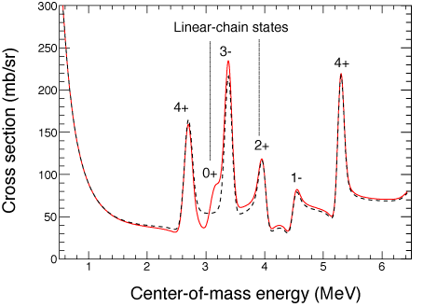
R-matrix analysis (simulation)
Identification of the predicted linear chain levels is possible (s-wave, 100-keV wide 0⁺ level is assumed).
Resonant parameters for other α-cluster-like levels in this energy region can also be obtained.
Γ₀₊=100 keV is an assumption. (<<50 keV…difficult to identify? >>100keV…the peak becomes broad, but R-matrix should tell something.)

Slide 18
Summary
CRIB is a low-energy RI beam facility operated by CNS, University of Tokyo, providing RI beams of good intensity and purity.
CRIB is good at producing RI beams of low-mass (A<40) and near the stability line.
Alpha resonant elastic scattering at CRIB…a good method to study alpha cluster structure.
⁷Li+α,⁷Be+α…strong resonances were observed. We studied astrophysical reactions and alpha-cluster structures.
New plans: ¹⁵O+α, ¹⁰Be+α, ⁴⁴Ti+α.
We welcome new ideas of experiments using the beams of CRIB.
Proposals can be accepted anytime. (Please consult Yamaguchi).
See also http://www.cns.s.u-tokyo.ac.jp/crib/crib-new

