Slide 1
チャーモニウムの軽い原子核への束縛状態
Charmonium Bound states in light nuclei
横田 朗^{A} 、 肥山 詠美子^{B} 、 岡 眞^{A}
東工大理工^{A}、理研仁科セ^{B}
Notes:
東工大理工、理研仁科セ
Charmonium Bound states in light nuclei

Slide 2
Contents
Introduction
・ Charmonium-nucleon interaction （QCD color van der Waals force ）
・ Charmonium-nucleus bound states
Formalism
・ Effective charmonium-nucleon potential and the scattering length
・ Charmonium-nucleus few-body systems
Results
・ Charmonium-deuteron system
・ Charmonium-⁴He system
・ Charmonium-⁸Be system
・ Comparison with lattice QCD data
Summary and conclusion

Slide 3
Introduction

Slide 4
Interaction between
Dominated by QCD color van der Waals force (weakly attractive)
Weakly attractive interaction
QCD color van der Waals force
and
・ They have no valence quarks in common :
Meson exchange is suppressed by the OZI rule
・They are color singlet :
Single gluon exchange is forbidden
・Dominated by multiple gluon exchange ( QCD color van der Waals force )
Therefore
・QCD color van der Waals force is weakly attractive force
・It is a short range force due to the color confinement
（M. Luke, et al. PLB 288, 355 (1992), D.Kharzeev, H.Satz, PLB 334, 155(1994)）
(S. J. Brodsky, et al., PRL 64 (1990) 1011, S. J. Brodsky, G. A. Miller PLB 412 (1997) 125)
Study of interaction is suitable for understanding
・the role of gluon (QCD) in hadronic interaction
・hadronic interactions in short range region which could not be described only by one meson exchange
Notes:
(S. J. Brodsky, G. A. Miller PLB 412 (1997) 125)
(J ^{π}= 1－)
But the details of the interaction is not yet known.

Slide 5
Interaction between
Dominated by QCD color van der Waals force (weakly attractive)
Weakly attractive interaction
QCD color van der Waals force
and
・ They have no valence quarks in common :
Meson exchange is suppressed by the OZI rule
・They are color singlet :
Single gluon exchange is forbidden
・Dominated by multiple gluon exchange ( QCD color van der Waals force )
Therefore
・QCD color van der Waals force is weakly attractive force
・It is a short range force due to the color confinement
（M. Luke, et al. PLB 288, 355 (1992), D.Kharzeev, H.Satz, PLB 334, 155(1994)）
(S. J. Brodsky, et al., PRL 64 (1990) 1011, S. J. Brodsky, G. A. Miller PLB 412 (1997) 125)
Study of interaction is suitable for understanding
・the role of gluon (QCD) in hadronic interaction
・hadronic interactions in short range region which could not be described only by one meson exchange
Notes:
(S. J. Brodsky, G. A. Miller PLB 412 (1997) 125)
(J ^{π}= 1－)
But the details of the interaction is not yet known.

Slide 6
Why studying bound state?
Low energy scattering data is not available
We have to study without direct information about the interaction.
Precise study of the binding energy and the structure
of the bound states
from both accurate theoretical calculations and experiments
is the only way to determine the properties of the interaction.
Weakly attractive force
QCD color van der Waals force
It should make a bound state with nucleus of large A
(A: the nucleon number)
Brodsky et al. PRL64 (1990) 1011
It is a new type of hadronic state in which particles with no common valence quarks are bound mainly by (multiple-)gluon exchange interaction.
Notes:
Also, it is the new type of hadronic state in which particles with no common quarks are bound mainly by multi-gluon exchange force.
These bound states, and if exist, excited states, themselves are interesting object to study.

Slide 7
Formalism

Slide 8
Effective potential between
Consider S wave (L=0) only. (We only want to see the ground state.)
Attraction is relatively weak and short ranged.
It could be expressed well by scattering length.
(The details of the potential is not important.)
Assume Gaussian type potential.
(J ^{π}= 0－)
(J ^{π}= 1－)
fm
(taken from color confinement scale)
Our strategy:
1, Solve the equation for 2-body system and obtain the
relation between the potential depth and the scattering length .
2, Solve the equation for 3-body system (by GEM) and
obtain the relation between and the binding energy B.
3, By combining these results, we obtain the relation between and B.
Notes:
T taken from color confinement scale
基底状態だけ見たい → L=0を考える
Our strategy
１、 の値を変えていきながら、 の２体の
シュレーディンガー方程式を解き、散乱長の値を求める。
２、 の値を変えていきながら、 の３体系をGauss 展開法で
解き、束縛エネルギーを求める。
３、上の１と２を合わせて、散乱長と束縛エネルギーの関係を調べる。
（束縛エネルギーは、deutron threshold -2.2MeV から測る。）
fm

Slide 9
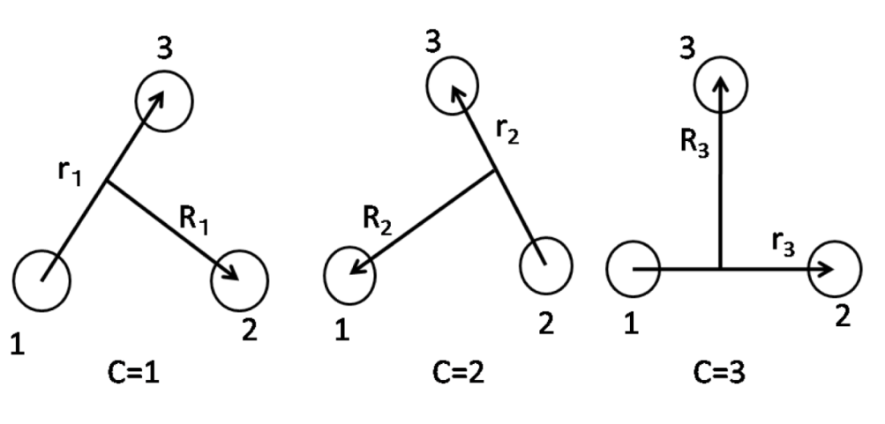
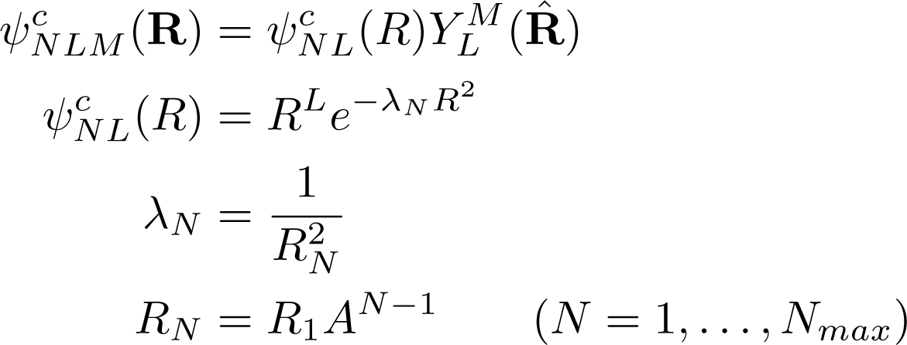
GEM 3-body calculation
E. Hiyama et al. Prog. Part. Nucl. Phys. 51, 223 (2003)
(variation method)
It is known empirically that
setting range parameters in geometric progression as shown below
produce accurate eigenfunctions and eigenvalues with a relatively few basis functions.
r_{n} : geometric progression
R_{N} : geometric progression
Generalized eigenvalue problem of symmetric matrix.
Notes:
E. Hiyama et al. Prog. Part. Nucl. Phys. 51, 223 (2003)
(variation method)

Slide 10
Results
Notes:
Results

Slide 11
The relation between potential strength and the scattering length
is needed to make a
J/Ψ－N bound state.
By the results, we can convert the value of into
A bound state is formed when
Notes:
A bound state is formed when
Similary, for
By the result, we can convert Veff into a bound state is formed when

Slide 12
Relation between v_{eff} of J/Ψ－N potential and binding energy B of J/Ψ－NN.
J/Ψ－deuteron bound state
v_{eff} < -33 MeV is needed
to make a bound state
-B
-B
is needed to make
a bound state
Relation between of J/Ψ－N
and binding energy B of J/Ψ－NN.
The binding energy is measured from
breakup threshold
-2.2 MeV.
A bound state is formed when
N-N potential: Minnesota potential
Notes:
Veff < -33 MeV で束縛する
N-N potential: Minnesota potential
The binding energy is measured from breakup threshold
This result is exactly the same for

Slide 13
Comparison with Lattice QCD data
Scattering lengths as functions of the square mass of derived by using Luscher’s formula.
(The notation of the sign of scattering length is opposite. )
・
・It is too weak to make a bound state with nucleus of
・But the results suggest that
there should be bound states for A>3 or A>4.
In terms of potential,
v_{eff} < -73 MeV is needed for J/Ψ-N (A=1)
v_{eff} < -33 MeV is needed for J/Ψ-NN (A=2)
(v_{eff}= -16 MeV corresponds to a= -0.35 fm )
v_{eff} < -?? MeV is needed for J/Ψ-NNN (A=3)
v_{eff} < -?? MeV is needed for J/Ψ-NNNN (A=4)
(T. Kawanai, S. Sasaki, Pos (Lattice 2010)156)
Implies the existence of J/Ψ-NNN or J/Ψ-NNNN
Notes:
Veff < -73 [MeV] is needed for J/Ψ-N
Veff < -33 [MeV] is needed for J/Ψ-NN
Implies the existence of J/Ψ-NNN or J/Ψ-NNNN

Slide 14
potential
⁴He is a deeply bound state (28MeV) --> Treat as one stable particle
N
potential : use folding potential
N
N
N
(nucleon density distribution in ⁴He)
Ref: R. Hofstadter, Annu. Rev. Nucl. Sci. 7, 231 (1957)
R.F. Frosch et al., Phys. Rev. 160, 4 (1967)
J.S. McCarthy et al., PRC15, 1396 (1977)
Nucleon density distribution in ⁴He may not be disturbed by J/Ψ since
interaction is weak.
Notes:
４He の電荷分布の実験データを再現するように選ぶ。
間のポテンシャル
N
α
Is chosen to reproduce the experimental data.
Ref: R. Hofstadter, Annu. Rev. Nucl. Sci. 7, 231 (1957)
McCarthy et al., PRC15, 1396 (1977)
We assume that the density distribution of nucleon in He is not deflected by J/Ψ as an approximation.
to calculate effective potential
the density of nucleon in
Treat as one stable particle

Slide 15
Binding Energy
lattice QCD
bound state is formed when
J/Ψ－⁴He bound state may exist!
Also, bound state may exist for A ≥ 4 nuclei.
Notes:
bound state is made when
There should be bound state!
4He より大きい原子核との間でも束縛状態が存在する

Slide 16
Relations between scattering length a of and binding energy B of and
Lattice QCD
⁸Be is a resonance state, 0.09 MeV above the α+α
break-up threshold with narrow width Γ=6 eV.
Notes:
Lattice QCD
Preliminary
⁸Be is a resonance state, 0.37 MeV above the α+α.

Slide 17
Summary and Conclusion
We calculate the binding energies of J/ψ - deuteron , J/ψ - ⁴He and
J/ψ – ⁸Be by using Gaussian Expansion Method and give the relations between
the J/ψ - N scattering length and the J/ψ - nucleus binding energy.
By comparing these results with the recent lattice QCD data, we see that
a shallow bound state of J/ψ - ⁴He may exist.
Since J/ψ - N interaction is attractive,
J/ψ - nucleus bound states may be formed with A > 4 nucleus.
The binding energy of J/ψ – ⁸Be is about a few MeV.
from breakup threshold and
from
within the potential strength of current lattice QCD data.

Slide 18
Back up slides

Slide 19
Density distribution between
r_{rms} = 3.0 fm
r_{rms} = 4.8 fm
Notes:
r_{rms} = 3.0 fm
r_{rms} = 4.8 fm

Slide 20
Discussion 1; “Glue-like role” of J/ψ
J/ψ
( J/ψ-deuteron system )
lattice QCD a ～ -0.35 fm
p
n
Shrinking of p-n density distribution in deuteron by the emergence of cc^{bar}
-B
B (MeV)
4.2
3.0
2.2
a =-2.6fm
a =-1.0fm
Glue like effect is suppressed for weak attraction
Notes:
Potential range dependence
引力が弱くなると、glue like effect は大幅に抑制される。
aa=-1.0fm
Llattice QCD a= -0.3 fm

Slide 21
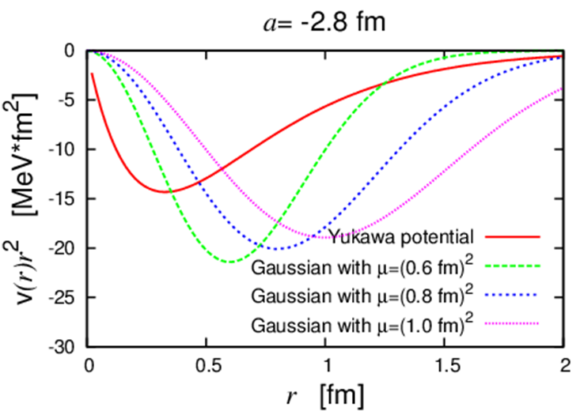
Yukawa-type Potential v.s. Gaussian-type Potential
Discussion 2;
J/ψ
J/ψ-deuteron system
Potentials
p
n
J/ψ-deuteron system
Notes:
Potentials

Slide 22
Comparison of potentials

Slide 23
Comparison with other research
 | A | A=1 | A=2 | A=3 | A=4 | Method
Wasson PRL 67, 2237 (1991) | -2.6 fm |  |  | 0.8 MeV | 5 MeV | Folding potential
Our calculation |  |  | B= 2.2 MeV for a=-2.6 fm |  | 1 MeV (a=-0.35 fm) 16 MeV (a=-2.6 fm) | GEM
A=2
A=4
-B [MeV]
-B
Lattice QCD
Notes:
A=2
-B [MeV]

Slide 24
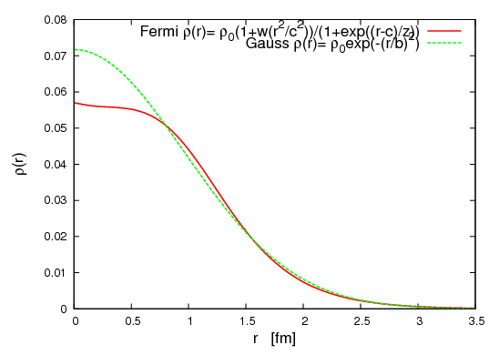
Nucleon density distribution
in ^{４}He
cc^{bar}-N potential
a = -2.8 fm
Yukawa-type
potential
cc^{bar}-⁴He folding potential
Gaussian-type potential
Removing motion of the Center of mass
Notes:
核子の密度分布 a = -2.6 fm
A cc^{bar}-N potential
cc^{bar}-⁴He folding potential
重心を抜いた
ガウス型ポテンシャル
湯川型ポテンシャル

Slide 26
Decay of J/ψ in nuclei

Slide 27
Decay of J/ψ in nuclei
requires the spin flippling of c quark
→ suppressed by ～1/m_{c}
Also, the channels allowed for mixing
are limited by angular momentum conservation.

Slide 28
Possible states for J/Ψ－NN system
Spin averaged J/Ψ-N potential in J/Ψ-NN system
T (isospin) | J | S_{NN} | S_{J/Ψ-N}
0 | 0 | 1 | 1/2
0 | 1 | 1 | 1/2, 3/2
0 | 2 | 1 | 3/2
J/Ψ-N potential
Spin averaged J/Ψ-N potential in J/Ψ-NN system
Notes:
J/Ψ-N potential in
Spin averaged J/Ψ-N potential in J/Ψ-NN system

Slide 29
Relations between scattering length a of and binding energy B of and
Lattice QCD
Notes:
Lattice QCD
Preliminary

Slide 30
Difference between and

