Slide 1


Beta decay and Charge Exchange reactions, shedding light on mirror symmetry
B. Rubio (IFIC Valencia, Y. Fujita (RCNP-Un.Osaka) and many others

Slide 2
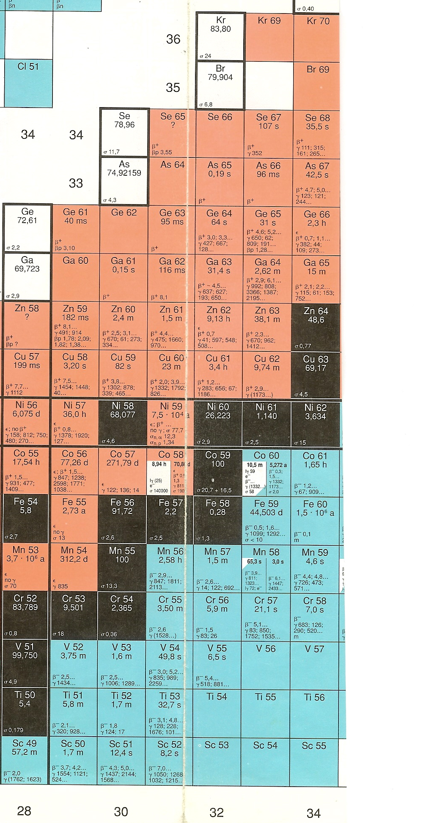
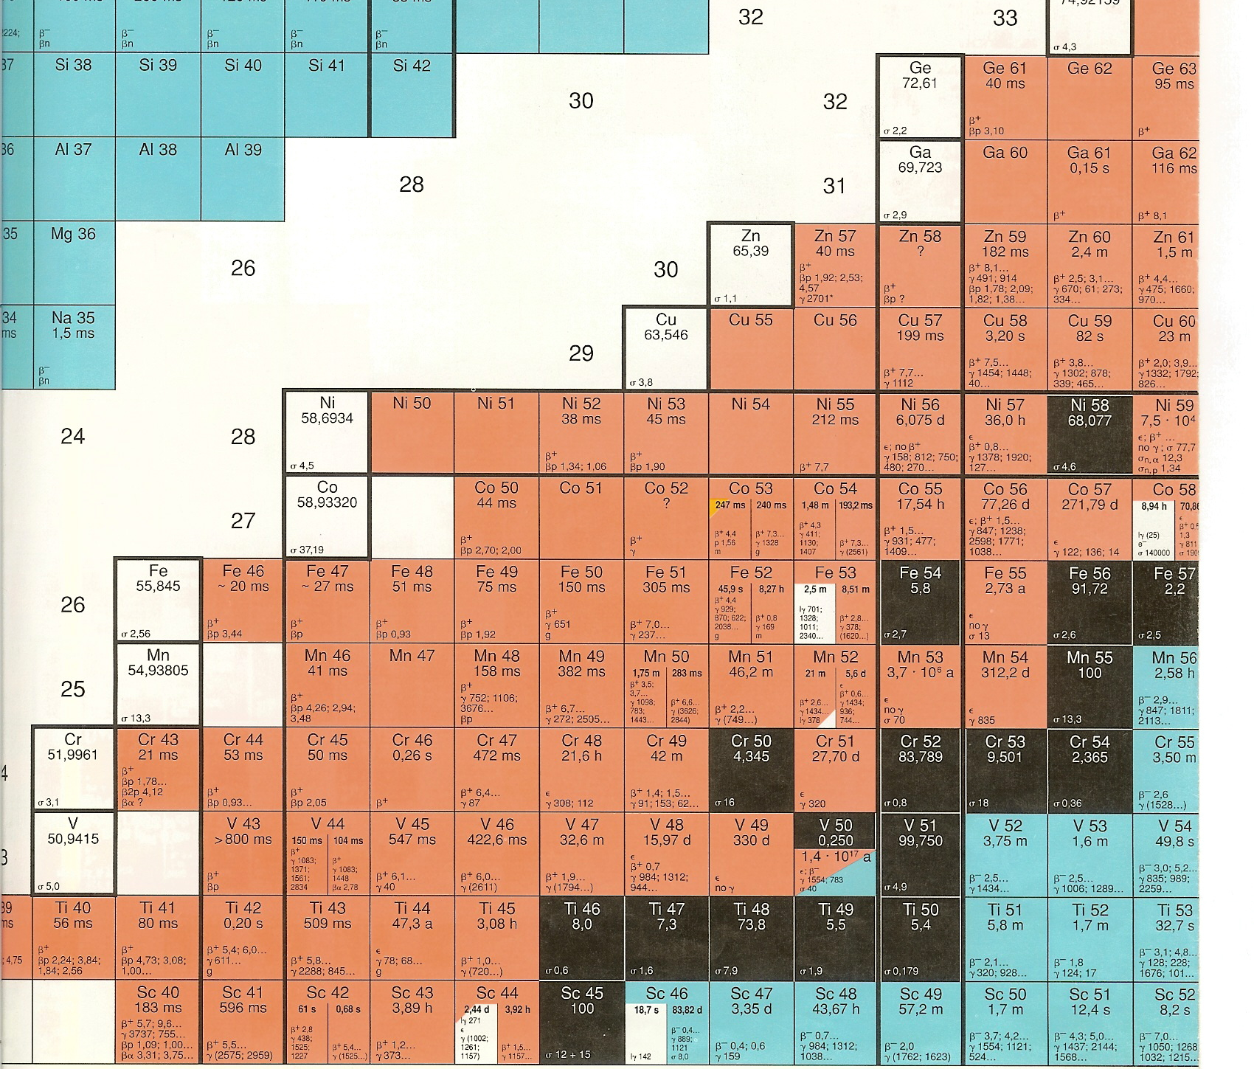
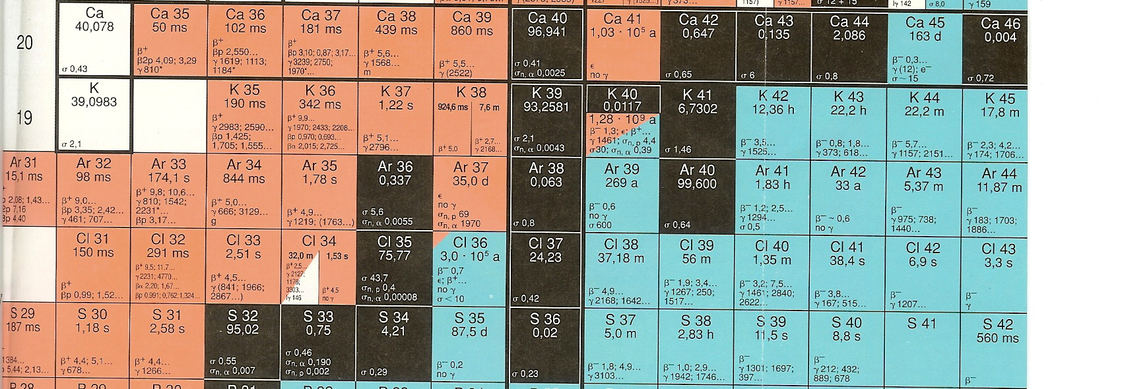
This is part of a series of experiments
aimed at comparing CE reactions
on stable targets with beta decay in proton
rich nuclei,
N=Z
Tz=-2
Z=28
Compare with
Comparison
Z=20
N=28
GSI
GANIL
N=20
RIKEN

Slide 3
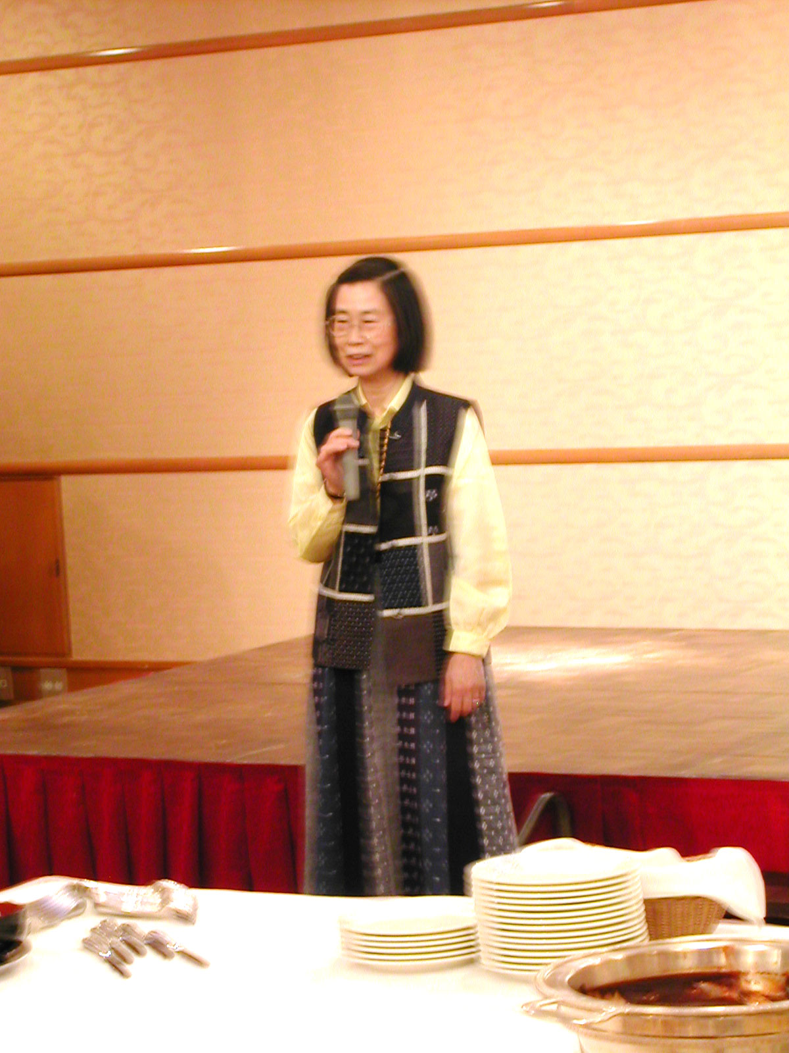
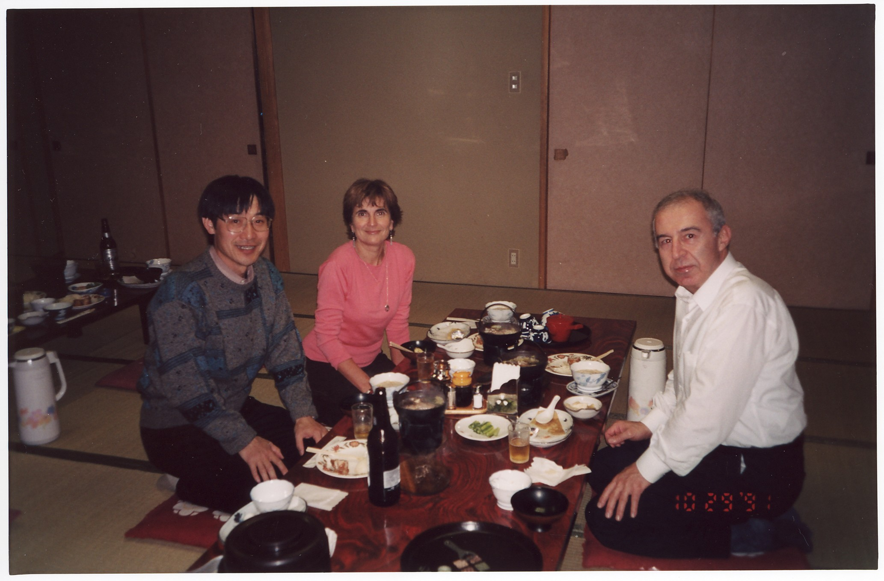
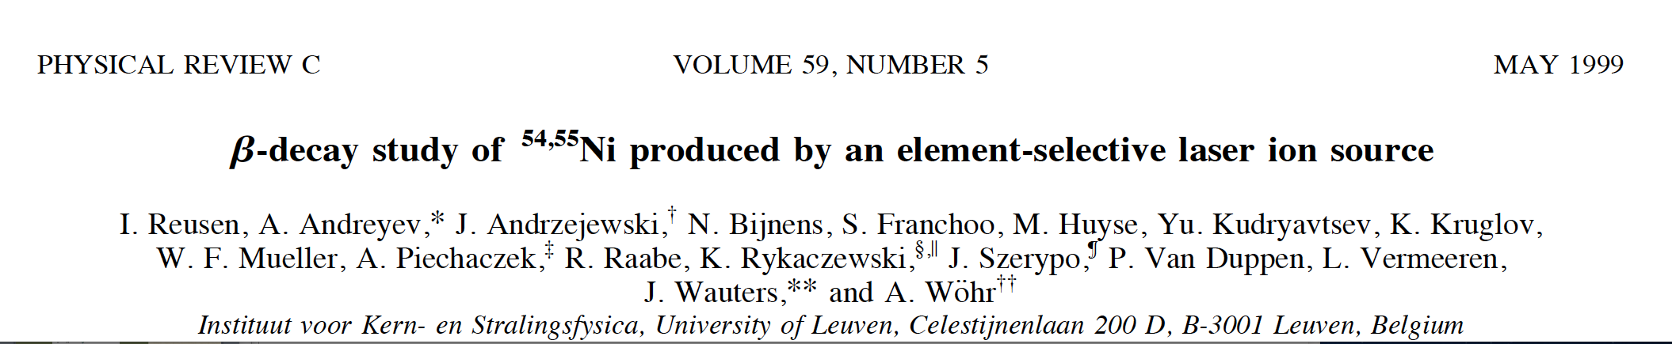
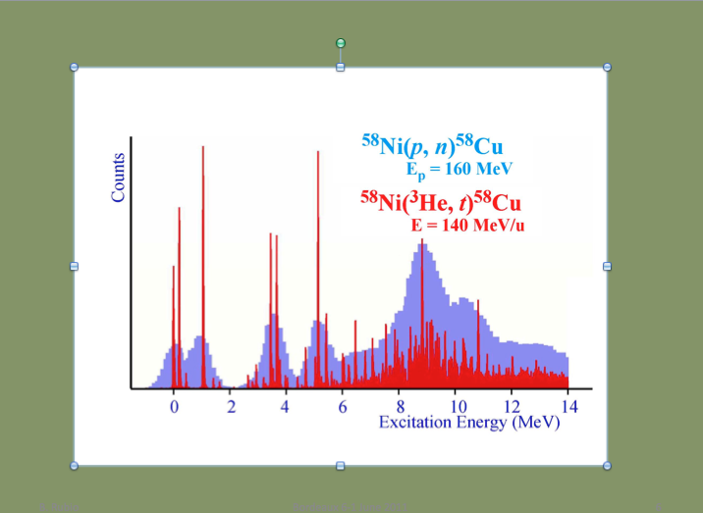
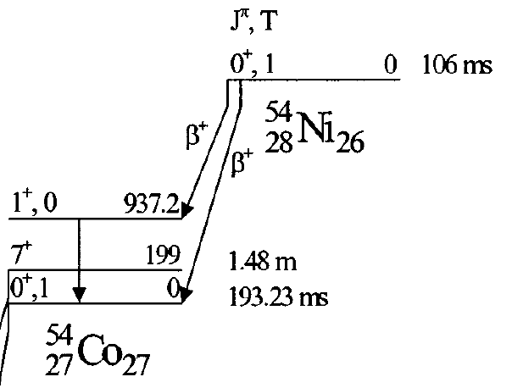
Some years ago……
AIZU2002
Beta decay
Charge Exchange Reactions
target
ν
Stable Target
β+
3He
RCNP experiments at Osaka
3He
t
Advantages :
triton

Slide 4
Beta decay
Charge Exchange Reactions
target
ν
β-
3He
t
CE reactions: No restriction in excitation energy of Gamow-Teller states.
Beta Decay: Absolute Normalization of B(GT).

Slide 5
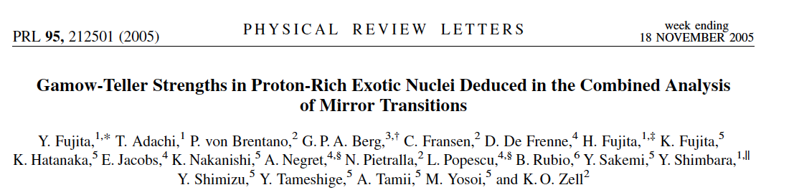

Slide 6
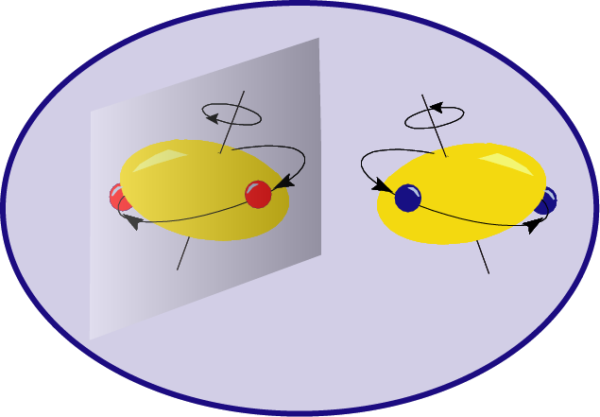
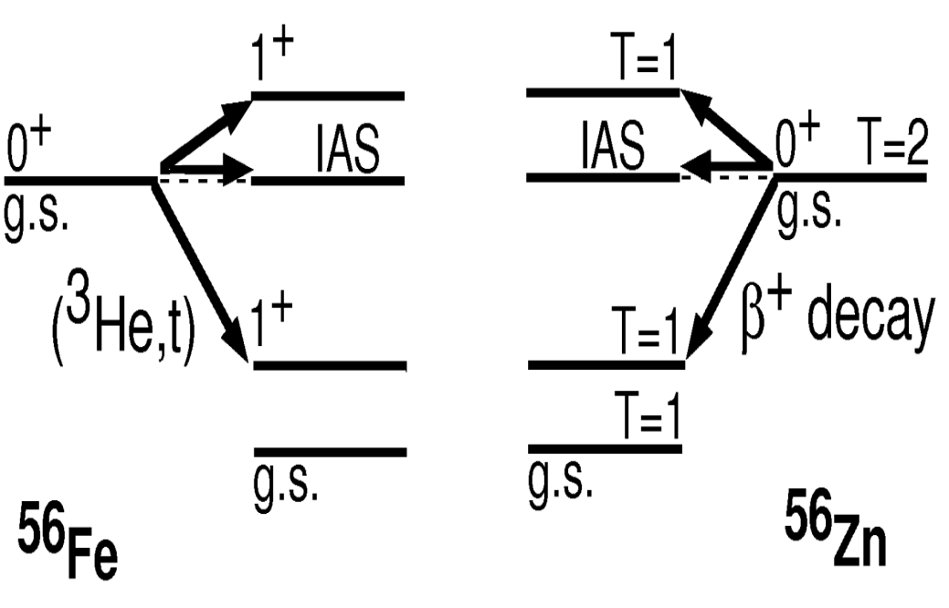
If isospin symmetry exists, mirror nuclei should populate the similar states in the
daughter nucleus, with the same probability, in the two mirror processes
©
στ
τ
στ
Notes:
Initial and final states are not identical.
We don´t expect gs to gs trasition

Slide 7
Theoretically
Experimentally
Charge Exchange
Beta feeding to states
in the daughter nucleus
Experimentally
Beta-decay
Parent
Parent beta half life

Slide 8

We could compare them in mirror nuclei
If isospin symmetry exists, mirror nuclei should populate the same states with the same probability, in the daughter nucleus, in the two mirror processes
Tz=-1
T=1
Tz=+1
T=1
στ
β⁺
(p,n)
(3He,t)
0+
Tz=0
T=1
τ
IAS

Slide 9
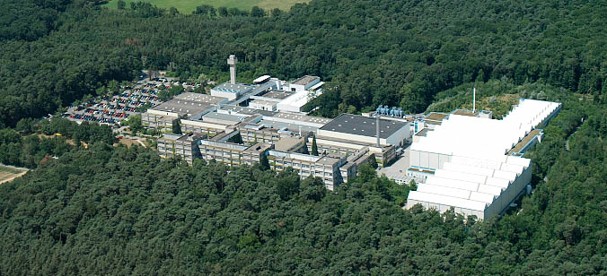
The first experiments on Tz=-1 nuclei were carried out at the GSI Large Scale Facility
⁵⁴Ni
β⁺
⁵⁰Fe
β⁺
⁵⁸Ni
⁴⁶Cr
β⁺
⁵⁴Fe
⁴²Ti
β⁺
⁵⁰Cr
⁴⁶Ti
N=Z
⁴²₂₀Ca₂₂

Slide 10
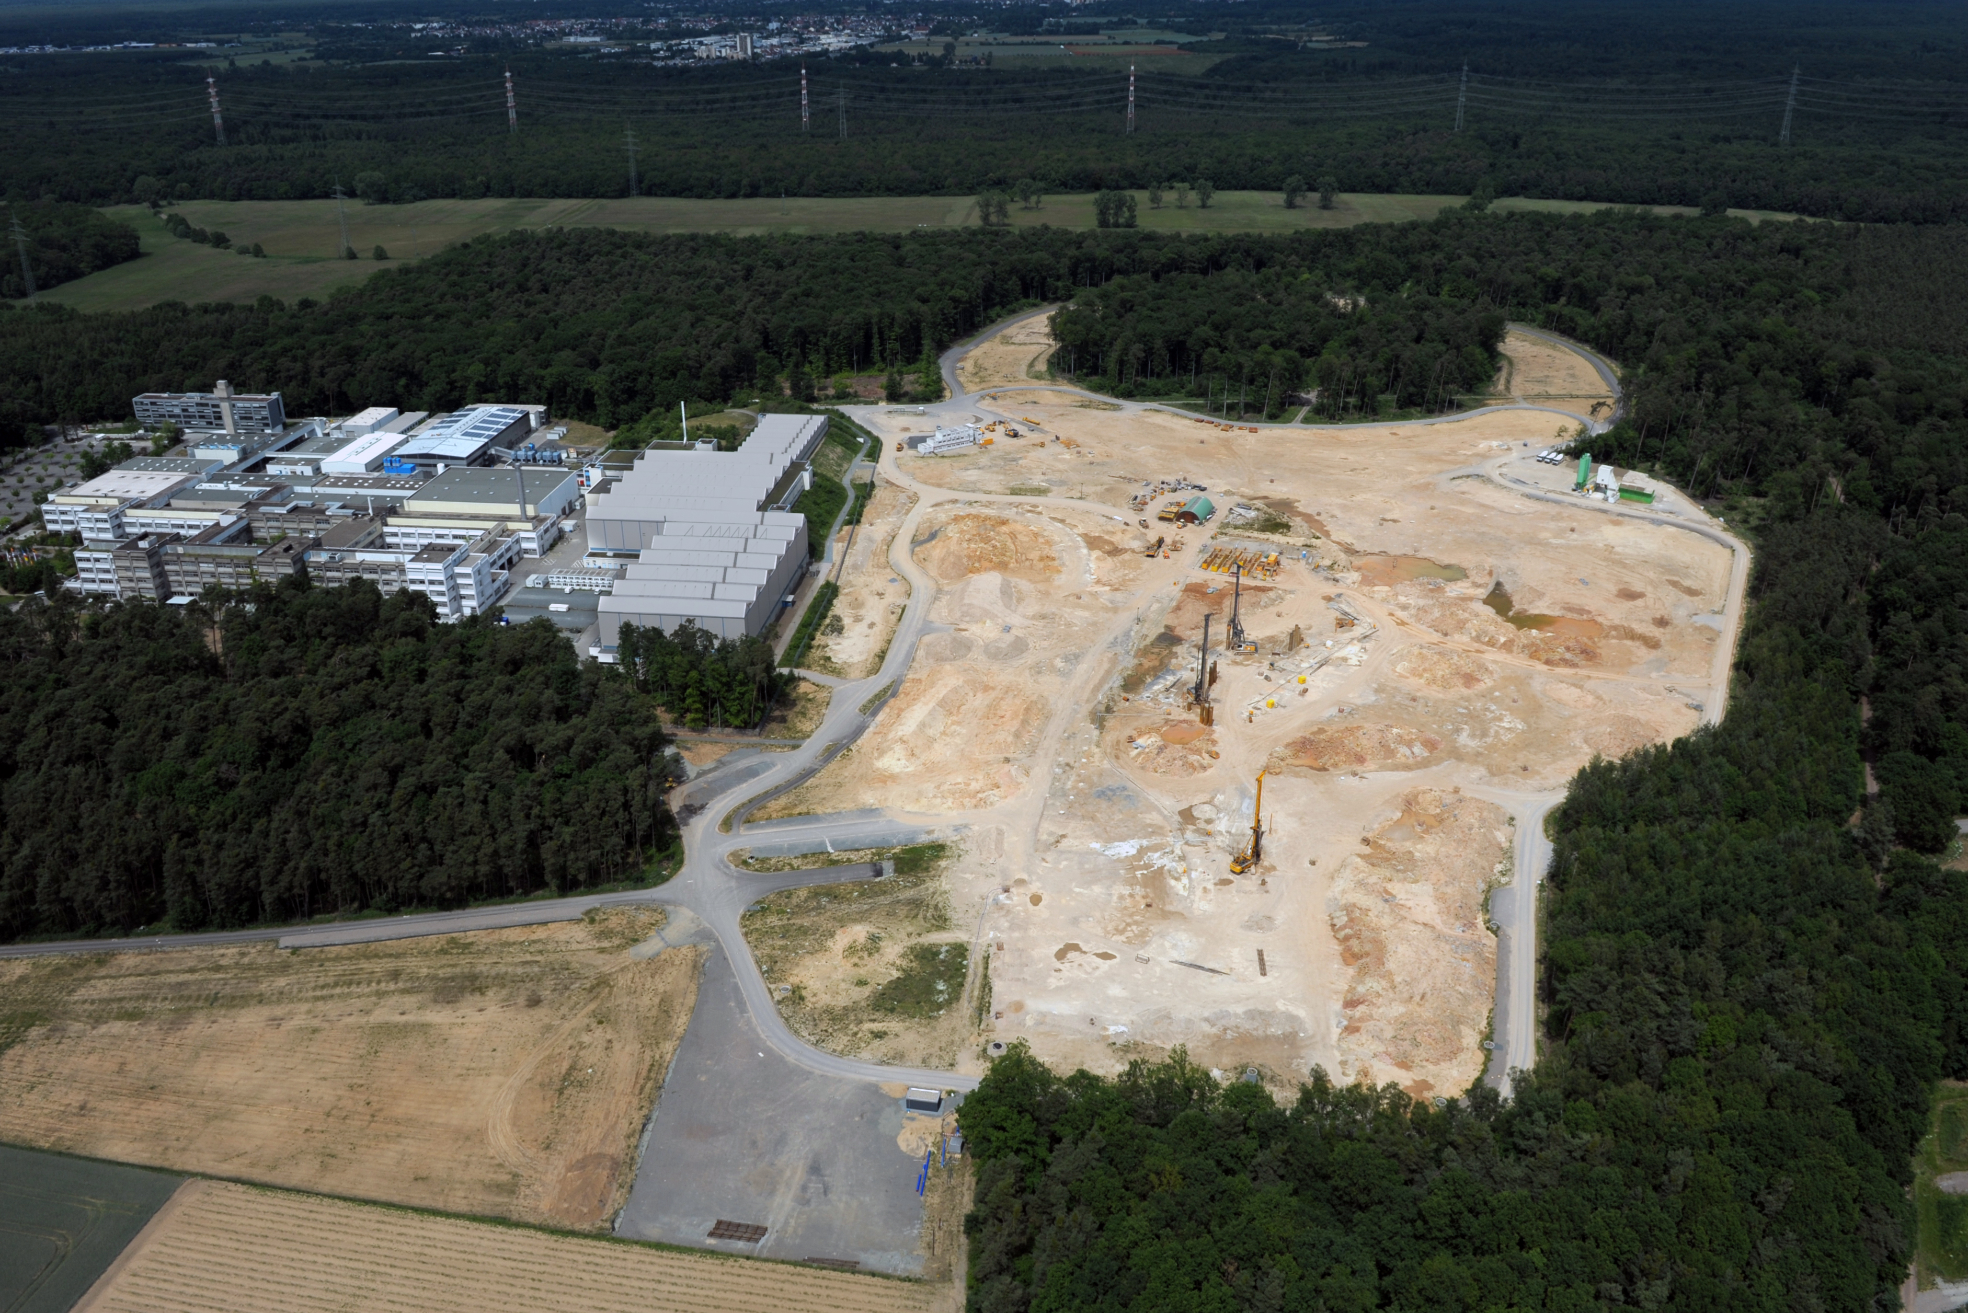

Slide 11
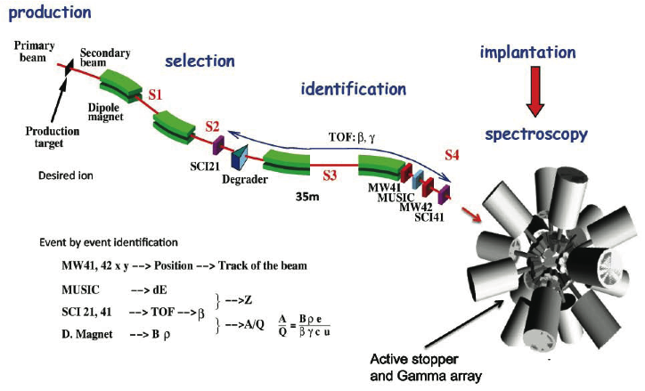
Beta Decay Experiments @ RISING
Beam 58Ni@680 MeV/u 10⁹ pps (part per spill) Target Be 4g/cm2
Separation in flight with the
Fragment Separator (FRS)
11

Slide 12
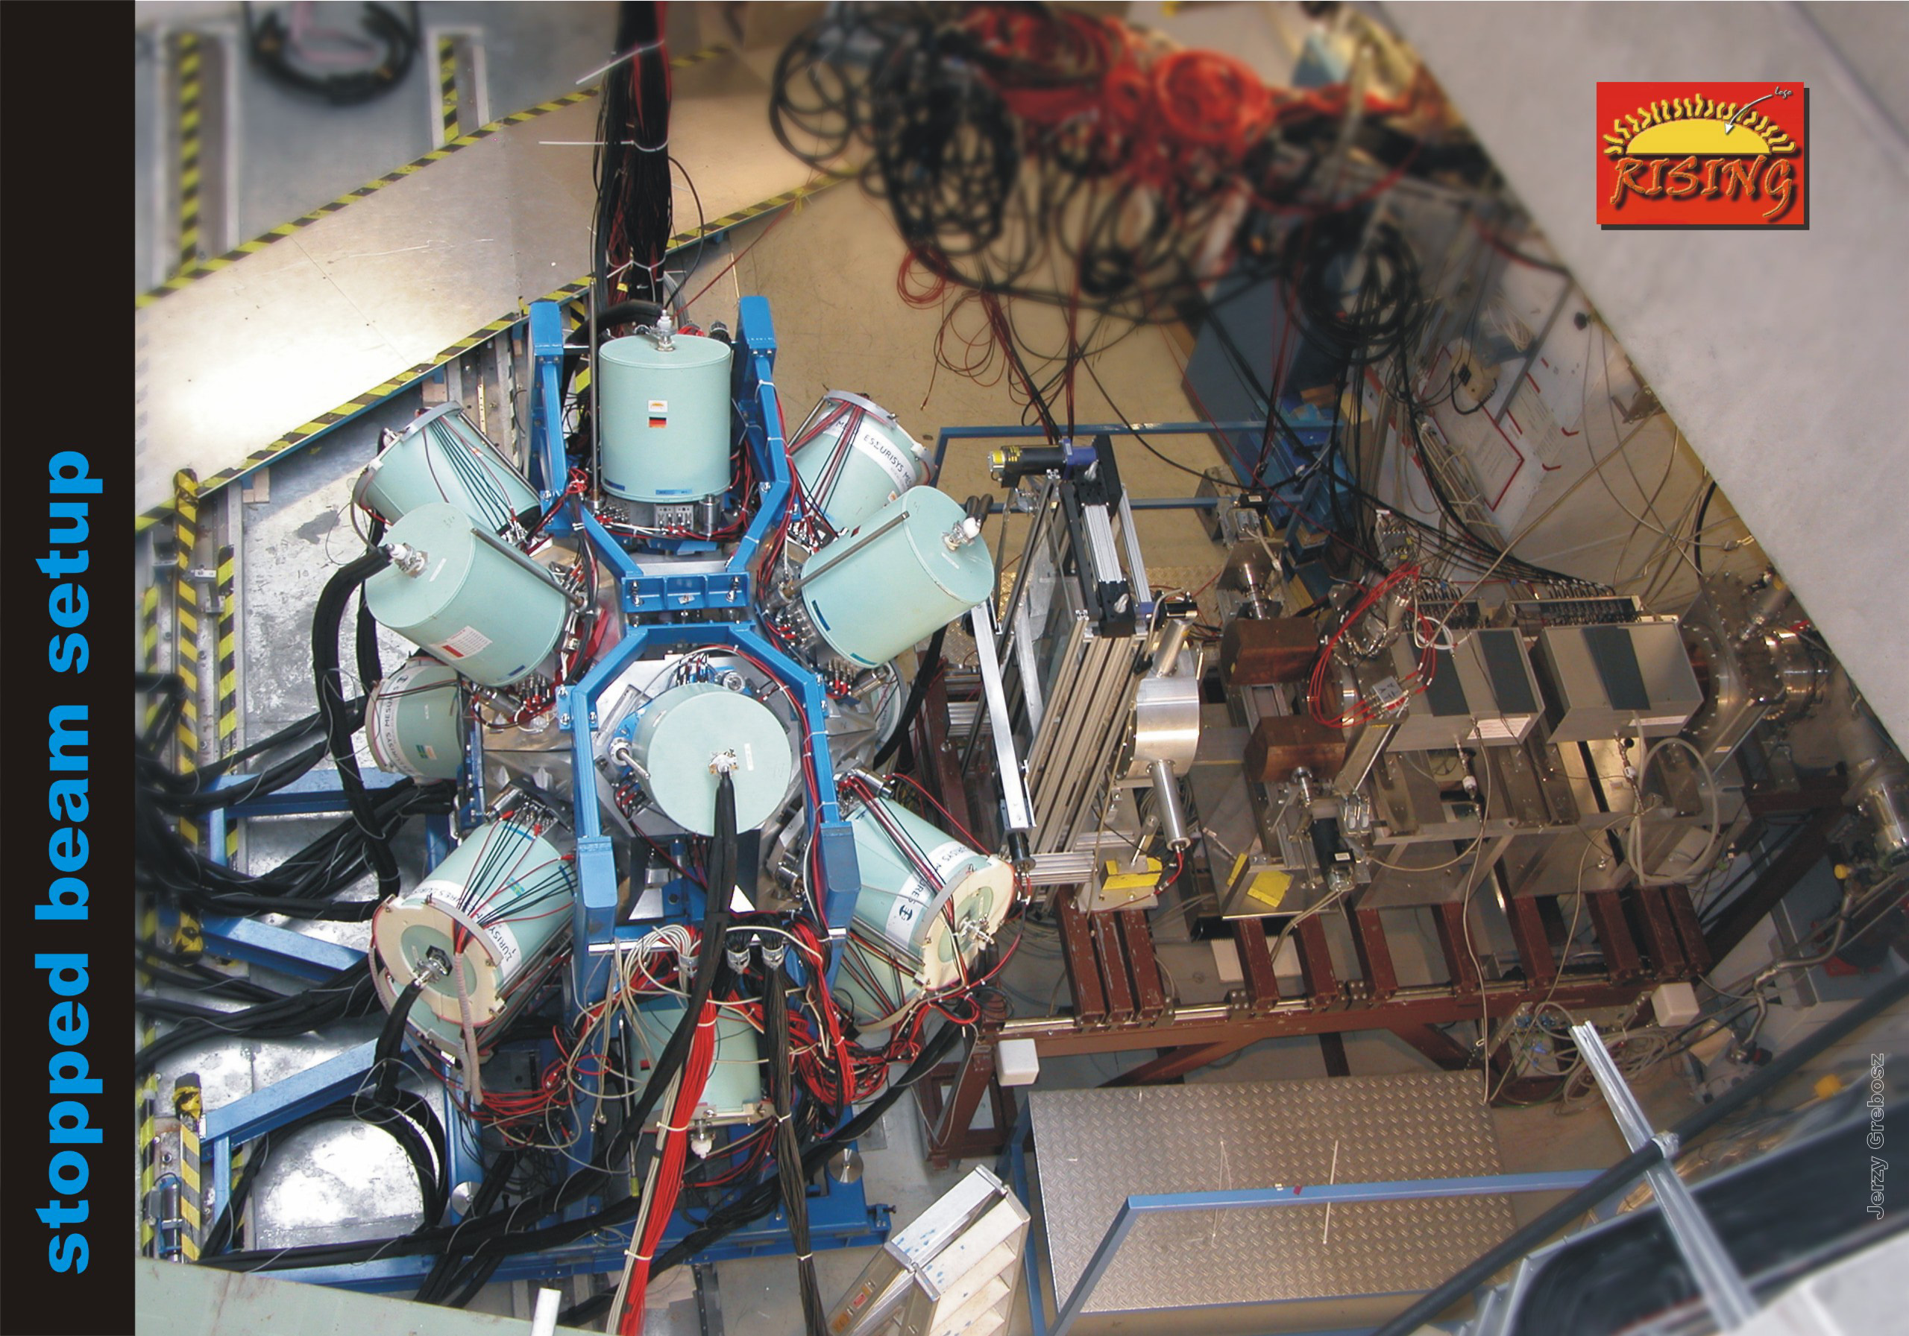
RISING (Ge Array)
12

Slide 13
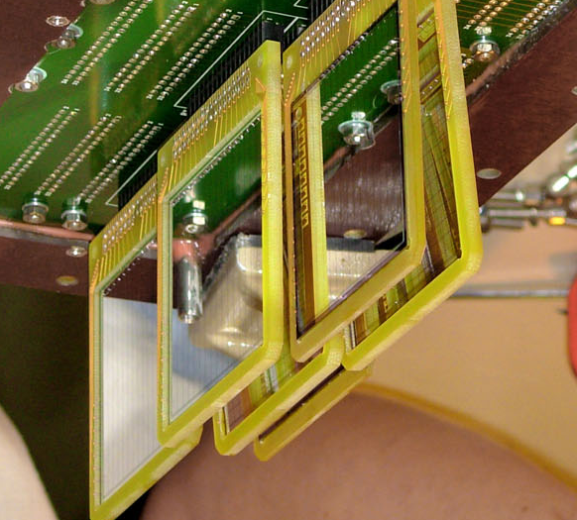
Detector Setup (Rising and DSSSD)
6 DSSSD detectors 1mm with
16 strips X and 16 strips Y,
1mm thick, 5 x 5 cm area
13

Slide 14
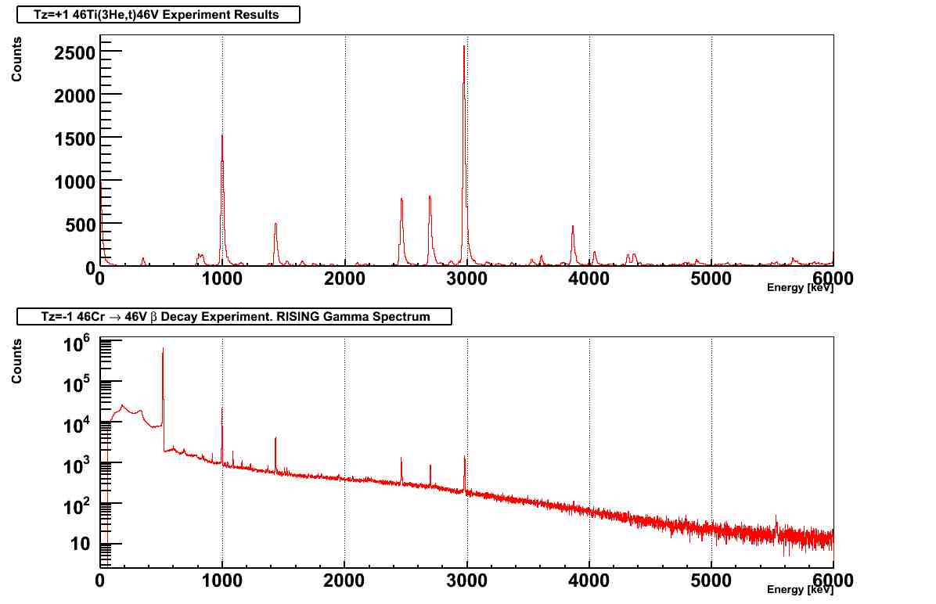
Triton spectrum after
(3He,t) at Osaka
994 1+
2978 1+
2461 1+
2699 1+
3870 1+
1433 1+
511 keV
1432.5 1+
993.2 1+
2459.8 1+
2977.8 1+
About 50pps
2697.4 1+
3867.6 1+
44Ti (5522.6)
Beta delayed Gamma Spectrum for the 46Cr run
Notes:
44 Ti within 2 keV @5.5MeV in comparison with lit. 7 gamma lines in 44Ti from the decay of 44m,g V

Slide 15
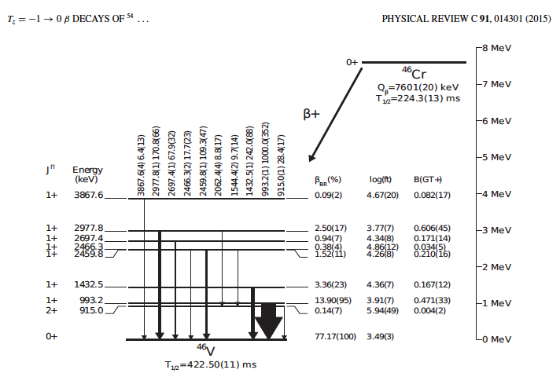

Slide 16
0+ to 0+ Superallowed Fermi transition

Slide 17
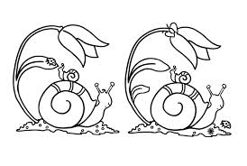
target
Are they really identical?
ν
β-
β−decay
3He,t
t
Find the difference

Slide 18
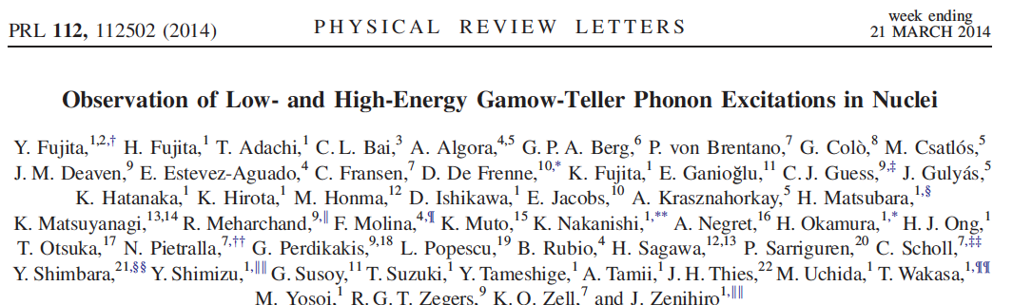
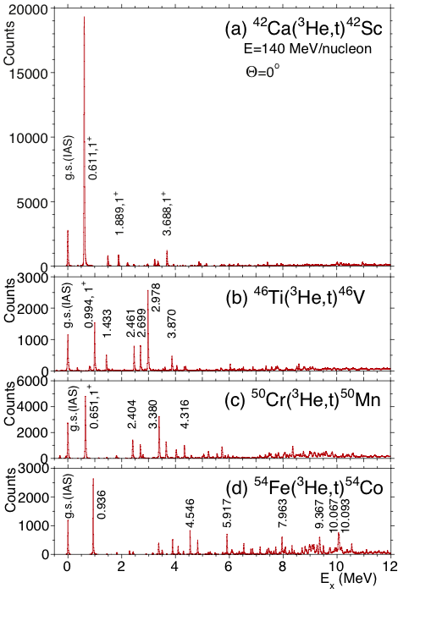

Slide 19
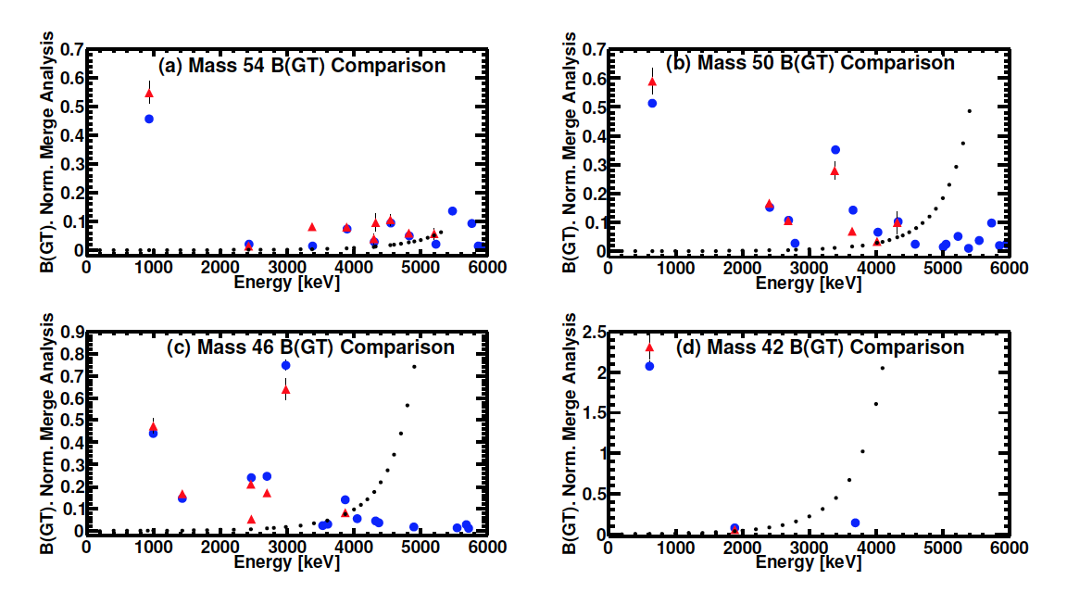
Comparison including sensitivity limit!
β−decay
3He,t

Slide 20
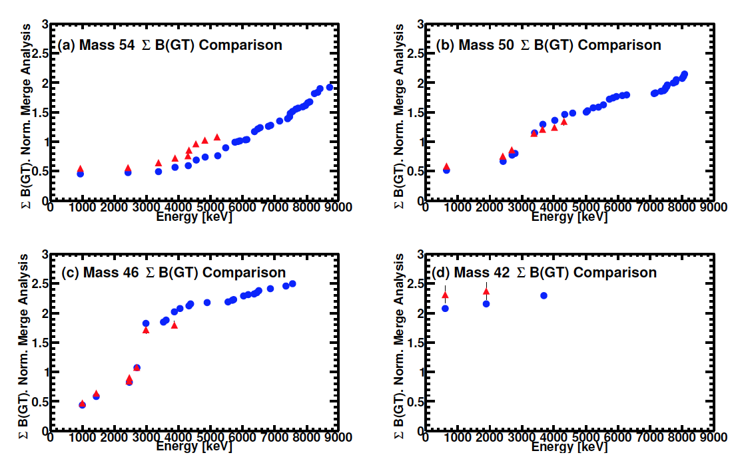
β−decay
Accumulated B(GT)
3He,t
Even inside the Q window, we miss some strength at high energy
Are they really identical?

Slide 21
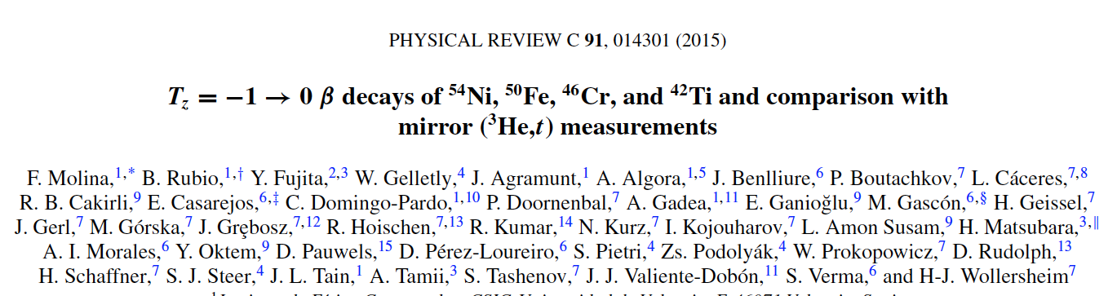
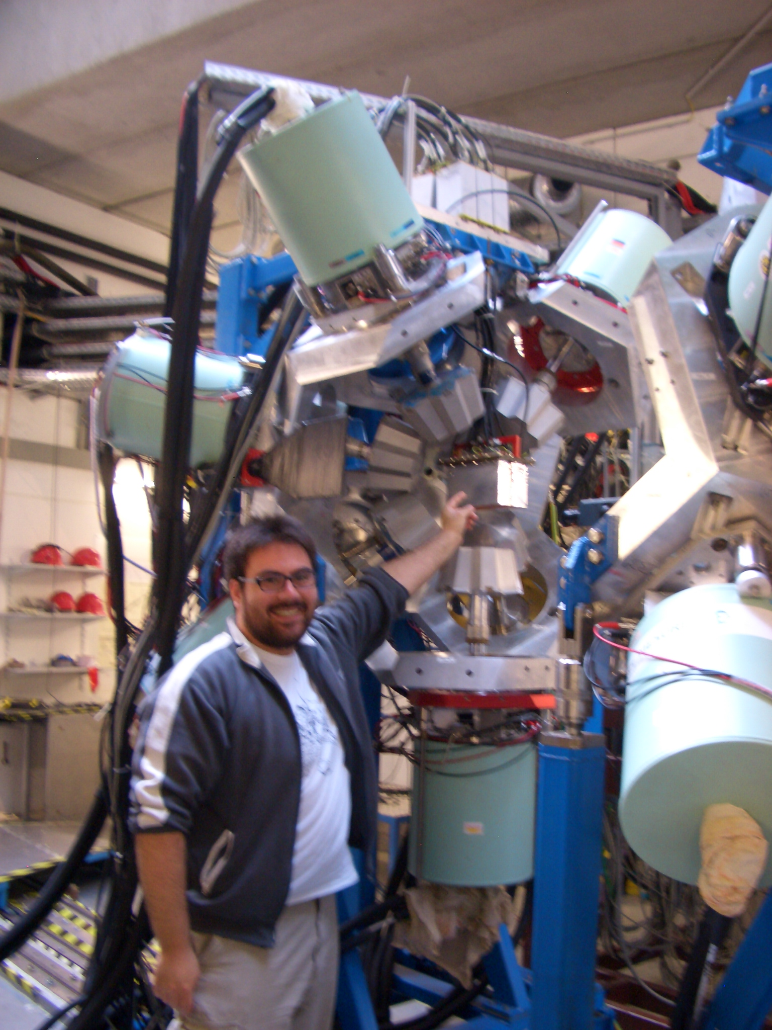
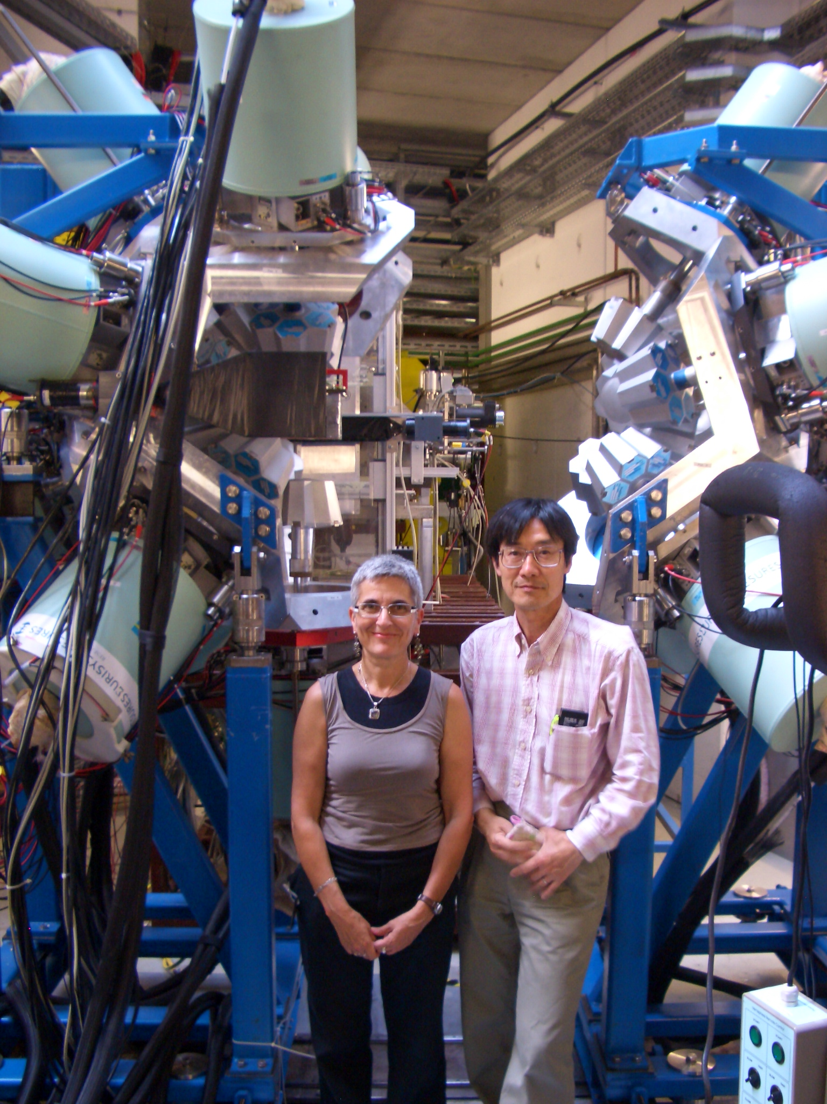
IFIC(Valencia)-Osaka-
Surrey-Santiago de
Compostela-Istanbul-
Warsaw-Lund-Lueven
Legnaro

Slide 22
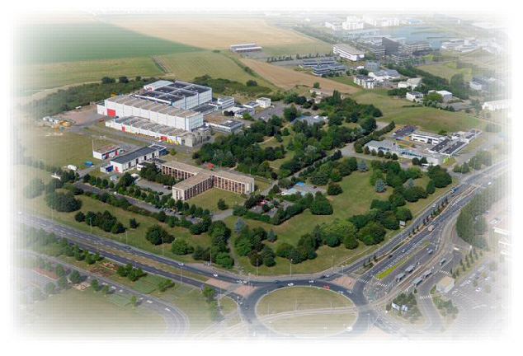
Next step, to compare Tz=-2 and Tz=+2
©
στ
τ
στ
Notes:
Initial and final states are not identical.
We don´t expect gs to gs trasition

Slide 23
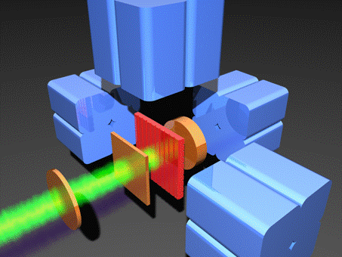
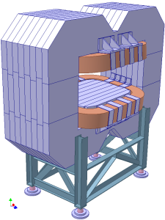
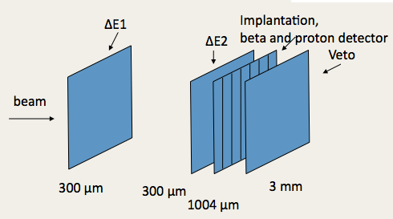
⁵⁸Ni²⁶⁺ (74.5 AMeV) + ^{nat}Ni @ GANIL 2010
Plus 4 EXOGAM
gamma detectors
74.5 MeV / nucleon
Incoming ⁵⁸Ni ²⁶⁺
3.7 eμA intensity
LISE 3 spectrometer
Cyclotrons
CSS1 and CSS2
Ni target
(natural)
Brho1
V₁^{ı}
Slits
wedge
200 μm thick
Brho2
V₂^{ı}
Slits
Wien Filter
V₃^{ı}
DETECTORS
DSSSD detector
Implantation and decay (β, p)
16 strips X and 16 strips Y
300 μm thick
3 mm pitch
5
300
Notes:
DSSSD = Double Sided Silicon Strip Detector. LISE. 16x16 = 256 pixels. 1 pixel is 3x3 mm2 -> total area (16*3)x(16*3)=48mm x 48mm = 4.8 x 4.8 cm2. From 1st to 2nd exp.: the beam is changed, in order to increase the production of 56Zn; the DSSSD thickness is reduced to optimize the resolution for the protons (in 1st exp. DSSSD only detects betas).
Ganil2010: production of 56Zn by double CE + 2n-removal, starting from 58Ni beam.
Ganil2008: production of 58Zn by 6n-removal, starting from 64Zn beam.

Slide 24
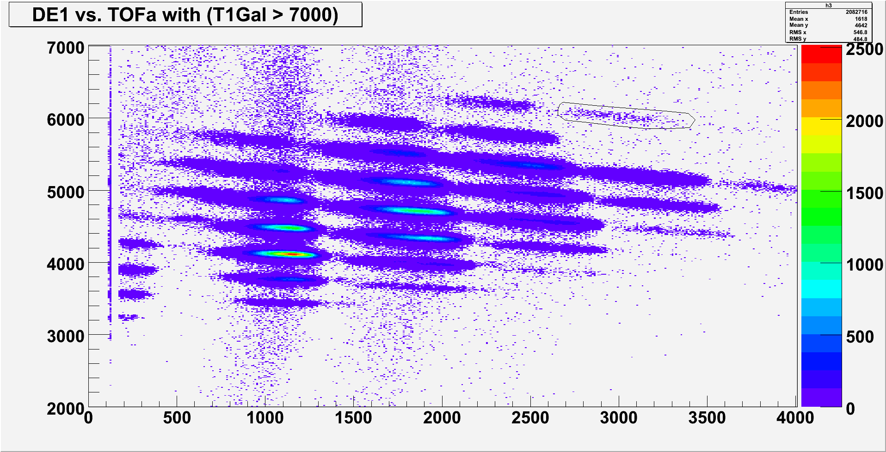
As expected, the statistics are limited:
In 3 days:
Total ⁵⁶Zn implantations = 8861
0.033 pps
⁵⁶Zn

Slide 25
Expectations for the beta decay of 56Zn
Because Sp is only 560 keV we expect most of the
decay to proceed by proton emission
T = 2
⁵⁶Zn
T_{Z} = -2
β
T = 2
IAS
p
T = 1
T = 1/2
S_{p} = 560 keV
⁵⁵Ni
T_{Z} = -1/2
⁵⁶Cu
T_{Z} = -1
Notes:
56Zn: 2 implant/minute. The proton decay of the IAS is isospin forbidden, but it has been observed. We assume that the only possible gamma branching is from the decay of IAS.

Slide 26
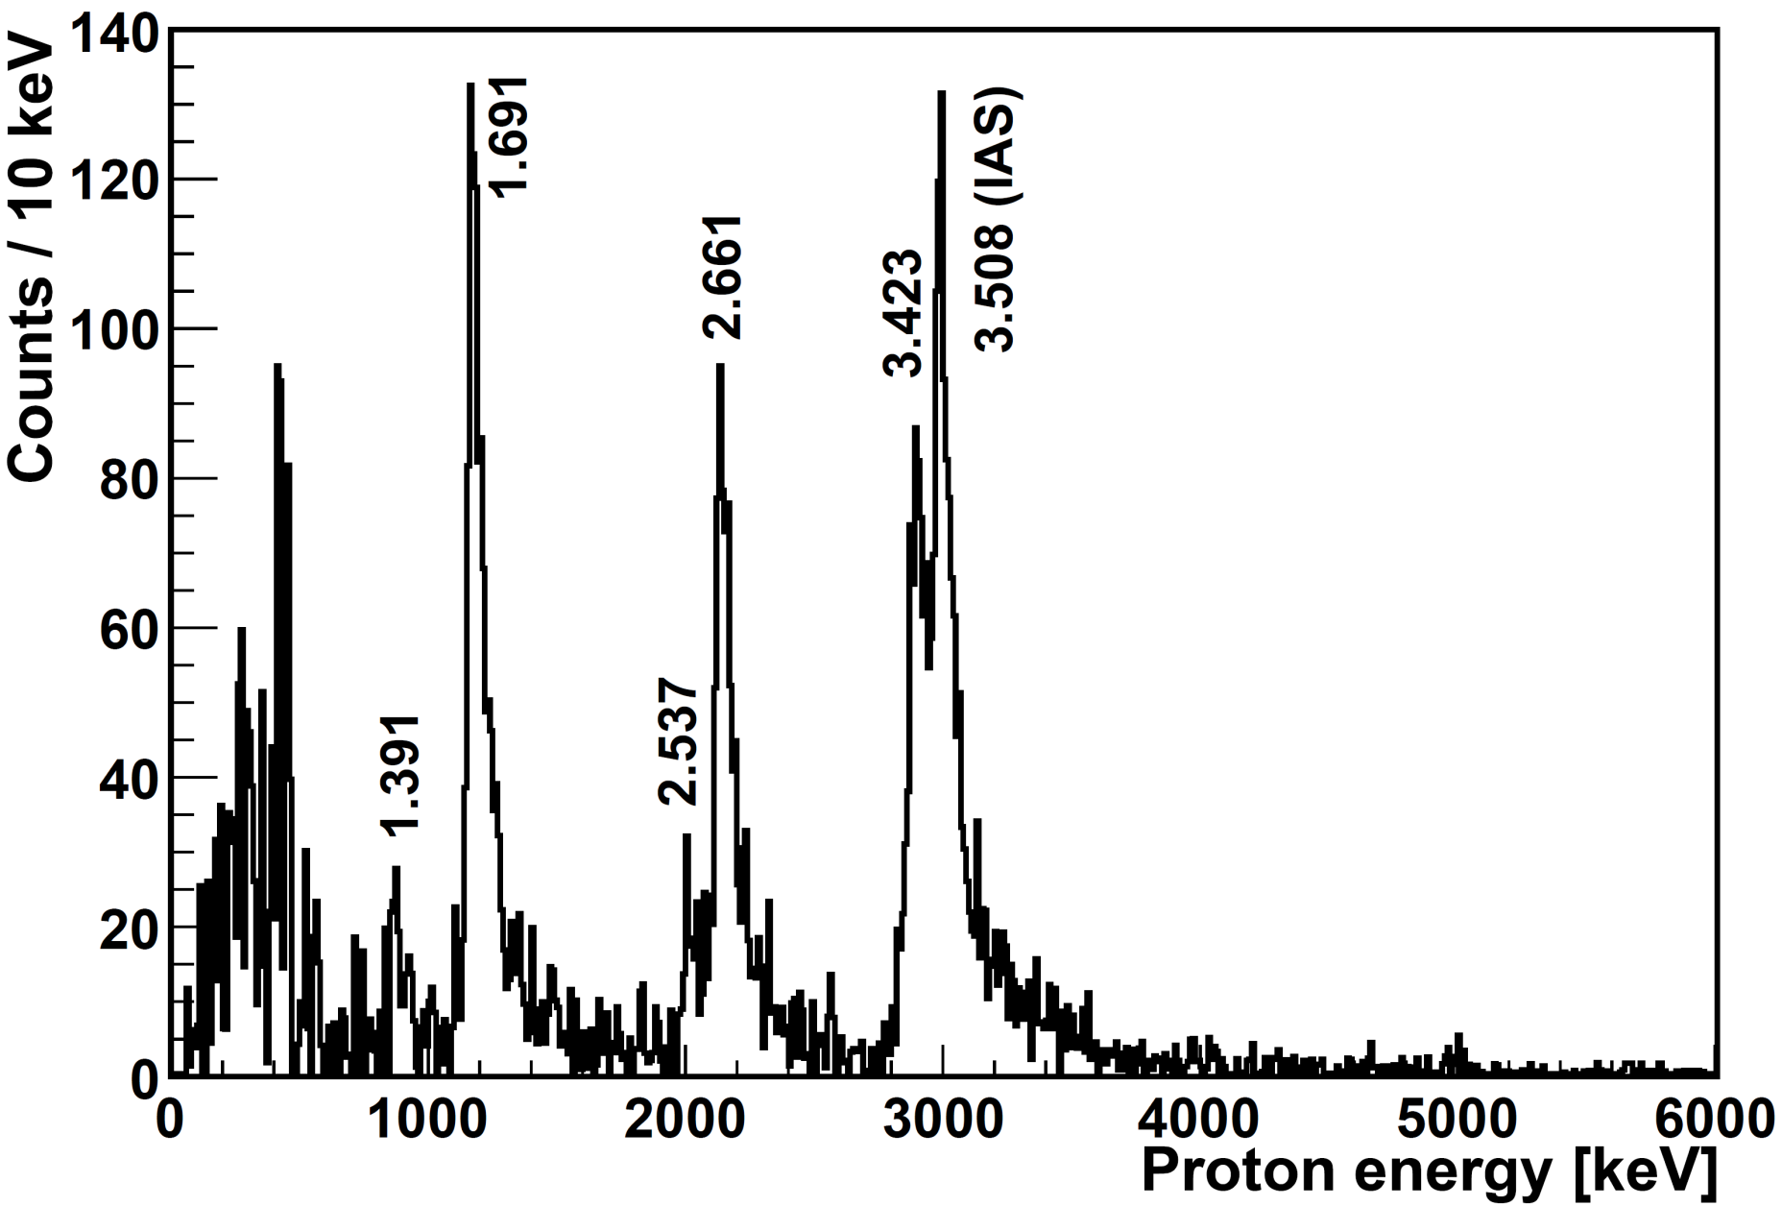
This is indeed what we saw
Particle
spectrum,
mainly protons
300 μm DSSD detector

Slide 27
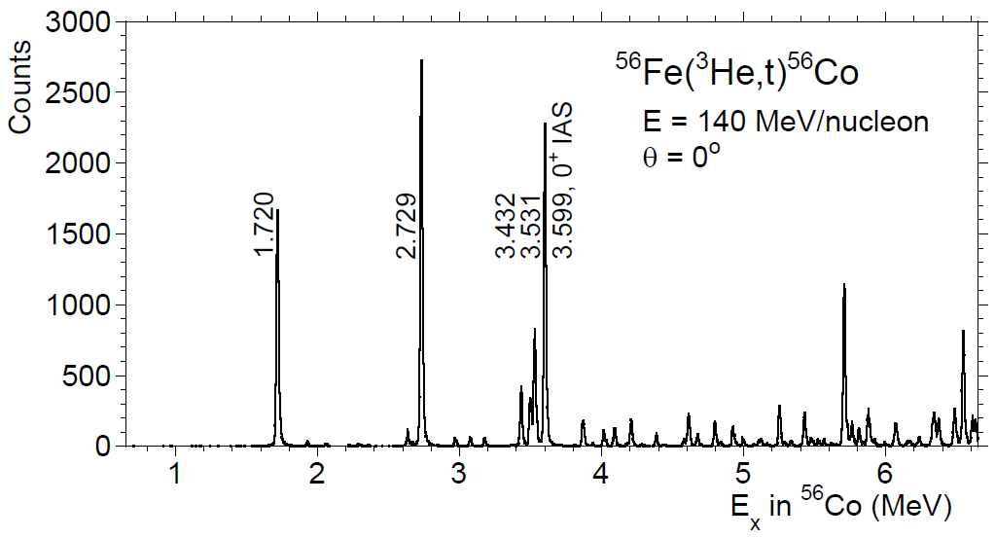
Comparison of mirror transitions for A = 56
The Isobaric Analog State (IAS) is clearly identified in both spectra
(In agreement with previous data (C. Dossat et al., NPA 792(2007)18)
⁵⁶Zn → ⁵⁶Cu + β⁺
E_{x}(⁵⁶Cu) = E_{p} + S_{p}
Isospin symmetry holds well !
All the dominant transitions are observed in both β decay and CE starting from mirror nuclei
H. Fujita et al., Annual Report
RCNP Osaka (2010)
⁵⁶Co
⁵⁶Cu
Notes:
E_{x} = (56/55)*E_{p} + 560 keV. Besides, E’_{p}=E_{p} - 44 keV to account for the external calibration made with alpha-source (recalibrated on 53Ni peaks).
Error = +- 10 keV. Beta-decay energy resolution ~ 70 keV. CE energy resolution ~ 20 keV.

Slide 28

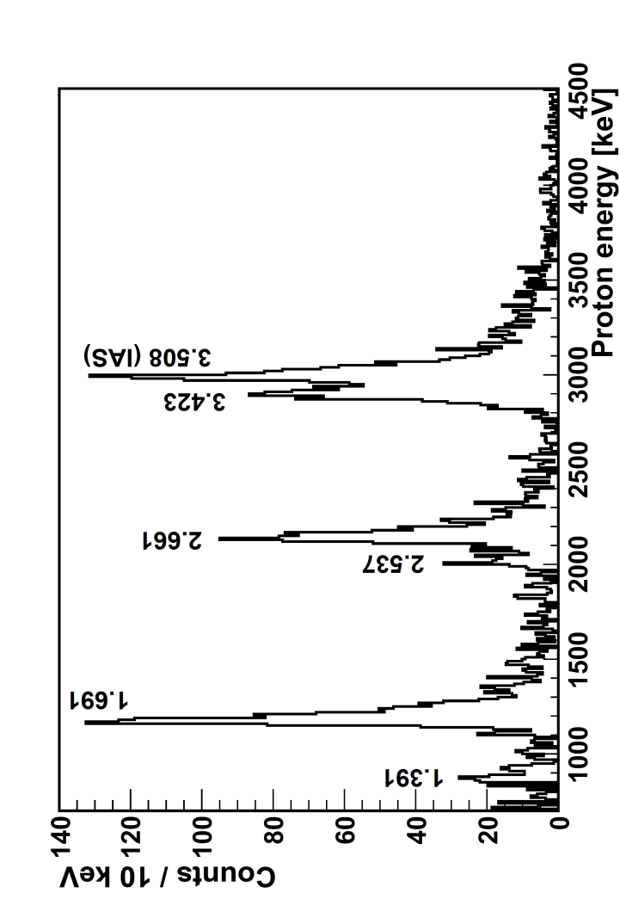
Naively
Naively one would
assume that these
intensities are
proportional to the
beta feeding intensity
T = 2
0+
⁵⁶Zn
T_{Z} = -2
The p-decay of the IAS is isospin forbidden
β
T = 2
IAS
0+
1+
p (T =1/ 2)
T = 1
γ ??
1+
T = 1
1+
T = 1
S_{p} = 560 keV
⁵⁵Ni
T_{Z} = -1/2
T=1/2
⁵⁶Cu
T_{Z} = -1
Notes:
“X” means hindrance of the p-decay of the IAS, because it is isospin forbidden. The p-decay of the IAS is ispospin forbidden, but it has been observed. The only possible gamma branching is expected from the decay of IAS. This is confirmed by the fact that we observe the de-excitation gamma-ray at 1835 keV. In CE the existence of isospin mixing T = 1 and T = 2 in the mirror 56Co IAS is seen. Thus the p-decay can be due to the T = 1 component of the IAS.

Slide 29
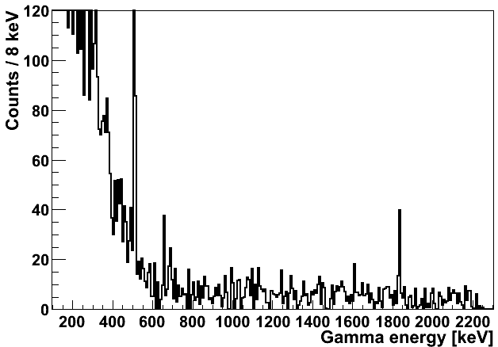
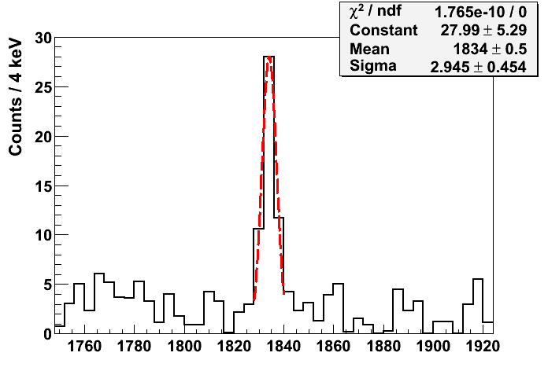
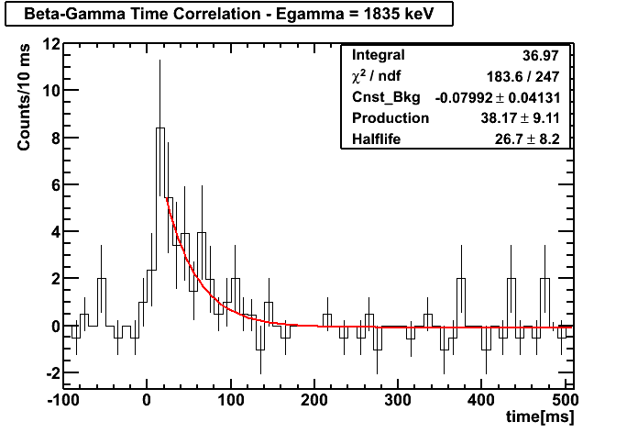
Indeed we observed the gamma transition deexciting the IAS
β-delayed
γ-proton emission
(β-γ)-implant time correlations
T_{1/2} = (27 ± 8) ms
A γ ray at 1834.5 ± 1.0 keV is observed in the ⁵⁶Zn-correlated γ-spectrum corresponding to the de-excitation of the IAS
Notes:
Gamma energy resolution ~4 keV. The beta-gamma coincidence window is 250 ns. Gamma calibration made with 152Eu, 60Co and 137Cs gamma sources. Gamma efficiency calibration made with 133Ba, 207Bi, 60Co and 137Cs gamma sources.
The discrepancy between the expected gamma energy = 1850 keV and the observed = 1834.5 keV, that is 15.5 keV, can be due to the uncertainty in the proton energy.

Slide 30
This is the first observation of
Beta-delayed gamma-proton decay in the fp shell
T = 2
0+
⁵⁶Zn
T_{Z} = -2
β
T = 2
IAS
0+
1+
T = 1
γ
1+
T = 1
1+
P
T = 1
S_{p} = 560 keV
⁵⁵Ni
⁵⁶Cu
T_{Z} = -1
Notes:
“X” means hindrance of the p-decay of the IAS, because it is isospin forbidden. The p-decay of the IAS is ispospin forbidden, but it has been observed. The only possible gamma branching is expected from the decay of IAS. This is confirmed by the fact that we observe the de-excitation gamma-ray at 1835 keV. In CE the existence of isospin mixing T = 1 and T = 2 in the mirror 56Co IAS is seen. Thus the p-decay can be due to the T = 1 component of the IAS.

Slide 31
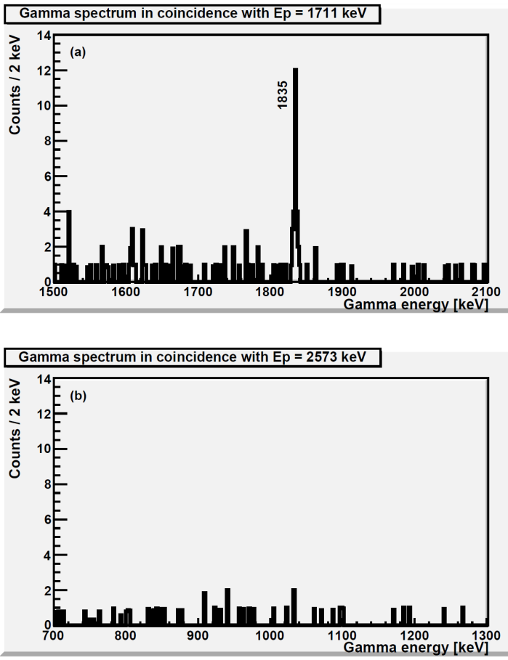
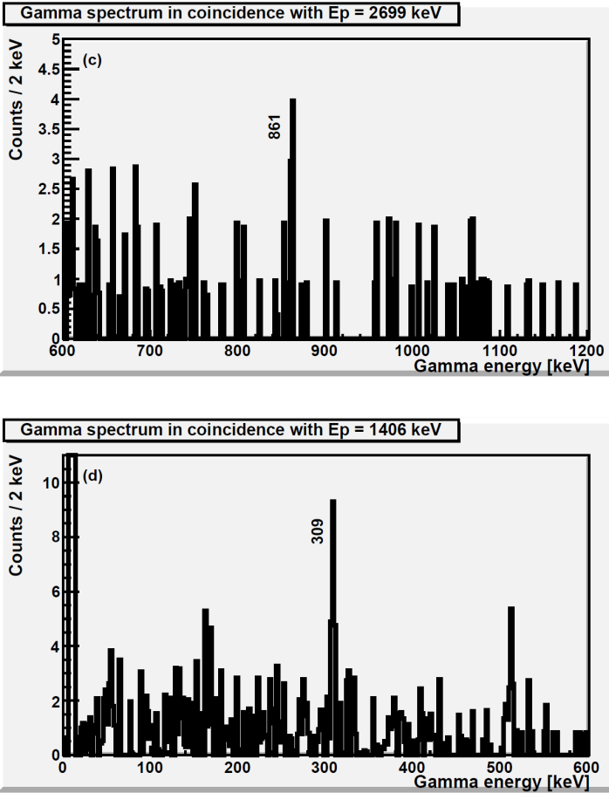
Proton-gamma coincidences
Gates on
protons
We have observed for the first time
beta-delayed gamma-proton emission
In three cases !!
IAS
γ
γ
(no)
γ
p
1711
γ
γ

Slide 32


⁵⁶Zn decay scheme, another surprise
  Q_{β} = 12870(300) keV
T_{1/2} = 32.9 (8) ms
0⁺
⁵⁶Zn (T_{Z} = -2)
β⁺
B(GT) B(F)
44%
56%
T = 2
B_{p} = (88.5 ± 2.6) %
2.7
p
861
T = 1
1.32
γ
T = 1
0.34
0
0.30
0
1835
T = 1
T = 1
309
66%
T = 1
34%
T = 1/2
11.5%
β⁺
S_{p} = 560 (140) (syst. AME2003)
⁵⁵Ni (T_{Z} = -1/2)
T = 1
T_{1/2} = 209 ms
β⁺
⁵⁶Cu (T_{Z} = -1)
T_{1/2} = 93 ms
Notes:
-We take the beta feedings from the protons. Assuming the gamma-branchings as in the mirror 56Co nucleus, we can estimate B(GT). The beta feeding to the IAS state has to be increased to account for the IAS part that is decaying by gammas. The beta feeding to the other states has to be decreased to account for the part that is coming from the gamma decay of the IAS (indirect feeding). Besides, the beta feeding of the 1711 keV state has also to be increased by adding the part that is gamma-decaying to the 1406 keV state.
-The states at 2.573 and 1.406 MeV are likely populated only by the gamma de-excitation of the IAS and 1.711 state (indirect feeding). Since they are not or very poorly observed in CE, they should not have GT strength (no 1+). The 1.406 MeV state is the so-called anti-analogue state (T=1 but J^{p}=0+).
-In order to get B(F) = |N – Z| = 4 we have to consider the IAS fragmentation and isospin mixing. The IAS is fragmented in the mirror 56Co: the closest peak to IAS has also 0+. Thus there is isospin mixing: the T = 2 and 1 components mix. So in the two 0+ states the T=2 part contributes to B(F) and to gamma decay, while the T=1 part contributes to B(GT) and proton decay.
-The biggest source of error for B(GT) and B(F) is the Q-value of the beta-decay, that is only know from systematics and has a big error (~23%), together with the uncertainty on the gamma efficiency. The biggest source of error for the excitation energy of 56Cu is the 56Cu mass, known with 140 keV of error.

Slide 33
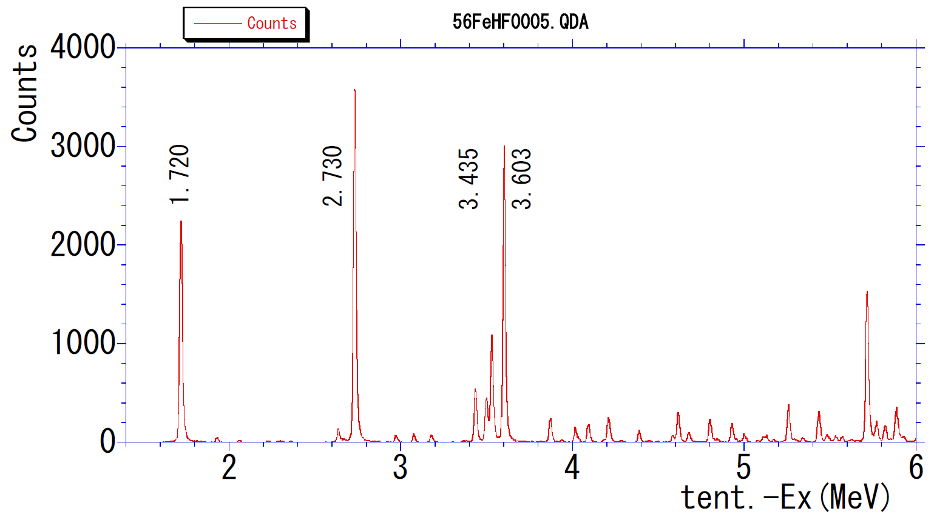
But this is NOT the end of the story!!!
H. Fujita et al., Annual Report
RCNP Osaka (2010)
IAS
⁵⁶Fe(³He,t)⁵⁶Co
E = 140 AMeV
ϑ = 0°
The IAS is fragmented in
the mirror!!
IAS
⁵⁶Co excitation energy [MeV]

Slide 34
the fragmentation of the IAS is important for isopin mixing and for the Mass evaluation
  Q_{β} = 12870(300) keV
T_{1/2} = 32.9 (8) ms
T = 2, 0⁺
⁵⁶Zn (T_{Z} = -2)
β⁺
B_{p} = (88.5 ± 2.6) %
56%
B(GT) B(F)
44%
T = 2
p
2.7
861
T = 1
0.02 1.3
γ
T = 1
0.34
0
0.30
0
1835
T = 1
T = 1
309
66%
T= 1
34%
T = 1/2
11.5%
β⁺
S_{p} = 560 (140)
⁵⁵Ni (T_{Z} = -1/2)
T = 1
T_{1/2} = 209 ms
β⁺
⁵⁶Cu (T_{Z} = -1)
T_{1/2} = 93 ms
Notes:
-We take the beta feedings from the protons. Assuming the gamma-branchings as in the mirror 56Co nucleus, we can estimate B(GT). The beta feeding to the IAS state has to be increased to account for the IAS part that is decaying by gammas. The beta feeding to the other states has to be decreased to account for the part that is coming from the gamma decay of the IAS (indirect feeding). Besides, the beta feeding of the 1711 keV state has also to be increased by adding the part that is gamma-decaying to the 1406 keV state.
-The states at 2.573 and 1.406 MeV are likely populated only by the gamma de-excitation of the IAS and 1.711 state (indirect feeding). Since they are not or very poorly observed in CE, they should not have GT strength (no 1+). The 1.406 MeV state is the so-called anti-analogue state (T=1 but J^{p}=0+).
-In order to get B(F) = |N – Z| = 4 we have to consider the IAS fragmentation and isospin mixing. The IAS is fragmented in the mirror 56Co: the closest peak to IAS has also 0+. Thus there is isospin mixing: the T = 2 and 1 components mix. So in the two 0+ states the T=2 part contributes to B(F) and to gamma decay, while the T=1 part contributes to B(GT) and proton decay.
-The biggest source of error for B(GT) and B(F) is the Q-value of the beta-decay, that is only know from systematics and has a big error (~23%), together with the uncertainty on the gamma efficiency. The biggest source of error for the excitation energy of 56Cu is the 56Cu mass, known with 140 keV of error.

Slide 35
And now we can compare with the Charge Exchange reaction in the mirror
⁵⁶Zn (T_{Z} = -2)
B-decay
PRELiM. CE
β⁺
B(GT) B(F)
B(GT) B(F)
B_{p} = (88.5 ± 2.6) %
44%
56%
T = 2
p
2.7(5)
2.9
861
T = 1
≤0.32 1.3(5)
0.13 1.1
γ
T = 1
0.34(6)
0
0.30(9)
0
0.43
0
0.28
0
1835
T = 1
T = 1
309
66%
T = 1
34%
T = 1/2
11.5%
β⁺
S_{p} = 560 (140)
⁵⁵Ni (T_{Z} = -1/2)
T = 1
T_{1/2} = 209 ms
β⁺
⁵⁶Cu (T_{Z} = -1)
Notes:
-We take the beta feedings from the protons. Assuming the gamma-branchings as in the mirror 56Co nucleus, we can estimate B(GT). The beta feeding to the IAS state has to be increased to account for the IAS part that is decaying by gammas. The beta feeding to the other states has to be decreased to account for the part that is coming from the gamma decay of the IAS (indirect feeding). Besides, the beta feeding of the 1711 keV state has also to be increased by adding the part that is gamma-decaying to the 1406 keV state.
-The states at 2.573 and 1.406 MeV are likely populated only by the gamma de-excitation of the IAS and 1.711 state (indirect feeding). Since they are not or very poorly observed in CE, they should not have GT strength (no 1+). The 1.406 MeV state is the so-called anti-analogue state (T=1 but J^{p}=0+).
-In order to get B(F) = |N – Z| = 4 we have to consider the IAS fragmentation and isospin mixing. The IAS is fragmented in the mirror 56Co: the closest peak to IAS has also 0+. Thus there is isospin mixing: the T = 2 and 1 components mix. So in the two 0+ states the T=2 part contributes to B(F) and to gamma decay, while the T=1 part contributes to B(GT) and proton decay.
-The biggest source of error for B(GT) and B(F) is the Q-value of the beta-decay, that is only know from systematics and has a big error (~23%), together with the uncertainty on the gamma efficiency. The biggest source of error for the excitation energy of 56Cu is the 56Cu mass, known with 140 keV of error.

Slide 36
Isospin mixing
Level(3508)=77%(T=2)+33%(T=1)
In the
Mirror
56Co

Slide 37
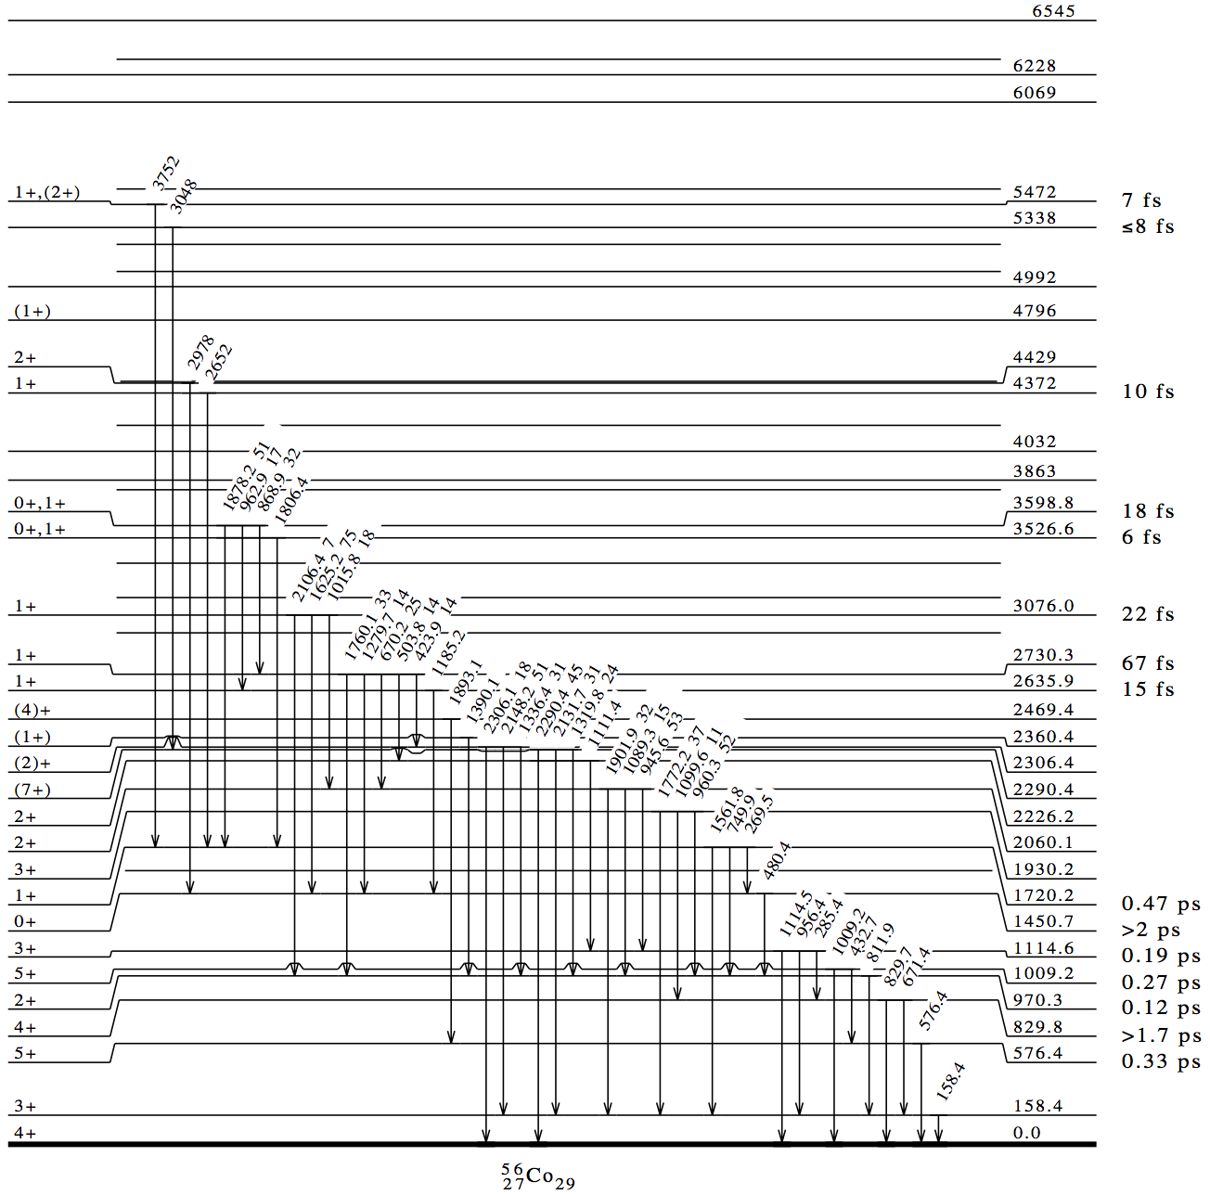
⁵⁶Co level scheme
We spy the gamma de-excitation in the mirror ⁵⁶Co nucleus
 | ⁵⁶Cu |  |  | ⁵⁶Co
⁵⁶Cu M1 | 1835 keV | 51% | 51% | 1878 keV | ⁵⁶Co M1
⁵⁶Cu M1 | 988 | 17% | 17% | 963 | ⁵⁶Co M1
⁵⁶Cu M1 | 862 | 32% | 32% | 869 | ⁵⁶Co M1
IAS
Notes:
56Co: alcuni valori degli stati sono presi dalla letteratura, nella CE sono leggermente diversi, inoltre nella CE si vede anche uno stato a 3500 (non mostrato qua).

Slide 38
We were puzzled for some time….
Aprox. 10⁻¹⁸ s
Aprox
10⁻¹⁵ s

Slide 39
⁵⁶₃₀Zn₂₆
πp_{3/2}
⁵⁶₂₉Cu₂₇
28
β-decay
28
νf_{7/2-}
p_{3/2}
28
28
f_{7/2}
⁵⁵₂₈Ni₂₇
p-emission
28
28
(For angular momentum conservation arguments,
proton decay can only originate from the f7/2 orbital)
This two-particle two-hole
excitation is well above the
55Ni ground state
28
28

Slide 40
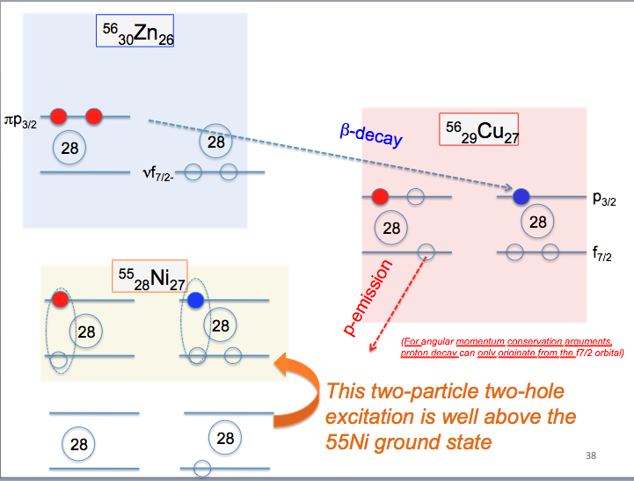
The spectroscopic factor for this component in the gs of 55Ni has been
calculated by A. Poves using the KB3GR interaction as 10⁻³, he can also
reproduce the mixing of the states and the
B(M1) branching.
Also calculations by Smirnova,
Lam et al. in print

Slide 41
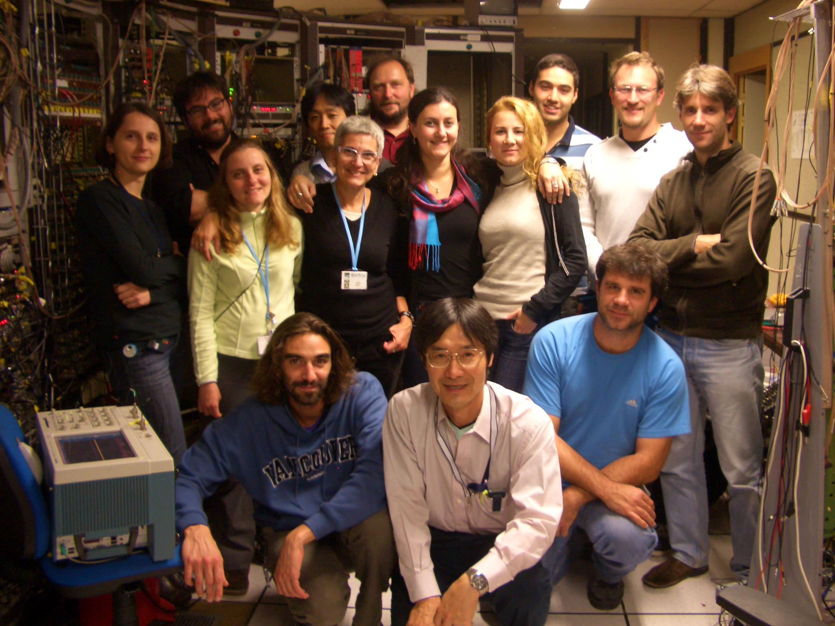

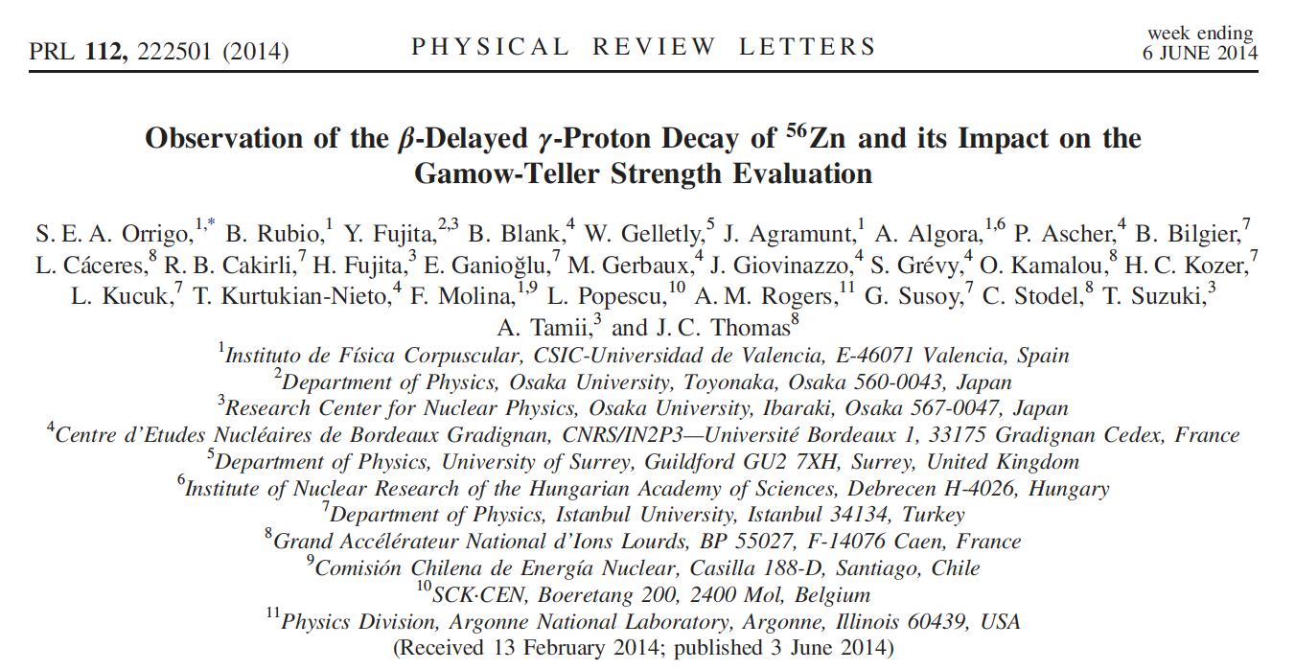
The Collaboration
See talk by Sonja Orrigo of Friday on this and
other Tz=-2 cases

Slide 42
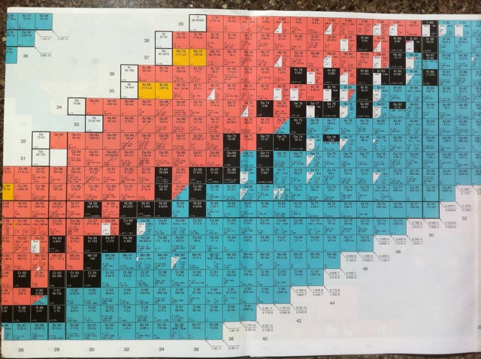
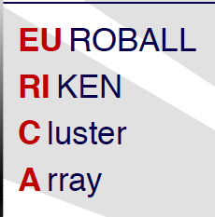
New measurements were carried out at RIKEN in May/june 2015
Tz=-1,-2 @RIKEN
64Se
66Se
60Ge
62Ge
Primary beam: ⁷⁸Kr,
In our request, 4 years ago,
We assumed 30 pnA, in
reality we got 200 to 300 pnA
0.01 pps
0.03 pps

Slide 43
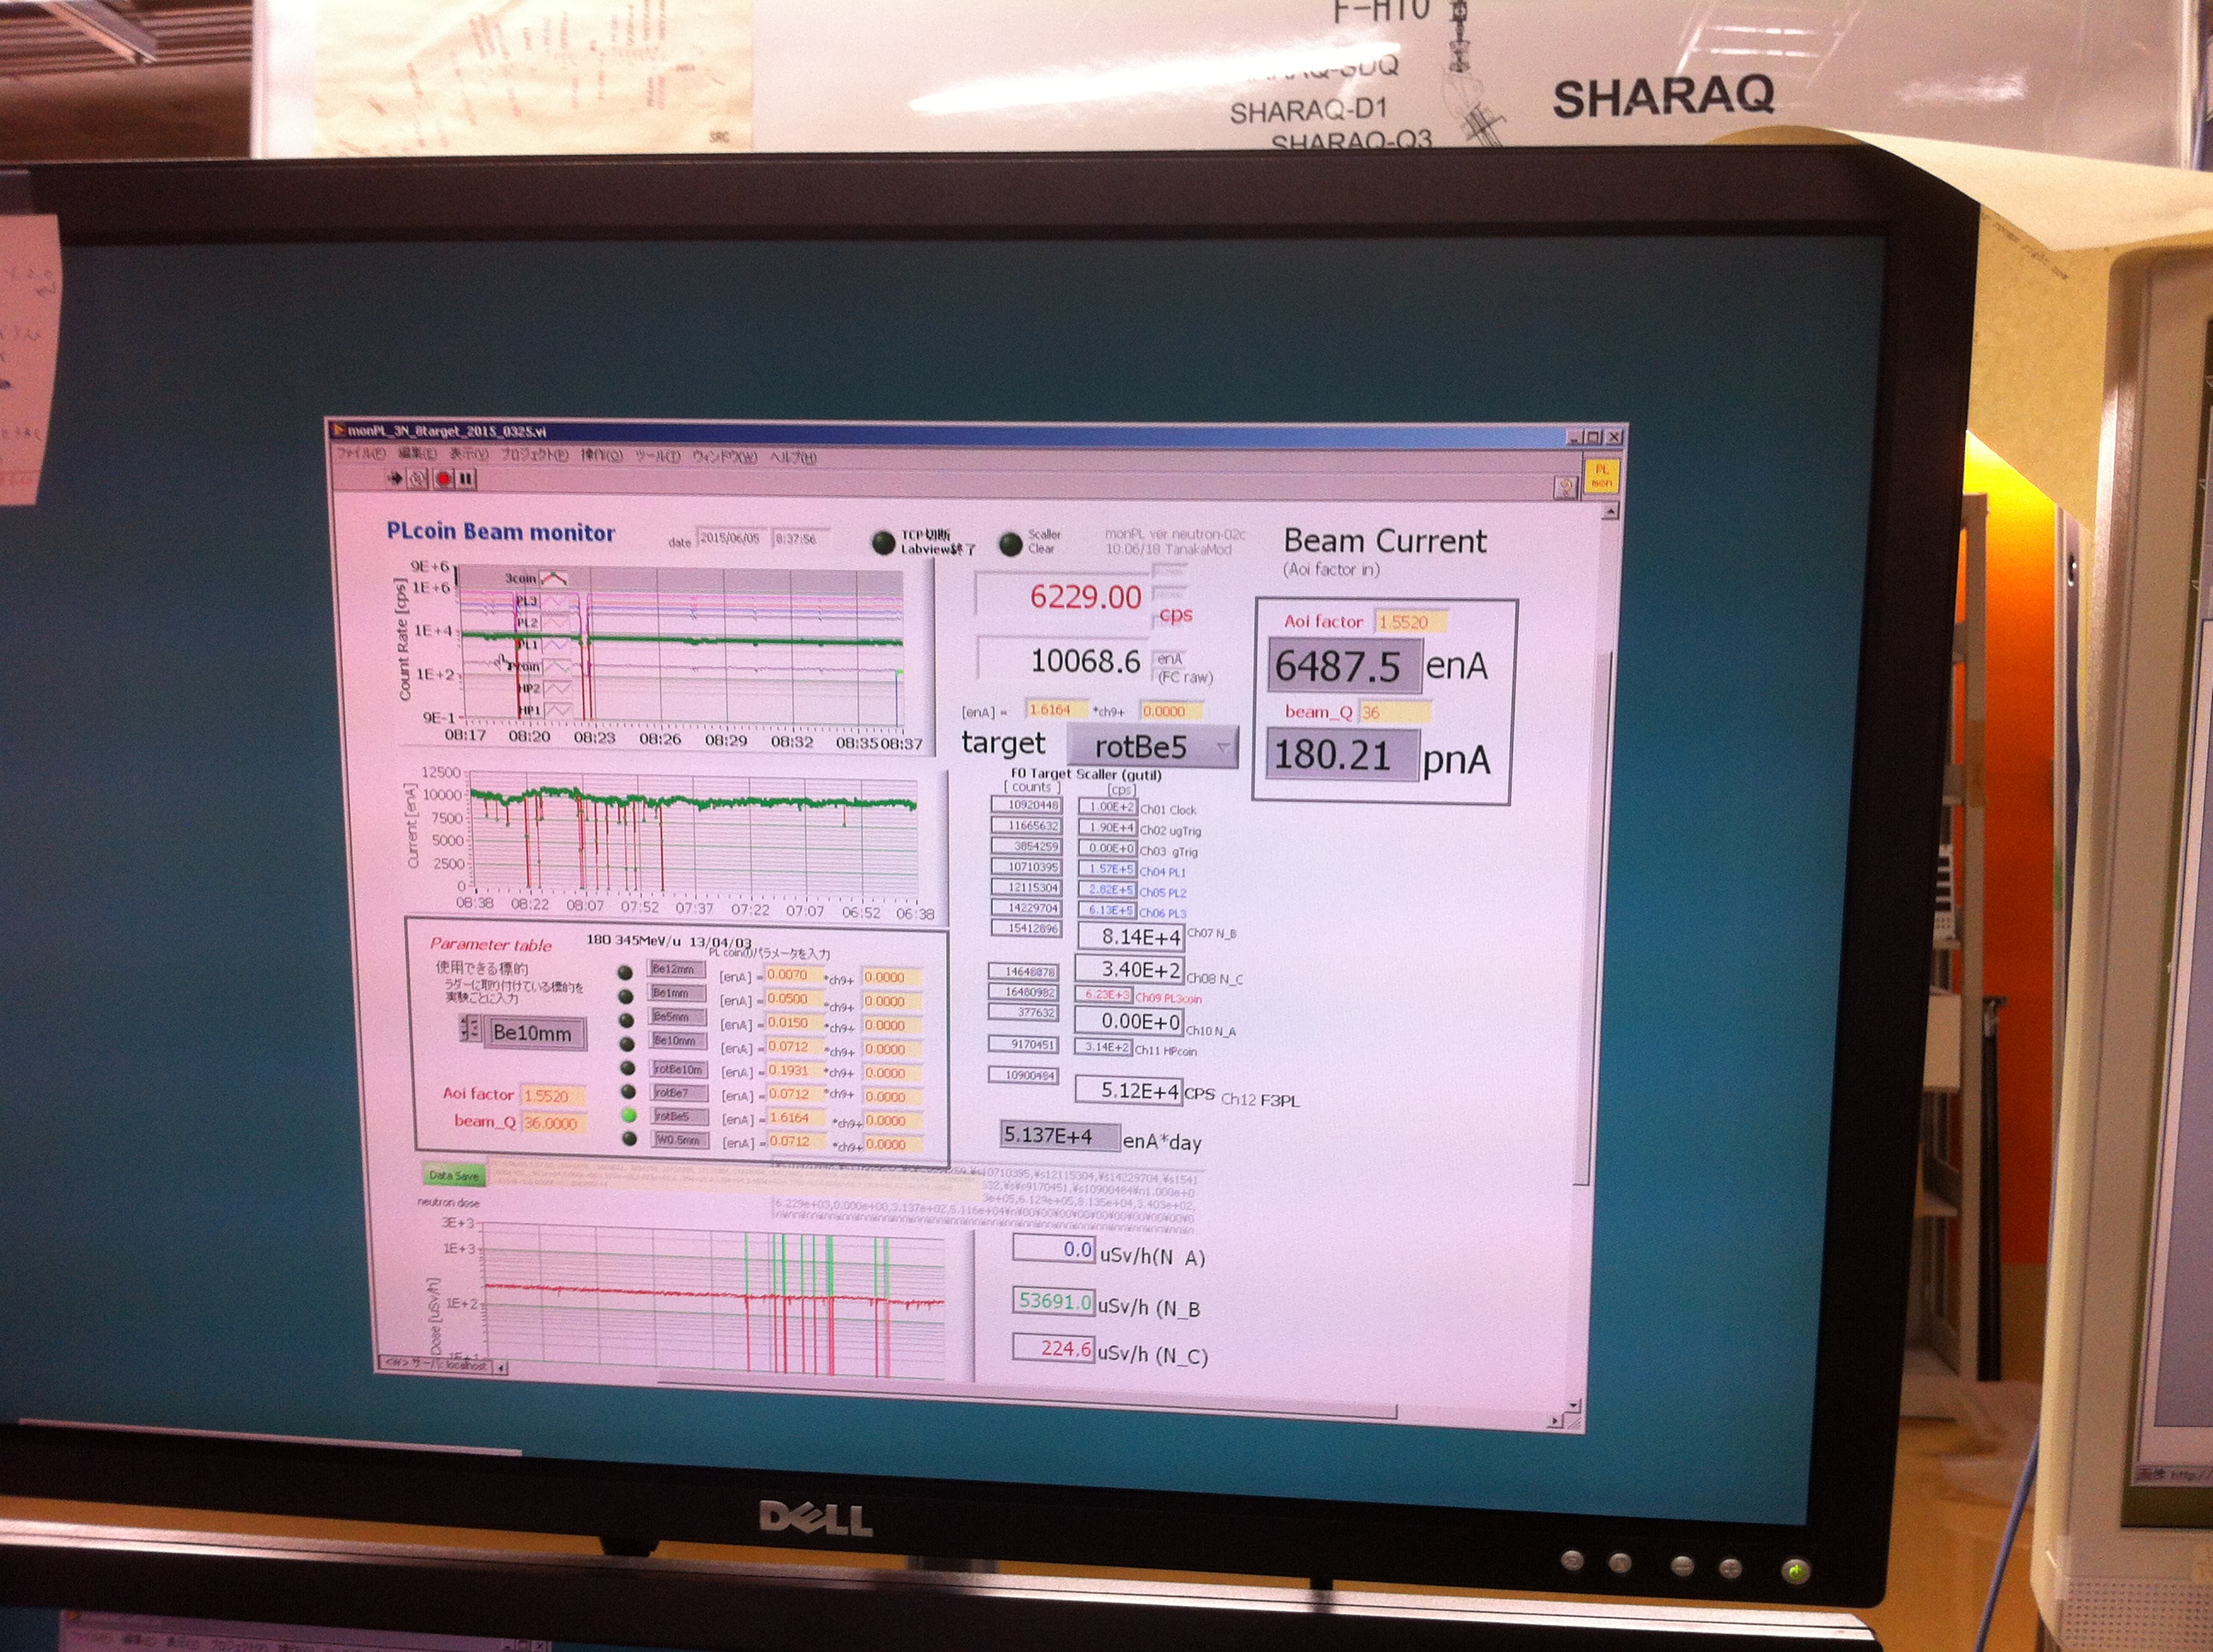
Primary beam: ⁷⁸Kr,
In our request, 4 years ago,
We assumed 30 pnA, in
reality we got 180 to 300 pnA

Slide 44
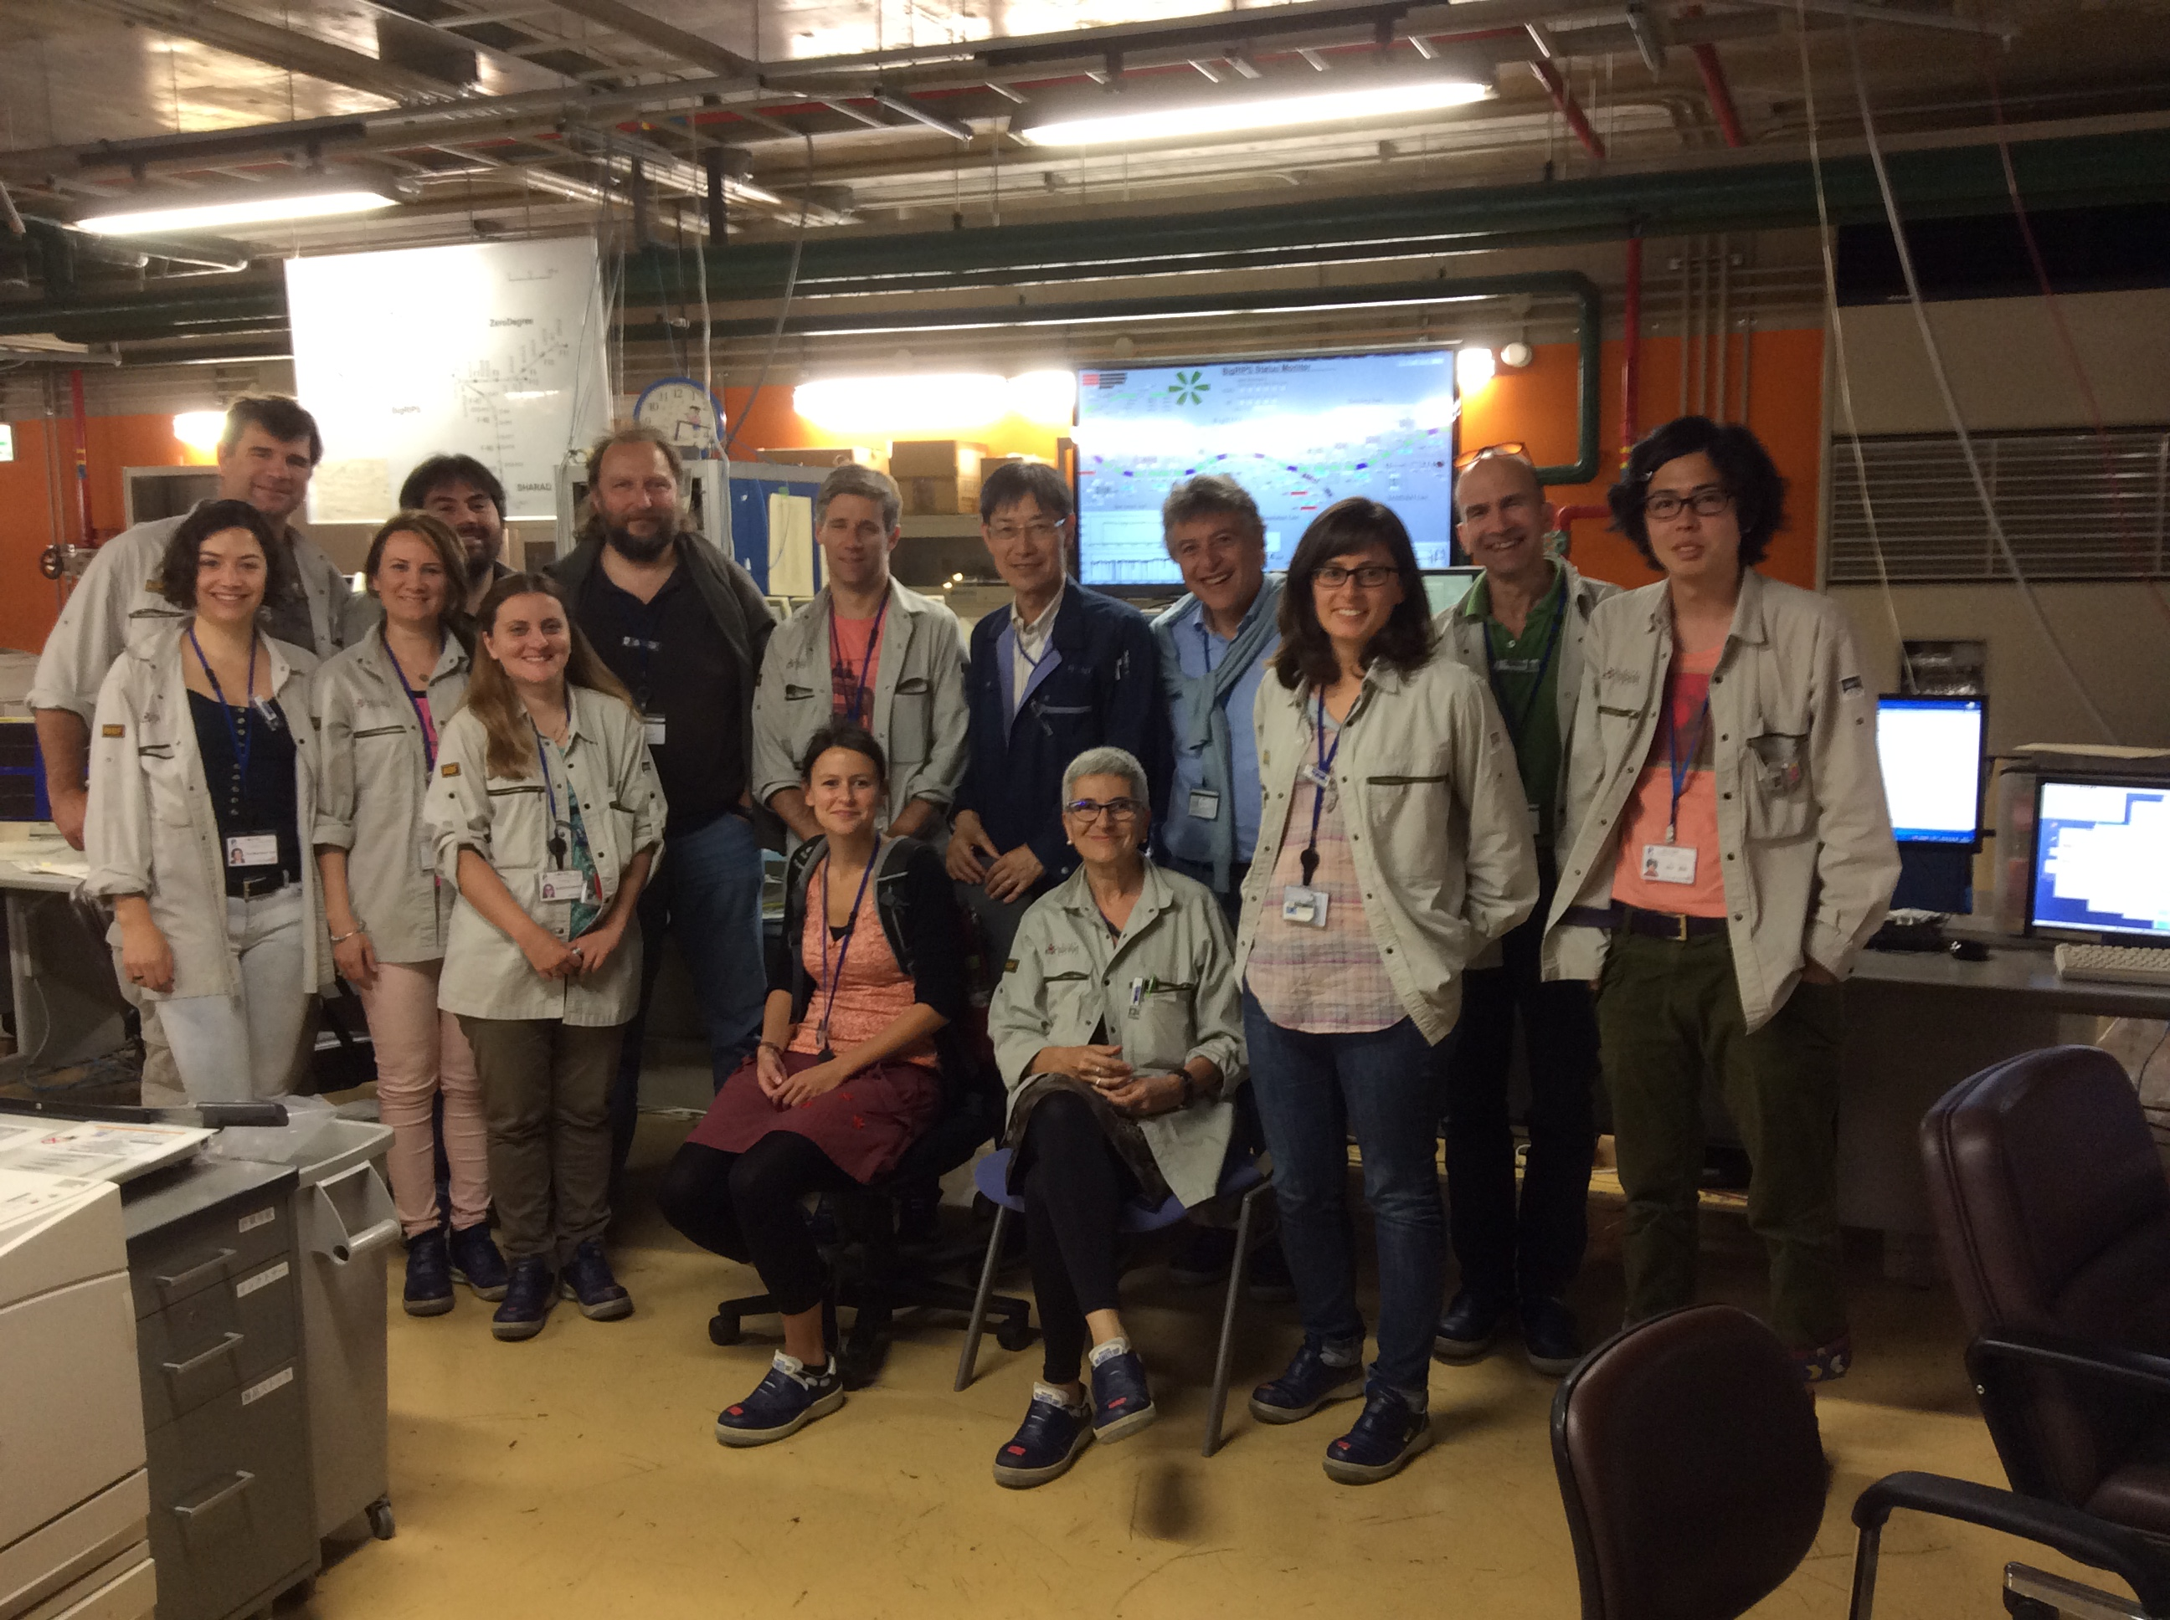
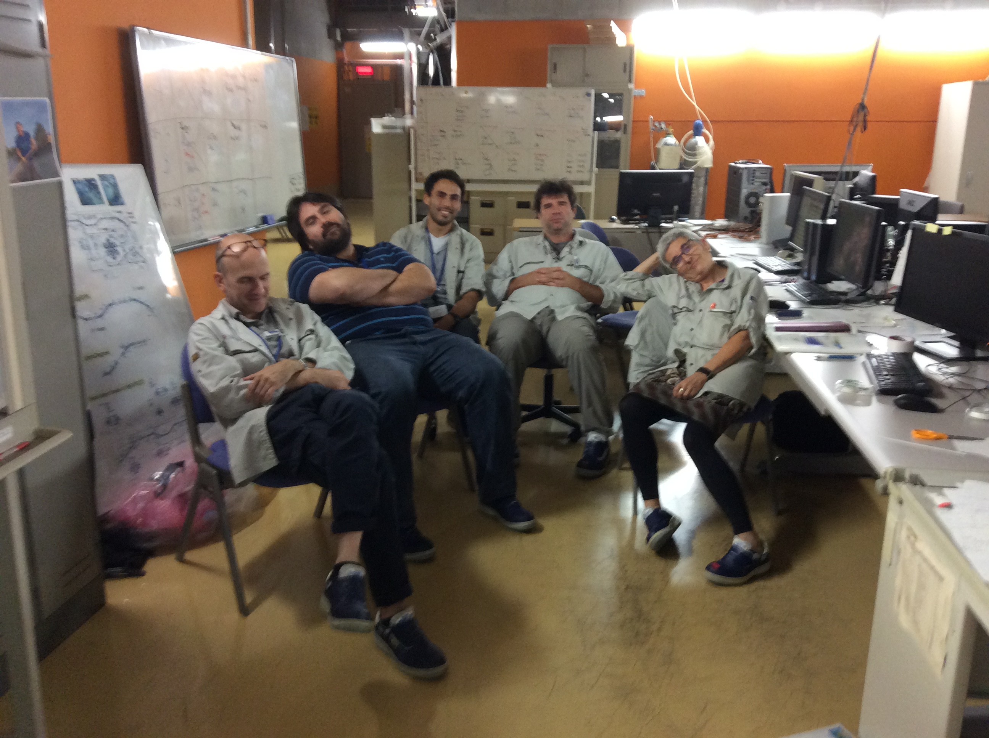
Four long intense and
exhausting weeks

Slide 45
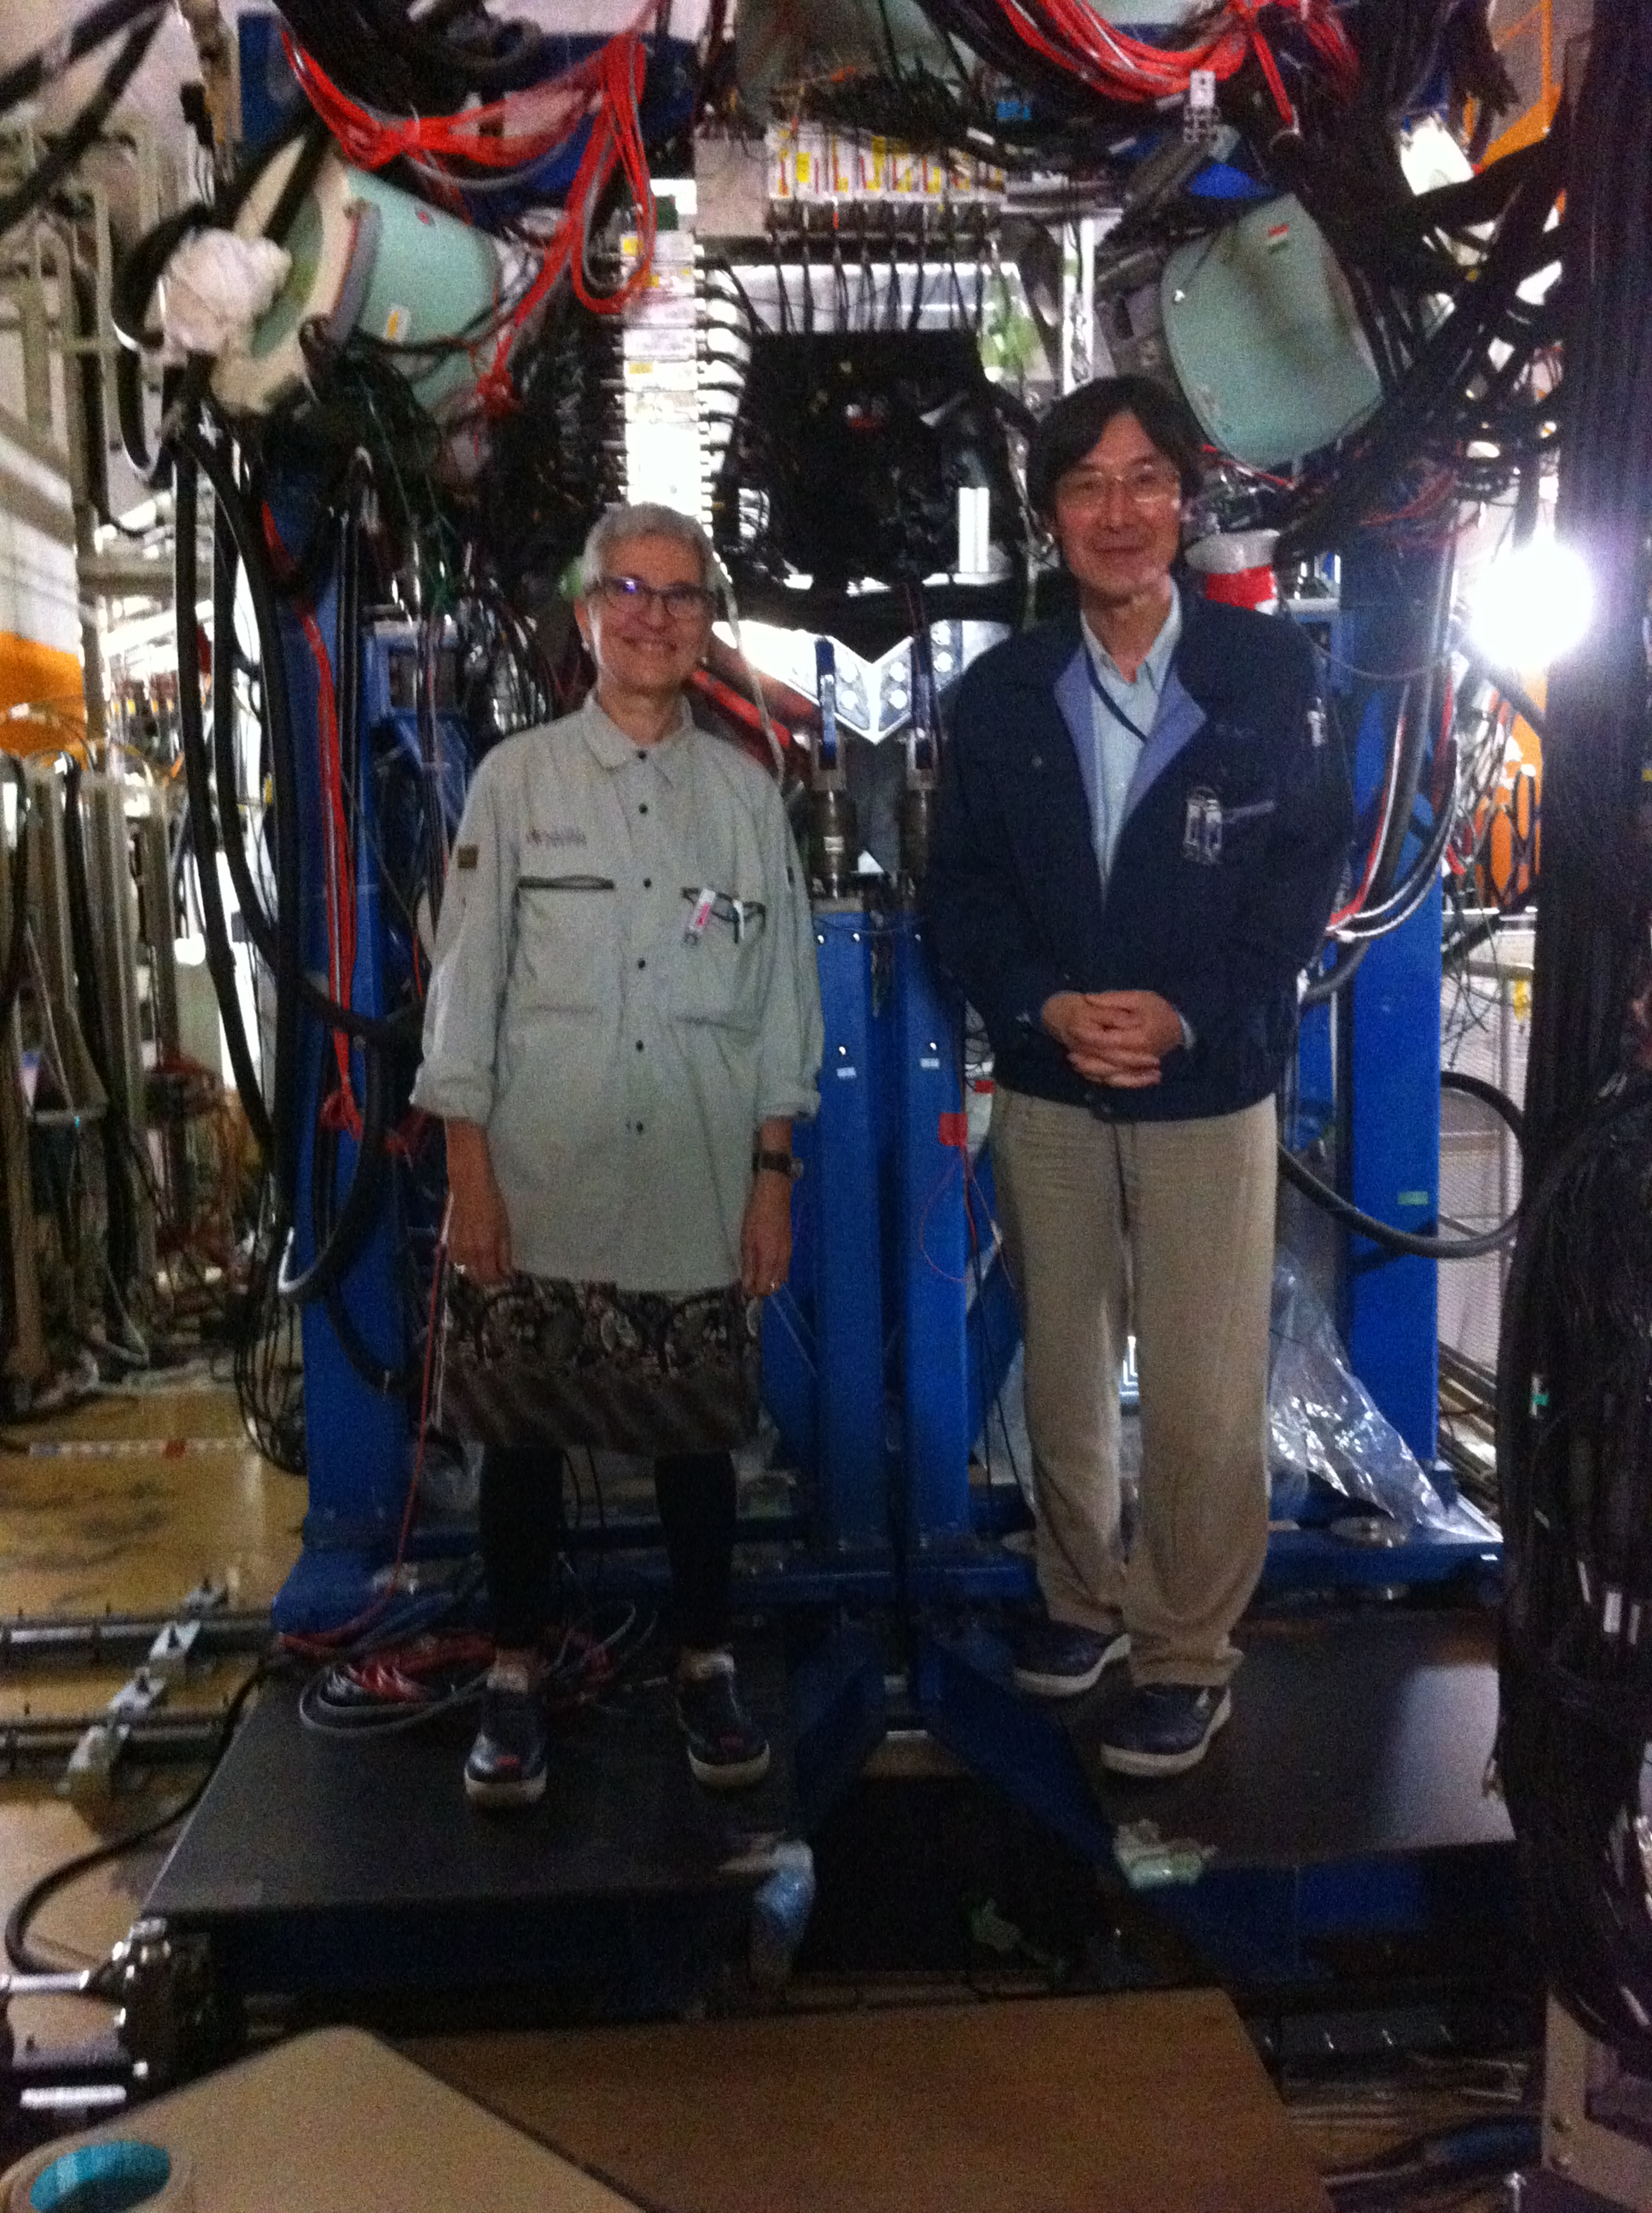

Slide 46





⁶⁴Se
⁶⁶Se
⁶⁰Ge
⁶²Ge
Preliminary
Compare with
First observation of
beta-delayed protons
⁶⁰Ge decay

Slide 47
Summary
We have studied the beta decay of the four Tz=-1 nuclei in the f7/2 shell
and compared them with the CE reaction on the mirror Tz=+1 nuclei.
This detailed comparison was done for the first time in the f shell.
Very important: we have put a sensitivity limit to our experimental results
Mirror symmetry works well but some differences remain which can
be due to mirror symmetry breaking or to extra contributions (tensor) in the
hadronic (CE) probe.
I have presented the study of several Tz=-2 decays carried out at
and their comparison with the mirror process Charge-Exchange reactions
on the mirror stable nuclei.
We have observed, for the first time beta-delayed gamma-proton
decay in the fp shell in three branches. From our data
we have extracted the isospin mixing.
We have observed evidence of the fragmentation of the isobaric analogue state
And obtained a value for the isospin mixing
Nuclear structure effects are responsible of the strong hindrance of the proton
decay. This idea has been corroborated by Shell Model
Calculations

Slide 48
One day, far in the future, one will be able to do high resolution experiments
with radioactive beams….
N=Z
FIN
Tz=-2
Z=28
Compare with
Comparison
Z=20
N=28
GSI
GANIL
N=20
RIKEN

Slide 49
Summary
I have presented the study of several Tz=-2 decays carried out at GANIL and their comparison
with the mirror process Charge-Exchange reactions on the mirror stable nuclei.
We have measured the beta, the protons and the gammas after the decay,
The beta decay of the Tz=-2 nucleus 56Zn was studied in detail.
We have observed evidence of the fragmentation of the isobaric analogue state
We have now a good understanding of this decay which could have never been
possible without the information from the mirror nucleus 56Fe, in particular the CE
experiment at Osaka.
We have observed, for the first time beta-delayed gamma-proton
decay in the fp shell in three branches. From our data
we have extracted the isospin mixing.
Nuclear structure effects are responsible of the gamma de-excitation in competition
with the fast proton decay of the IAS. This idea has been corroborated by Shell Model
Calculations
We will have a lot of new data for the next PROCON Conference, 48Fe, 52Ni, almost ready, 60Ge,
64Se first decay studies.

