Slide 1
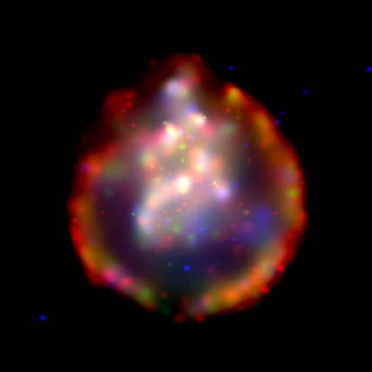
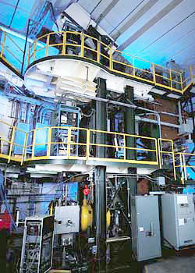
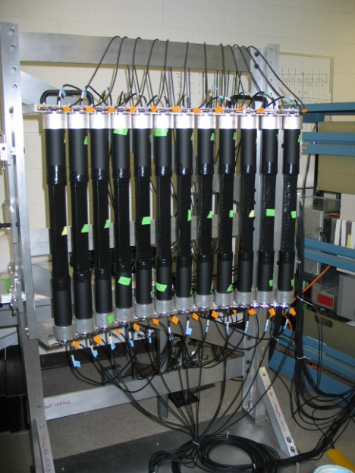
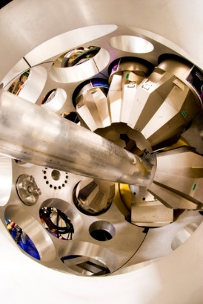
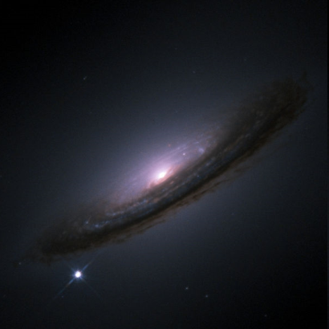







High-Resolution Spectroscopy in charge-exchange reactions with rare-isotope beams
Applications to weak-reaction rates for astrophysics
Remco G.T. Zegers
For the NSCL Charge-Exchange group and Collaborators

Slide 2
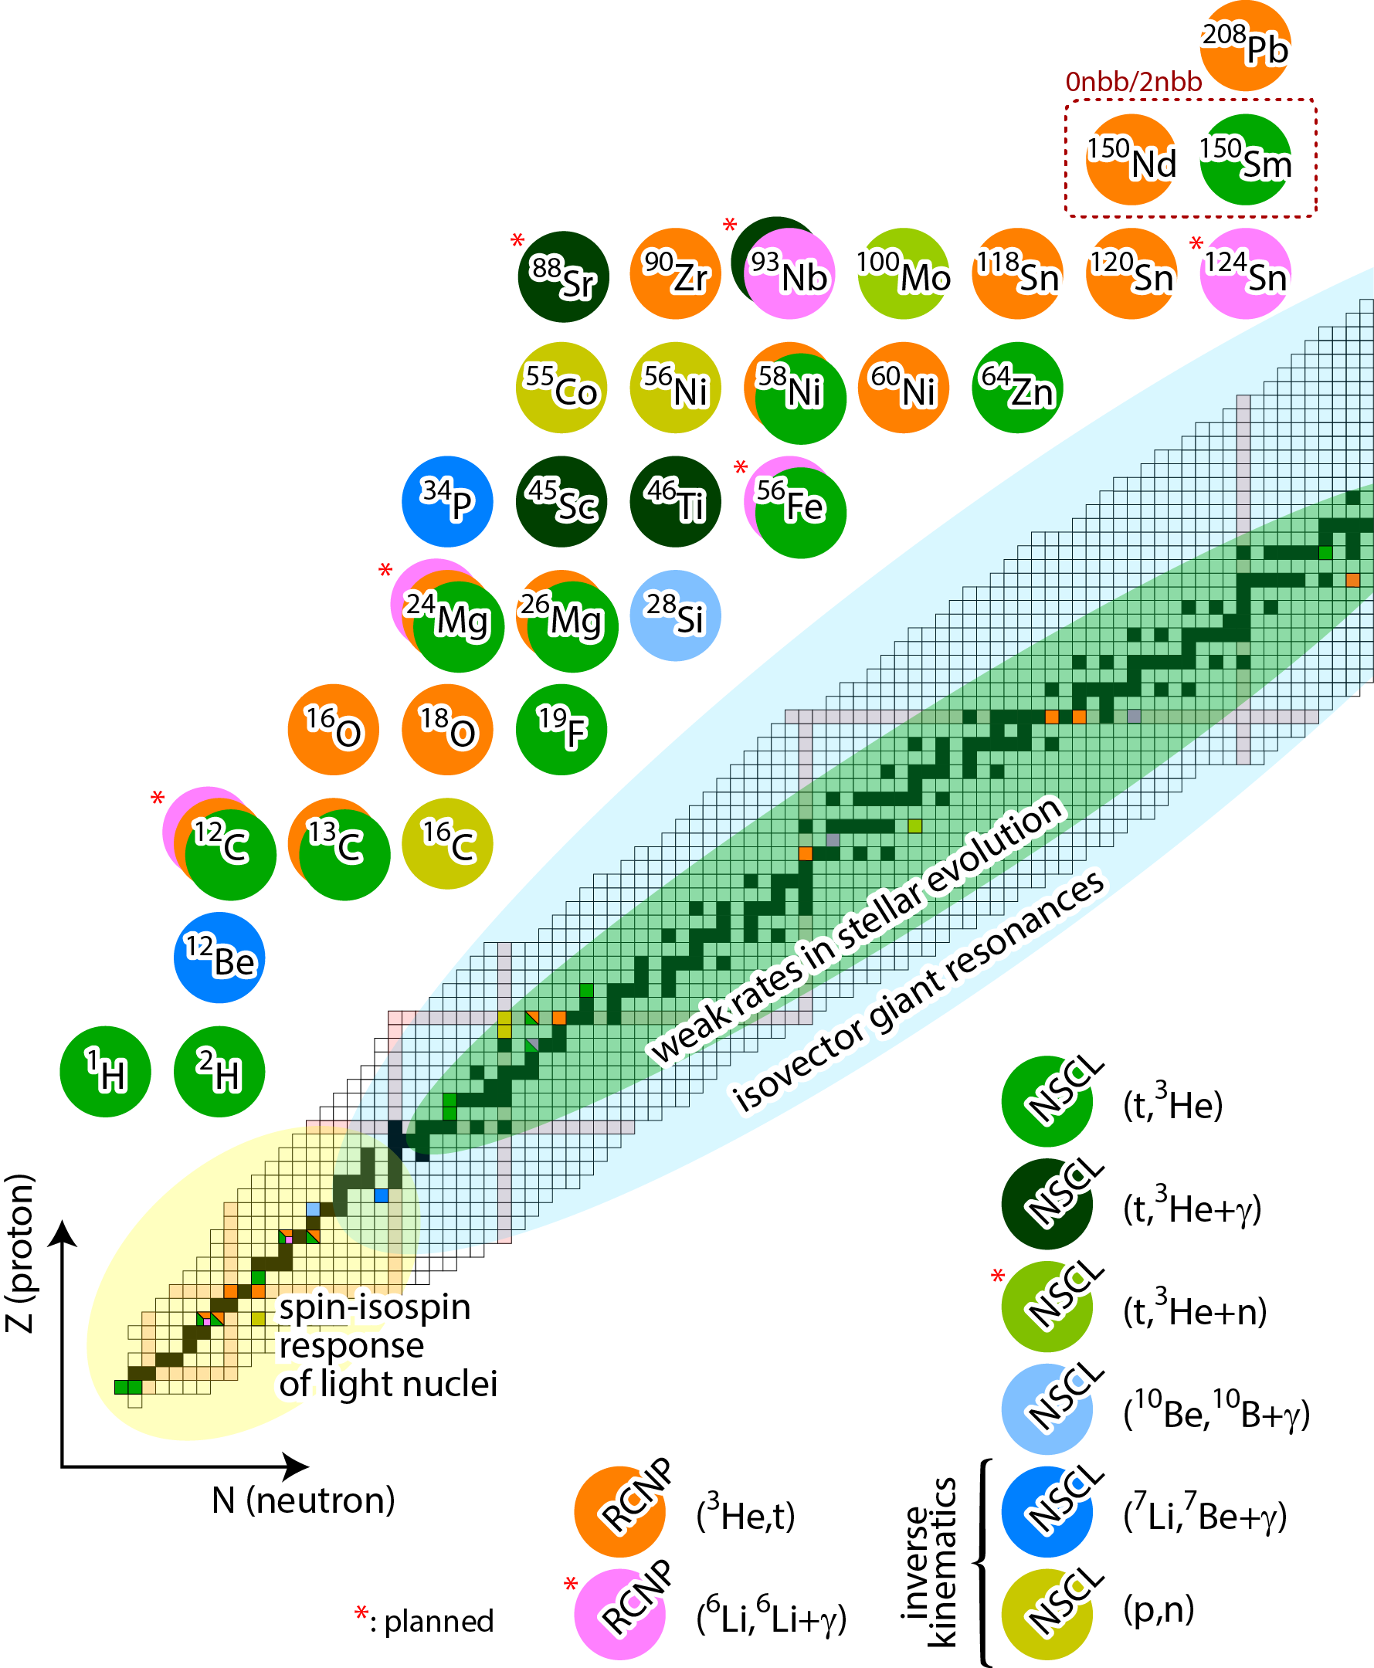
NSCL charge-exchange group program
Charge-exchange experiments with different probes for a variety of objectives:
Astrophysics – weak reaction rates
(Neutrinoless) Double beta decay
Shell evolution in light systems
Giant resonances and the macroscopic properties of nuclear matter
Novel probes for isolating particular multipole responses
Studies of the charge-exchange reaction mechanism

Slide 3
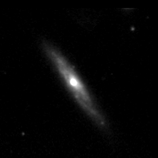
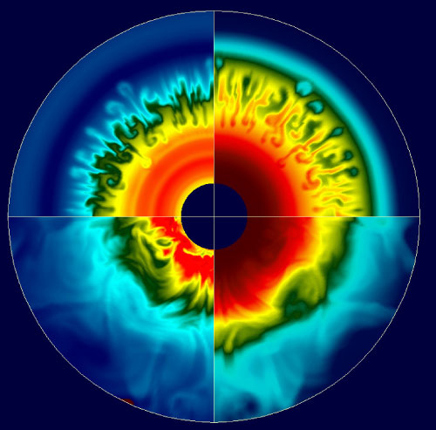
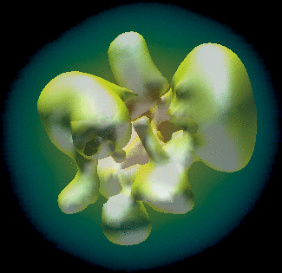
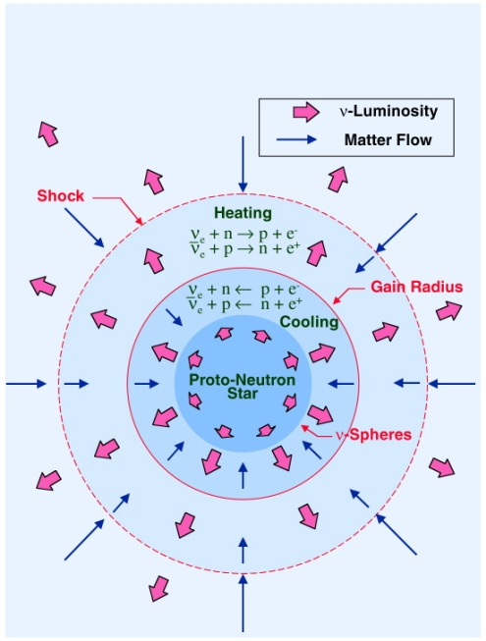
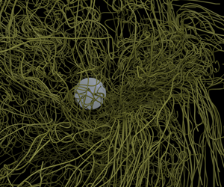
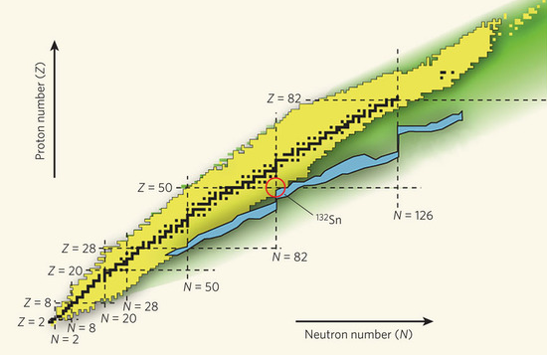
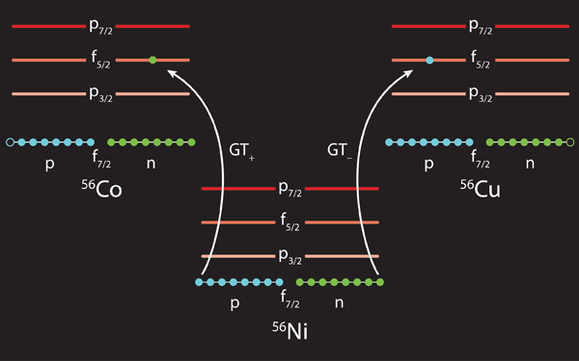
Core-Collapse Supernovae: a multi-physics problem
Hydrodynamics – Convection, Turbulence
Multi-Dimensional Effects - Asymmetries
Neutrino physics (transport/ oscillations / interactions)
Müller, E. and Janka, H.-T.
A&A 317, 140–163, (1997)
Magnetic fields
Fryer, C. L., & Warren, M. S. 2002, ApJ, 574, L65
r-process
Pugmire et al., ORNL
“Despite experimental and theoretical progress, lack of knowledge of relevant or accurate weak-interaction data still constitutes a major obstacle in the simulation of some astrophysical scenarios today.”
P. Cottle Nature 465, 430–431 (2010)
electron captures
K. Langanke, Physics 4, 91 (2011)
K. Langanke and G. Martinez-Pinedo, RMP 75, 819 (2003).

Slide 4
electron captures
on groundstate
Dominated by allowed (Gamow-Teller) weak transitions between states in the initial and final nucleus:
No transfer of orbital angular momentum (ΔL=0)
Transfer of spin (ΔS=1)
Transfer of isospin (ΔT=1)
EC
on exited state
β
from groundstate
Due to finite temperature in stars, Gamow-Teller transitions from excited states in the mother nucleus can occur
E_{x}
Direct empirical information on strength of transitions [B(GT)] is limited to low-lying excited states e.g. from the inverse (β-decay) transitions, if at all
groundstate
Q
groundstate
Daughter (Z,A)
Mother (Z+1,A)
In astrophysical environments, typically EC on many nuclei play a role – we need accurate theories to estimate the relevant rates, benchmarked by experiments

Slide 5
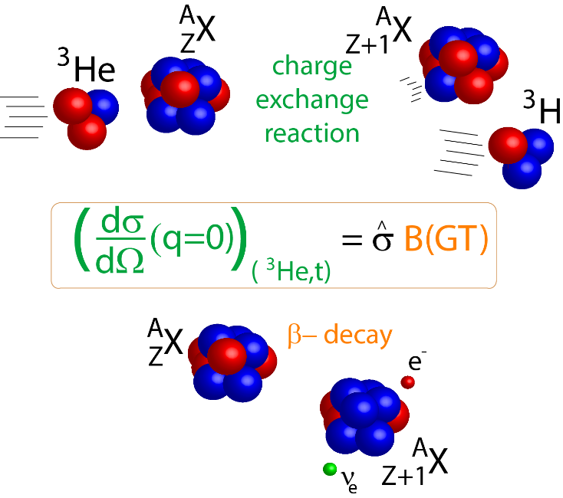
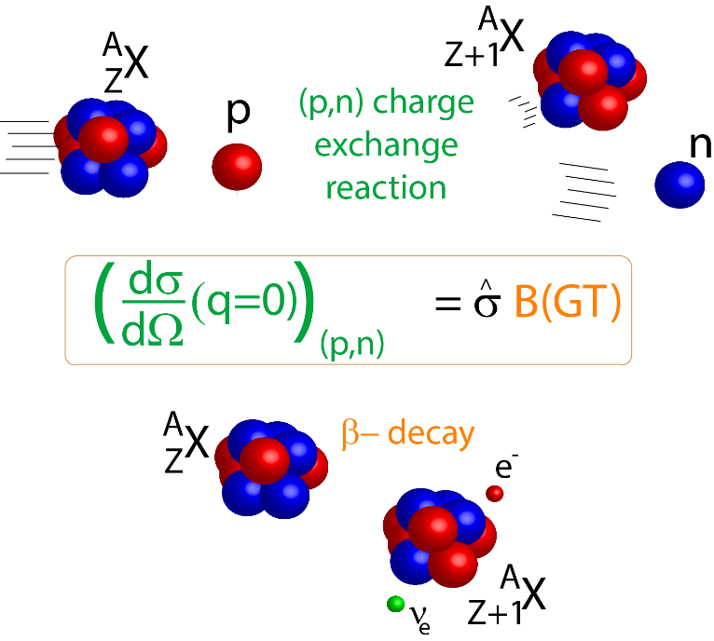
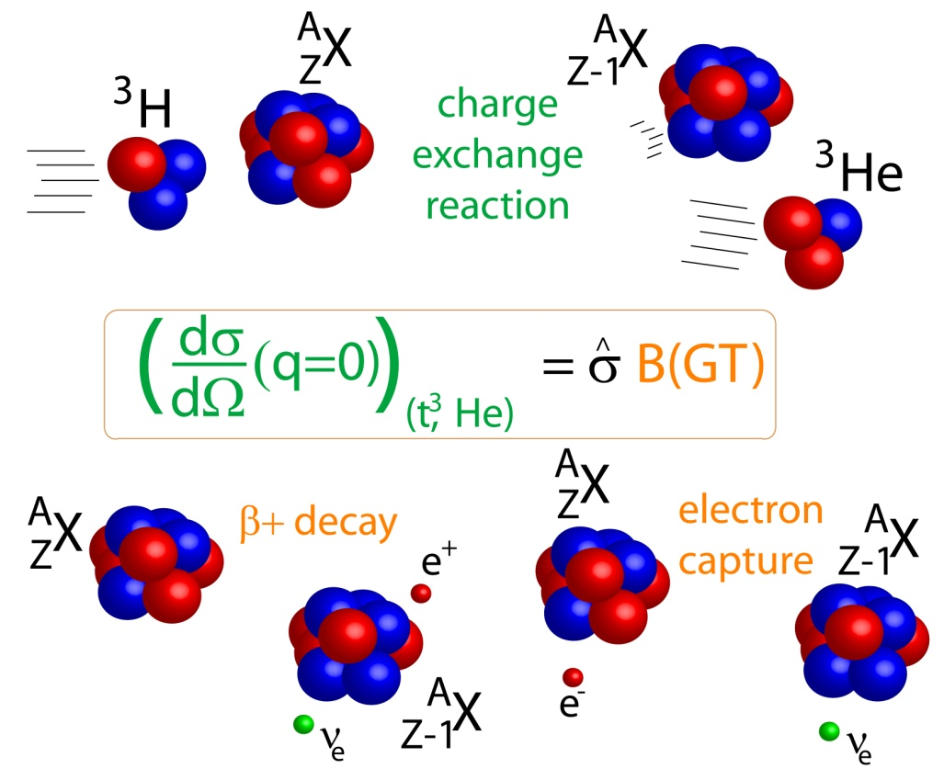
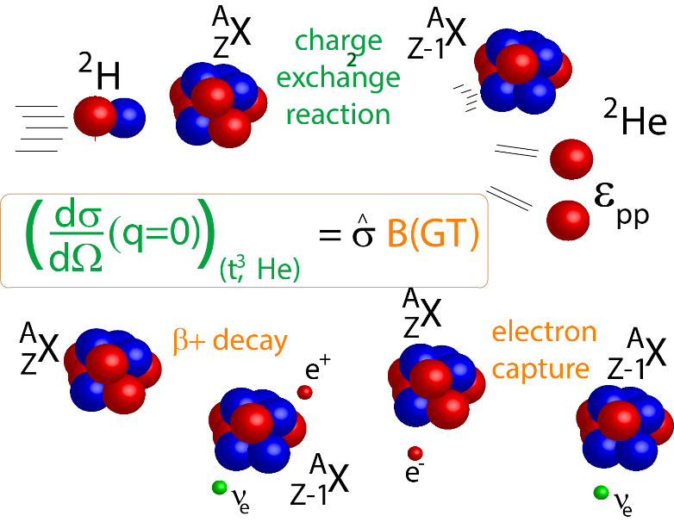
A,Z+1
(p,n)
(³He,t)
HICE
(n,p)
(t,³He)
(d,²He)
HICE
β⁻
A,Z
A,Z-1
e-capture/β⁺

Slide 6
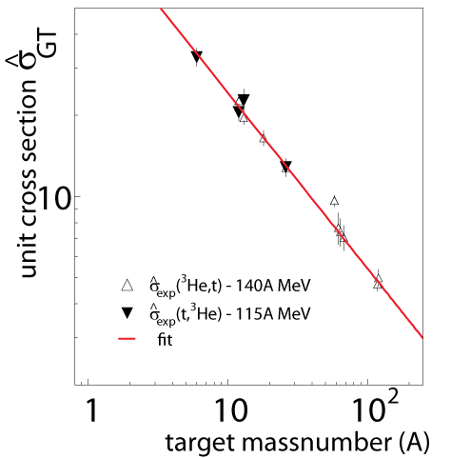
calibrating the proportionality
The unit cross section is conveniently calibrated using transitions for which the Gamow-Teller strength is known from β-decay.
The unit cross section depends on beam energy, charge exchange probe and target mass number: empirically, a simple mass-dependent relationship is found for given probe
CE
β-decay
A,Z
A,Z±1
Once calibrated, Gamow-Teller strengths can be extracted model-independently.
R.Z. et al., Phys. Rev. Lett. 99, 202501 (2007)
G. Perdikakis et al., Phys. Rev. C 83, 054614 (2011)

Slide 7
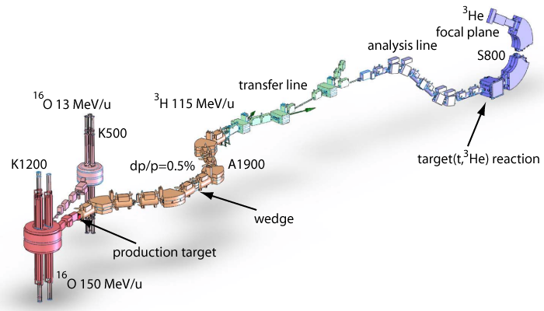
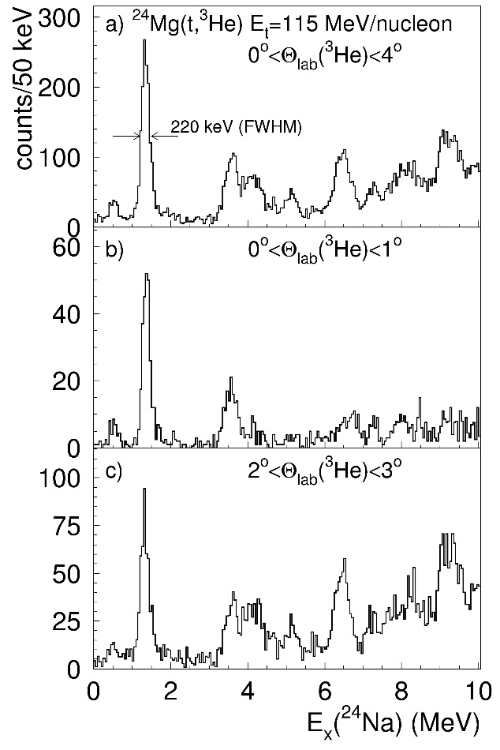
Producing a triton beam for (t,³He) experiments
Primary ¹⁶O beam 150 MeV/n
  rate @ A1900 FP 1.2x10⁷pps @ 130 pnA ¹⁶O
  transmission to S800 spectrometer ~70%
  ³H rate at S800: up to 2x10⁷ pps
Without wedge
190 keV (FWHM)
Thin wedge is needed to remove ⁶He (⁹Li)
Background channel ⁶He->³He + 3n
G.W. Hitt Nucl. Instr. and Meth. A 566 (2006), 264.

Slide 8
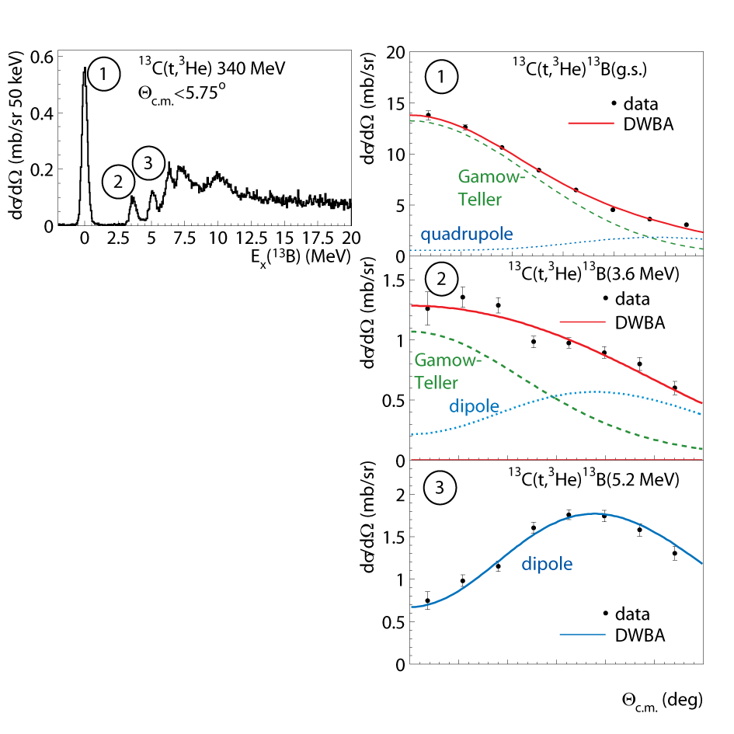
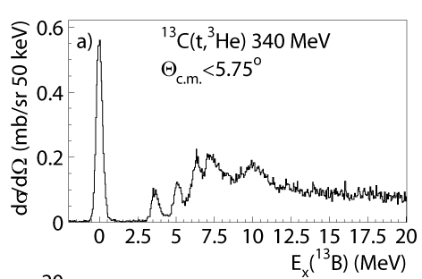
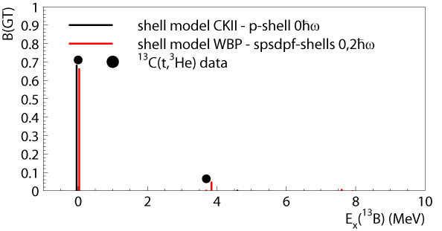

Multipole decomposition
1
Multipole
Decomposition
Analysis
3
2
0 1 2 3 4 5
C. Guess et al., Phys. Rev. C 80, 024305 (2009)

Slide 9
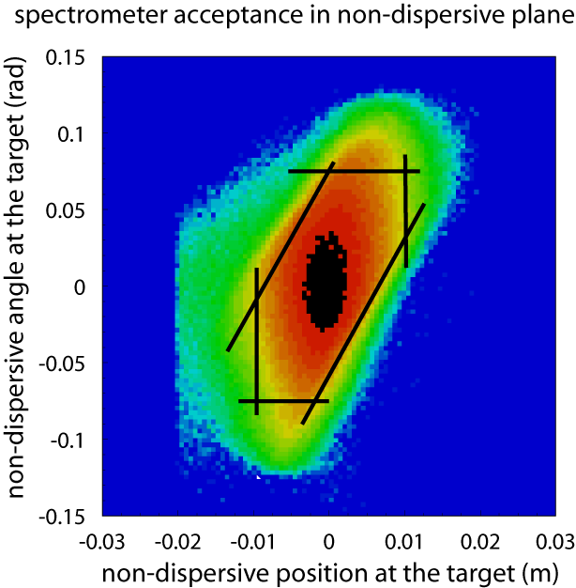
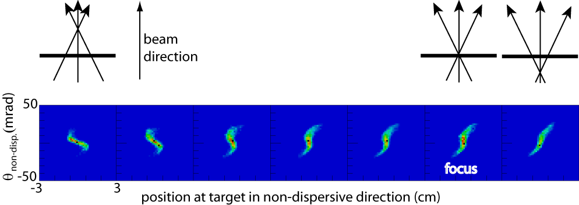
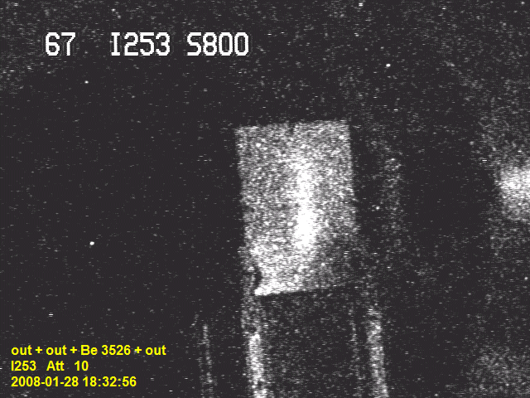
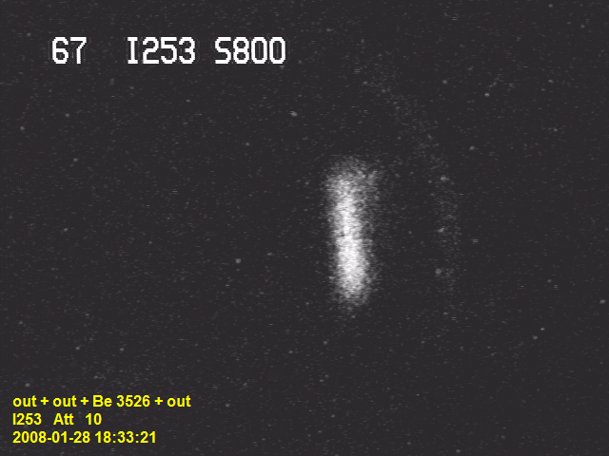
(t,³He) at the S800 spectrometer
dispersion matching: ~3 MeV ΔE_{triton} ⇒ σ_{E}(t,³He) ~ 250 keV
raytracing with 5th order map ~1º angular resolution
Low momentum
At S800 target
dispersive
7.5 cm
High momentum
Non-dispersive defocusing of the beam to increase angular resolution Improves angular resolution to ~0.5º.
Acceptance is a complex function of:
X_{non-dispersive}
θ_{non-dispersive}
X_{focal plane}
θ_{dispersive}
Test experiment
Using ⁹²Mo⁴¹⁺
Monte-Carlo Simulations
needed

Slide 10
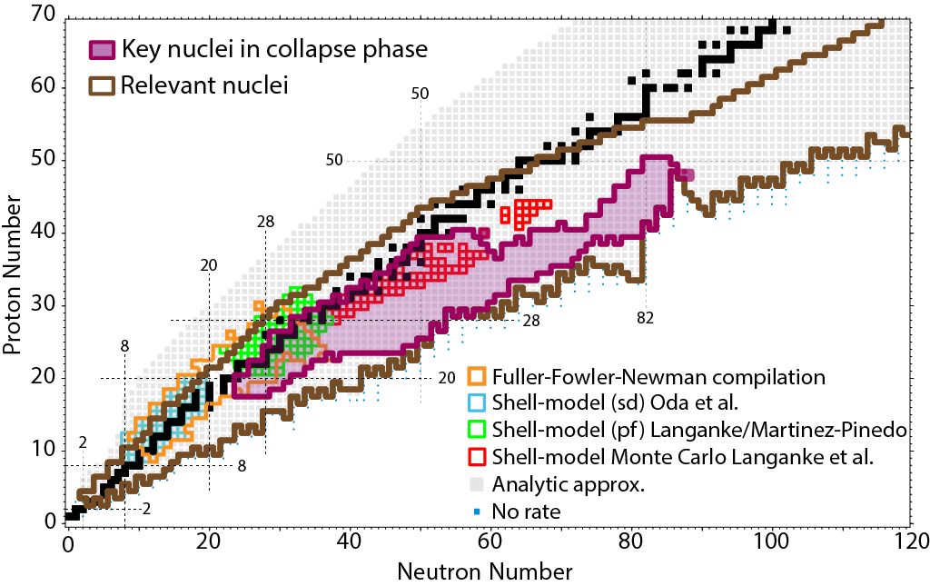
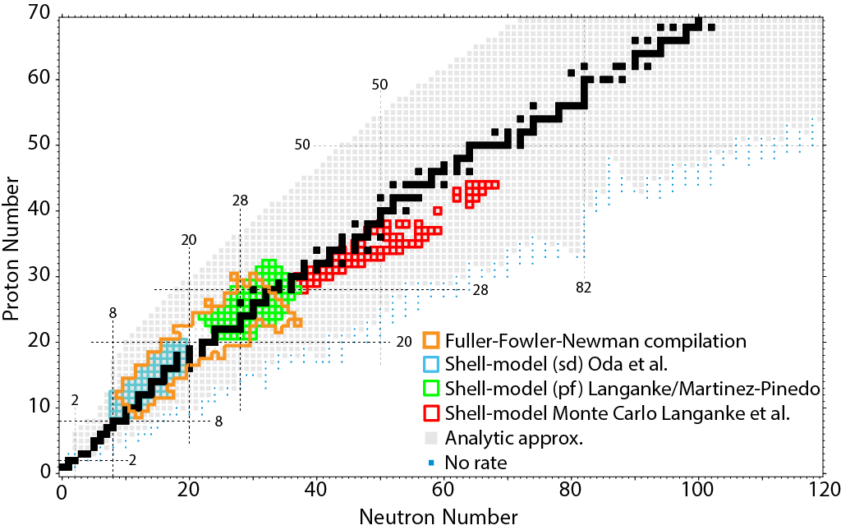
Theoretical weak reaction rates weak rate library: Sullivan et al. arXiv:1508.07348, Ap. J. to be published

Slide 11
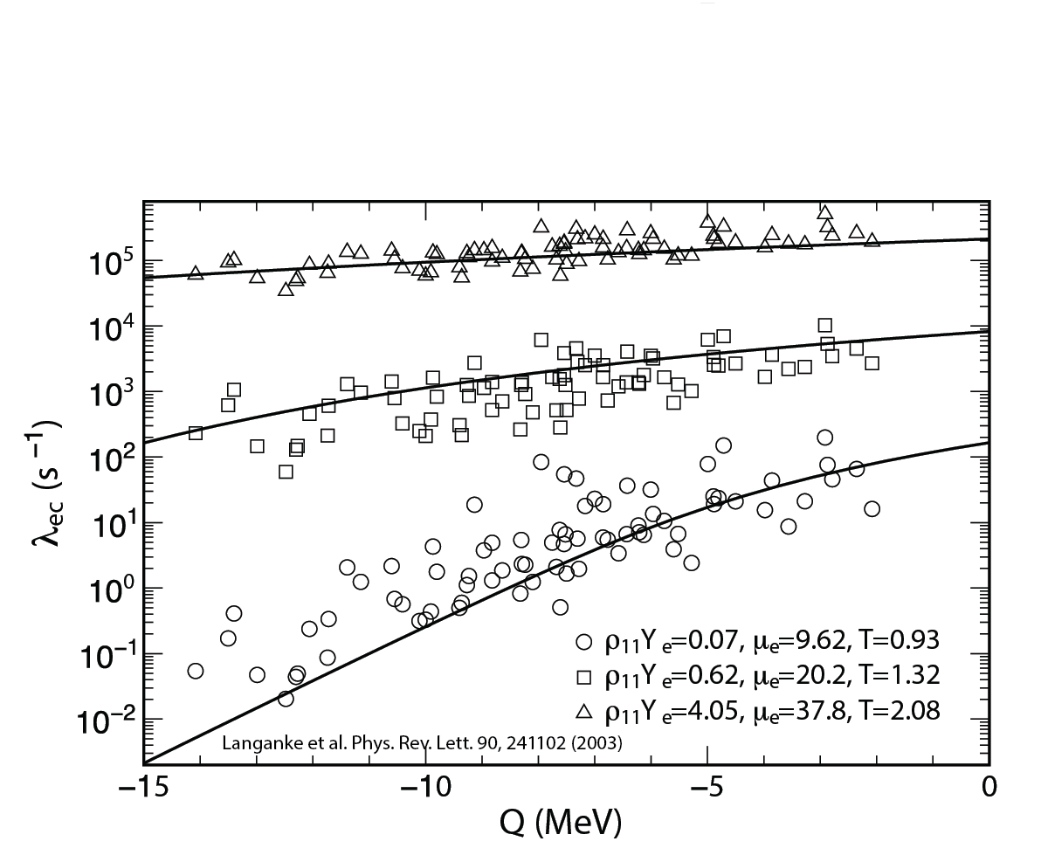
Theoretical weak reaction rates weak rate library: Sullivan et al. arXiv:1508.07348, Ap. J. to be published

Slide 12
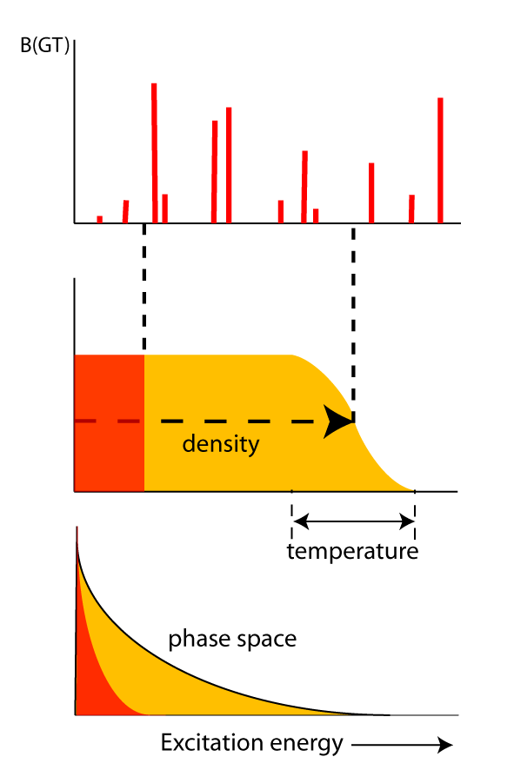
Excitation energy and resolution
At different astrophysical densities and temperatures, different ranges in excitation energy contribute to the weak reaction rates
Fermi energy:
U_{F}
U_{F}
Degeneracy:
Low density: e-captures on low-lying states
High density: e-captures up to high E_{x}
Low temperature: Fermi surface cut off sharply
High temperature: Fermi surface smeared out
At low densities/temperature, accurate knowledge of low-lying states is critical, even if transitions are week

Slide 13
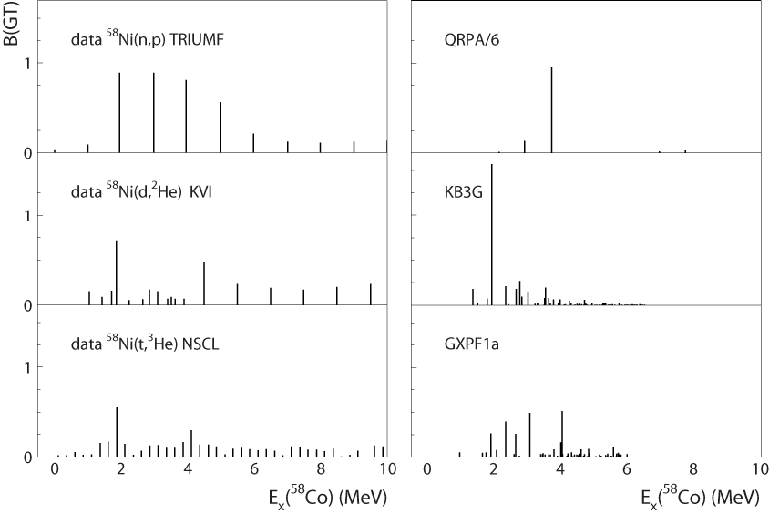
Benchmarking the library & guiding the theory

Slide 14
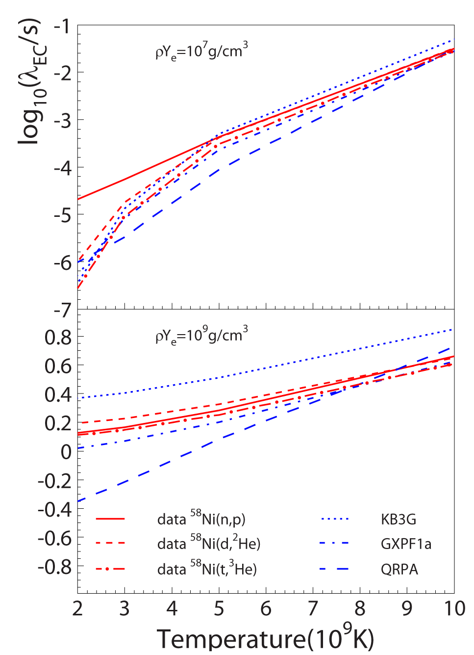

Electron-capture rates
Phase-space
Transition strength

Slide 15
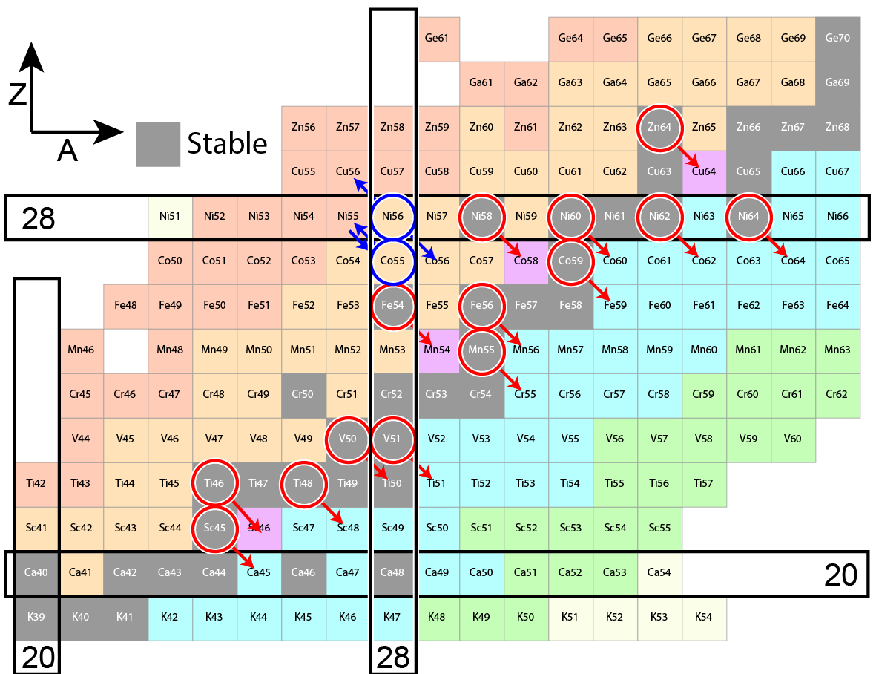
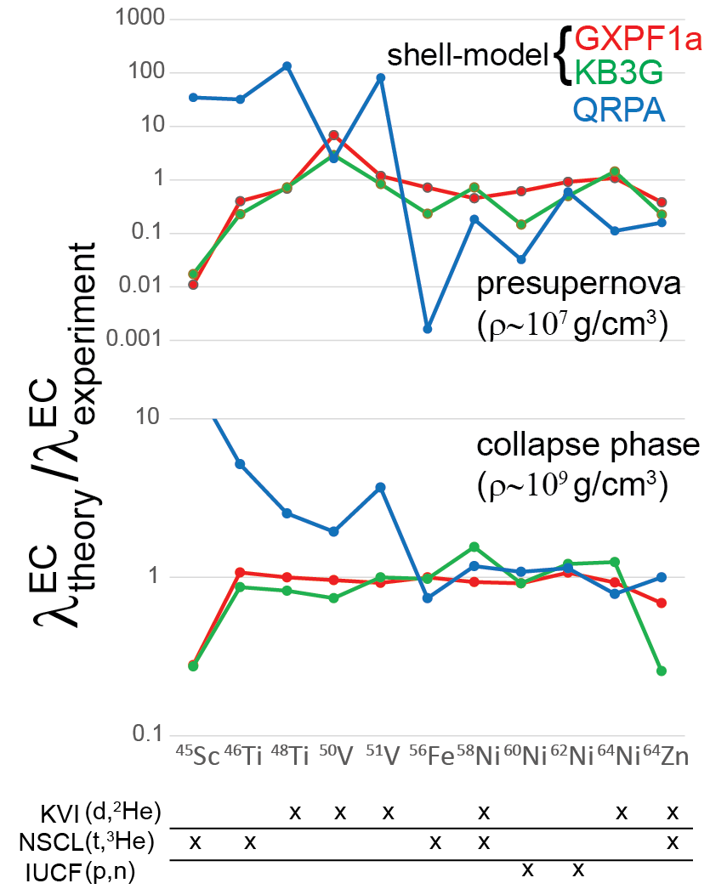
A.L. Cole et al., PRC 86, 015809 (2012)

Slide 16
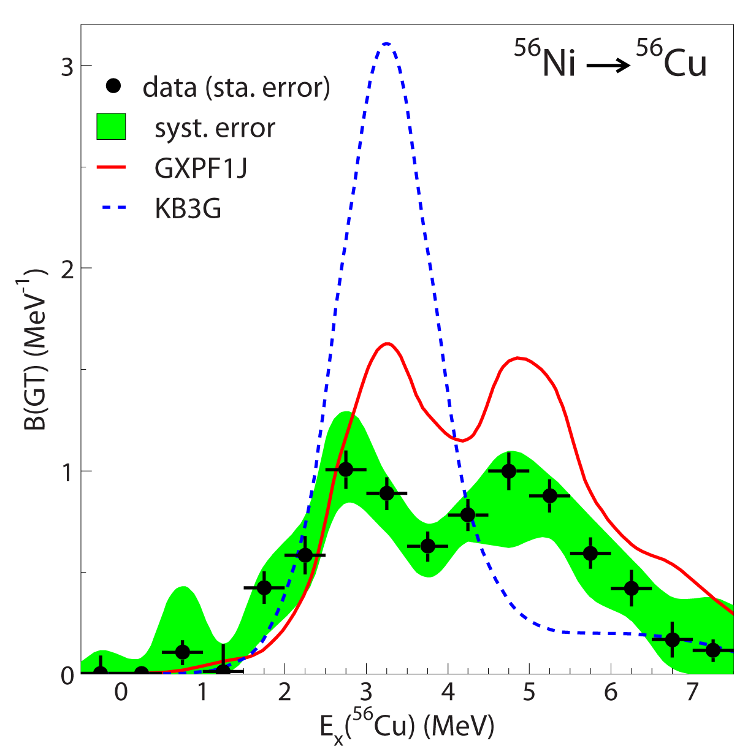
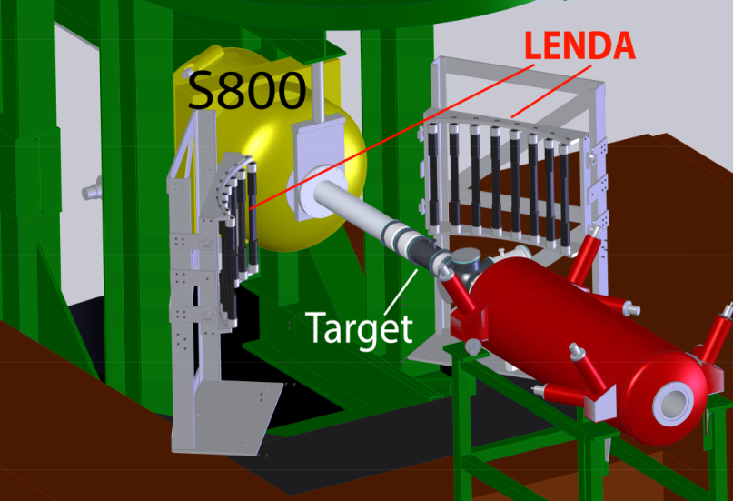
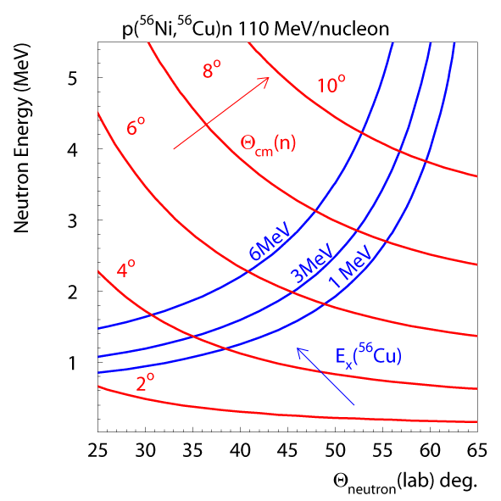
⁵⁶Ni-understanding the model differences development of (p,n) in inverse kinematics
n
RI beam
See talk by M. Sasano
S800 spectrometer
Low-Energy Neutron Detector
LH₂ target

Slide 17
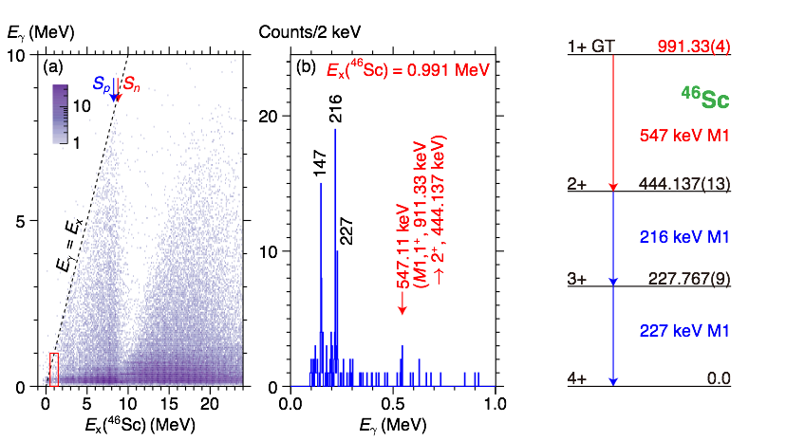


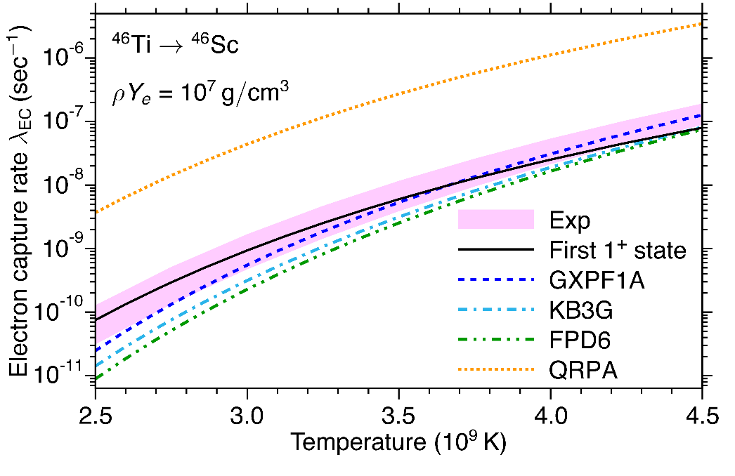
Searches for very weak transitions
Development of (t,³He+γ) reaction using S800+GRETINA
For ⁴⁶Ti: B(GT)_{0.991}=0.009 ± 0.005(exp) ± 0.003 (sys)
See talk by S. Noji

Slide 18
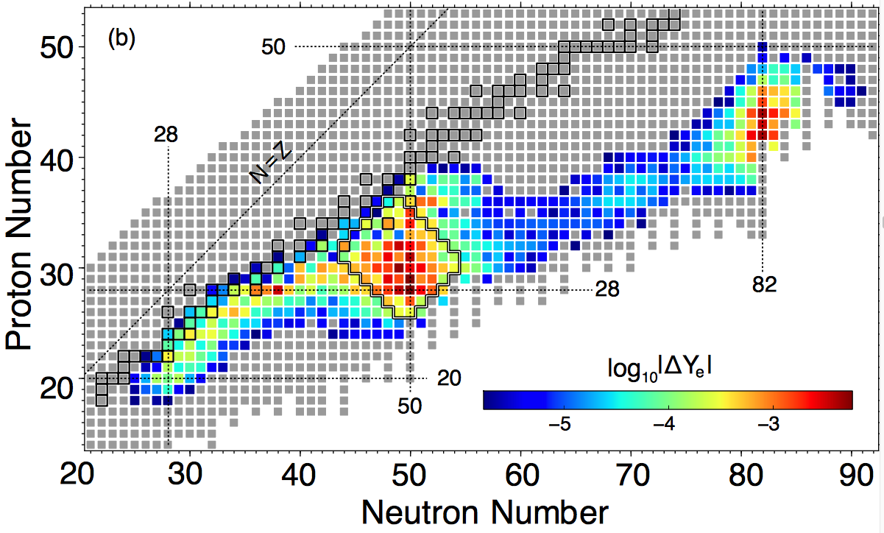
EC Sensitivity studies – core-collapse supernovae
C. Sullivan et al., arxiv:1508.07348 – Ap. J.
NSCL created weak rate library (as part of NuLIB) for astrophysical simulations - Collaboration between NSCL charge-exchange group and E. O’Connor (NCSU)
Library allows for electron-capture sensitivity studies: first applied for core-collapse supernovae using the GR1D code – further uses in simulations of thermonuclear supernovae and neutron-star crusts foreseen
Work on β⁻ rates and ν-scattering rates should be included
Future Thrust
Past focus

Slide 19
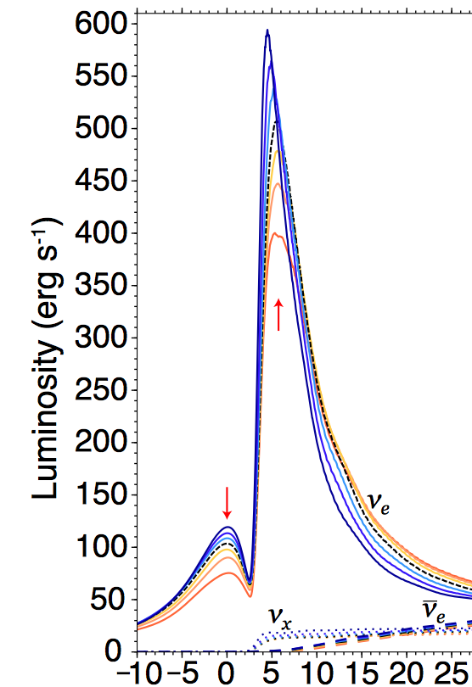
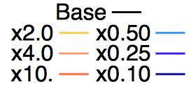
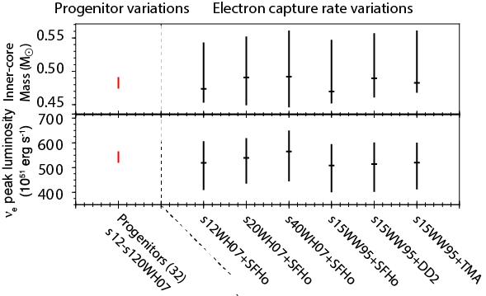
GR1D simulations of core-collapse supernovae
GR1D simulations and sensitivity studies: uncertainties in EC rates have 20% effects on key properties of core-collapse supernovae
EC Variation:
Time (ms)

Slide 20
Theoretical weak reaction rates
weak rate library: Sullivan et al. arXiv:1508.07348, Ap. J. to be published
Additional studies will be pursued
  2D simulations of CCSN using GR1D output as input to FLASH
  Thermonuclear supernovae
Additional input to library sought - also need constraints on β⁻ strengths

Slide 21
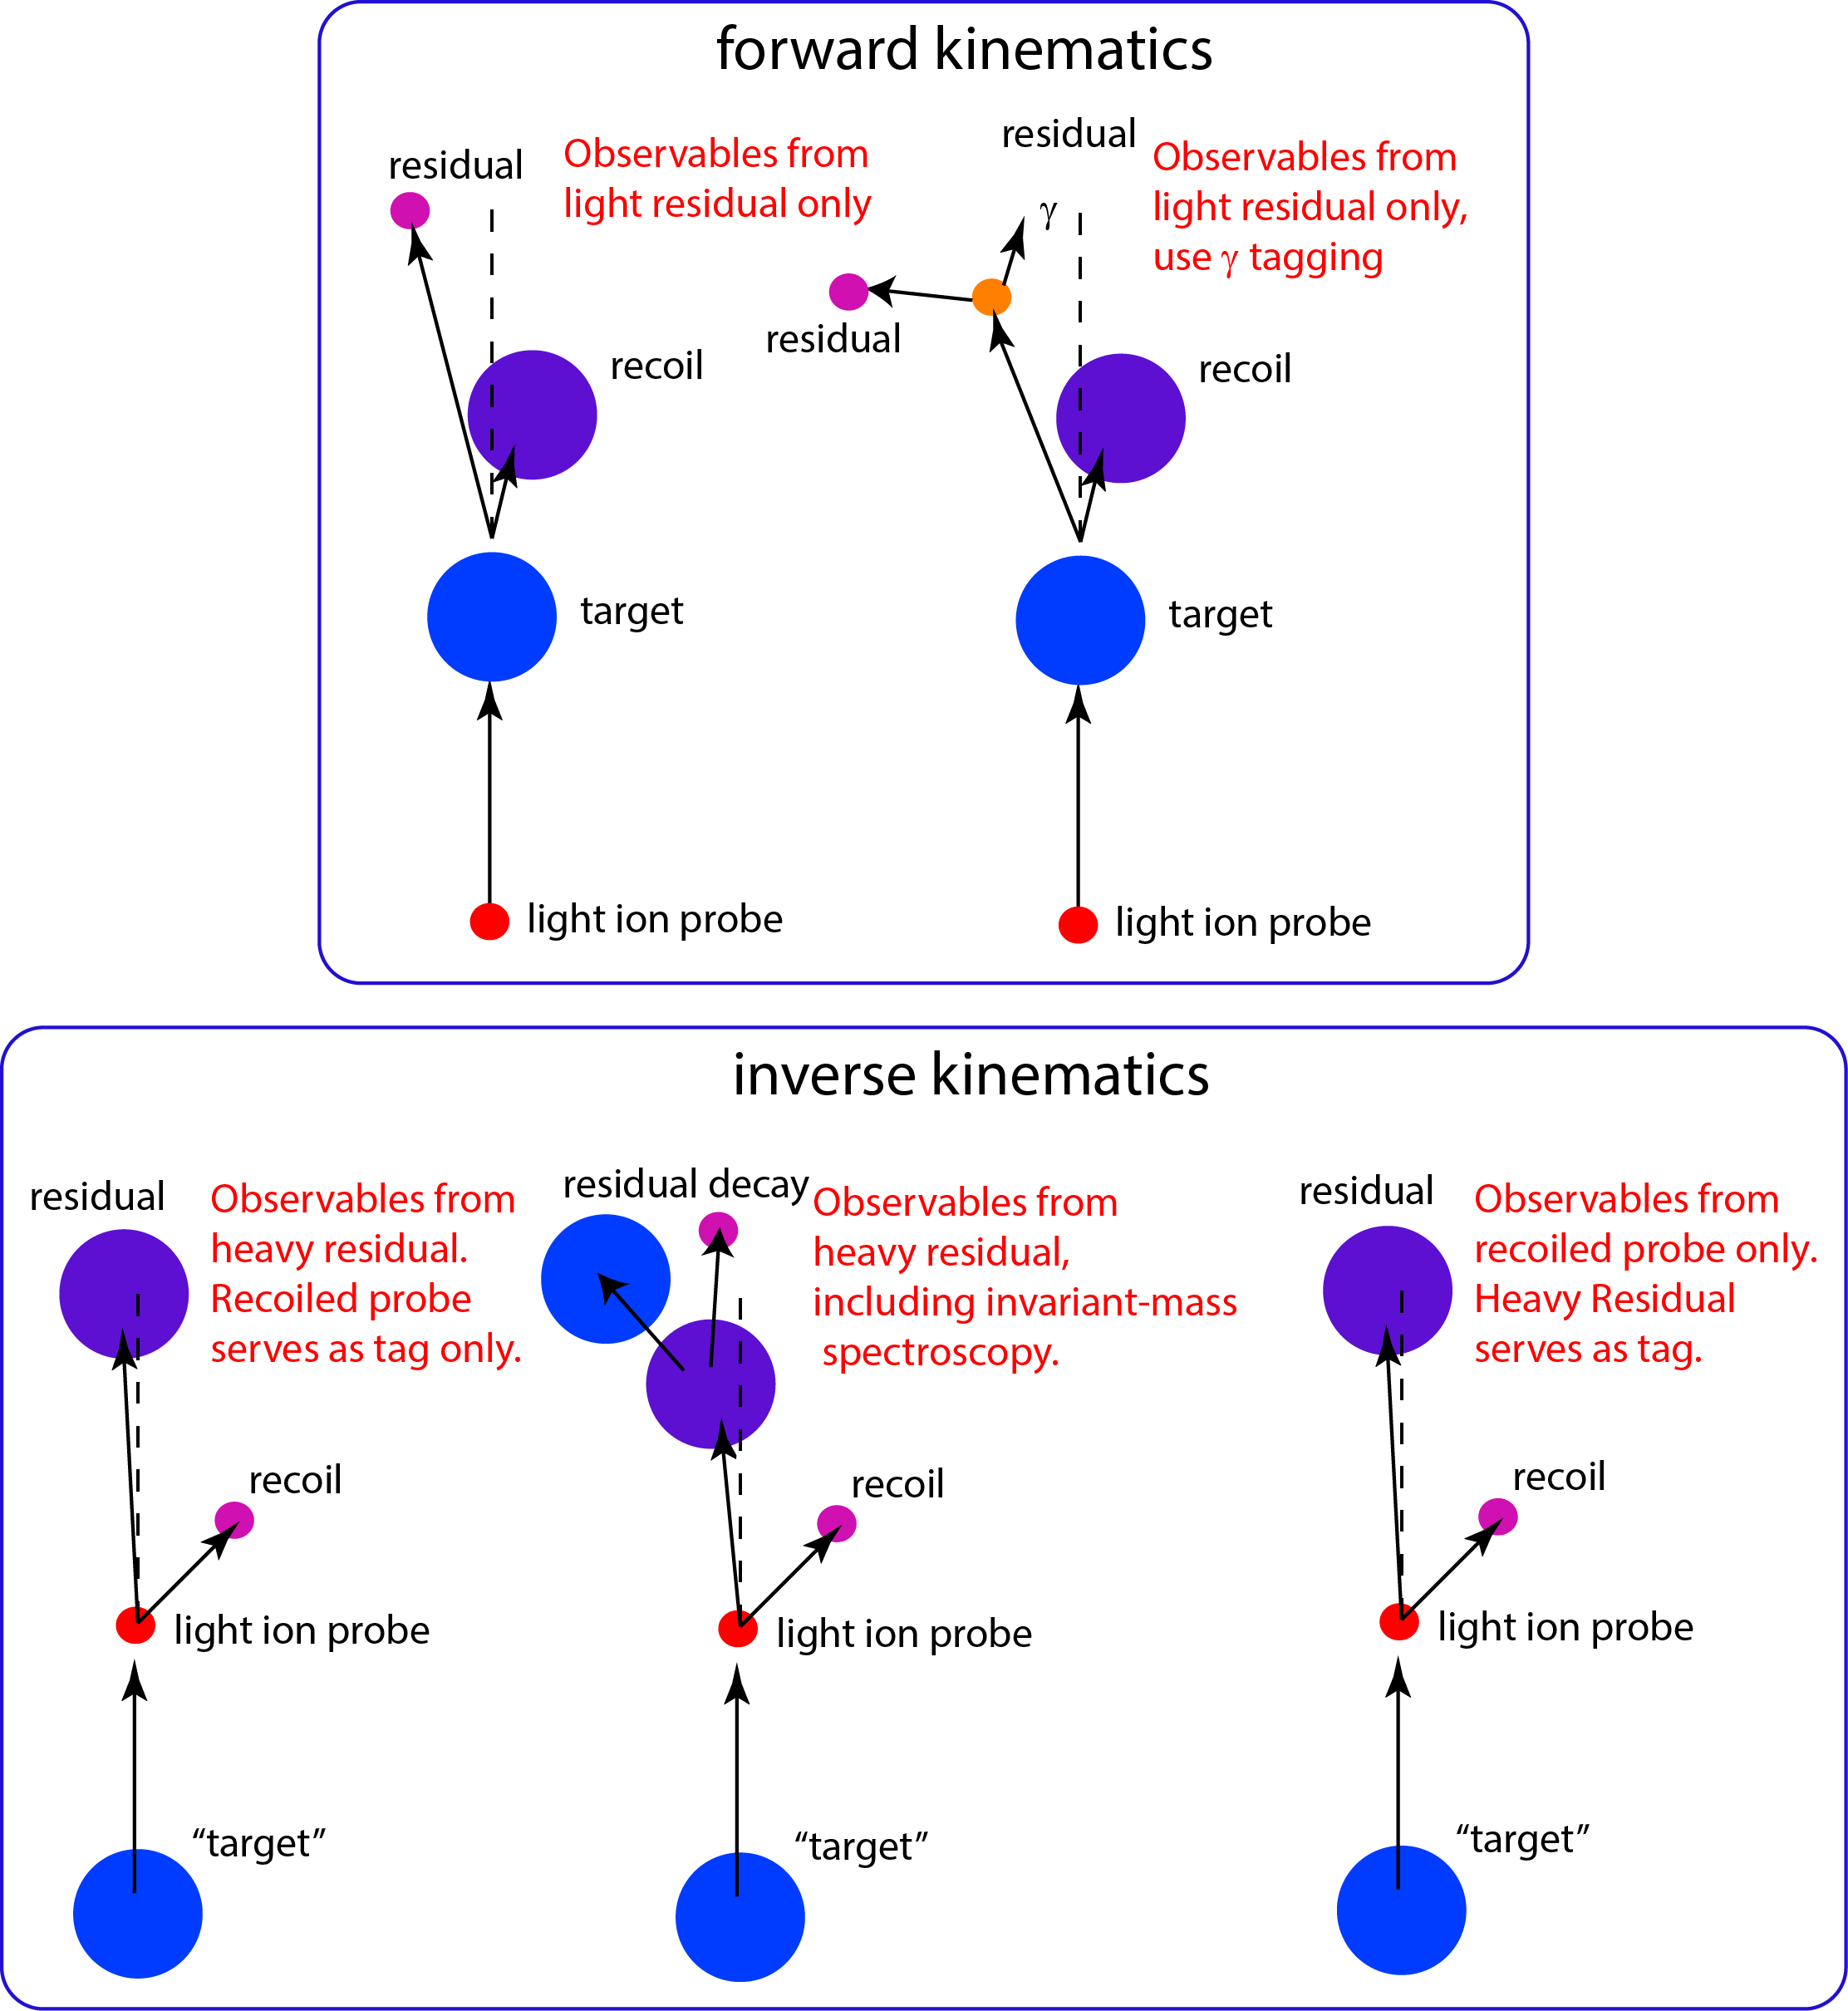
(p,n) (n,p)
(d,²He)
(³He,t) (t,³He)
HICEX
π-CEX
(⁷Li,⁷Be+γ)
(¹⁰C,¹⁰B+γ)
(¹⁰Be,¹⁰B+γ)
(¹²N,¹²C+γ)
etc…
(⁷Li,⁷Be+γ):
Successfully
applied for light ions, will require invariant mass spectroscopy for heavy ions
(p,n) – OK!
(d,²He)?

Slide 22
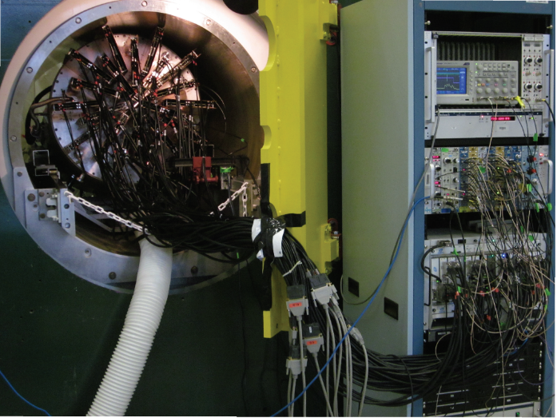
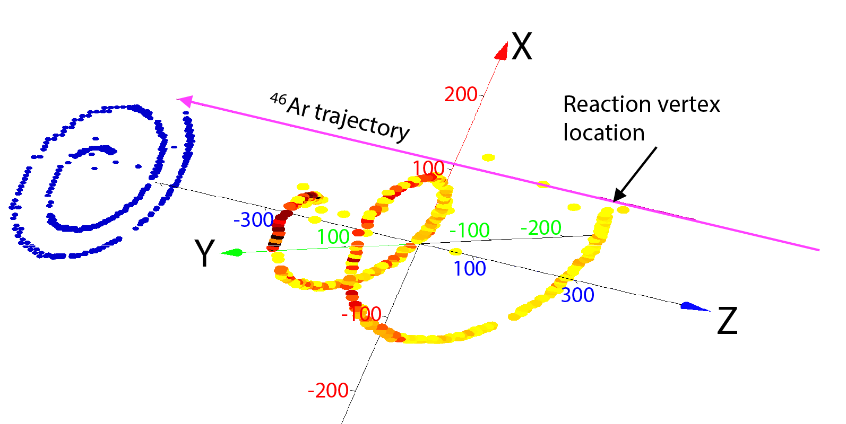
(d,²He) in inverse kinematics?
Use Active Target Time Projection Chamber at S800
From recent ⁴⁶Ar+p resonant scattering experiment
AT-TPC was used reaccelerated beam of ⁴⁶Ar isotopes

Slide 23
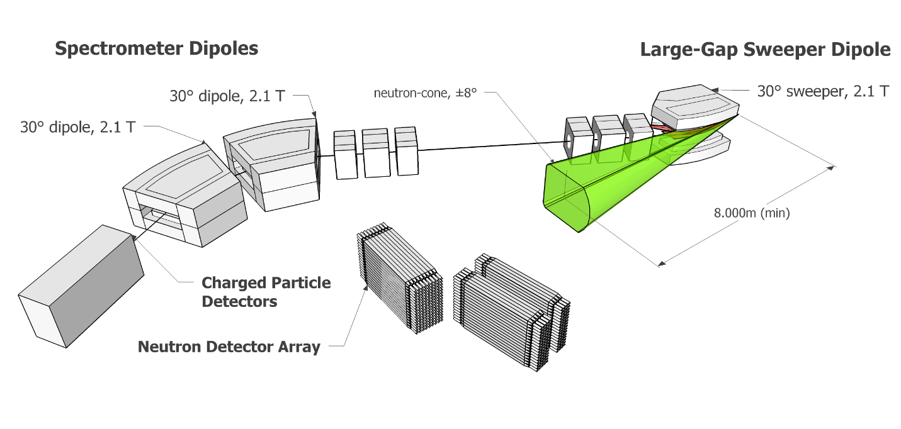
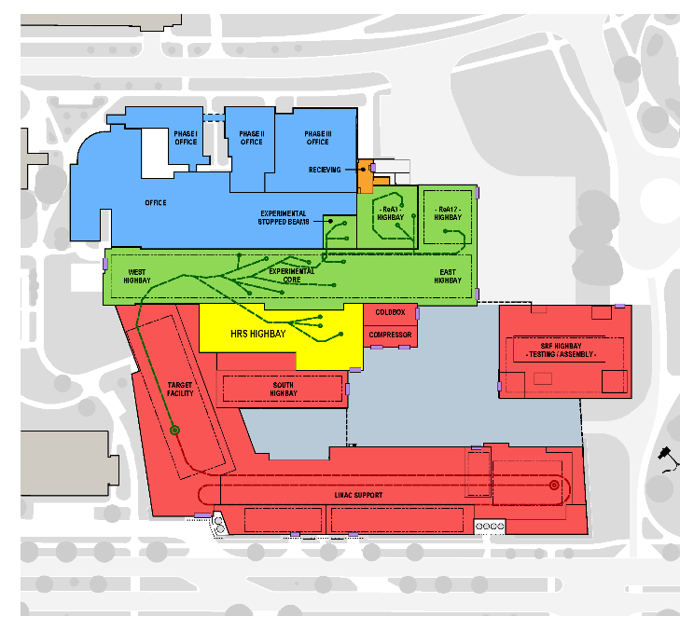
A High-Rigidity Spectrometer for FRIB
Pre-conceptual design
By T. Baumann
Magnetic bending power: up to 8 Tm
Large momentum (10% dp/p) and angular acceptances (80x80 mrad)
Particle identification capabilities extending to heavy masses (~200)
Momentum resolution 1 in 5000; intermediate image after sweeper
Invariant mass spectroscopy: ±6º opening in sweeper dipole for neutrons

Slide 24
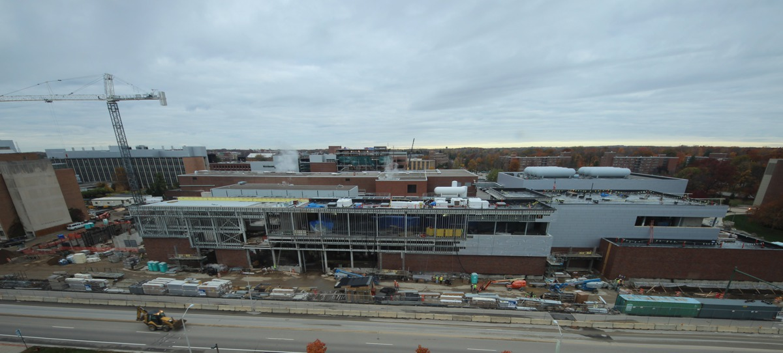




Facility for Rare Isotope Beams (FRIB)
October 2015
view

