Slide 1


Dispersion Matching of Stable and Radioactive Beams
HST15, RCNP, Osaka
November 16-19, 2015
Georg P. Berg
University of Notre Dame
Joint Institute for Nuclear Astrophysics

Slide 2
Outline
Dispersion matching in a nutshell
Brief summary of long history of dispersion matching
Dispersion matching at stable beam facilities
Dispersion matching at RI facilities

Slide 3
Why do we dispersion match beam lines and spectrometers?
Resolution better than energy spread of accelerator, limited by resolving power of spectrometer D/(M*2x₀)
Reconstruction of scattering angle Θ_{target} (Θ_{fp}) in dispersive plane (x); non-dispersive plane, angle φ(y), out-of-focus mode
What ion-optical parameters on target need to be “matched” to the
spectrometer?
Spacial Dispersion b16, for resolution
Angular dispersion b26, for Θ_{target} (Θ_{fp}) reconstruction
Focus on target b12=0, for k = dp/(dΘ*p) = 0

Slide 4
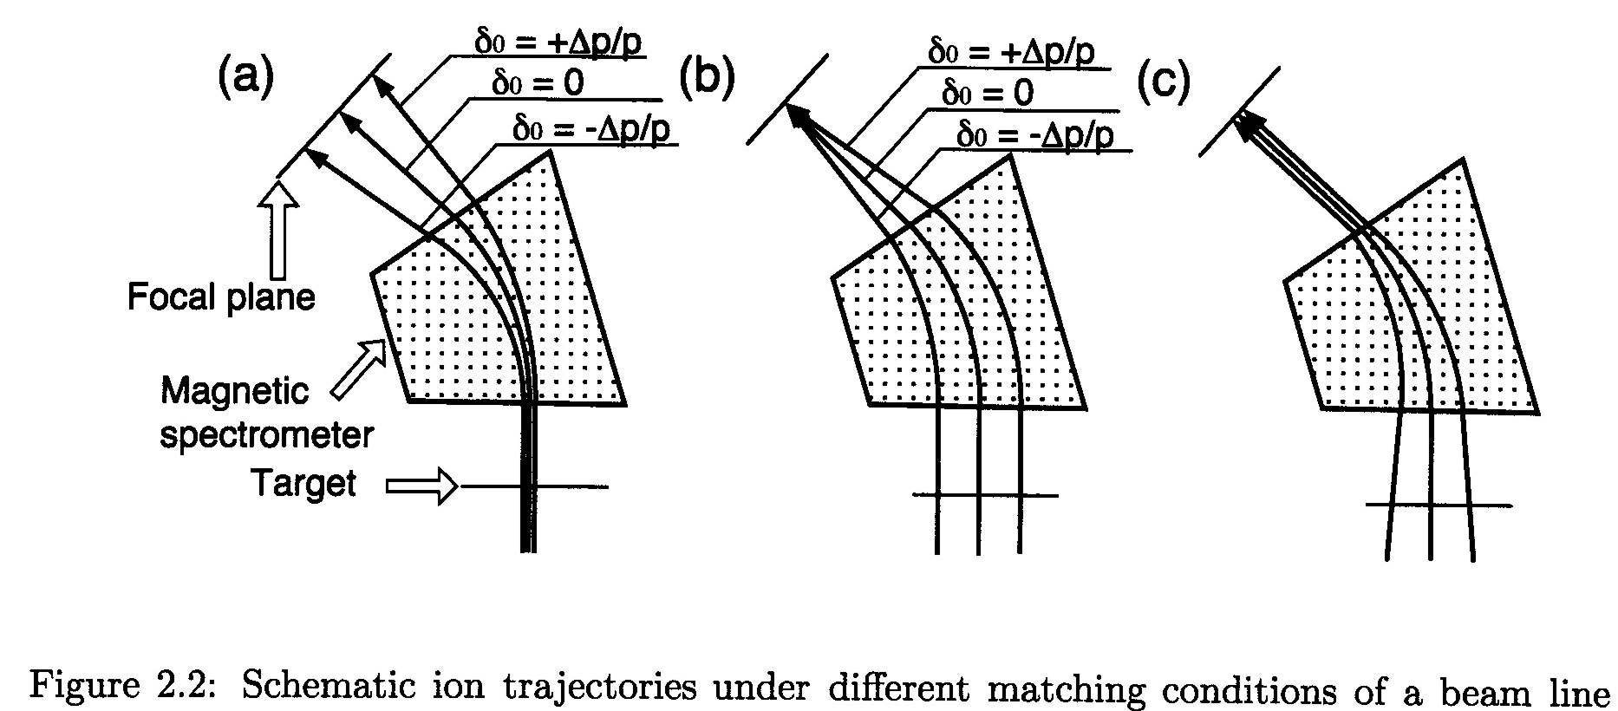
Spacial and Angular Dispersion Matching
A Cartoon to Remember
Achromatic Beam
on Target
Dispersive Beam
on Target
Angular dispersion
on Target
Great diagnostic for beam
momentum distribution
s₁₆ C
b₂₆ = (s₂₁ s₁₆ - s₁₁ s₂₆) C
b₁₆ = - ⎯ (1 + s₁₁ s₂₆ K - s₂₁ s₁₆K) ⎯
s₁₁ T

Slide 5
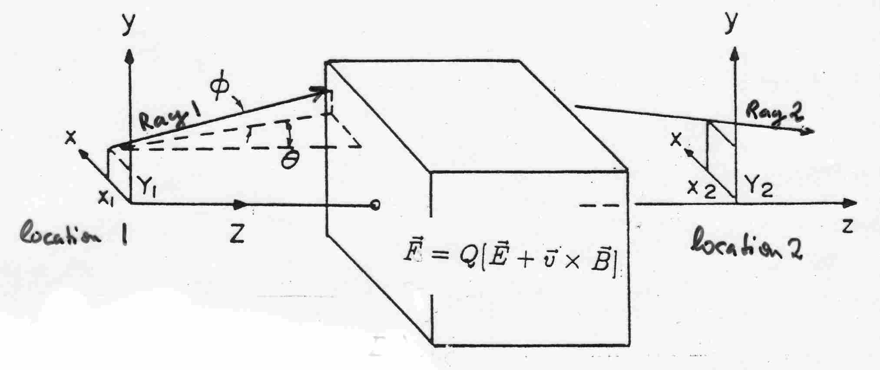
Defining a RAY
Code TRANSPORT:
(x, Θ, y, Φ, l, dp/p)
(1, 2, 3, 4, 5, 6 )
Convenient “easy to use” program
for beam lines with paraxial beams
Ion-optical
element
Not defined in the figure are:
dp/p = rel. momentum
l = beam pulse length
All parameters are relative
to “central ray”
central ray
Not defined in the figure are:
δ_{K} = dK/K = rel. energy
δ_{m} = dm/m = rel. mass
δ_{z} = dq/q = rel. charge change
a = p_{x}/p₀
b = p_{y}/p₀
All parameters are relative
to “central ray” properties
Code: COSY Infinity:
(x, a, y, b, l, δ_{K}, δ_{m}, δ_{z})
Needed for complex ion-optical systems including several
charge states
different masses
velocities (e.g. Wien Filter)
higher order corrections
Note: Notations in the Literature are not consistent!

Slide 6
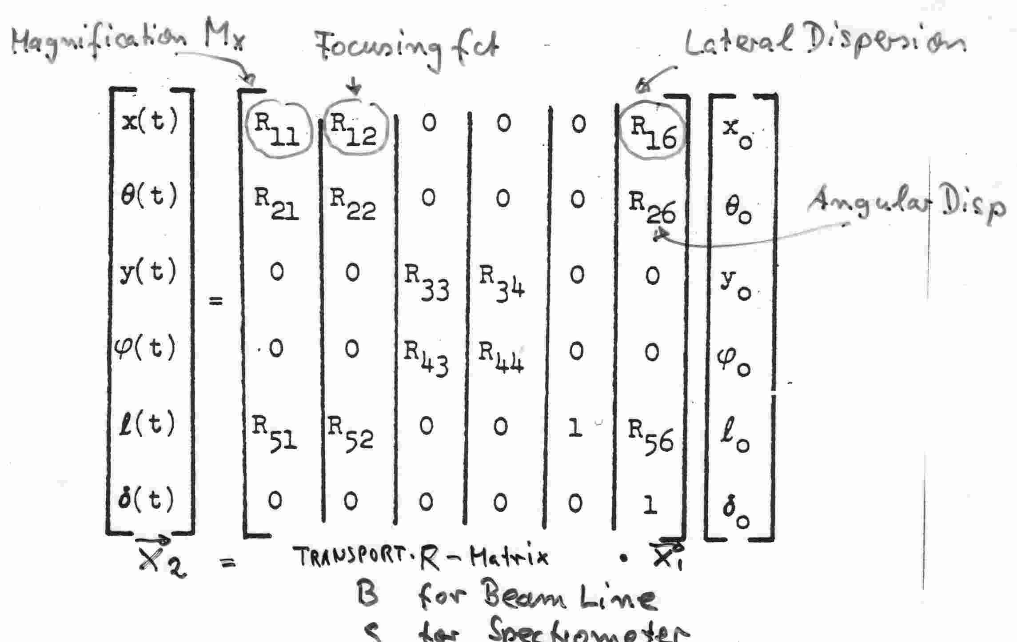
Transport of a ray
6x6 Matrix
representing
optic element
(first order)
→
→
→
Note: We are not building “random” optical elements.
Many matrix elements = 0
because of symmetries, e.g. mid-plane symmetry
Ray after element at
Location t
Ray at initial
Location 0

Slide 7
Transport of a ray through a system of beam line elements
6x6 Matrix
representing
first optic element
(usually a Drift)
→
x_{n} = R_{n} R_{n-1} … R₀ x₀
→
→
Ray at initial
Location 0
(e.g. a target)
Ray at final
Location n
Complete system is represented by
one Matrix R_{system} = R_{n} R_{n-1} … R₀

Slide 8
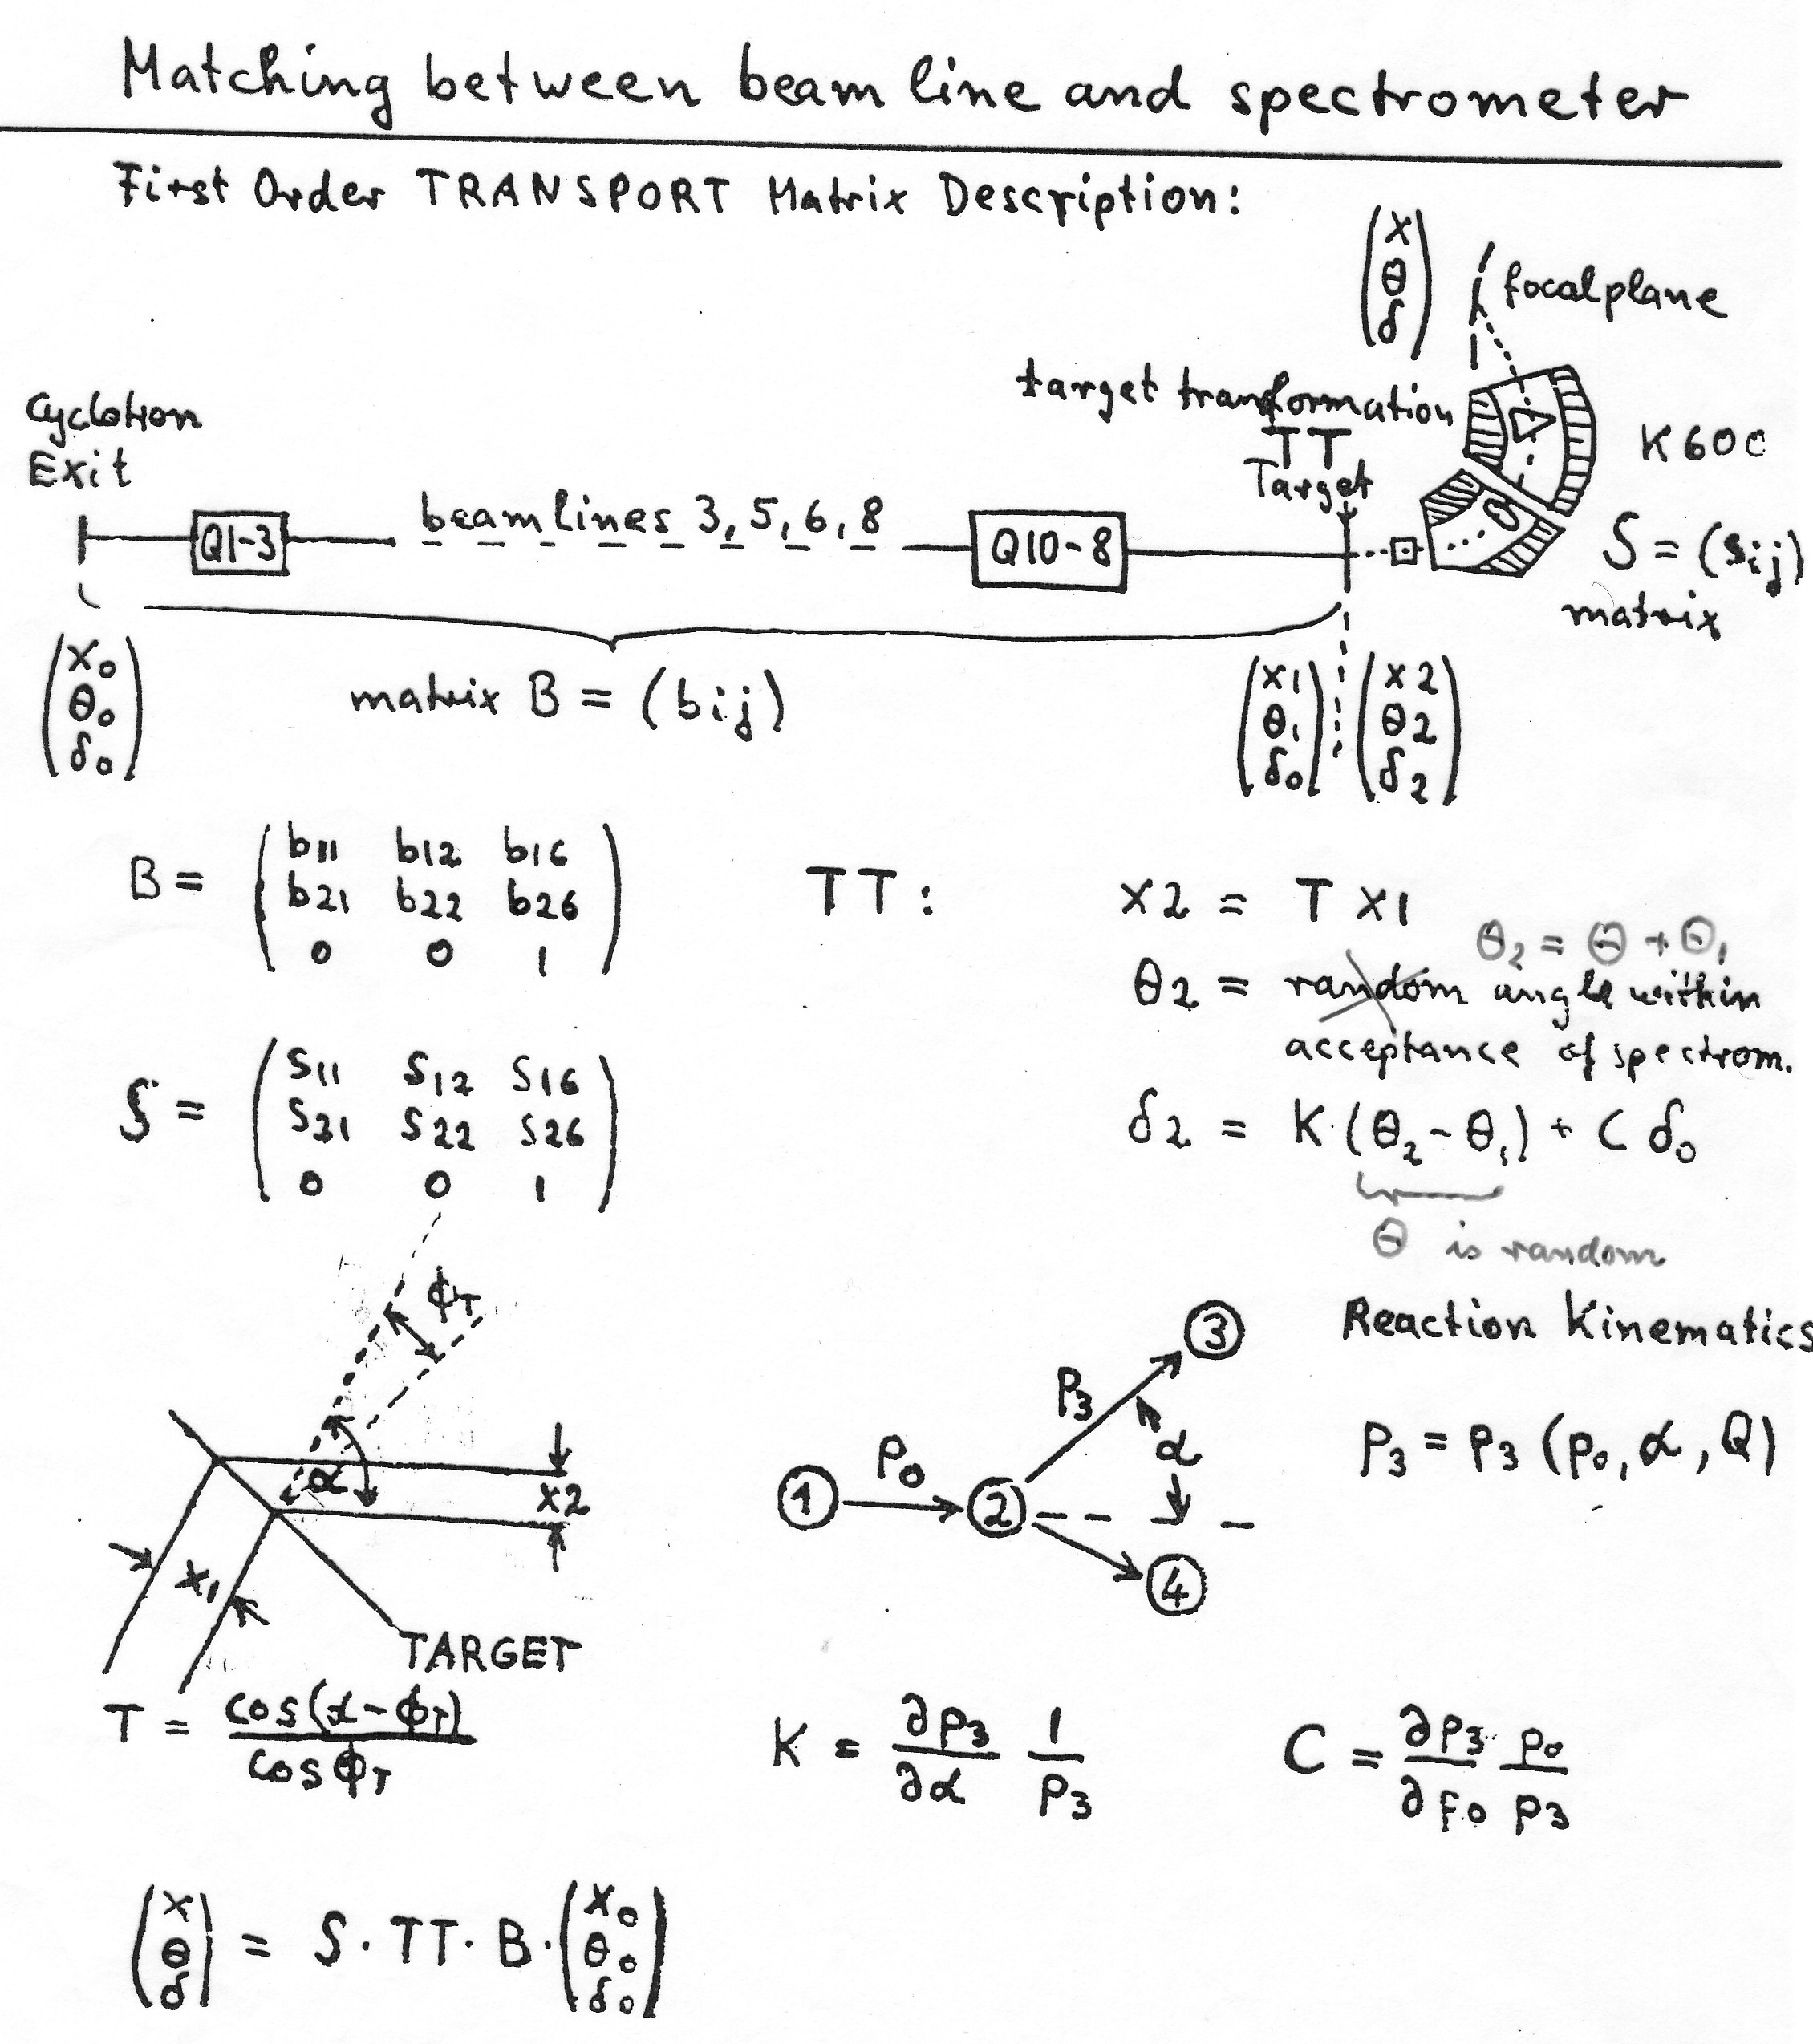
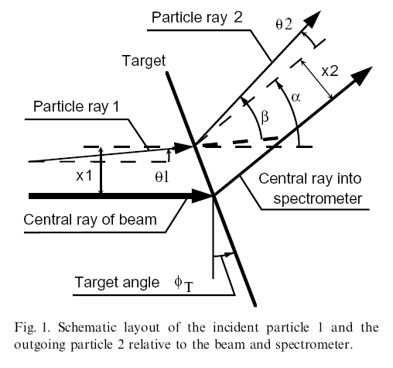
Dispersion
Matching
High resolution experiments
Secondary beam (large dp/p)

Slide 9
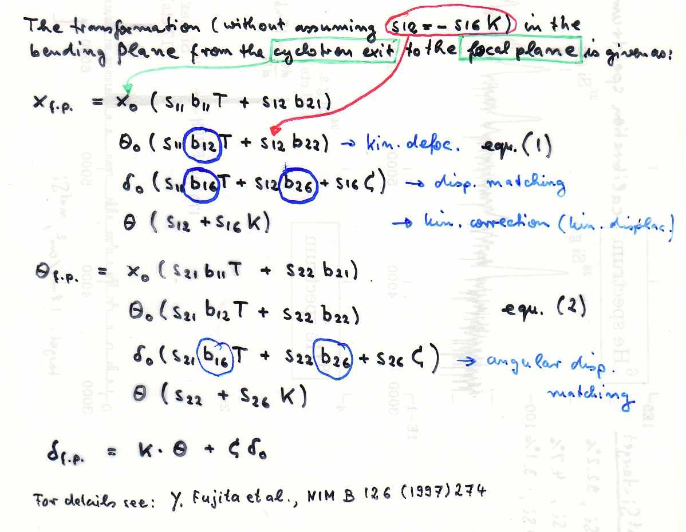
Solution of first order Transport and Complete Matching
Complete Matching
For best Resolution in the
focal plane, minimize the
coefficients of all terms
in the expression of x f.p.
(1)
For best Angle Resolution
Minimize Coefficients of
d 0 in expression of U f.p.
Note: Also the beam focus
b12 on target is important
(b12 = 0 for kinem. k = 0)
(2)
Spacial Dispersion Matching:
D.L. Hendrie In: J. Cerny, Editor,
Nuclear Spectroscopy and Reactions, Part A,
Academic Press, New York (1974), p. 365.
D = s₁₆ = Spectrometer dispersion
D C
M T
Hendrie, Dispersion Matching b₁₆ = - — ∗ —
M = s₁₁ = Spectrometer magnification

Slide 10
Spacial and Angular Dispersion Matching
Solutions for b₁₆ and b₂₆ under conditions that
both δ₀-coefficients = 0 in (1) and (2)
s₁₁ b₁₆ T + s₁₂ b₂₆ + s₁₆ C = 0
s₂₁ b₁₆ T + s₂₂ b₂₆ + s₂₆ C = 0
Solutions:
s₁₆ C
(19)
Spacial Dispersion Matching
b₁₆ = - ⎯ (1 + s₁₁ s₂₆ K - s₂₁ s₁₆K) ⎯
s₁₁ T
b₂₆ = (s₂₁ s₁₆ - s₁₁ s₂₆) C
(20)
Angular Dispersion Matching
s₁₂ b₂₂
s₁₆ b₂₂ K
(21)
b₁₂ = - ⎯⎯⎯−
= ⎯⎯⎯−
Focusing Condition
s₁₁ T
s₁₁ T

Slide 11
Brief History of Dispersion matching
1956 Early spectrometers, MIT, ND (Browne-Buechner), effects on resolution
1974 D.L. Hendrie, - D*C/(M*T), target functions T,C, k defined and discussed
1978 Big Karl, disp. matched BL,ion-optics,insufficient diagn.,S. Martin, K. Brown
1986 K600, IUCF, Disp. Matching incl. angular dispersion, improved diagnostics, k>0 matching, 0 deg measurements, angle reconstruction.
1994, 1996 Study group to develop disp. Matching for GRAND RAIDEN (M. Fujiwara), lead: Y. Fujita, K. Hatanaka, T. Wakasa, T.Kawabata et al., H. Ejiri secured funds from Japanese government for fully dispersion matched WS course.
2000 Grand Raiden, developm. WS incl. all known effects and diagnostics, k=0 disp. matching. Resolv. Power limit of about p/dp =37000 at 300 – 400 MeV (p,p’)
Grand Raiden unique (one on this planet) high Resol. facility to study (GT fine structure with 20- 30 keV at 140 MeV/u, Yoshi Fujita, ( K600 E(3He) ~ 70Mev/u)
2008 K600, iThembaLABS (Ricky Smit, R. Neveling): Successful Int’l initiative (Japan (Hiro Fujita, Yoshi Fujita), Germany (P. von Neumann-Cosel, USA(GB) to implement dispersion matching incl. 0 deg measurements.
2006 T. Kawabata design of Matching for RI beam at BigRIPS/SHARAQ system.
> 2015 Future developments of High Energy Spectrometers at RI beam facilities,
e.g. FAIR, LEBS, H. Geissel, H.Weick, J. Winfield; FRIB, HRS, Remco, GB.

Slide 12
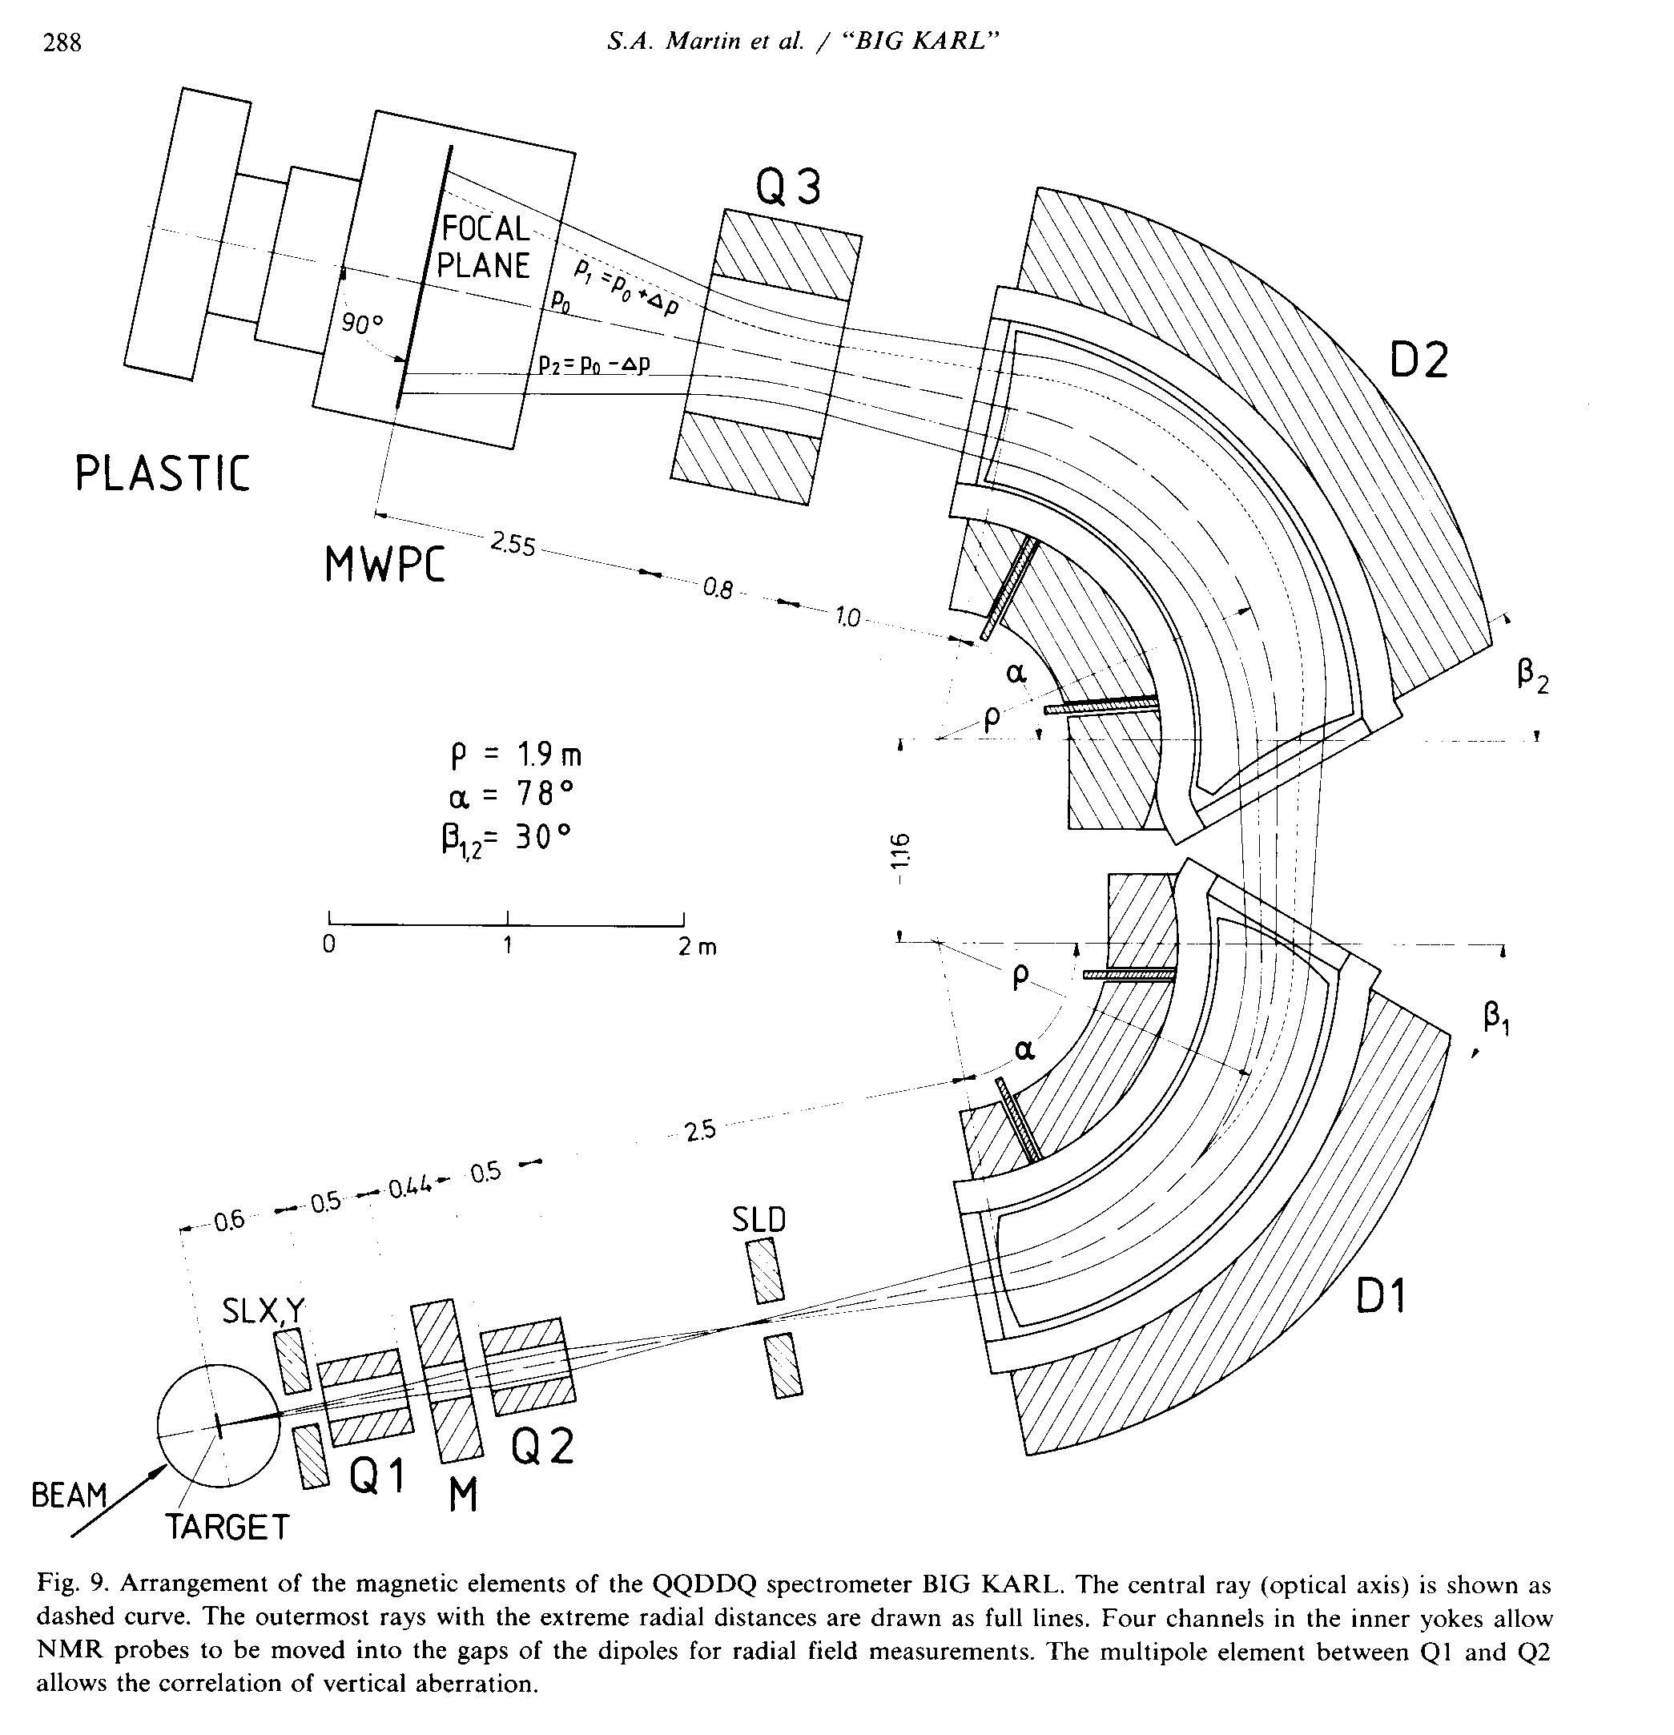
BIG KARL
Spectrometer
(Juelich, KFZ)
Bending radius ρ₀ = 1.98 m
B_{max} = 1.7 T
Gap = 6cm
Weight = ~ 50 tons (D1)
~ 70 tons (D2)
Resolv. power: p/Δp = 0 - 20600
Dispersion = -2.0 to 26 cm/%
Magnification M_{x} = 0.63 – 1.26
Magnification M_{y} = 25.4 – 1.94
Large range: E_{min} /E_{max} = 1.14
Solid angle: < 12.5 msr

Slide 13
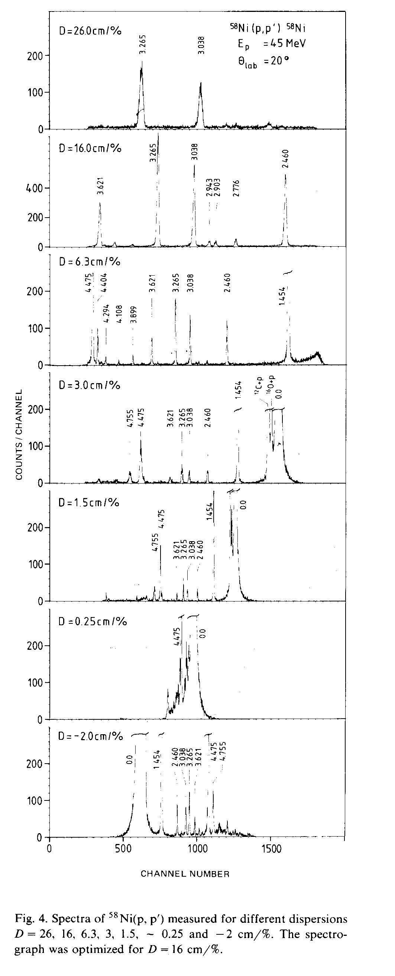
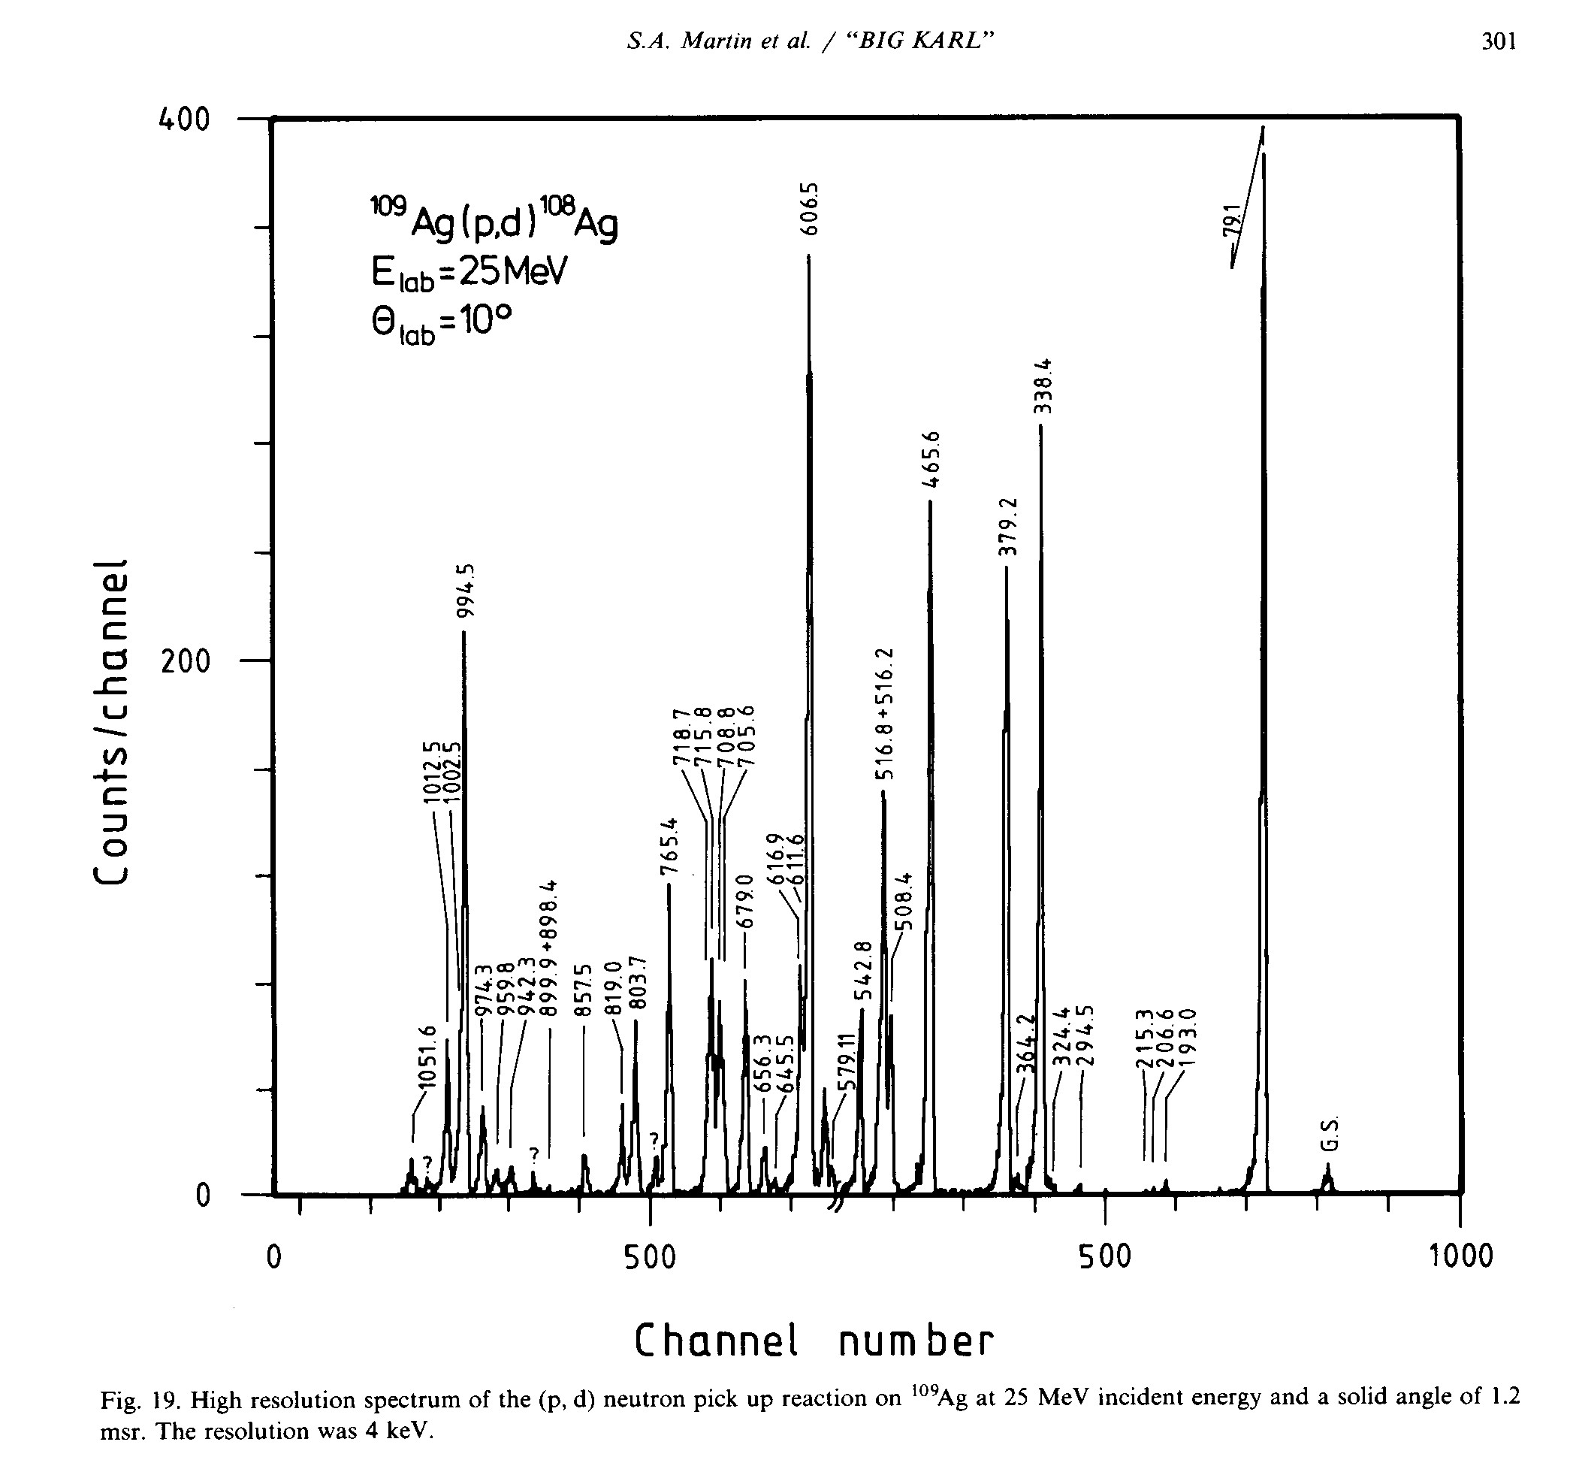
BIG KARL Sample Spectra

Slide 14
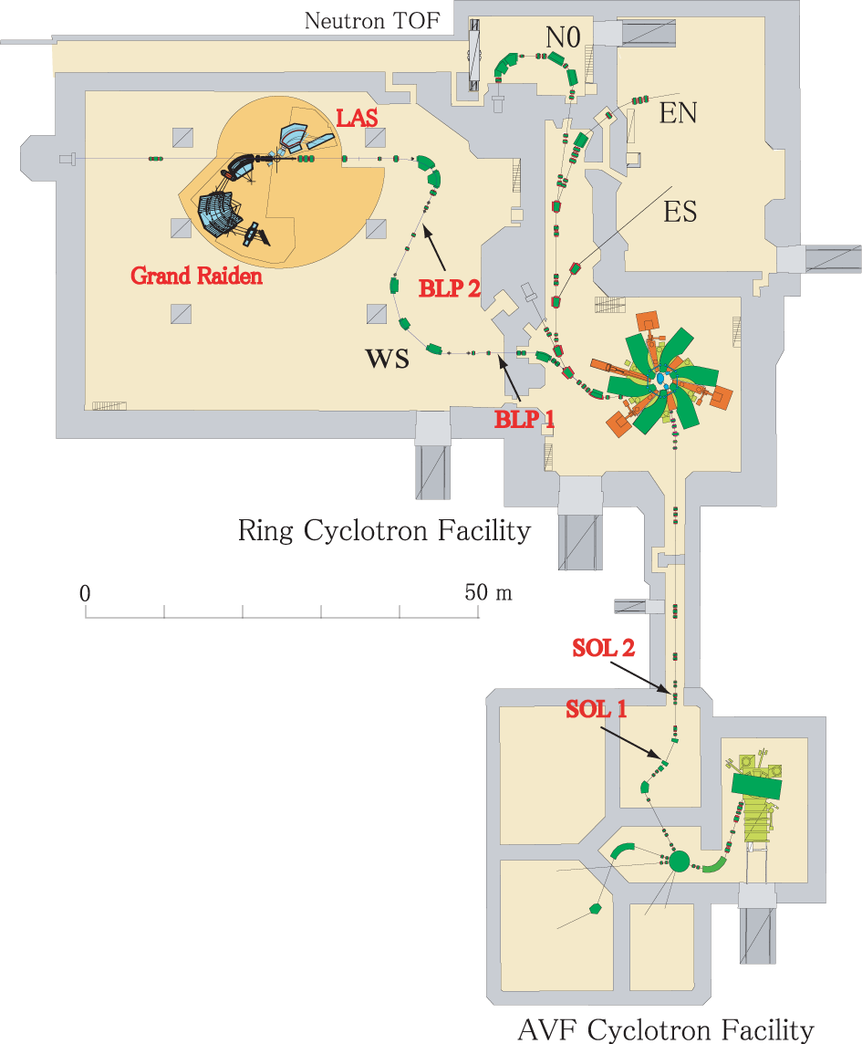
RCNP Facility Layout
Osaka, Japan
D = S₁₆ = 17 cm/% = 17 m
M = S₁₁ ~ - 0.45
Dispersion on target:
B₁₆ = D/M = - 37 m
Resolving power:
2x₀ = 1 mm
R = p/Δp = 37000
Dispersion matched beam line WS to the high resolution spectrometer Grand Raiden

Slide 15
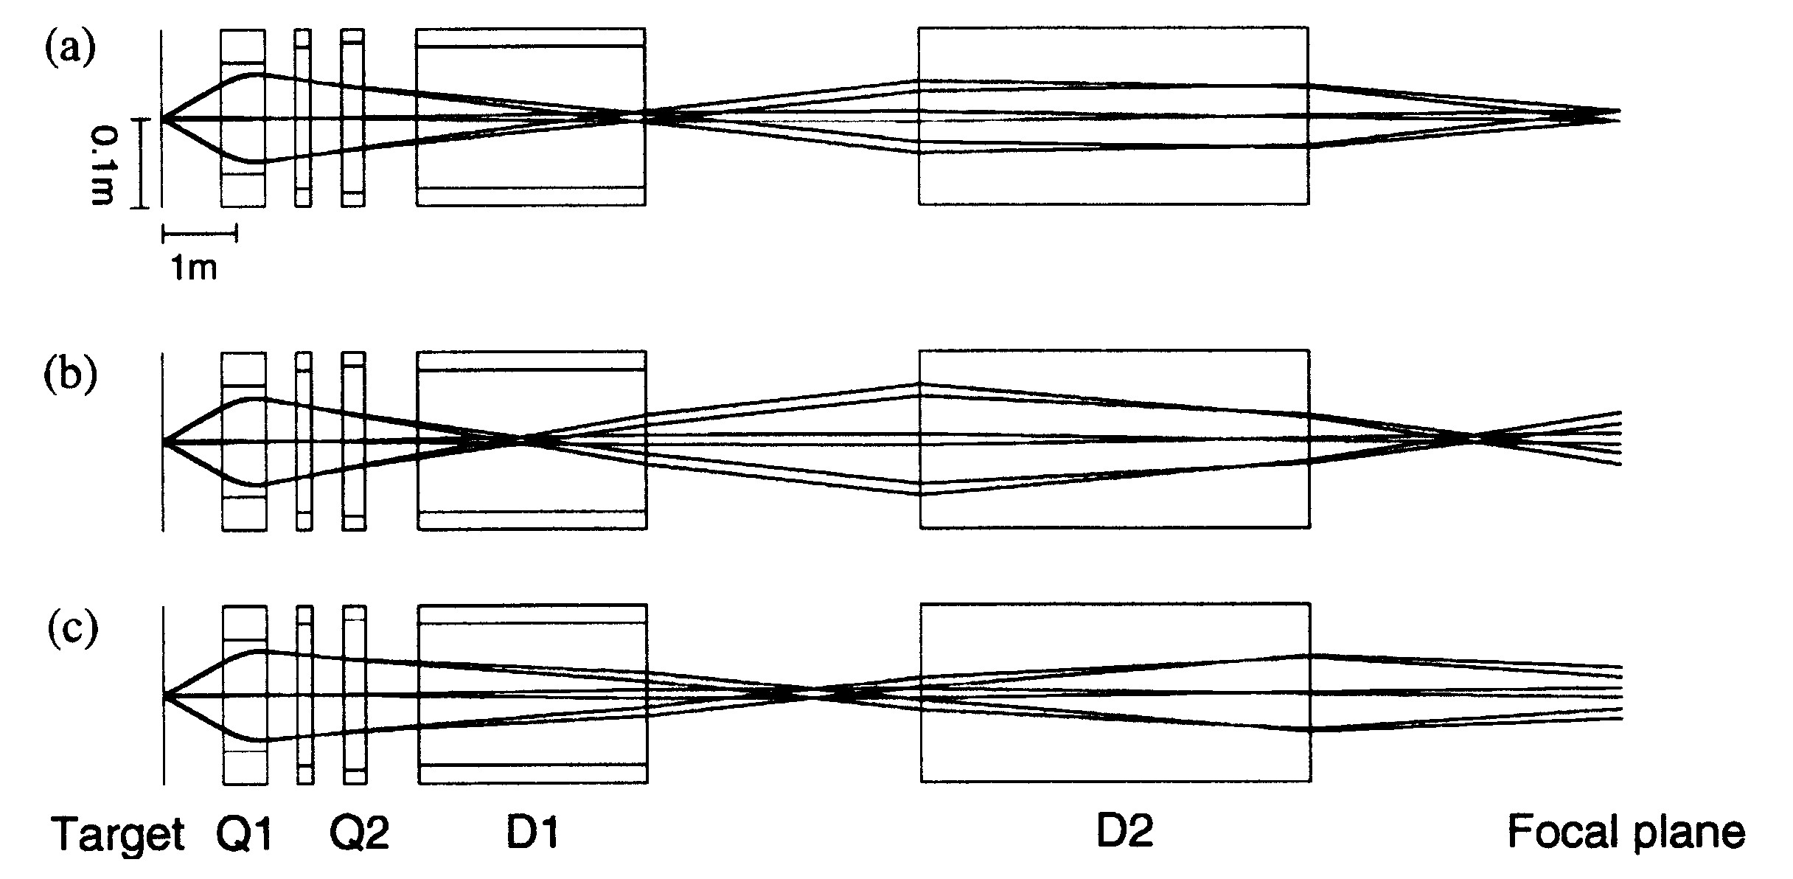
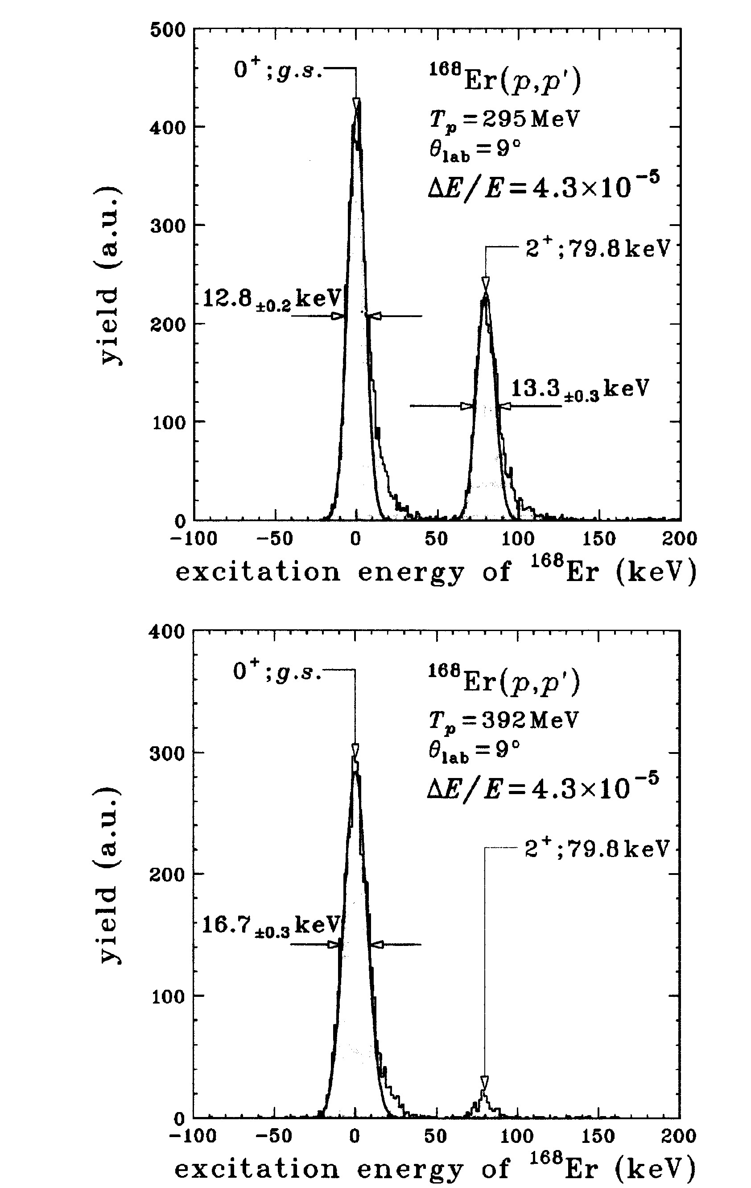
Momentum and Angular Resolution
Spacial & Angular Dispersion Matching & Focus Condition allows
Energy Resolution: E/DE=23000, p/Dp = 40000, despite beam spread: E/DE = 1700 - 2500
Angular resolution: DU_{scatt} = SQRT(DU²_{hor}+DF²) = 4 - 8 msr
At angles close to beam (e.g. 0 deg) vert. angle
component is needed → Overfocus mode, small
target dimension, because (y|y) is large,
Limitation: multiple scattering in detector
Refs.: Y.Fujita et al, NIM B126(1997)274, H.Fujita et al. NIM A 469(2001)55, T.Wakasa et al, NIM A482(2002)79

Slide 16
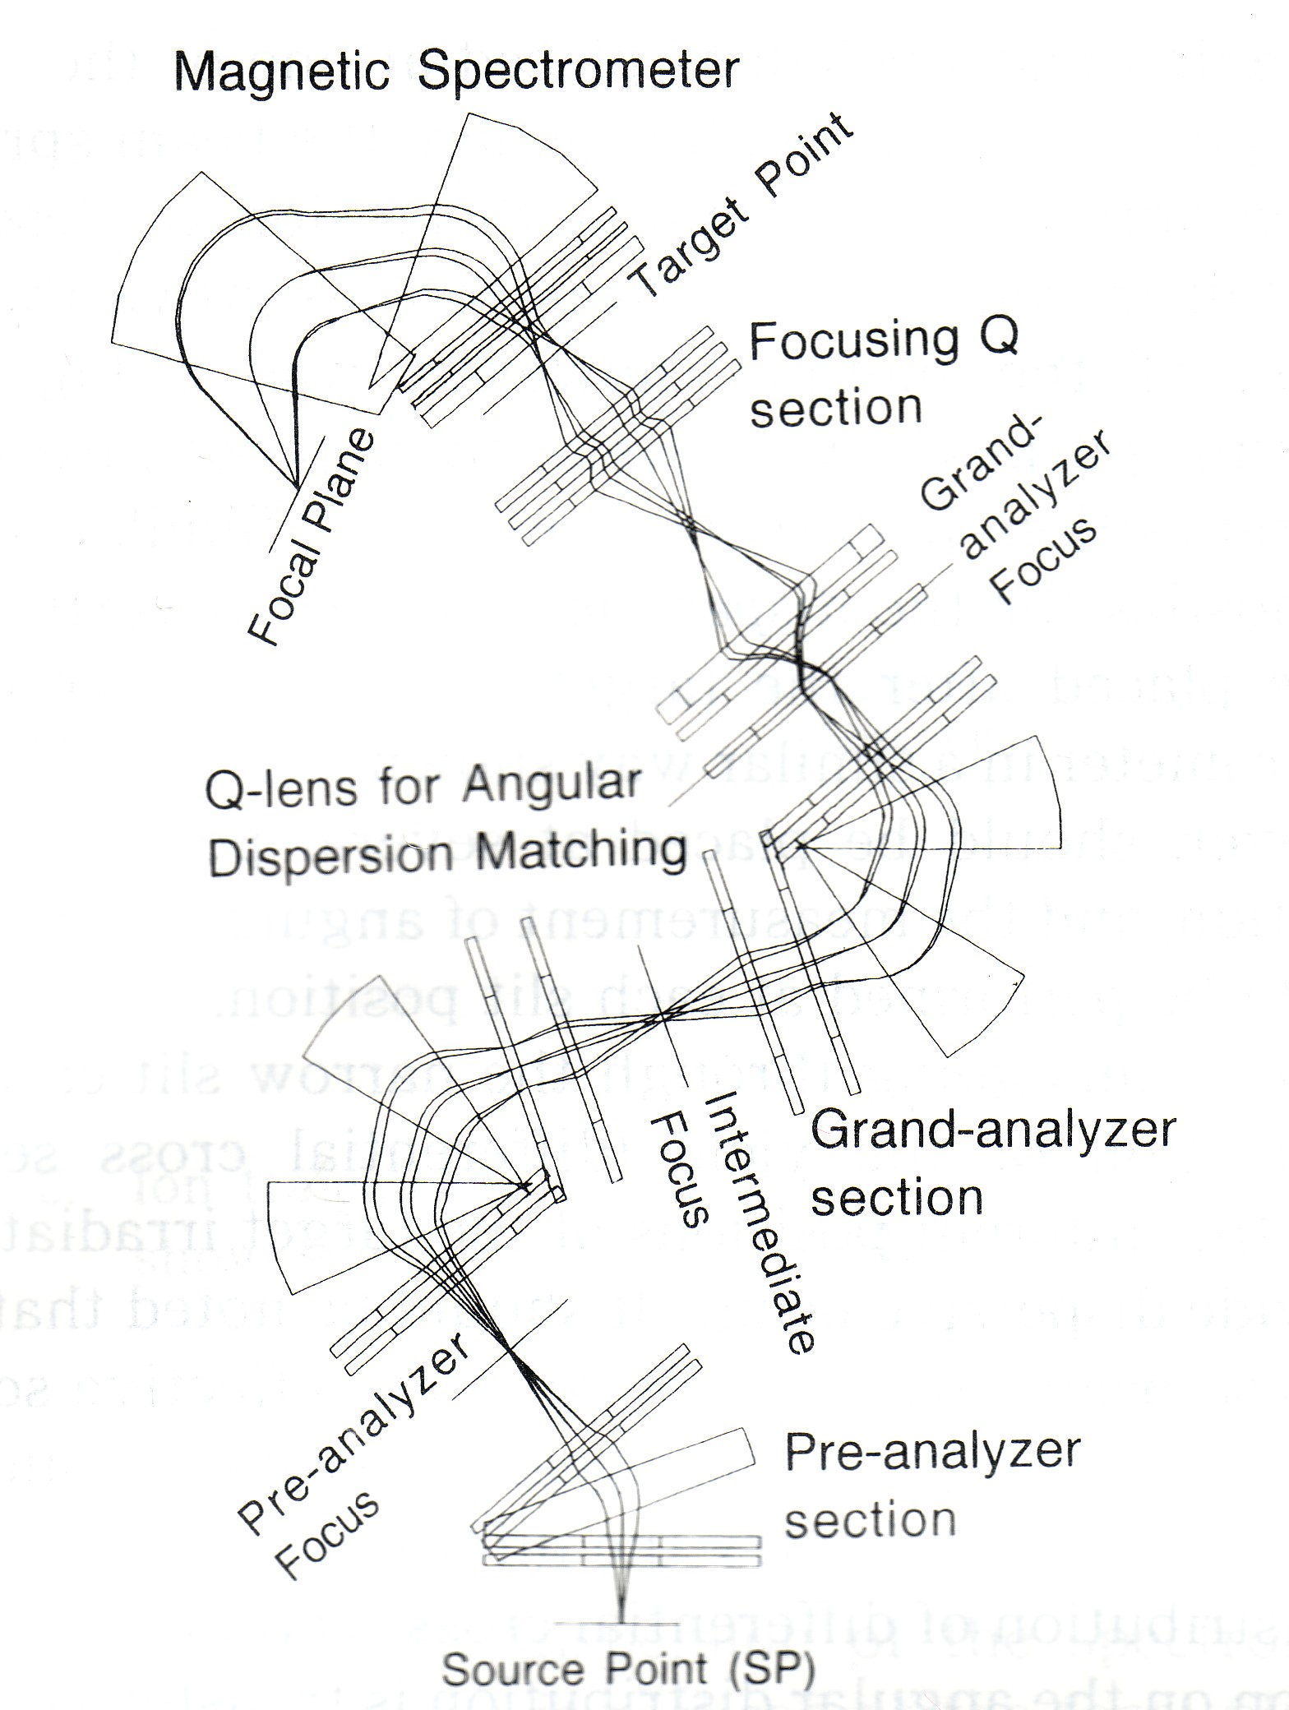
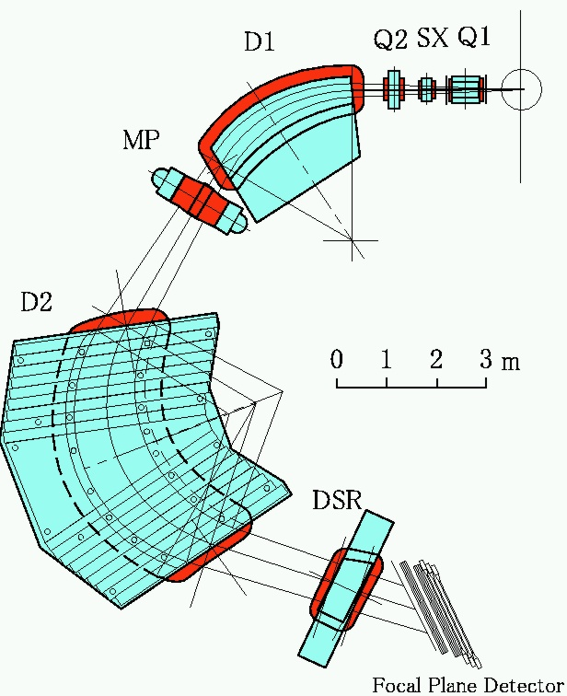
Grand Raiden High Resolution Spectrometer
Max. Magn. Rigidity: 5.1 Tm
Bending Radius ρ₀: 3.0 m
Solid Angle: 3 msr
Resolv. Power p/dp 37000
Beam Line/Spectrometer fully matched
←
Faraday cup
for (³He,t)
Bρ(t) ~ 2*Bρ(³He)
IUCF
K600 !
Dipole for in-
plane spin component

Slide 17
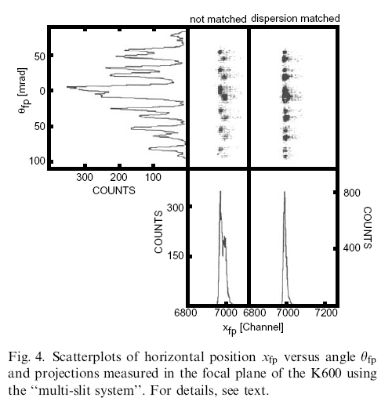
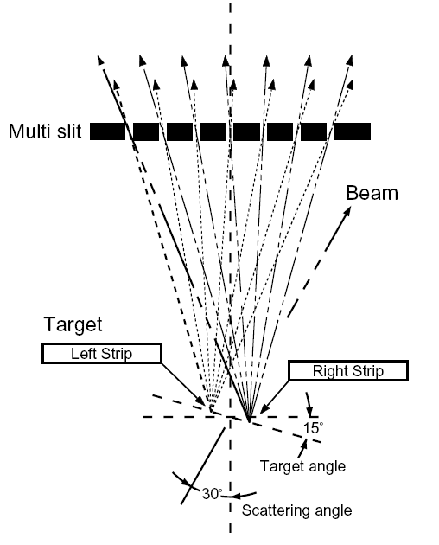
Diagnostic of Dispersion Matching
of beam line & spectrometer using a double strip target & multi slit
IUCF K600, 1986

Slide 18
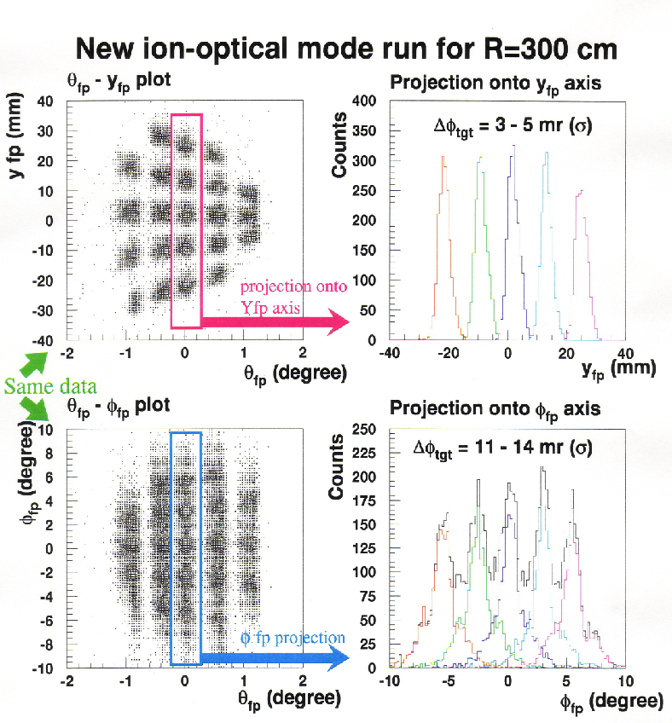
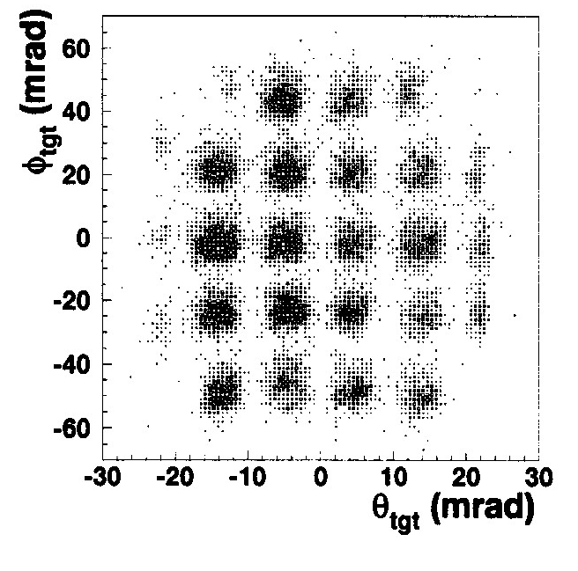
Grand Raiden
Angle Calibration
Data suggest: Use y_{fp} not Φ_{fp} to calibrate angle!
Over-focus mode (b)
Calibrated!

Slide 19
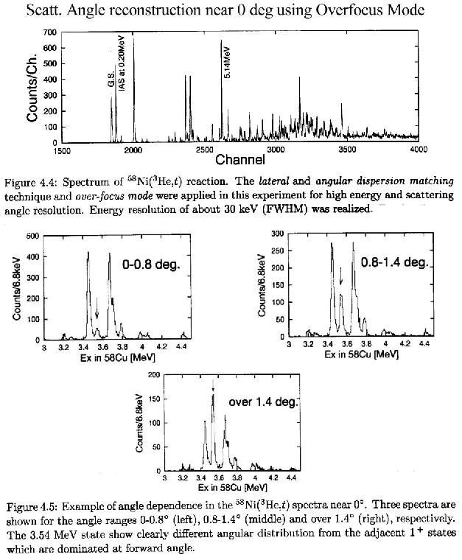
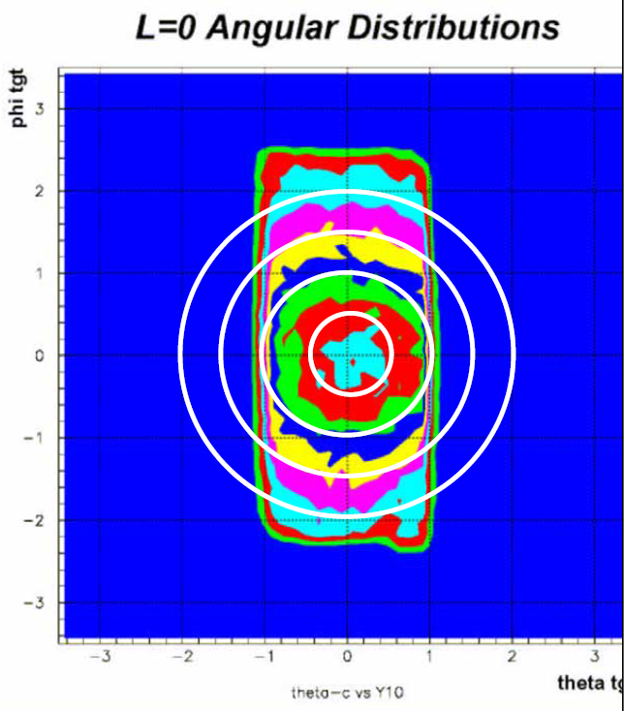
Scattering Angle reconstructed from focal plane measurements using complete dispersion matching techniques
E(³He) = 420 MeV
Φ(target)
Θ(target)

Slide 20
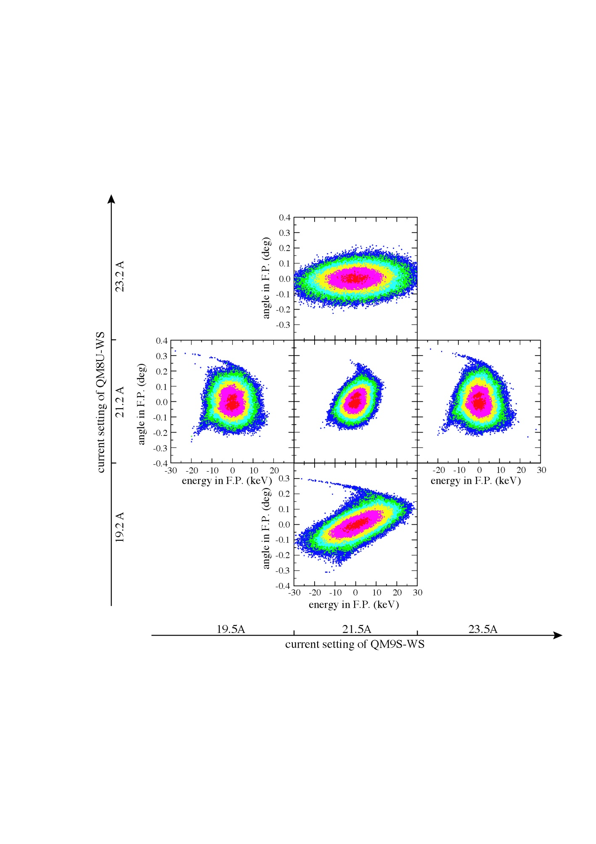
Horizontal Beam Profiles in the Focal Plane of Grand Raiden
Dispersion matching for K = 0 with faint beam
QM8U
→Control lateral
dispersion
QM9S
→Control angular
dispersion
Lateral and angular dispersions can be controlled independently
References
  Y. Fujita at al., NIMB 126(1997)274
  H. Fujita et al., NIMA 469(2001)55
  T. Wakasa et al., NIMA 482(2002)79

Slide 21
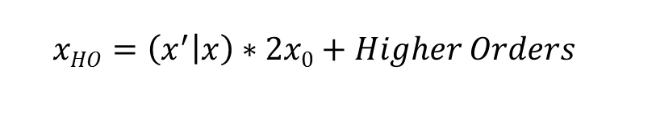
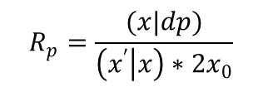

High Resolution Spectrometers
Momentum Analysis
(x|dp) = M₁₆ = Momentum (p) dispersion
Momentum Resolving Power
Momentum Resolution:
For High Resolution using Spectrometers (no physical separation) consider the following
Momentum resolving power R_{p} has to meet the design goal (e.g. Grand Raiden: 37000, SHARAQ: 15000 for 2x₀ = 1 mm), given by science requirements.
If beam momentum spread δp/p > 1/ R_{p} need Dispersion Matching or Beam Tracking, count rate limit ~10⁶ p/sec, not suitable for high intensity stable beams.
RI beam with δp/p ~ 1- 3 % dispersion matched beam (-S₁₆/S₁₁) on target too large (50 –100 cm). Therefore, SHARAQ has several modes (achromatic, high resol. achromatic, dispersive)
RI beams, high energies, 100 – 300 MeV/A, tracking detectors in beam line (BigRips, SHARAQ)
Within limits (multiple-scattering in focal plane (FP) detectors) HO can be corrected using standard FP detectors (x,x’,y,y’).
$$R_{p}=\frac{(x|dp)}{\left(x^{′} | x\right)∗2x_{0}}$$
(x’|x) = M₁₁ = Magnification
Image size
2x₀ = Target spot size
$$R_{p}^{HO}=\frac{(x|dp)}{x_{HO}}$$

Slide 22
Dispersion matching modes
Beam momentum spread p/dp < Resolving power R_{p}: Full resolution without dispersion matching, beam line achromatic mode sufficient.
Beam momentum spread p/dp ~ (1- 10)* R_{p}: Full resolution requires dispersion matching, e.g. Grand Raiden: 300 MeV p: beam ~150 keV, resolution 13 keV, 400 MeV p: beam ~ 150 keV, resol. 17 keV
Secondary Radioactive Beam (RI) : Beam momentum spread p/dp > 10* R_{p}: Dispersion matching with full beam is possible but typically dispersed beam on target impractically large, e.g. SHARAQ: > 10 cm). Mitigation: Intermediate modes with reduced beam momentum spread/intensity or reduced resolution.

Slide 23
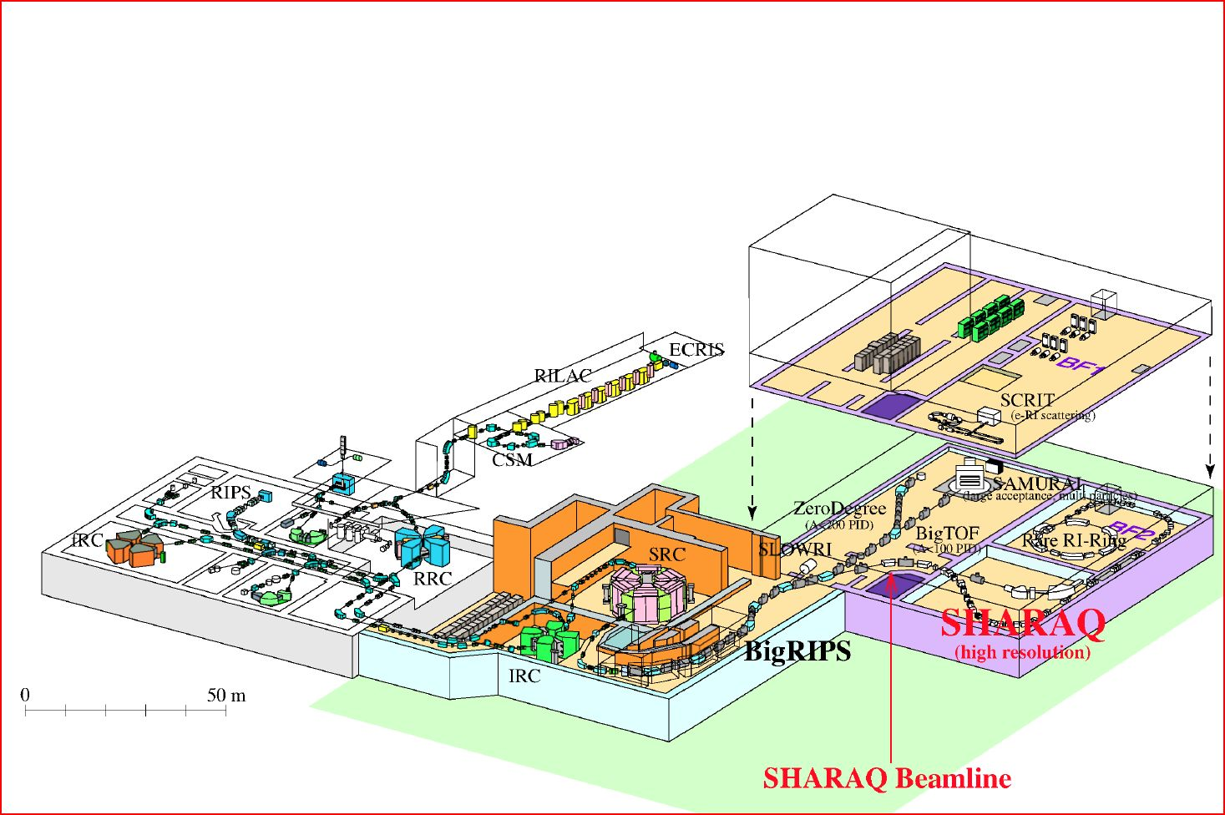
Beam Factory RIBF at the RIKEN Accelerator Research Facility (RARF)
SHARAQ: Pionieering spectrometer in high resolution Dispersion Matching with RI beam.
BigRIPS: T. Kubo
Ion-optical design: T. Kawabata
Spectrometer: H. Sakai, T. Uesaka
Future projects under design:
FAIR, GSI: LEBS (Low energy buncher spectrometer)
FRIB, MSU: HRS (High rigidity spectrometer)
SMART

Slide 24
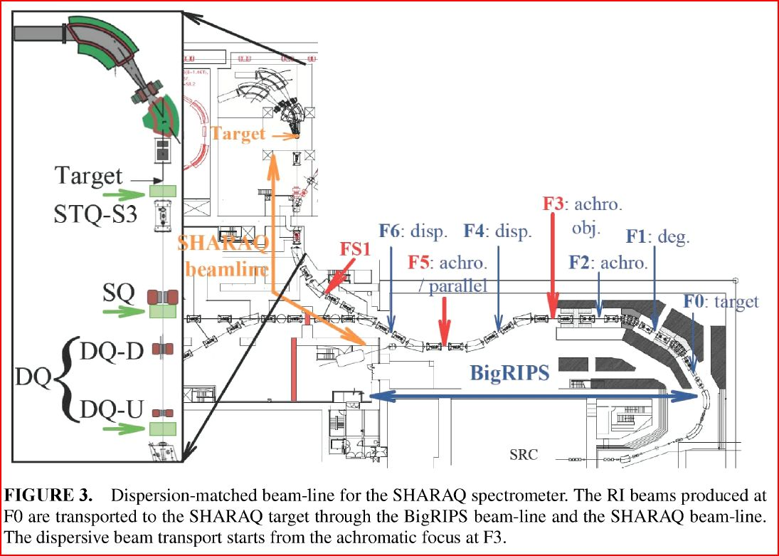

Slide 25
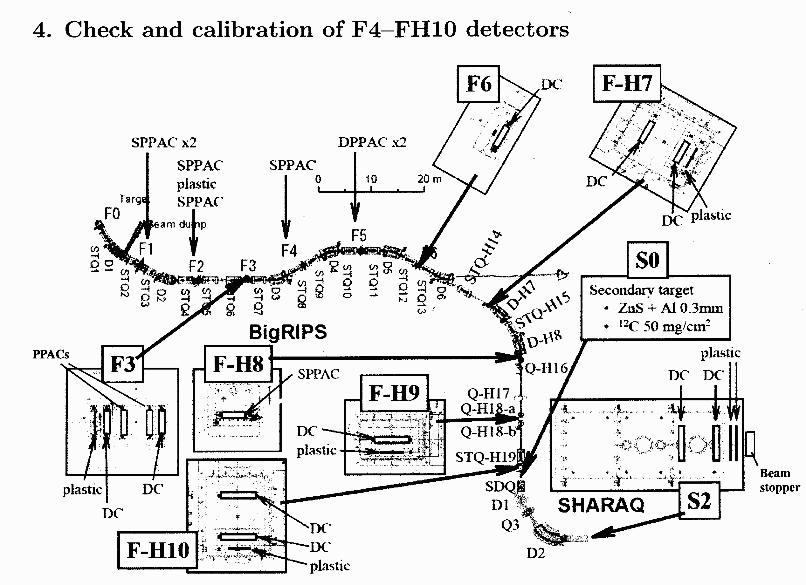

Slide 26
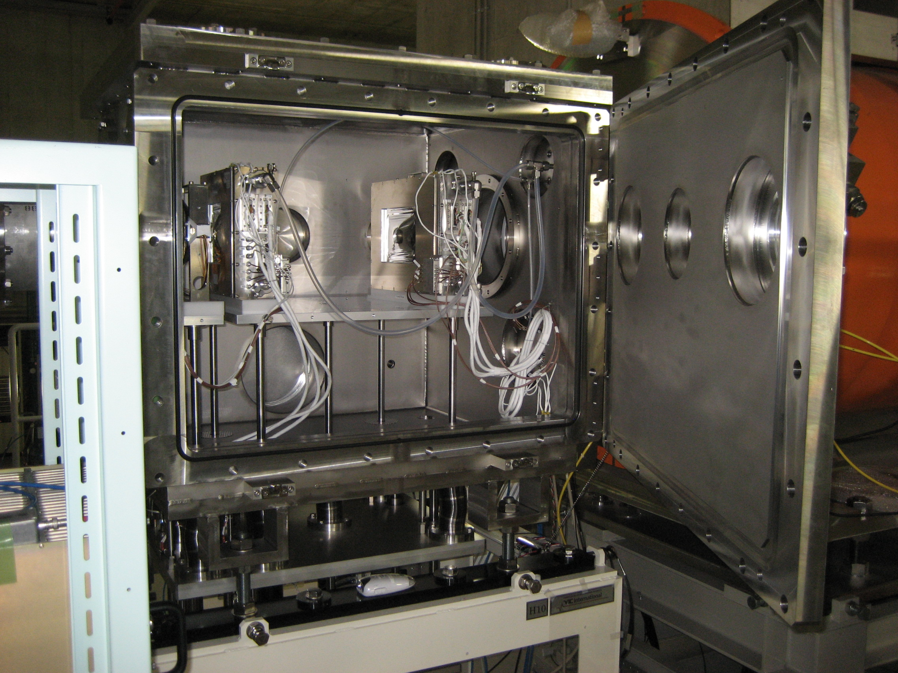
Pair of Drift Chambers at Location H10

Slide 27
SHARAQ, Modes of Operation
Beam line requires special design for high-resolution spectrometer measurements with RI-beams.
To achieve the high-resolution measurement with SHARAQ both dispersion matching and beam tracking methods are used.
Depending on experiments, the following modes are available
Achromatic
(high resolution)
Achromatic
(large acceptance)
Mode
Dispersive
Resolution
Δp/p=1/15000
Δp/p=1/7500
Δp/p=1/1500
at target
Tracking at F6
Tracking at F5
Acceptance
Δp/p = +/- 0.3 %
Δp/p = +/- 0.3 %
Δp/p = +/- 2 %
Δθx= +/- 10 mr,
Δθy= +/- 30 mr
Δθx= +/- 10 mr,
Δθy= +/- 30 mr
Δθx= +/- 20 mr,
Δθy= +/- 20 mr
Hor. Target spot : ~100 mm ~30 mm ~30 mm

Slide 28
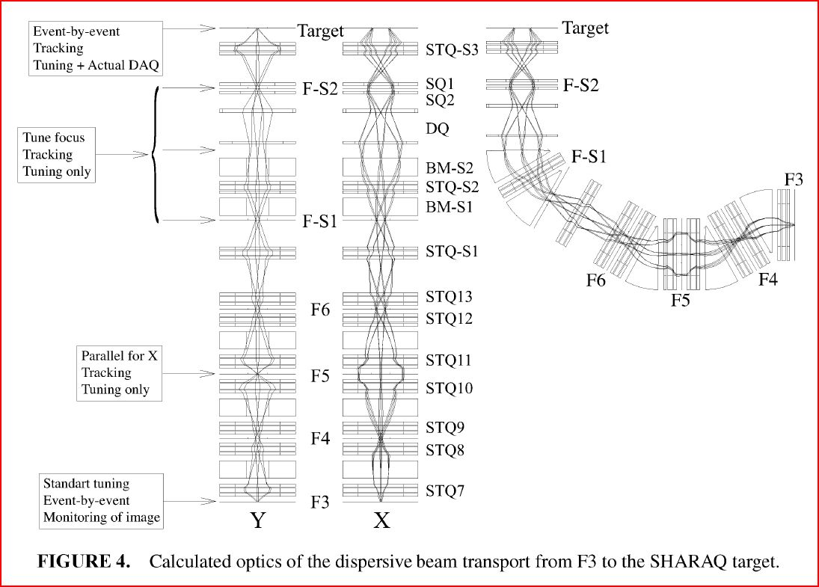
Matching condition
b₁₆ = -14.76 m
b₂₆ = 4.79 rad
b₁₂ = 0, for k=dp/dθ/p = 0
T. Kawabata et. al.
NIM B 266 (2008).

Slide 29
“High resolution” achromatic mode
Δθ_{x}= +/− 10 mr, Δθ_{y}= +/− 30 mr,
Δx = +/− 3 mm, Δy = +/− 3 mm,
ΔP= +/− 0.3 %
target
FH9
same as diper. mode
Beam size < a few cm
FH8
FH7
F6
F5
1.56
0.00
0.00
0.00
0.64
0.36
1.36
0.00
T. Kawabata
0.00
0.74
F4
F3
Momentum acceptance is ± 0.3 %, keeping Δp/p of ~ 1/7500.
( F6)

Slide 30
“Large acceptance” achromatic mode
Δθ_{x}= +/− 20 mr, Δθ_{y}= +/− 20 mr,
Δx = +/− 3 mm, Δy = +/− 3 mm,
ΔP= +/− 2 %
target
Momentum acceptance
can be increase up to ± 2 %.
F-H9
F-H8
Beam transport is different
from dispersion matching mode.
F-H7
F5
same as the standard BigRIPS
transport up to F5.
F6
F3
F4
resolution Δp/p~1/1500 (at F5 )

Slide 31
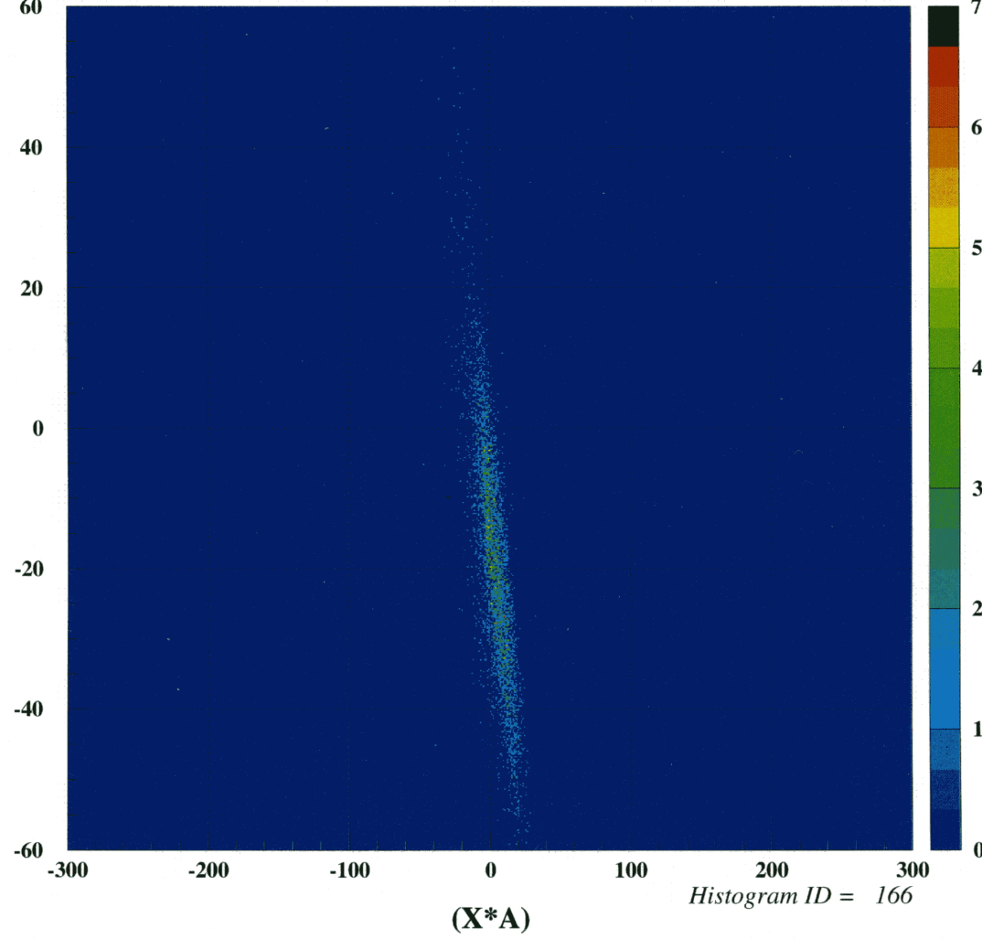
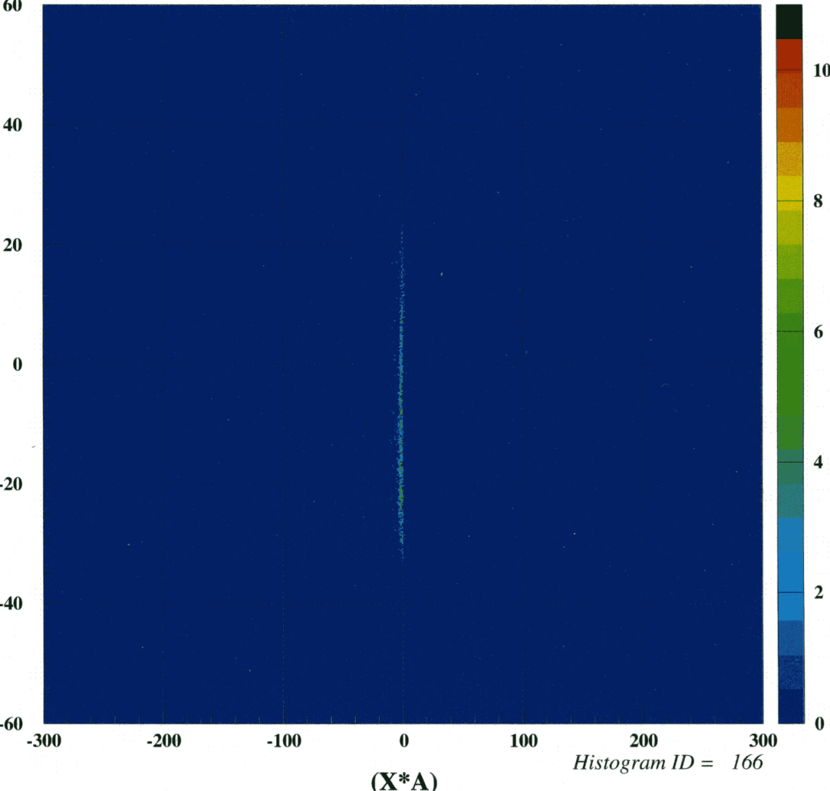
Dispersion Matching of Beam Line and SHARAQ Spectrometer
250 MeV/u ¹⁴N beam, approx. 1000 events/s

Slide 32
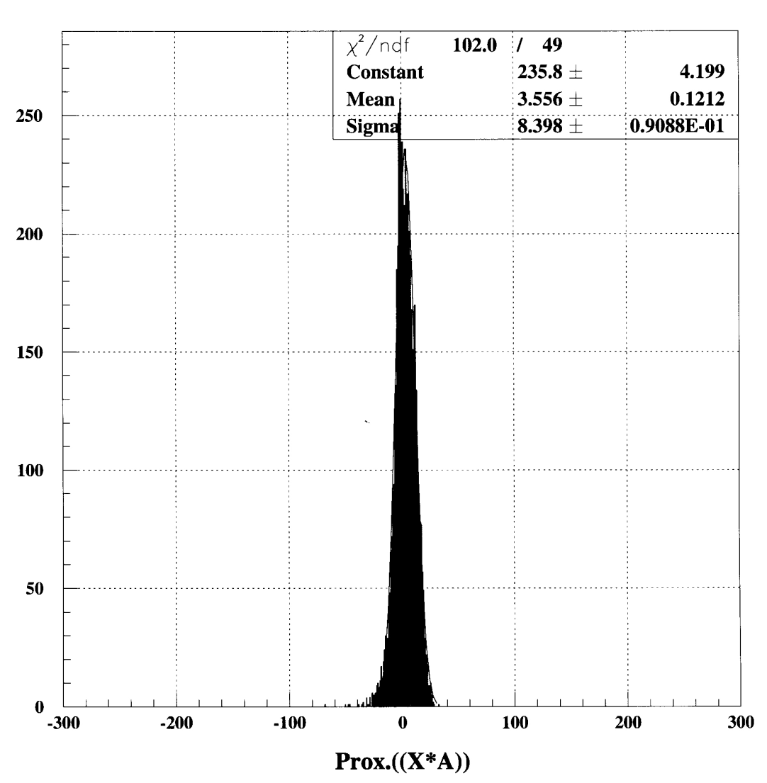
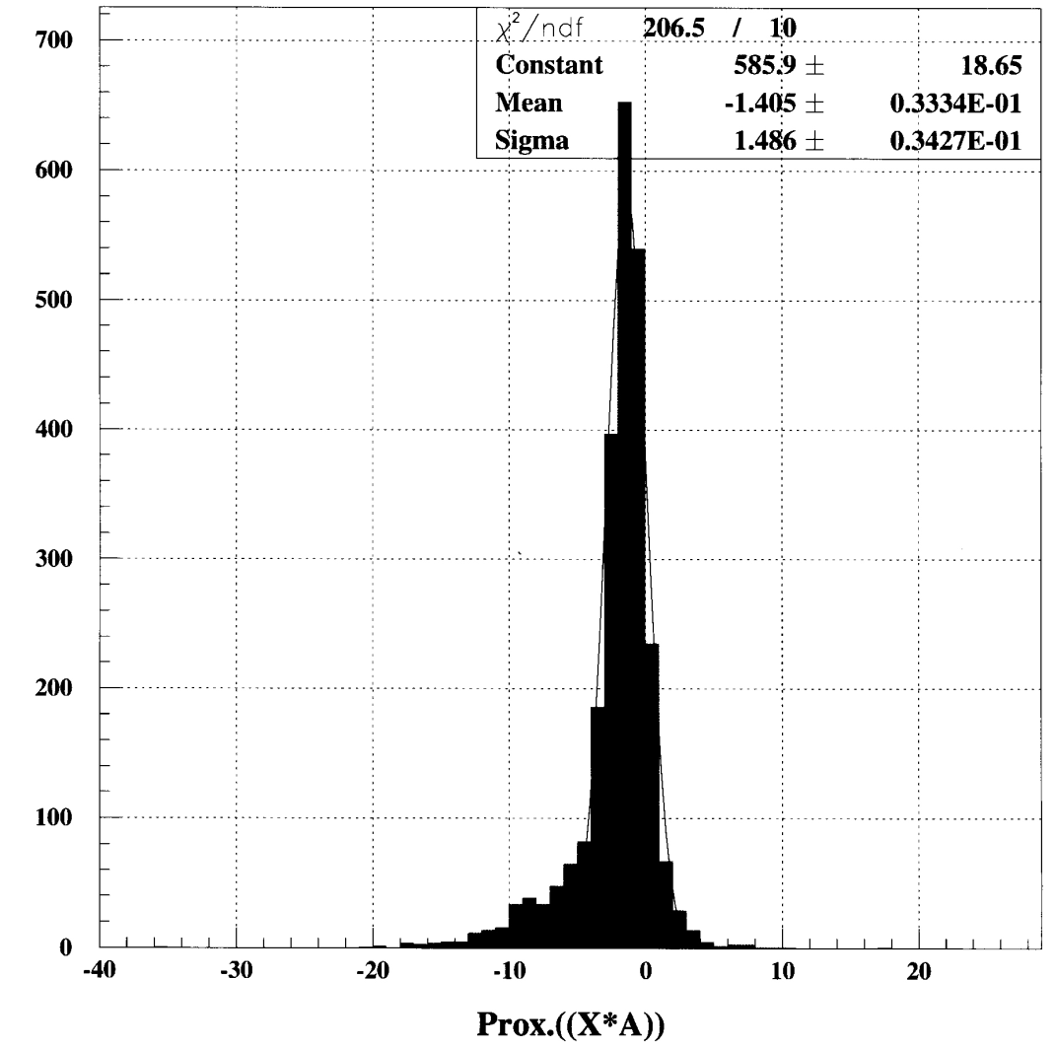
Resolution
Resolution: approx. 3.5 MeV
Resolution: approx. 0.65 MeV
Resolv. Power: 0.43 MeV

Slide 33
End

Slide 34
