Slide 1
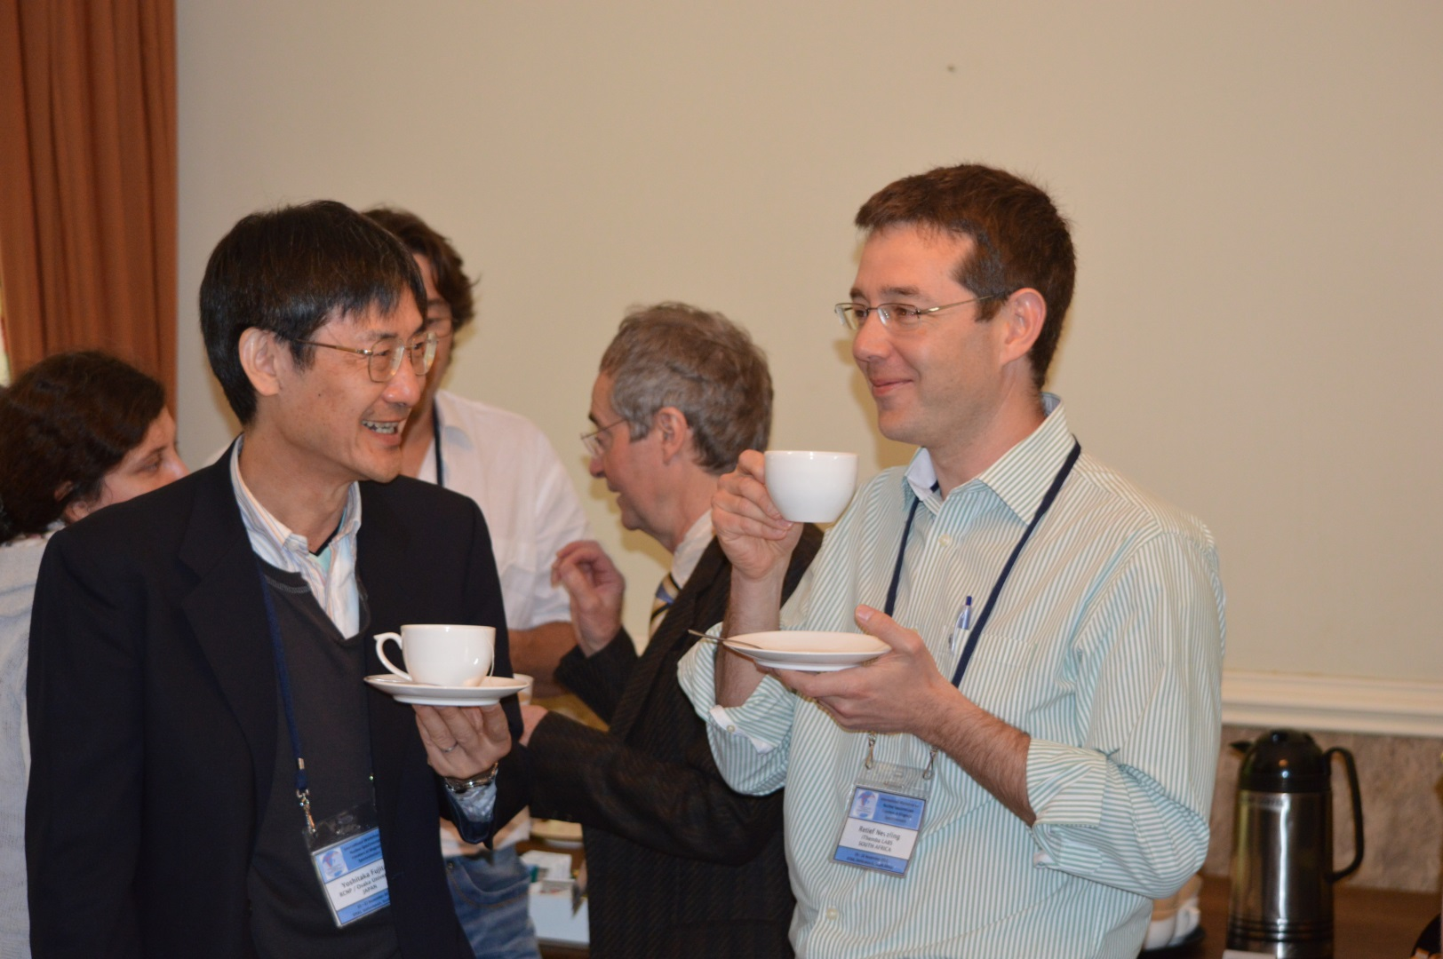
High energy resolution spectroscopy with K600 magnetic spectrometer at iThemba LABS – FD Smit

Slide 2
Beginning of 0˚ mode for K600 at iTL
Invitation by Peter von Neumann-Cosel to take part in an RCNP experiment
Meet Yoshi at RCNP in May 2002
Yoshi strongly advises that 0˚ at iTL is possible
Biggest worry is that weekends only beam time would make it impossible
Return home to considering

Slide 3
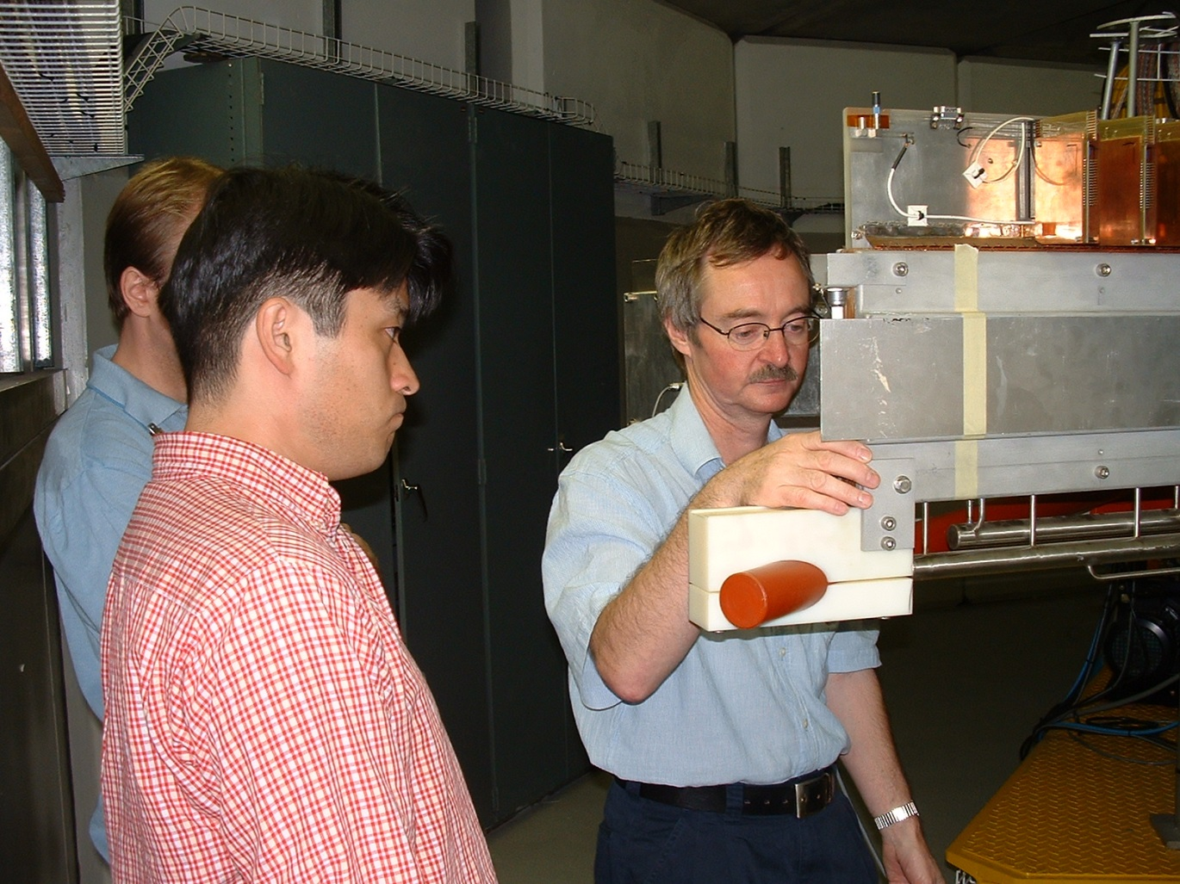
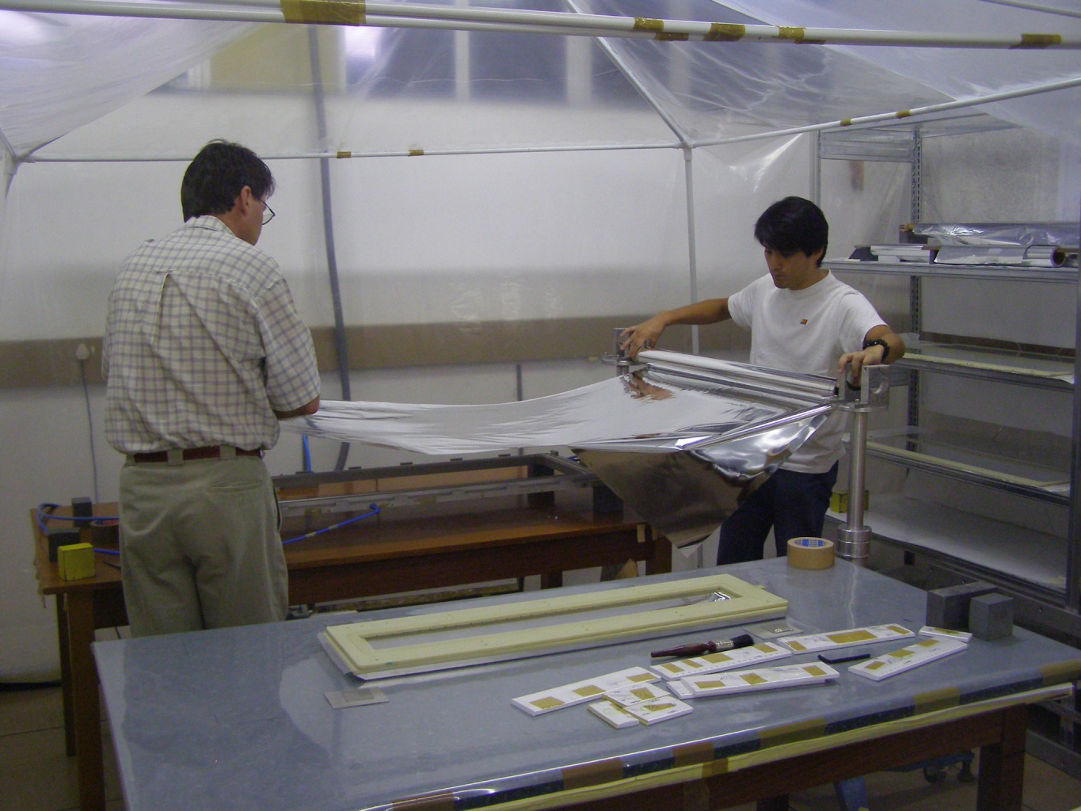
Work commences with Japanese help (2003)
Yoshi’s right hand man helps
H Fujita
J Carter
Financing :
TUD (DFG)
Wits (NRF)
Oct’ 2006 – First beam in new 0˚ beam dump

Slide 4
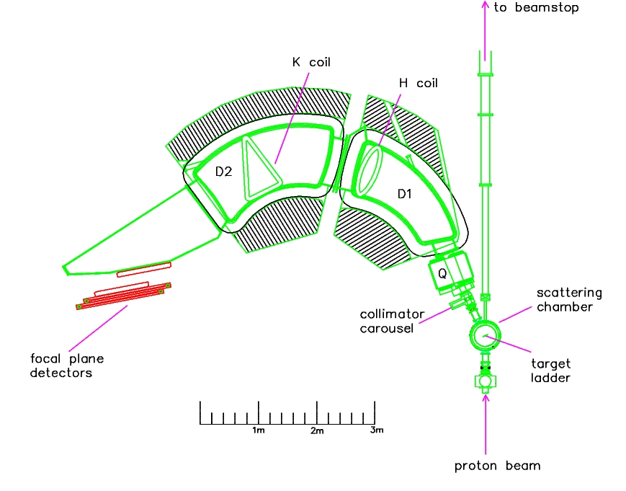
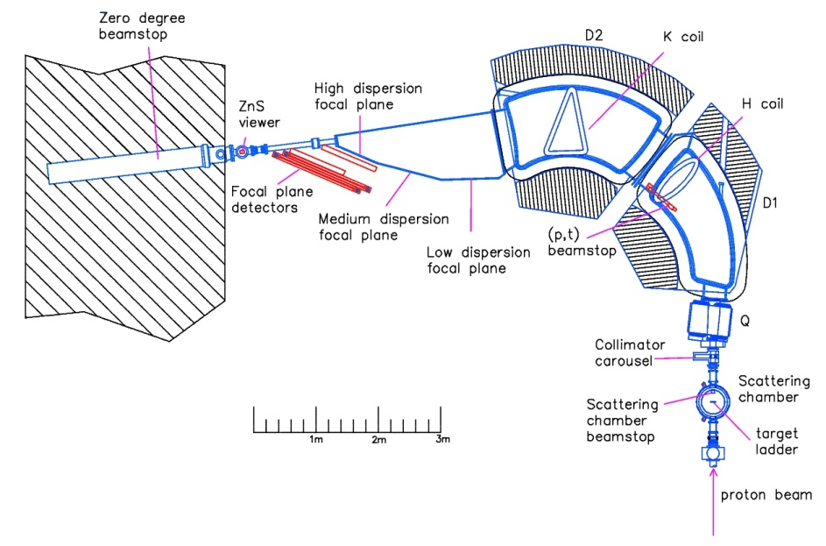
The K600 at iThemba LABS
A kinematically corrected QDD magnetic spectrometer for light ions
Indiana University Cyclotron Facility design
Since 1993
Finite angle measurements (θ_{scat}>5°)
Medium dispersion focal plane B(D1)=B(D2)‏
Large momentum range: p_{max}/p_{min}=1.097
Resolving power: ∆p/p = 1/28000
Horizontal magnification M_{x} =-0.52
Vertical magnification M_{y} =-5.5
Dispersion: 8.4 cm/%
Since 2009
Zero degree measurements (θ_{scat}<2°)
High dispersion focal plane B(D1)/B(D2)=1.49‏
Momentum range: p_{max}/p_{min}=1.05
Horizontal magnification M_{x} =-0.74
Vertical magnification M_{y} =-7.05
Dispersion: 10.9 cm/%
Solid angle: 3.5 msr

Slide 5
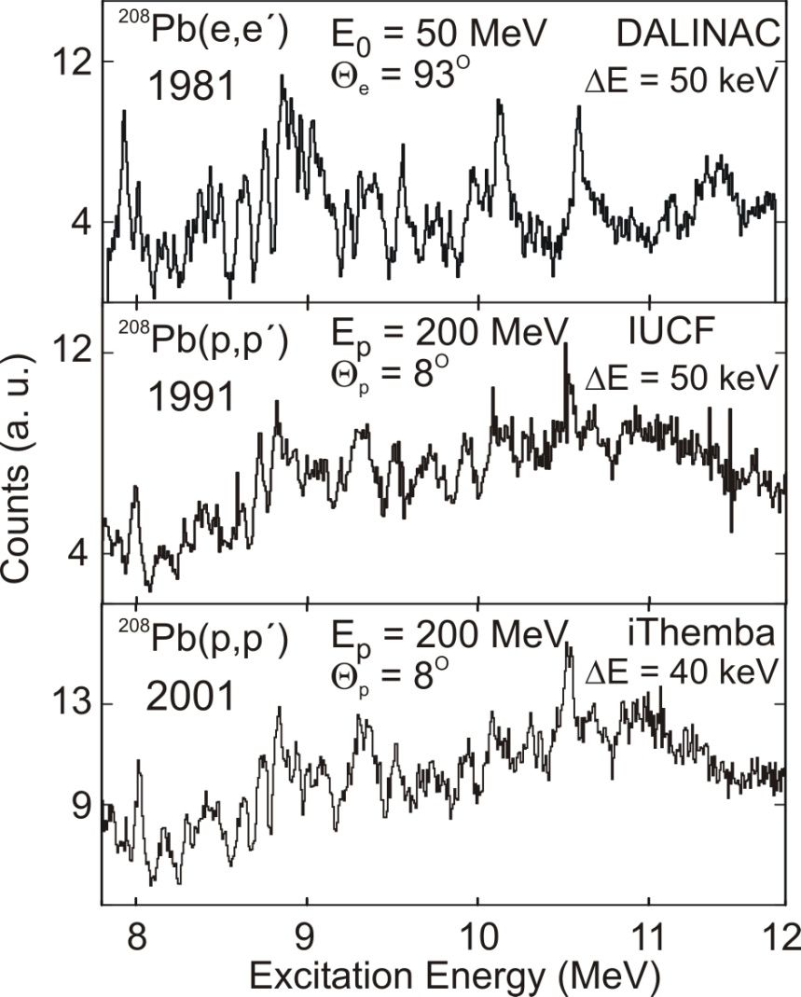
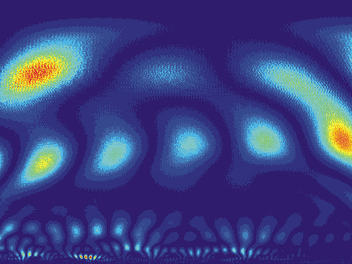
ISGQR & IVGDR fine structure
Fine structure seems to be global phenomenon: different
targets, different resonances
Wavelet analysis: scales characterize the fine structure
Use scales to study dissipative mechanisms of GR
208
Pb(p,p)‏
’
E = 200 MeV
o
θ
= 8
o
Power Spectrum
Scale
Scale
Wavelet Power (a.u.)‏
Excitation Energy (MeV)‏
A. Shevchenko et al., Phys. Rev. Lett. 93, 122501 (2004)
Notes:
can in this way investigate dissipative mechanism of giant resonance: i.e. coupling to surface vibrations, or 2p2h excitiations? Answer is in the scales

Slide 6
iTL K600 zero degrees
Special thanks :
Y Fujita
H Fujita
K Hatanaka
G Berg

Slide 7
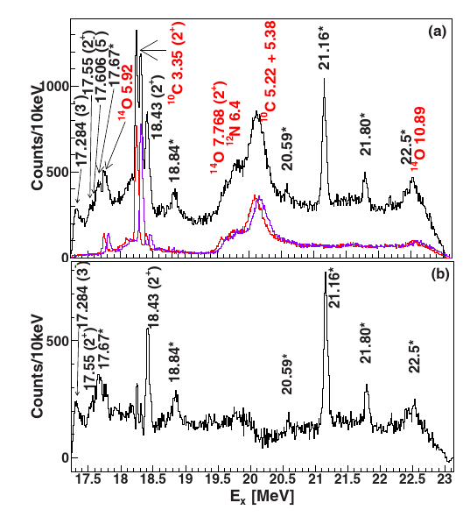
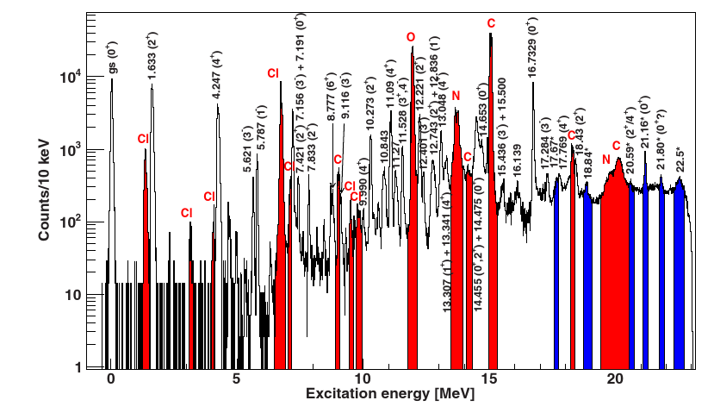
Clustering - Recent ²⁰Ne results from iThemba LABS
(p,p') at 0°
Physical Review C 91 (2015) 034317
²²Ne(p,t)²⁰Ne at 60 MeV
0°, 7°,16°,27°, gas target
Discovered 6 new, narrow, states in E_{x}=17-23 MeV
17.67, 18.84, 20.59, 21.16, 21.80, 22.5 MeV
Low spin values: J=0-2
Only state at 22.5 MeV could not be interpreted
by shell-model calculations

Slide 8
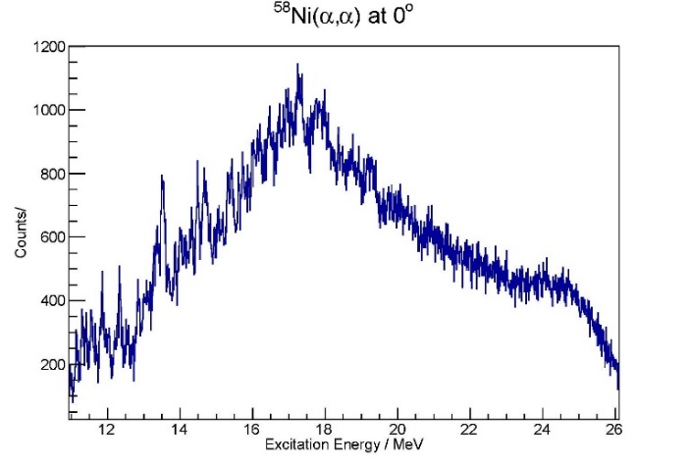
ISGMR Data -- Spin Dependence of Level Densities
Do as well or better than RCNP at (α,αʹ)
Being Analyzed – 75 keV

Slide 9
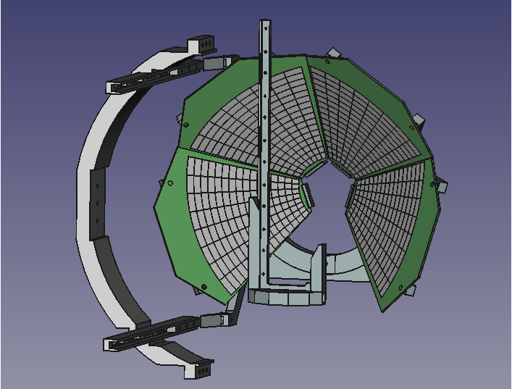
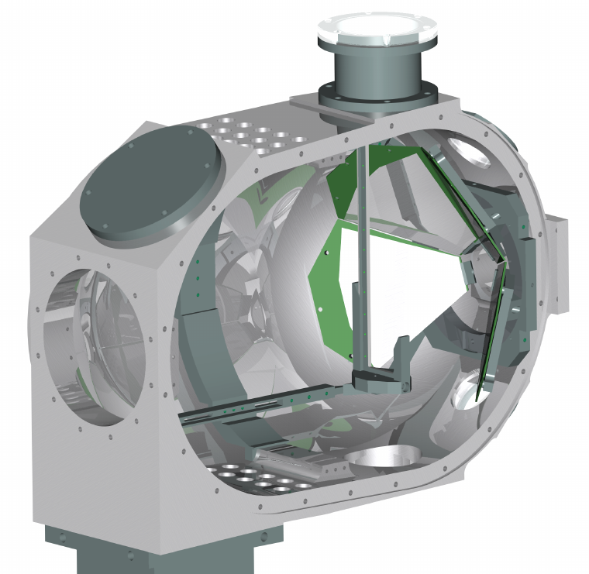
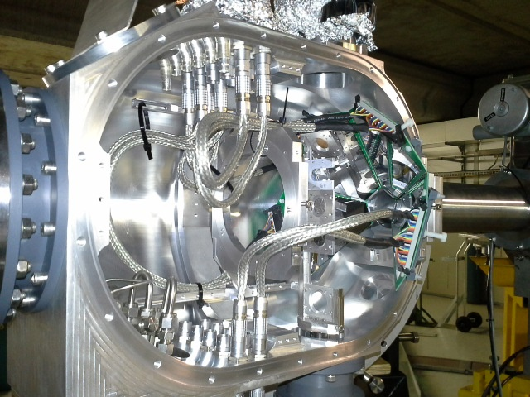
Add a Coincidence DSSSD array: CAKE
Coincidence Array for K600 Experiments
4× MMM-400 Double Sided Silicon Strip
Detectors (DSSSD)
Lampshade configuration
400 μm thick (7 MeV p, 28 MeV α)
16 rings, 8 sectors
θ range: 114° - 166°
total solid angle: 21% of 4π; 0.66 msr/DSSSD
target to detector separation: 100-110 mm
rates during experiment <5kHz/DSSSD
target
beam
NRF NEP funding UID 86052

Slide 10


Clustering: the ¹⁶O nucleus
0 0+
6049.4 0+
6129.89 3-
6917.1 2+
7116.85 1-
9585 1-
9844.5 2+
10356 4+
11097 4+ 11260? (0+)
11520 2+ 11600 3-
Natural parity states (NNDC)
0⁺ state at 15.097:
few hundred keV above 4α threshold
0⁺ state at 15.097:
E_{x} the weighted mean of 4 studies:
Reference Energy Width Reaction
(MeV) (keV)
NPA 180 (1972) 282 15.17 ± 0.05 190 ± 30 ¹²C(α,α₀)
NPA 294 (1978) 161 15.10 ± 0.05 327 ± 100 ¹⁵N(p,α_{i}),(p,p₀)
NPA 305 (1978) 63 15.103 ± 0.005 - ¹⁴N(³He,p)
PRC 25 (1982) 729 15.066 + 0.011 166 ± 30 ¹²C(α,α_{i}),(α,p₀)
Width from Ames (PRC 25)
12049 0+
12440 1-
13020 2+ 13090 1-
13129 3- 13259 3-
S_{4α}= 14437 keV
13600 0+
13869 4+ 14032 0+ 14100 3-
14620 4(+) 14660 5-
14815 6+ 14926 2+
15097 0+ 15260 2+ 15408 3-
15828 3-
16200 1- 16275 6+ 16352 (2+)
16442 2+
16844 4+ 16930 2+
17090 1- 17129 2+
(Also 0⁺ states at: 22040 keV & 22721 keV)
Notes:
Ames give sigma_a0/Sigma=0.35

Slide 11


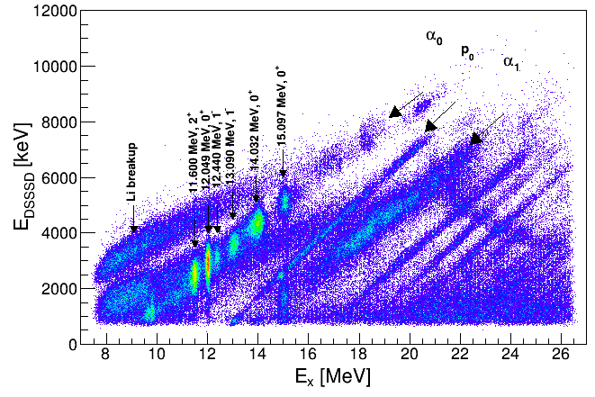
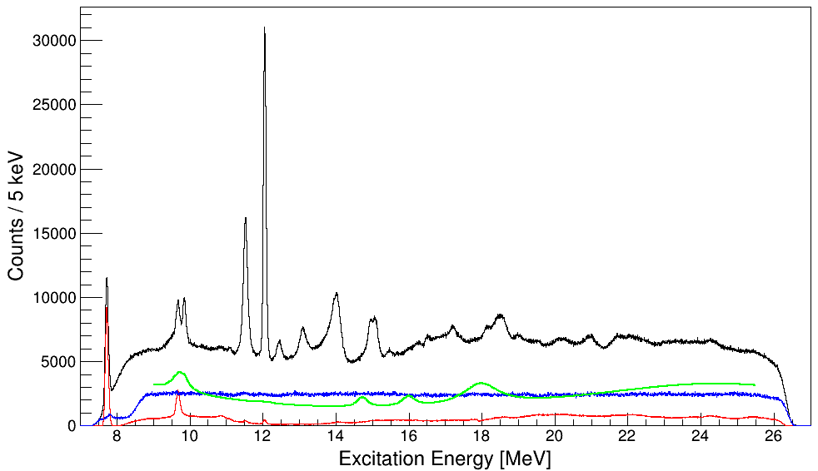
Li₂CO₃(α,α') coincidence results @ 200 MeV, 0˚
DSSSD θ range: 114° - 162°
coincidences: random/real = 1/50
Search for Hoyle-like state in ¹⁶O
Characterize decay of 0⁺₆
at 15.097 MeV
Singles spectrum components:
total yield
fitted Li background
experimental backgrond
measured ¹²C
SetMinimum(3)
Notes:
And here is some results from the first experiment
we did with CAKE.
Keeping with the clustering theme, we looked at the 6th 0+ state in 16O and will attempt to characterize how it decays. This state is at the moment considered to be the candidate for a hoyle-like state in 16O
We used a LiCO target, which while being complicated results in a rather featherless background for the 16O states
You can clearly see the different decay loci in this
2D scatterplot of the energies detected in CAKE
and the excitation energies measured with the K600.

Slide 12
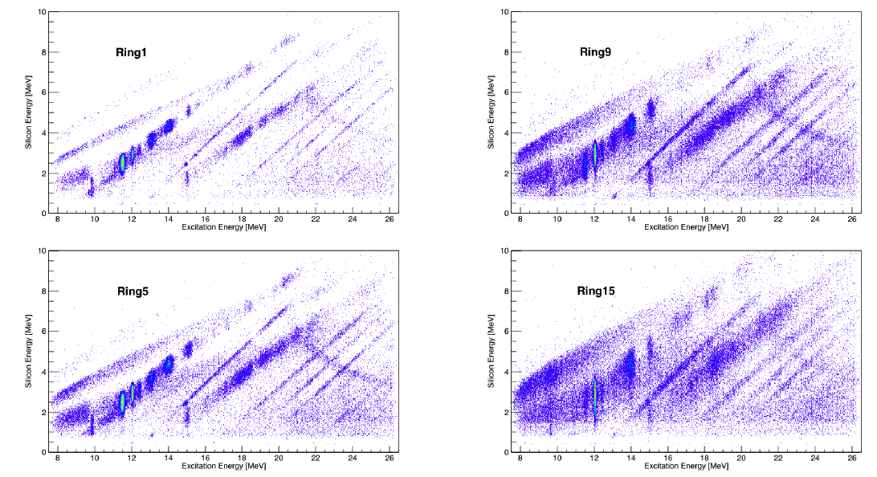
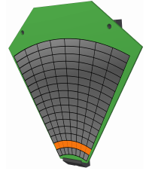
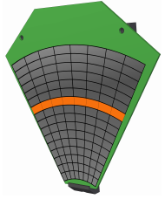
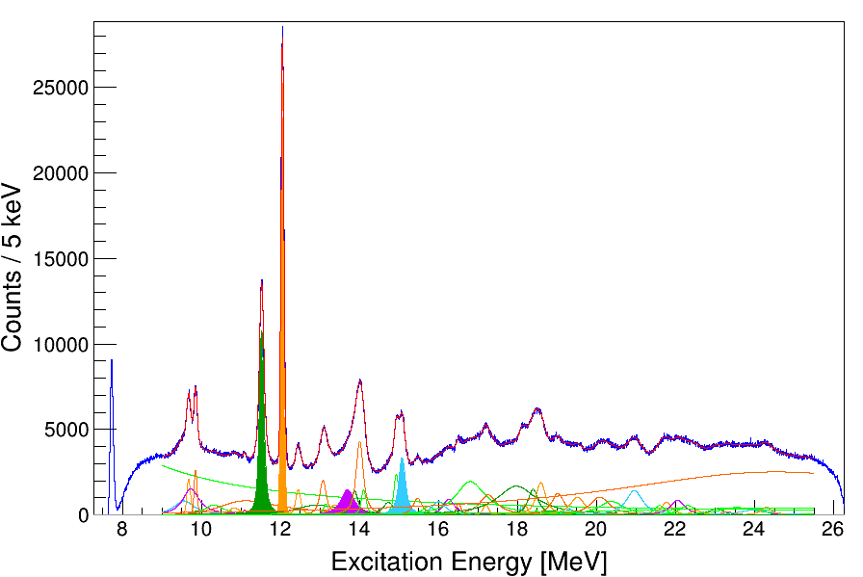
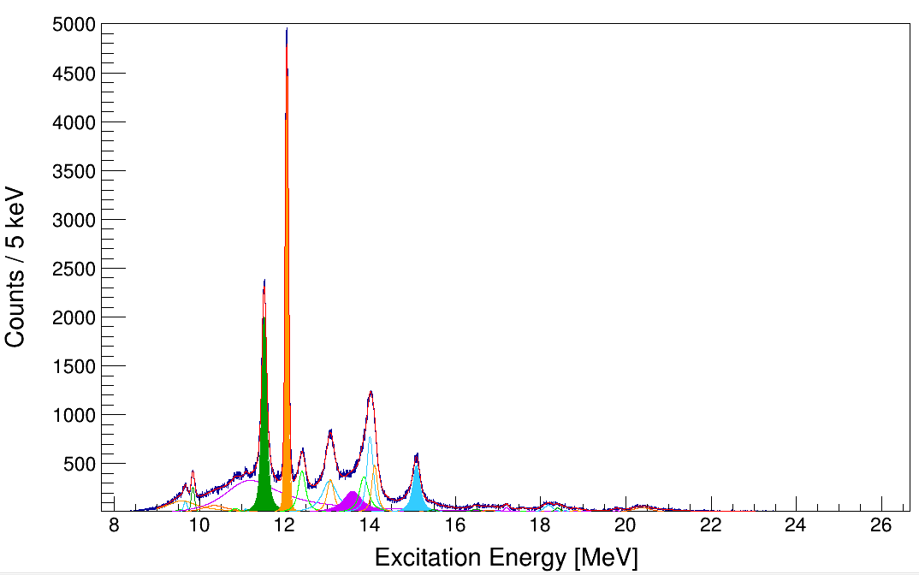
Li₂CO₃(α,α') coincidence results @ 200 MeV
singles
α₀ decay
Notes:
While the resolution of the scatterplot may have you worried, it is because it is the sum of all decay angles. As you can see from this plot the bigger the theta the more target effects for the low energy recoil and decay particles comes into play
The one dimensional plots shown are for the singles and the alpha-zero decay. These were fitted to extract the strenght of the relevant states

Slide 13
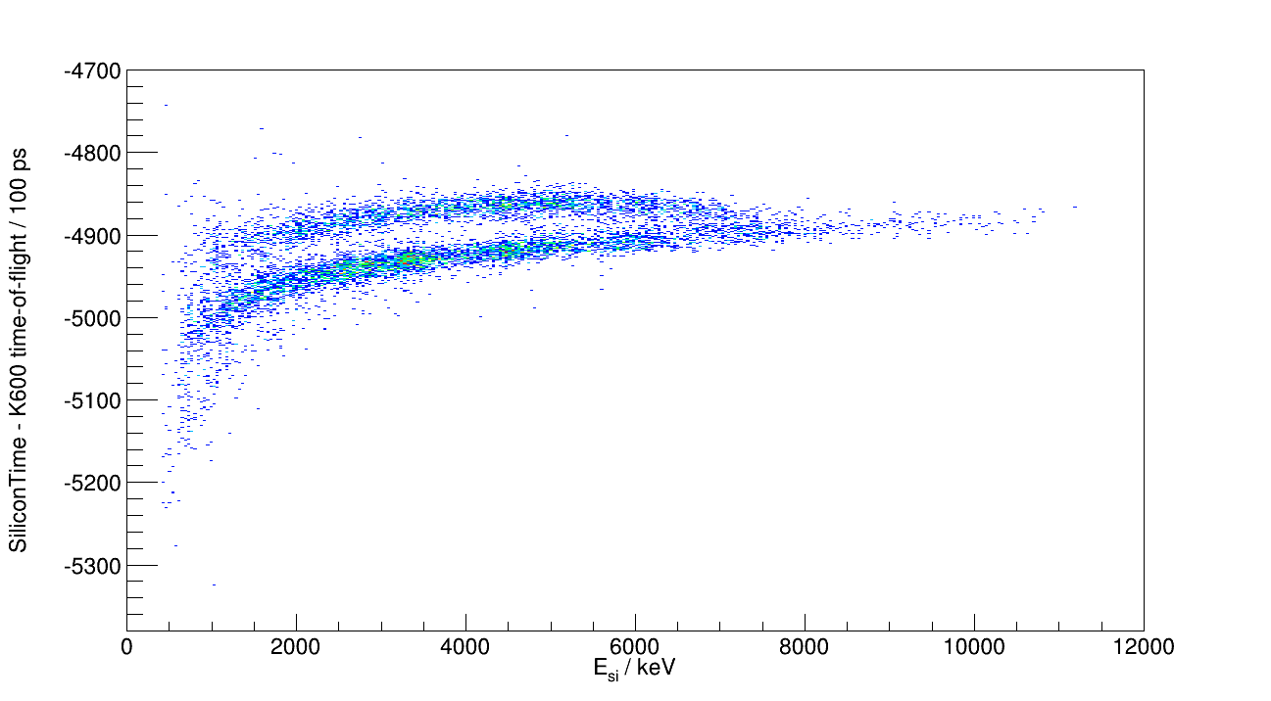
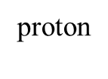
Particle Separation via Time-of-Flight to Si detectors
DSSSD PID :
α

Slide 14
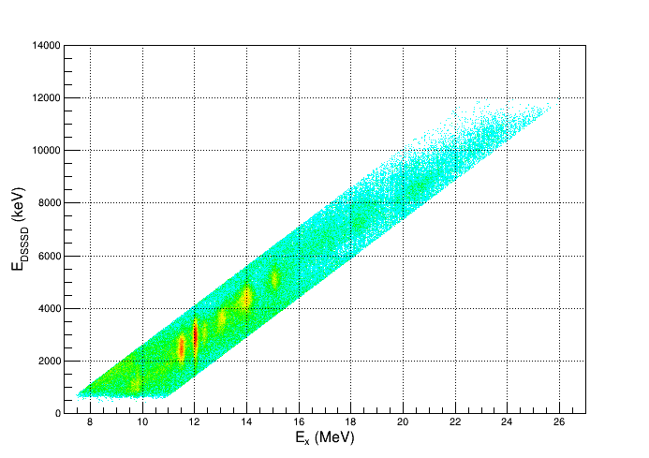
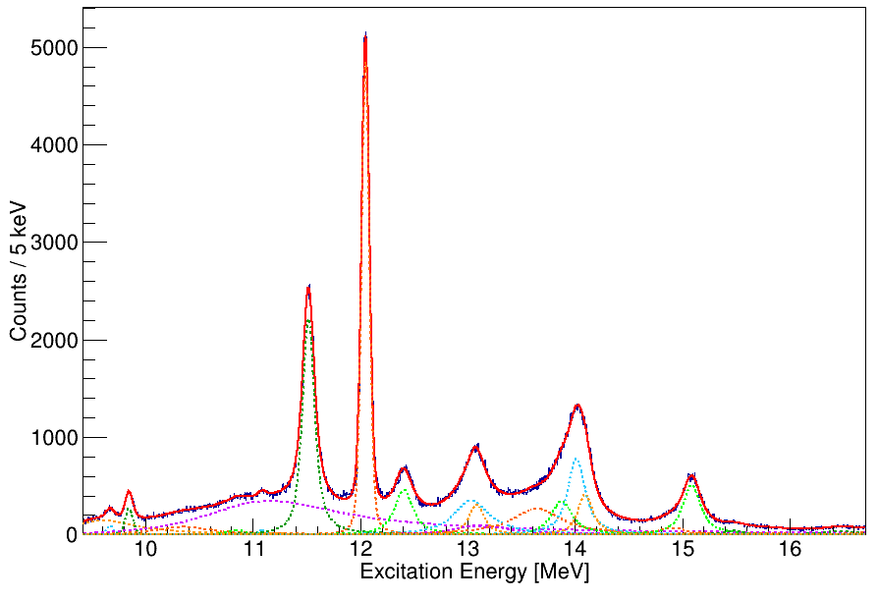
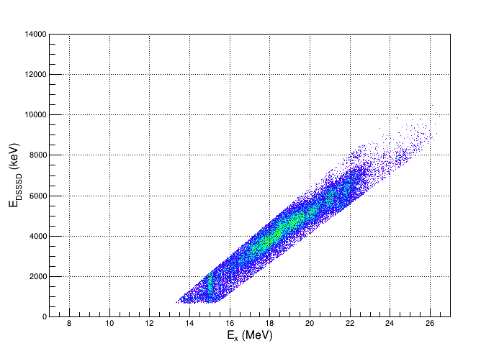
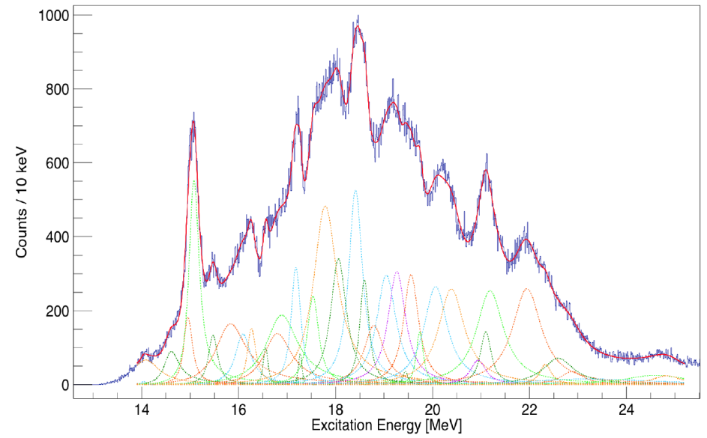
Coincidence results: Li₂CO₃
¹⁶O α₀
¹⁶O α₀
¹⁶O α₁
¹⁶O α₁
¹⁶O p₀

Slide 15
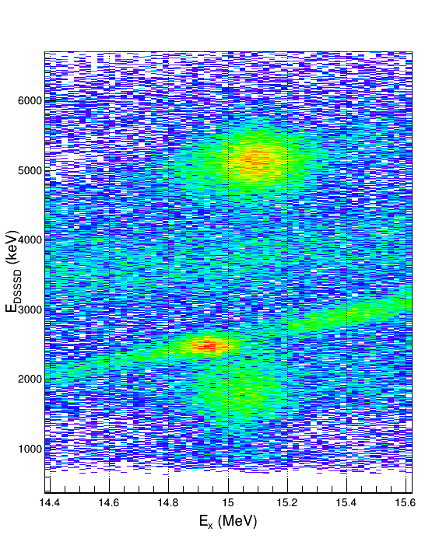
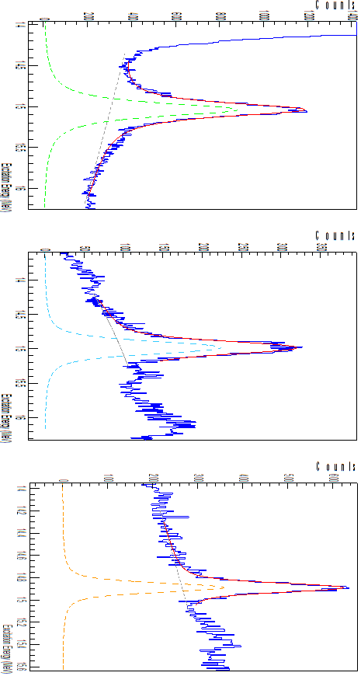
15.097 MeV not one state?
p₀
α₀
Set Minimum(2)
Preliminary
α₁

Slide 16

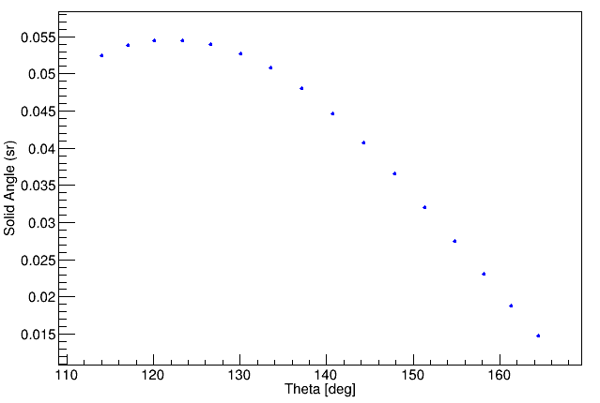
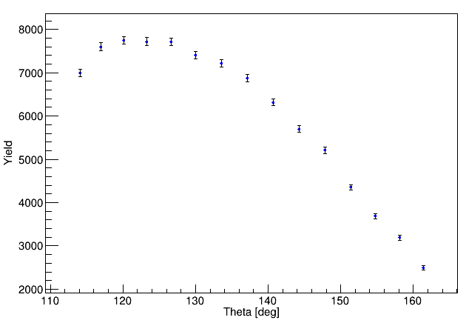
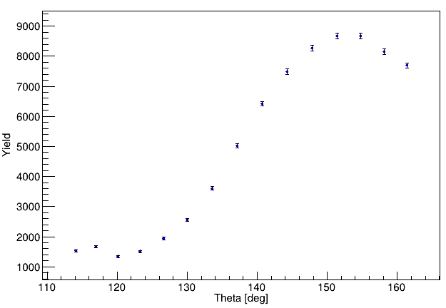
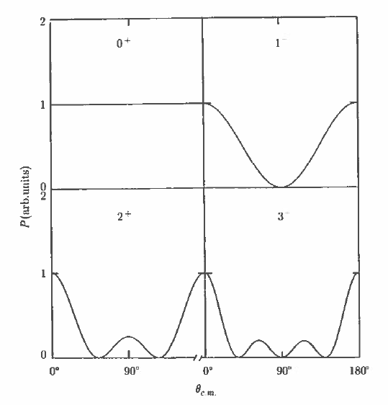
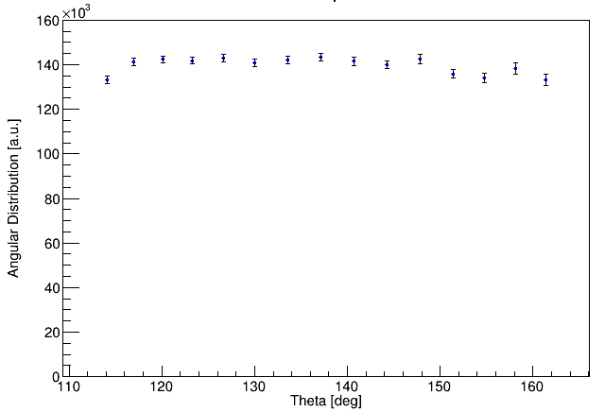
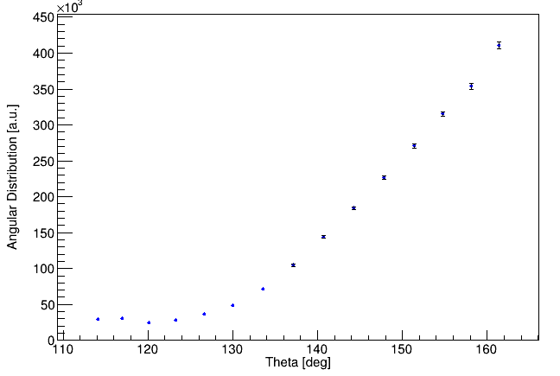
Test cases: 2⁺ 11.52 MeV & 0⁺ 12.049 MeV
0⁺ 12.049 α₀ extracted branching ratio: 97%
solid angle / ring
0⁺ 12.049 α₀
2⁺ 11.52 α₀
Yield
Yield
Angular distribution
Angular distribution

Slide 17
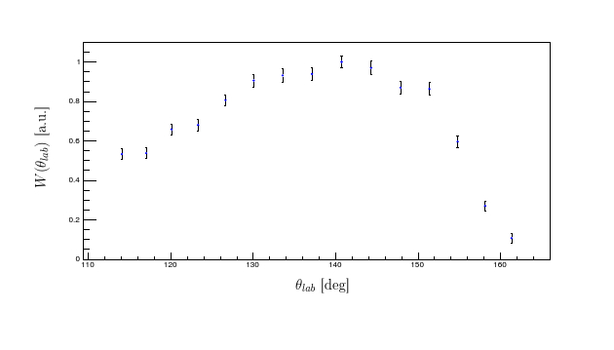
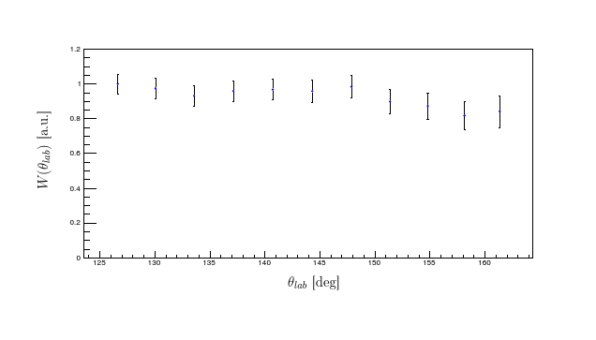
15.097 MeV results
0⁺ 15.097 α₀ angular distribution 0⁺ 15.097 α₁ angular distribution
Preliminary
If isotropic distribution assumed …
0⁺ 15.097 α₀ branching ratio
counts(α₀)/counts(singles)*SA = 0.89 ± 0.06
0⁺ 15.097 α₁ branching ratio
counts(α₁)/counts(singles)*SA = 0.35 ± 0.05
X

Slide 18

15.097 MeV results
0⁺ 15.097 α₀ angular distribution 0⁺ 15.097 α₁ angular distribution
Preliminary
0⁺ state at 15.097:
E_{x} the weighted mean of 4 studies:
Reference Energy Width Reaction
(MeV) (keV)
NPA 180 (1972) 282 15.17 ± 0.05 190 ± 30 ¹²C(α,α₀)
NPA 294 (1978) 161 15.10 ± 0.05 327 ± 100 ¹⁵N(p,α_{i}),(p,p₀)
NPA 305 (1978) 63 15.103 ± 0.005 - ¹⁴N(³He,p)
PRC 25 (1982) 729 15.066 + 0.011 166 ± 30 ¹²C(α,α_{i}),(α,p₀)
Width from Ames (PRC 25)
This work
?? 15.090(1) α₀ - Width 164 ± 5 keV
0⁺ 15.046(3) α₁ - Width 216 ±10 keV

Slide 19

Prospect of benefit for fine structure Giant Resonance
²⁴Mg(α,αʹ) at 0˚ with K600 and CAKE
-- Singles
--- α₀ gs ²⁰Ne
--- α₁ 1st ²⁰Ne
Being Analyzed

Slide 20
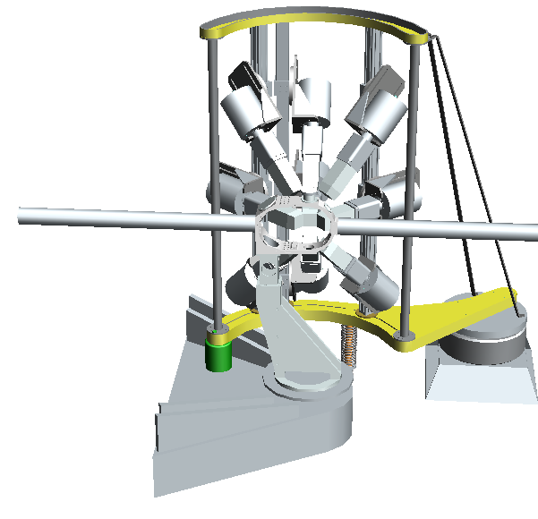
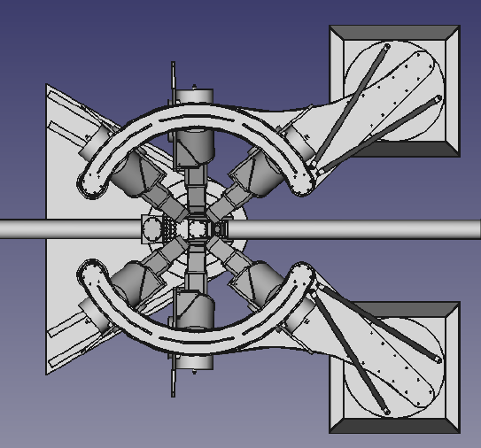

Add a Coincidence HPGe array: BAGEL
Beautiful Array of GErmaniums for L-value determination

Slide 21
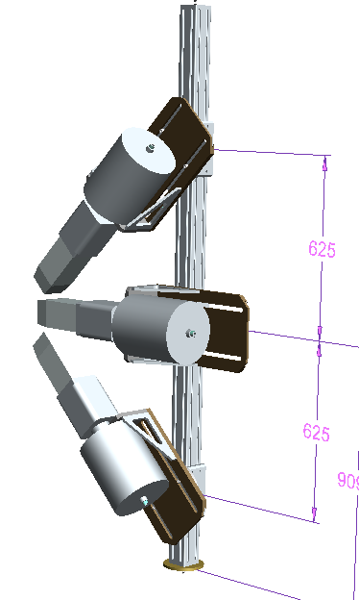
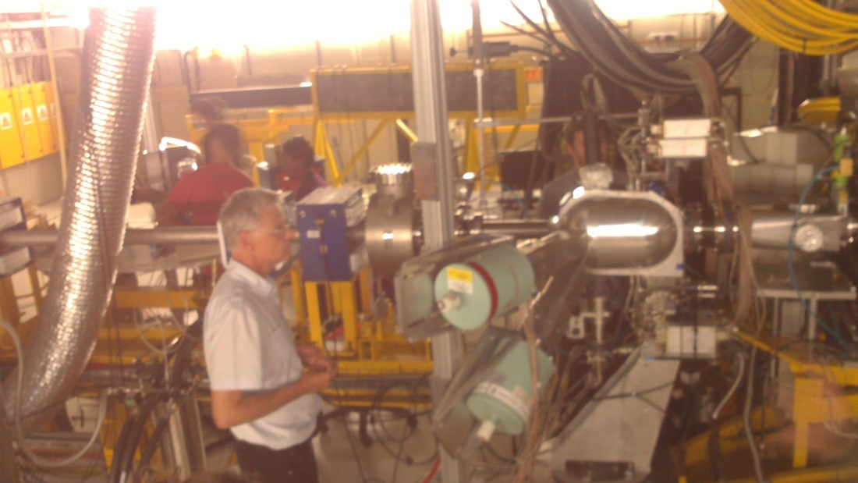
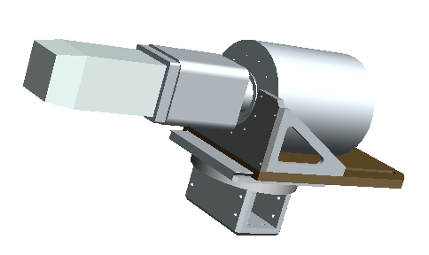
BAGEL array: soon to be assembled
Assembly start February 2016

Slide 22
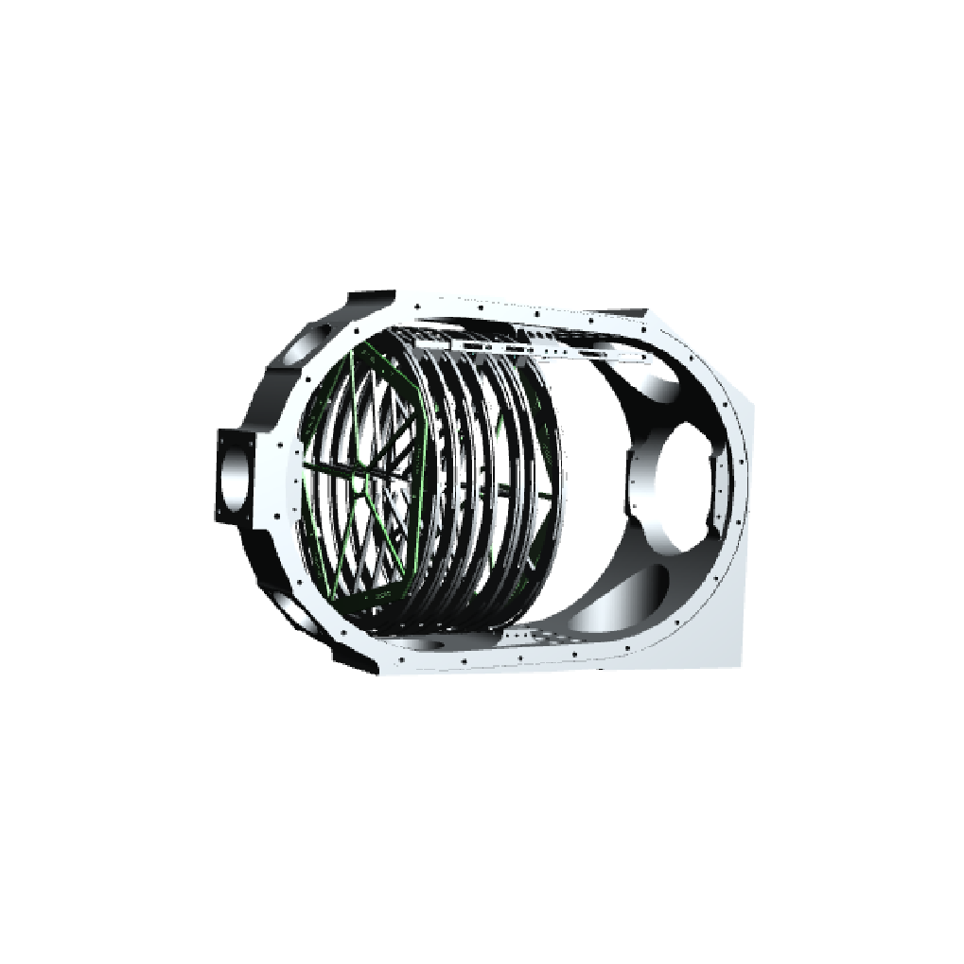
GATEAU – Gaseous Active-TargEt Ancilliary Unit

Slide 23









Contributors and support
Y Fujita, H Fujita, K Hatanaka, A Tamii
A Richter, P von Neumann-Cosel
J Carter, E Sideras-Haddad, I Usman
G Berg
P Papka R Fearick
R Neveling, G Steyn, S Frötsch, L Conradie, D Fourie
Deutsche Forschungsgemeinschaft
National Research Foundation

Slide 24
New Post Docs
P Adsley – Stell. Univ. & iTL
L Pellegri – Wits Univ. & iTL
D Marin-Lambarri – Univ. West. Cape & iTL
V Pesudo – Univ. West. Cape & iTL
Students MSc work
¹⁶O – KCW Li – Univ. Stellenbosch
GATEAU – JW Brümmer – Univ. Stellenbosch

Slide 25
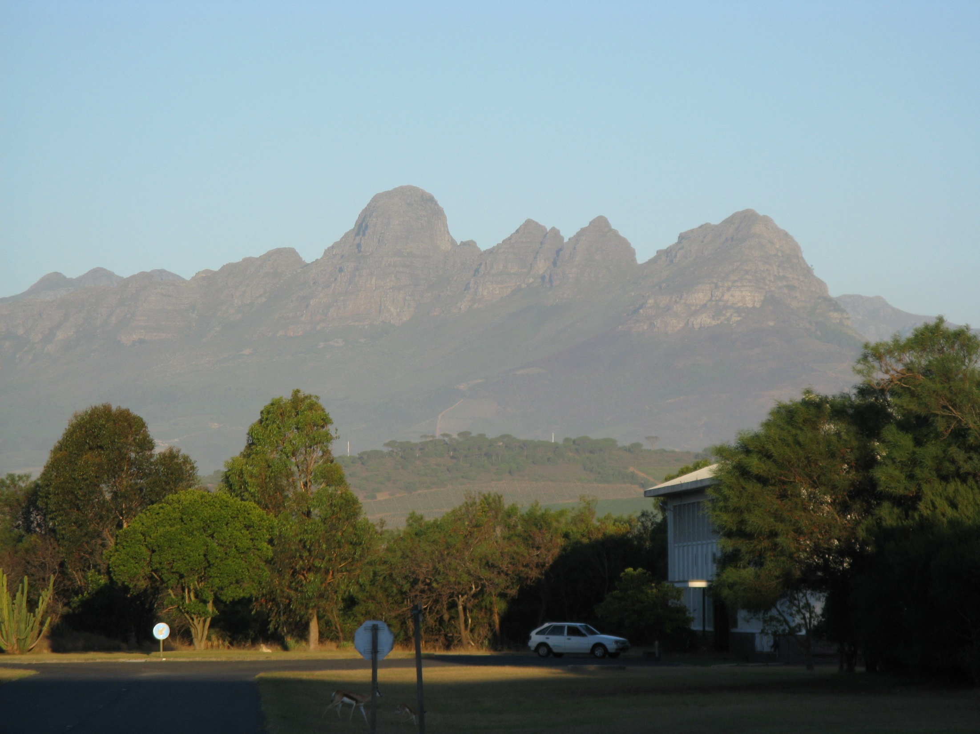
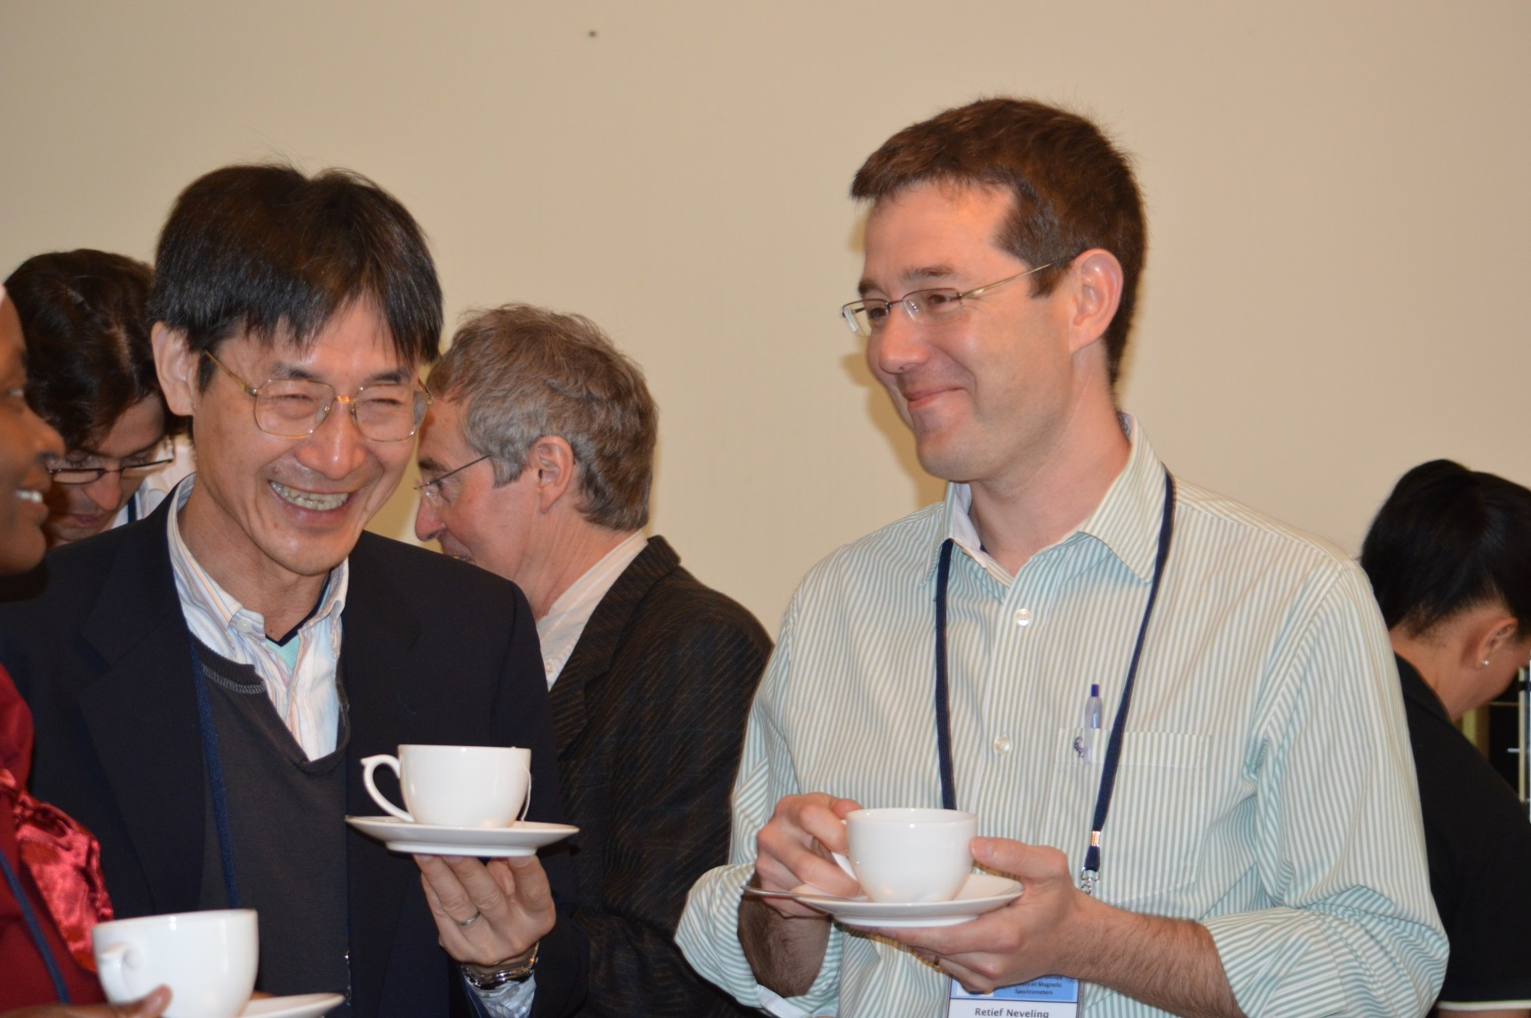


Slide 27
