Slide 1




Sectoral Operational Programme
„Increase of Economic Competitiveness”
“Investments for Your Future”
Extreme Light Infrastructure – Nuclear Physics (ELI-NP)
Project co-financed by the European Regional Development Fund
EUROPEAN UNION
GOVERNMENT OF ROMANIA
Structural Instruments
2007-2013
The Nuclear Science Program at ELI-NP
Dimiter L. Balabanski
HST15, Osaka
Nov. 16th-19th, 2015

Slide 2
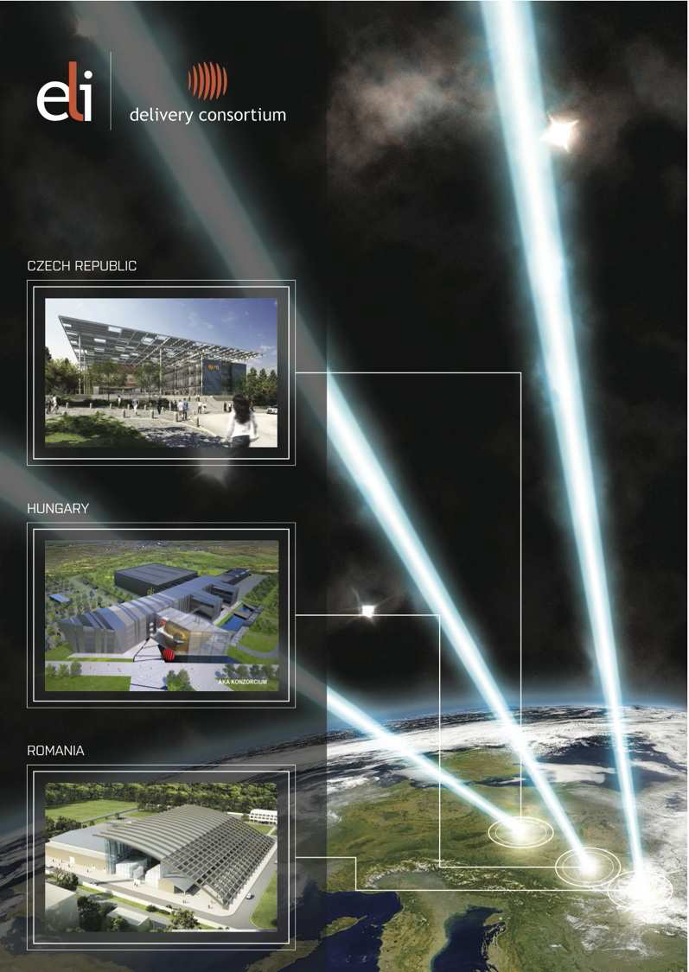
Infrastructure for Intense Light
the world’s first international laser research
infrastructure
“The CERN of Laser Research”
a distributed research infrastructure based
initially on 3 facilities in CZ, HU and RO
ELI–ALPS, Szeged, HU
Attosecond Laser Science
  new regimes of time resolution
ELI–Beamlines, Prague, CZ
High–Energy Beam Facility
  development and application of ultra–short pulses of high–energy particles and radiation
ELI–NP, Magurele, RO
Nuclear Physics Facility with ultra–intense laser and brilliant gamma beams (up to 19 MeV)
  novel photonuclear studies
ELI 4 , to be decided
Ultra–High–Field Science
  direct physics of the unprecedented laser field strength

Slide 3

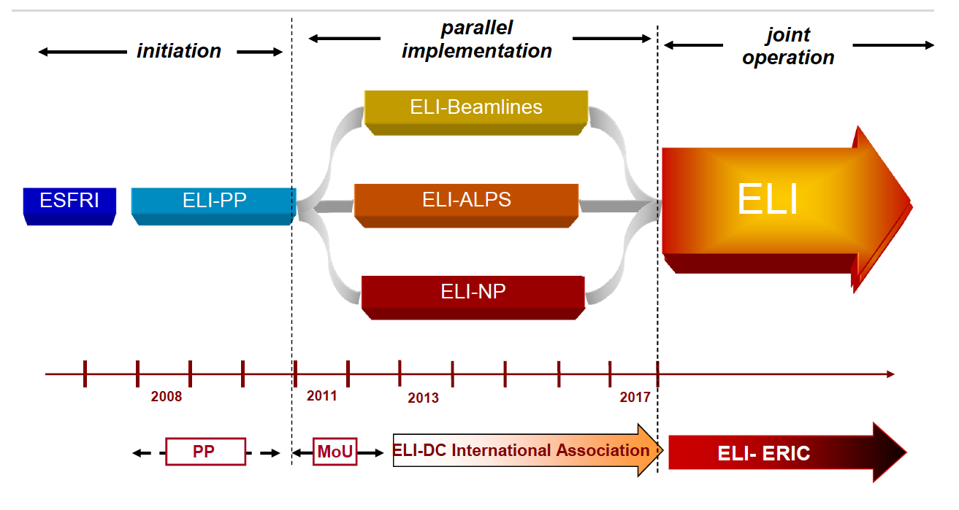
ELI Road Map
total cost of the ELI project: ≈ 1 B€; ~300 M€ per pillar,;87% EC funding
W. Sandner, ELI DC

Slide 4
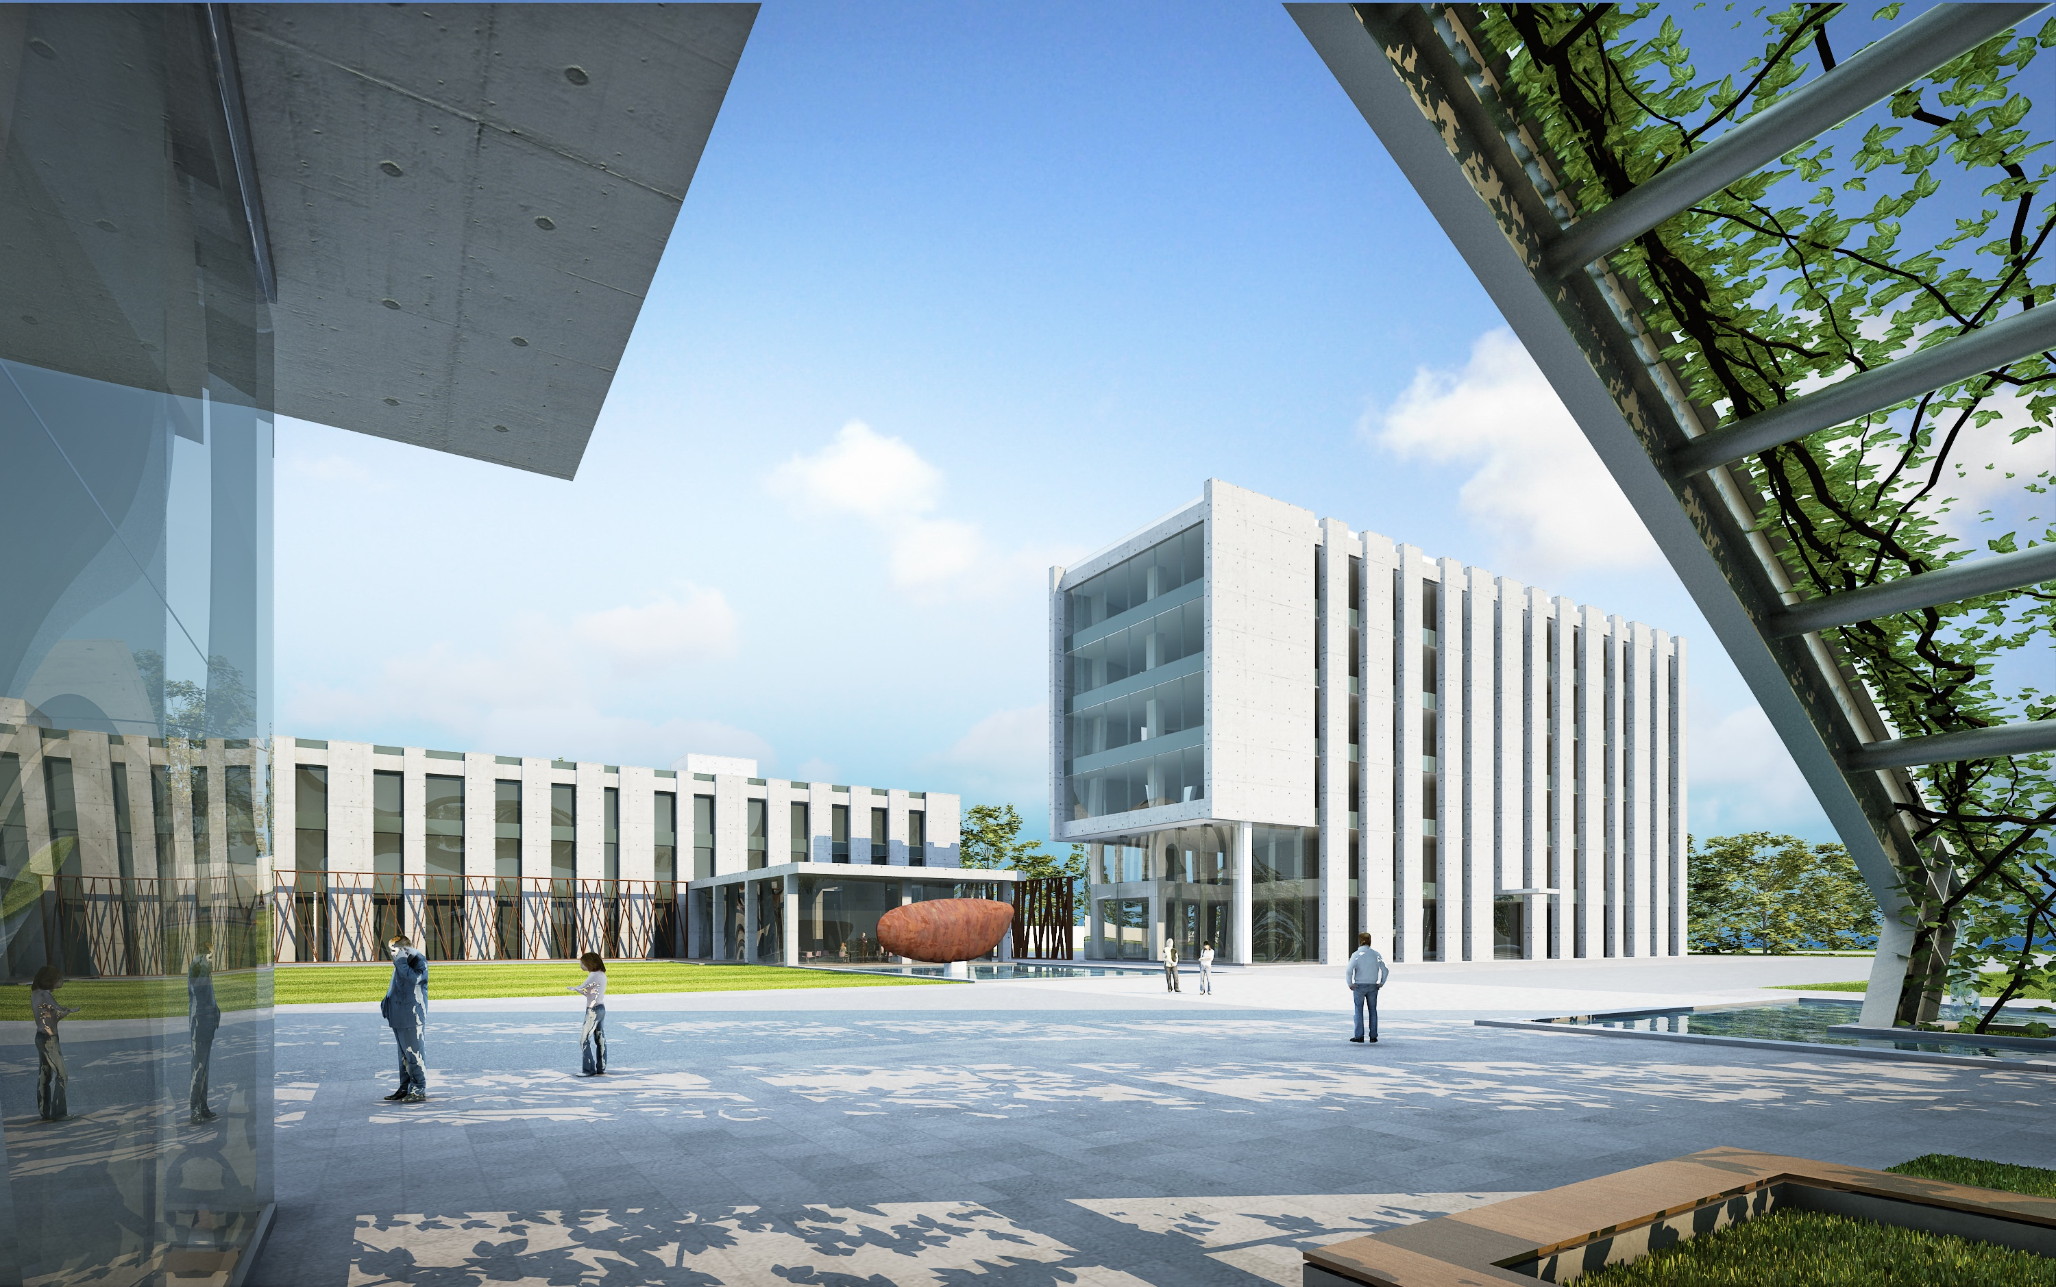

Extreme Light Infrastructure –
Nuclear Physics
Mission: Nuclear Physics studies with high-intensity lasers and brilliant γ beams

Slide 5
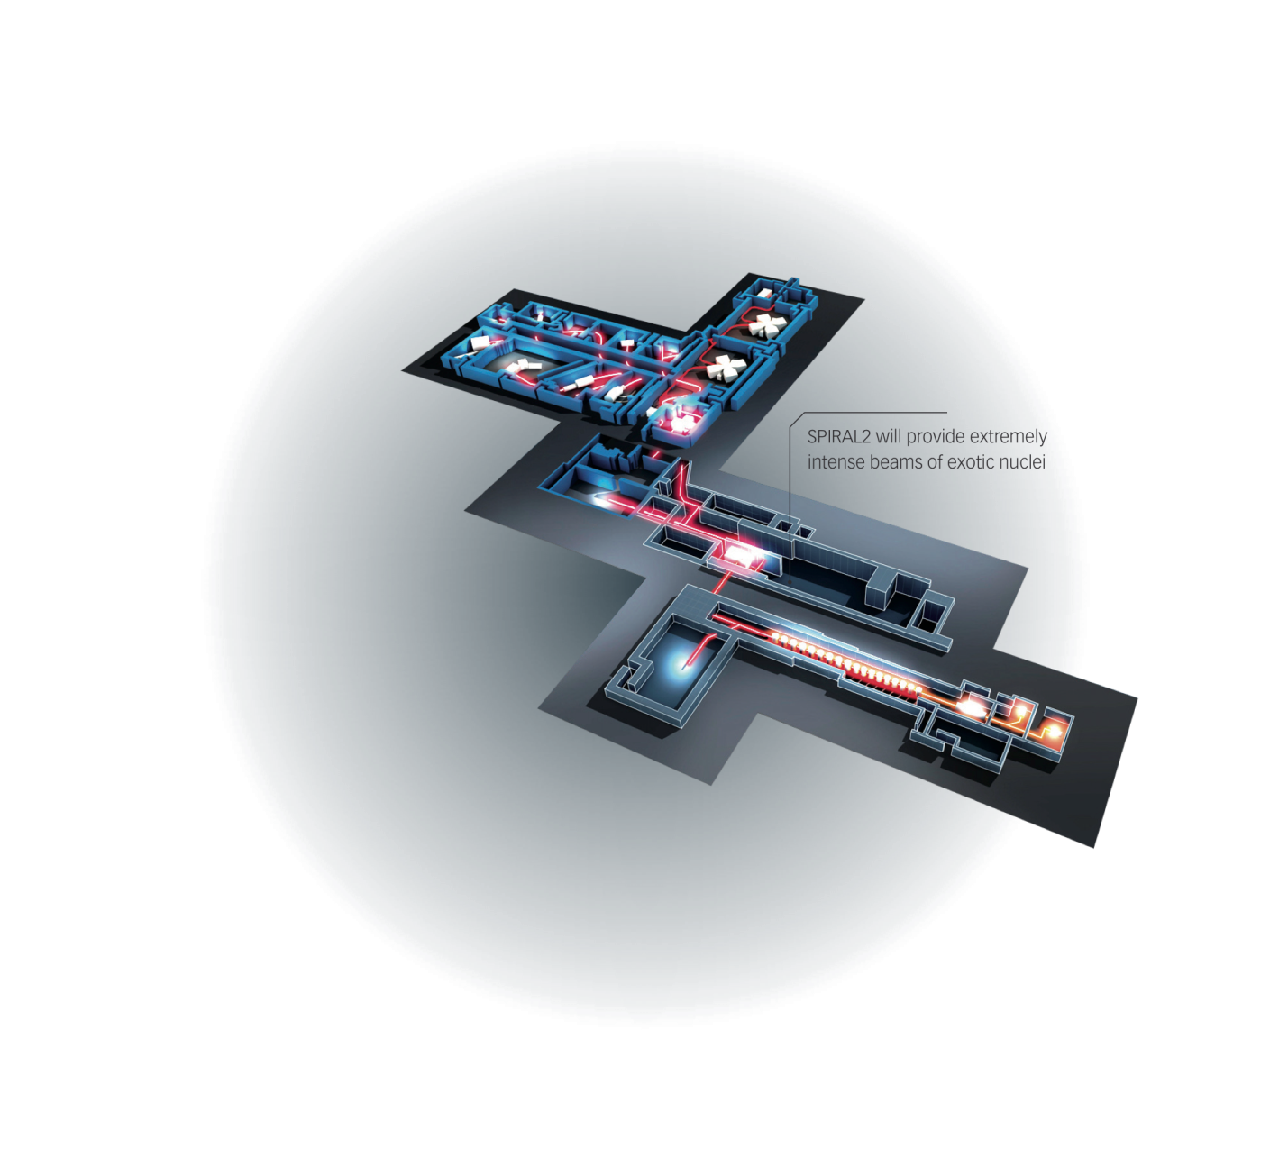
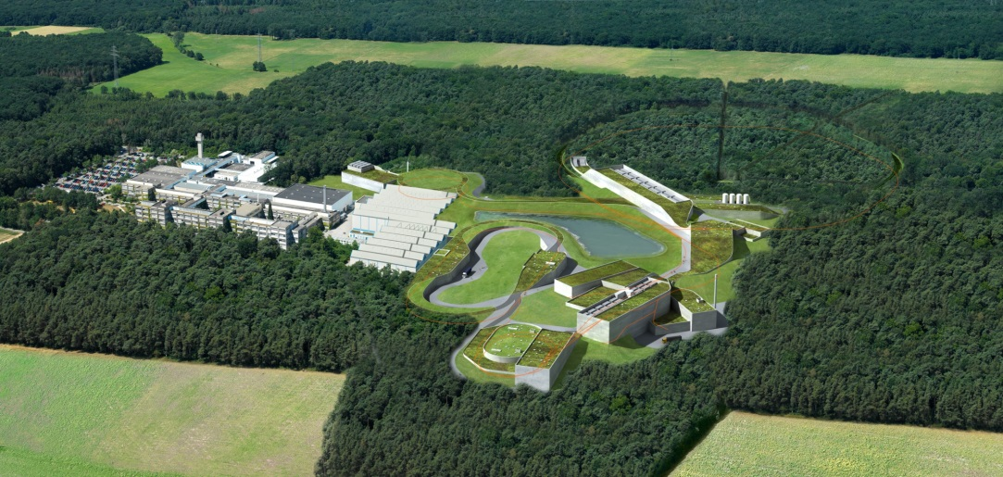
ESFRI Nuclear Physics Infrastructures
FAIR @ Darmstadt
SPIRAL2 @ Caen
ELI-NP @ Bucharest

Slide 6
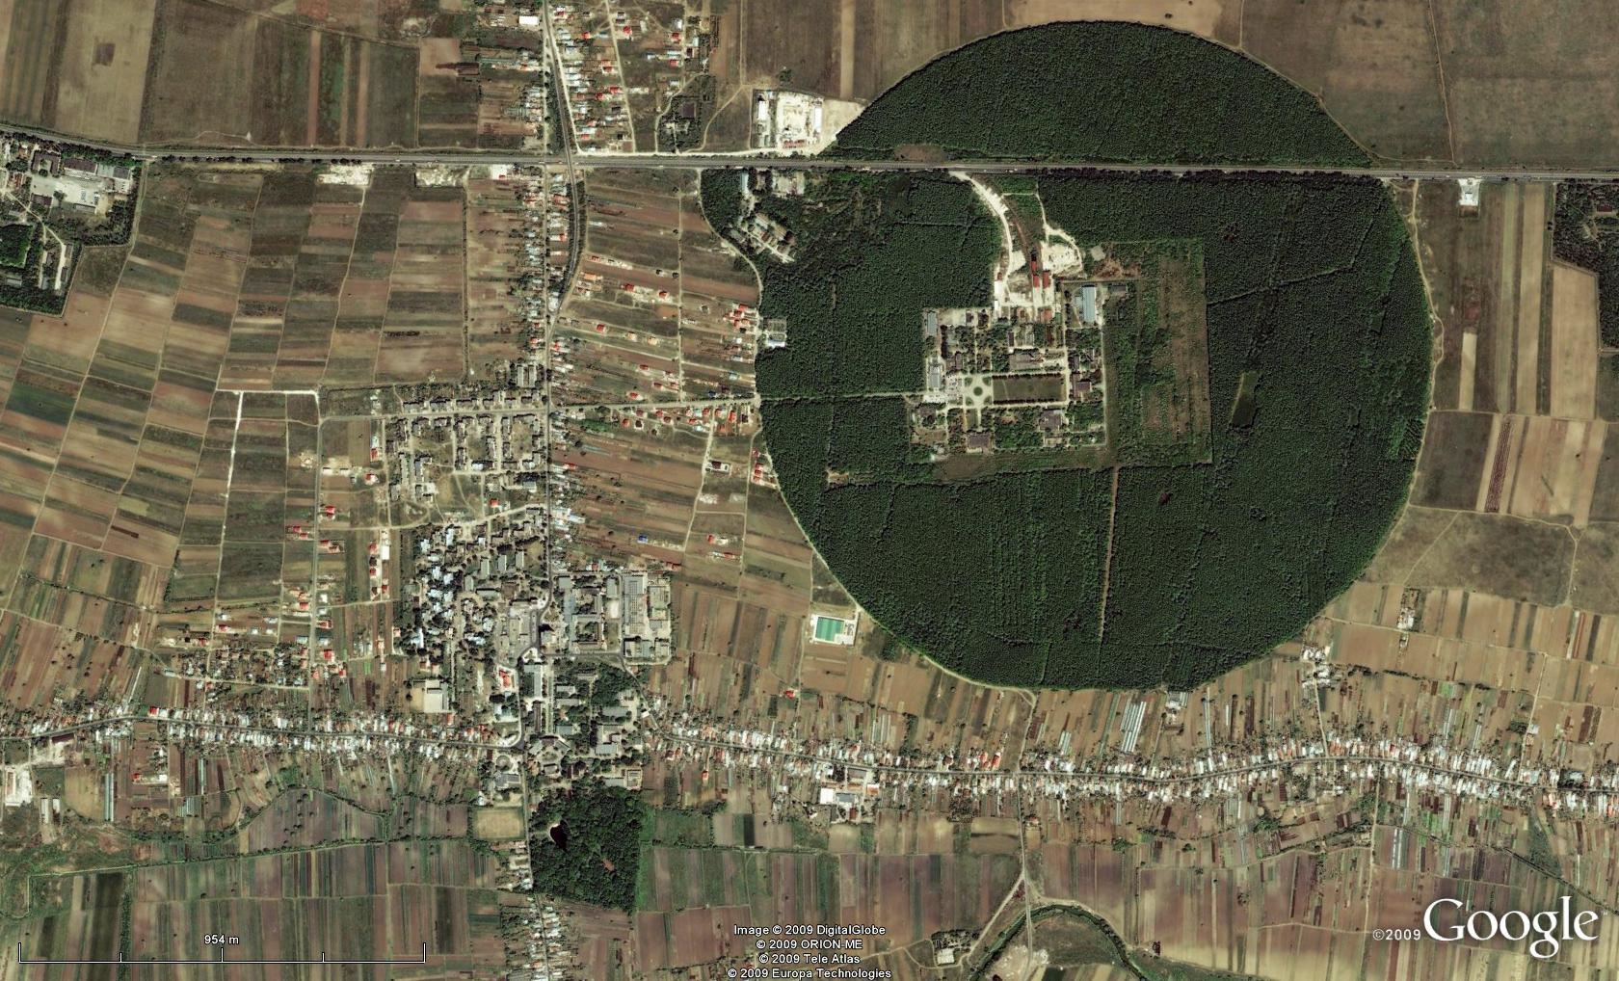
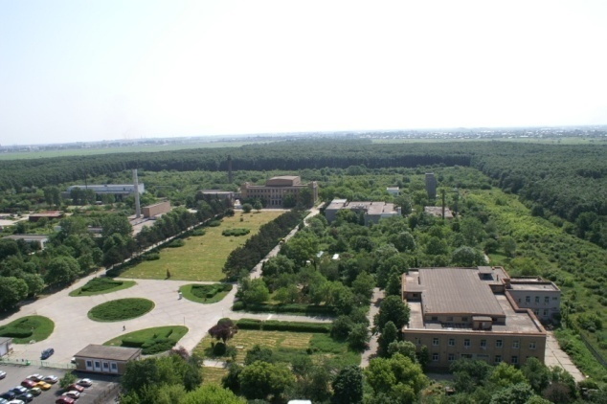
Bucharest-Magurele
National Physics Institutes
NUCLEAR
Tandem accelerators Cyclotrons
γ – Irradiator
Advanced Detectors
Biophysics
Environmental Physics
Radioisotopes
BUCHAREST
ring rail/road
ELI-NP
ELI-NP
Lasers
Plasma
Optoelectronics
Material Physics
Theoretical Physics
Particle Physics
Physics Faculty, Uni. Bucharest

Slide 7

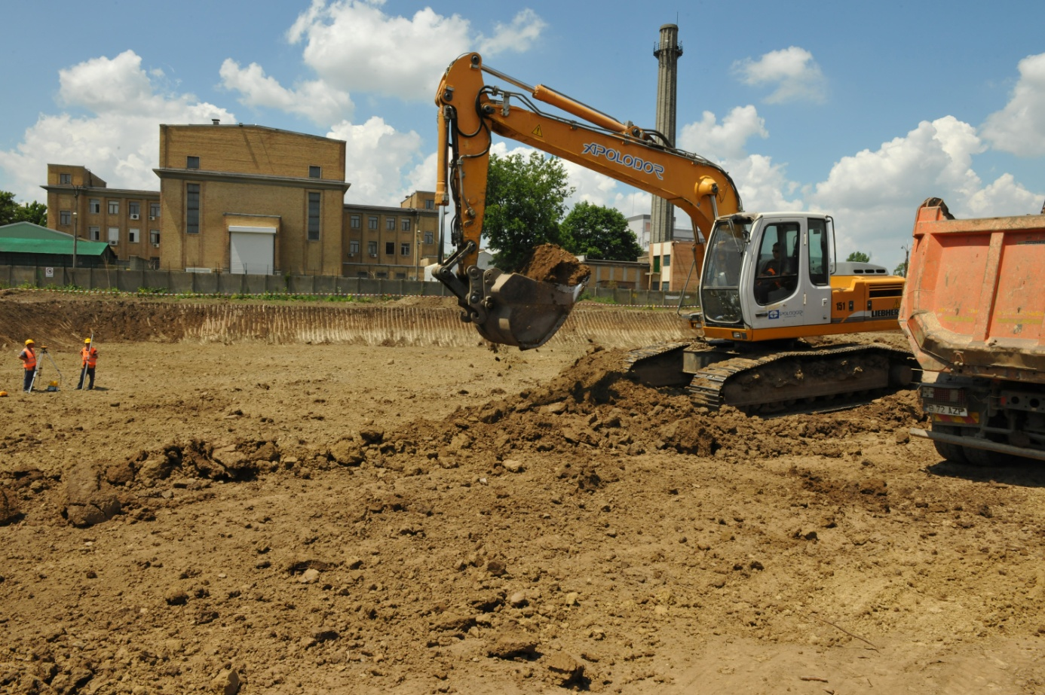
June 7th, 2013

Slide 8
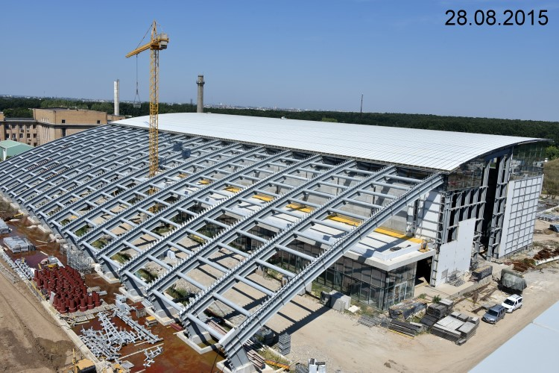
current view
Buildings – one contractor, 33000 m² total

Slide 9

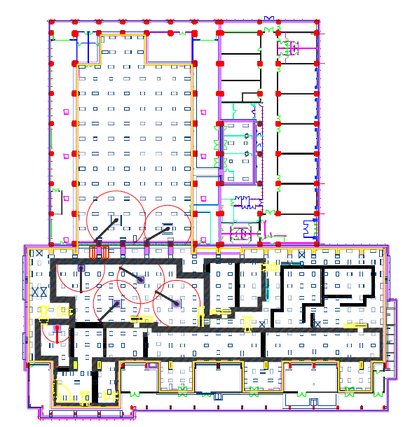
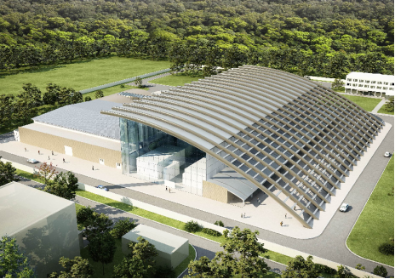
ELI–NP Building Structure
A – A
HPLS
Laboratories
accelerator
bays
A
laser
rooms
basement
anti–vibration
mounts
Experiments
Platform supported on dampers
GBS
Anti–vibration platform
±1 μm @ < 10 Hz
A

Slide 10

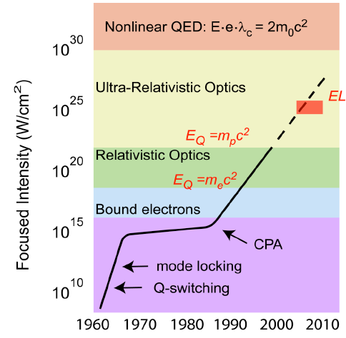
Extreme Light Infrastructure (ELI)
Gerard Mourou 1985: Chirped Pulse Amplification (CPA)
Strickland, Mourou, Opt. Commun. 56, 219 (1985)
10²⁶ W ~ Sun’s
total power
on 1 cm²
I – NP
10²³ W/cm²
10⁹ W ~ power
of an nuclear
reactor on 1 cm²

Slide 11
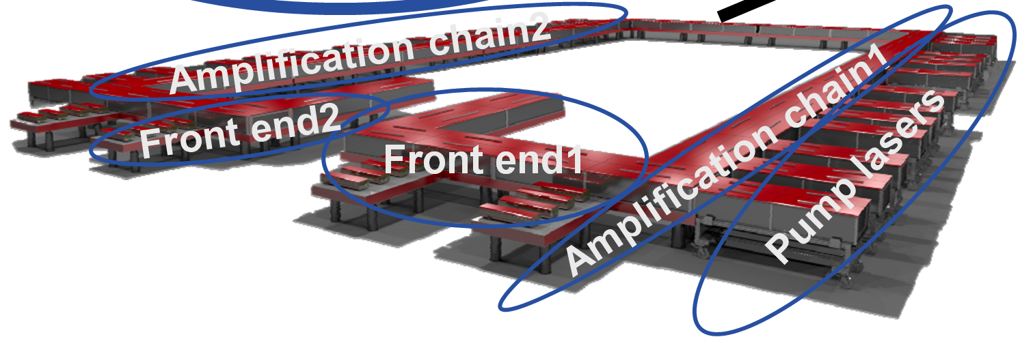
ELI–NP HPLS
2 HPLS up to 10 PW – 6 output lines
2 x 0.1 PW 10 Hz
2 x 1 PW 1 Hz
2 x 10 PW 0.1 Hz
at present the most powerful lasers are 1 PW,
e.g. CETAL at Magurele (commissioned in 2015)
Provided by THALES – France and THALES - Romania
to compressors
40 m
50 m (70 m with compressors)

Slide 12
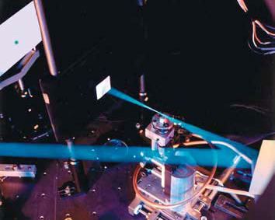
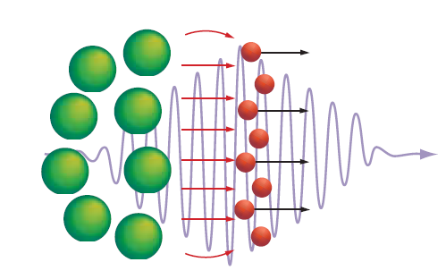
Electrons and ions accelerated at solid state densities 10²⁴e cm⁻³ never reached before

Slide 13
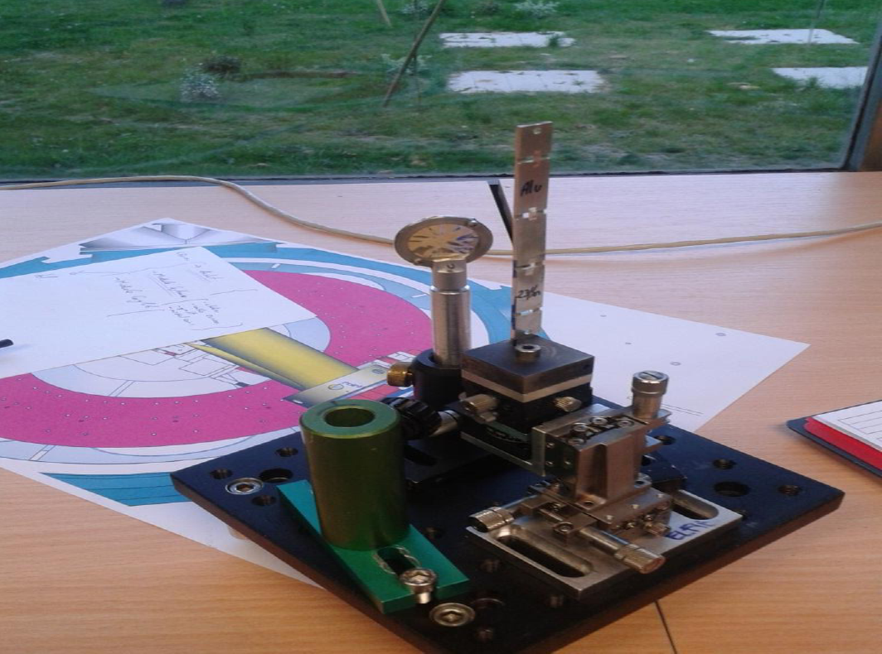
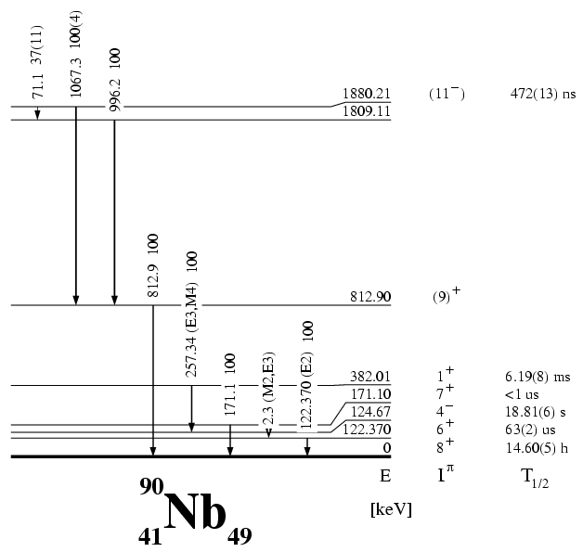
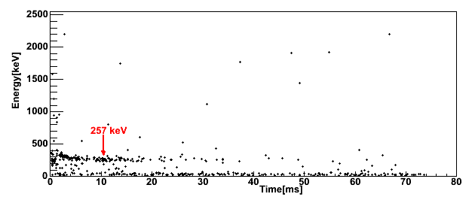
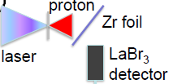
Nuclear isomer spectroscopy
experiment of Florin Negoita @ LULI
⁹⁰Zr(p,n)⁹⁰Nb
2cm

Slide 14
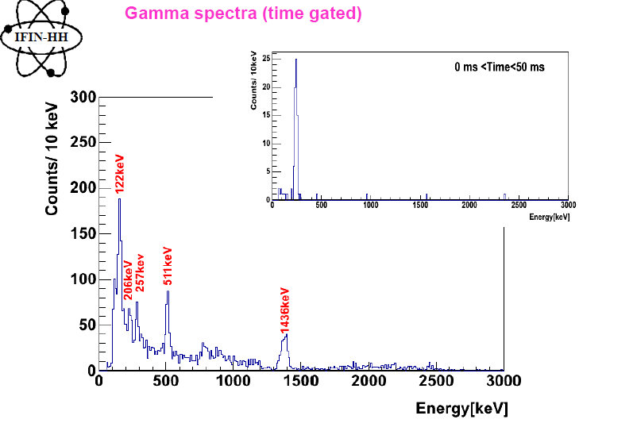
γ-ray spectra
F. Negoita et al. (2015) AIP Conf. Proc. 1645 228
F. Negoita et al. (2015) AIP Conf. Proc. 1645 228

Slide 15
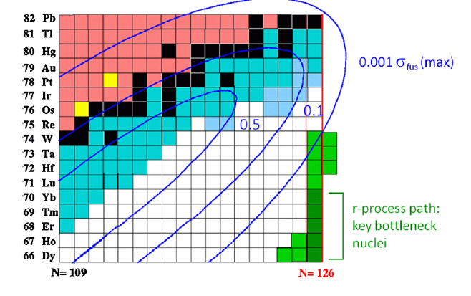
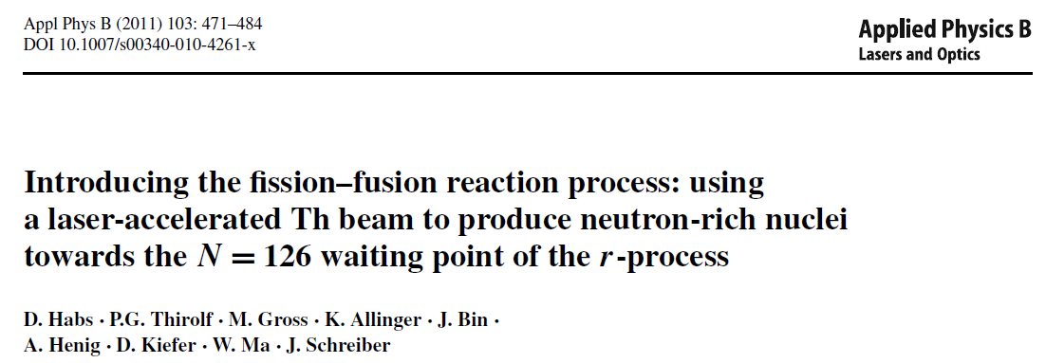
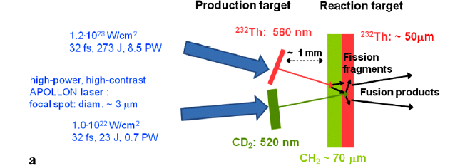
Laser-induced nuclear studies
F_{L} + F_{L} → <^{A}Z> ≈ ¹⁹²Re

Slide 16
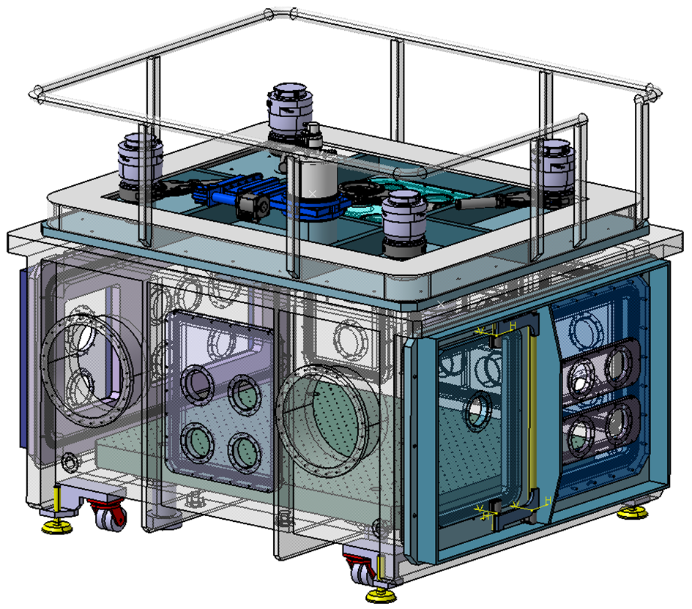
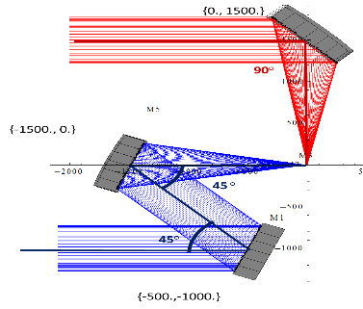
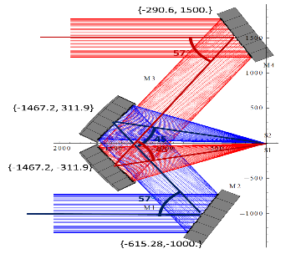
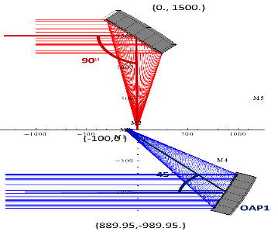
E1 Interaction Chamber (under construction)
Shape: Rectangular
Material: aluminium
Volume: 3 × 4 × 2 (=24) m³
Vacuum:
10⁻⁶ mbar (empty chamber)
Pump-down to
5x10⁻⁶ mbar: 45 min.
Multiple flanges and ports
Isolation of optical table
Removable roof and
side flanges
Access on top for target exchange system
Internal crane for heavy equipment (mirrors) manipulation
Door for access inside through a cleanroom attached to the chamber
(not shown)
Focal length for all parabolas: 1500 mm

Slide 17
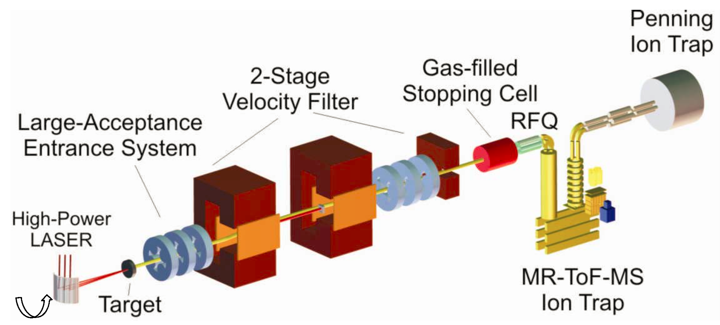
In-flight separator for the ELI-NP laser-driven studies
concept proposed by H. Geissel (GSI/U Giessen)
for separation of nuclei of interest from all other
accelerated particles and reaction products
Measuring basic properties of N~126 nuclei: masses
lifetimes
decay modes

Slide 18
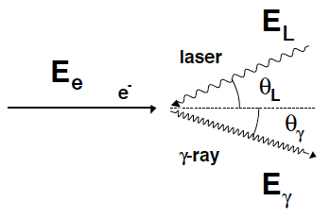
ELI-NP Gamma Beam System (GBS)
Strong forward focusing
10²¹
Brilliance
MEGA-ray
ELI–NP
10¹⁹
ph/(mm²・mrad²・s・0.1%bw)
T-REX
10¹⁷
10¹⁵
LNBL
PLEIADES
HIGS
10¹³
1995 2000 2005 2010 2015 2020
year
1
+
+
Dynamitron
T-REX
0.1
PLEIADES
+
+
HIGS
bw
0.01
ELI–NP
0.001
+
MEGA-ray
0.0001
Bandwidth
~ 4γ²·E_{L}
year
Laser Compton backscattering (LCB)
Narrow bandwidth (≤0.3%) gamma-beams up to 19.5 MeV

Slide 19
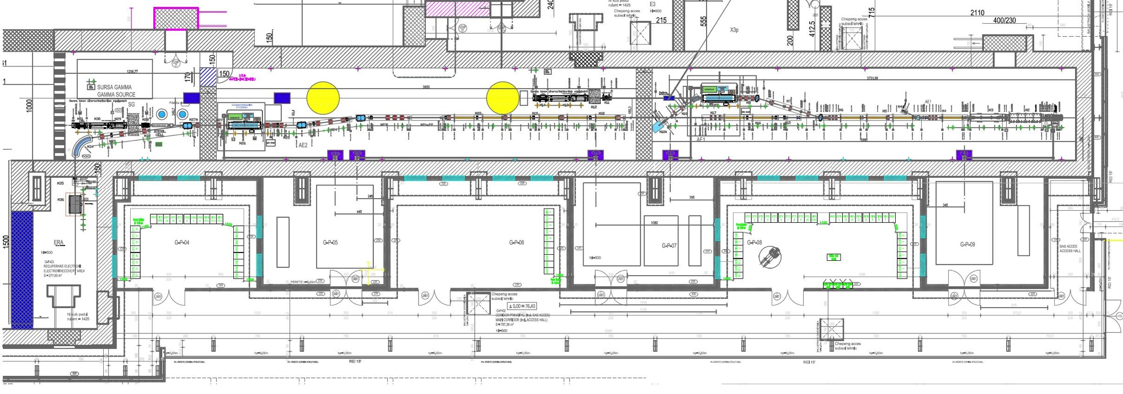
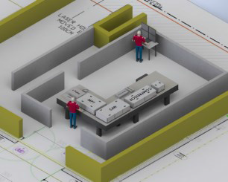
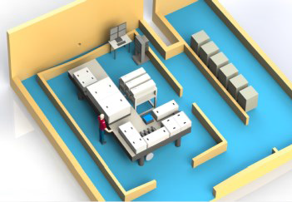
Gamma Beam System – Layout
e– beam
dump
Interaction Point
High Energy
e– beam
dump
Interaction Point
Low Energy
Photogun
multi-bunch
beam
coll&diag
beam
coll&diag
e– beam
dump
Control
Room
Racks
Room
Control
Room
Racks
Room
Interaction Laser
High Energy
e– RF LINAC
High Energy
720 MeV
Interaction Laser
Low Energy
e– RF LINAC
Low Energy
300 MeV
Photo–gun Laser
Master clock synchronization @ < 0.5 ps
High-Energy Stage: γ rays up to 19.5 MeV
Low-Energy Stage: γ rays up to 3.5 MeV

Slide 20
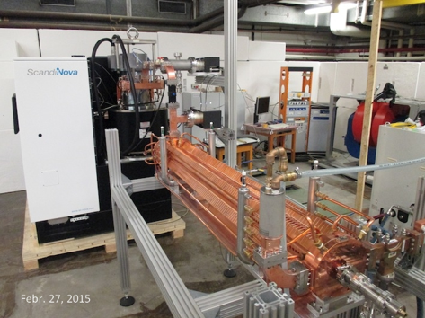
The Electron LINAC
Factory Acceptance Tests – C–Band structure + Modulator

Slide 21
Photonuclear Reactions
Separation
threshold
~ 8 MeV
Absorption
γ
γ´
γ´
β
^{A´}Y
β
gs
^{A}X
Nuclear Resonance Fluorescence (NRF)
Photoactivation
Photodesintegration
Photofission
(-activation)

Slide 22
TDRs on GBS experiments (2013-2015) approved by the ELI-NP ISAC in June 2015
Beam delivery
GBS TDR0: Gamma-beam delivery and diagnostics, H. Weller, C.A. Ur
Basic Science
GBS TDR1: Nuclear Resonance Fluorescence, A. Zilges, C.A. Ur
GBS TDR2: Gamma above the Neutron Threshold, H. Utsunomiya, F. Camera, D. Filipescu
GBS TDR3: Photofission Experiments, F. Ibrahim, A. Krasznahorkay, D.L. Balabanski
GBS TDR4: Charge-Particle Experiments, M. Gai, O. Tesileanu
Applications
GBS TDR5.1: Positron production by Gamma-beams, C. Hugenschmidt, N. Djourelov
GBS TDR5.2: Gamma-Beam Industrial applications, H. Ohgaki, G. Suliman
GBS TDR5.3: Production of Medical Radioisotopes, D. Niculae, M. Bobeica
Rom. Rep. Phys. (2015) in print

Slide 23
RA4: Experiments with Brilliant Gamma Beams
RA4 management
Basic research
ELIADE
GANT-GN
GANT-N
DSBIC
THGEM
IGISOL
g-factors
e-TPC
Si DSSD
Ge Clover array
30 ³He counters
THGEM 4π array
HTS magnet
4π DSSD array
LaBr₃ and LqSci
array
Bragg IC and
DSSD array
IGISOL facility: CSC, RFQ, MR-MoF-MS
TPC with
GEM readout
Applications
medical radioisotopes
NRF applications
positrons
Theory
Laboratories
γ-spectroscopy/detector laboratory
electronic laboratory
total of ~60 WP have been defined

Slide 24
RA4 Work Packages (implementation phase)
ELIADE
ELIGANT-GN
ELI-eTPC
ELI IGISOL
WP1: Ge detectors
WP1: LaBr₃ and CeBr₃ detectors
WP1: GEM read-out and electronics
WP1: gas-cell (CSC)
WP2: electronics and digital read-out
WP2: targets
WP2: neutron detectors
WP2: TPC design and mechanics
WP3: cryostat and LN₂ system
WP3: DAQ
WP3: electronics and digital read-out
WP3: DAQ
WP4: mechanics, vacuum and integration
WP4: gas-flow system and control
WP4: gas-flow system and control
WP4: DAQ
WP5: RFQ system
WP5: LN₂ system
WP5: mechanics, vacuum and integration
WP1: Ge detectors
WP6: mechanics, vacuum, alignment and integration
WP2: electronics and digital read-out
WP7: mass spectrometer
WP3: DAQ
WP4: mechanics and integration
WP8: beamline and beam diagnostics
WP5: LN₂ system
WP9: β-decay array

Slide 25
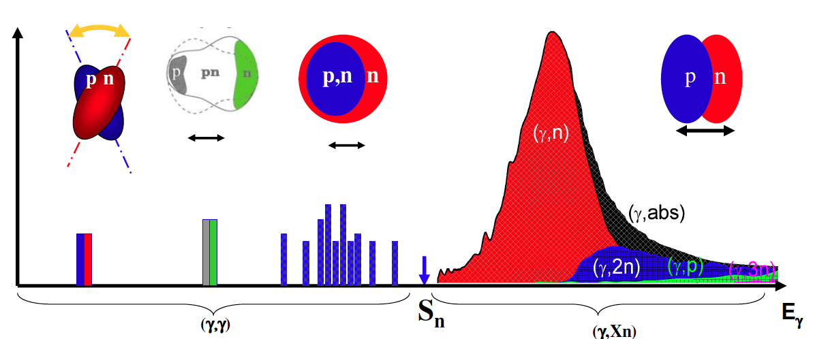

Nuclear Photonics
Electromagnetic dipole response of nuclei
Nuclear structure
Modes of excitation below the GDR Impact on nucleosynthesis
Gamow window for photo–induced reactions in explosive stellar events
Understanding exotic nuclei
E1 strength will be shifted to lower energies in neutron rich system
NRF
γ
E1 strength distribution

Slide 26
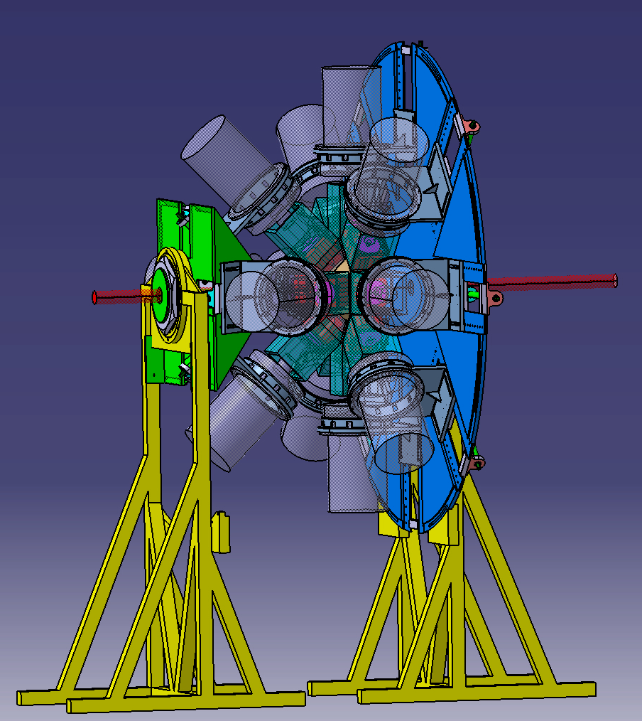
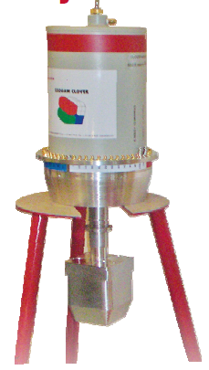
γ-ray spectroscopy
delivery of 4 Tigress-type Clovers and electronics is underway
ELIADE array
Calin A. Ur

Slide 27
ELIADE array
γγ coincidences
angular distributions
polarization measurements
γ beam

Slide 28
NRF experiments

Slide 29
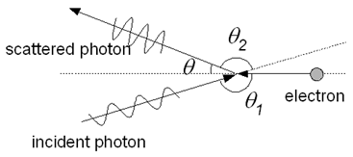
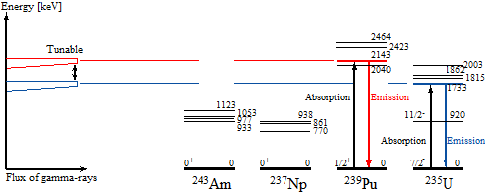
Nuclear Resonance Fluorescence

Slide 30
NRF Physics cases @ ELI-NP
Self-absorption measurements (Γ₀/Γ_{i})
Low-energy dipole response (e.g. Actinides)
Dipole response and parity measurements for weakly-bound nuclei
Investigation of the Pigmy Dipole Resonance
Rotational 2⁺ states of the scissor mode
Parity violation in nuclear excitation: ²⁰Ne
Constraints on the 0νββ-decay matrix elements of the scissors mode decay channel: ¹⁵⁰Sm

Slide 31
NRF Physics Case (cont’d)
(1) PYGMY DIPOLE RESONANCE
ambition: derive proper photon strength functions from data
goal: determine the neutron-skin thickness
experiment: spherical nuclei at or near magic shells
investigations into deformed regions
day one: ^{204,208}Pb and ^{116,124}Sn
new data: detailed strength distributions, knowledge on γ-decay
branches, and spin and parity information

Slide 32
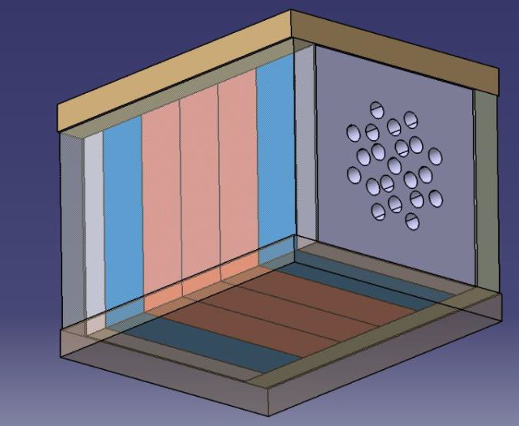
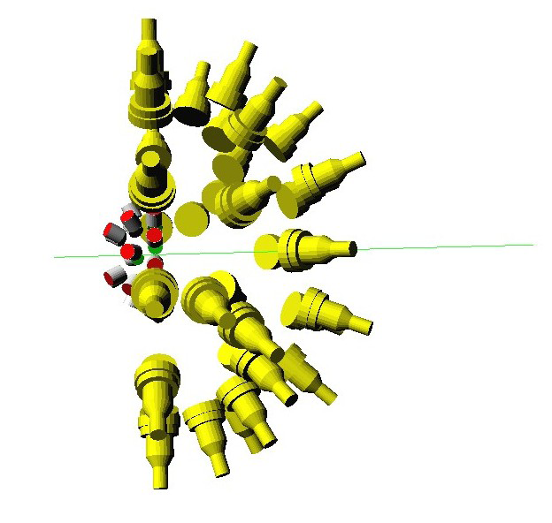
Physics above S_{n}
30 ³He, 15 LaBr₃ , 15 CeBr₃, 20 NE213 detectors and electronics
One very important aspect of giant resonances rather poorly known is the properties of their particle and gamma decays. In fact, gamma decay measurements are extremely difficult as the nucleus has an excitation energy higher than the particle binding energy. Therefore high intensities and efficient detector systems are mandatory. The measurement of the neutron decay requires either an accurate measurement of the neutron kinetic energy or, alternatively, an extremely precise knowledge of the excitation energy of the nucleus. Also in this case an extremely intense beam with a very small bandwidth and an efficient detector system are mandatory.
Studies of GDR and PDR decay
Studies of spin-flip M1 resonances
(γ, n) cross section measurements, e.g. p process related measurements:
  the ¹³⁸La(γ,n) ¹³⁷La reaction,
  the ^{180m}Ta(γ,n)¹⁷⁹Ta reaction.
Instrumentation:
LaBr₃(Ce) array,
Fast-neutron detector array
NE213 liquid scintillator array

Slide 33
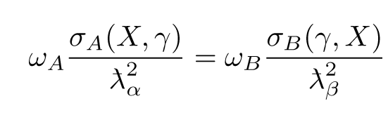
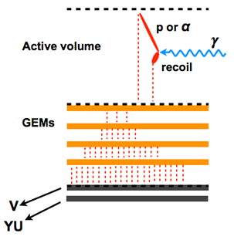
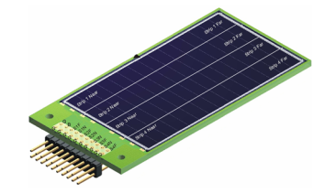
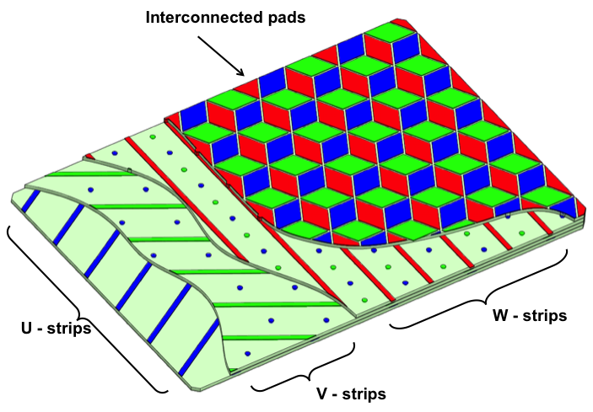
Nuclear Astrophysics
tender for 20 DSSD Si detectors is open
Molecular states and symmetries in light nuclei
The ¹⁶O(γ,α)¹²C reaction
The ²⁴Mg(γ,α)²⁰Ne reaction
The ²²Ne(γ,α)¹⁸O reaction
The ¹⁹F(γ,p)¹⁸O reaction
The ²¹Ne(γ,α)¹⁷O reaction
Instrumentation:
Large-area Si DSSD array,
eTPC
Bubble-chamber detector
Day One experiment:
The ⁷Li cosmological problem
ELI-NP will be the ideal cite to study the
⁷Li(γ, α)³H reaction

Slide 34
Photofission
tenders for 5 BICs, 8 Si DSSD, THGEM array, electronics and support infrastructure are open or in preparation
Studies in the 2nd and 3rd minimum of the fission barrier: transmission resonances
Rare fission modes: ternary fission
Structure of neutron-rich nuclei: the rare-earth neutron-rich deformed region

Slide 35
Studies of the 2nd and 3rd minimum
schematical description of the occurrence of transmission resonances
P.G. Thirolf et al., EPJ Web of Conferences 38, 08001 (2012)

Slide 36
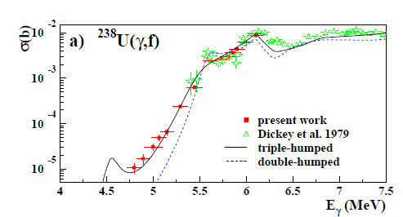
(γ,f) experiment at HIγS, Csige et al., Phys. Rev. C (2013)

Slide 37

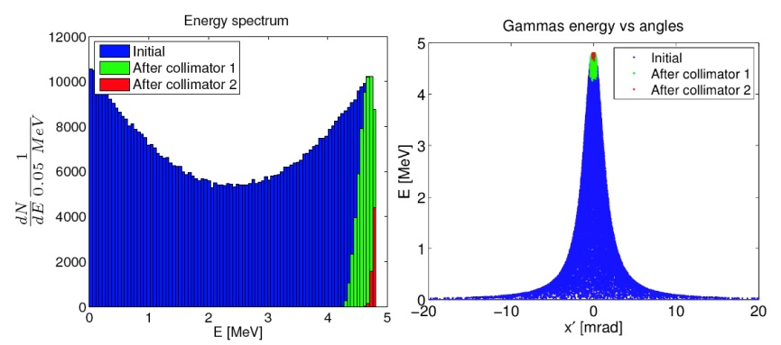
ALTO, ARIEL, etc.
ELI-NP
Laser Compton back-scattering
γ–beam spectrum at the IP
(without collimator)
~ 10¹¹ γ/s

Slide 38
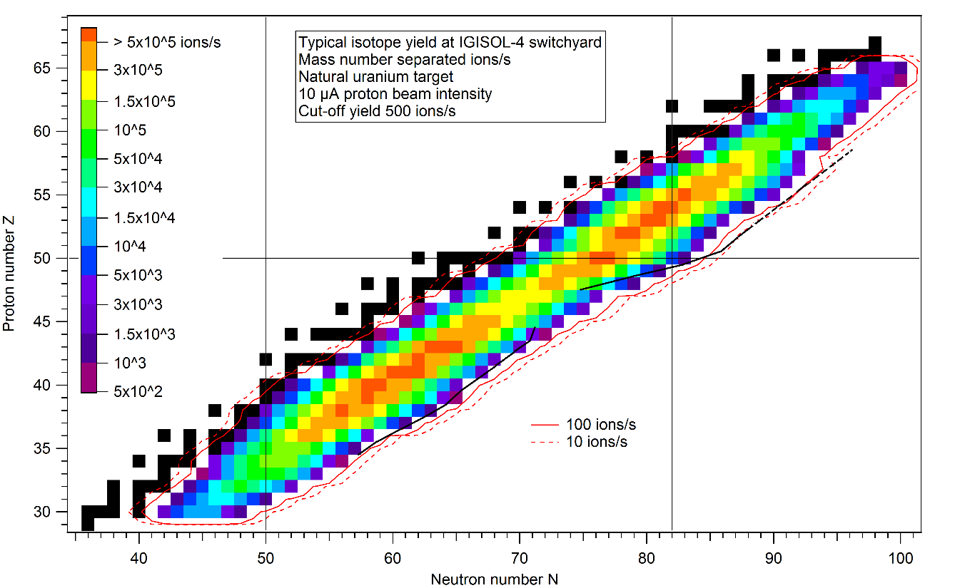
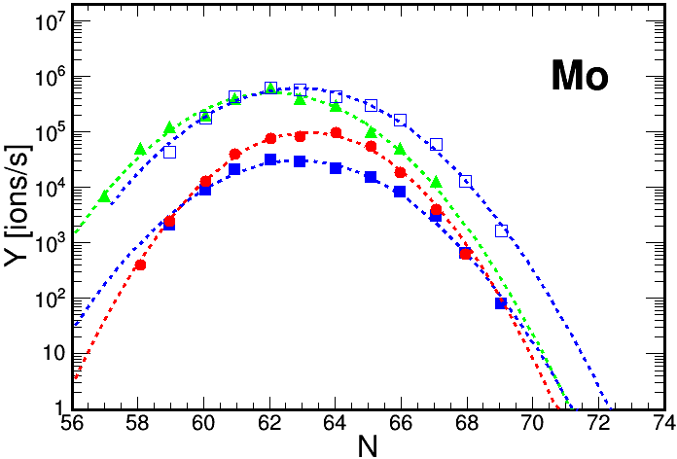
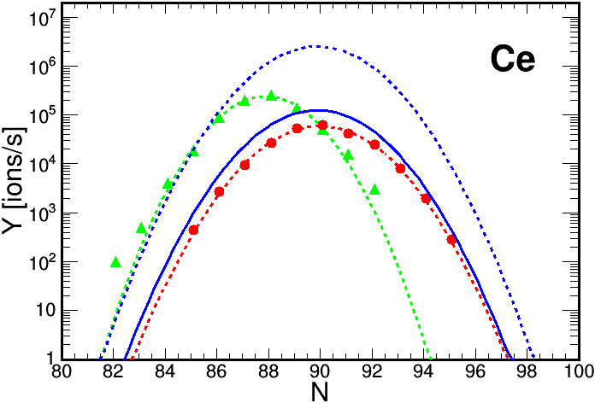
Fragment Yields at the IGISOL-4 facility at JYFL

Slide 39

Human Resources
Today
Attracting the best competencies:
public announcements
international recruitment
head–hunting for
management positions
junior researchers
specializing in a unique and
top-level field of research
PhD students will benefit of
a very high specialization
with enormous possibilities
http://www.eli-np.ro/jobs.php

Slide 40
Summary
The laser-driven and gamma-beam science program at ELI-NP address key problems of present-day research.
ELI-NP provides beyond-state-of-the-art gamma beams in terms of intensity, monochromaticity and polarizability, as well as intense laser pulses at much higher frequencies compared to existing facilities, which define experiments that cannot be done anywhere else.
The facility will push ahead laser-driven research and photonuclear physics and their applications.
Thank you!

