Slide 1
Collective modes: past, present and future perspectives
Muhsin N. Harakeh
KVI, Groningen; GANIL, Caen
International Symposium on High-resolution Spectroscopy and Tensor interactions (HST15)
Osaka, Japan
16-19 November 2015

Slide 2
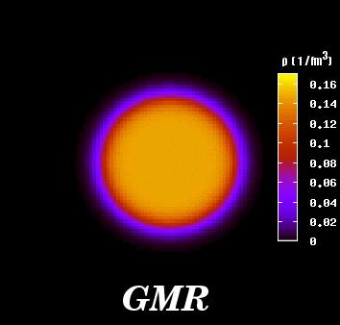
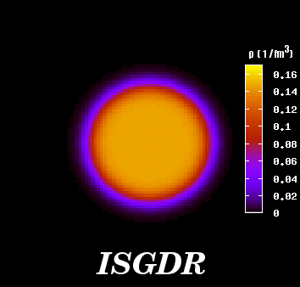
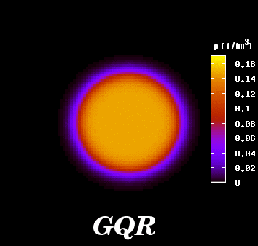
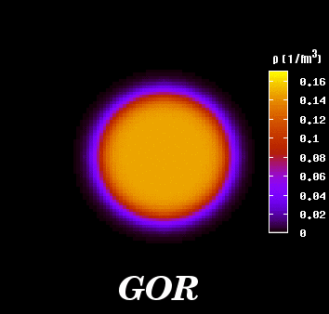
L=0
L=1
M. Itoh
ISGMR
ISGDR
L=2
L=3
ISGQR
ISGOR

Slide 3


Microscopic picture: GRs are coherent (1p-1h) excitations
induced by single-particle operators
Microscopic structure of ISGMR & ISGDR
Transition operators:
Constant Overtone
2ћω excitation
Spurious c.o.m. motion
Overtone
3ћω excitation (overtone of c.o.m. motion)

Slide 4
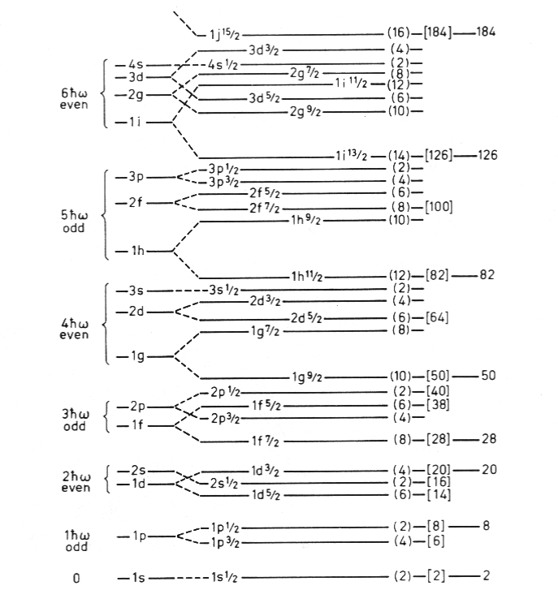
IVGDR
τ rY₁
ΔN = 1 E1 (IVGDR)
ΔN = 2 E2 (ISGQR)
&
ΔN = 0 E0 (ISGMR)
ISGMR
ISGQR
r²Y₀
r²Y₂

Slide 5
Equation of state (EOS) of nuclear matter
More complex than for infinite neutral liquids
Neutrons and protons with different interactions
Coulomb interaction of protons
Governs the collapse and explosion of giant stars (supernovae)
Governs formation of neutron stars (mass, radius, crust)
Governs collisions of heavy ions.
Important ingredient in the study of nuclear properties.

Slide 6
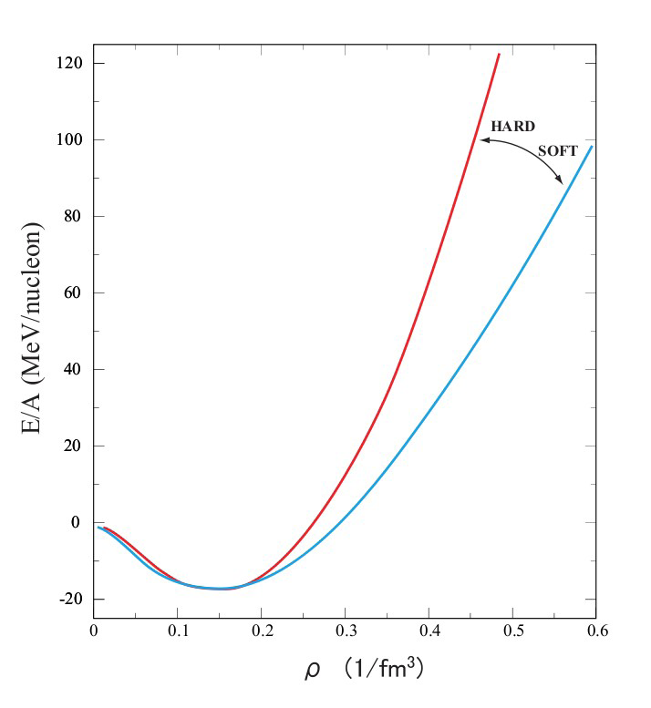
For the equation of state of symmetric nuclear matter at saturation nuclear density:
and one can derive the incompressibility of nuclear matter:
E/A: binding energy per nucleon
ρ : nuclear density
ρ₀ : nuclear density at saturation
J.P. Blaizot, Phys. Rep. 64, 171 (1980)

Slide 7
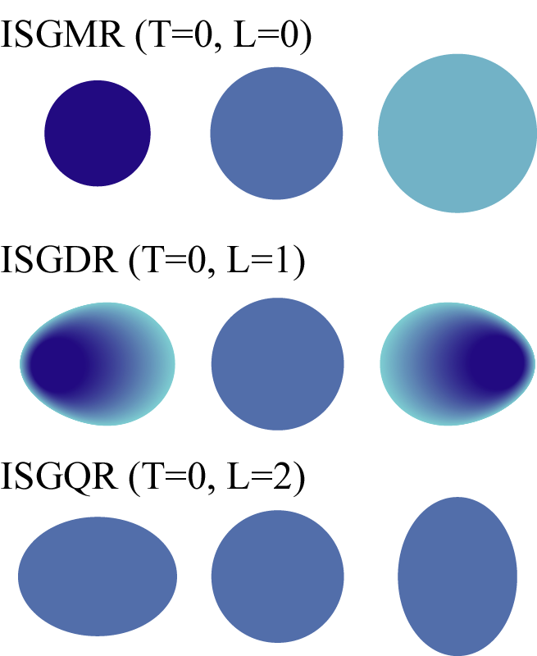
Isoscalar Excitation Modes of Nuclei
Hydrodynamic models/Giant Resonances
Coherent vibrations of nucleonic fluids in a nucleus.
Compression modes: ISGMR, ISGDR
In Constrained and Scaling Models:
=
K
E
ћ
A
ISGMR
m
r
2
+
27
ε
7
K
E
=
ћ
A
25
F
ISGDR
3
2
m r
ε_{F} is the Fermi energy and the nucleus incompressibility:
K_{A} =[r²(d²(E/A)/dr²)]_{r =R0}
J.P. Blaizot, Phys. Rep. 64 (1980) 171

Slide 8
Giant resonances
Macroscopic properties: E_{x}, Γ, %EWSR
Isoscalar giant resonances; compression modes
ISGMR, ISGDR ⇒ Incompressibility, symmetry energy
K_{A} = K_{vol} + K_{surf} A^{−1/3} + K_{sym}((N−Z)/A)²+K_{Coul}Z²A^{−4/3}

Slide 9
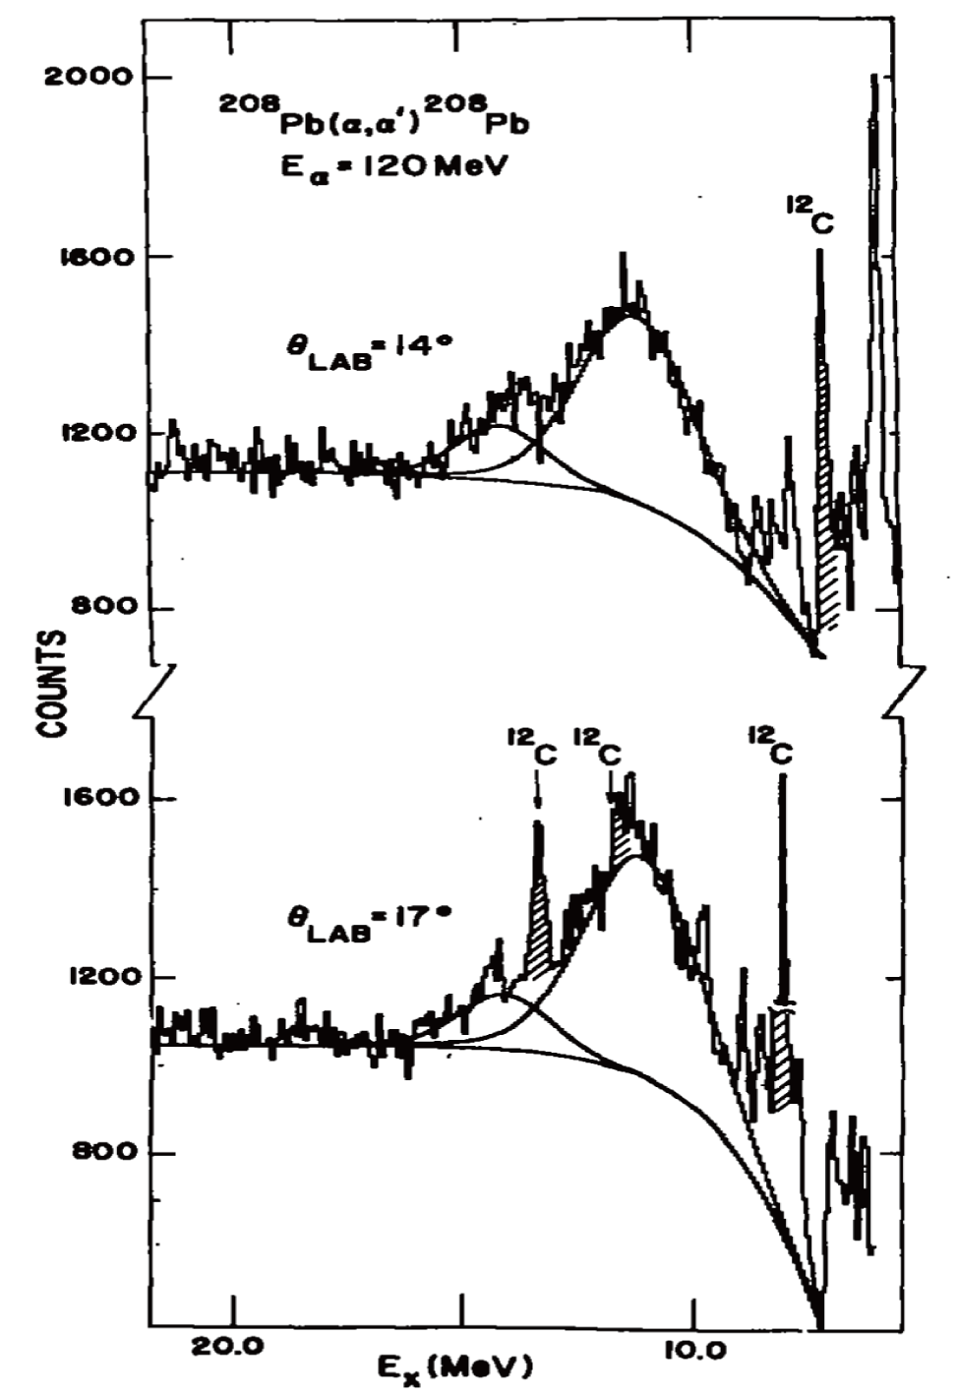
ISGQR, ISGMR
10.9 MeV
KVI (1977)
⇐ ²⁰⁸Pb(α,α′) at E_{α}=120 MeV
13.9 MeV
Large instrumental background
and nuclear continuum!
M. N. Harakeh et al., Phys. Rev. Lett. 38, 676 (1977)

Slide 11
ISGMR, ISGDR
ISGQR, HEOR
100 % EWSR
At E_{x}= 14.5 MeV

Slide 12
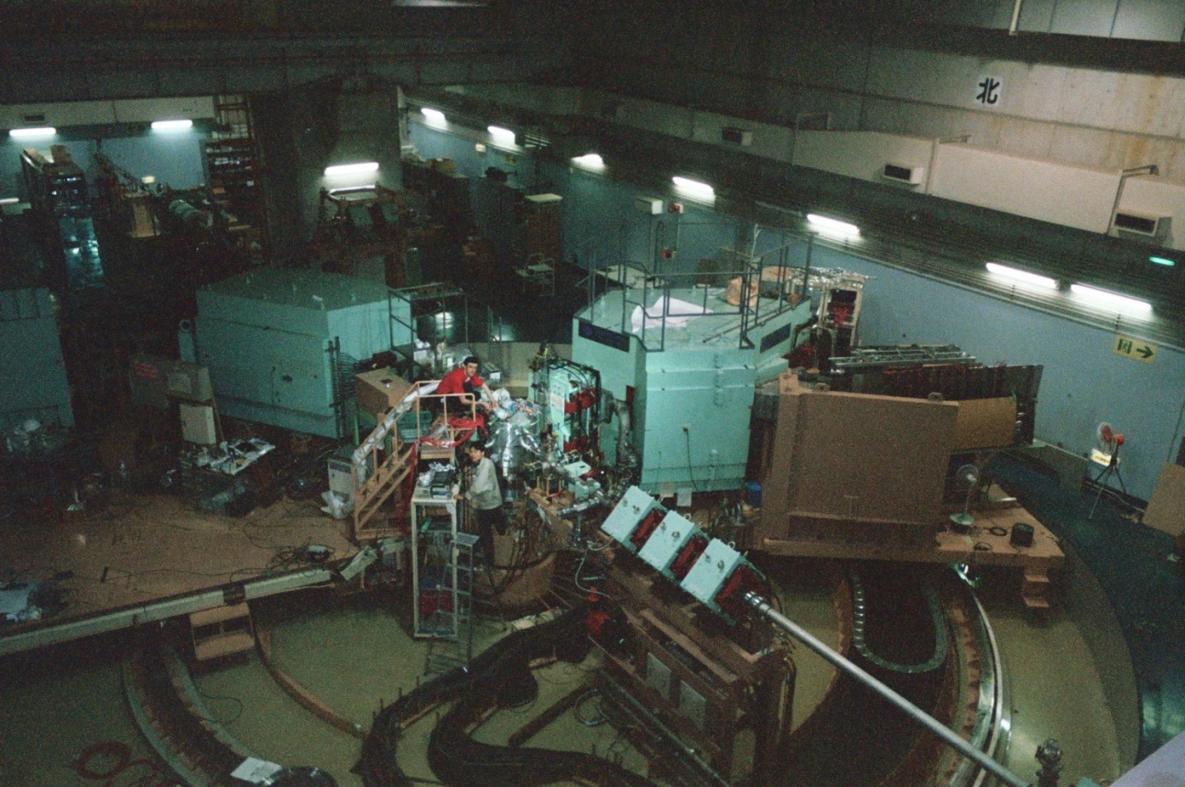
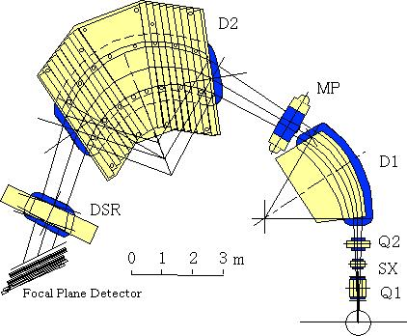
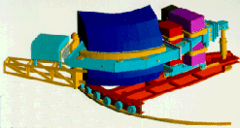
Grand Raiden@
RCNP
(α,α′) at E_{α}~ 400 & 200 MeV at RCNP & KVI,
respectively
BBS@KVI

Slide 13
ISGQR at 10.9 MeV
ISGMR at 13.9 MeV
↑
↑

Slide 14
Difference of spectra
0° < θ_{α′} < 3°
0° < θ_{α′} < 1.5°
1.5° < θ_{α′} < 3°
Difference

Slide 15
′

Slide 16
Multipole decomposition analysis (MDA)
ISGR (L<15)+ IVGDR (through Coulomb excitation)
DWBA formalism; single folding ⇒ transition potential

Slide 17
Transition density
ISGMR Satchler, Nucl. Phys. A472 (1987) 215
ISGDR Harakeh & Dieperink, Phys. Rev. C23 (1981) 2329
Other modes Bohr-Mottelson (BM) model

Slide 18
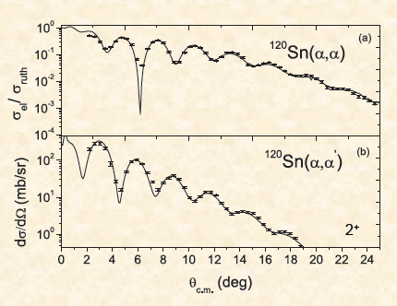

Slide 19
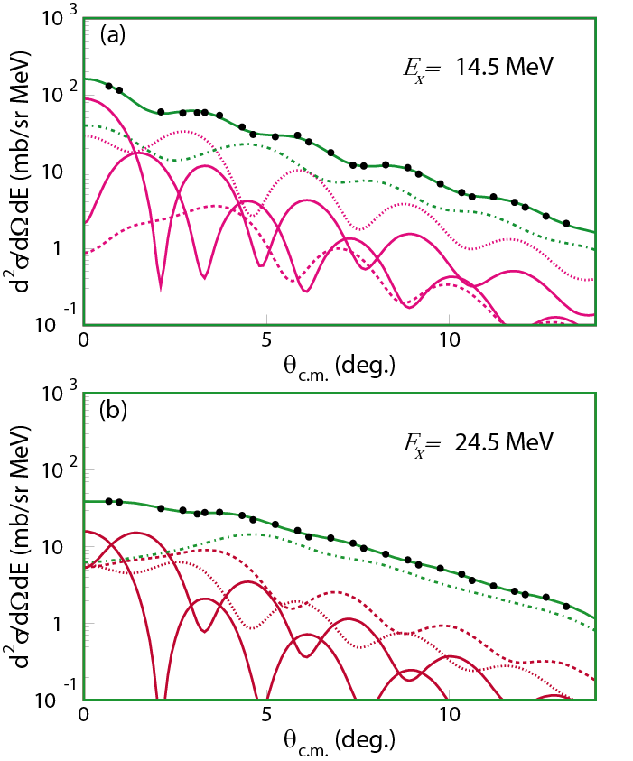
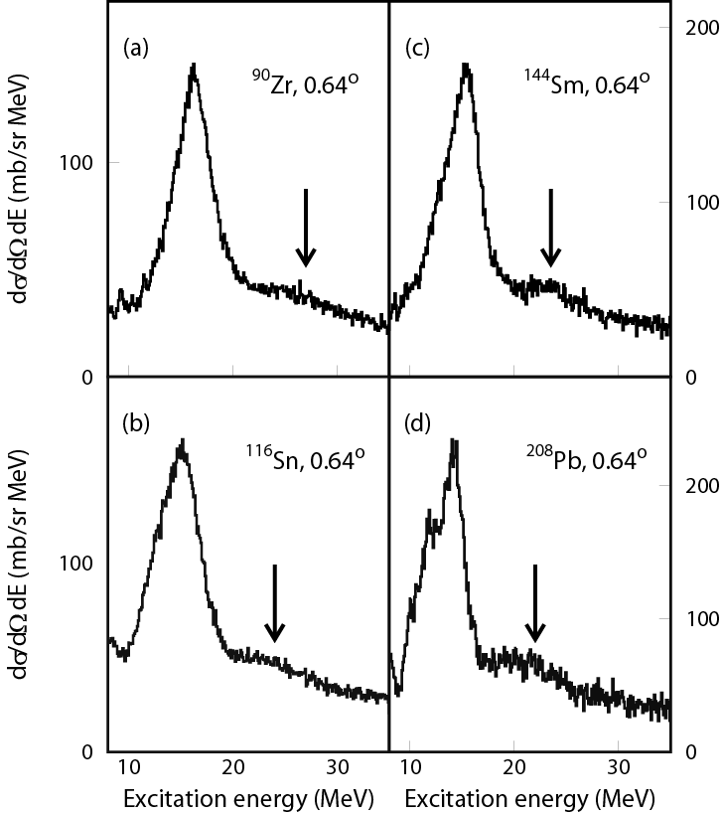
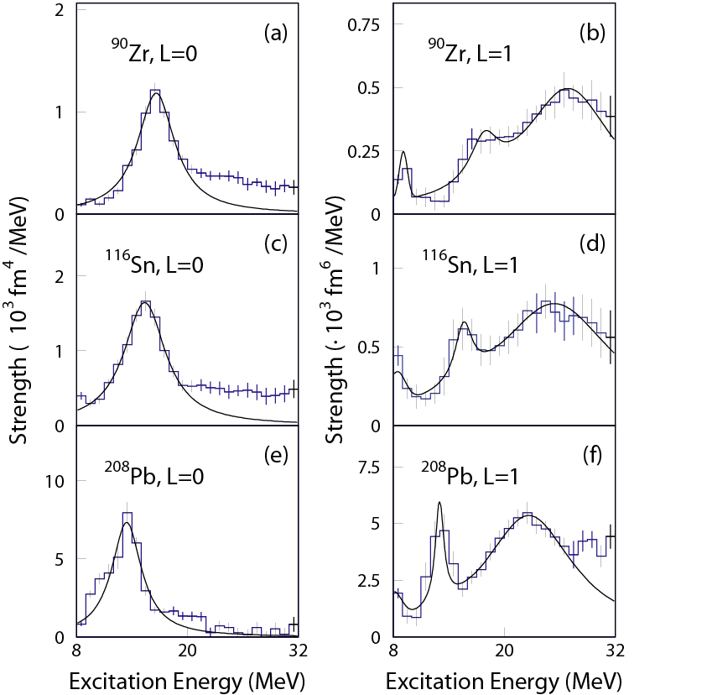
Uchida et al.,
Phys. Lett. B557 (2003) 12
Phys. Rev. C69 (2004) 051301
¹¹⁶Sn
(α,α′) spectra at 386 MeV
ISGDR
ISGDR
MDA results for L=0 and L=1
ISGMR
ISGMR
ISGDR
ISGDR
ISGMR
ISGMR

Slide 20
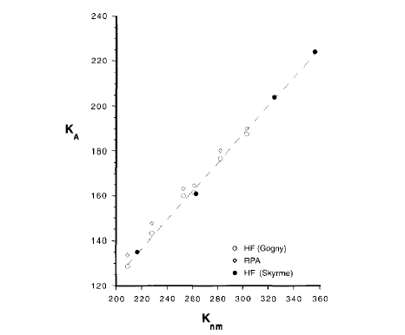
In HF+RPA calculations,
Nuclear matter
E/A: binding energy per nucleon K_{A}: incompressibility
ρ : nuclear density
ρ₀ : nuclear density at saturation
²⁰⁸Pb
K_{A} is obtained from excitation energy of ISGMR & ISGDR
K_{A} =0.64K_{nm}- 3.5
J.P. Blaizot, NPA591, 435 (1995)

Slide 21
From GMR data on ²⁰⁸Pb and ⁹⁰Zr,
K∞ = 240 ± 10 MeV [± 20 MeV]
[See, e.g., G. Colò et al., Phys. Rev. C 70 (2004) 024307]
This number is consistent
with both ISGMR and ISGDR Data
and
with non-relativistic and relativistic calculations
Notes:
21

Slide 22
Isoscalar GMR strength distribution in Sn-isotopes obtained by Multipole Decomposition Analysis of singles spectra obtained in ^{A}Sn(α,α′) measurements at incident energy 400 MeV and angles from 0º to 9º
T. Li et al., Phys. Rev. Lett. 99, 162503 (2007)

Slide 23
K_{A} ~ K_{vol} (1 + cA^{-1/3}) + K_{τ} ((N - Z)/A)² + K_{Coul} Z²A^{-4/3}
K_{A} - K_{Coul} Z²A^{-4/3} ~ K_{vol} (1 + cA^{-1/3}) + K_{τ} ((N - Z)/A)²
~ Constant + K_{τ} ((N - Z)/A)²
We use K_{Coul} = - 5.2 MeV (from Sagawa)
K_{A} = K_{vol} + K_{surf} A^{−1/3} + K_{sym}((N−Z)/A)²+K_{coul} Z²A^{−4/3}
(N - Z)/A
¹¹²Sn – ¹²⁴Sn: 0.107 – 0.194

Slide 24
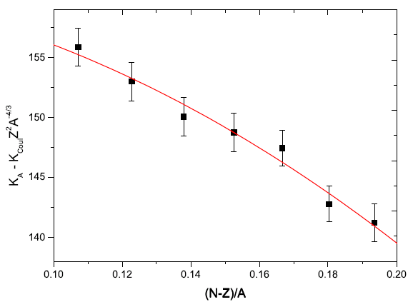
K_{τ} = − 550 ± 100 MeV
Notes:
24

Slide 25
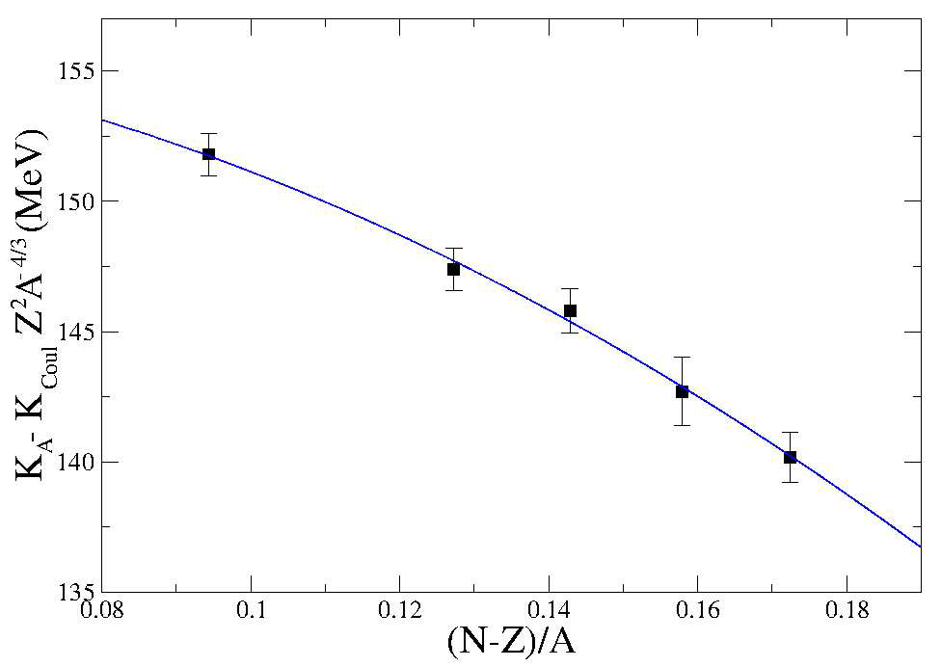
D. Patel et al., Phys. Lett. B 718, 447 (2012)

Slide 26
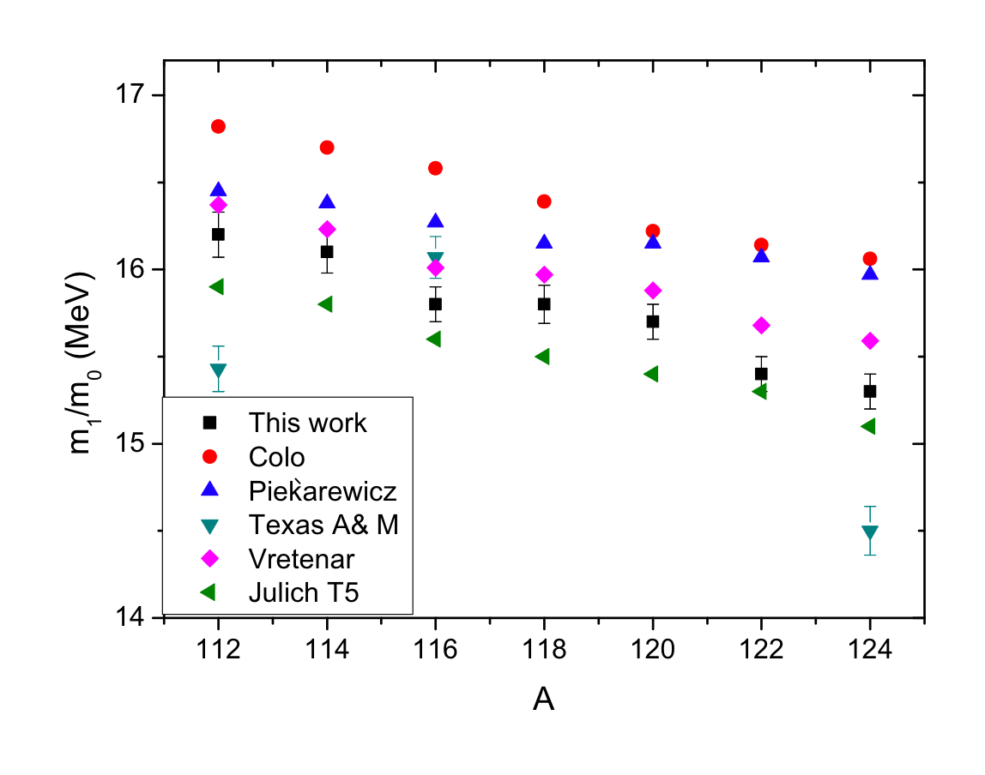
RPA [K∞ = 240 MeV]; RRPA FSUGold [K∞ = 230 MeV];
RMF (DD-ME2) [K∞ = 240 MeV]; (QTBA) (T5 Skyrme) [K∞ = 202 MeV]
Notes:
26

Slide 27
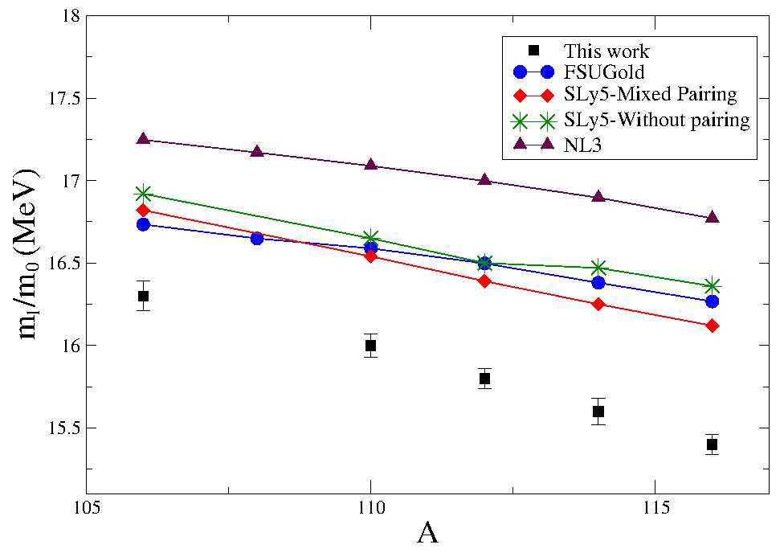
RRPA: FSUGold [K∞ = 230 MeV]; SLy5 [K∞ = 230 MeV];
NL3 [K∞ = 271 MeV]

Slide 28
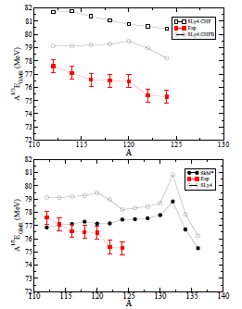
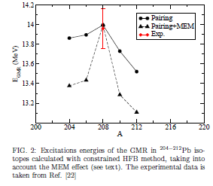
E. Khan, PRC 80, 011307(R) (2009)
The Giant Monopole Resonances in Pb isotopes
E. Khan, Phys. Rev. C 80, 057302 (2009).
K∞ = 230
K∞ = 230
K∞ = 216
Mutually Enhanced
Magicity (MEM)?

Slide 30
Conclusions!
There has been much progress in understanding ISGMR & ISGDR macroscopic properties
Systematics: E_{x}, Γ, %EWSR
⇒ K_{nm}≈ 240 MeV
⇒ K_{τ} ≈ − 500 MeV
Sn and Cd nuclei are softer than ²⁰⁸Pb and ⁹⁰Zr.

Slide 31
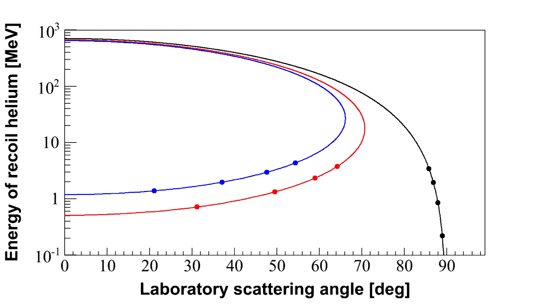
Challenges with exotic beams
Inverse kinematics
E_{x} = 0 MeV
E_{x} = 30 MeV
⁵⁶Ni(α,α′)⁵⁶Ni*
α = Target
⁵⁶Ni = Projectile
8º
4º
6º
2º
E_{x} = 20 MeV
Intensity of exotic beams is very low (∼10⁴ – 10⁵ pps)
To get reasonable yields thick target is needed
Very low energy (∼ sub MeV) recoil particle will not come out of the thick target

Slide 32
Nuclear structure studies with reactions in inverse kinematics
- Possible at FAIR, RIKEN, GANIL, FRIB
(beam energies of 50-100 MeV/u are needed!)‏
Approach at GSI-FAIR (EXL):
Helium gas-jet target
Measure the recoiling alphas
(α,α′)
⁴He target
heavy projectile
α′
heavy ejectile
Inconvenience:
difficulty to detect the low-energy alphas
recoiling
α

Slide 33
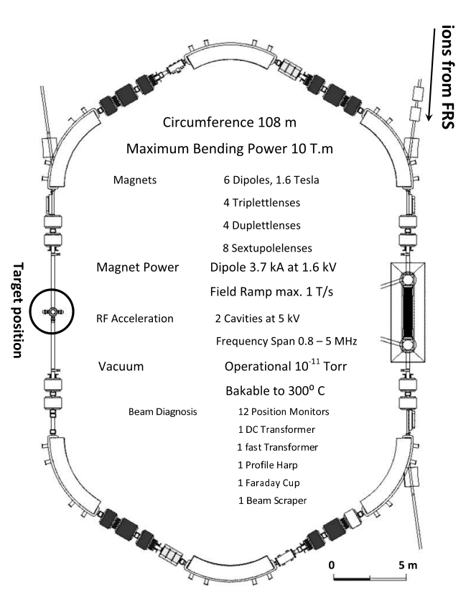
Storage Ring
Experimental storage ring at GSI
Luminosity: 10²⁶ – 10²⁷ cm⁻²s⁻¹
EPJ Web of Conferences 66, 03093 (2014)

Slide 34
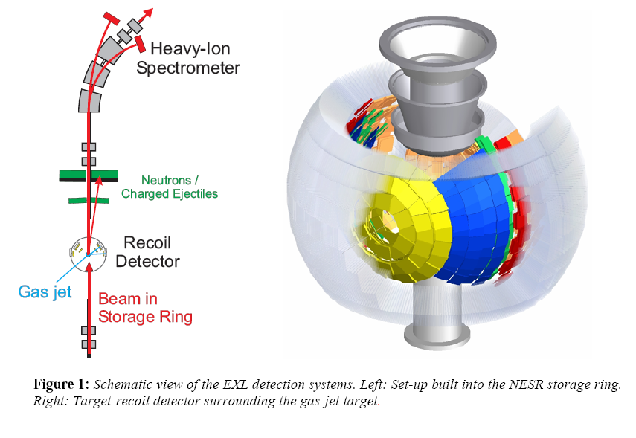
Detection system @ FAIR
EXL recoil prototype detector has been commissioned

Slide 37
Active target
A gas detector where the target gas also acts as a detector
Good angular coverage
Effective target thickness can be increased without much loss of resolution
Detection of very low energy recoil particle is possible
MAYA active-target detector at GANIL

Slide 38
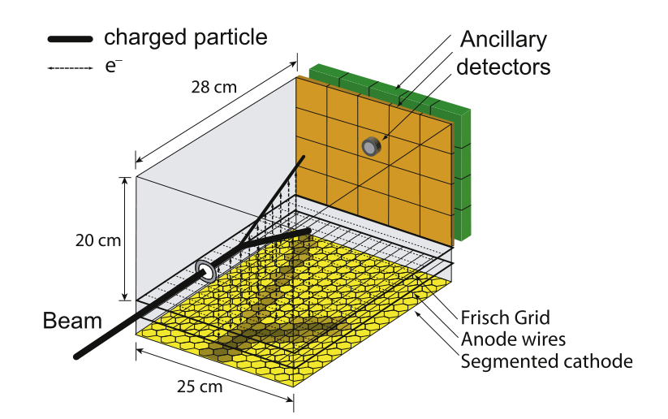
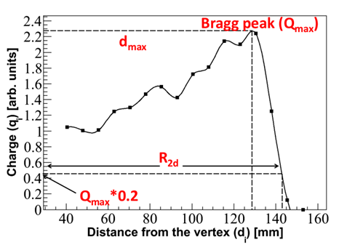
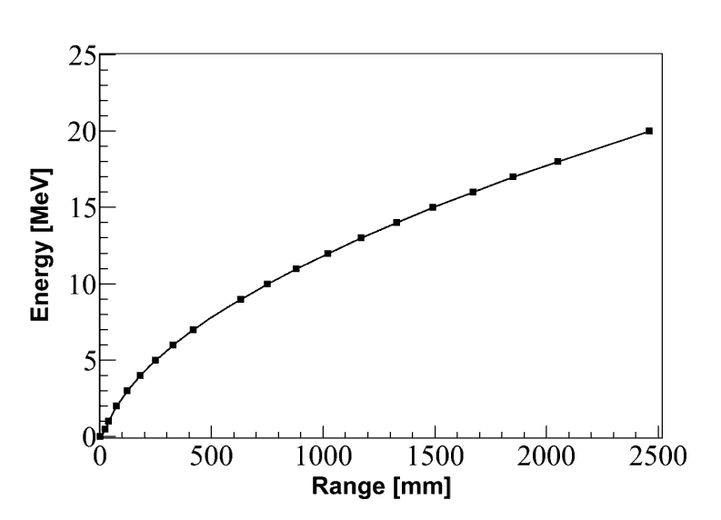
Basics of kinematics reconstruction inside MAYA
20 Si detectors
80 CsI detectors
Beam ⁵⁶Ni
500 mbar
95% He and 5% CF₄
Timing information from Amplification wires
Range → Energy
(SRIM)
R_{2d} → R_{3d ,} θ_{2d} → θ_{3d}

Slide 39
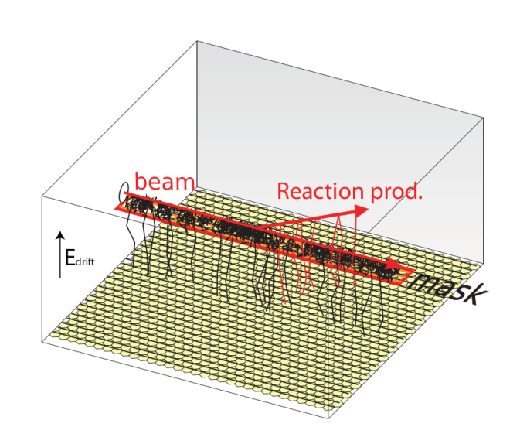
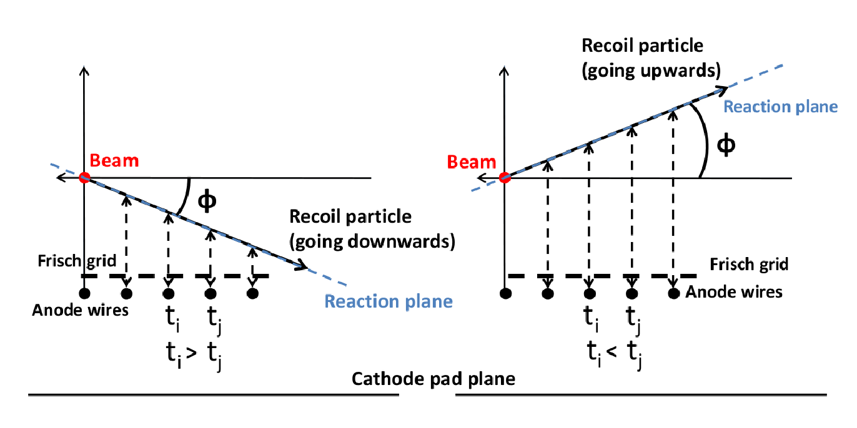
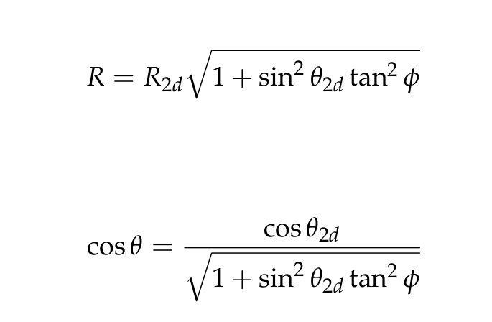
3rd dimension from timing information of the anode wires
Range Energy

Slide 40
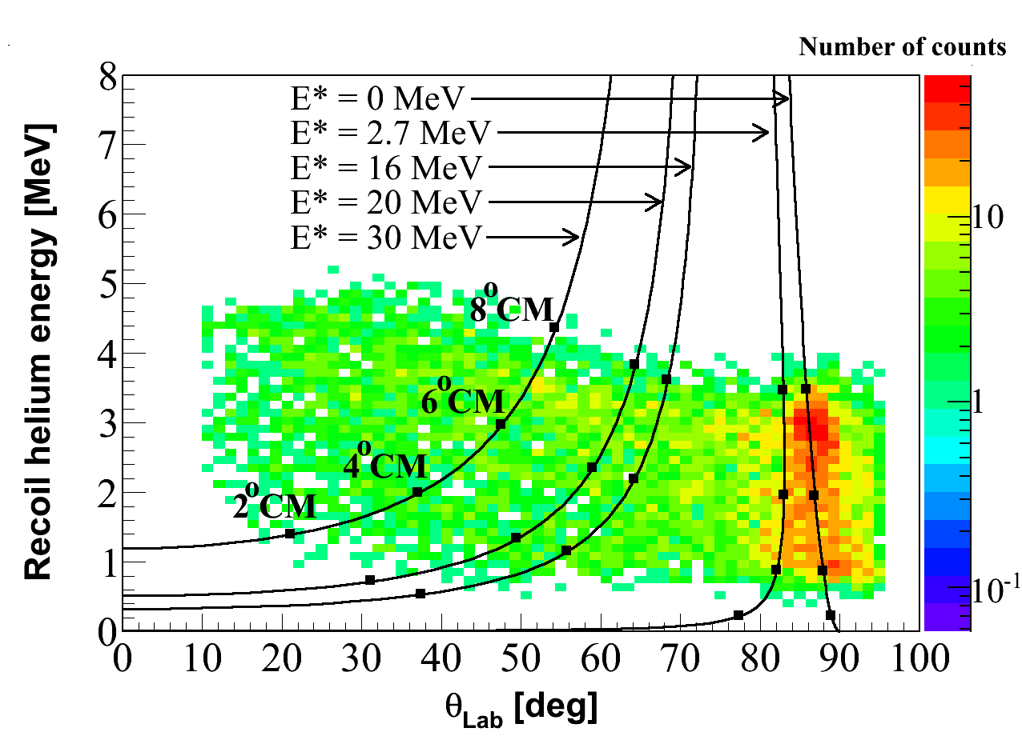
Kinematics plot
Data
⁵⁶Ni(α,α′)⁵⁶Ni*

Slide 41
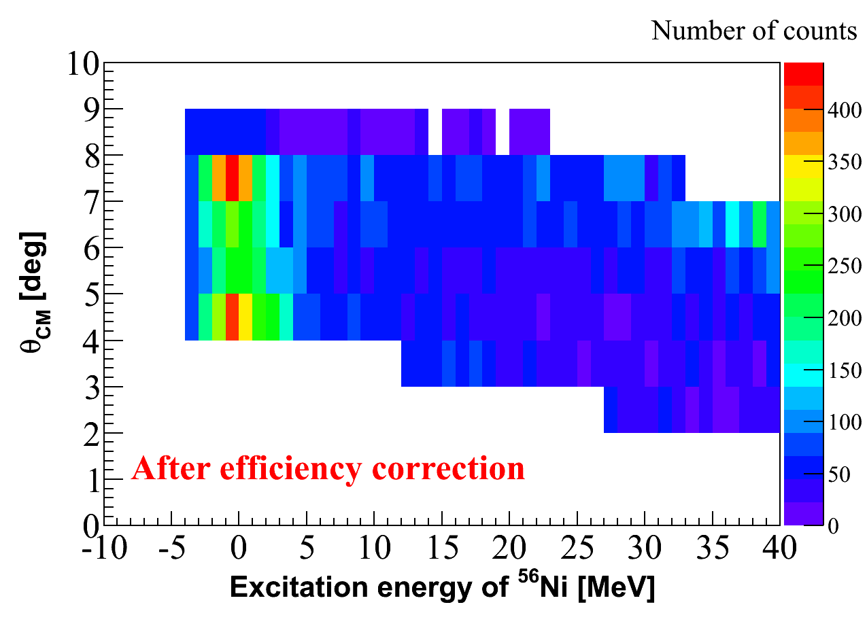
Peak fitting method
Data (Efficiency corrected)

Slide 42
Participants
ATOMKI
NDU
RCNP
M. Csatlós
L. Csige
J. Gulyás
A. Krasznahorkay
D. Sohler
U. Garg
T. Li
B.K. Nayak
M. Hedden
M. Koss
D. Patel
S. Zhu
H. Akimune
H. Fujimura
M. Fujiwara
K. Hara
H. Hashimoto
M. Itoh
T. Murakami
K. Nakanishi
S. Okumura
H. Sakaguchi
H. Takeda
M. Uchida
Y. Yasuda
M. Yosoi
KVI
A.M. van den Berg
M.N. Harakeh
M. Hunyadi (Atomki)
M.A. de Huu
H.J. Wörtche
WWU
C. Bäumer
B.C. Junk
S. Rakers

Slide 43
E605: ISGDR in ⁵⁶Ni EXL Collaboration
Soumya Bagchi Juan Carlos Zamora
Marine Vandebrouck
M. Vandebrouck et al., Phys. Rev. Lett. 113 (2014) 032504
M. Vandebrouck et al., Phys. Rev. C 92 (2015) 024316
S. Bagchi et al., Phys. Lett. B751 (2015) 371

Slide 44
Thank you for your attention

Slide 46
⇒ K_{t} = -500 ⁺¹²⁵ MeV
−100
M. Centelles et al., Phys. Rev. Lett. 102, 122502 (2009)

Slide 47
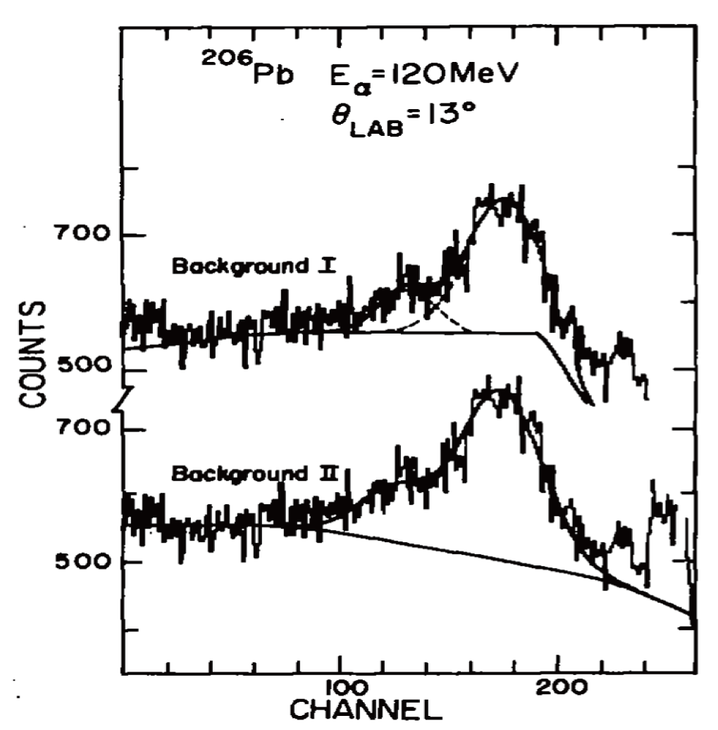
10.9 MeV
11.0 MeV
13.9 MeV
14.0 MeV
M.N. Harakeh et al., Nucl. Phys. A327, 373 (1979)

Slide 48
S. Brandenburg et al., Nucl. Phys. A466 (1987) 29

Slide 49
S. Brandenburg et al.,
Nucl. Phys. A466 (1987) 29

Slide 50
S. Brandenburg et al., Nucl. Phys. A466 (1987) 29

Slide 51
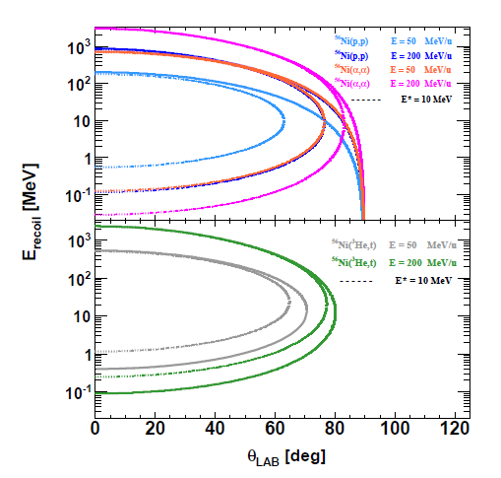

Slide 54
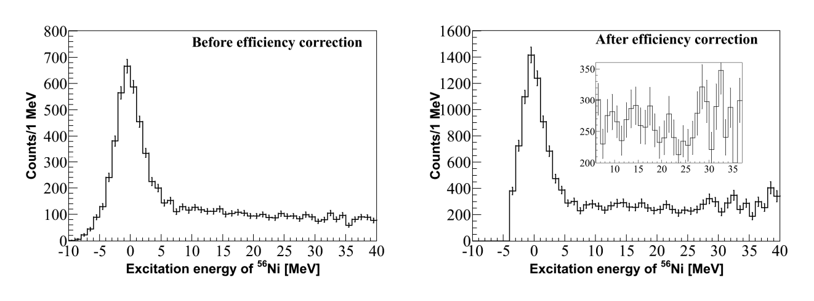
Excitation energy of ⁵⁶Ni
Data (Not efficiency corrected)
Data (Efficiency corrected)

Slide 55
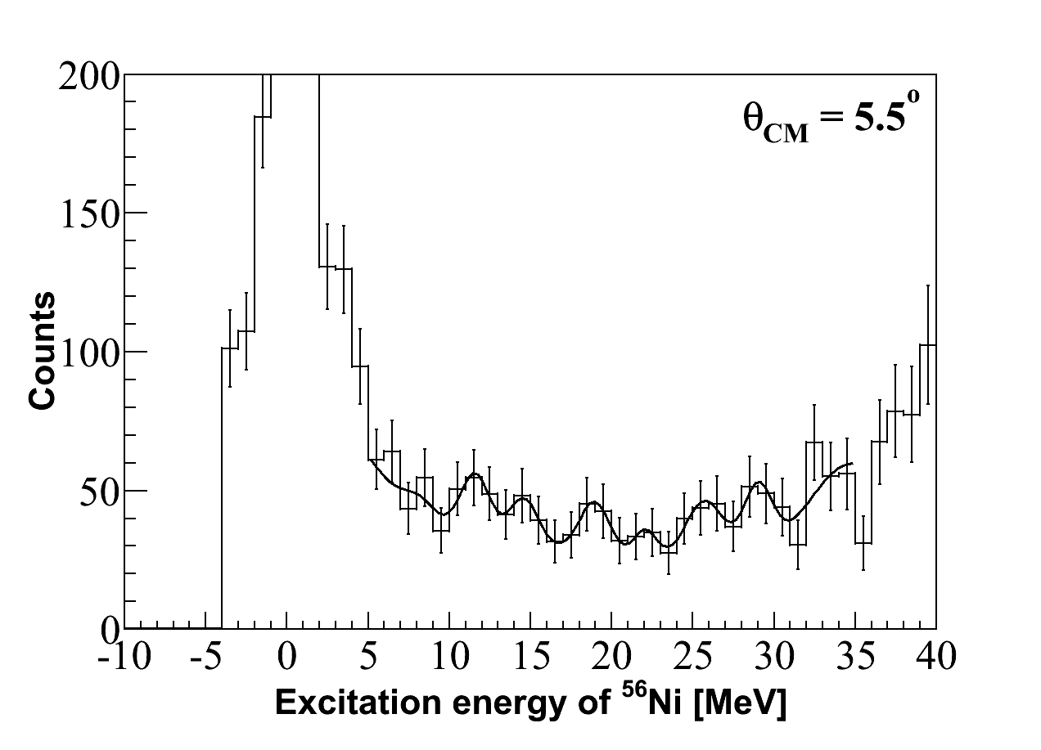
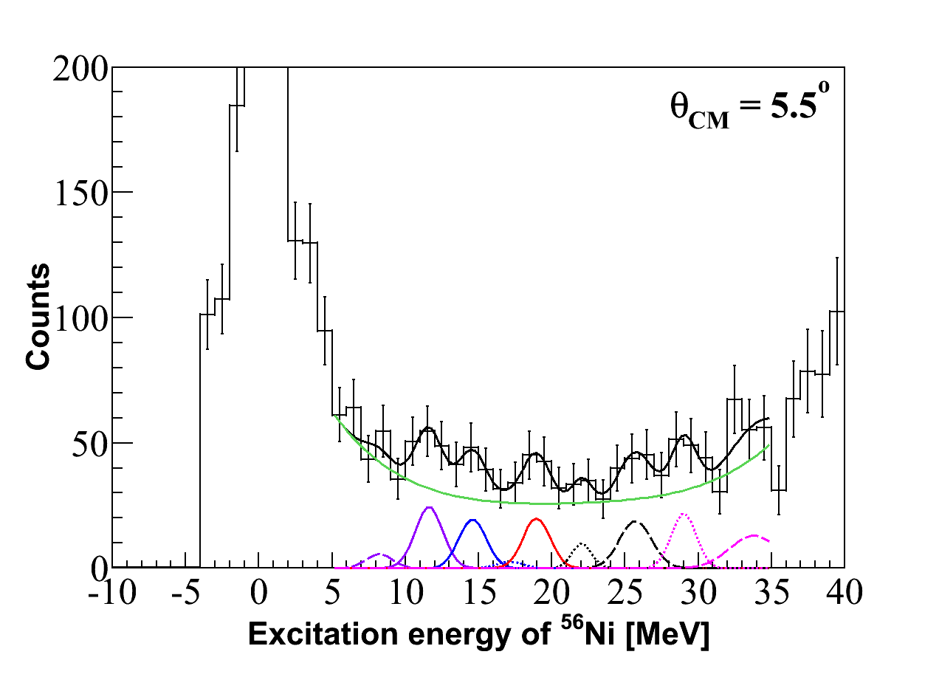
Peak fitting method
Background shape fixed manually (Background 1)
Total fit = 9 Gaussian
Func. + PoL4 + C
Final background
(PoL4 + C)

Slide 56
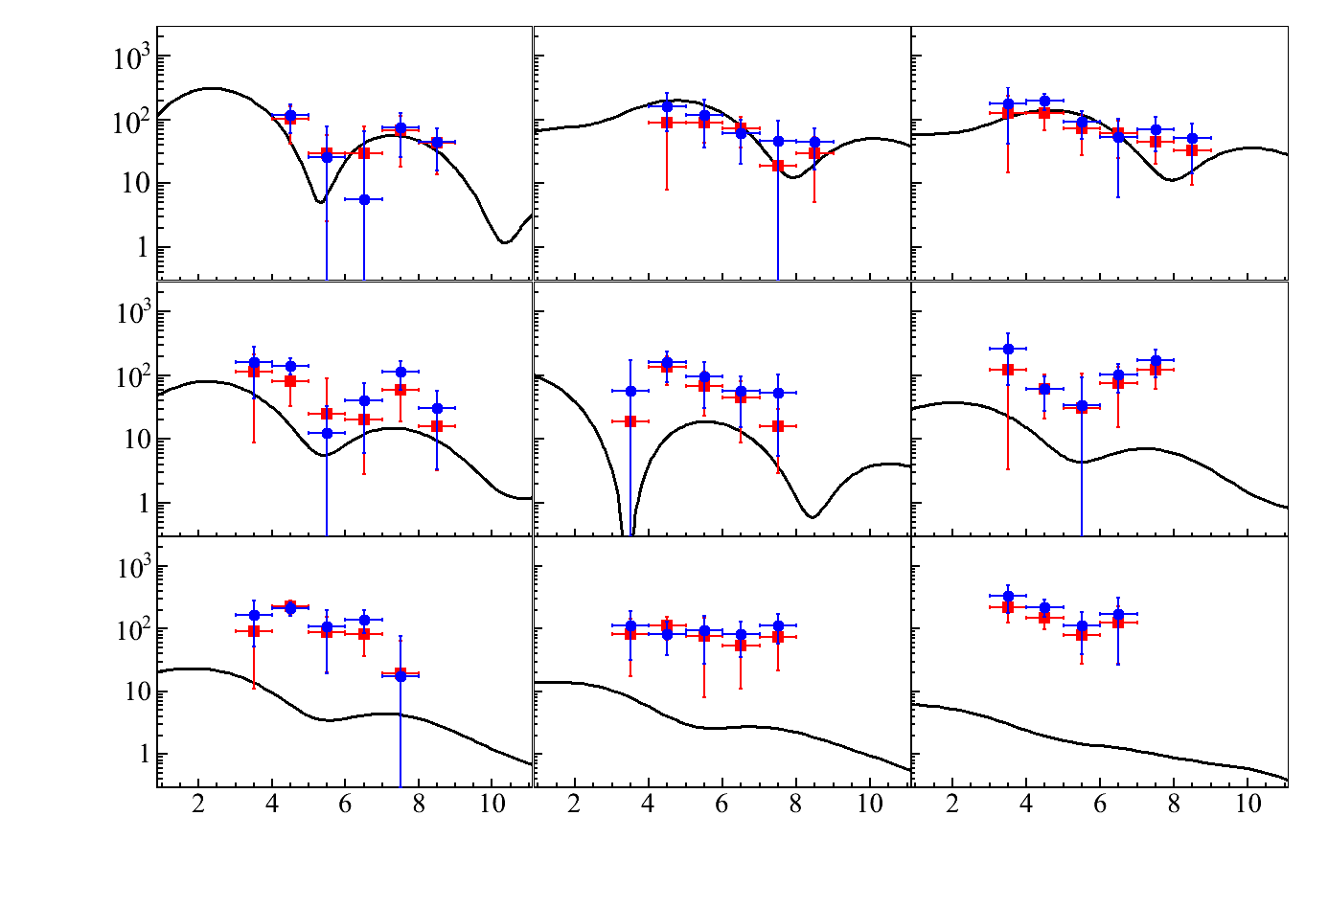
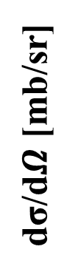
E* = 8.5 MeV, L = 1
E* = 11.5 MeV, L = 2
E* = 14.5 MeV, L = 2
E* = 17.5 MeV, L = 1
E* = 19.5 MeV, L = 0
E* = 22.5 MeV, L = 1
dσ/d$Ω$ [mb/sr]
E* = 25.5 MeV, L = 1
E* = 28.5 MeV, L = 1
E* = 33.5 MeV, L = 1
Background 1
θ_{CM} [deg]
Background 2

