Slide 1
S=−2原子核実験
T.Takahashi (KEK)

Slide 2
Contents
Introduction
  Motivation to Study S=-2 System
Experiments at Early Stage
  Spectroscopy of Ξ-Nucleus
Future Plans
Summary

Slide 3
Motivation to Study S=−2 Systems
New sector of Baryon-Baryon interaction
  A little information on B-B Int.
    ΛΛ weakly attractive
    ΞN attractive ?
    ΞN−>ΛΛ weak or strong
Very dynamic system
  Mixing of ΞN and ΛΛ
Significant step toward multi-strangeness systems
  Core of neutron stars

Slide 4
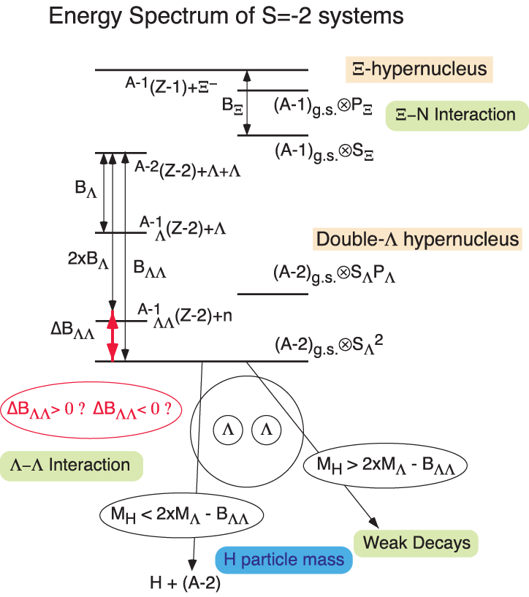
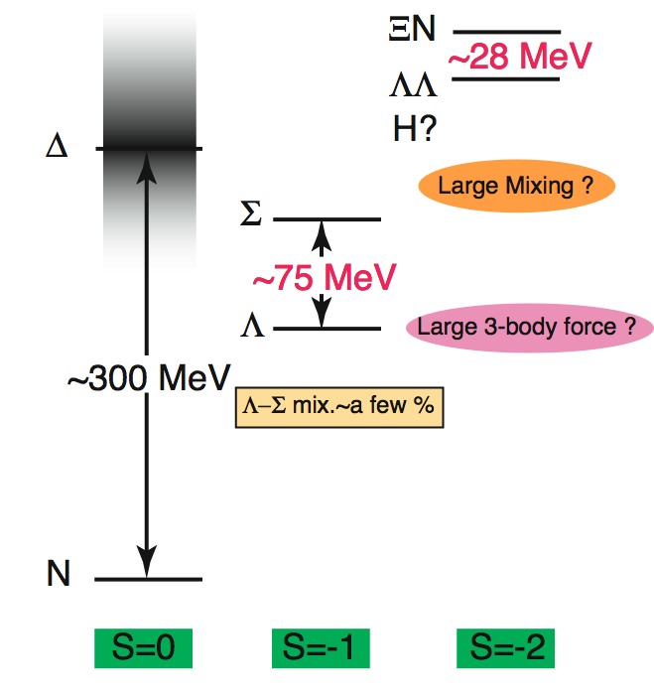
S=−2 System
ΞN−>ΛΛ coupling
Mixing effect is more
significant in S=−2 system

Slide 5
Ξ Potential and B-B Int. Models
U_{Ξ} , Γ_{Ξ} and Partial Wave Contributions in Nuclear Matter
(MeV)
Model | T | ¹S₀ | ³S₁ | ¹P₁ | ³P₀ | ³P₁ | ³P₂ | U_{Ξ} | Γ_{Ξ}
NHC-D | 0 1 | −2.6 −3.2 | 0.1 −2.3 | −2.1 −3.0 | −0.2 −0.0 | −0.7 −3.1 | −1.9 −6.3 | −25.2 | 0.9
Ehime | 0 1 | −0.9 −1.3 | −0.5 −8.6 | −1.0 −0.8 | 0.3 −0.4 | −2.4 −1.7 | −0.7 −4.2 | −22.3 | 0.5
ESC04d* | 0 1 | 6.3 7.2 | −18.4 −1.7 | 1.2 −0.8 | 1.5 −0.5 | −1.3 −1.2 | −1.9 −2.8 | −12.1 | 12.7
OBE (NHC-D, Ehime)
  no t-channel meson exchange
  odd-state attraction
  strong A-dependence of V_{Ξ}
  small width
ESC04d*
  strong attraction of ³S₁(T=0)
  large width

Slide 6
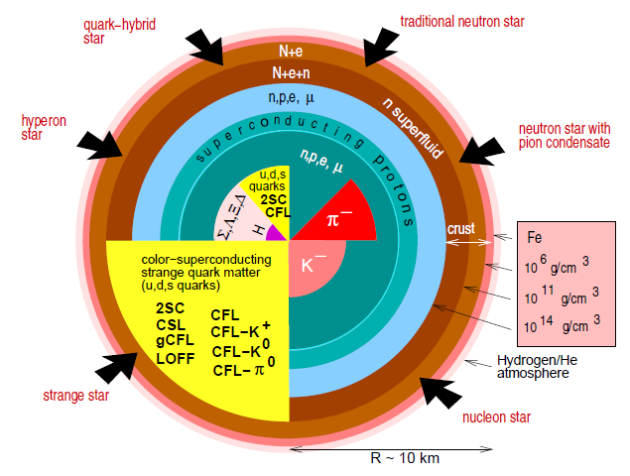
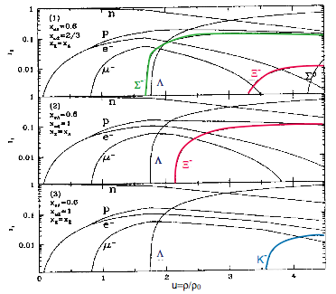
Ξ Potential and
Impact on Neutron Stars
Strange hadrons appear in the core of neutron star...
What kind of hadrons? / How much density?
  depends on mass, charge, and interaction
  Negative baryons are favored.
Σ⁻ was supposed to be important. However its interaction with neutron matter is found to be strongly repulsive.
Ξ⁻ and its interaction should be important.
U_{Σ}<0, U_{Ξ}<0
U_{Σ}>0, U_{Ξ}<0
U_{Σ}>0, U_{Ξ}>0

Slide 7
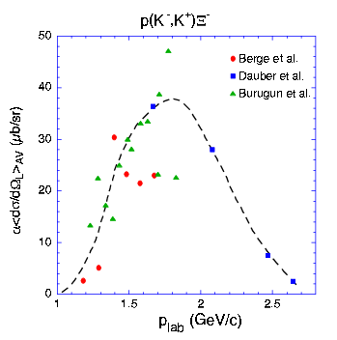
How to produce and study S=−2 systems
Direct production
Reaction Spectroscopy
(E05)
X-rays Measurements
(E03)
Ξ-hypernuclei,
ΛΛ-hypernuclei
K⁻ + p −> K⁺ + Ξ⁻
p(K⁻)~1.8GeV/c
Decay measurements
Emulsion (E07)
ΛΛ-hypernuclei

Slide 8
Previous Studies on
Ξ-Hypernuclei and Ξ Potential (1)
Dover & Gal; Analysis of old emulsion data
Ann. of Phys. 146 (1983) 309
Ξ-Captured events at KEK E176
Prog. Thoer.Phys. 89 (1993) 493 Phys. Lett. B355 (1995) 45
Analysis by Yamamoto
        Few-Body Syst. Suppl. 9 (1995) 145

Slide 9
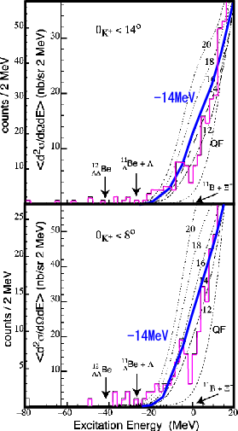
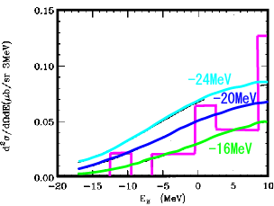
Previous Studies on
Ξ-Hypernuclei and Ξ Potential (2)
(K⁻,K⁺) Missing Mass Spectroscopy
ΔM=14MeV
BNL-E885
KEK-E224
P.Khaustov et al,
PRC61(2000)0546
T.Fukuda et. al, PRC58(1998)1306
ΔM=22MeV
Evidence !?
V_{Ξ} = −14 MeV
0.21±0.07 μb/sr E_{Ξ}<7 MeV
60 ±45 nb/sr −20<E_{Ξ}<0 MeV
−20 < E_{Ξ} < 0 MeV
89±14 nb/sr θ< 8°
42± 5 nb/sr θ<14°

Slide 10
E05 (K⁻,K⁺) Spectroscopy on ¹²C
ー ¹²_{Ξ}Be ー
(K⁻,K⁺) reaction at p=1.8GeV/c
  Missing mass resolution ~3 MeV/c²(FWHM)
K1.8 beamline@J-PARC
  High intensity 1.4 x 10⁶ /spill @ Phase1
  High purity K⁻/π⁻ = 6.9
  H.R. spectrometer Δp/p ~3.3x10⁻⁴(FWHM)
SksPlus spectrometer
  Δp/p = 1.2x10⁻³ (FWHM)
  ~30msr

Slide 11
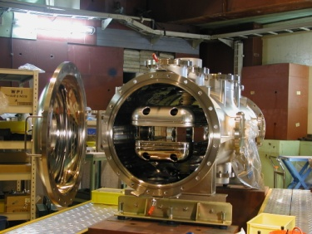
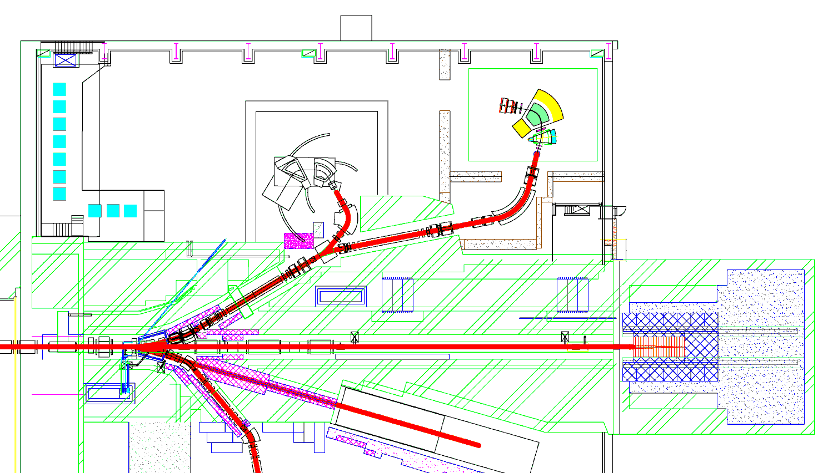
K1.8 beamline
Primary proton beam | 50 GeV-15μA | 30 GeV-9μA
Length (m) | 45.853
Acceptance (msr.%) | 1.4
K⁻(π) intensity (ppp) @1.8 GeV/c | 6.6E+06 | 1.4E+06
@1.5 GeV/c | 2.7E+06 | 0.54E+06
@1.1 GeV/c | 0.38E+06 | 0.08E+06
Electrostatic separator | 750kV/10cm, 6m×2
Single rate @ MS2 @ 1.8 GeV/c | ＞33E+06 | ＞8E+06
K⁻/(π⁻+μ⁻ ) @ FF @ 1.8 GeV/c | 4 | 3.5
X/Y(rms) size @ FF (mm) | 19.8/3.2
Double-stage of
electrostatic separators
Beam spectrometer
Δp/p~3.3x10⁻⁴(FHWM)
Singles-rate of B.S.
assumed 0.6s ext.
13.3MHz@upstream
3.0MHz@downstream

Slide 12
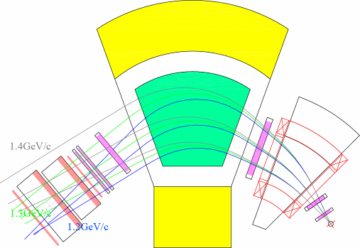
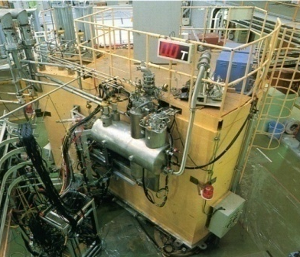
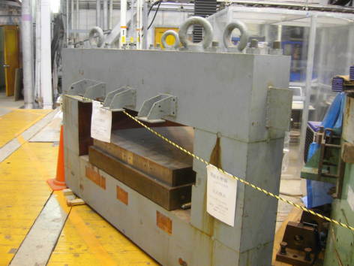
SksPlus spectrometer
95°total bend
~7m flight path
Δx=0.3 mm (RMS)
SKS
2.7T
~30msr
1.5T
SKS(existing)
D magnet (modification)
Δp/p=0.12%

Slide 13
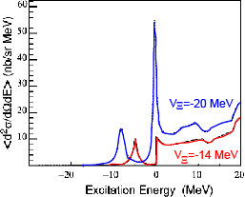
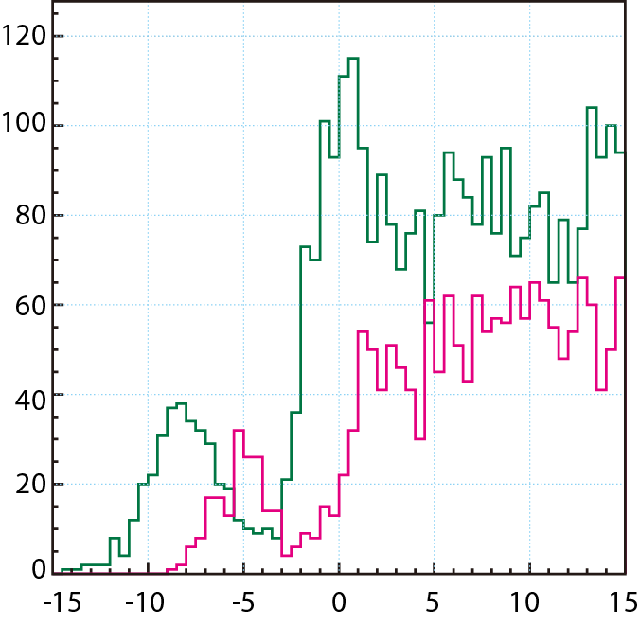
E05 Expected Yield
60nb/sr
4.0x10¹⁰ K⁻/day
  1.4x10⁶ K⁻/spill
  0.7 sec. FT (2.3MHz@FF)
  95% running efficiency
3 cm (5.4 g/cm²) target
30 msr
fdecay ~0.5
fana ~0.7
1month data-taking
6.8 evts/day
48 evts/week
~200 evts/month
P.Khaustov et al,
PRC61(2000)0546
p _{Ξ}
V_{Ξ}= −20MeV
s _{Ξ}
[counts/0.5MeV]
V_{Ξ}= −14MeV
-B_{Ξ} [MeV]

Slide 14
After E05 …
No narrow peak
  No bound state
  Broad width
    Direct production of ΛΛ-nucleus
    (ΛΛ spectroscopy )
Obs. bound state(s)
  Heavier targets for mass dependence
    ²⁷Al, ⁴⁰Ca, ⁸⁹Y, …
  Coulomb-assisted states
    Narrow width for high-l
  ³He(K⁻,K⁺) reaction
    p-n-Ξ⁻(n-n-Ξ⁰) state
    Spin-isospin structure
  (K⁻,K⁰) reaction
    Isospin ΔI=0 excitation
Other than nuclear spectroscopy
is necessary to study ΞN int.
Quasi-free shape analysis
Atomic X-ray measurement

Slide 15
Ξ Single-Particle Energy
0
s_{Ξ}
W.S. pot.
(w/o Coulomb)
p_{Ξ}
−10
f_{Ξ}
¹²C
d_{Ξ}
E [MeV]
−20
²⁷Al
⁴⁰Ca
−30
NHC-D
Ehime
⁸⁹Y
ESC04d*
−40
0
20
40
60
80
100
A

Slide 16
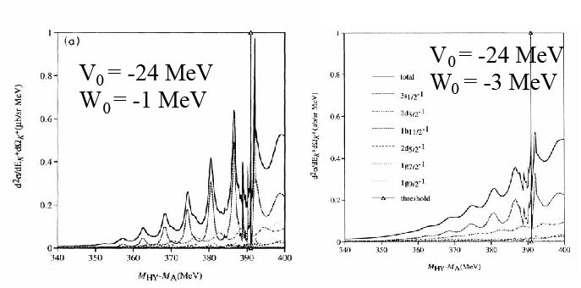
²⁰⁸Pb(K⁻,K⁺) Spectrum
Woods-Saxon potential
S.Tadokoro, H.KObayashi and Y.Akaishi,
Phys. Rev. C 51 (1995) 2656.
Centrifugal barrier
Low nuclear density region
Suppression of ΞN−>ΛΛ Conversion
Very narrow peaks with a large orbital angular momentum.

Slide 17
Yield for heavier targets
Cross section ? ∝A^{1/3} (best case?)
Target (thickness) ∝1/A
Yield for the same intensity and time
  Y∝A^{−2/3}
Y(⁸⁹Y) = (12/89)^{−2/3} Y(¹²C) = 0.26Y(¹²C)
Y(²⁰⁸Pb)=(12/208)^{−2/3}Y(¹²C)=0.15Y(¹²C)
Higher intensity & long beam time are necessary.

Slide 18
If 50GeV-15μA is achieved …
6.6x10⁶/spill with 0.7s FT
  14MHz singles rate @ downstream O.K.
  55MHz singles rate @ upstream N.G.?
  1.5x10¹¹ K⁻ /day x 3.75
Why N.G.?
  Detector rate ability other than wire chamber
  Accidental backgrounds fast device / analysis
1.7s FT
  20 MHz singles rate @ upstream
  1.2x10¹¹ K⁻/day x 3
Give up point-to-point condition of B.S.
  Larger beam size at upstream
  loose resolution. How much?

Slide 19
(K⁻,K⁰) reaction
(K⁻,K⁺) can excite only ΔI=1, but (K⁻,K⁰) can excite ΔI=0.
  Isospin dependence
K⁰ is measured by K_{S} −>π⁺π⁻.
  Opening angle η~35°@1.3GeV/c
  How to distinguish K0 and K0bar
    Tagged with weak decay
  Resolution
    ~10MeV is OK, but a few MeV is ?

Slide 20
Summary
Physics of S=-2
  Baryon-baryon interaction
  High density matter
Experiments at early stage
  Spectroscopy of Ξ-nucleus
  Emulsion exp.
  X-rays of Ξ-atomic state
Future
  Spectroscopy for heavy targets
  (K⁻,K⁰) reaction
  High intensity beam & handling technology

Slide 21
Target | NHC-D |  |  | Ehime |  |  | ESC04d* |  |  | WS
 | E | Γ | r | E | Γ | r | E | Γ | r | E
 | [MeV] | [MeV] | [fm] | [MeV] | [MeV] | [fm] | [MeV] | [MeV] | [fm] | [MeV]
¹²C s w/o Coul. | −4.4 −1.9 | 0.5 0.5 | 3.2 3.7 | −4.5 −1.9 | 0.3 0.2 | 3.1 3.7 | −4.6 −2.1 | 4.6 3.9 | 3.3 3.7 | −2.2
²⁷Al s w/o Coul. p w/o Coul. | −14.9 −8.4 −7.1 −2.0 | 0.7 0.7 0.4 0.3 | 2.0 2.2 3.4 4.0 | −13.4 −7.3 −5.9 −1.1 | 0.2 0.2 0.2 0.1 | 2.3 2.6 3.6 4.5 | −10.1 −4.7 −5.2 −0.8 | 5.7 4.7 2.8 1.9 | 3.0 3.4 4.1 5.1 | −5.1
⁴⁰Ca s w/o Coul. p w/o Coul. | −19.7 −10.8 −13.7 −5.7 | 0.6 0.6 0.5 0.4 | 2.2 2.4 3.0 3.3 | −18.7 −9.9 −11.5 −3.9 | 0.2 0.2 0.2 0.2 | 2.4 2.6 3.3 3.7 | −14.1 −6.2 −9.3 −2.4 | 5.9 4.9 3.3 2.5 | 3.0 3.4 3.9 4.5 | −6.5 −1.2
⁸⁹Y s w/o Coul. p w/o Coul. d w/o Coul. f | −31.4 −16.4 −26.2 −12.0 −20.6 −7.3 −14.8 | 0.6 0.6 0.5 0.4 0.4 0.3 0.3 | 2.3 2.5 3.0 3.2 3.5 3.9 4.1 | −29.8 −15.0 −23.6 −9.8 −17.3 −4.6 −11.0 | 0.2 0.2 0.2 0.2 0.2 0.1 0.1 | 2.5 2.8 3.3 3.6 3.9 4.4 4.6 | −22.4 −8.5 −17.8 −5.3 −13.3 −2.0 −8.7 | 6.5 5.2 3.9 2.8 2.4 1.7 1.6 | 3.0 3.7 4.0 4.6 4.7 5.5 5.4 | −9.0 −4.6 −0.2

Slide 22
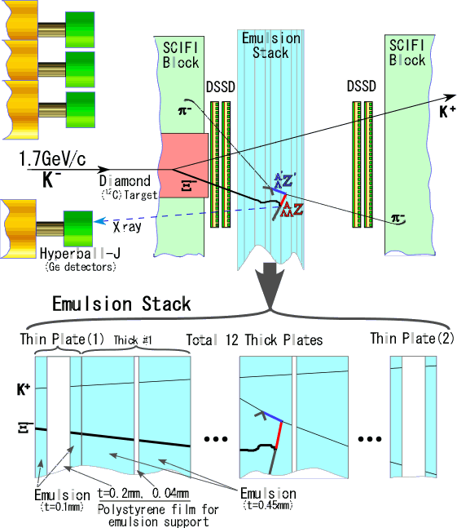
E07
Systematic Study of Double Strangeness
Systems with an Emulsion-counter Hybrid Method
l
Double Λ Hypernuclei
  expected ~100 events
  extend known species
    species dependence of ΔB_{ΛΛ}
    decay form
H-dibaryon
Ξ-Nucleus Interaction
  twin hypernuclei
  X-ray from atomic states
Unknown Phenomena
l
t
l
i
(¹²C)
r
l
p
b
l
 | # of absorbed Ξ⁻ | # of ΛΛ-hypernuclei | # of twin hypernuclei
1965 D. Davis | 4 (expected) | 1
1987-1997 (KEK-E176) | 80 | 1 | 2
1998-present (KEK-E373) | ~800 | 7 (1) | 3
J-PARC E07 | ~10000 | ~100 | 20-30?

Slide 23
E03
  Measurement of X rays from Ξ⁻ Atom
target
K⁻
K⁺
Ξ⁻ Nuclues potential
  Real part
    Level energy shift
  Imaginary part
    Width
    X ray yield
Regardless of potential detail
  attractive / repulsive
  strong / weak absorption
Complementary to E05
  E03 surface region of the potential
  E05 inner part of the potential
Ξ⁻
X ray
l=n-2
l=n-1
l=n-3
...
Ξ
...
Z
Energy (arb.)
...
nuclear absorption
...
Z
Ξ
l (orbital angular momentum)

