Slide 1
Probing Majorana Neutrinos
(in Rare Decays of Mesons)
arXiv:1005.4282 (PRD82,053010,2010)
G. Cvetic, C. Dib, S.K. Kang, C.S. Kim
11/17/2011 - DBD11
C. S. Kim

Slide 2
Outline
1. Prologue
2. Issues on neutrino masses
3. Probing Majorana neutrinos via
(a) 0nbb
(b) K, D, Ds, B, Bc meson RARE decays
(c) at the LHC (and ILC)
4. Concluding remarks

Slide 3
1. Prologue
Neutrinos are massless in the SM
No right-handed ν’s ➔ Dirac mass term is not allowed.
Conserves the SU(2)_L gauge symmetry, and only contains
the Higgs doublet (the SM accidently possesses (B - L)
symmetry); ➔ Majorana mass term is forbidden.
Historic Era in Neutrino Physics
Atmospheric ν_{μ}’s are lost. (SK) (1998)
converted most likely to ν_{τ} (2000)
Solar ν_{e} is converted to either ν_{μ} or ν_{τ} (SNO) (2002)
Only the LMA solution left for solar neutrinos
(Homestake+Gallium+SK+SNO) (2002)
Reactor anti-ν_{e} disappear (2002) and reappear (KamLAND) (2004)

Slide 4
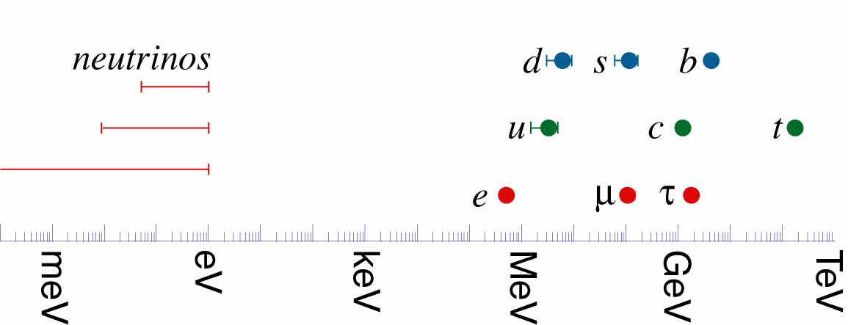
What we have learned
Lepton Flavor is not conserved
Neutrinos have tiny mass, not very hierarchical
Neutrinos mix a lot
Very different from quark sectors
the first evidence for
incompleteness of Minimal Standard Model

Slide 5
What we don’t know
absolute mass scale of neutrinos remains an open question.
m₁ and m₃, which is bigger? ➔ normal or inverted hierarchy?
What is the value of θ₁₃? Is it zero or not? how small?
➔ Reactor & accelerator ν-oscillation experiments can answer,
but possibly estimated from a global fit
Why θ₂₃ and θ₁₂ are large and close to special values?
➔ Very strong hints at a certain (underlying) flavor symmetry.
Is CP violated in leptonic sector?
Neutrinos are Dirac or Majorana?

Slide 6
2. Issues on neutrino masses
Why are physicists interested in neutrino mass ?
➔ Window to high energy physics beyond the SM!
How exactly do we extend it?
➔ Without knowing if neutrinos are Dirac or Majorana,
any attempts to extend the Standard Model are
not successful.
Effective Observability of Difference between
Dirac and Majorana Nu is proportional to

Slide 7
2 possible types of neutrino masses
chiral projection :
Dirac mass terms are invariant under a global symmetry
, but Majorana mass terms are not so.
Thus Dirac mass can be associated with a conserved quantum
number, but Majorana mass violates L number conservation.

Slide 8
If Neutrinos are Majorana
The mass eigenstates are self-conjugate up to a phase. The relative phases between two ν’s become observable
U = U_{D} X
The Majorana character is only observable for processes
ΔL=2 through the mass term that connects interacting
neutrinos with antineutrinos:
^{A}Z→ ^{A}(Z+2) + 2e⁻, μ⁻ + ^{A}Z → e⁺ + ^{A}(Z-2), etc.

Slide 9
Neutrino masses, if neutrinos are of Majorana nature, must
have a different origin compared to the masses of charged
leptons and quarks.
A natural theoretical way to understand why 3 ν-masses
are very small :
Seesaw mechanism
Type-I : Right-handed Majorana neutrinos.
Type-II : Higgs triplet.
Type-III : Triplet fermions.
ν
:

Slide 10
Fundamental physics and seesaw scale
For k order of one, seesaw scale : 10¹³⁻¹⁴ GeV.
no hope of direct observation
For testability, low scale seesaw is desirable
We may keep L free and look for theoretical predictions
TeV scale seesaw
it may harms naturalness problem

Slide 11
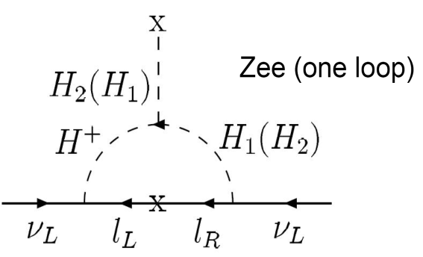
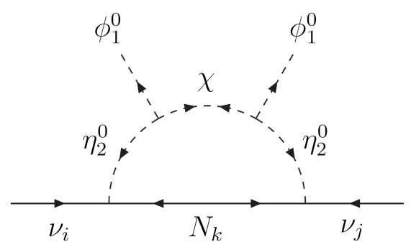
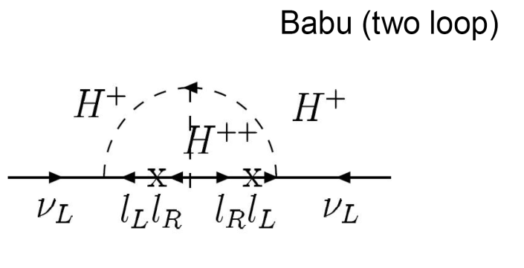
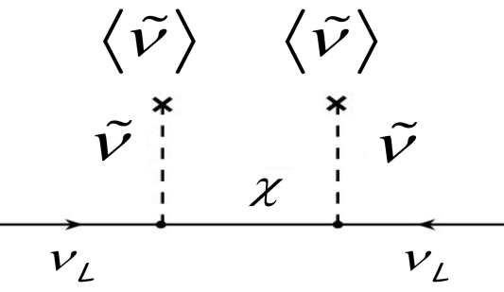
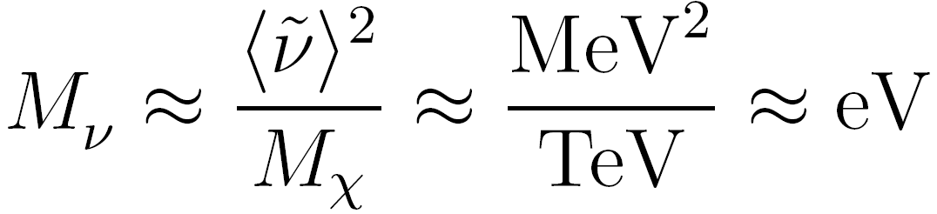
Alternative mechanisms for majorana ν mass
Loop Models: Light neutrino masses are radiatively induced.
Ma
RPV: Sneutrino gets small VeVs inducing a mixing between ν & χ.

Slide 12
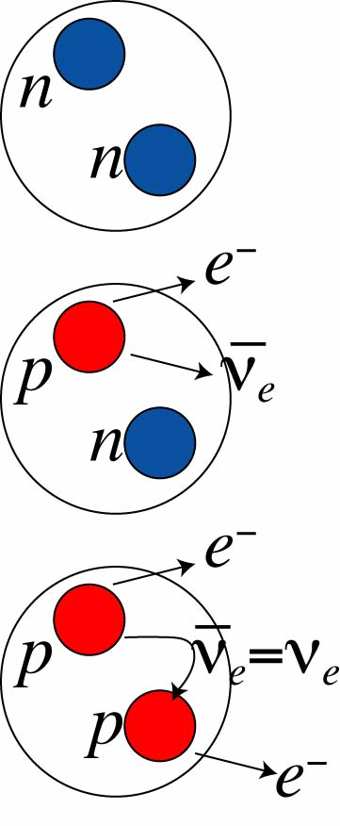
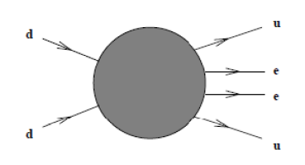
3. Probing Majorana neutrinos
Lepton number violation by 2 units plays a crucial role
to probe the Majorana nature of ν’s,
(a) The observation of 0νββ
Black Box 0νββ
,
Provides a promising lab. method for determining the
absolute neutrino mass scale that is complementary to
other measurement techniques

Slide 13
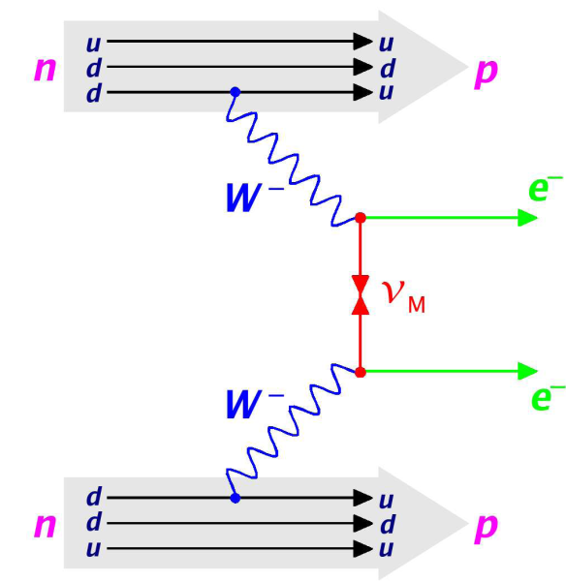
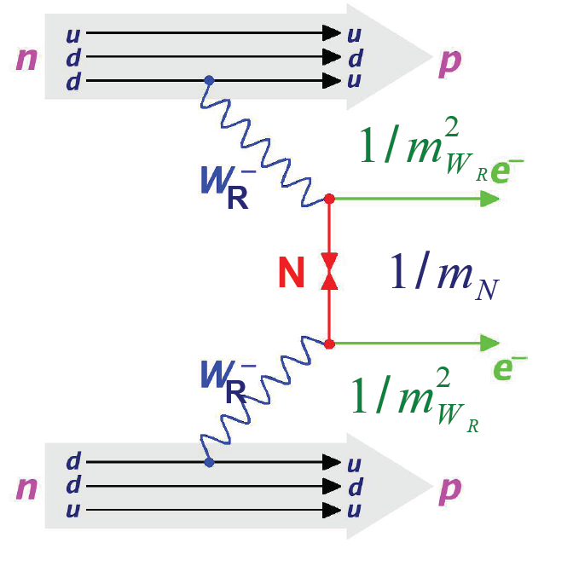



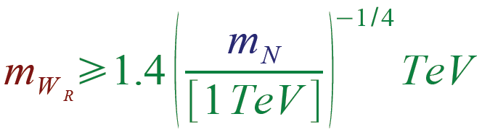
Opening Black Box 0νββ
exchange of a virtual light neutrino
Helicity mismatch ➔ mass mechanism
Neutrino ➔ Majorana particle
L/R symmetric models
R
Exchange of a massive neutrino
Constraints on the model parameters:
R

Slide 14
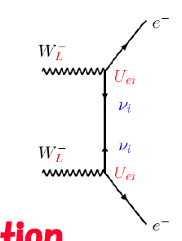

In the limit of small neutrino masses :
the half-life time, ,of the 0νββ decay can be factorized as :
: Nuclear matrix element
: phase space factor
: effective neutrino mass (model independent)
➔ depends on neutrino mass hierarchy

Slide 15
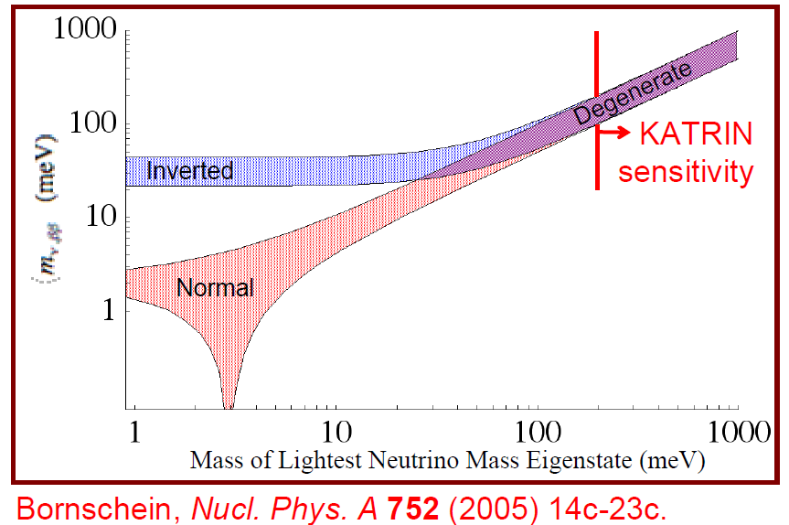
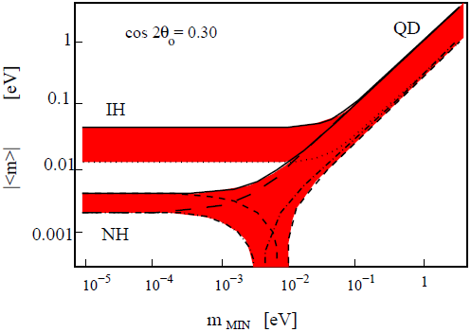

Estimate by using the best fit values of parameters including uncertainties in Majorana phases
Long Baseline

Slide 16
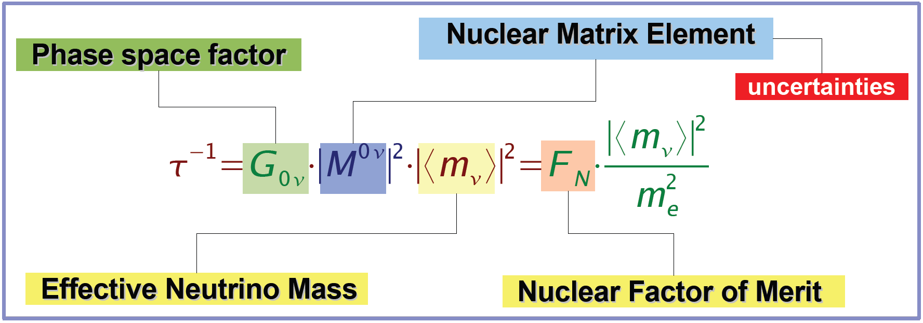
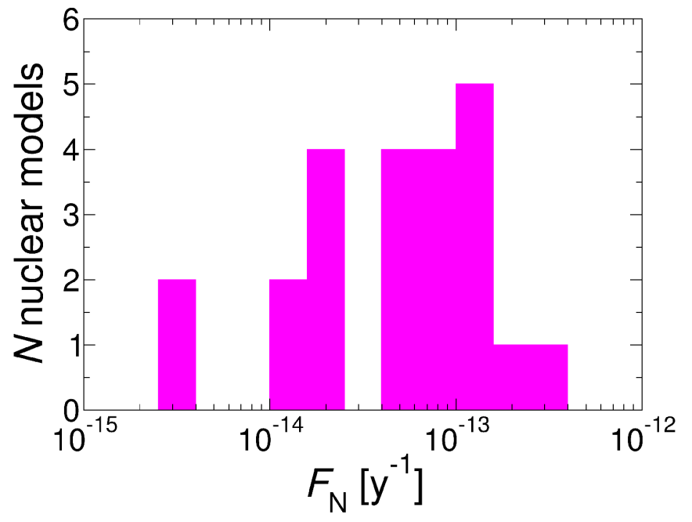
Large uncertianties in NME
Uncertianties
(O.Cremonesi, 05)
About factor of 100 in NME ➔
affect order 2-3 in |< m_{ν}>|

Slide 17
Best present bound :
Heidelberg-Moscow
Half-life
consistent with cosmological bound

Slide 18
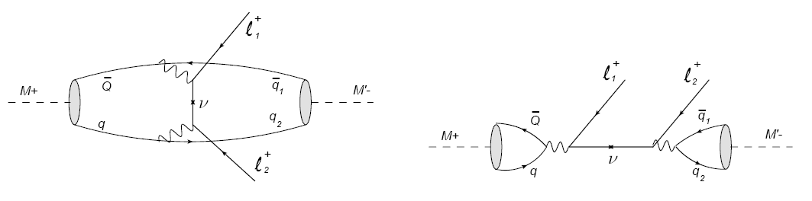
(b) Probe of Majorana neutrinos via
rare decays of mesons
(G.Cvetic, C. Dib, S.Kang, C.S.Kim, arXiv:1005.4282 (PRD82,053010,2010))
Taking mesons in the initial and final state to be
pseudoscalar (M : K, D, Ds, B, Bc / M’=pi, K, D,…)
Not involve the uncertainties from nuclear matrix
elements in 0βνν

Slide 19
Effective Hamiltonian:
Decay Amplitude:

Slide 20
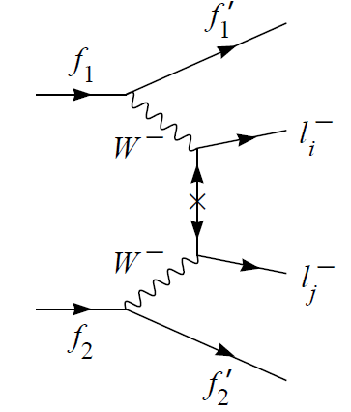
transition rates are proportional to

Slide 21
For example, leptonic current :

Slide 22
Model Independence of Effective Theory approach
This could be any gauge boson,
e.g. ,…
This could be any Majorana particle,
e.g. neutralino, heavy N,…
Propagator changed

Slide 23
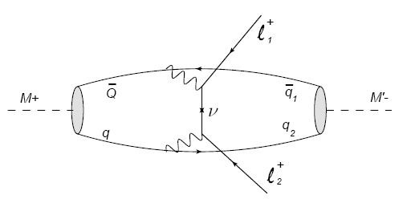
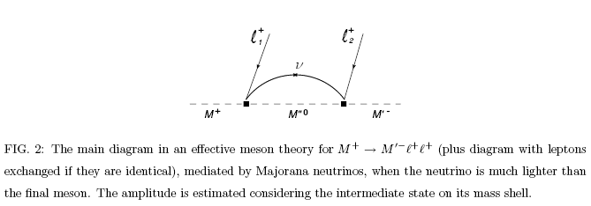
(i) Light neutrino case

Slide 24


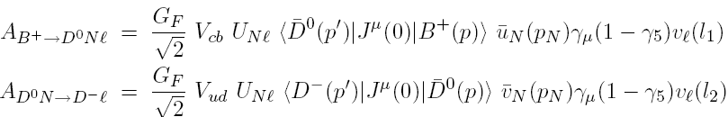
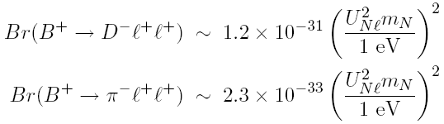
Neutrinoless decay, e.g. with light neutrinos:
(In the limit of absorptive dominance, the amplitude can be expressed
in a model independent way.)

Slide 25
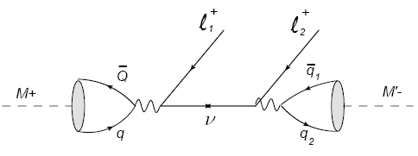
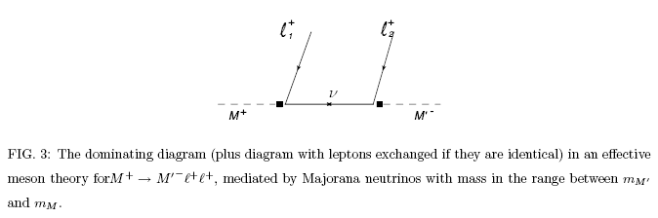
(ii) Intermediate mass scale neutrino case
dominant contribution to the process is from the “s-type” diagram because the neutrino propagator is kinematically entirely on-shell

Slide 26


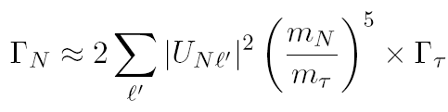

Effective amplitude at meson level:
If we neglect charged lepton masses;

Slide 27
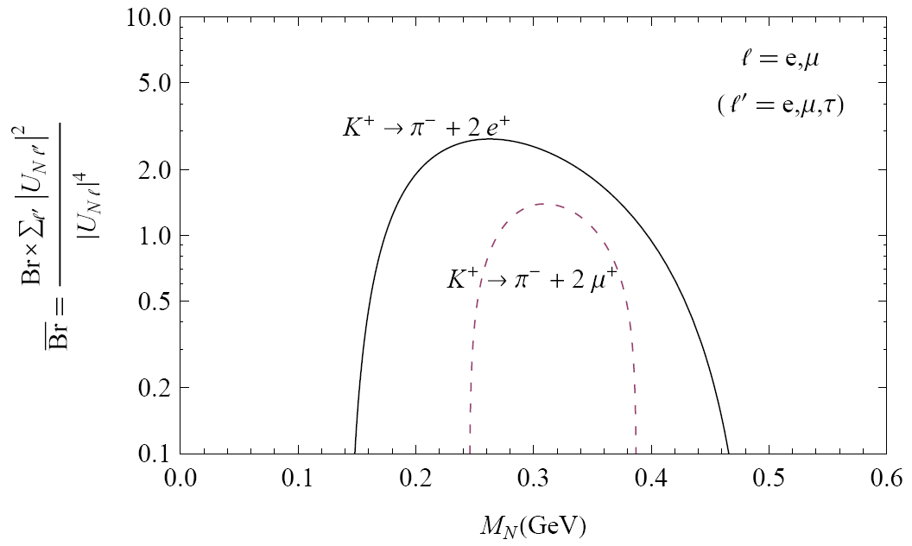
Br for as function of mN, with lepton mixings divided out

Slide 28
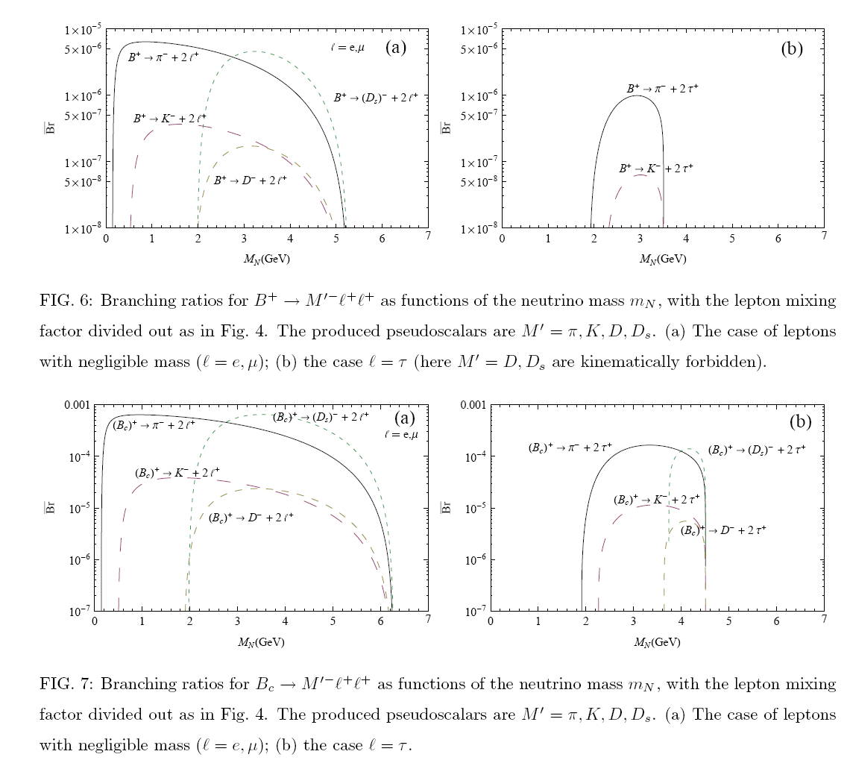

Slide 29
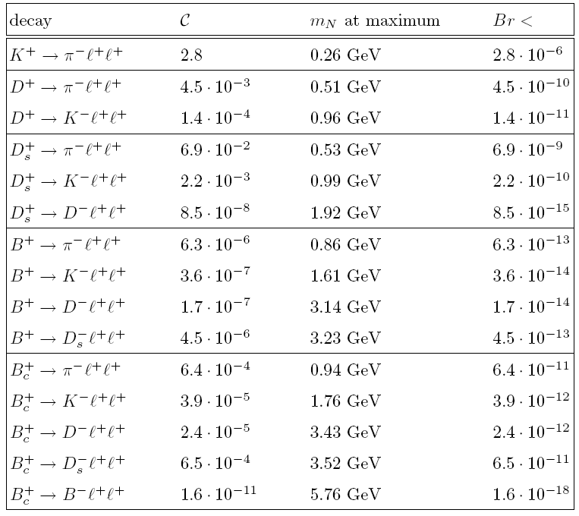



Slide 30
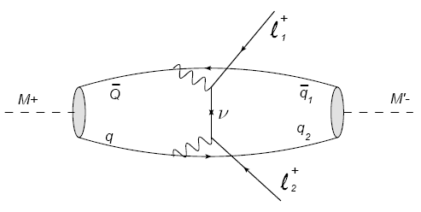
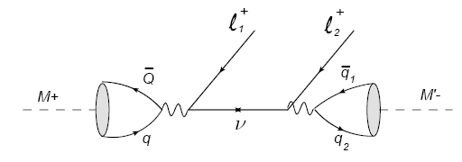
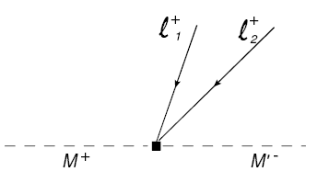
(iii) Heavy neutrino case
In this case, both contributions of “s-type” and “t-type” diagrams are rather comparable.
neutrino propagators reduce to -1/(m_{N})²

Slide 31
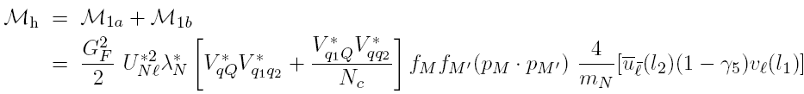


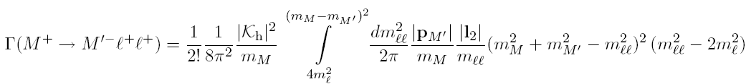
Present bounds on PMNS for MN > 100 GeV [Nardi etal, PLB327,319]:

Slide 32
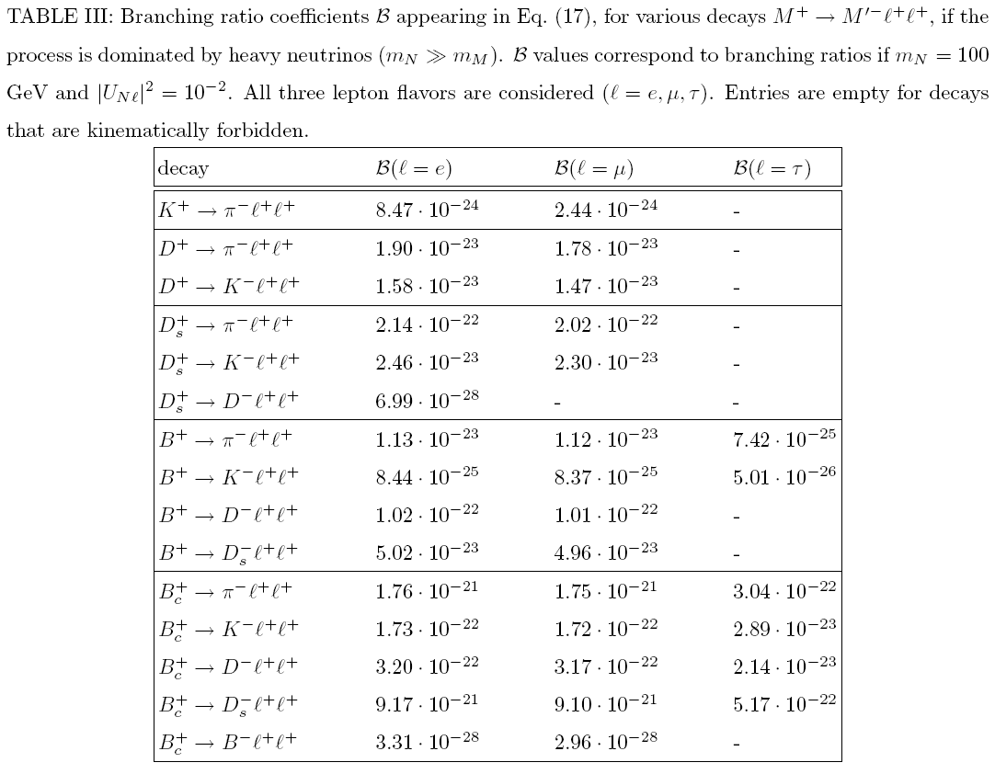

Slide 33
(c) Probing Majorana Neutrinos at LHC
In accelerator-based experiments, neutrinos in the final
state are undetectable by the detectors, leading to the
“missing energy”.
So it is desirable to look for charged leptons in the final
state.
It is hard to avoid the TeV-scale physics to contribute
to flavor-changing effects in general whatever it is,
  SUSY, extra dimensions, TeV seesaw, technicolor, Higgsless, little Higgs

Slide 34
Basic process we consider
transition rates are proportional to

Slide 35
Testability at the LHC
Two necessary conditions to test at the LHC:
-- Masses of heavy Majorana ν’s must be less than TeV
-- Light-heavy neutrino mixing (i.e., M_{D}/M_{R}) must be large
enough.
LHC signatures of heavy Majorana ν’s are essentially
decoupled from masses and mixing parameters of
light Majorana ν’s.
Non-unitarity of the light neutrino flavor mixing matrix might lead to observable effects.

Slide 36
Nontrivial limits on heavy Majorana neutrinos can be
derived at the LHC, if the SM backgrounds are small for
a specific final state.
ΔL = 2 like-sign dilepton events

Slide 37
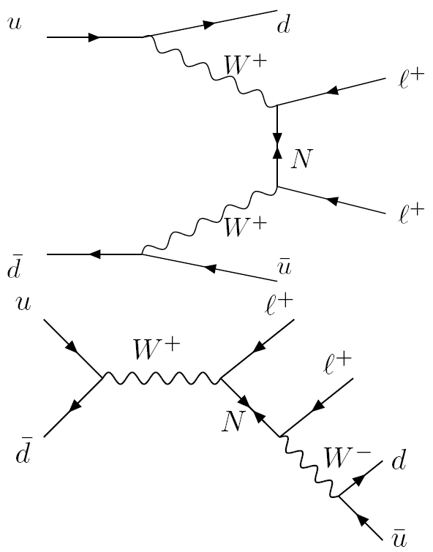
Collider Signature
Lepton number violation: like-sign dilepton events at hadron colliders, such as Tevatron (~2 TeV) and LHC (~14 TeV).
collider analogue to 0νββ decay
dominant channel
N can be produced on resonance

Slide 38
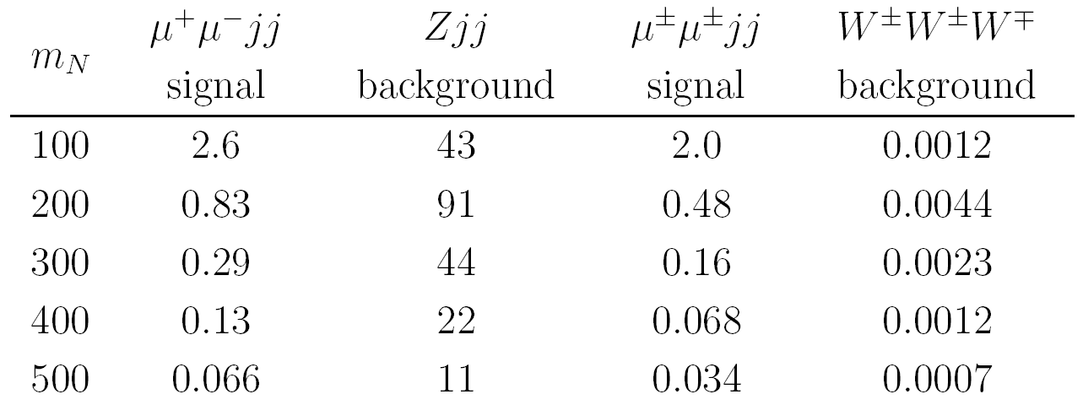
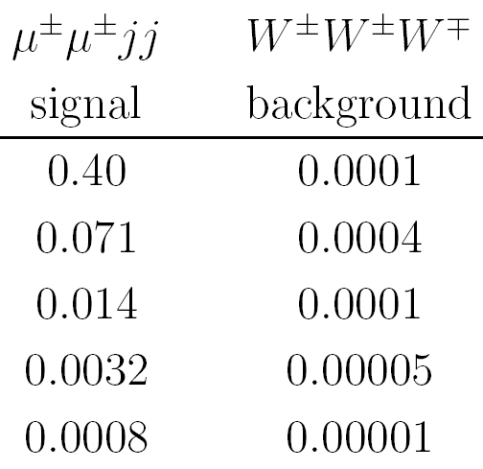
Some Results
Cross sections are generally smaller for larger masses of heavy
Majorana neutrinos. [ Han, Zhang (hep-ph/0904064) ]
Signal & background cross sections (in fb) as a function of the
heavy Majorana neutrino mass (in GeV) :
[ Del Aguila et al (hep-ph/0906198) ]
*Background could be much larger by soft-piling up !!
Tevatron
LHC

Slide 39
4. Concluding Remarks
Knowing that neutrinos are Dirac or Majorana is THE MOST
important to go beyond the SM.
We have discussed three possible ways to probe Majorana
neutrinos, and three possible mass ranges for rare meson
decays.
Hoping that probing Majorana neutrinos via meson’s rare
decays and collider signature would become more and more
relevant in forthcoming future.

