Slide 1
N* Spectrum from ANL-Osaka Dynamical Coupled-Channels Analysis of Pion- and Photon-induced Meson Production Reactions
Hiroyuki Kamano
Research Center for Nuclear Physics (RCNP)
Osaka University
Baryons2013, Glasgow, Scotland, UK, June 24-28, 2013

Slide 2
Outline
1. Background and motivation for N* spectroscopy
2. Results of ANL-Osaka Dynamical Coupled-
Channels (DCC) analysis of πN and γN reactions
3. Ongoing projects and future plans with
ANL-Osaka DCC approach
4. Summary
(H. Kamano, S.X. Nakamura, T.-S. H. Lee, T. Sato, arXiv:1305.4351)

Slide 3
Hadron spectrum and reaction dynamics
Various static hadron models have been proposed to calculate
hadron spectrum and form factors.
In reality, excited hadrons are “unstable” and can exist
only as resonance states in hadron reactions.
Quark models, Bag models, Dyson-Schwinger approaches, Holographic QCD,…
Excited hadrons are treated as stable particles. → The resulting masses are real.
“molecule-like” states
“Mass” becomes complex !!
→ “pole mass”
u
u
d
core (bare state) + meson cloud
What is the role of reaction dynamics in interpreting
the hadron spectrum, structures, and dynamical origins ??
Constituent quark model
N*
meson cloud
bare state

Slide 4

N* spectroscopy with ANL-Osaka Dynamical Coupled-Channels (DCC) approach
Reaction Data
Objectives and goals:
Through the comprehensive analysis
of world data of πN, γN, N(e,e’) reactions,
Determine N* spectrum (pole masses)
Extract N* form factors
(e.g., N-N* e.m. transition form factors)
Provide reaction mechanism information
necessary for interpreting N* spectrum,
structures and dynamical origins
Analysis Based on Reaction Theory
Spectrum, structure,…
of N* states
“Dynamical coupled-channels model of meson production reactions”
A. Matsuyama, T. Sato, T.-S.H. Lee Phys. Rep. 439 (2007) 193
Hadron Models
Lattice QCD
QCD

Slide 5




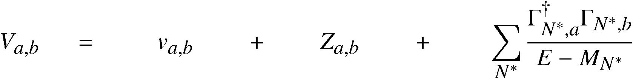
Dynamical coupled-channels (DCC) model for meson production reactions
For details see Matsuyama, Sato, Lee, Phys. Rep. 439,193 (2007)
Partial wave (LSJ) amplitudes of a → b reaction:
Reaction channels:
Transition Potentials:
t-channel
contact
s-channel
u-channel
π, ρ, σ, ω,..
N
N, Δ
π
coupled-channels effect
ρ, σ
Δ
π
Exchange potentials
π
N
N
Δ
Δ
Meson-Baryon Green functions
π
Z-diagrams
Stable channels
Quasi 2-body channels
N*_{bare}
Bare N* states
N
π
Δ
Δ
ρ, σ
ρ, σ
π
π
π
π
N
N
Exchange potentials
Z-diagrams
bare N* states

Slide 6
ANL-Osaka DCC analysis
Fully combined analysis of πN , γN → πN , ηN , KΛ, KΣ reactions !!
(more than 22,000 data of unpolarized & polarized observables to fit)
2006 - 2009
6 channels
(γN,πN,ηN,πΔ,ρN,σN)
< 2 GeV
< 1.6 GeV
< 2 GeV
―
―
―
2010 - 2012
8 channels
(γN,πN,ηN,πΔ,ρN,σN,KΛ,KΣ)
< 2.3 GeV
< 2.1 GeV
< 2.1 GeV
< 2.1 GeV
< 2.1 GeV
< 2.1 GeV
# of coupled
channels
    πp → πN
    γp → πN
    πp → ηN
    γp → ηp
    πp → KΛ, ΚΣ
    γp → K⁺Λ, KΣ
Kamano, Nakamura, Lee, Sato
arXiv:1305.4351

Slide 7
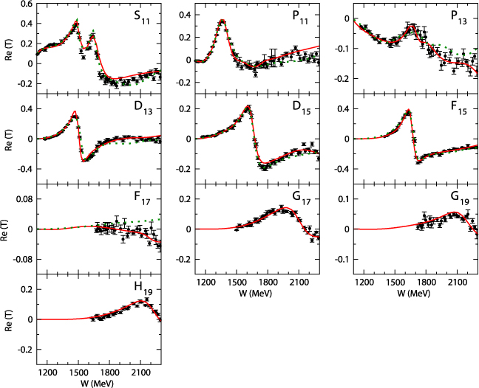
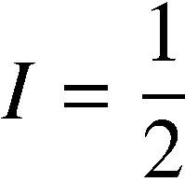
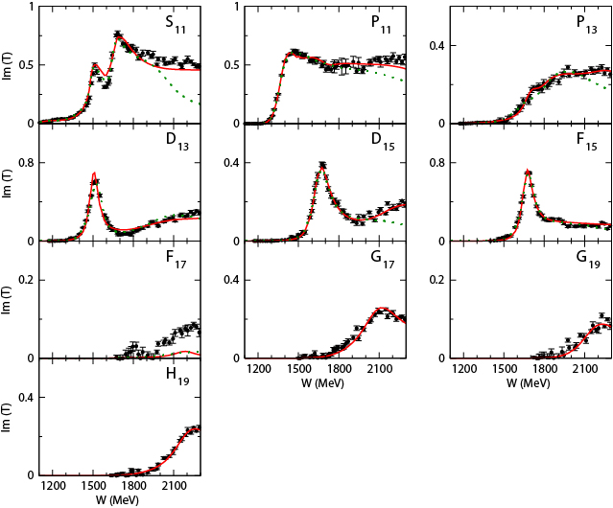
Partial wave amplitudes of πN scattering
Real part
8ch DCC-analysis
(Kamano, Nakamura, Lee, Sato, arXiv:1305.4351)
previous 6ch DCC-analysis
(fitted to πN → πN data only up to
W = 2 GeV and F wave)
[PRC76 065201 (2007)]
Imaginary part

Slide 8
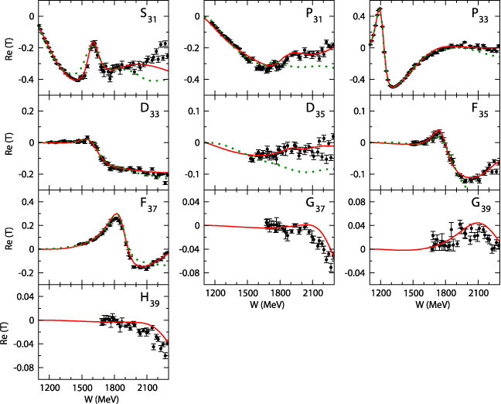
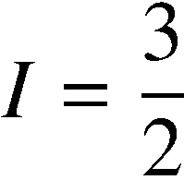
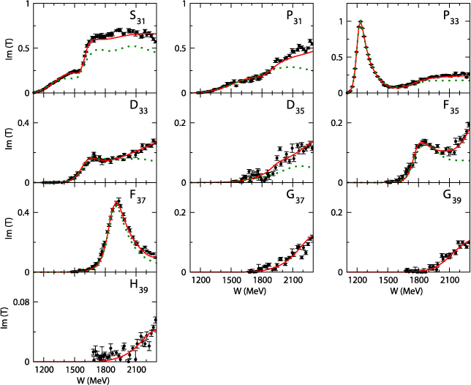
Partial wave amplitudes of πN scattering
Real part
8ch DCC-analysis
(Kamano, Nakamura, Lee, Sato, arXiv:1305.4351)
previous 6ch DCC-analysis
(fitted to πN → πN data only up to
W = 2 GeV and F wave)
[PRC76 065201 (2007)]
Imaginary part

Slide 9
γ p → π⁰ p reaction (1/3)
DCS

Slide 10
γ p → π⁰ p reaction (2/3)
Σ
Note: In computing polarization obs. of pseudoscalar-meson photoproductions, we followed
convention defined in Sandorfi, Hoblit, Kamano, Lee, J. Phys. G38 (2011) 053001.
(See arXiv:1108.5411 for comparison of conventions used in different analysis groups.)

Slide 11
γ p → π⁰ p reaction (3/3)
P
H
T
G
hat E

Slide 12
π⁺ p → K⁺ Σ⁺ reaction
DCS
β
Note: spin-rotation β is modulo 2π
P

Slide 13
γ p → K⁺ Σ⁰ reaction
DCS
P
Cx’
Cz’
Σ

Slide 14
Definition of N* parameters
Definitions of
N* masses (spectrum) ➔ Pole positions of the amplitudes
N* → MB, γN decay vertices ➔ Residues^{1/2} of the pole
N* → b
decay vertex
Consistent with the resonance theory based on Gamow vectors
G. Gamow (1928), R. E. Peierls (1959), …
A brief introduction of Gamov vectors: de la Madrid et al, quant-ph/0201091
(complex) energy eigenvalues = pole values
transition matrix elements = (residue)^{1/2} of the poles
N* pole position
( Im(E₀) < 0 )
Make an analytic continuation to (lower-half) complex energy plane.
Suzuki, Sato, Lee PRC79(2009)025205

Slide 15
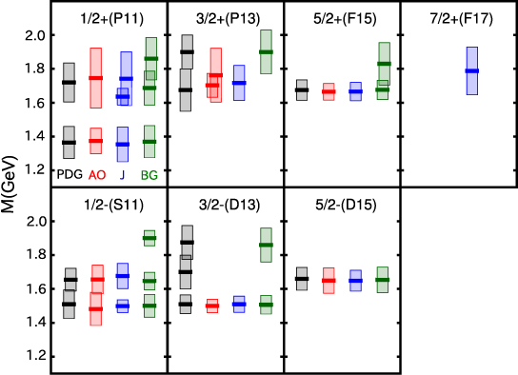
Spectrum of N* resonances
Kamano, Nakamura, Lee, Sato, arXiv:1305.4351
J^{P}(L_{2I 2J})
“N” resonances (I=1/2)
-2Im(M_{R})
(“width”)
Re(M_{R})
M_{R} : Resonance pole mass
(complex)
NOTE:
Plot only N*s with
Re(M_{R}) < 2 GeV
-2Im(M_{R}) < 0.4 GeV
PDG: 4* & 3* states assigned by PDG2012
AO : ANL-Osaka
J : Juelich (DCC)
[EPJA49(2013)44, Model A]
BG : Bonn-Gatchina (K-matrix)
[EPJA48(2012)5]

Slide 16
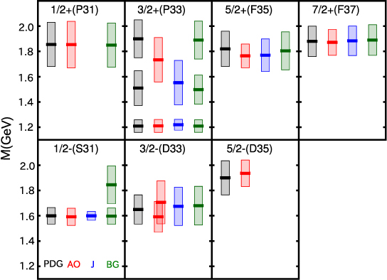
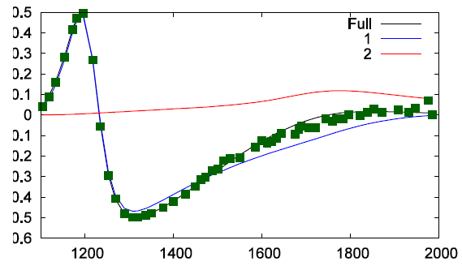
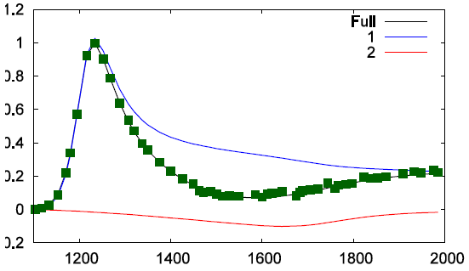
Spectrum of N* resonances
Kamano, Nakamura, Lee, Sato, arXiv:1305.4351
J^{P}(L_{2I 2J})
“Δ” resonances (I=3/2)
-2Im(M_{R})
(“width”)
Re(M_{R})
M_{R} : Resonance pole mass
(complex)
πN → πN P33 amp.
NOTE:
Plot only N*s with
Re(M_{R}) < 2 GeV
-2Im(M_{R}) < 0.4 GeV
Re
PDG: 4* & 3* states assigned by PDG2012
AO : ANL-Osaka
J : Juelich (DCC)
[EPJA49(2013)44, Model A]
BG : Bonn-Gatchina (K-matrix)
[EPJA48(2012)5]
Im

Slide 17
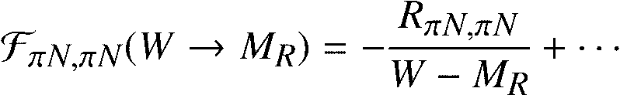

Residues of πN scattering amplitudes at resonance poles
Kamano, Nakamura, Lee, Sato, arXiv:1305.4351
J^{P} (Re[M_{R}])
“N” resonances (I=1/2)
Residue
Interpreted as square of
“N*Nπ coupling constant”
(complex value !!)
“Δ” resonances (I=3/2)
= resonances showing good
agreement for pole masses

Slide 18
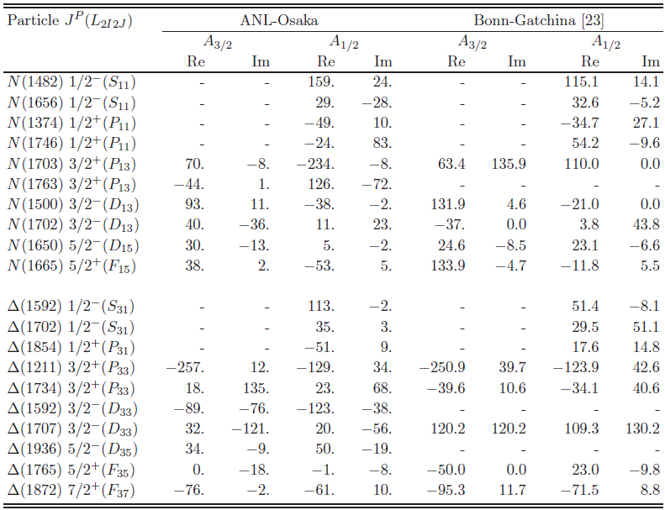
Helicity amplitudes of γp → N* transition
at resonance poles
Kamano, Nakamura, Lee, Sato, arXiv:1305.4351
Good agreement:
1st P33
Qualitative agreement:
1st S11
2nd S11
1st P11
1st D13
1st D15
1st S31
1st F37
(10⁻³ GeV^{-1/2})
Coupling consts. &
helicity amps. seem
much more sensitive
to the analysis than
the pole masses !!

Slide 19
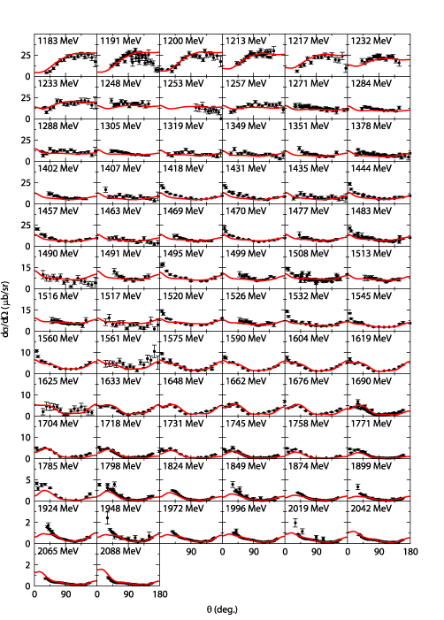
Ongoing projects & future plans with
ANL-Osaka DCC approach (1/4)
γ “n” → π⁻p DCS
Further study of N* spectroscopy with the current ANL-Osaka DCC model
Extraction of N-N* e.m. transition form factors via the analysis of
electroproduction reactions
Study of photoproduction reactions off a “neutron” target
γ
q
Extend our early analysis [PRC80(2009)025207] of
p(e,e’π)N data from CLAS6 to higher Q² region: 1.5 → 6.0 (GeV/c)²
- (Hopefully) see how the transition between hadron and
quark-gluon degrees of freedom occurs as Q² increases.
(q² = -Q²)
N
N*
N-N* e.m. transition
form factor
VERY PRELIMINARY
e.g.) Nucleon - 1st D13 e.m. transition form factors
Expected to be a crucial
source of information on
internal structure of N*s !!
For I=1/2 N* states, BOTH proton-N* and neutron-N* e.m. transition form factors are
needed for decomposing to isoscalar and isovector form factors.
Explore a possible existence of N* states that strongly couple to “neutron”-target
photoproductions.
➔ Necessary for neutrino-induced reactions !!
● Real
■ Imaginary
Julia-Diaz, Kamano, Lee, Matsuyama, Sato, Suzuki
PRC80(2009)025207
Suzuki, Sato, Lee, PRC82(2010)045206

Slide 20
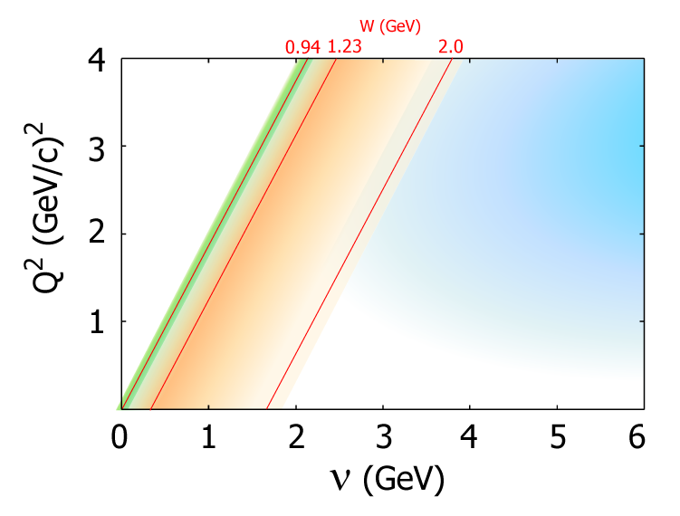
Ongoing projects & future plans with
ANL-Osaka DCC approach (2/4)
Application to neutrino-induced reactions in GeV-energy region
Precise knowledge of neutrino-nucleon/nucleus
interactions is necessary for reliable extractions
of neutrino parameters (CP phase, mass hierarchy, etc.)
from the future neutrino-oscillation experiments.
First application of 8ch DCC model to neutrino-nucleon
reactions in N* region (forward angle limit)
QE
region
Need to tackle overlapping regions
between QE, RES, and DIS regions !!
DIS
region
RES
region
Full
Collaboration@J-PARC Branch of KEK Theory Center
Y. Hayato (ICRR, U. of Tokyo), M. Hirai (Tokyo U. of Sci.)
H. Kamano (RCNP, Osaka U.), S. Kumano (KEK)
S. Nakamura (YITP, Kyoto U.), K. Saito (Tokyo U. of Sci.)
M. Sakuda (Okayama U.), T. Sato (Osaka U.)
[➔ arXiv:1303.6032]
πN
KΛ
ππN
KΣ
ηN
CP phase & mass
hierarchy studies
with atmospheric exp.
T2K
Kamano, Nakamura, Lee, Sato, PRD86(2012)097503

Slide 21
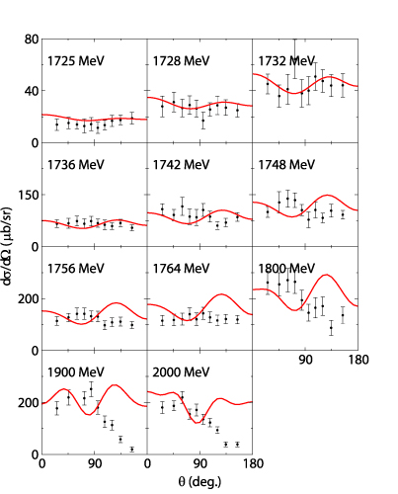
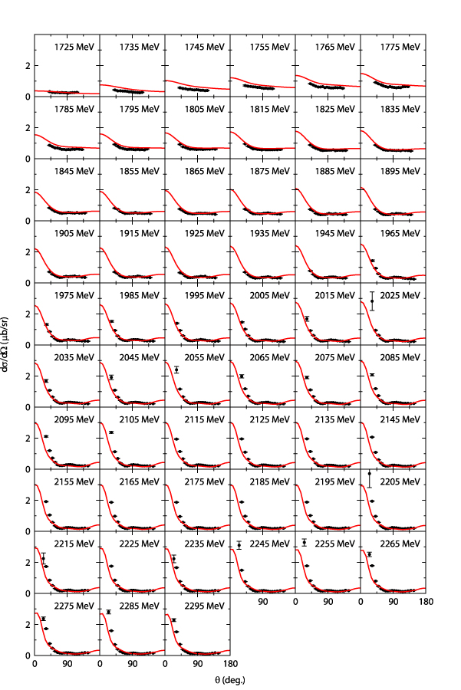
Ongoing projects & future plans with
ANL-Osaka DCC approach (3/4)
2006-2009
6 channels
(γN,πN,ηN,πΔ,ρN,σN)
< 2 GeV
< 1.6 GeV
< 2 GeV
―
―
―
―
―
2010-2012
(arXiv:1305.4351)
8 channels
(6ch + KΛ, KΣ)
< 2.3 GeV
< 2.1 GeV
< 2.1 GeV
< 2.1 GeV
< 2.1 GeV
< 2.1 GeV
―
―
2013-
9 channels
(8ch + ωN)
< 2.5 GeV
< 2.3 GeV
< 2.3 GeV
< 2.3 GeV
< 2.3 GeV
< 2.3 GeV
< 2.3 GeV
< 2.3 GeV
γp → ωp DCS
After the 9-channel analysis, next task is to include ππN data !!
π⁻p → ωn DCS
Extending
DCC analysis
ππN has the largest cross section in πN and γN reactions above W = 1.6 GeV.
(Precise data of πN → ππN will be available from J-PARC [K. Hicks et al., J-PARC P45])
Most N*s decay dominantly to ππN.
# of coupled
channels
Ambiguity over N* → ππN decay processes can be
eliminated by
the πN → ππN data !!
    πp→ πN
    γp → πN
    πp → ηp
    γp → ηp
    πp → KΛ, KΣ
    γp → KΛ, KΣ
    π⁻p → ωn
    γp → ωp
πN→πN F37 amp.
π+p →π+π+n
VERY PRELIMINARY
8ch DCC
(arXiv:1305.3451)
Combined analysis
including ωN data
is in progress !!
Refit F37 amp keeping
bare N* → πΔ off
Kamano arXiv:1305.6678
Before the combined analysis including ππN data,
need further improvement/tune of the analysis code.

Slide 22






Ongoing projects & future plans with
ANL-Osaka DCC approach (4/4)
Y* spectroscopy via DCC analysis of kaon-induced reactions
Nucleon target
Deuteron target
Simplest reaction processes
to study Y* resonances.
Extensive data would become
available from J-PARC after
the extension of Hadron Hall.
$$\overline{\text{K}}$$
$\overline{\text{K}}$, π, π, …
$$\overline{\text{K}}$$
K
Λ*, Σ*
Λ*, Σ*
Ξ*
M
N
N, Σ, Λ, …
N
B
K⁻ p → K⁻ p TCS
$$\overline{\text{K}}$$
π, K
$$\overline{\text{K}}$$
Directly accessible to Λ(1405)
region below $\overline{\text{K}}$N threshold.
Expected to be a crucial
source of information on
YN and YY interactions
VERY PRELIMINARY
Y
Y
d
d
π
N
Y
+ …
+ …
K
(Noumi et al., J-PARC E31)

Slide 23
Summary
Performed a fully combined analysis of pion- and photon-induced
πN, ηN, KΛ, KΣ production reactions with the ANL-Osaka Dynamical
Coupled-Channels approach.
The extracted N* parameters (pole masses, residues,…) are compared
with other multi-channel analyses:
Further applications and extensions of the ANL-Osaka DCC model
are in progress.
N* spectroscopy is an ideal laboratory for studying “resonance”,
a universal phenomena over a wide range of areas of physics !!
Extracted resonance masses agree well for almost all the 1st excited states in
each partial wave, while sizable differences are found for several higher excited states.
Compared with pole masses, residues (“coupling constants”) are more sensitive
to the analysis performed.
e.g.) YITP workshop on “Resonances and non-Hermitian systems in quantum mechanics” (Dec., 2012)
http://hatano-lab.iis.u-tokyo.ac.jp/hatano/NonHermite/Top.html

Slide 24
back up

Slide 25
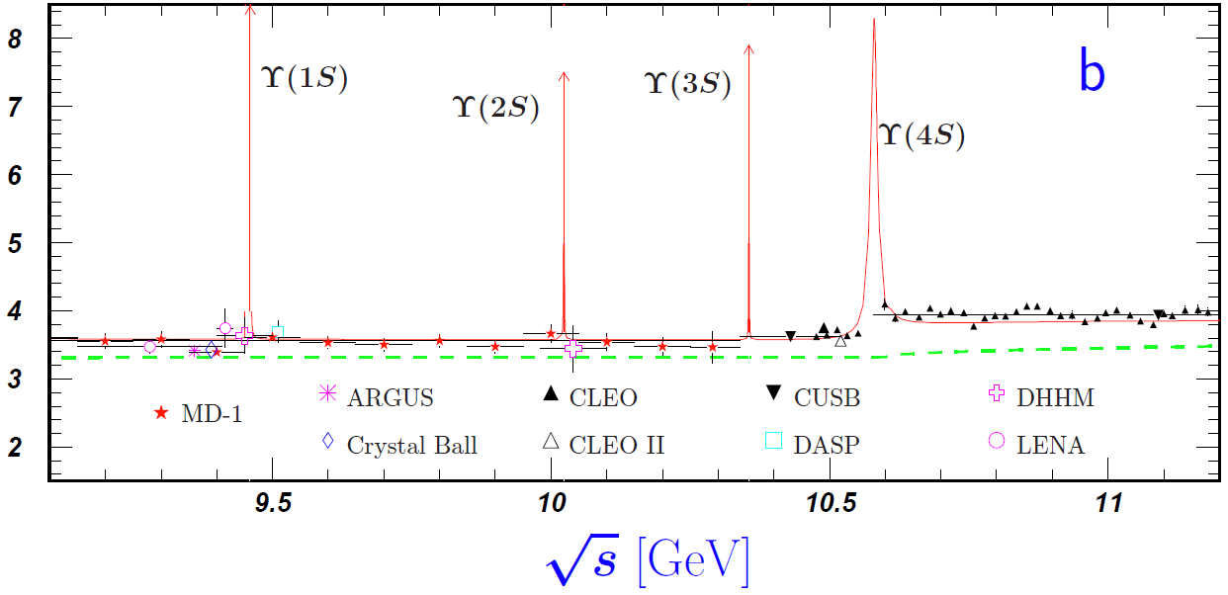
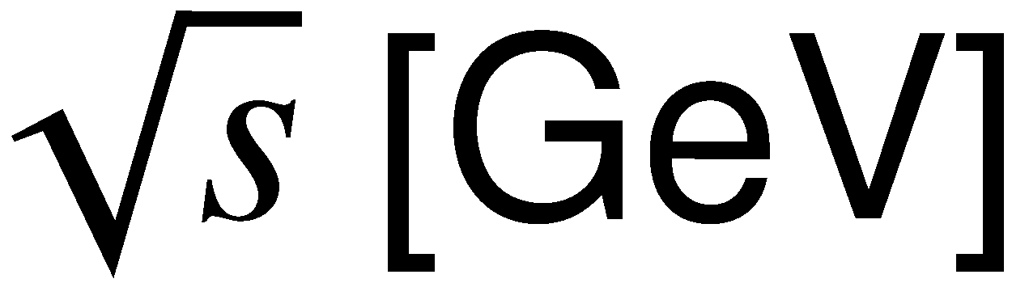
N* spectroscopy :
Physics of broad & overlapping resonances
N* : 1440, 1520, 1535, 1650, 1675, 1680, ...
Δ : 1600, 1620, 1700, 1750, 1900, …
Δ (1232)
Width: a few hundred MeV.
Resonances are highly overlapping
in energy except Δ(1232).
Width: ~10 keV to ~10 MeV
Each resonance peak is clearly separated.

Slide 26
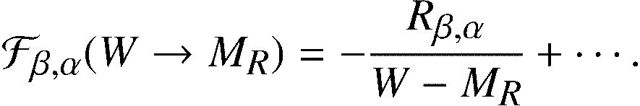




Conventions for coupling constants
α → β reaction amplitude at resonance pole position M_{R} is expressed as
The residue is then interpreted as the product of “coupling constants” of
N*-β and N*-α:
If one tries to get the coupling constants from the residues, the constants can be
determined up to a sign. We fix the sign ambiguity by choosing the phase of
the pi N scattering residue as
This corresponds to taking the real part of πNN* coupling constants
always positive: Re(g_N*,πN) > 0.
With this convention, the relative signs of
all coupling constants are uniquely fixed.
Im
Im
Re
Re

Slide 27
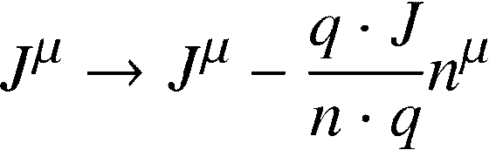



Phenomenological prescriptions of constructing conserved-current matrix elements
As commonly done in practical calculations in nuclear and particle physics,
currently we take a phenomenological prescription to construct conserved
current matrix elements [T. Sato, T.-S. H. Lee, PRC60 055201 (2001)]:
: Full e.m. current matrix elements obtained by solving DCC equations
: photon momentum
: an arbitrary four vector
A similar prescription is applied, e.g., in Kamalov and Yang, PRL83, 4494 (1999).
There are also other prescriptions that enable practical calculations satisfying
current conservation or WT identity:
Gross and Riska, PRC36, 1928 (1987)
Ohta, PRC40, 1335 (1989)
Haberzettl, Nakayama, and Krewald, PRC74, 045202 (2006).

Slide 28
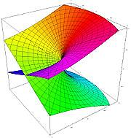
Multi-layer structure of the scattering amplitudes
e.g.) single-channel two-body scattering
physical sheet
2-channel case (4 sheets):
(channel 1, channel 2) =
(p, p), (u, p) ,(p, u), (u, u)
p = physical sheet
u = unphysical sheet
Scattering amplitude is a double-valued function of complex E !!
Essentially, same analytic structure as square-root function: f(E) = (E – E_{th})^{1/2}
unphysical sheet
N-channels → Need 2^{N} Riemann sheets
physical sheet
unphysical sheet
Re(E) + iε ＝“physical world”
Im (E)
0
Im (E)
0
E_{th}
(branch point)
E_{th}
(branch point)
×
×
×
×
Re (E)
Re (E)

Slide 29
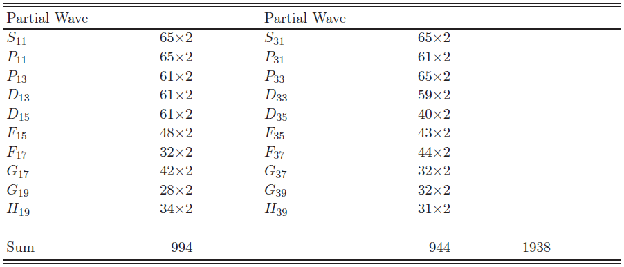
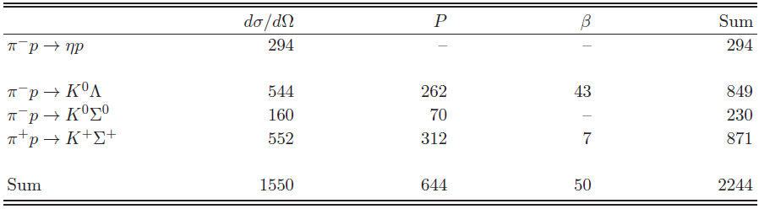
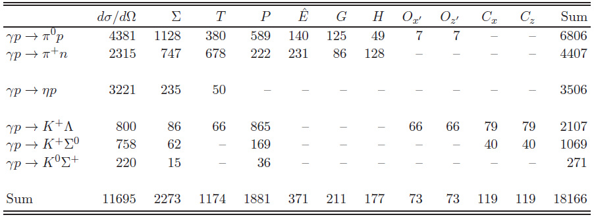
Database used for the analysis
πN → πN Partial wave amp. (SAID EIS)
πN → ηN, KΛ, KΣ observables
γN → πN, ηN, KΛ, KΣ observables
Total 22,348 data points

Slide 30
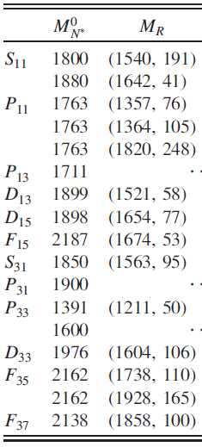
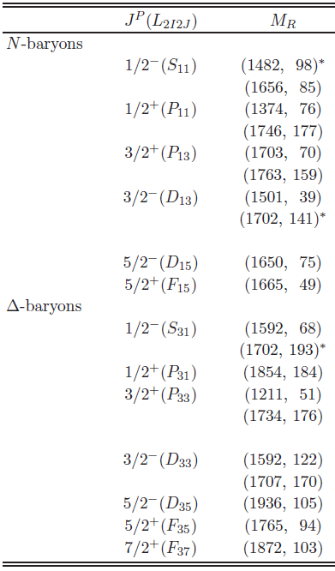
N* resonances from analyses with the old 6ch and current 8ch models
6ch DCC analysis
[PRL104(2010)042302]
8ch DCC analysis
[arXiv:1305.4351]

Slide 31
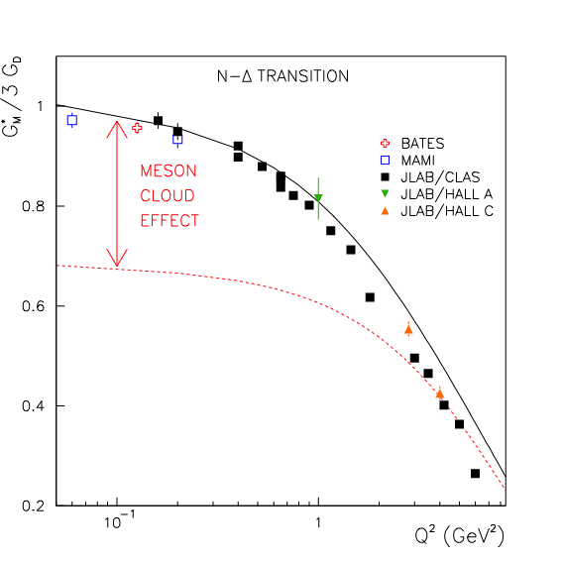
Meson cloud effect in gamma N → N* form factors
G_{M}(Q²) for γ N → Δ (1232) transition
N, N*
Full
Bare
Note:
Most of the available static
hadron models give G_{M}(Q²)
close to “Bare” form factor.

Slide 32
π- p → ηn reaction
DCS
NOTE:
It is known that there is an inconsistency on the normalization of
the π-p → ηn data between different experiments.
The data used in our analysis are carefully selected according to
the discussion by Durand et al. PRC78 025204.

Slide 33
π- p → K⁰Λ reaction
DCS
β
P

Slide 34
π- p → K⁰ Σ⁰ reaction
DCS
P

Slide 35
γ p → π⁺ n reaction (1/3)
DCS
Σ

Slide 36
γ p → π⁺ n reaction (2/3)
P
T

Slide 37
γ p → π⁺ n reaction (3/3)
hat E
G
H

Slide 38
γ p → η p reaction (1/2)
DCS

Slide 39
γ p → η p reaction (2/2)
Σ
T

Slide 40
γ p → K⁺ Λ reaction (1/2)
DCS
Σ
P

Slide 41
γ p → K⁺ Λ reaction (2/2)
T
Cx’
Ox’
Cz’
Oz’

Slide 42
γ p → K⁰ Σ⁺ reaction
DCS
P
Σ

