Slide 1
Recent results on N* spectroscopy with
ANL-Osaka dynamical coupled-channels approach
[Kamano, Nakamura, Lee, Sato, PRC88 (2013) 035209]
Hiroyuki Kamano
Research Center for Nuclear Physics (RCNP)
Osaka University
HADRON2013, Nara, Japan, November 4-8, 2013

Slide 2
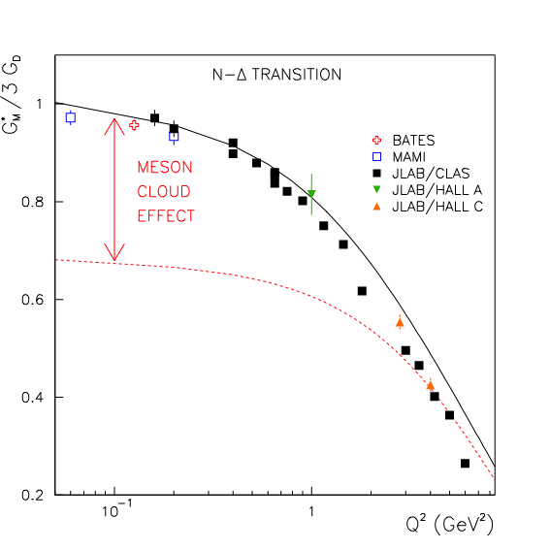
Why reaction dynamics is so important?
➔ Because it’s the origin of turning excited states into unstable resonances !!
(Multichannel) reaction dynamics:
generates MANY physical resonances from
a single bare state.
produces sizable mass shifts.
is the origin of “meson cloud.”
makes “physical quantities (= masses,
coupling constants,…)” associated with
resonances COMPLEX.
…
Corresponds to a baryon
within static hadron models
(quark models etc.)
Dynamical origin of
P11 resonances
Suzuki, Julia-Diaz, HK, Lee, Matsuyama, Sato
PRL104 065203 (2010)
G_{M}(Q²) for γ p → Δ (1232) transition
N, N*
Full
Meson clouds are indispensable
for quantitative description of
N* form factors
Bare
Julia-Diaz, Lee, Sato, Smith, PRC75 015205 (2007)

Slide 3
Pion- and photon-induced meson production reactions off nucleon
➔ Most useful reactions for studying N* resonances !
A huge amount
of precise data
are available from
JLab, CBELSA,
MAMI, SPring-8, ELPH,… !!
π, γ^{(*)}
πN
ηN
ππN
KΛ
KΣ
ωN
…
N-N* e.m. transition form factors
N* mass, width
.
.
N
.
“Dynamical coupled-channels model of meson production reactions”
N*
A. Matsuyama, T. Sato, T.-S. H. Lee, Phys. Rep. 439 (2007) 193
HK, S.X. Nakamura, T.-S. H. Lee, T. Sato Phys. Rev. C 88 (2013) 035209
N* → πN, ηN, ππN, … coupling constants
Comprehensive & simultaneous PWA of
ALL the relevant meson productions
is required !!
Analysis based on multichannel scattering
theory including three-body ππN channel
is necessary !!
γp reaction total cross sections in N* region

Slide 4



ANL-Osaka Dynamical Coupled-Channels (DCC) model for meson production reactions
For details see Matsuyama, Sato, Lee, Phys. Rep. 439 (2007)193;
HK, Nakamura, Lee, Sato, Phys. Rev. C88 (2013) 035209
Coupled-channels integral equations:
coupled-channels effect
meson cloud
baryon
core
meson
Coupled-channels unitarity is satisfied for important meson-baryon
channels (including the 3-body ππN channel) in the N* region.
Off-shell effect are properly treated (➔ not possible within on-shell
K-matrix approaches)
Enables comprehensive description of two pictures of N* resonances,
i.e., “bare N* + meson cloud” and “meson-baryon molecule.”

Slide 5
ANL-Osaka DCC analysis
Fully combined analysis of πN , γN → πN , ηN , KΛ, KΣ reactions !!
(more than 22,000 data of unpolarized & polarized observables to fit)
2006 - 2009
6 channels
(γN,πN,ηN,πΔ,ρN,σN)
< 2 GeV
< 1.6 GeV
―
―
―
―
2010 - 2012
8 channels
(γN,πN,ηN,πΔ,ρN,σN,KΛ,KΣ)
< 2.3 GeV
< 2.1 GeV
< 2.1 GeV
< 2.1 GeV
< 2.1 GeV
< 2.1 GeV
# of coupled
channels
    πp → πN
    γp → πN
    πp → ηN
    γp → ηp
    πp → KΛ, ΚΣ
    γp → K⁺Λ, KΣ
Julia-Diaz, Lee, Matsuyama, Sato,
PRC76 065201 (2007);
Julia-Diaz, et al., PRC77 045205 (2008)
HK, Nakamura, Lee, Sato
PRC88 035209 (2013)

Slide 6
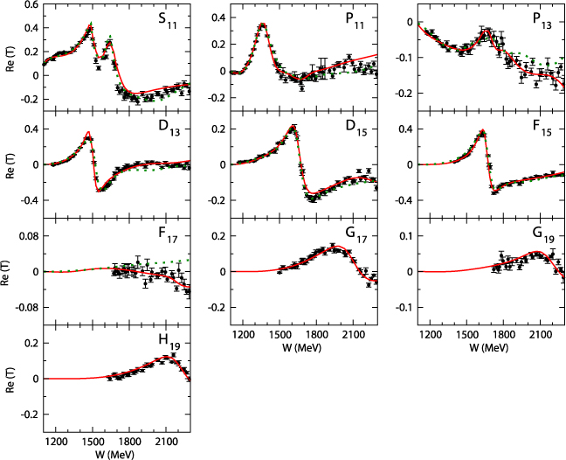
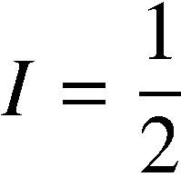
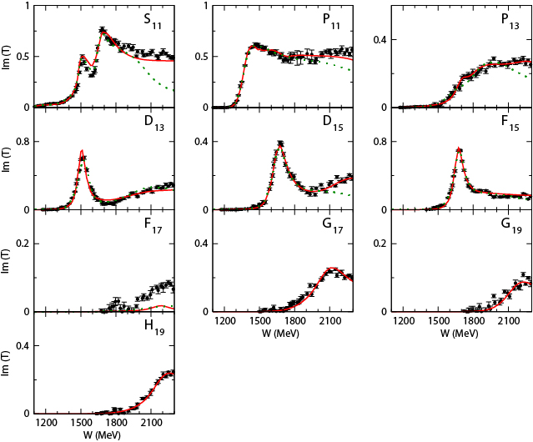
Partial wave amplitudes of πN scattering
Real part
8ch DCC-analysis
[HK, Nakamura, Lee, Sato, PRC88 035209 (2013)]
previous 6ch DCC-analysis
(fitted to πN → πN data only up to
W = 2 GeV and F wave)
[Julia-Diaz et al., PRC76 065201 (2007)]
Imaginary part

Slide 7
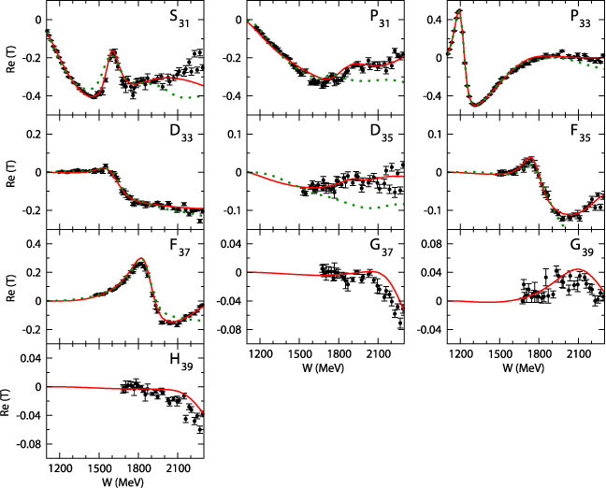
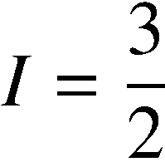
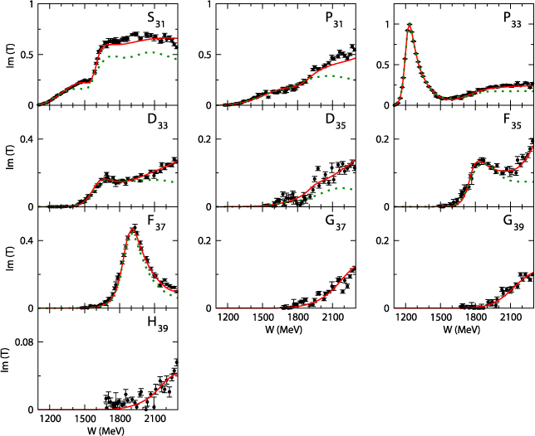
Partial wave amplitudes of πN scattering
Real part
8ch DCC-analysis
[HK, Nakamura, Lee, Sato, PRC88 035209 (2013)]
previous 6ch DCC-analysis
(fitted to πN → πN data only up to
W = 2 GeV and F wave)
[Julia-Diaz et al., PRC76 065201 (2007)]
Imaginary part

Slide 8
γ p → π⁰ p reaction
Differential cross section (W = 1.08-2.1 GeV)
1.6 GeV
1.9 GeV
8ch DCC-analysis
[HK, Nakamura, Lee, Sato, PRC88 035209 (2013)]
previous 6ch DCC-analysis
(fitted to γN → πN data only up to W = 1.6 GeV)
[Julia-Diaz et al., PRC77 045205 (2008)]

Slide 9
γ p → K⁺ Σ⁰ reaction
8ch DCC-analysis
[HK, Nakamura, Lee, Sato, PRC88 035209 (2013)]
DCS
P
Cx’
Cz’
At present, NO data are available for
the other 11 observables:
T, E, F, G, H, Ox’, Oz’, Lx’, Lz’, Tx’, Tz’
Σ

Slide 10

Coupled-channels effect on observables
Full
KΛ, KΣ channels off
π⁻ p → η n
Full
KΣ channel off
Cusp effect
due to opening
of KΣ channel
π⁻ p → K⁰ Λ
W(MeV)

Slide 11
Extraction of N* parameters
Definitions of
N* masses (spectrum) ➔ Pole positions of the amplitudes
N* → MB, γN coupling constants ➔ Residues^{1/2} at the pole
N* → b
coupling constant
Consistent with the resonance theory based on Gamow vectors
G. Gamow (1928), R. E. Peierls (1959), …
A brief introduction of Gamov vectors: de la Madrid et al, quant-ph/0201091
N* pole position
( Im(E₀) < 0 )
(complex) energy eigenvalues = pole values
transition matrix elements = (residue)^{1/2} of the poles
Analytic continuation to (lower-half) complex energy plane.
Suzuki, Sato, Lee PRC79(2009)025205

Slide 12
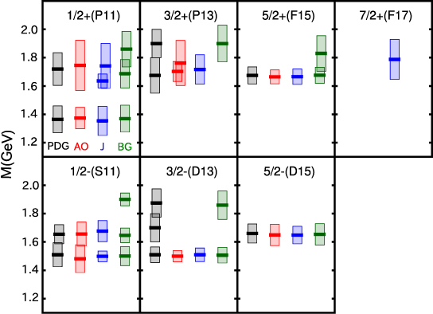
Comparison of N* spectrum
with other multichannel analyses
HK, Nakamura, Lee, Sato, PRC88 035209 (2013)
J^{P}(L_{2I 2J})
“N” resonances (I=1/2)
-2Im(M_{R})
(“width”)
Re(M_{R})
1st J^{P}=1/2⁻ N* resonance
6ch DCC 8ch DCC
M_{R} : Resonance pole mass
(complex)
width: 382 MeV ➔ 196 MeV
NOTE:
Plot only N*s with
Re(M_{R}) < 2 GeV
-2Im(M_{R}) < 0.4 GeV
Due to inclusion of
ηN production data
into the analysis !!
PDG: 4* & 3* states assigned by PDG2012
AO : ANL-Osaka
J : Juelich (DCC, fit πN reactions)
[EPJA49(2013)44, Model A]
BG : Bonn-Gatchina (On-shell K-matrix)
[EPJA48(2012)5]

Slide 13
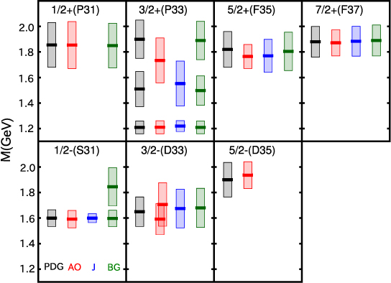
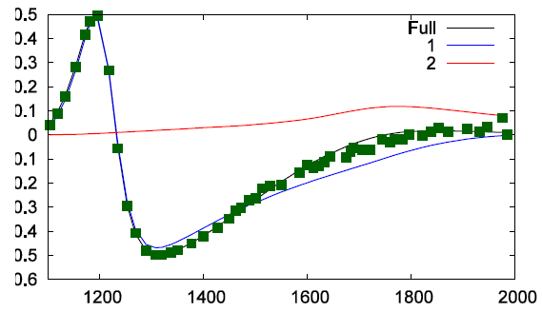
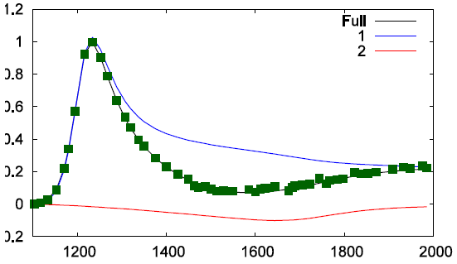
Comparison of N* spectrum
with other multichannel analyses
HK, Nakamura, Lee, Sato, PRC88 035209 (2013)
J^{P}(L_{2I 2J})
“Δ” resonances (I=3/2)
-2Im(M_{R})
(“width”)
Re(M_{R})
M_{R} : Resonance pole mass
(complex)
NOTE:
Plot only N*s with
Re(M_{R}) < 2 GeV
-2Im(M_{R}) < 0.4 GeV
πN → πN P33 amp.
Re
PDG: 4* & 3* states assigned by PDG2012
AO : ANL-Osaka
J : Juelich (DCC, fit πN reactions)
[EPJA49(2013)44, Model A]
BG : Bonn-Gatchina (On-shell K-matrix)
[EPJA48(2012)5]
Im

Slide 14
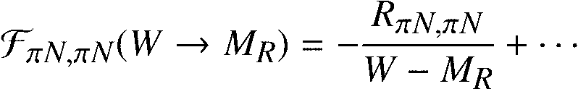

Residues of πN scattering amplitudes at resonance poles
HK, Nakamura, Lee, Sato, PRC88 035209 (2013)
J^{P} (Re[M_{R}])
“N” resonances (I=1/2)
Residue
Interpreted as square of
“N*Nπ coupling constant”
(complex value !!)
“Δ” resonances (I=3/2)
= resonances showing good
agreement for pole masses

Slide 15
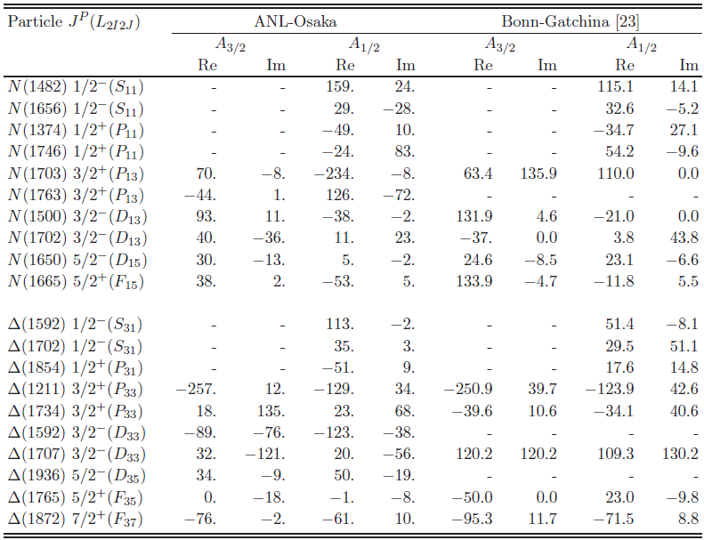
Helicity amplitudes of γp → N* transition
(e.m. transition form factors at Q² = 0)
HK, Nakamura, Lee, Sato, PRC88 035209 (2013)
Good agreement:
1st P33
Qualitative agreement:
1st S11
2nd S11
1st P11
1st D13
1st D15
1st S31
1st F37
(10⁻³ GeV^{-1/2})
Coupling consts. &
helicity amps. seem
much more sensitive
to the analysis than
the pole masses !!

Slide 16
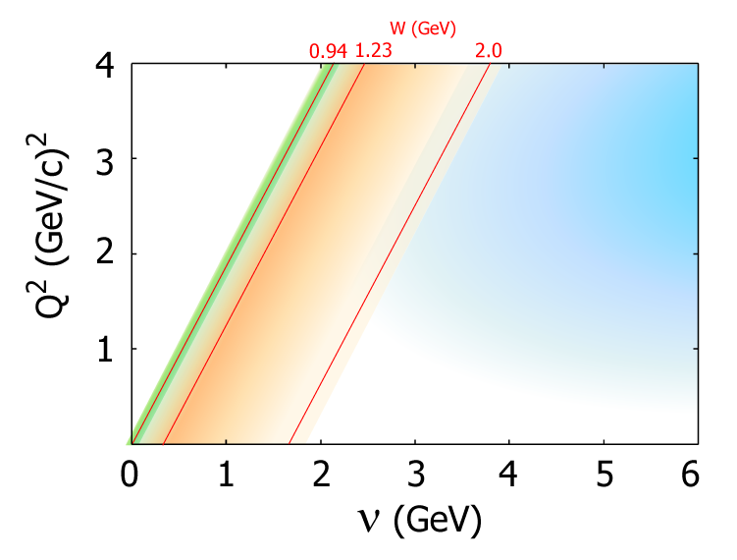
Ongoing & future projects
γ
q
(q² = -Q²)
Extract N-N* e.m. transition form factors up to Q² = 6 (GeV/c)²
by analyzing all available data of p(e,e’π)N from CLAS.
Extend the DCC model by including ωN and ππN data;
application to deuteron (“neutron”) target reactions.
Y* spectroscopy via the analysis of kaon-induced reactions
Three-body unitary model for meson spectroscopy (COMPASS, GlueX,…)
Neutrino-nucleon/deuteron reactions in the N* region to study N-N* axial transition form factors
N
N*
Extensive measurement of
πN → ππN is planned at J-PARC !!
K. Hicks & H. Sako et al.,
the J-PARC E45 experiment.
HK, Nakamura, Lee, Sato, PRD84(2011)114019; Nakamura, HK, Lee, Sato, PRD86(2012)114012
HK, Nakamura, Lee, Sato, PRD86(2012)097503
Developing a unified neutrino reaction model describing
overlapping regions between QE, RES, and DIS !!
e.g.) GlueX : γp →3πN
QE
region
DIS
region
RES
region
Collaboration@J-PARC Branch of KEK Theory Center
( http://nuint.kek.jp/index_e.html ; arXiv:1303.6032 )
Y. Hayato (ICRR, U. of Tokyo), M. Hirai (Nippon Inst. Tech.)
W. Horiuchi (Hokkaido U.), H. Kamano (RCNP, Osaka U.)
S. Kumano (KEK), S. Nakamura (Osaka U.),
K. Saito (Tokyo U. of Sci.), M. Sakuda (Okayama U.)
T. Sato (Osaka U.)
CP phase & mass
hierarchy studies
with atmospheric exp.
T2K

Slide 17
back up

Slide 18
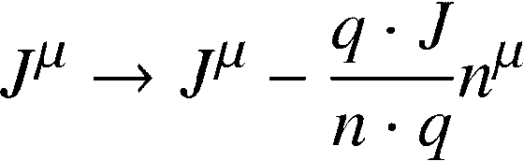



Phenomenological prescriptions of constructing conserved-current matrix elements
As commonly done in practical calculations in nuclear and particle physics,
currently we take a phenomenological prescription to construct conserved
current matrix elements [T. Sato, T.-S. H. Lee, PRC60 055201 (2001)]:
: Full e.m. current matrix elements obtained by solving DCC equations
: photon momentum
: an arbitrary four vector
A similar prescription is applied, e.g., in Kamalov and Yang, PRL83, 4494 (1999).
There are also other prescriptions that enable practical calculations satisfying
current conservation or WT identity:
Gross and Riska, PRC36, 1928 (1987)
Ohta, PRC40, 1335 (1989)
Haberzettl, Nakayama, and Krewald, PRC74, 045202 (2006).

Slide 19
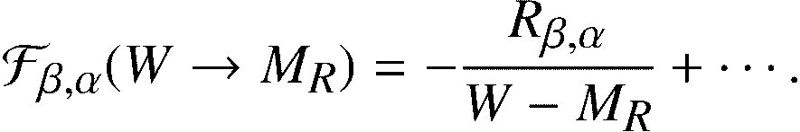




Conventions for coupling constants
α → β reaction amplitude at resonance pole position M_{R} is expressed as
The residue is then interpreted as the product of “coupling constants” of
N*-β and N*-α:
If one tries to get the coupling constants from the residues, the constants can be
determined up to a sign. We fix the sign ambiguity by choosing the phase of
the pi N scattering residue as
This corresponds to taking the real part of πNN* coupling constants
always positive: Re(g_N*,πN) > 0.
With this convention, the relative signs of
all coupling constants are uniquely fixed.
Im
Im
Re
Re

Slide 20



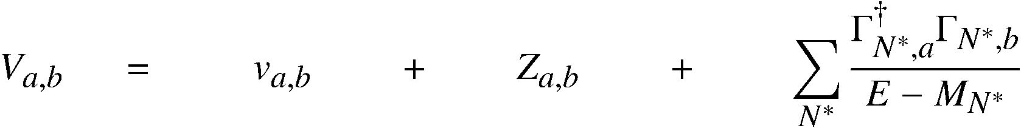
Dynamical coupled-channels (DCC) model for meson production reactions
For details see Matsuyama, Sato, Lee, Phys. Rep. 439,193 (2007)
Partial wave (LSJ) amplitudes of a → b reaction:
Reaction channels:
Transition Potentials:
t-channel
contact
s-channel
u-channel
π, ρ, σ, ω,..
N
N, Δ
π
coupled-channels effect
ρ, σ
Δ
π
Exchange potentials
π
N
N
Δ
Δ
Meson-Baryon Green functions
π
Z-diagrams
Stable channels
Quasi 2-body channels
N*_{bare}
Bare N* states
N
π
Δ
Δ
ρ, σ
ρ, σ
π
π
π
π
N
N
Exchange potentials
Z-diagrams
bare N* states

Slide 21
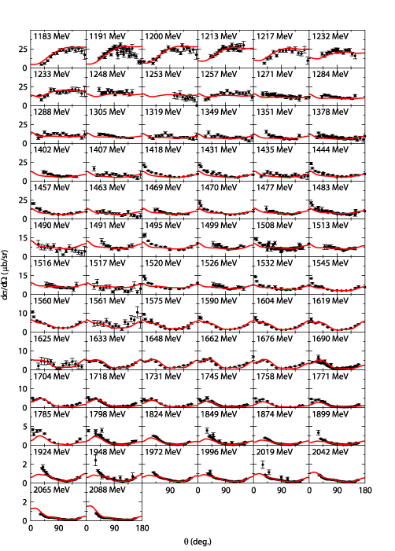
Ongoing projects & future plans with
ANL-Osaka DCC approach (1/4)
γ “n” → π⁻p DCS
Further study of N* spectroscopy with the current ANL-Osaka DCC model
Extraction of N-N* e.m. transition form factors via the analysis of
electroproduction reactions
Study of photoproduction reactions off a “neutron” target
γ
q
Extend our early analysis [PRC80(2009)025207] of
p(e,e’π)N data from CLAS6 to higher Q² region: 1.5 → 6.0 (GeV/c)²
- (Hopefully) see how the transition between hadron and
quark-gluon degrees of freedom occurs as Q² increases.
(q² = -Q²)
N
N*
N-N* e.m. transition
form factor
VERY PRELIMINARY
e.g.) Nucleon - 1st D13 e.m. transition form factors
Expected to be a crucial
source of information on
internal structure of N*s !!
For I=1/2 N* states, BOTH proton-N* and neutron-N* e.m. transition form factors are
needed for decomposing to isoscalar and isovector form factors.
Explore a possible existence of N* states that strongly couple to “neutron”-target
photoproductions.
➔ Necessary for neutrino-induced reactions !!
● Real
■ Imaginary
Julia-Diaz, Kamano, Lee, Matsuyama, Sato, Suzuki
PRC80(2009)025207
Suzuki, Sato, Lee, PRC82(2010)045206

Slide 22
Ongoing projects & future plans with
ANL-Osaka DCC approach (2/4)
Application to neutrino-induced reactions in GeV-energy region
Precise knowledge of neutrino-nucleon/nucleus
interactions is necessary for reliable extractions
of neutrino parameters (CP phase, mass hierarchy, etc.)
from the future neutrino-oscillation experiments.
First application of 8ch DCC model to neutrino-nucleon
reactions in N* region (forward angle limit)
QE
region
Need to tackle overlapping regions
between QE, RES, and DIS regions !!
DIS
region
RES
region
Full
Collaboration@J-PARC Branch of KEK Theory Center
Y. Hayato (ICRR, U. of Tokyo), M. Hirai (Tokyo U. of Sci.)
H. Kamano (RCNP, Osaka U.), S. Kumano (KEK)
S. Nakamura (YITP, Kyoto U.), K. Saito (Tokyo U. of Sci.)
M. Sakuda (Okayama U.), T. Sato (Osaka U.)
[➔ arXiv:1303.6032]
πN
KΛ
ππN
KΣ
ηN
CP phase & mass
hierarchy studies
with atmospheric exp.
T2K
Kamano, Nakamura, Lee, Sato, PRD86(2012)097503

Slide 23
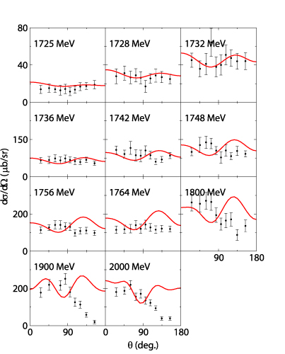
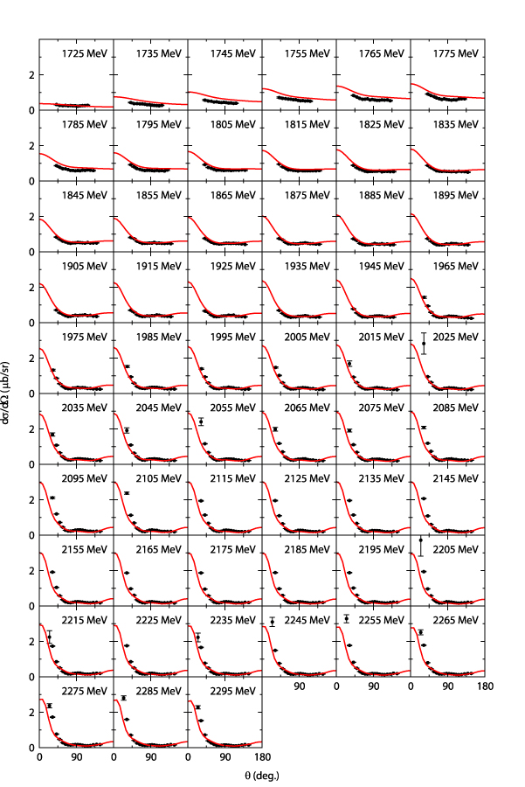
Ongoing projects & future plans with
ANL-Osaka DCC approach (3/4)
2006-2009
6 channels
(γN,πN,ηN,πΔ,ρN,σN)
< 2 GeV
< 1.6 GeV
< 2 GeV
―
―
―
―
―
2010-2012
(arXiv:1305.4351)
8 channels
(6ch + KΛ, KΣ)
< 2.3 GeV
< 2.1 GeV
< 2.1 GeV
< 2.1 GeV
< 2.1 GeV
< 2.1 GeV
―
―
2013-
9 channels
(8ch + ωN)
< 2.5 GeV
< 2.3 GeV
< 2.3 GeV
< 2.3 GeV
< 2.3 GeV
< 2.3 GeV
< 2.3 GeV
< 2.3 GeV
γp → ωp DCS
After the 9-channel analysis, next task is to include ππN data !!
π⁻p → ωn DCS
Extending
DCC analysis
ππN has the largest cross section in πN and γN reactions above W = 1.6 GeV.
(Precise data of πN → ππN will be available from J-PARC [K. Hicks et al., J-PARC P45])
Most N*s decay dominantly to ππN.
# of coupled
channels
Ambiguity over N* → ππN decay processes can be
eliminated by
the πN → ππN data !!
    πp→ πN
    γp → πN
    πp → ηp
    γp → ηp
    πp → KΛ, KΣ
    γp → KΛ, KΣ
    π⁻p → ωn
    γp → ωp
πN→πN F37 amp.
π+p →π+π+n
VERY PRELIMINARY
8ch DCC
(arXiv:1305.3451)
Combined analysis
including ωN data
is in progress !!
Refit F37 amp keeping
bare N* → πΔ off
Kamano arXiv:1305.6678
Before the combined analysis including ππN data,
need further improvement/tune of the analysis code.

Slide 24






Ongoing projects & future plans with
ANL-Osaka DCC approach (4/4)
Y* spectroscopy via DCC analysis of kaon-induced reactions
Nucleon target
Deuteron target
Simplest reaction processes
to study Y* resonances.
Extensive data would become
available from J-PARC after
the extension of Hadron Hall.
$$\overline{\text{K}}$$
$\overline{\text{K}}$, π, π, …
$$\overline{\text{K}}$$
K
Λ*, Σ*
Λ*, Σ*
Ξ*
M
N
N, Σ, Λ, …
N
B
K⁻ p → K⁻ p TCS
$$\overline{\text{K}}$$
π, K
$$\overline{\text{K}}$$
Directly accessible to Λ(1405)
region below $\overline{\text{K}}$N threshold.
Expected to be a crucial
source of information on
YN and YY interactions
VERY PRELIMINARY
Y
Y
d
d
π
N
Y
+ …
+ …
K
(Noumi et al., J-PARC E31)

Slide 25
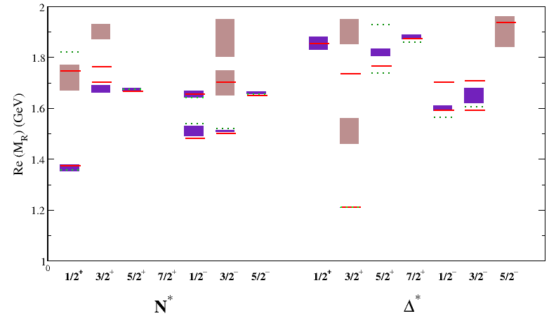
Mass spectrum of N* resonances from
ANL-Osaka DCC analysis
HK, Nakamura, Lee, Sato, PRC88 035209 (2013)
1st 1/2⁻ state
5ch: 1540 –i 191
PDG 4* N*s
PDG 3* N*s
8ch: 1482 –i 98
Due to inclusion of ηN production data !!
8 ch DCC
5 ch DCC

Slide 26
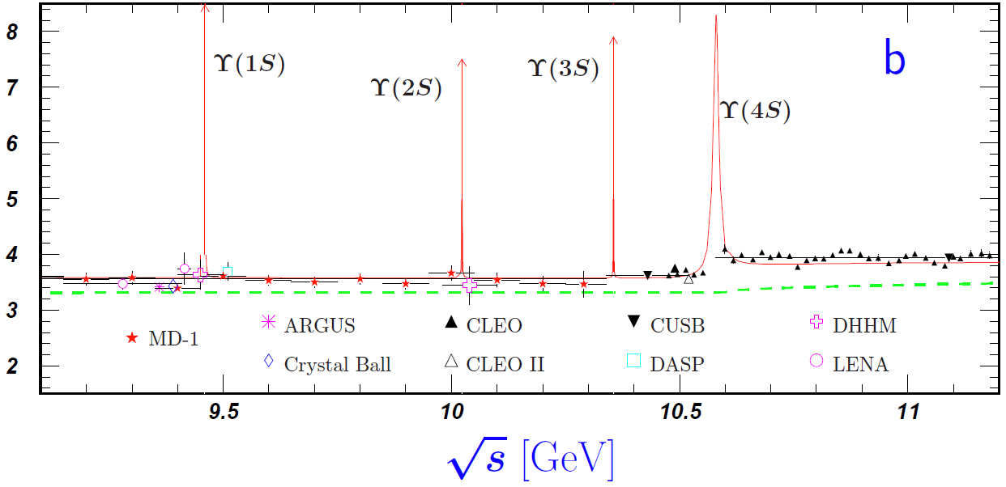
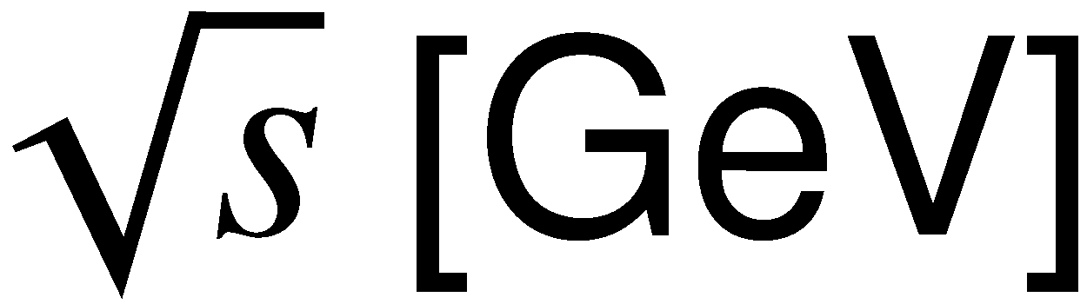
N* spectroscopy :
Physics of broad & overlapping resonances
N* : 1440, 1520, 1535, 1650, 1675, 1680, ...
Δ : 1600, 1620, 1700, 1750, 1900, …
Δ (1232)
Width: a few hundred MeV.
Resonances are highly overlapping
in energy except Δ(1232).
Width: ~10 keV to ~10 MeV
Each resonance peak is clearly separated.

Slide 27
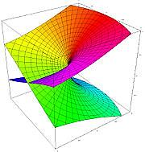
Multi-layer structure of the scattering amplitudes
e.g.) single-channel two-body scattering
physical sheet
2-channel case (4 sheets):
(channel 1, channel 2) =
(p, p), (u, p) ,(p, u), (u, u)
p = physical sheet
u = unphysical sheet
Scattering amplitude is a double-valued function of complex E !!
Essentially, same analytic structure as square-root function: f(E) = (E – E_{th})^{1/2}
unphysical sheet
N-channels → Need 2^{N} Riemann sheets
physical sheet
unphysical sheet
Re(E) + iε ＝“physical world”
Im (E)
0
Im (E)
0
E_{th}
(branch point)
E_{th}
(branch point)
×
×
×
×
Re (E)
Re (E)

Slide 28
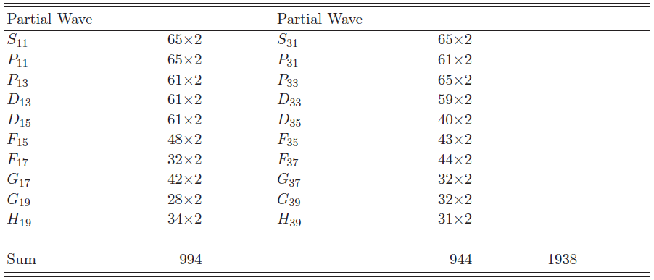
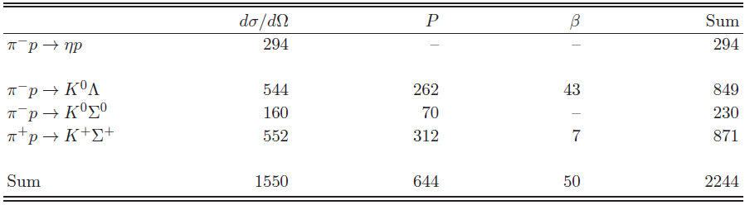
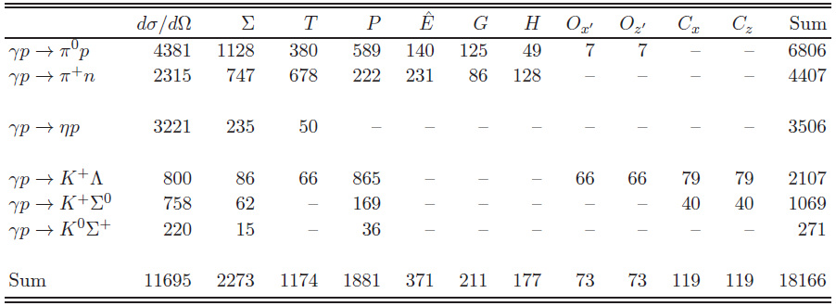
Database used for the analysis
πN → πN Partial wave amp. (SAID EIS)
πN → ηN, KΛ, KΣ observables
γN → πN, ηN, KΛ, KΣ observables
Total 22,348 data points

Slide 29
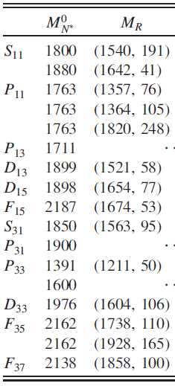
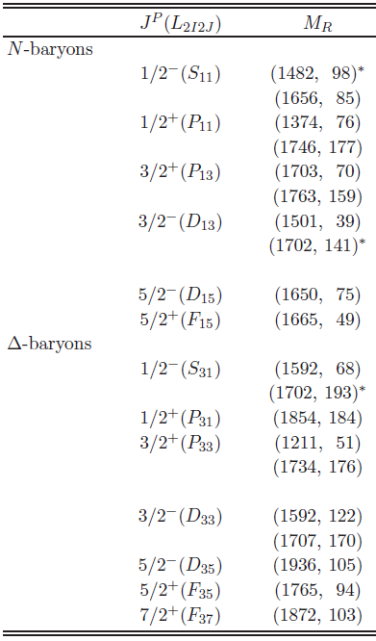
N* resonances from analyses with the old 6ch and current 8ch models
6ch DCC analysis
[PRL104(2010)042302]
8ch DCC analysis
[arXiv:1305.4351]

Slide 30
π⁺ p → K⁺ Σ⁺ reaction
DCS
β
Note: spin-rotation β is modulo 2π
P

Slide 31
γ p → π⁰ p reaction (2/3)
Σ
Note: In computing polarization obs. of pseudoscalar-meson photoproductions, we followed
convention defined in Sandorfi, Hoblit, Kamano, Lee, J. Phys. G38 (2011) 053001.
(See arXiv:1108.5411 for comparison of conventions used in different analysis groups.)

Slide 32
γ p → π⁰ p reaction (3/3)
P
H
T
G
hat E

Slide 33
π- p → ηn reaction
DCS
NOTE:
It is known that there is an inconsistency on the normalization of
the π-p → ηn data between different experiments.
The data used in our analysis are carefully selected according to
the discussion by Durand et al. PRC78 025204.

Slide 34
π- p → K⁰Λ reaction
DCS
β
P

Slide 35
π- p → K⁰ Σ⁰ reaction
DCS
P

Slide 36
γ p → π⁺ n reaction (1/3)
DCS
Σ

Slide 37
γ p → π⁺ n reaction (2/3)
P
T

Slide 38
γ p → π⁺ n reaction (3/3)
hat E
G
H

Slide 39
γ p → η p reaction (1/2)
DCS

Slide 40
γ p → η p reaction (2/2)
Σ
T

Slide 41
γ p → K⁺ Λ reaction (1/2)
DCS
Σ
P

Slide 42
γ p → K⁺ Λ reaction (2/2)
T
Cx’
Ox’
Cz’
Oz’

Slide 43
γ p → K⁰ Σ⁺ reaction
DCS
P
Σ

