Slide 1


Wasa-at-COSY
Dibaryons at COSY
Mikhail Bashkanov

Slide 2
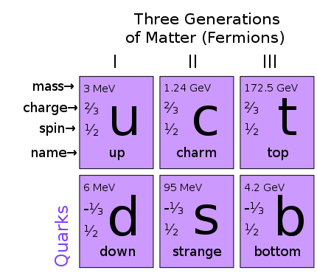
Types of particles/resonances
Meson
Baryon
white
color
anticolor

Slide 3
Possible particles
Tetraquark
Meson-Meson molecule
Hexaquark
Baryon-Baryon molecule
Pentaquark
Meson-Baryon molecule

Slide 4
Deuteron to Deltaron
I(J^{p}) = 0(1⁺)
I(J^{p}) = 0(3⁺)
u
u
u
d
d
d
u
u
u
d
d
d
Threshold
2.2 MeV
p
n
80 MeV
Δ
Δ
deuteron
d*

Slide 5
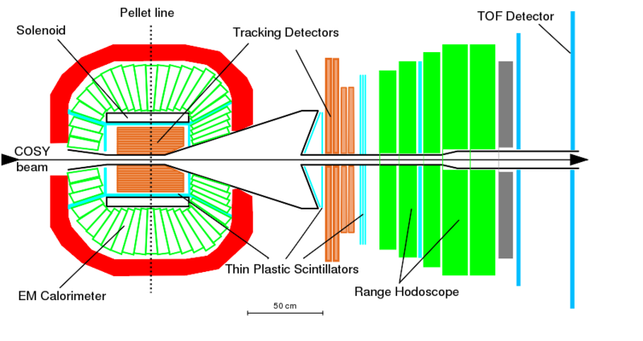
WASA 4π Detector
$$pn→dibaryon→dπ^{0}π^{0}$$
π
γ
γ
p
d
n
γ
γ
π

Slide 6
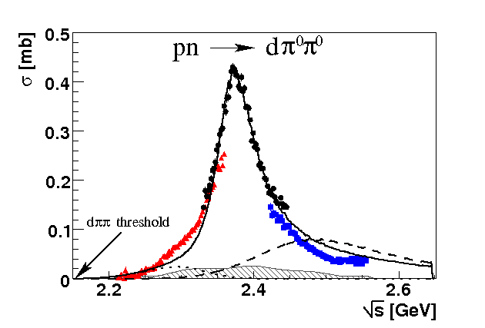
Total cross section pn → dπ⁰π⁰
“d* resonance”
Γ∼70 MeV
ΔΔ
NN*(1440)
P. Adlarson et. al Phys. Rev. Lett. 106:242302, 2011

Slide 7
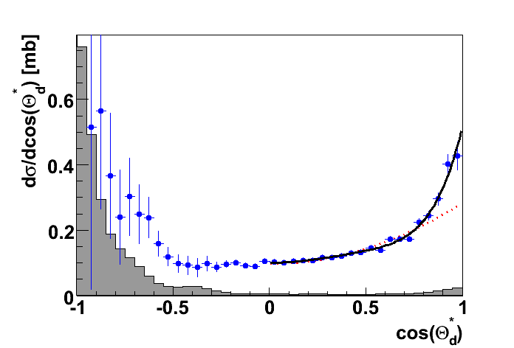
Angular distribution in the peak
J=3
J=1
P. Adlarson et. al Phys. Rev. Lett. 106:242302, 2011

Slide 8
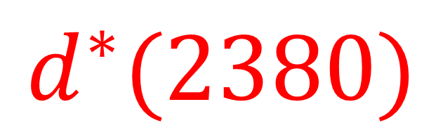
The extracted properties of the new particle
$$d^{∗}(2380)$$
pn → dibaryon → ΔΔ → dπ⁰π⁰
p
Δ
π
d
n
Δ
π
I(J^{p}) = 0(3⁺)
$$M_{d^{∗}}=2.38 GeV≈2M_{Δ}−80 MeV$$
$$Γ_{d^{∗}}=70 MeV≪Γ_{ΔΔ}=240 MeV$$

Slide 9



Total cross section pN → dππ
$$dπ^{+}π^{−}$$
$$\frac{1}{2}∙dπ^{+}π^{0}$$
$$2∙dπ^{0}π^{0}$$
P. Adlarson et. al Phys. Lett. B721 (2013) 229

Slide 10
Non-fusion channels

Slide 11
From fusion to free case
pn → d* → ΔΔ → dππ
pn → d* → ΔΔ → NNππ
π
p
Δ
π
Δ
p
N
d
n
Δ
π
n
N
Δ
π
Fäldt & Wilkin, PLB 701 (2011) 619
Albaladejo & Oset, Phys.Rev. C88 (2013) 014006

Slide 12


pn → pnπ⁰π⁰
Conventional process +d*
d*
d*
Conventional process
$$\sqrt{s} [GeV]$$
$$\sqrt{s} [GeV]$$
P. Adlarson et al., Phys.Lett. B743 (2015) 325-332

Slide 13
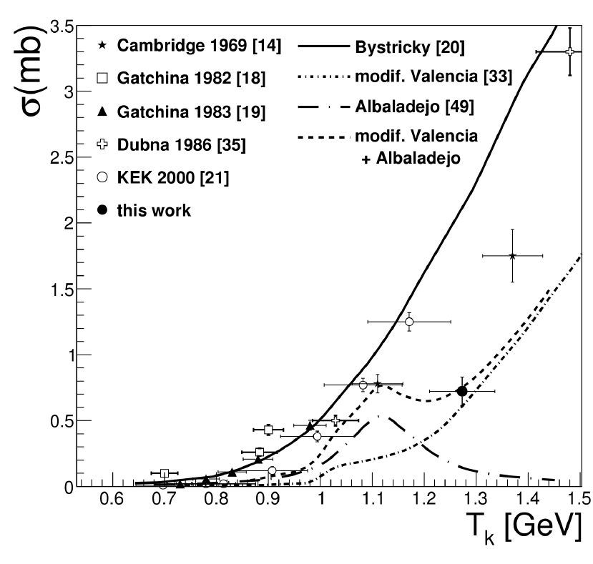
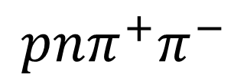
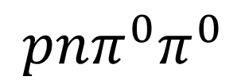
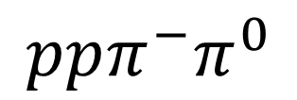
Dibaryon non-fusion decays
$$ppπ^{−}π^{0}$$
$$pnπ^{0}π^{0}$$
$$pnπ^{+}π^{−}$$
d*
d*
PRC 88 (2013) 055208
PLB 743 (2015) 325
HADES
arXiv:1503.04013

Slide 14
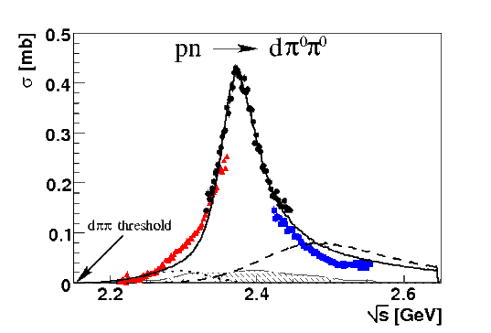
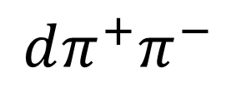
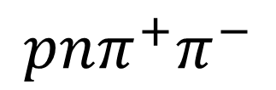
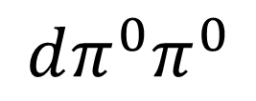
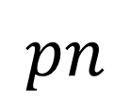
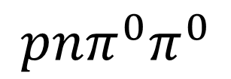
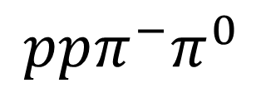
Dibaryon hadronic decays
PRL 106 (2011) 242302
PLB 721 (2013) 229
WASA data
$$dπ^{0}π^{0}$$
$$dπ^{+}π^{−}$$
pn → d*(2380)
$$pn$$
$$ppπ^{−}π^{0}$$
$$pnπ^{0}π^{0}$$
$$pnπ^{+}π^{−}$$
PRL 112 (2014) 202301
PRC 90, (2014) 035204
d*
d*
PRC 88 (2013) 055208
PLB 743 (2015) 325
d*

Slide 15
The decay modes of the dibaryon
Channel | Publications
d π⁰π⁰ | M. Bashkanov et. al Phys.Rev.Lett. 102 (2009) 052301 P. Adlarson et. al Phys. Rev. Lett. 106:242302, 2011 P. Adlarson et. al Phys.Lett. B721 (2013) 229-236
d π⁺π⁻ | P. Adlarson et. al Phys.Lett. B721 (2013) 229-236
ppπ⁰π⁻ | P. Adlarson et. al Phys. Rev. C 88, 055208
npπ⁰π⁰ | P. Adlarson et. al Phys.Lett. B743 (2015) 325
np | A. Pricking, M. Bashkanov, H. Clement. arXiv:1310.5532 P. Adlarson et al. Phys. Rev. Lett. 112, 202301, (2014) P. Adlarson et al. Phys. Rev. C 90, 035204 , (2014)
pn e⁺e⁻ | M. Bashkanov, H. Clement, Eur.Phys.J. A50 (2014) 107
³He ππ | M. Bashkanov et. al Phys.Lett. B637 (2006) 223-228 P. Adlarson et. al Phys. Rev. C 91 (2015) 1, 015201
⁴He ππ | P. Adlarson et. al Phys.Rev. C86 (2012) 032201
+ activities from other groups
M. Bashkanov, Stanley J. Brodsky, H. Clement Phys.Lett. B727 (2013) 438-442

Slide 16
Elastic channel

Slide 17

From $ΔΔ$ to pn decay
pn → d* → ΔΔ → dππ
pn → d* → ΔΔ → NNππ
π
p
Δ
π
Δ
p
N
d
n
Δ
π
n
N
Δ
π
pn → d* → pn
p
p
n
n

Slide 18
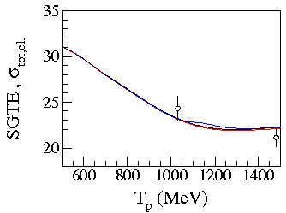
Expectations
p
p
n
n
SAID with resonance
SAID
A. Pricking, M. Bashkanov, H. Clement: arXiv:1310.5532

Slide 19
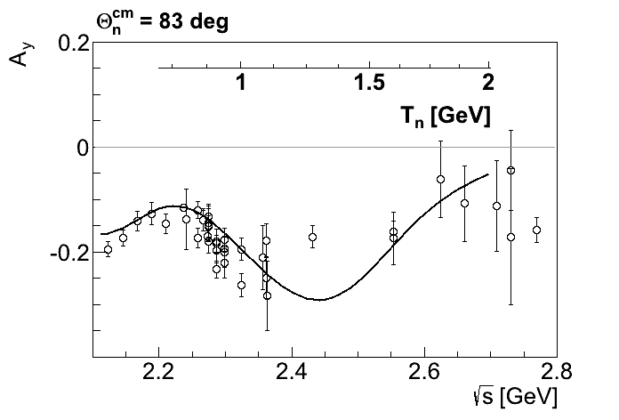

$A_{y}$ energy dependence at $83°$
p
p
n
n
SAID
A. Pricking, M. Bashkanov, H. Clement: arXiv:1310.5532

Slide 20
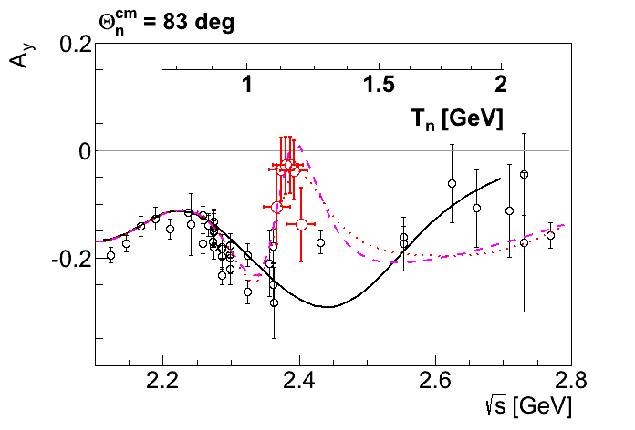
$A_{y}$ energy dependence at $83°$
p
p
n
n
SAID
New SAID
solutions
P. Adlarson et al. Phys. Rev. Lett. 112, 202301, (2014)

Slide 21
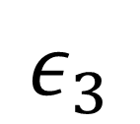
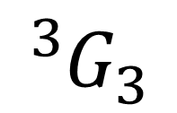

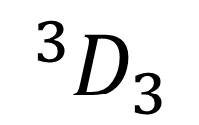
Dimensionless partial wave amplitudes
Pole at $(2380±10)−i(40±5) MeV$
Dimensionless partial wave amplitudes
Im
SP14
SP07
Re
$${}_{}^{3}{D_{3}}$$
$$ε_{3}$$
$${}_{}^{3}{G_{3}}$$
Resonance in the pn system
P. Adlarson et al. Phys. Rev. Lett. 112, 202301, (2014)

Slide 22
Argand plot
P. Adlarson et al. Phys. Rev. Lett. 112, 202301, (2014)
P. Adlarson et al. Phys. Rev. C 90, 035204 , (2014)

Slide 23
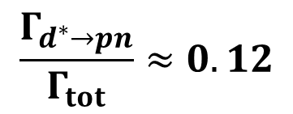


Argand plots
P. Adlarson et al. Phys. Rev. Lett. 112, 202301, (2014)
P. Adlarson et al. Phys. Rev. C 90, 035204 , (2014)
$$\frac{Γ_{d^{∗}→pn}}{Γ_{tot}}≈0.12$$
$$Γ_{d^{∗}→pn({}_{}^{3}{D_{3}})}≈10 MeV$$
$$Γ_{d^{∗}→pn({}_{}^{3}{G_{3}})}≈1 MeV$$

Slide 24
Molecule vs Hexaquark

Slide 25
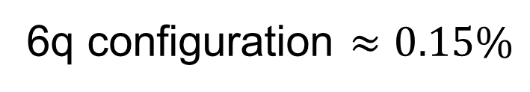

Deuteron
L=0
n
p
n
p
L=2
0.9 fm
4 fm
$$≈5\%$$
6q configuration $≈0.15\%$

Slide 26




Deltaron vs Hexaquark
L=0
$$≈33\%$$
Δ
Δ
0.9 fm
0.9 fm
0.7 fm
$$≈66\%$$
1.2 fm
Δ
Δ
L=2
$$?$$
$$≈5\% of ΔΔ configuration$$
F. Huang et al, arXiv:1408.0458

Slide 27

d*(2380) internal structure and the ABC effect
$$pn→dibaryon→dπ^{0}π^{0}$$
L=0
Δ
Δ
$$M_{ππ}$$
0.9 fm
0.9 fm
1.2 fm
Δ
Δ
L=2
M. Bashkanov et al, arXiv:1502.07500

Slide 28
The family of dibaryons

Slide 29
Mirror dibaryon
d*
I(J^{p}) = 0(3⁺)
I(J^{p}) = 3(0⁺)
Δ
Δ
Δ
Δ
u
u
u
d
d
d
u
u
u
u
u
u
Freeman J. Dyson, Nguyen-Hue Xuong Phys. Rev. Lett. 13(1964) 815
Avraham Gal, Humberto Garcilazo Nucl. Phys. A928, (2014), 73

Slide 30
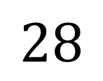
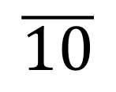


How many ways can you combine 6q?
Isospin
$$J^{P}=3^{+}$$
$$J^{P}=0^{+}$$
Strangeness
$$\overline{10}$$
$$28$$
Δ⁻Δ⁻
Δ⁺⁺Δ⁺⁺
d*
ΔΔ
ΔΣ*
Σ*Σ*+ΔΞ*
Ξ*Σ*+ΔΩ
Ξ*Ξ*+Σ*Ω
Ξ*Ω
ΩΩ

Slide 31
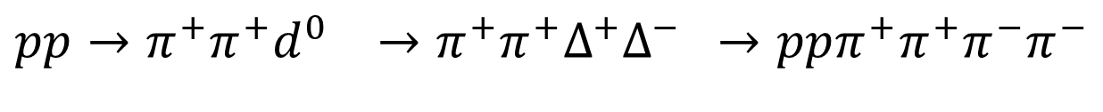

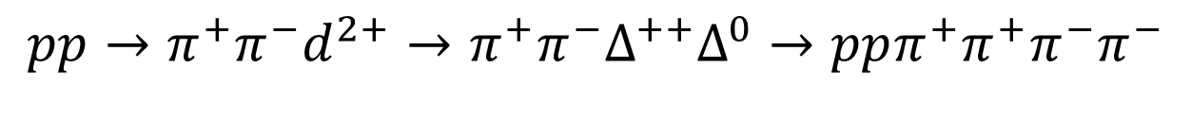

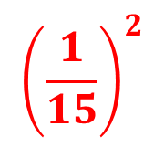

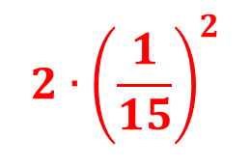


Z=+4 dibaryon isospin coefficients
$$π$$
$$π$$
p
p
p
p
$$π$$
I
$$π$$
$${pp→π^{−}π^{−}d}^{4+}→π^{−}π^{−}Δ^{++}Δ^{++}→ppπ^{+}π^{+}π^{−}π^{−}$$
$$1$$
$$2∙{\left(\frac{1}{15}\right)}^{2}$$
$${pp→π^{+}π^{−}d}^{2+}→π^{+}π^{−}Δ^{++}Δ^{0}→ppπ^{+}π^{+}π^{−}π^{−}$$
$${\left(\frac{1}{15}\right)}^{2}$$
$${pp→π^{+}π^{+}d}^{0} →π^{+}π^{+}Δ^{+}Δ^{−} →ppπ^{+}π^{+}π^{−}π^{−}$$

Slide 32
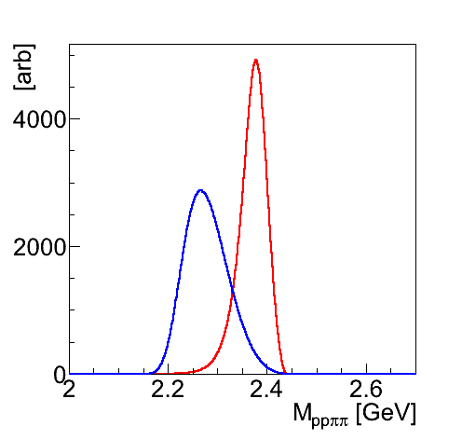
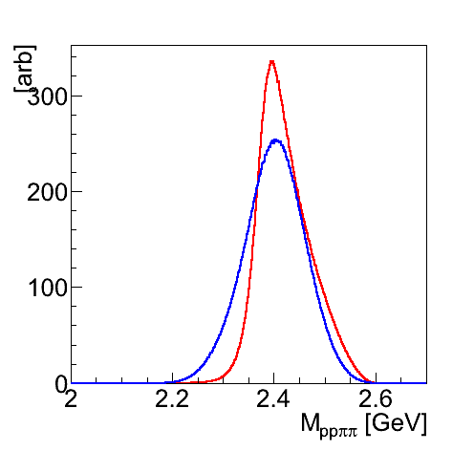
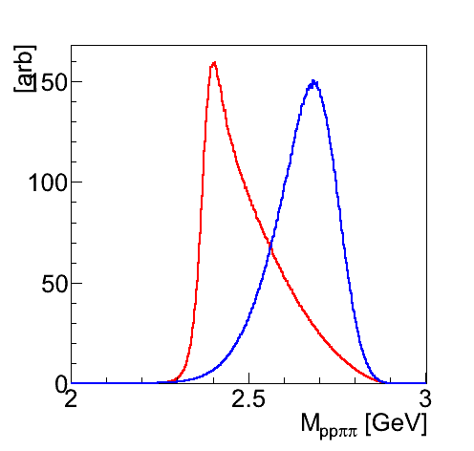
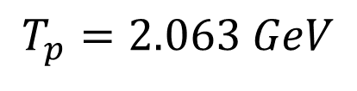
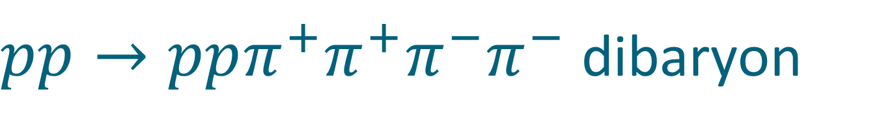
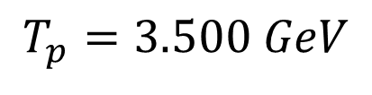
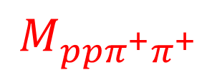
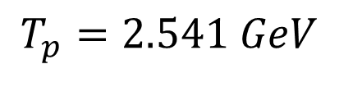
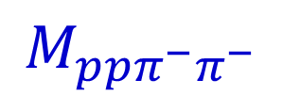
$pp→ppπ^{+}π^{+}π^{−}π^{−}$dibaryon
$$T_{p}=2.063 GeV$$
$$T_{p}=2.541 GeV$$
$$T_{p}=3.500 GeV$$
$$M_{ppπ^{−}π^{−}}$$
$$M_{ppπ^{+}π^{+}}$$

Slide 33
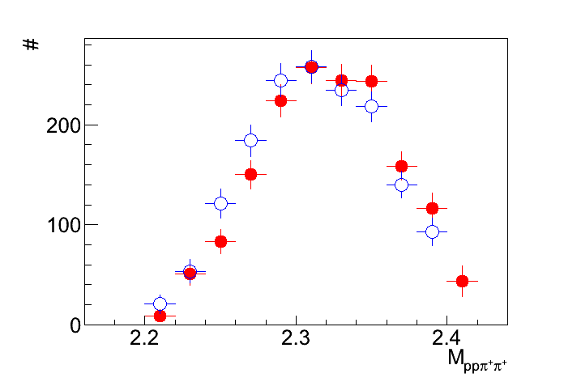
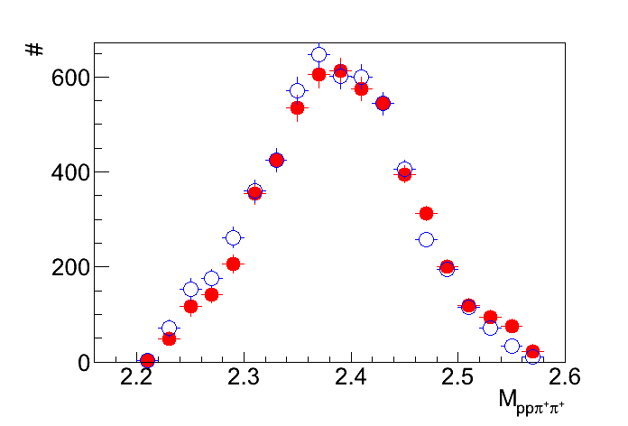
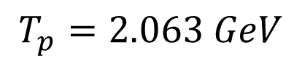
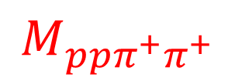
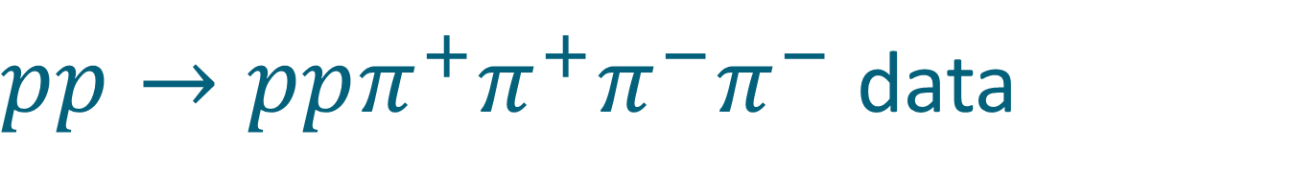

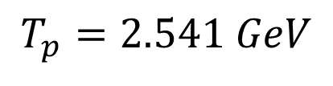
$pp→ppπ^{+}π^{+}π^{−}π^{−}$data
$$T_{p}=2.063 GeV$$
$$T_{p}=2.541 GeV$$
Preliminary
$$M_{ppπ^{+}π^{+}}$$
$$M_{ppπ^{−}π^{−}}$$

Slide 34
















$$pp→ppπ^{+}π^{+}π^{−}π^{−}$$
$background$+resonance
$$π^{−}$$
$$π^{−}$$
$$π^{+}$$
$$π^{+}$$
$$N^{∗}$$
$$N^{∗}$$
Δ
p
p
p
p
p
p
p
p
Δ
$$N^{∗}$$
$$N^{∗}$$
$$π^{+}$$
$$π^{+}$$
$$π^{−}$$
$$π^{−}$$
$$π^{−}$$
$$π^{+}$$
p
p
p
p
$$π^{+}$$
$$π^{−}$$

Slide 35
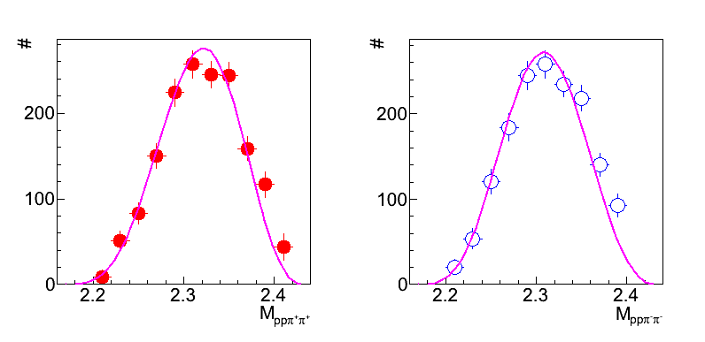
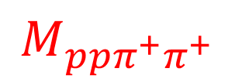

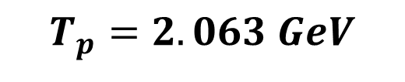
$pp→ppπ^{+}π^{+}π^{−}π^{−}$data
$$T_{p}=2.063 GeV$$
$$M_{ppπ^{+}π^{+}}$$
$$M_{ppπ^{−}π^{−}}$$
Double-Roper
Preliminary

Slide 36



Charge Z=+4 dibaryon upper limit
$$Γ=150 MeV$$
$$Γ=100 MeV$$
$$Γ=50 MeV$$
Preliminary

Slide 37

NN vs ΔΔ
$${}_{}^{1}{S_{0}}$$
Z=+4
p
n
Δ
Δ
66 keV
Threshold
?
2.2 MeV
p
n
80 MeV
Δ
Δ
deuteron
d*

Slide 38
How many ways can you combine 6q?
Isospin
$$J^{P}=3^{+}$$
$$J^{P}=0^{+}$$
Strangeness
$$\overline{10}$$
$$28$$
Δ⁻Δ⁻
Δ⁺⁺Δ⁺⁺
d*
ΔΔ
ΔΣ*
Σ*Σ*+ΔΞ*
Ξ*Σ*+ΔΩ
Ξ*Ξ*+Σ*Ω
Ξ*Ω
ΩΩ

Slide 39




d*(2380) SU(3) multiplet
J^{p} = 3⁺
ΔΔ
$$d^{∗}(2380)$$
$$M_{d^{∗}}−M_{Δ}+M_{Σ^{∗}}<M_{d_{s}^{∗}}≤M_{Δ}+M_{Σ^{∗}}$$
ΔΣ*
$$d_{s}^{∗}(2.53−2.60)$$
ΔΞ*
$$d_{ss}^{∗}(2.68−2.76)$$
ΔΩ
$$d_{sss}^{∗}(2.82−2.90)$$

Slide 40







Strange Dibaryon
Isospin
$$pn$$
$$\overline{10}$$
$d^{∗}$(2380)
Strangeness
d*
ΔΔ
ΔΣ*
$$ΔΔ→NNππ$$
Σ*Σ*+ΔΞ*
Ξ*Σ*+ΔΩ
$$NΛ$$
$d_{s}^{∗}$(2530-2600)
$$ΔΣ^{∗}→(Nπ)(Λπ)→NNπππ$$

Slide 41


d*(2380) in photoproduction?
R. Gilman and F. Gross nucl-th/0111015 (2001)
d*
γ
p
T. Kamae, T. Fujita Phys. Rev. Lett. 38, Feb 1977, 471
d
n
H. Ikeda et al., Phys. Rev. Lett. 42, May 1979, 1321
I(J^{p}) = 0(3⁺)
$$M=2.38 GeV$$

Slide 42

The benchmark measurement
Newly installed
Edinburgh polarimeter
γ
p
d*
d
n
Measure polarization of both
proton and neutron !
M.H. Sikora, D.P. Watts et al, Phys.Rev.Lett. 112 (2014) 022501

Slide 43
Conclusion
The very first dibaryon d*(2380) is established
  Mass
  Width
  Quantum numbers
  Main decay branches
  Structure: Hexaquark vs Molecule?
No convincing signs for the mirror dibaryon (charge Z=+4) so far
  Size and shape of the conventional background?
  Mirror multiplet (28-plet) is likely to be unbound

Slide 44
Thank you

Slide 45


$$γd→dπ^{0}π^{0}$$
γ
Δ
π
d
d
Δ
π
A. Fix, H. Arenhoevel. Eur. Phys. J. A 25, 115, (2005).

Slide 46

Z=+4 dibaryon
$$d^{4+}→Δ^{++}Δ^{++}→ppπ^{+}π^{+}$$
π
Δ
N
N
Δ
π
$$π^{−}$$
$$π^{+}$$
p
p
p
p
$$π^{+}$$
$$π^{−}$$
$${pp→π^{−}π^{−}d}^{4+}→π^{−}π^{−}Δ^{++}Δ^{++}→ppπ^{+}π^{+}π^{−}π^{−}$$
WASA, HADES

Slide 47





$pp→ppπ^{+}π^{+}π^{−}π^{−}$dibaryon
$$T_{p}=2.063 GeV$$
$$T_{p}=2.541 GeV$$
$$T_{p}=3.500 GeV$$
$$M_{ppπ^{−}π^{−}}$$
$$M_{ppπ^{+}π^{+}}$$

Slide 48


Model calculations of the $d^{∗}$and $d^{4+}$
M(GeV) | 1 | 2 | 3 | 4 | 5 | exp
$$d^{∗}$$ | 2.35 | 2.361 | 2.45 | 2.38 | 2.38 | 2.38
$$d^{4+ }$$ | 2.35 | 2.833 | unbound | 2.69 | 2.40 | ⎯
Dyson-Xuong, PRL 13 (1964) 815
Mulders-Aerts-de Swart, PRD 21 (1980) 2653
Oka-Yazaki, PLB 90 (1980) 41.
Mulders-Thomas, JPG 9 (1983) 1159.
A. Gal, H. Garcilazo Nucl.Phys. A928 (2014) 73-88

