Slide 1
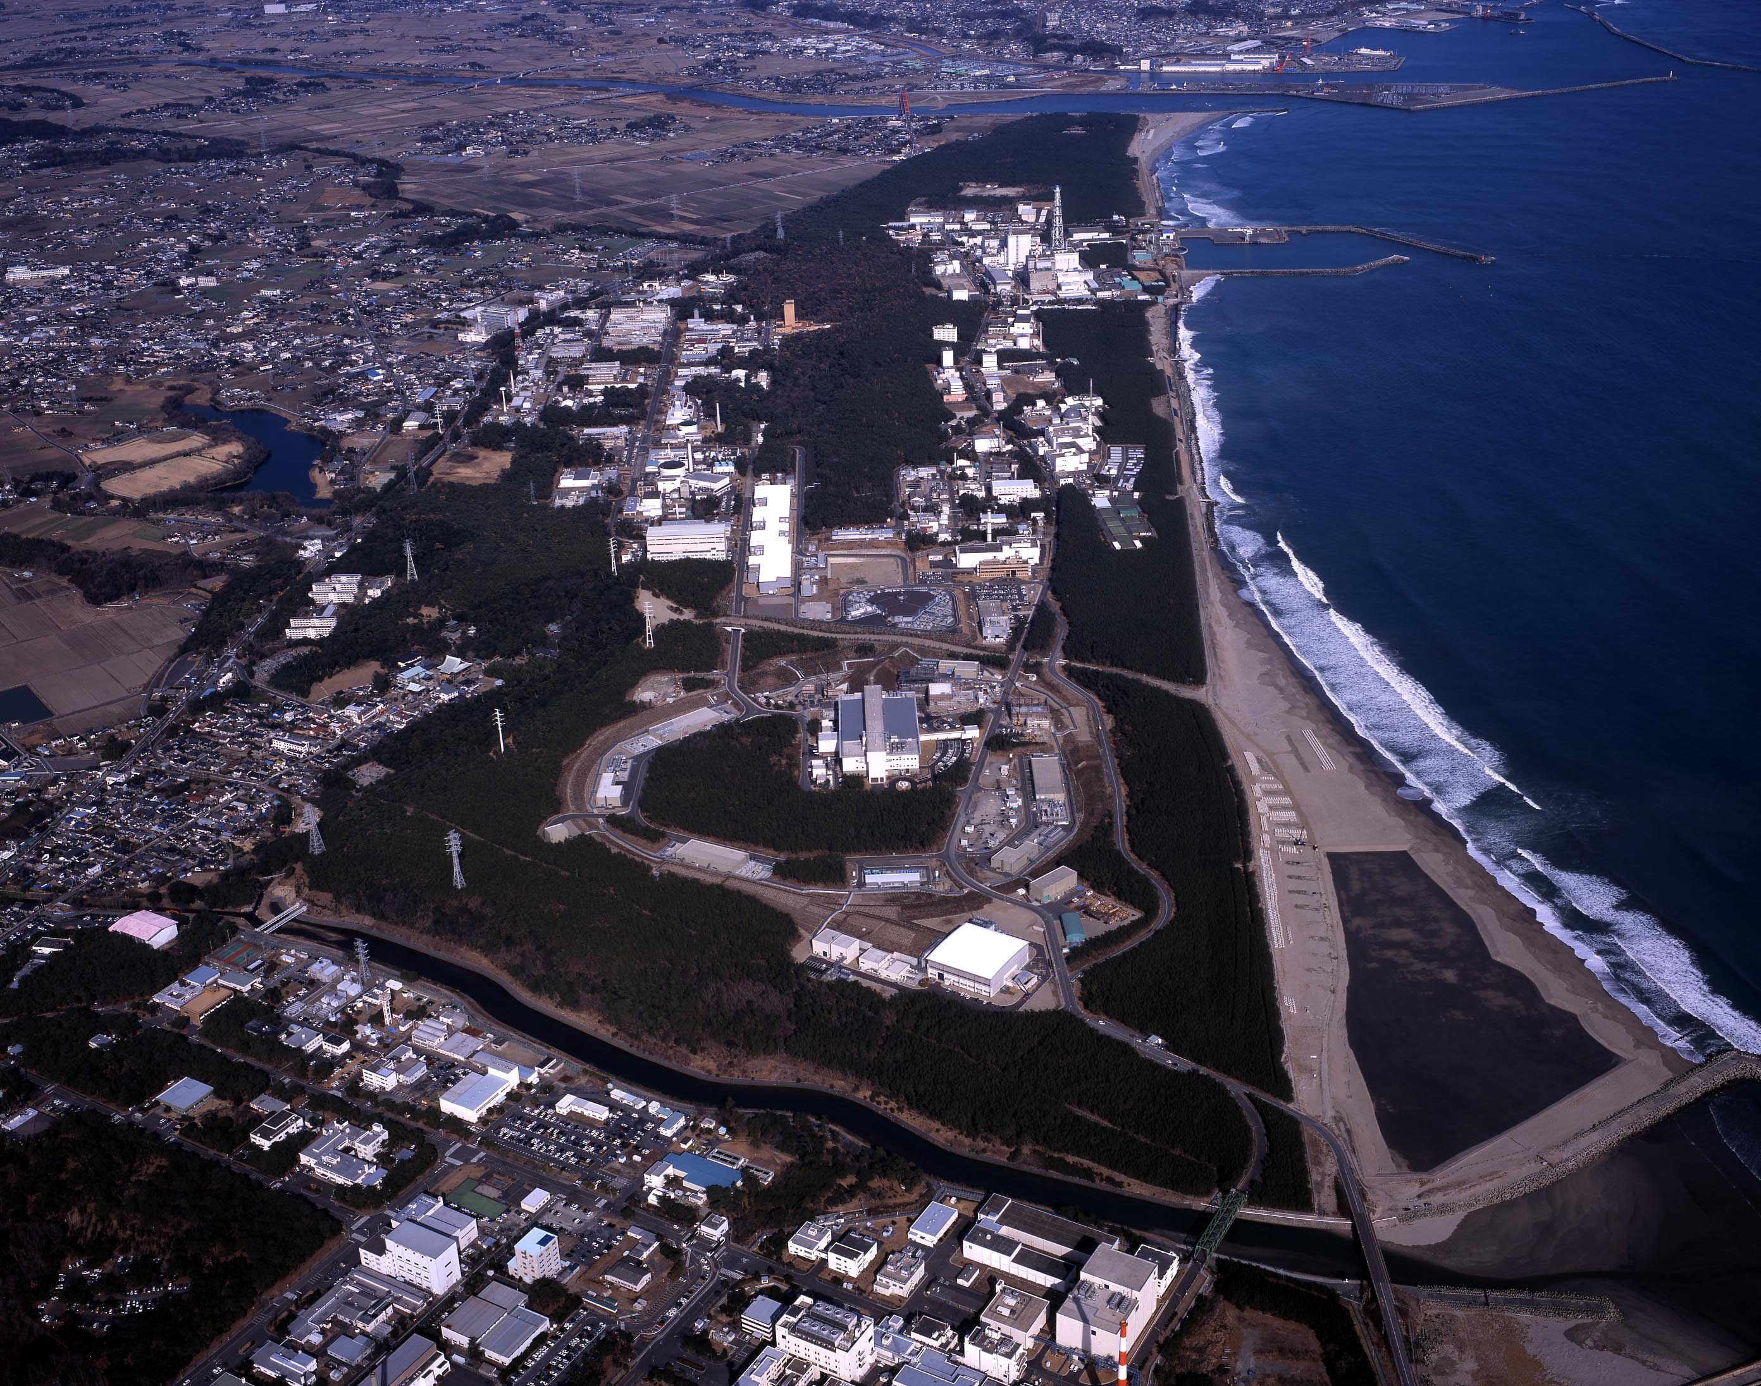



Overview of Hadron Physics at J-PARC
Kiyoshi Tanida (Japan Atomic Energy Agency)
28/May/2015
NSTAR2015 workshop @Osaka U.

Slide 2
Contents
Introduction to J-PARC
Results of initial experiments related to baryon spectroscopy
E19 (pentaquark search)
E27 (Kpp search)
Some of experiments in near future
E45 (N*/Y* spectroscopy)
E42 (H dibaryon)
E50 (charm baryon spectroscopy)

Slide 3
Part I. Introduction of J-PARC

Slide 4
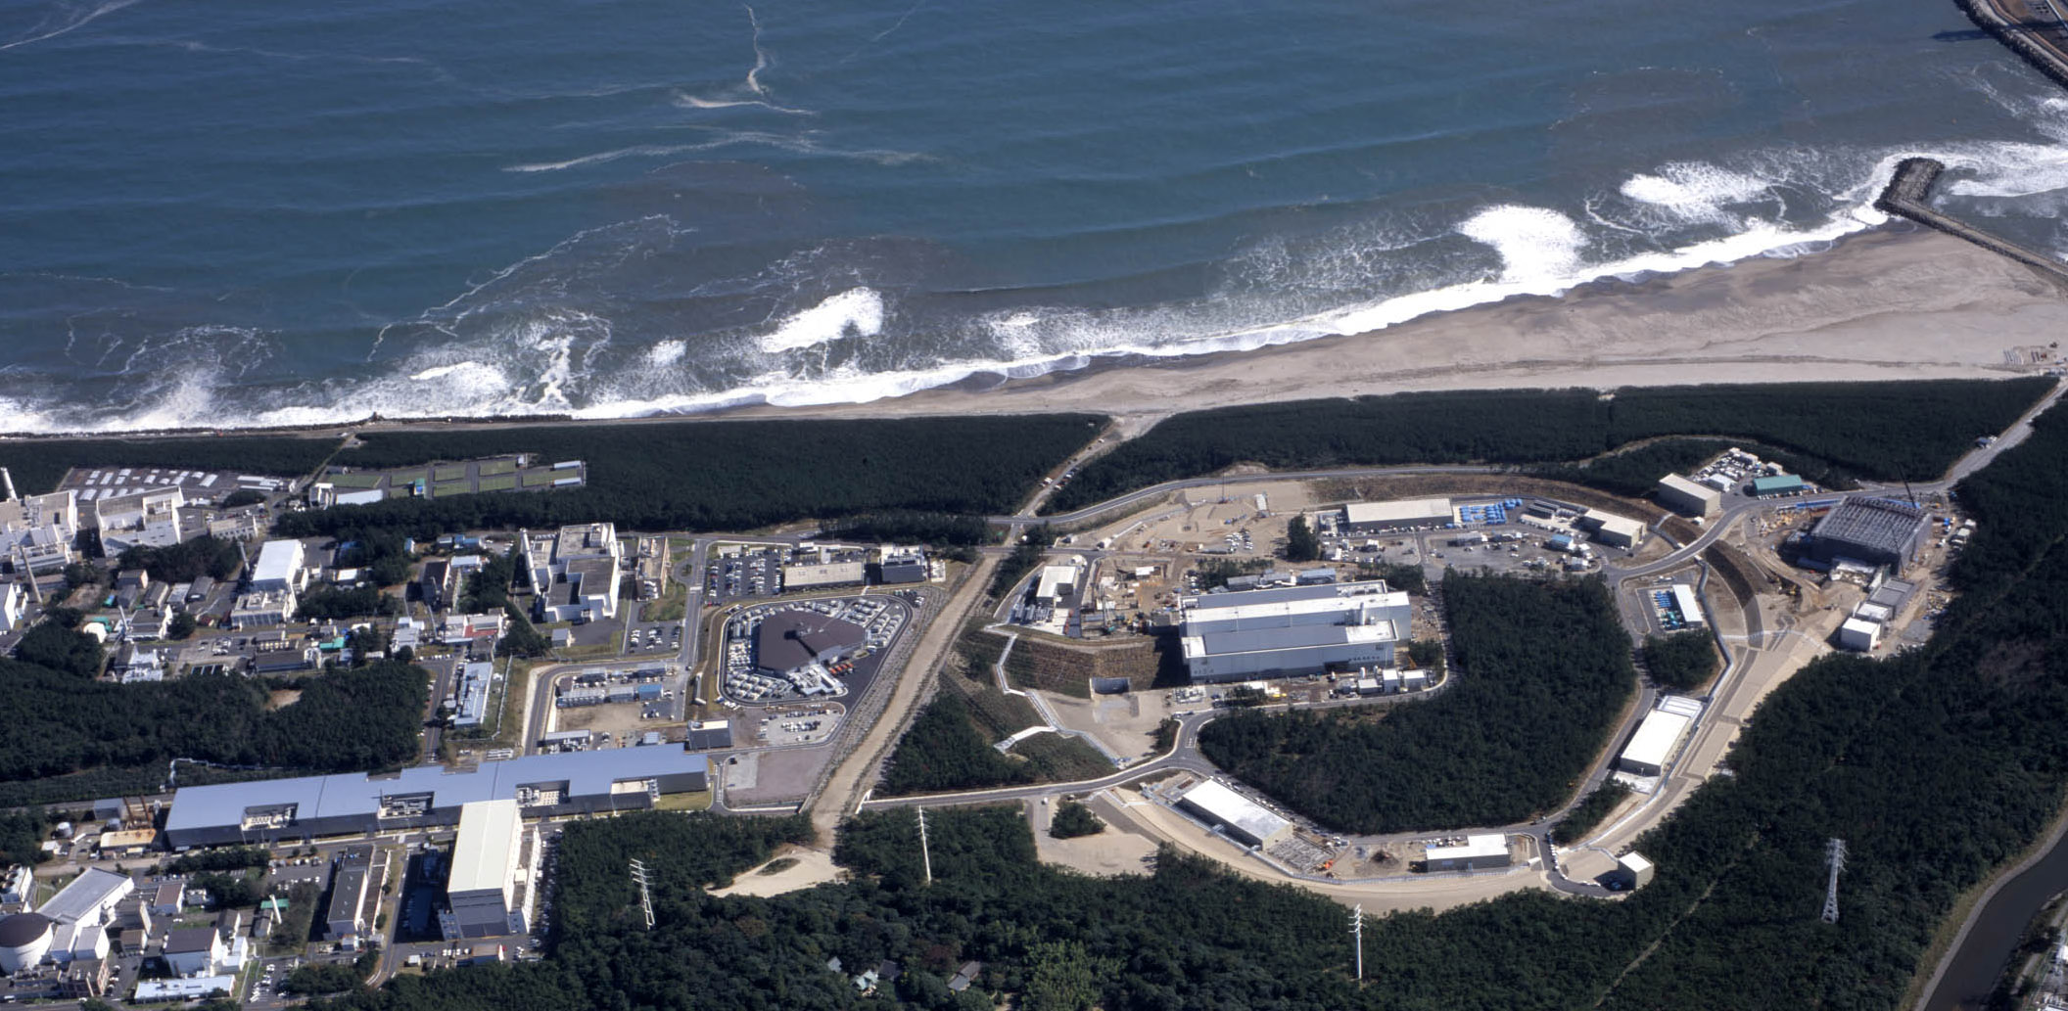
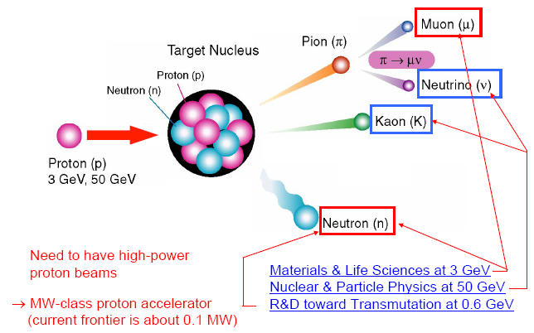
J-PARC (Japan Proton Accelerator Research Complex)
Tokai, Japan
Material and Biological Science Facility
50 GeV Synchrotron (15 μA)
3 GeV Synchrotron (333 μA)
400 MeV Linac (350m)
Neutrino Facility
World-highest beam intensity : ~1 MW
x10 of BNL-AGS, x100 of KEK-PS

Slide 6
Nuclear & Hadron Physics in J-PARC

Slide 7
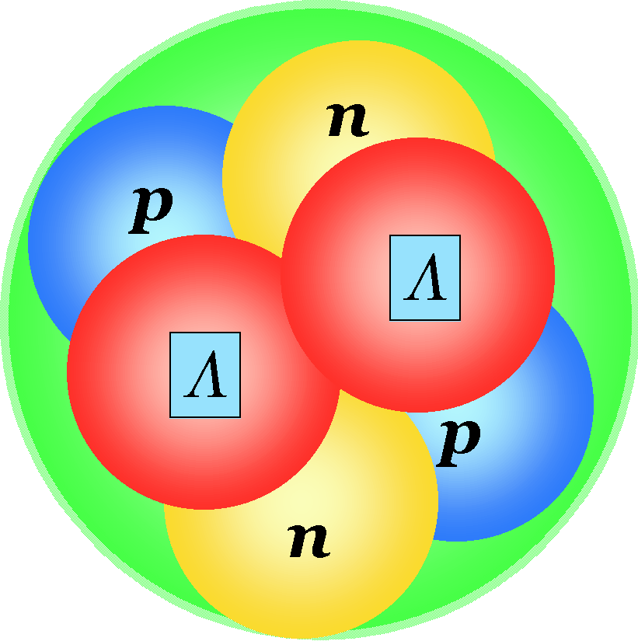

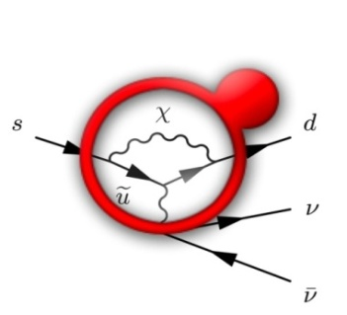
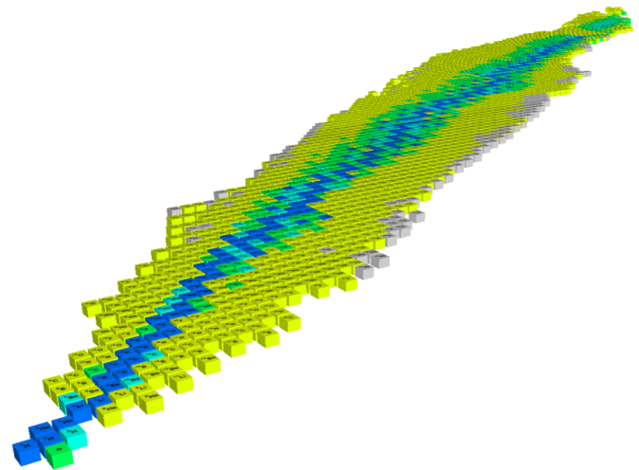
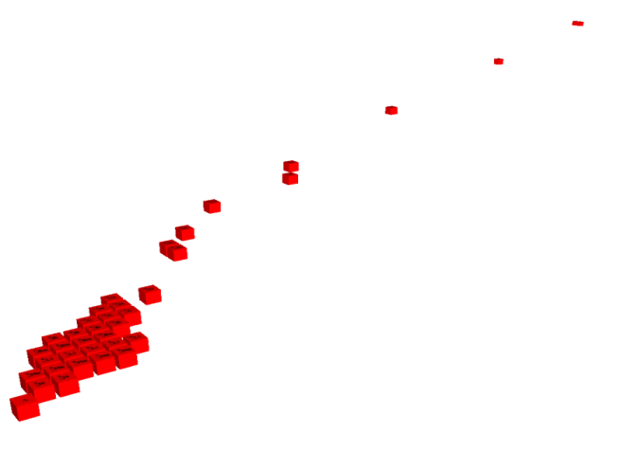


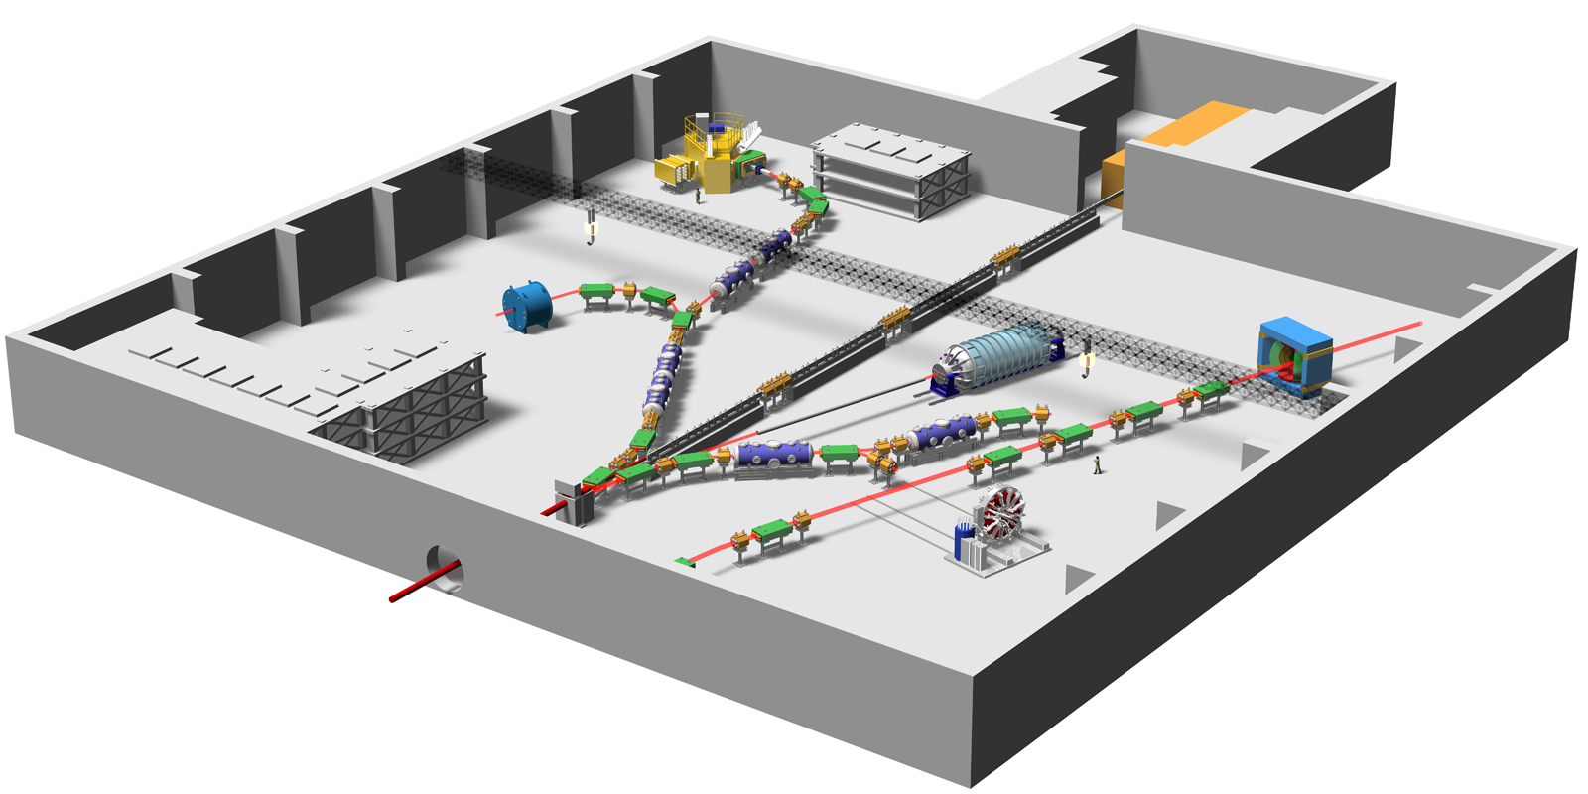
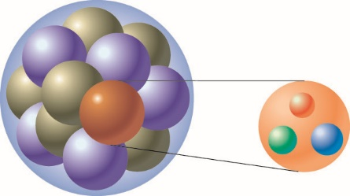
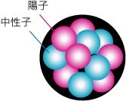
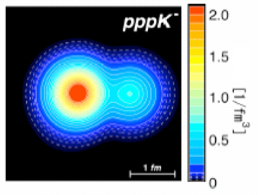
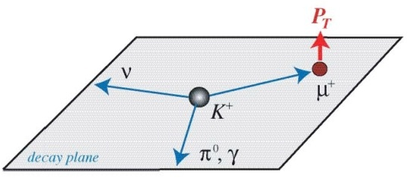

Experiments at a glance (not all)
Nuclear & Hadron Physics at J-PARC
K⁰ → π⁰ νν
d
_{L}
High Density Nuclear Matter, Nucelar Force
s
u
Hypernuclei
d
u
Strangeness
_{ΛΛ}He
Pentaquark Θ⁺
Origin of Mass
⁶
Confinement
ΛΛ, Ξ Hypernuclei
Z
Quark
-2
Λ, Σ Hypernuclei
-1
Λ,Ξ
N
0
SKS
Free quarks
Bound quarks
K1.8
Why are bound quarks heavier？
Mass without Mass Puzzle
K1.8BR
KL
K1.1
K-meson
High-p
Implantation of
Kaon and the
nuclear shrinkage
High Density Nuclear Matter,
Nucelar Force
K1.1BR
COMET
Beam line
Ｋ⁻
Proton Beam
μ-e conversion
T-Viola
tion
→
Ｘray
e⁻
Kaonic atom
Kaonic nucleus
Notes:
7
On the other hand, the hadron experimental hall looks like this.
● Proton beam comes here and various kaon beam lines are prepared, where K=1.8 means kaons with momentum of 1.8 GeV/c.
● At SKS, hypernuclear spectroscopy will be performed for a variety of nuclei. ● In particular, searches for double hypernucleus and pentaquark are the highlights in here.
● In this beamline, kaon implantation is planned. When kaon is implanted inside the nucleus, there is a possibility that high density matter is created. ● Kaonic atom and kaonic nucleus will be studied.
● This beam line is the neutral kaon line to study CP violation, and ● this line is for T-violation experiment.
● Finally, this line, which is not yet completed, is dedicated to the study of chiral symmetry, namely, the mass generation mechanism of bound quarks.
7

Slide 8
Accidents
Construction started in 2002
Construction of MR finished in 2008
First physics beam time in Nov. 2010
Lost ～1year due to the earthquake on Mar. 11, 2011

Slide 9
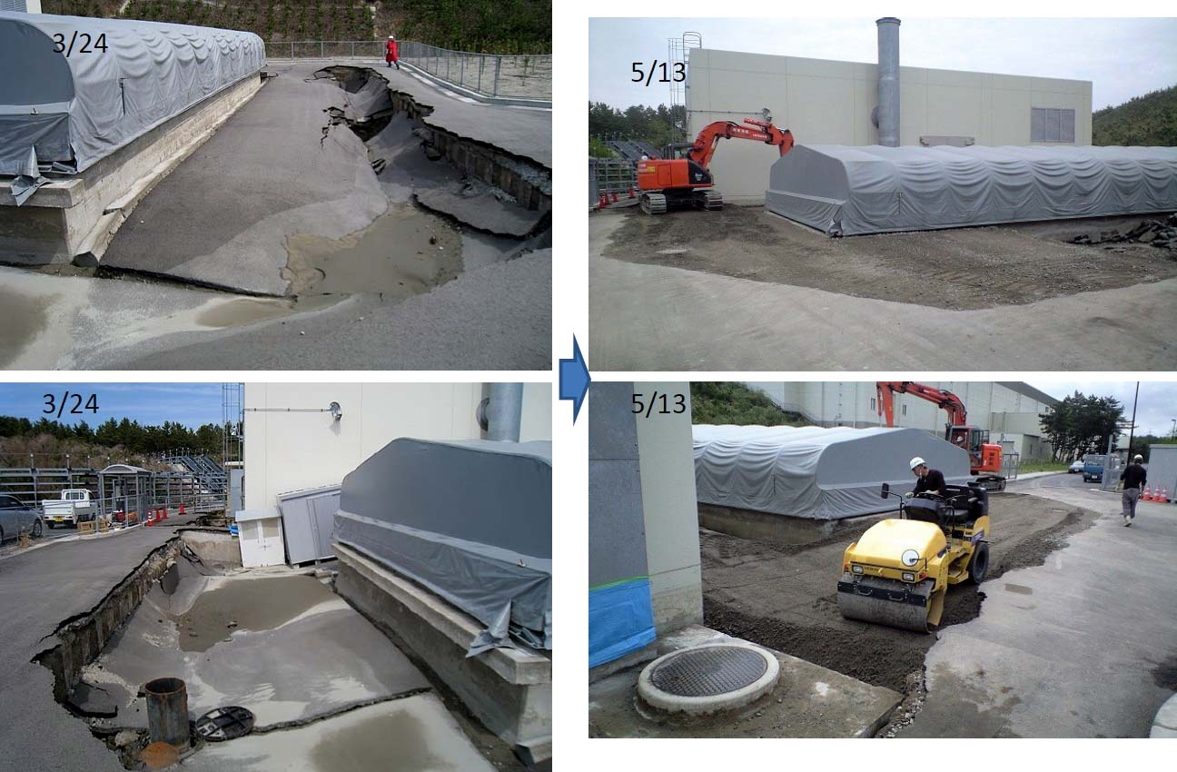
How things went with the EQ
Photos were taken around the Beam Dump
Notes:
9

Slide 10
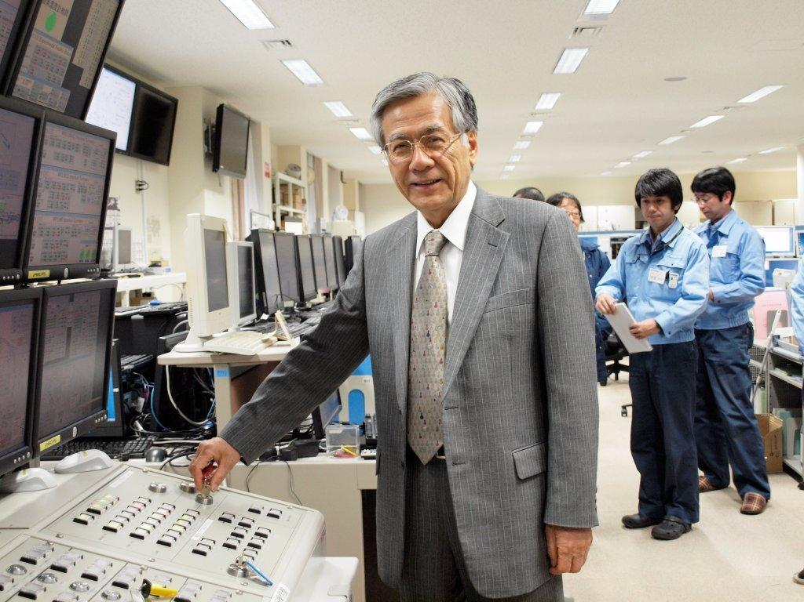
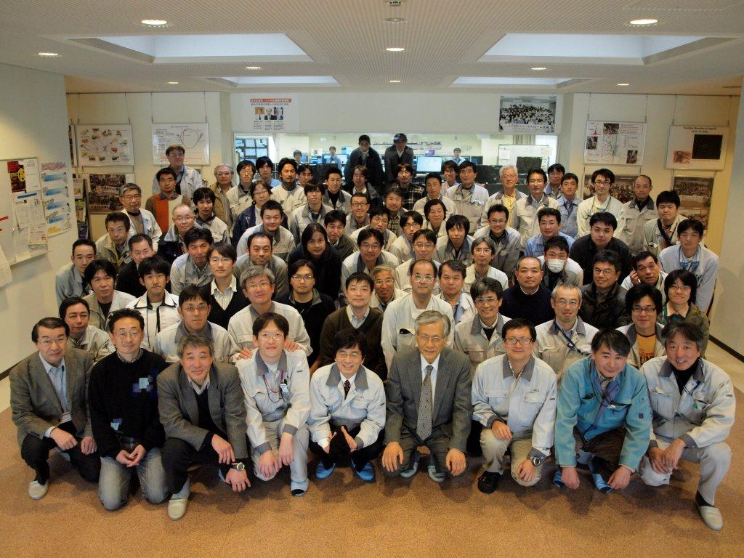
December 9, 2011
14:00 Beam went throughout the Linac
at 3 MeV with RFQ acceleration.
09:30 Key was on.
Notes:
Let me summarize my talk.
● Concerning J-PARC, the facility was completed in JFY2009, the last year.
Neutrino facility started to take data at Superkamiokande.
Hadron facility is about ready to run many experiments.
Materials and Life Facility. Neutron and muons beams already started to produce many data and results are being published.
● In all the areas, we are waiting for more international users to come and use it, in particular from Asian countries.

Slide 11
Accidents
Construction started in 2002
Construction of MR finished in 2008
First physics beam time in Nov. 2010
Lost ～1year due to the earthquake on Mar. 11, 2011
Experiments ran again from Feb. 2012
Radioactivity leak accident on May 23, 2013
Abnormally short beam hit the gold target, which melted
Took almost 2 years for renovation

Slide 12
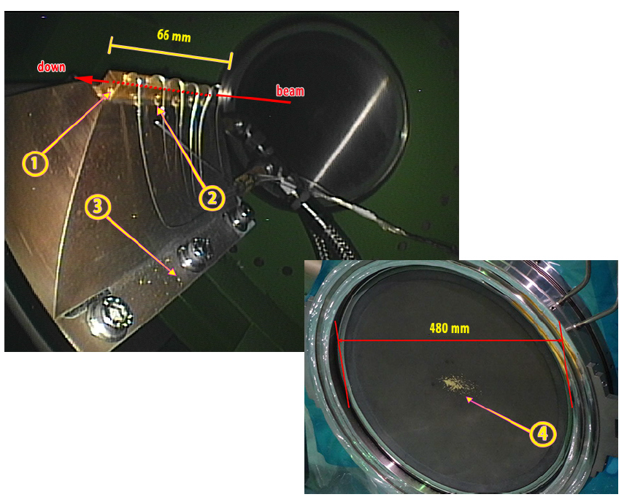
The gold target
Hole in ①, scattered gold seen in ②③④

Slide 13
Hadron hall renovation
Make things air-tight
Target vessel, primary beamline
Exhaust lines are monitored for radioactivities
New target
More efficiently cooled
Radiation monitor is strengthened

Slide 14
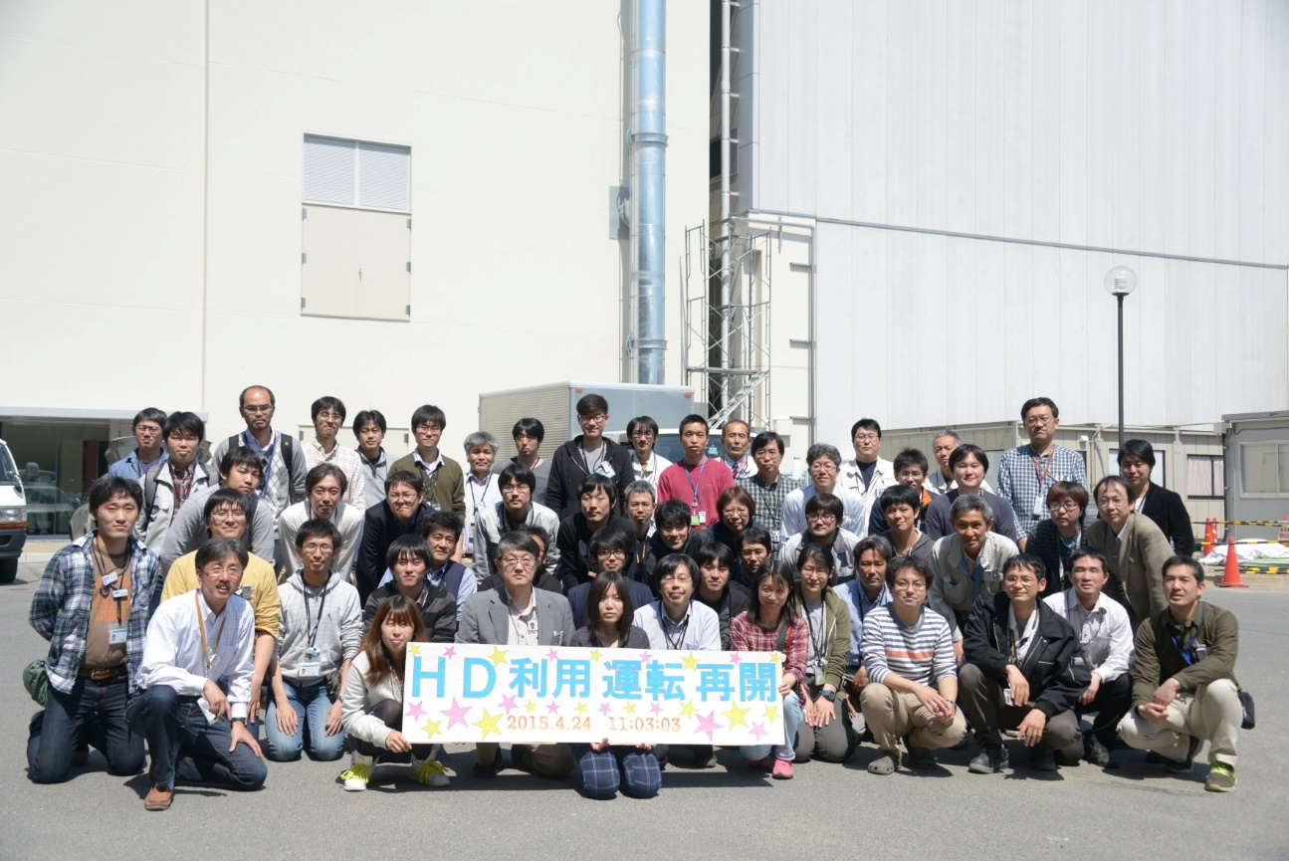
Beam came back in April, 2015

Slide 15
Accidents
Construction started in 2002
Construction of MR finished in 2008
First physics beam time in Nov. 2010
Lost ～1year due to the earthquake on Mar. 11, 2011
Radioactivity leak accident on May 23, 2013
Abnormally short beam hit the gold target, which melted
Took almost 2 years for renovation
We were not able to take data for these periods. Still we have interesting results!

Slide 16
Part II. Results of initial experiments related to baryon spectroscopy E19 – pentaquark search E27 – spectroscopy with d(π⁺,K⁺)

Slide 17
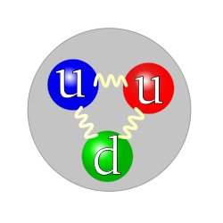

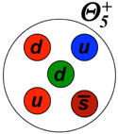
E19 Experiment
Search for pentaquark, Θ⁺
There are two kinds of usual hadrons (= feel strong force)
Baryon (Fermion): Meson (Boson):
Color neutrality required from QCD But they are not the only cases → Exotic hadrons
Pentaquark = 5 quarks

Slide 18
Pentaquark Θ⁺
First reported in 2003 by LEPS collaboration
Both positive and negative results
Still controversial
Mysteries
Why so narrow? Γ < 1 MeV
Spin-parity?
What’s that eventually?
T. Nakano et al.,PRC79 (2009) 025210

Slide 19
High resolution search by p(π⁻,K⁻)Θ
A good resolution: ~2 MeV (FWHM)
thanks to SKS
Why high resolution?
Good S/N ratio
Width measurement Almost certainly Γ < 1 MeV
Typical resolution in the past ~ 10 MeV
No high resolution search
There is a good chance

Slide 20
Moritsu et al., PRC90 (2014) 035205
Spectra well represented by known backgrounds

Slide 21
at both energies

Slide 22
Upper limit on decay width
Based on an effective Lagrangian approach: Hyodo et al., PTP128 (2012) 523
Upper limit: 0.36 MeV for ½⁺ 1.9 MeV for ½⁻ For most conservative cases, taking theoretical uncertainties into account
Comparable to DIANA result

Slide 23
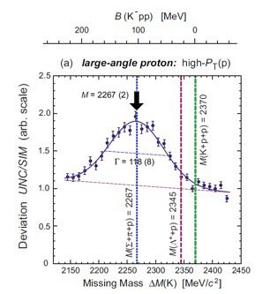
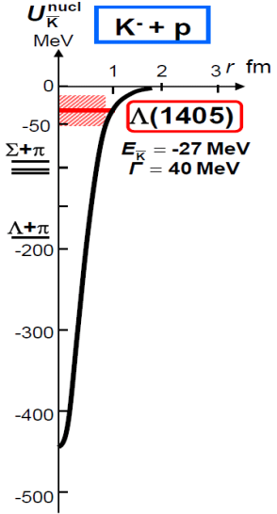
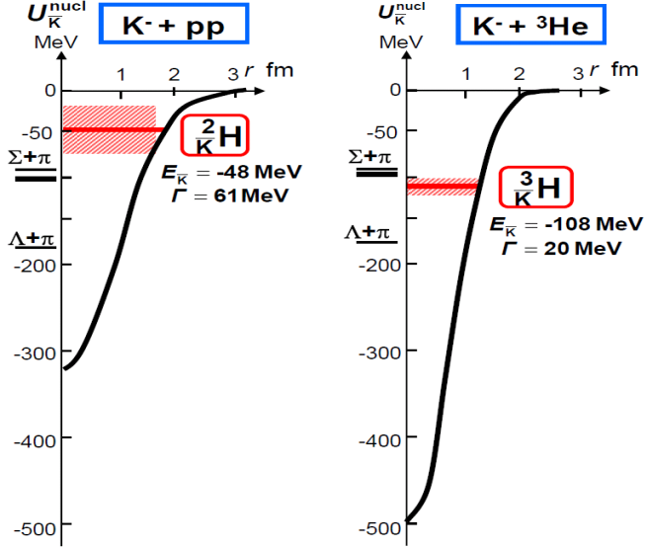
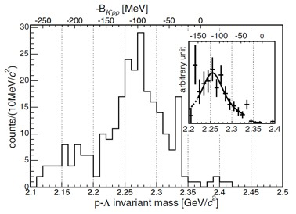
E27: Deeply bound Kaonic nuclei
Λ(1405) = K⁻p bound state → deeply bound nuclei? Kaon condensation in neutron stars?
DISTO (PRL 94, 212303)
FINUDA PRL104, 132502
Akaishi & Yamazaki, PRC 65 (2002) 044005
B_{K} > 100 MeV??

Slide 24
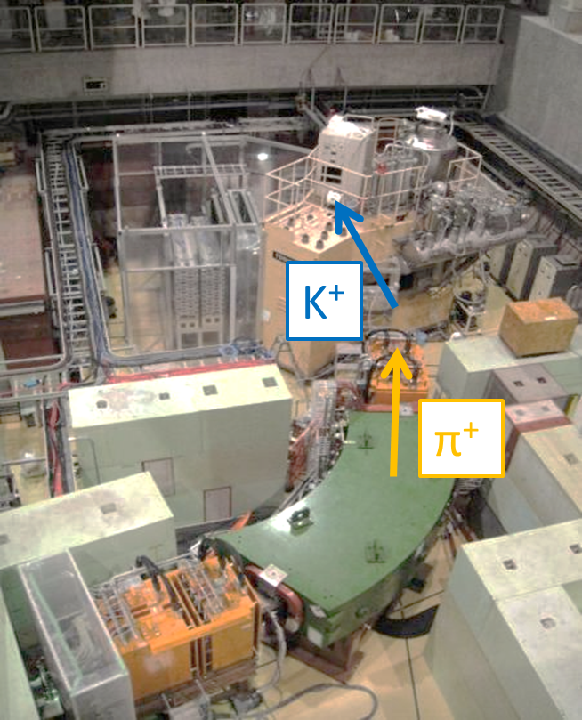
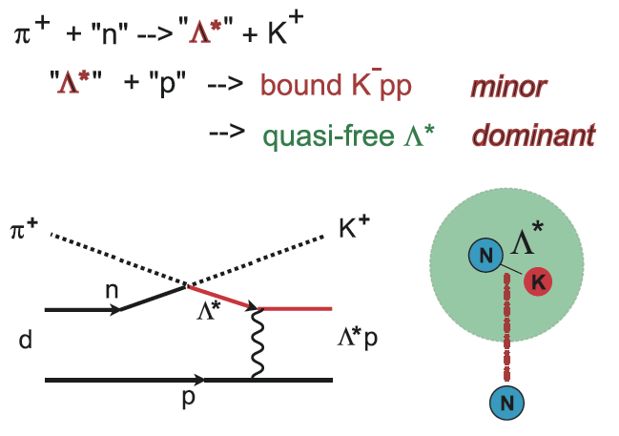
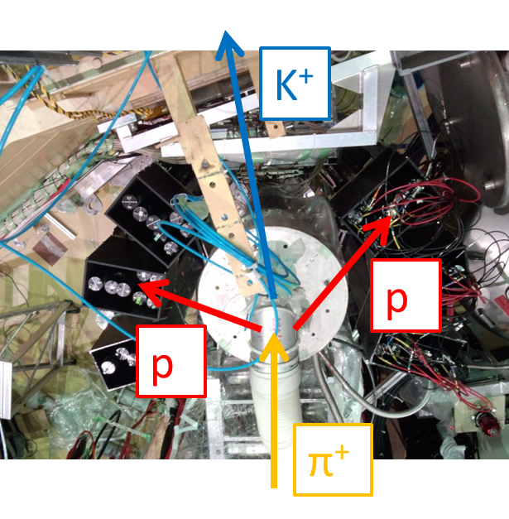
E27
Search for K⁻pp by d(π,K⁺) reaction
missing mass spectroscopy
Decay counter to detect ppπ
from Kpp → Λp → ppπ

Slide 25
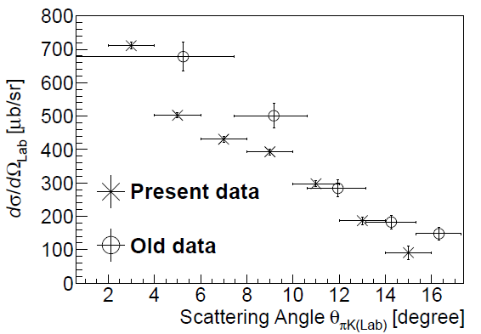
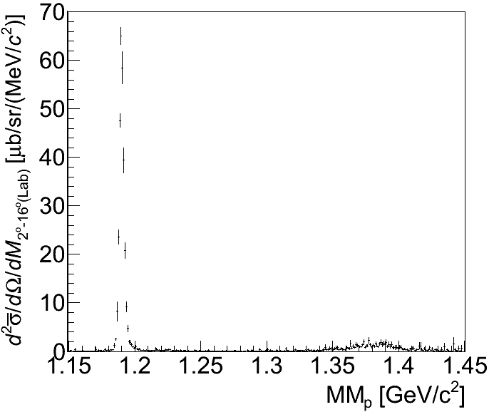
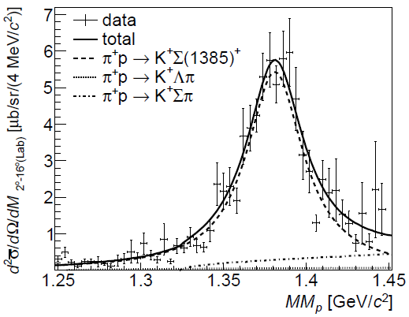
Calibration: p(π⁺, K⁺)Σ⁺ at 1.69 GeV/c
Σ⁺
Σ(1385)⁺
Zoom
Data:
M = 1381.1 ± 3.6 MeV/c²
Γ = 42 ± 13 MeV
PDG: M = 1382.8 ± 0.35 MeV/c²,
Γ = 36.1 ± 0.7 MeV

Slide 26
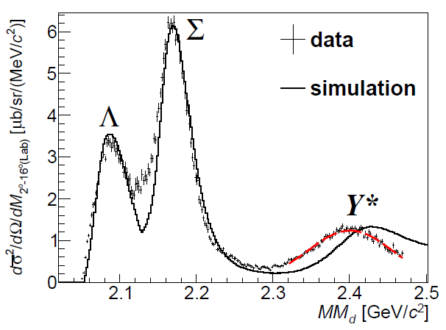
d(π⁺, K⁺) at 1.69 GeV/c (Inclusive spectrum)
Y* peak; data = 2400.6 ± 0.5(stat.) ± 0.6(syst.) MeV/c²
sim = 2433.0 (syst.) MeV/c²
``shift” = －32.4 ± 0.5(stat.) (syst.) MeV/c²
+2.8
-1.6
+2.9
-1.7
Mass shift of Λ*(1405) and/or Σ*(1385)?
due to final state interaction?
Gaussian fit
PTEP 101D03 (2014)

Slide 27
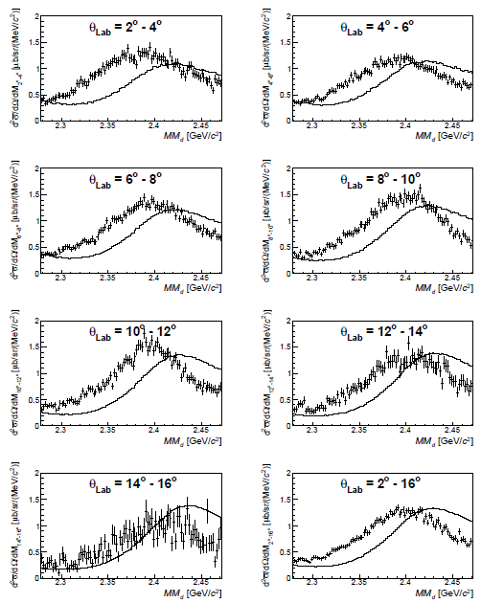
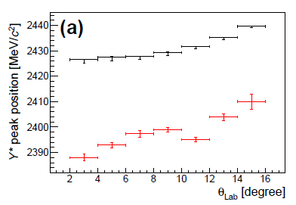
θ_{πK} dependence (＋data, ―sim)
Y* peak positions are
shifted to the low
mass side for all
scattering angles.
< Peak position >
＋ data
＋ simulation

Slide 28
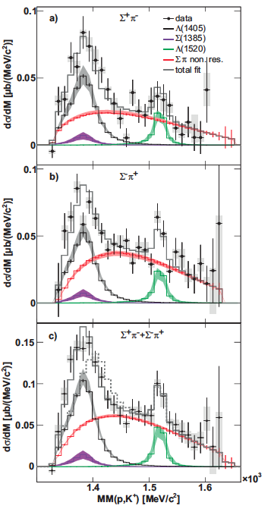

HADES experiment for Λ(1405)
The peak position of Λ(1405)
is shifted to low-mass side.
M = 1385 MeV/c²,
Γ = 50 MeV
S-wave Breit Wigner function

Slide 29
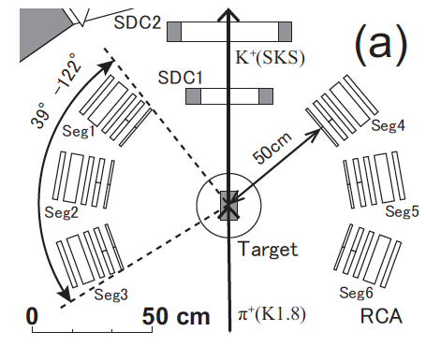
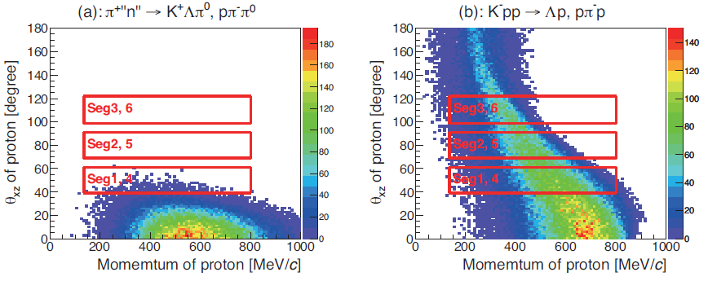
Range counter array(RCA) for the coincidence measurement
RCA is installed to measure the proton from the K⁻pp.
K⁻pp→Λp→pπ⁻p; K⁻pp→Σ⁰p→pπ⁻γp; K⁻pp→Ypπ→pπp+(etc.)
Proton is also produced from the QF processes.
π⁺``n’’→K⁺Λπ⁰, Λ→pπ⁻
However, these proton’s kinematics is different.
We suppress the QF background by tagging a proton.
☆ Seg2 and 5 are free from QF background.
More strongly suppress by tagging two protons.
K⁺
p
p
π⁺

Slide 30
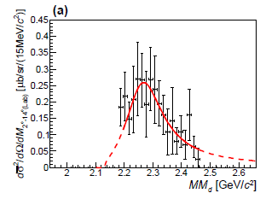
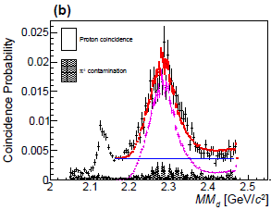
``K⁻pp’’-like structure(coincidence)
Broad enhancement ~2.28 GeV/c² has been observed in the Σ⁰p spectrum.
Mass: (BE: )
Width:
dσ/dΩ_{``K}‐_{pp’’→Σ}0_{p} =
[Theoretical value: ~1.2]
PTEP 021D01 (2015)
T. Sekihara, D. Jido and Y. Kanada-En’yo, PRC 79, 062201(R) (2009).
<2proton coincidence analysis>
π⁺d→K⁺X, X→Σ⁰p
<1 proton coincidence probability>

Slide 31
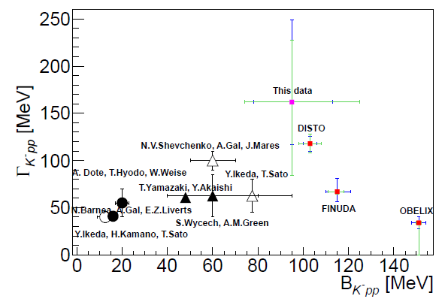
Discussion on the ``K⁻pp’’-like structure
Obtained mass (BE ~ 100 MeV) and broad width are not inconsistent with the FINUDA and DISTO values.
Theoretical calculation for the K⁻pp is difficult to reproduce such a deep binding energy about 100 MeV.
The other possibilities?
A dibaryon as πΛN – πΣN bound states?
(It should not decay to the Λp mode because of I = 3/2.)
Λ*N bound state?
A lower πΣN pole of the K⁻pp?
(The K⁻pp might have the double pole structure like Λ(1405).)
Partial restoration of chiral symmetry on the KN interaction?
H. Garcilazo and A. Gal, NPA 897, 167 (2013).
T. Uchino et al., NPA 868, 53 (2011).
A. Dote, T. Inoue and T. Myo, PTEP 2015 4, 043D02 (2015).
―
S. Maeda, Y. Akaishi and T. Yamazaki, Proc. Jpn. B 89, 418 (2013).

Slide 32
Part III. (some of ) experiments in (near) future

Slide 33
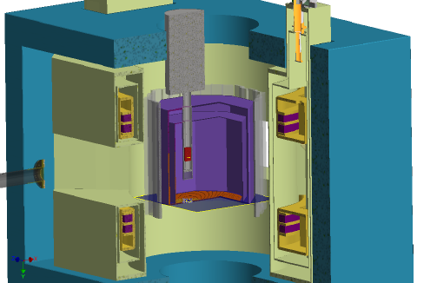
E45 HypTPC Spectrometer
27A2 Hosomi
Measure (π,2π) in large acceptance TPC in dipole magnetic field
π⁻p→π⁺π⁻n, π⁰π⁻p 2 charged particles + 1 neutral particle
π⁺p→π⁰π⁺p, π⁺π⁺n →missing mass technique
πN→KY (2-body reaction)
π⁻p→K⁰Λ,
π⁺p→K⁺Σ⁺ (I=3/2, Δ*)
π⁺⁻ beam on liquid-H target
(p= 0.73 – 2.0 GeV/c
W=1.5-2.15 GeV)
LH target: Φ5cm
Trigger with hodoscope
LH target
π beam
Superconducting Helmholtz
Dipole magnet (1.5 T)
Hyp-TPC

Slide 34
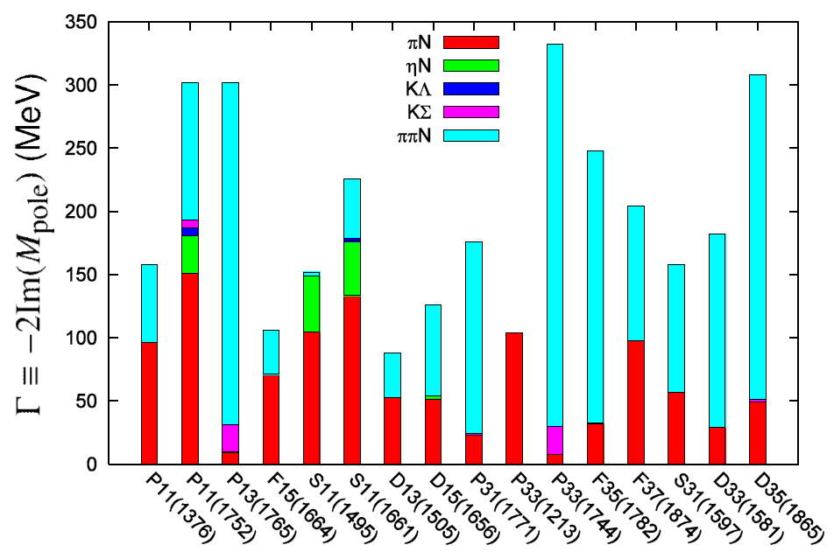
Importance of ππN (Width of N* resonances)
27A2 Hosomi
Over half of the decay branchig fraction goes into 2π channel.
Kamano, Nakamura, Lee, Sato, 2012

Slide 35
H dibaryon
Flavor-singlet (00) state (strangeness -2, isospin 0, or ¹S₀ state in ΛΛ-ΞＮ-ΣΣ system)
Color-magnetic force is not
repulsive, but attractive
u
u
s
s
d
d
6 quark state may exist → H dibaryon
but not found so far
A resonant state just above ΛΛ threshold?
⇒ Still an open and important question
u
s
s
d
d
u
All 6 quarks in s-state

Slide 36
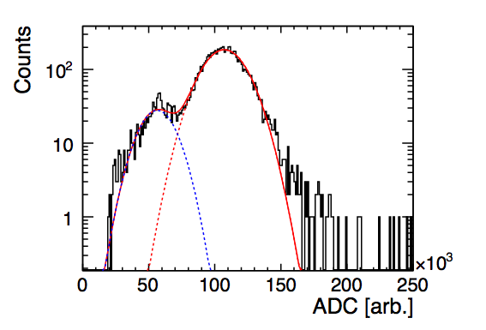
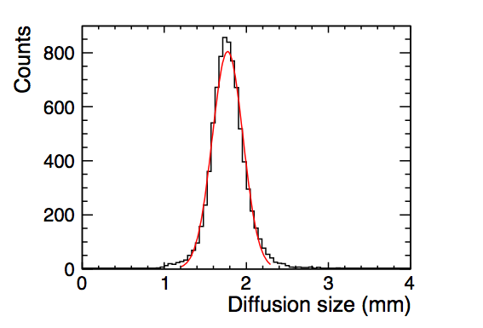
HypTPC test with ⁵⁵Fe (x-ray) source
27A2 Hosomi
J-PARC E42: Search for H-dibaryon
Gain : 120fC, Shap T: 70ns, GEM Curr.: 315 μA
2.7 keV peak
5.9 keV peak
¹²C(K-,K+)X at 1.6 GeV/c
H→2Λ→ppπ-π-
ΔE/E :14.3 ± 0.2 %
Diffusion size : 1.87 ± 0.02 mm
(Peak)/(Esp. Peak): 0.52 ± 0.01
cf. prototype TPC(5 cm to 10 cm) : 1.7 ~ 2.0 mm
The TPC operation is consistent with the prototype TPC!!

Slide 37
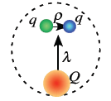
E50: Charmed Baryon Spectroscopy
Charm quark in Baryon
Bare quark ≒ constituent quark
Heavy enough to make a “static core”, light quarks play around
New symmetry – heavy quark symmetry
Diquark correlation?
How analog states appear?
Λ(1405) → ?, Roper resonance → ?
Helps to understand the nature of those states.
Missing resonances?
New exotic states? E.g., DN bound state, pentaquarks, ....

Slide 38
Missing mass spectroscopy by p(π⁻,D*⁻)
Analogous to p(π,K)Y reaction
Direct reaction – possibility to produce resonances not made in fragmentation
Production rate gives valuable information
No bias on decays
Absolute branching ratio can be measured
Shape analysis for Λ_{c}(2595)
Cross Section: σ ∼ 1 nb
Intense Beam at J-PARC is indispensable.
> 10⁷ Hz at 15 GeV/c pions
Notes:
To study these states, a missing mass spectroscopy via the (pi-,D*-) is vital.
Inaddition to mass and width, Production rate gives us valuable information on the structure of the states…

Slide 39
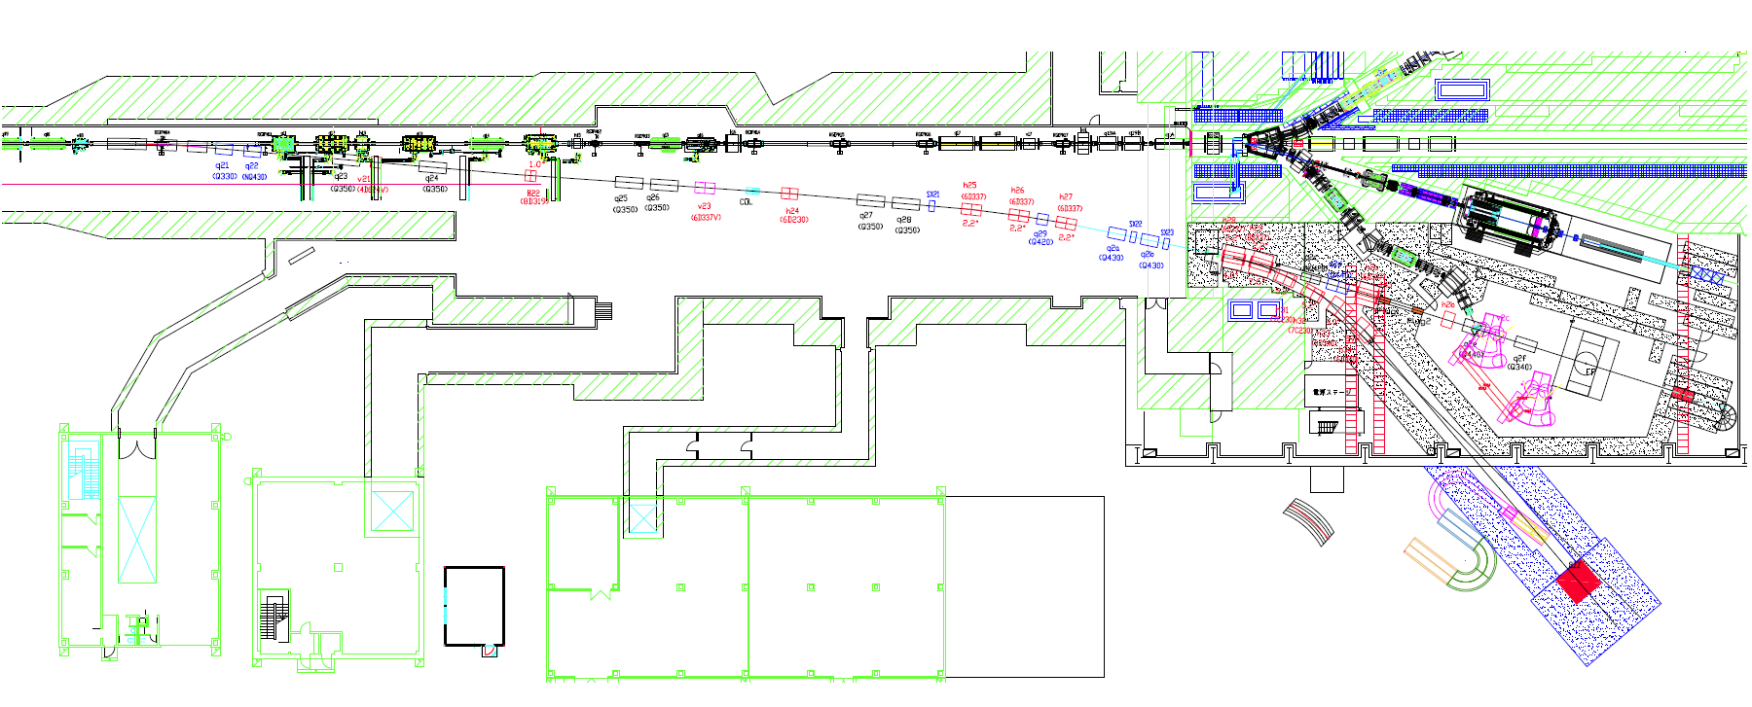
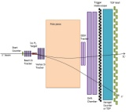
High momentum beam line
High-intensity secondary beam（unseparated）
2 msr・%、1.0 x 10⁷ Hz @ 15GeV/c π
High-resolution beam: Δp/p~0.1%
Momentum dispersion and eliminate 2nd order aberrations
Exp. TGT（FF)
Collimator
15kW Loss Target
(SM)
Dispersive Focal Point（IF)
Δp/p~0.1%
Notes:
高運動量ビームライン

Slide 40
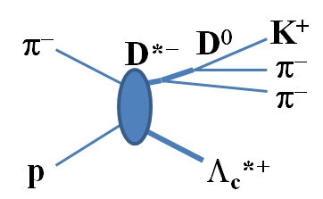
Concept
2.3 Tm Dipole
Κ⁺
DC
PID
H₂ TGT
PID
Beam π⁻
High rate Trackers
(Fiber, SSD)
DC
π⁻
TOF
π⁻
Large Acceptance, Multi-Particle
K, π from D⁰ decays
Soft π from D*⁻ decays
(Decay products from Y_{c}*)
High Resolution
High Rate
SFT/SSD: >10M/spill at K1.8

Slide 43
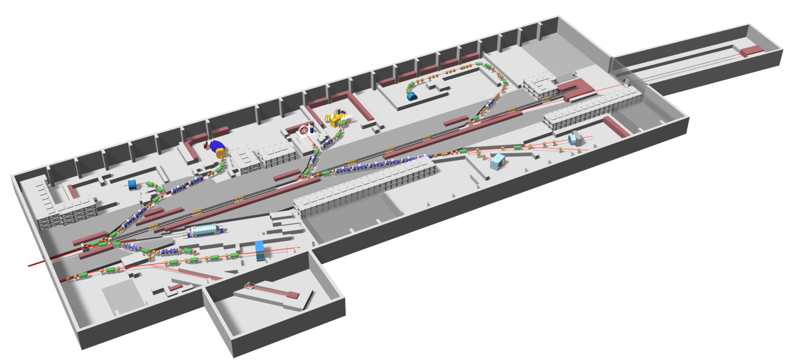
Even further...
Extended
Hadron Hall (??)
Details under discussion

Slide 44
Summary
J-PARC: multi-purpose facility
Hadron, nuclear, and particle physics in the Hadron Hall
E19: Θ⁺ search:
No peak observed.
Stringent limit on production cross section and width
E27: Search for deeply bound Kpp state
Mass shift of Λ∗(1405) and/or Σ∗(1385)?
Hint of “Kpp”-like structure
Coming experiments
E45: N* in πN→ππN, KN, …
E42: Search for H-dibaryon
E50: Charmed baryon spectroscopy
And more…

