Slide 1
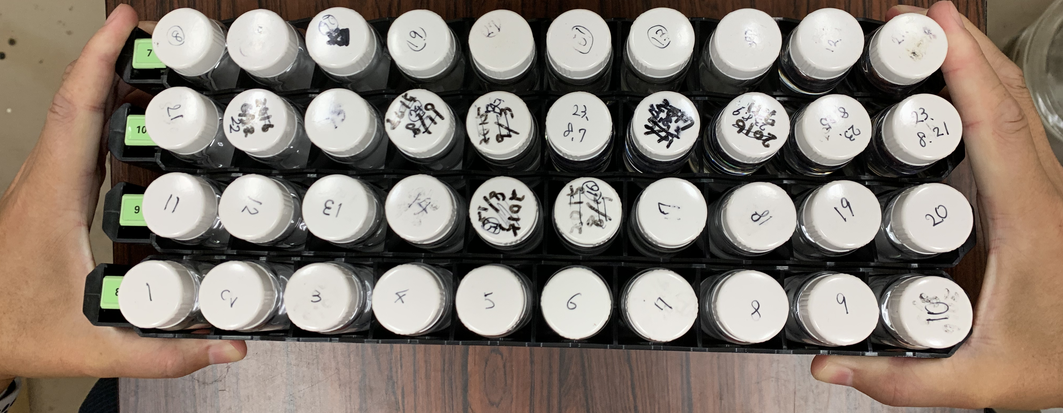
Incident Examples：
When transporting liquid scintillator vials from the laboratory to the measurement room, several racks were carried together, causing one rack to slip and the vial to break.
During measurement work with a liquid scintillation counter, the experimenter dropped a rack containing glass vials onto the floor, causing them to break and the scintillator to scatter.

Slide 2
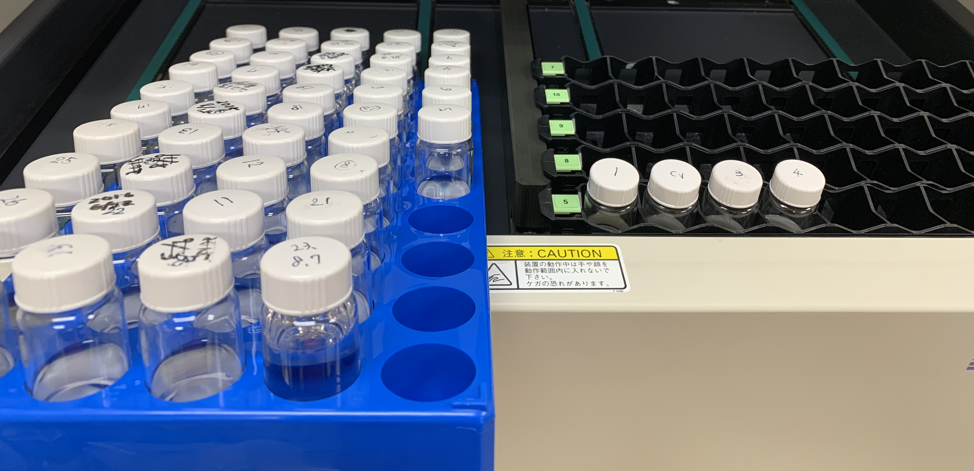
As a result of contact with the manufacturer, Aloka ：
「 This rack is not for transport. Use it inside a liquid scintillation system. 」
Countermeasure taken by the information provider
It was decided to transport the racks one at a time.
Suggested countermeasures
For transporting large quantities of vials, use vial racks (e.g., AsONE 4-4456-02).

Slide 3
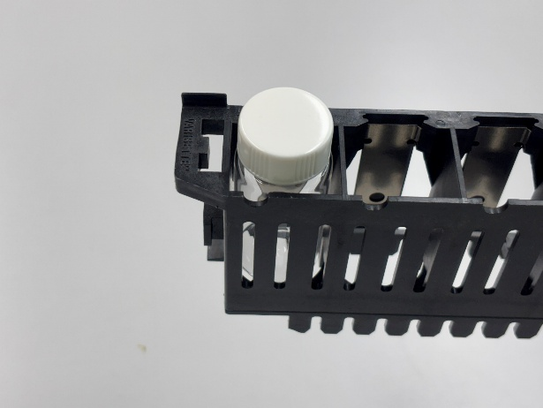
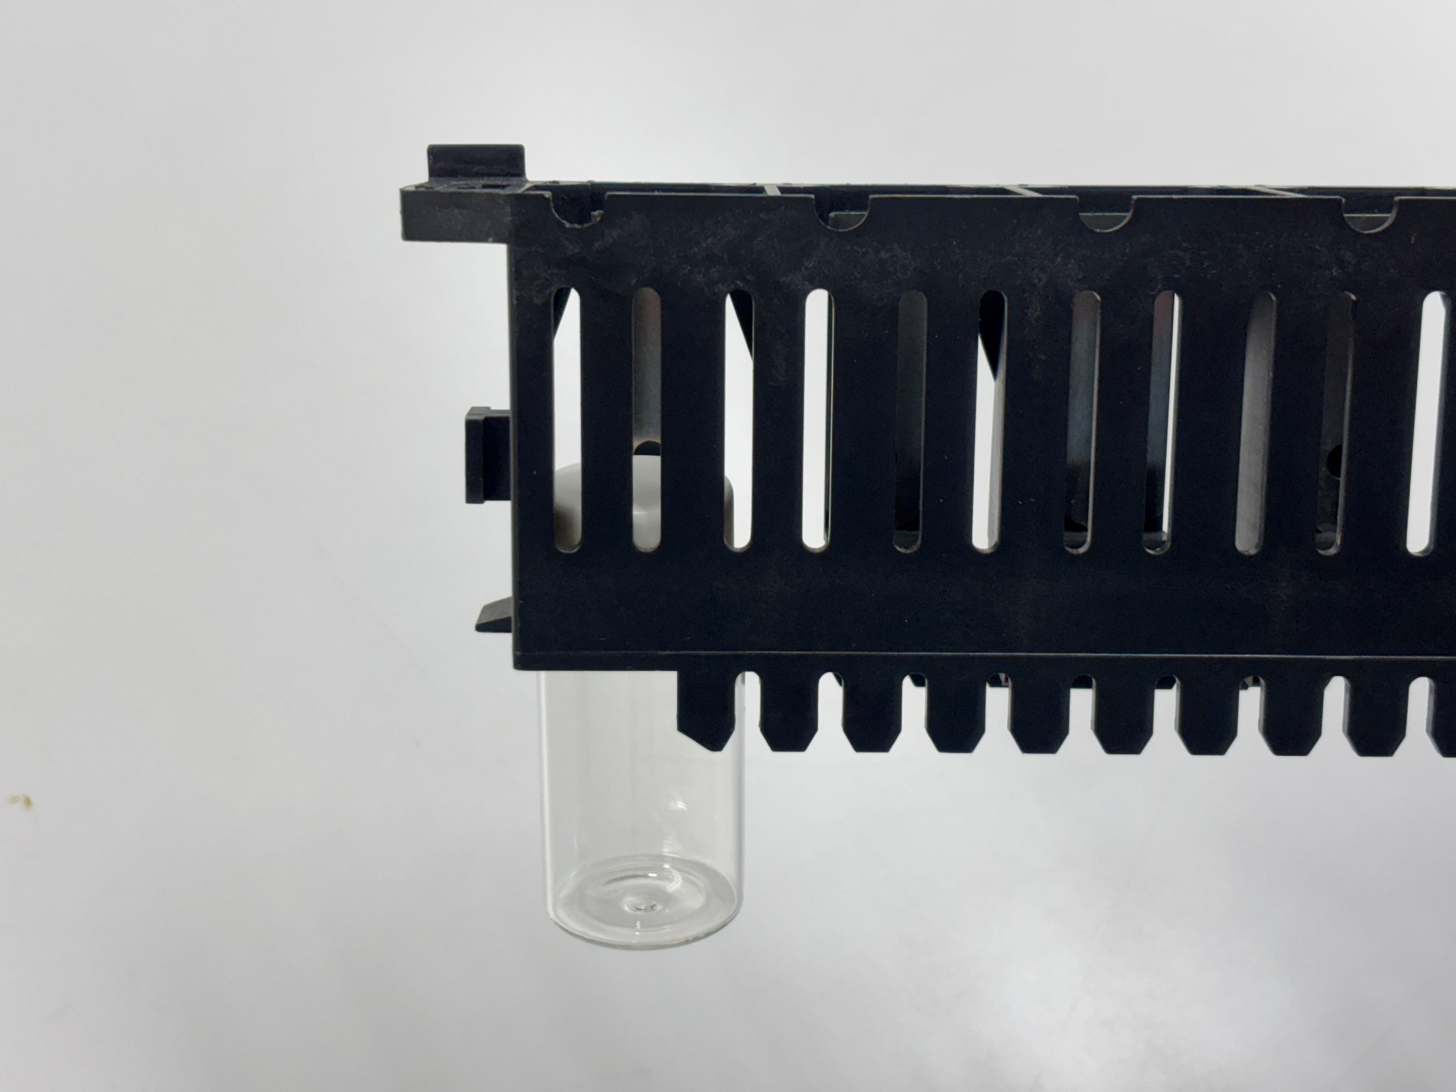
In Parkin Elmer's liquid scintillation system, the vials are lowered within the system.
With the racks used by PerkinElmer, there is a risk that the vials may fall even if the rack does not fall.
Lesson：
The rack of the liquid scintillation system must not be used to transport vials. When transporting a lot of vials, use a vial rack. It is even better to place the vial rack in a basket.

