Slide 1
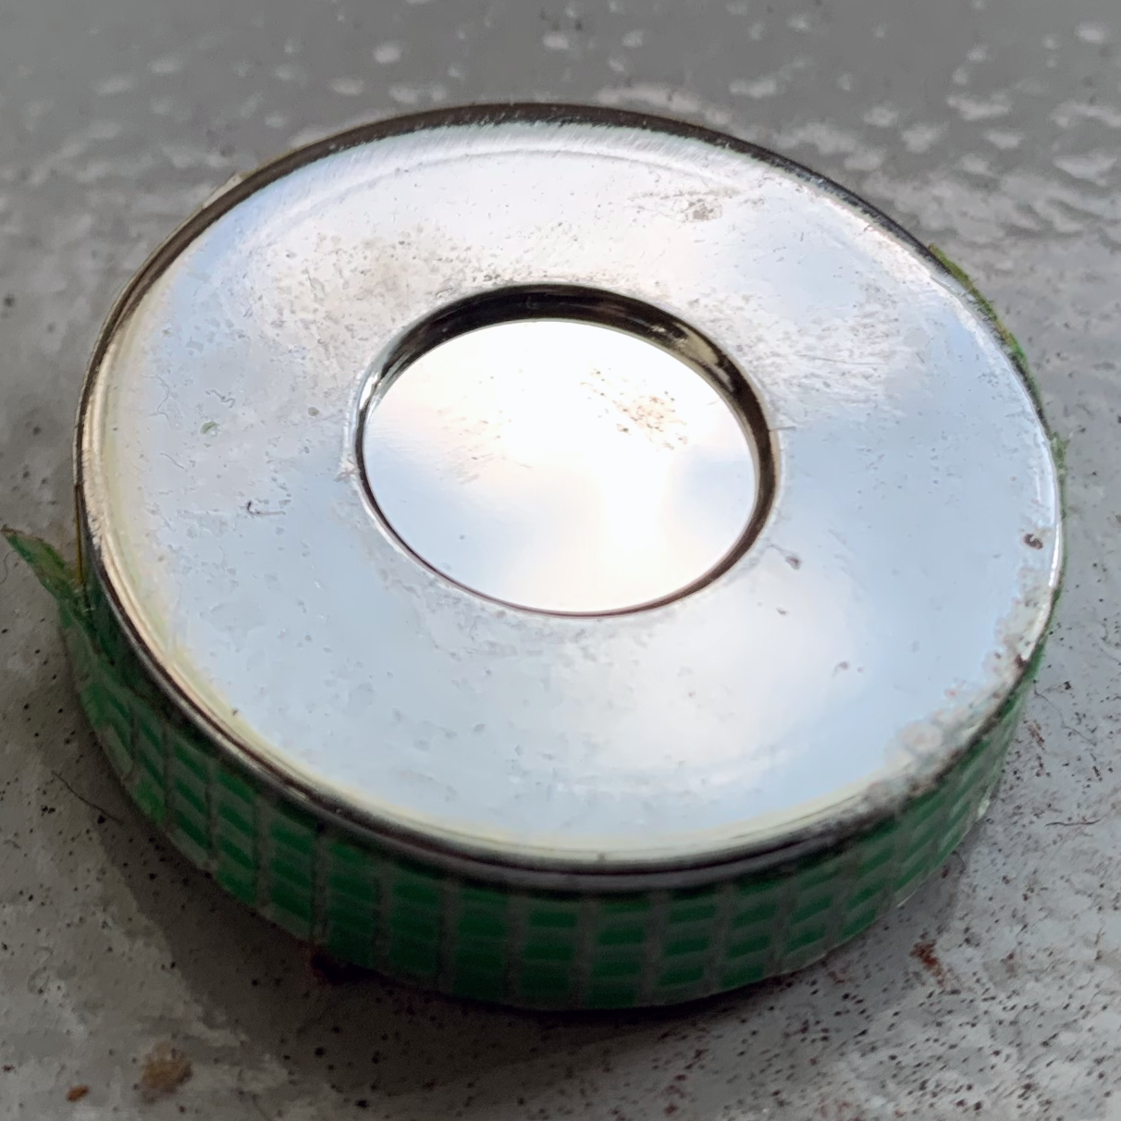
Incident Cases:
The beta ray source was placed in the vacuum chamber and the vacuum was pulled.
The window of the beta source is made of thin aluminum evaporated polyester film, etc., and is weak. There is a risk of damage when force (impact, pressure) is applied.
Manufacturers of sealed radiation sources design the material and thickness of the capsule based on the intended use of the source and the environment in which it will be used.
Understand the structure of the source and consider the use of the source in a vacuum.

Slide 2
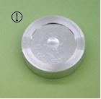
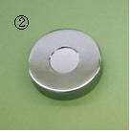
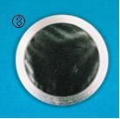
⁹⁰Sr source from JRIA
Type 301
  JIS grade: JIS Z/15/C22111
The two digits following JIS Z/ indicate the year of JIS publication used to determine the grade (15 means 2015), C is toxicity, and the numbers after that indicate the test grade for temperature, pressure, shock, vibration, and puncture.
nuclide | nominal radioactivity | code number
⁹⁰Sr. | 5 kBq 10 kBq | SR301
Type 303
  JIS grade: JIS Z/15/C22212
JIS Z/15/C22111
nuclide | nominal radioactivity | code number
⁹⁰Sr. | 5 kBq 10 kBq | SR303
←punk
← Vibration
←Shock
← pressure
← temperature
← Toxicity
According to JIS Z 4821-1: 2015
321 Type
  JIS grade: JIS Z/15/C22111
nuclide | nominal radioactivity | code number
⁹⁰Sr. | 10 kBq | SR321
However, just because it was tested under these conditions does not mean that it will withstand use under these conditions.
The photo of the radiation source is taken from the Japan Radioisotope Association page (https://www.jrias.or.jp/products/cat3/catalog08.html).

Slide 3
Test Conditions for Grading Sealed Radiation Sources (JIS Z 4821-1: 2015)
test case | class
 | 1 | 2 | 3 | 4 | 5 | 6 | an unknown
Temperature | without an examination | -40°C (20 min) +80°C (1h) | -40°C (20 min) +180°C (1h) | -40°C (20 min) +400°C (1h) thermal shock 400°C → 20°C | -40°C (20 min) +600°C (1h) thermal shock 600°C → 20°C | -40°C (20 min) +800°C (1h) thermal shock 800°C → 20°C | special examination
pressure | without an examination | 25 kPa (absolute pressure) → Atmospheric pressure | 25 kPa (absolute pressure) →2 Mpa (absolute pressure) | 25 kPa (absolute pressure) →7 MPa (absolute pressure) | 25 kPa (absolute pressure) →70 Mpa (absolute pressure) | 25 kPa (absolute pressure) →170 Mpa (absolute pressure) | special examination
shock | without an examination | 50 g or equivalent energy from 1 m | 200 g or equivalent energy from 1 m | 2 kg or equivalent energy from 1 m | 5 kg or equivalent energy from 1 m | 20 kg or equivalent energy from 1 m | special examination
vibration | without an examination | 10 min x 3 times 25~500 Hz Maximum acceleration 49 m/s² (5G) | 10 min x 3 times 25~50 Hz Maximum acceleration 49 m/s² (5G) and 80~90 Hz p-p value 0.635 mm and 90~500 Hz Maximum acceleration 98 m/s² (10G) | 10 min x 3 times 25~80 Hz p-p value 1.5 mm and 90~2000 Hz Maximum acceleration 196 m/s² (20G) | - | - | special examination
punk | without an examination | 1 g or equivalent energy from 1 m | 10 g or equivalent energy from 1 m | 50 g or equivalent energy from 1 m | 300 g or equivalent energy from 1 m | 1 kg or equivalent energy from 1 m | special examination
Notes:
Since the atmosphere is roughly 100 kPa, you can see that the performance test standard does not test very extensively on the vacuum side.

Slide 4
For approved device with certification label
Approved device with certification label must be used in compliance with what is written in the accompanying documentation.
[Shape, structure, etc.]
This product is a sealed radiation source with a sealed radiation source grade (C22212) as specified in JIS Z 4821-1:2015 "Sealed radiation sources Part 1: General requirements and grades". However, the hermetically sealed nature of this product is not guaranteed under all conditions of use and storage. Use the product under normal temperature and pressure and in an atmosphere that will not cause corrosion or other adverse effects. Do NOT subject the product to physical shocks such as dropping, hitting, pressurizing (depressurizing), heating, cooling, etc.
FROM Beta radiation source 303CE Safety Instruction Manual
2024/4/1(16th Edition) for SP13-3-Attachment 4
Vacuum use of approved device with certification label is not permitted.
Notes:
In the case of certified equipment with labeling, even if it is an alpha source 162CE or a gamma source, there is a similar statement that the equipment should not be subjected to physical shocks such as dropping, hitting, pressurizing (depressurizing), heating, cooling, and so on. On the other hand, the grade is as high as C64444 for alpha radiation source 162CE, and as high as C64445 for gamma radiation source 454CE.

Slide 5
Whether the source can be used in a vacuum or not
In the JIS grading test, the reduced pressure side is only done up to 25 kPa. This does not mean that it can withstand up to 25 kPa under all conditions, so it does not guarantee soundness in a vacuum.
The beta source window is made of aluminum evaporated polyester film, which is not very strong. If not handled carefully, there is a risk of damage.
Beta radiation sources are not subjected to very graded testing.
Therefore, the use of beta radiation sources in a vacuum should be avoided.
Alpha sources must be placed in a vacuum to obtain good spectra. However, the grading test is the same as for other sources. If it is unavoidable to handle the source in a vacuum, set up a glass window or the like so that the source can be observed, and slowly pull the vacuum while checking to see if the source portion does not expand. If any abnormality is found, stop use immediately.
Approved device with certification label must not be used in a vacuum.

Slide 6
Other Notes
When the radiation source is in use, a sticker should be posted to prevent exposure and loss of the source. In the case of a vacuum chamber, this sticker will prevent the accidental vacuuming of the chamber.
When using a wire source in a vacuum, do not pay attention to it once you get used to it. Understand that no matter how many times you use it, it is only an exceptional use. Also, let your collaborators know that this is not the usual way to use the source.

