Slide 1
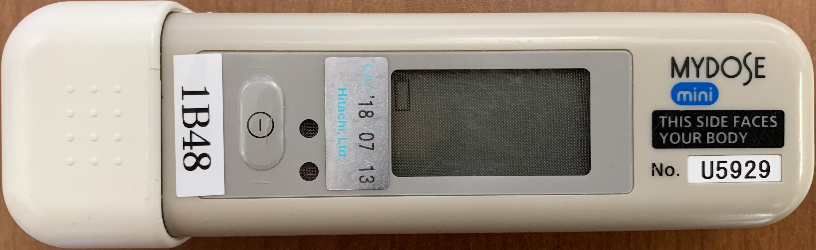
Recently, there has been an increase in records of exposure that is not due to radiation work. This is probably due to airport baggage inspections.
Start wearing | Wearing ends | H1cm | H70um
2023/12/1 | 2023/12/31 | 1.7 | 1.5
2023/11/1 | 2023/11/30 | 2.9 | 2.7
2023/11/1 | 2023/11/30 | 0.7 | 0.7
2022/8/1 | 2022/8/31 | 0.3 | 0.3
2022/5/1 | 2022/5/31 | 0.8 | 0.9
2022/1/1 | 2022/1/31 | 0.7 | 0.6
2021/11/1 | 2021/11/30 | 0.2 | 0.5
2021/6/1 | 2021/6/30 | 1.2 | 1.1
2021/5/1 | 2021/5/31 | 1.8 | 1.8
2020/3/1 | 2020/3/31 | 0.1 | 0.1
2020/2/1 | 2020/2/29 | 0.7 | 0.7
2019/9/1 | 2019/9/30 | 0.1 | 0.1
2019/10/1 | 2019/10/31 | 0.8 | 0.6
2019/10/1 | 2019/10/31 | 0.1 | 0.1
Put the pocket dosimeter in the carry-on luggage and go through the carry-on luggage inspection.
2024/2/14 | Osaka (ITM) | 0.7
2024/2/17 | Miyazaki | 1.4
2024/2/29 | Osaka (ITM) | 4.1
2024/9/6 | Tokyo (HND) | 740.2
2024/9/8 | Sapporo (CTS) | 8.0
2024/9/17 | Tokyo (HND) | 893.4
2024/9/19 | Sendai | 10.5
→ Only measurements at Haneda Airport are high.
Notes:
The table on the left is an excerpt from one facility's personal dosimeter report. The badges of workers who were not originally exposed to the experiment showed significant values, so we interviewed them and they said they had passed the baggage check. since 2019, there have been several cases a year, and the values have varied from 0.1 mSv to about 2 mSv. The value has varied from 0.1 millisieverts to 2 millisieverts. Until recently, we were told that airport baggage x-ray inspections are not sensitive to ISO 1600 film, so initially we did not know why we were getting values above 1 millisievert. The right figure shows the result of a person who intentionally left a pocket dosimeter in his airport baggage inspection. Incidentally, this dosimeter is for gamma radiation, so the absolute value of the measured value cannot be relied upon. As a result, we found that the measured values were higher at Haneda Airport in Tokyo.

Slide 2
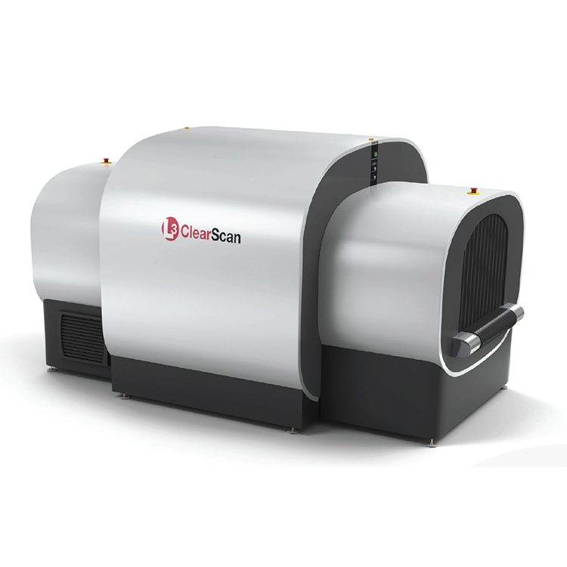
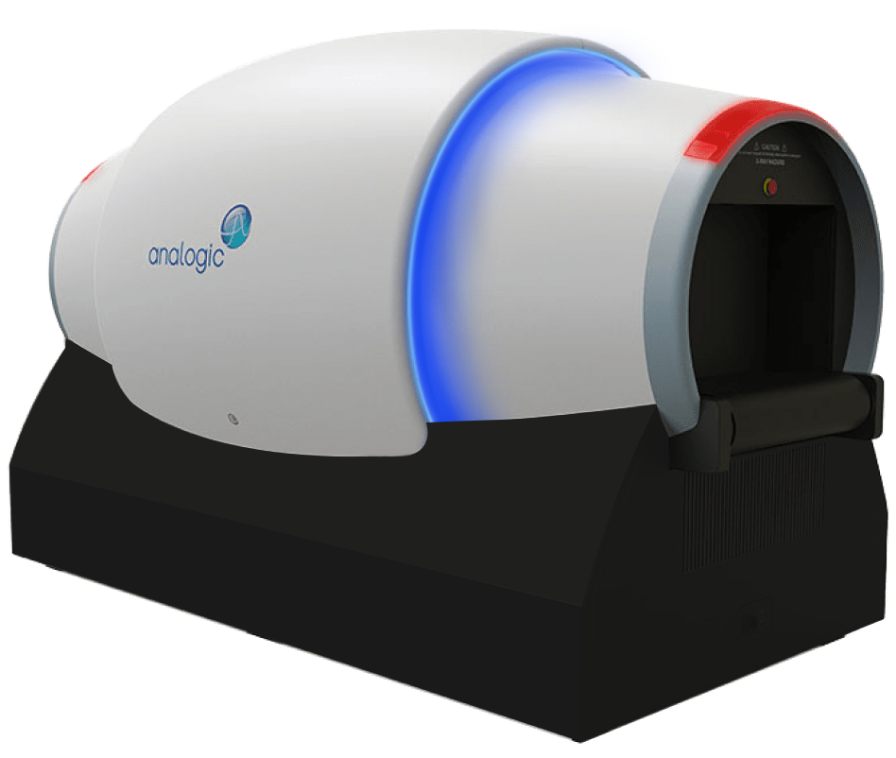
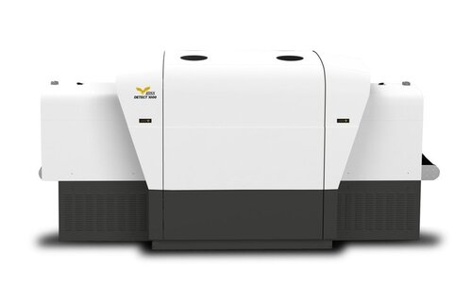
Ministry of Land, Infrastructure, Transport and Tourism Press Release, April 16, 2018
Advanced Security Inspection Equipment Begins Operation ~Operation of Japan's first CT-type X-ray inspection system for carry-on baggage inspection~.
In preparation for the 2020 Tokyo Olympics and Paralympic Games, the Ministry of Land, Infrastructure, Transport and Tourism's Civil Aviation Bureau is working to improve aviation security inspections to reduce the burden on passengers, smooth inspections, and realize strict standards by promoting the introduction of advanced security inspection equipment with the aim of creating a "terror-resistant airport" for the 2020 Tokyo Olympics and Paralympic Games. As a part of these efforts, we have been working to improve the quality of airline safety inspections. As part of these efforts, we have installed a CT (Computerized Tomography) type X-ray inspection system for carry-on baggage inspection (below, called "CT machine") in the Terminal Building of the International in Haneda Airport, which will be in operation from April 19, 2018.
The CT machine uses CT technology, which has not been used in conventional X-ray inspection systems, to generate images that can be monitored from all directions, and it has higher detection performance and advanced analytical processing than conventional systems.
* Photos are taken from each company's website.
Analogic ConneCT
HISSCO L-3 Clearscan
IDSS DETECT1000
Notes:
This information is taken from a press release by the Ministry of Land, Infrastructure, Transport and Tourism in April 2018. Around 2018, CT scanner-type X-ray inspection devices were introduced at Haneda Airport. The inspection using this equipment is thought to use stronger X-rays than conventional inspection equipment. This news report says that it has been introduced at Haneda Airport, but since it has been introduced as a counter-terrorism measure, it may be introduced at regional airports in the future. In addition, it is possible that these have been introduced at some airports overseas. Therefore, in the future, you will need to avoid passing through the personal dosimeter at airport baggage inspections.

Slide 3
Mismeasurement of Personal Dosimeters in Airport Security Inspections
Until now, airport security (carry-on) X-rays were weak and even ISO 1600 film was said not to be photosensitive.
Recently, some airports have been using CT scanners to inspect baggage, increasing the amount of X-rays.
In fact, mismeasurements due to airport security checks have occurred.
It would be best if, in consultation with the person in charge of dose control, personal dosimeters could not be taken when there is air travel.
if possible, request that a personal dosimeter be issued at the destination of your business trip in order to determine whether the incorrect measurement was due to the effects of the baggage inspection.
When mismeasurements are caused by airport security inspections, it is possible to correct the calculated effective dose for Glass badges, Luminess badges and TLD badges.
If you must board an aircraft with a personal dosimeter, explain to the airport inspector that it is a personal dosimeter and request a visual inspection.
Notes:
So, until now, airport security inspections of carry-on baggage have been told that the X-rays used in the inspections are weak and that even ISO 1600 film is not photosensitive. Recently, however, CT scanners have been used to inspect baggage at some airports, increasing the amount of X-rays. In fact, false measurements due to airport security inspections have occurred.
<This should be arranged according to the management reality of the facility.>
If you are traveling by air, it is better not to take your personal dosimeter with you if possible. On the other hand, it is also necessary to manage your exposure at your destination. If you are not taking your dosimeter with you, you should discuss with the person in charge of radiation dose management what you should do. If you are taking it with you, you must be able to show that the measurement was taken during the baggage inspection if it is measured incorrectly. If possible, it would be better to have a personal dosimeter issued at your destination. If you don't take a dosimeter with you, make sure to get one for measuring the radiation dose at your destination. If the airport security check causes a wrong measurement, it is possible to correct the calculated effective radiation dose for both glass badges and luminous badges. If there is a possibility of this happening, be sure to report it to the Radiation Protection Supervisor. Also, if you absolutely have to take a personal dosimeter on board the aircraft, explain to the airport security staff that it is a personal dosimeter and request a visual inspection.

Slide 4
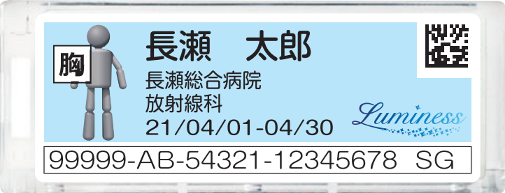
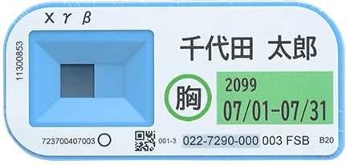
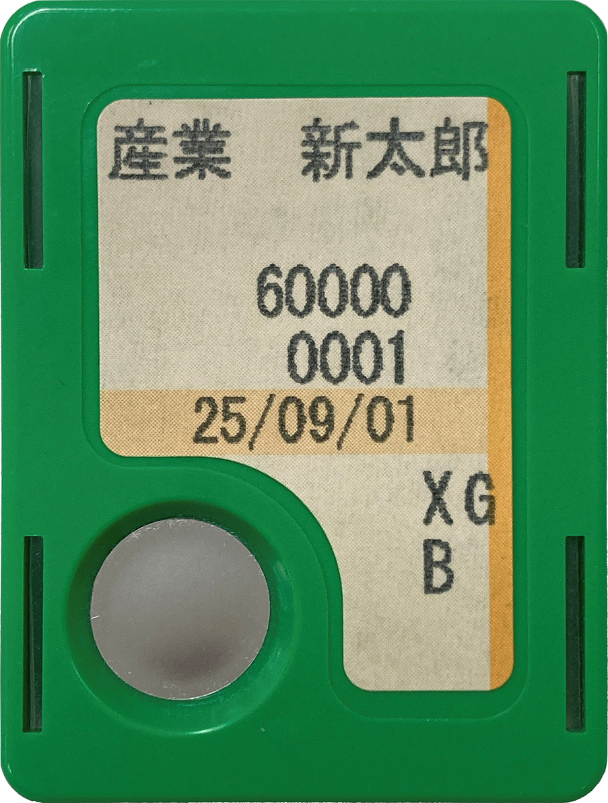
これらは、放射線業務従事者の外部被ばくを測定するための個人線量計です。外部被ばくの量を測定することで、従事者の健康管理を行っています。これにエックス線等を照射すると、それが外部被ばく量として測定されるため、従事者の外部被ばくを測定することができません。従って、空港の保安検査においても、エックス線による検査ではなく目視による検査をお願いします。
These are personal dosimeters used to measure the external exposure of radiation workers. By measuring the amount of external exposure, the health of radiation workers is managed. When these are irradiated with X-rays, etc., they are measured as the amount of external exposure, and the external exposure of the workers cannot be measured. Therefore, we request that airport security inspections be conducted visually, not by X-rays.
Notes:
このように説明をしても良いですし、この画面を検査担当者に見せても良いでしょう。

