Slide 1
B-field calculation for new TPC experiment and some calibration
Ryosuke Yamamura
2007.12.22

Slide 2
Outline
Calculation of magnetic field
(using Radia)
Drift line
Calibration

Slide 3
Radia

Slide 4
About Radia
Radia was magnetic calculation code built at the European Synchrotron Radiation Facility(ESRF)
using Boundary Integral Methods
(TOSCA : using Finite Elementary Methods)

Slide 5
Radia(compared with TOSCA)
The advantages
・free software
・does not need to mesh the vacuum
・could calculate full-geometry
(It is hard using TOSCA)
The disadvantages
・could not use on miho
more

Slide 6
Calculation
・z-position
Solenoid center=-1545.4mm(test exp)
=-1613.9mm(next exp)
Dipole center=0mm
・Gap(Dipole-solenoid)
400mm(test exp)
468.5mm(next exp)
Solenoid current = 60A,45A (45A: for test exp)

Slide 7
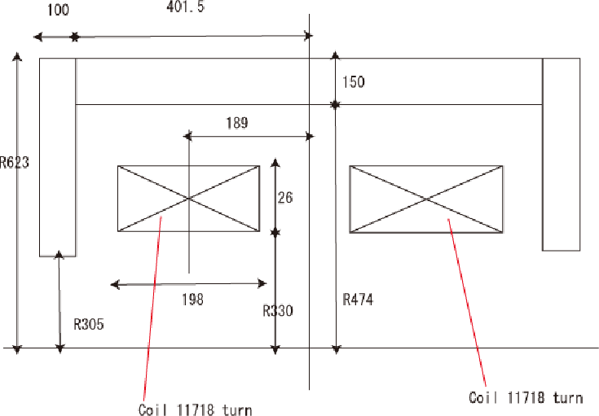
Solenoid cross section
z(mm)

Slide 8
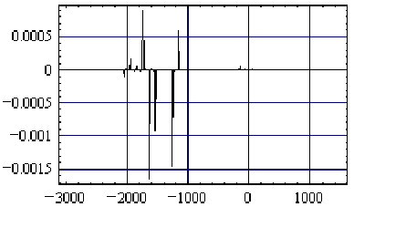
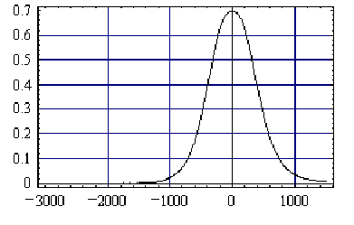
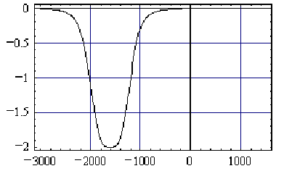
B-field(on z-axis)
Dipole
Bx(T)
By(T)
z(mm)
z(mm)
Solenoid
Bz(T)
z(mm)
z=-1545.4mm

Slide 9
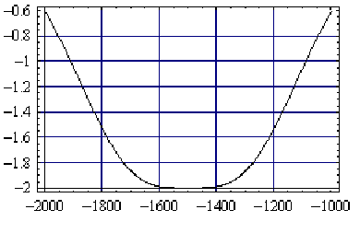
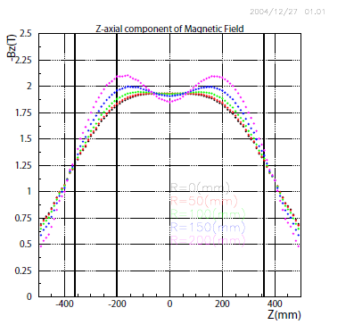
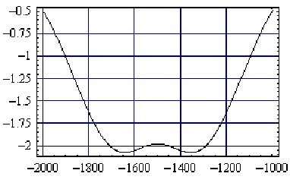
Solenoid magnetic field
Using Radia(x=0,y=0)
Bz(T)
Master thesis Sawada-san
(using TOSCA)
z(mm)
Bz(T)
(x=150mm,y=0)

Slide 10
LEPS Magnet 3D view from Radia

Slide 11
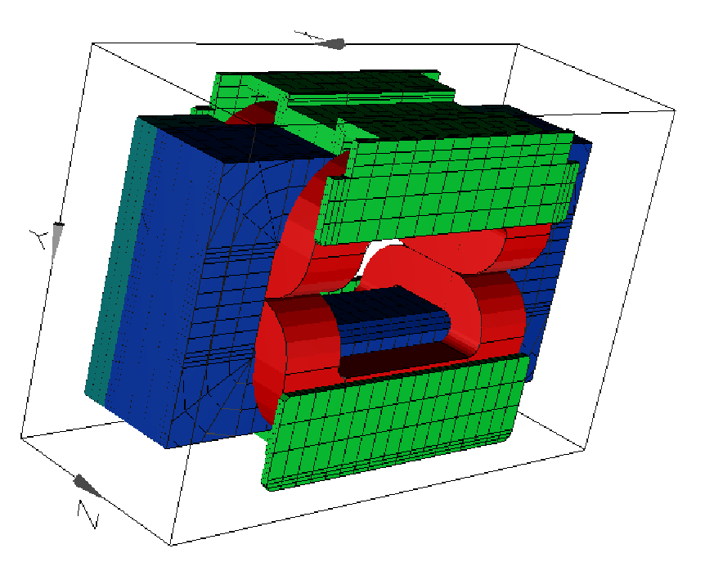
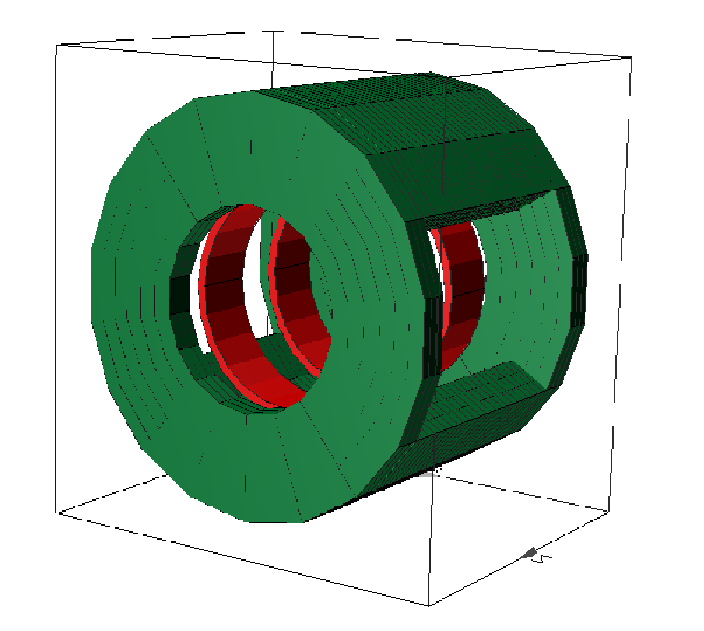
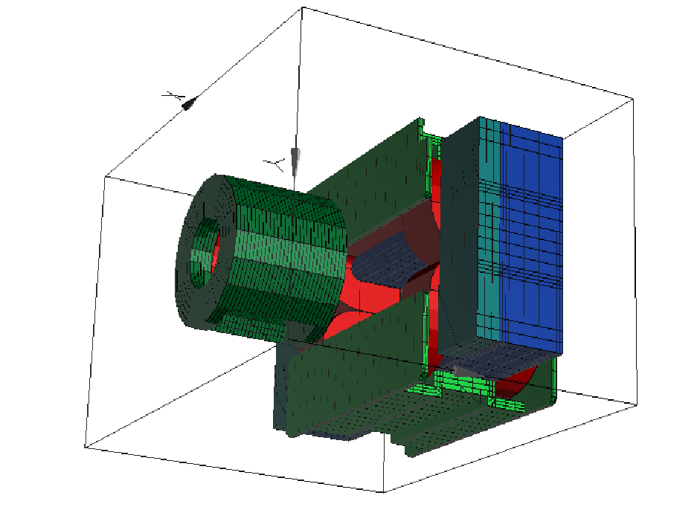
Other pictures

Slide 12
Drift-line
・using B-field map made by Radia(60A)

Slide 13
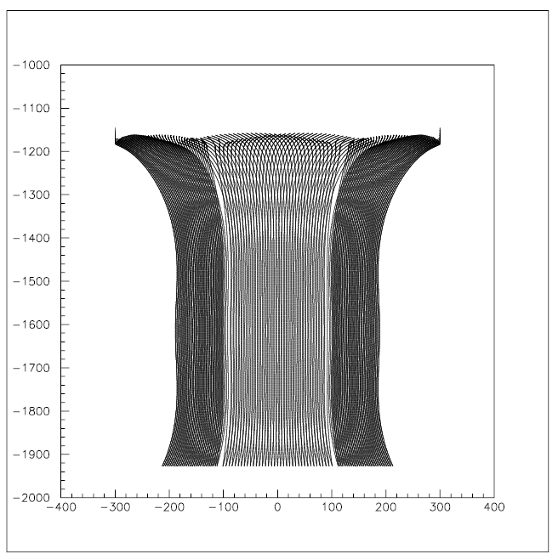
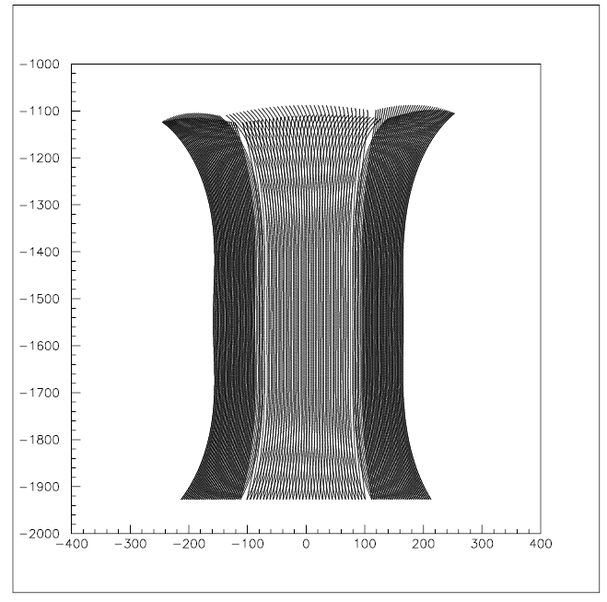
Drift line(x-z plane)
Move solenoid magnet 68.5mm upstream
Test exp
(solenoid-Dipole gap=400mm)
Next exp
(Solenoid-Dipole gap=468.5mm)
mm
mm
TPC
Drift plane
Shield
mm
mm
loss
Improve!

Slide 14
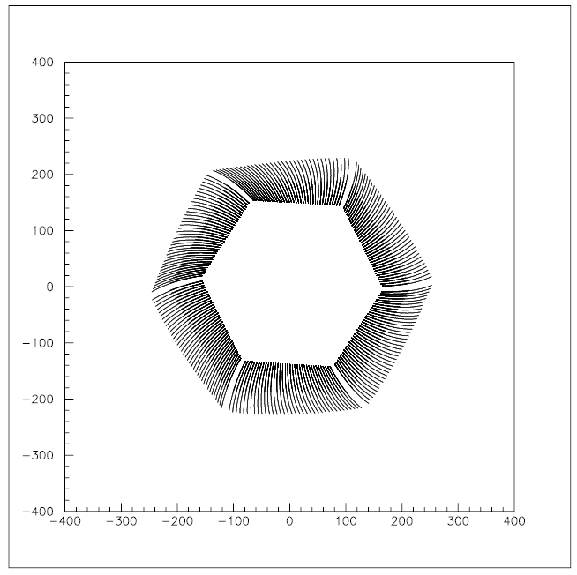
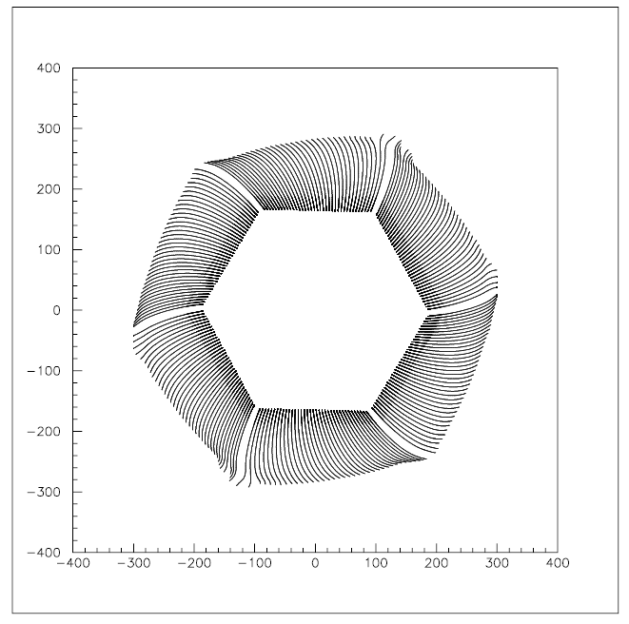
Drift line(x-y plane) for pad9
Test exp
(solenoid-Dipole gap=400mm)
Next exp
(Solenoid-Dipole gap=468.5mm)
mm
mm
overlap
mm
TPC
mm

Slide 15
Calibration(TPC test exp r11028) -still in progress

Slide 16
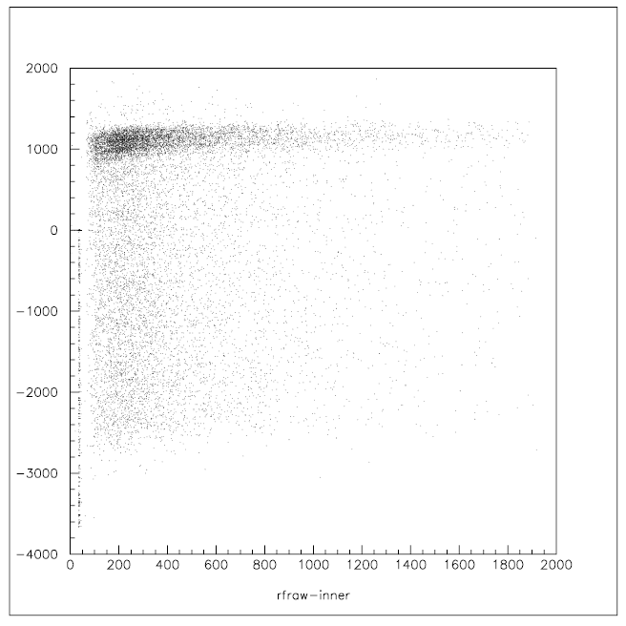
Rf-inner
・It couldn’t solve the 2ns bunch(rf)
using inner scintillator
・inner scintillator’s time resolution was
more than 700ps (from cosmic-ray test)
→so use Rf-tagger

Slide 17
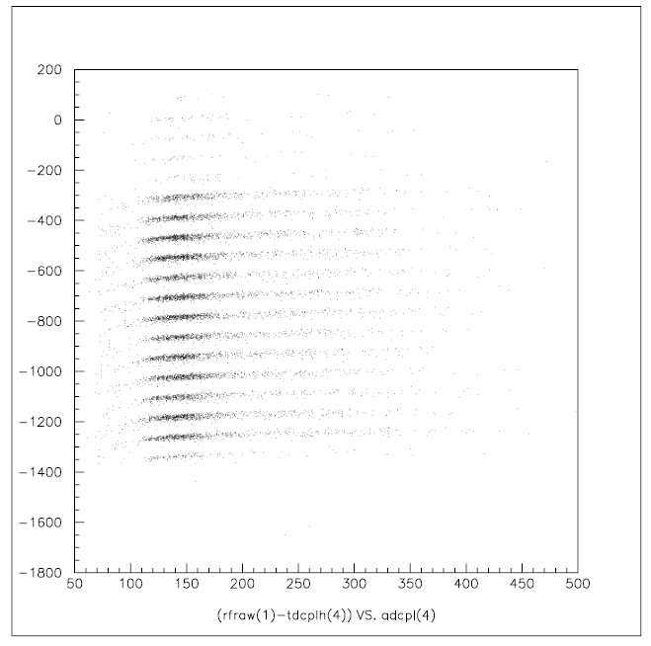
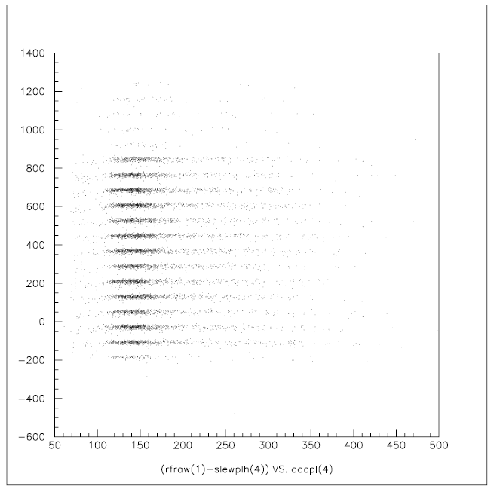
Rf-Tagger
Before slewing correction
After slewing correction

Slide 18
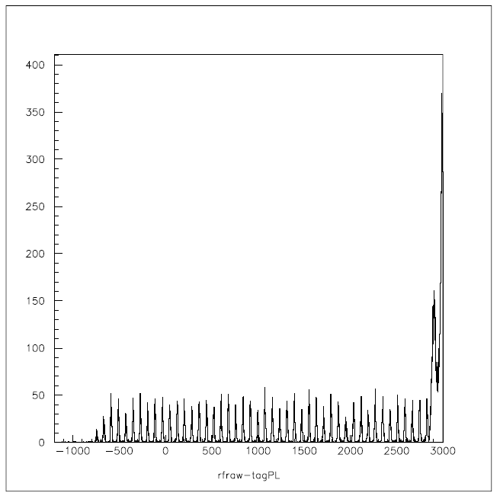
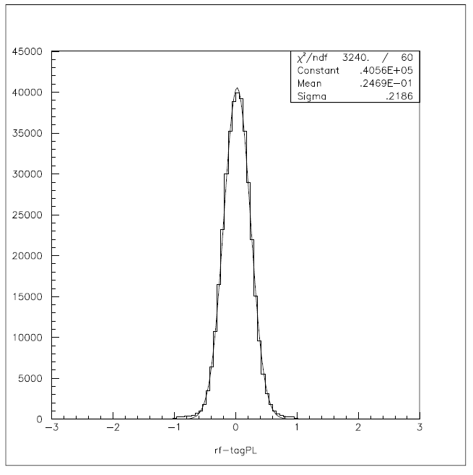
Rf-Tagger
It could solve 2ns bunch(rf)
using rf-tagger
Tagger PL resolution
≅219ps
Gaussian Fitting

